Slide 1
A Game Theoretic Model of Computer Network Exploitation Campaigns
Robert Mitchell mitchellrr@mitre.org*
*The author’s affiliation with The MITRE Corporation is provided for identification purposes only, and is not intended to convey or imply MITRE’s concurrence with, or support for, the positions, opinions or viewpoints expressed by the author.
Approved for Public Release; Distribution Unlimited. Case Number 18-1312

Slide 2
Disclosure
This briefing is based on work I created while at Sandia National Laboratories (SNL)
The SNL product is publicly available at http://ieeexplore.ieee.org/document/8301630/

Slide 3
Agenda
Motivation
Threat Model
Introduction To Game Theory
The Basics Of Our Game
Extensive Form Game
Nash Equilibrium
Information Sets
Parameters
Applications
Conclusions

Slide 4
Motivation
Recent cyber events
US Democratic National Committee (DNC) hack
Banner Health Personally Identifiable Information (PII) spill
Dyn Domain Name System (DNS) Distributed Denial of Service (DDoS)
San Francisco Municipal Transportation Agency (MTA) ransom
WannaCry pandemic
Get inside the adversary’s tactical loop
Support needed for strategic and tactical decisions

Slide 5
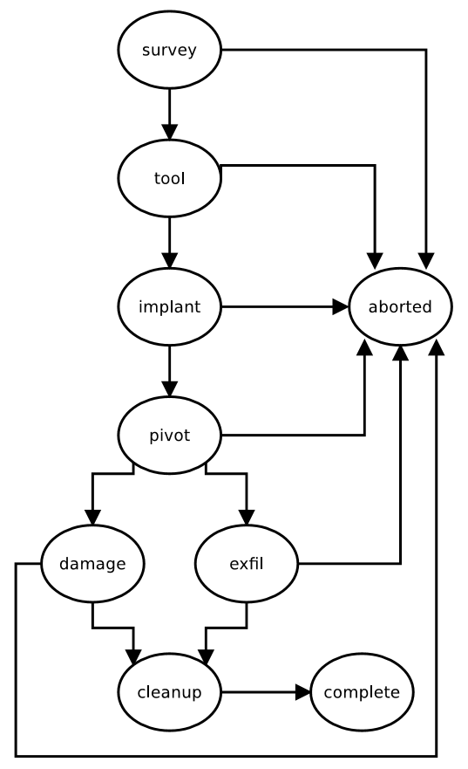
Threat Model
Sophisticated adversary
Attacker’s goal: private data theft
Attacker’s objective: avoid detection
Contrast with Computer Network Attack (CNA) campaigns

Slide 6
Introduction to Game Theory
Other approaches
Closed form math, stochastic modeling, simulation, emulation
Considers collusion among and competition between rational players
Payoffs must be complete: any two can be ranked and transitive
Variants
Static/dynamic, complete/incomplete information, symmetric/asymmetric, zero/general sum
Popular examples
Prisoner’s dilemma, stag hunt, Cournot competition
Widely used in economics

Slide 7
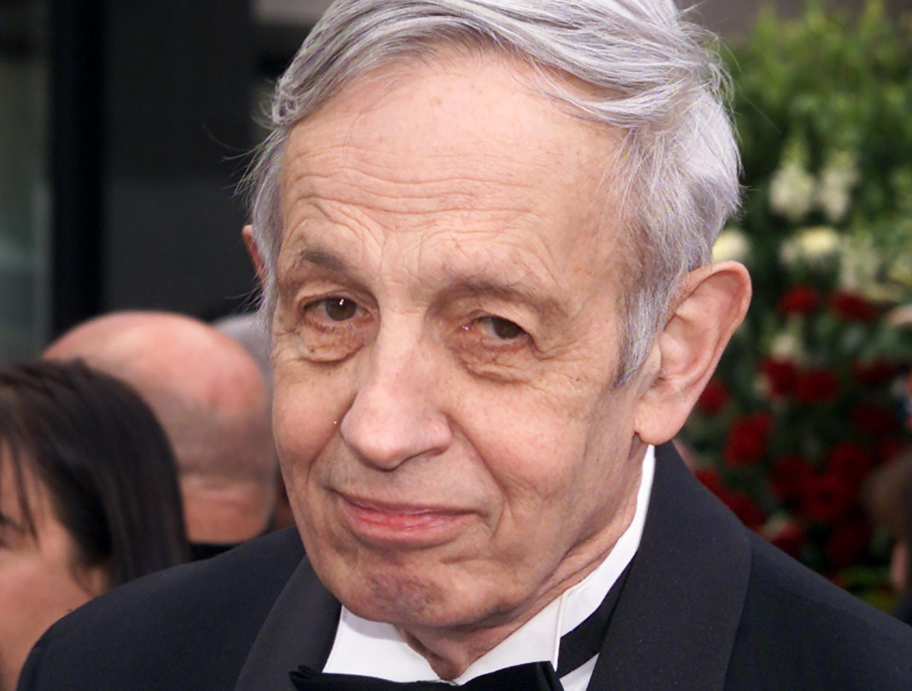
John Nash
Notes:
John Nash won a Nobel Prize in economics for his game theory work.
He was born in 1926 in Bluefield, WV.
John Nash graduated from Princeton, and worked there and at MIT.
Unfortunately, he died in a car accident in 2015.

Slide 8
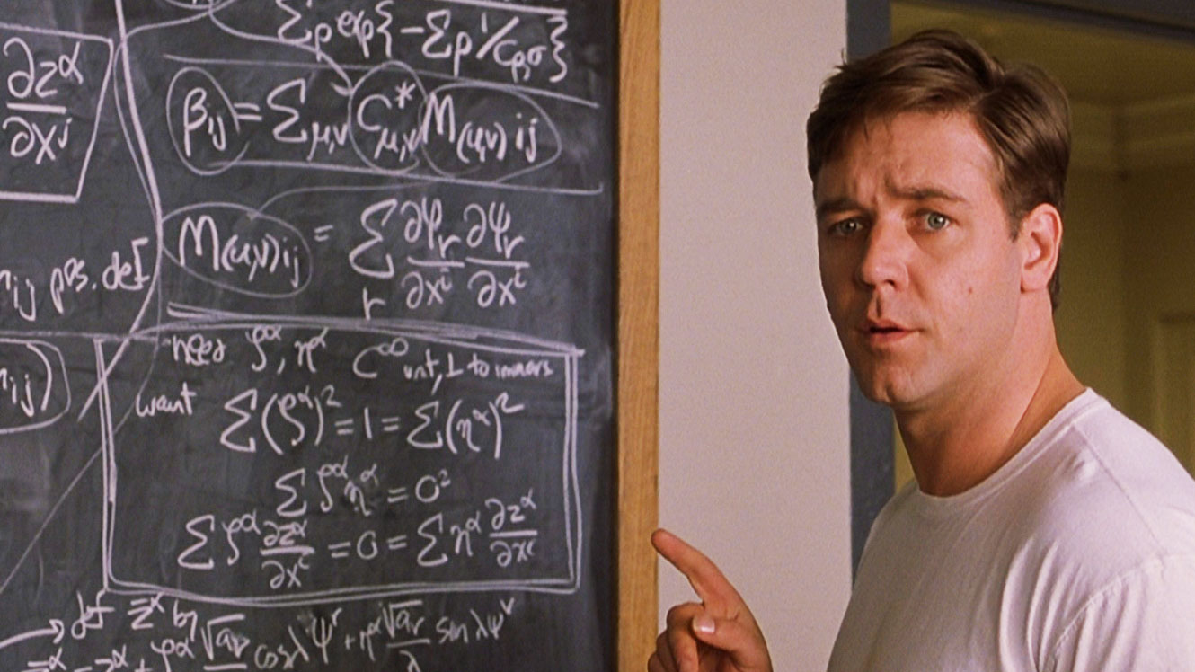
Not John Nash
Notes:
Russell Crowe starred in a movie about John Nash’s life in 2001.

Slide 9
The Basics Of Our Game
Players
Attacker, nature, defender
Information
Attacker: all payoffs, all previous moves
Defender: all payoffs, all previous moves
Actions
Attacker: quit or proceed
Nature: detect or miss
Defender: passive or active response
Payoffs
Function of parameters and strategies

Slide 10
Why Tempt Fate?
Why would the defender not actively respond at an early stage?
We can tease out additional tools
Defenders gain intelligence
Attackers must write new tools
Competing force
Make the call that could give away the store

Slide 11
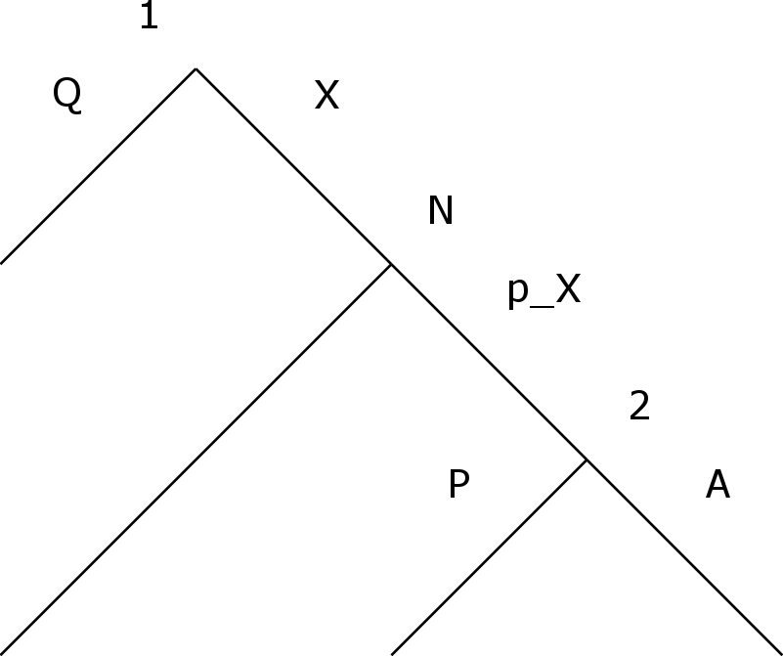
Extensive Form Game - One Stage
Notes:
This single stage game will allow us to build up to the more complicated full campaign game.
The vertices are labeled to indicate the player who moves: 1 is the attacker, N is nature and 2 is the defender.
The edges are labeled with the player’s strategy: Q indicates quit, X indicates the attacker proceeds with stage X, p_X is the probability the defender detects the stage, P indicates a passive defender response and A indicates an active defender response.

Slide 12
Extensive Form Game
Notes:
This picture is hard to read, but the basic idea is that the campaign level game is a hierarchical composition of the stage games from the last slide.
This is an ambitious game: there are 48 possible outcome and 512 strategy sets.

Slide 13
Extensive Form Game - Payoffs
u_{i}(o): payoff to player i of outcome o
Outcome 0
u₁(o₀) = no stages funded, no private data harvested
u₂(o₀) = no active response, no private data spilled, no tools burned
Outcome 36
u₁(o₃₆) = five stages funded, private data harvested
u₂(o₃₆) = no active response, private data spilled, no tools burned
Outcome 47
u₁(o₄₇) = five stages funded, no private data harvested
u₂(o₄₇) = active response to exfil, no private data spilled, four tools burned

Slide 14
Extensive Form Game - Payoffs
v_{i}(s): expected payoff to player i given strategy set s
s = (s₁, s₂)
Timid Attacker
s₁ = (Q,*,*,*,*) s₂ = (*,*,*,*)
v_{i}(s) = u_{i}(o₀)
Curious Attacker, Cagey Defender
s₁ = (S,Q,*,*,*) s₂ = (P,*,*,*)
v_{i}(s) = (1 - p_{S}) u_{i}(o₁) + p_{S} u_{i}(o₂)
Curious Attacker, Paranoid Defender
s₁ = (S,Q,*,*,*) s₂ = (A,*,*,*)
v_{i}(s) = (1 - p_{S}) u_{i}(o₁) + p_{S} u_{i}(o₃)

Slide 15
Nash Equilibrium
Solution concepts
Restrict the set of possible outcomes to a subset of reasonable ones
Help explain why games play out like they do
Find the “hot spots”
Basic ideas behind a Nash equilibrium
A strategy profile where each player’s strategy is the best response to the opponent’s strategy
Finite games will always have at least one Nash equilibrium
May not be sequentially rational

Slide 16
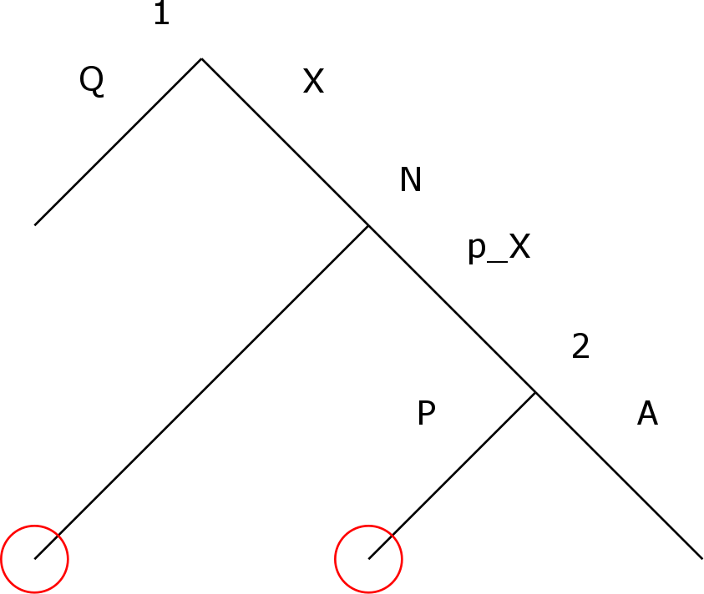
Information Sets
Notes:
Information sets are collections of nodes that a player cannot distinguish between.
For example, in this stage game, the attacker does not know if the defender failed to detect the attack or the defender responded passively.

Slide 17
Parameters
Too many
Attacker facing parameters
Costs of surveillance, tooling, implantation, movement and exfiltration
Reward of obtaining private data
Defender facing parameters
Costs of active response to surveillance, implantation, movement and exfiltration
Rewards of detecting surveillance, implantation, movement and exfiltration
Probabilities of detecting surveillance, implantation, movement and exfiltration
Cost of spilling private data

Slide 18
Applications
Managers
Study investment decisions
Study defensive measures and policies
Incident handlers
Forecast impact of tactical responses
Identify TTPs that make attacks unprofitable
Channelize the attacker

Slide 19
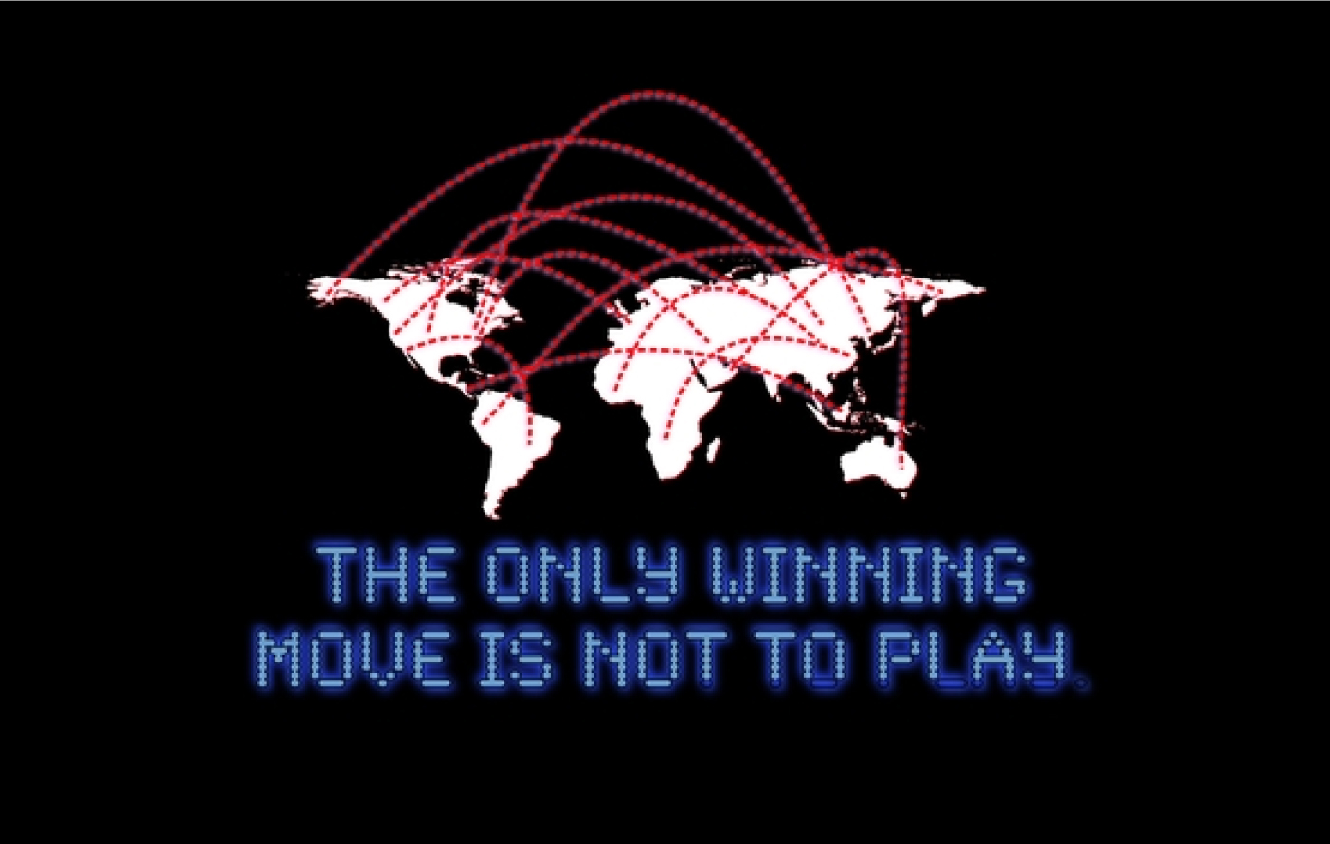
Blue Team Goal
Notes:
Creating an impenetrable system is an unrealistic goal for economic, technical and operational reasons, but defenders can prepare the battlefield in a way that makes campaigns unprofitable for attackers.

Slide 20
Conclusions
Contributions
Campaign-level dynamic complete-information CNE game
Software that finds Nash equilibria of this game
Future work
Consider Computer Network Attack (CNA)
Enhance the movement phase to be a repeated game
Continuous, instead of discrete, defender response
Consider different player types (risk averse vs. greedy)
Consider subgames

Slide 21
Summary
Motivation
Threat Model
Introduction To Game Theory
The Basics Of Our Game
Extensive Form Game
Nash Equilibrium
Information Sets
Parameters
Applications
Conclusions

Slide 22
A Game Theoretic Model of Computer Network Exploitation Campaigns
Robert Mitchell mitchellrr@mitre.org*
*The author’s affiliation with The MITRE Corporation is provided for identification purposes only, and is not intended to convey or imply MITRE’s concurrence with, or support for, the positions, opinions or viewpoints expressed by the author.
Approved for Public Release; Distribution Unlimited. Case Number 18-1312

