Slide 1
GDPR and You
Bob Siegel
President
Privacy Ref, Inc.

Slide 2

Agenda
What is GDPR?
Why should you care?
Security in GDPR
GDPR Requirements
What to do?

Slide 3
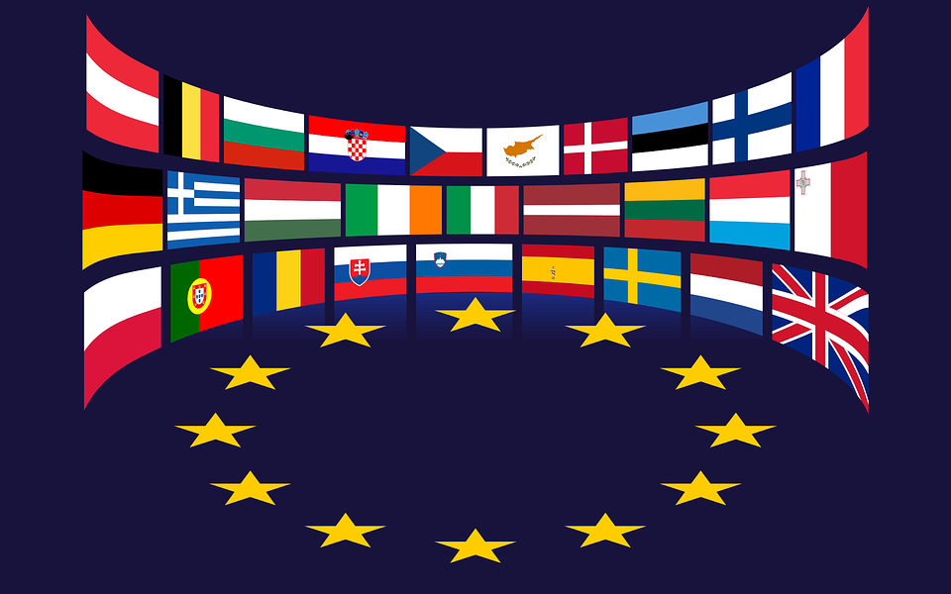
What is GDPR?
General Data Protection Regulation
Regulation (EU) 2016/679
Repealed the EU Privacy Directive 95/46/EC
Applies to the EU and the EEC countries
A Pan-European Law
Harmonizes 33 individual state laws
Supplemented by
ePrivacy Directive / Regulation
Member state sectoral and criminal laws
Enhances business by protecting personal information

Slide 4

Why should you care?
Broad scopes
Territorial scope
Material scope
Personal information definition
Fines and sanctions

Slide 5
Why should you care?
Territorial Scope
European establishment regardless of where the processing occurs
Processing by a non-European establishment where
The offering of goods or services to EU residents
the monitoring of their behavior as far as takes place in the EU
Processing by a non-European establishment, but in a place where Member State law applies by virtue of public international law.

Slide 6
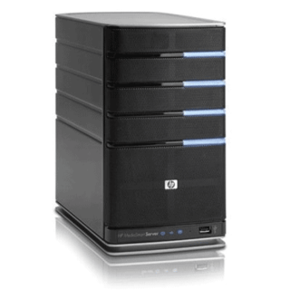


Why should you care?
Material Scope
This Regulation applies to the processing of personal data wholly or partly by automated means and to the processing other than by automated means of personal data which form part of a filing system or are intended to form part of a filing system.”

Slide 7

Why should you care?
Personal Information
“Any information related to an identified or identifiable natural person”

Slide 8

Why should you care?
Administrative fines
Up to €20 million or 4% of global revenues whichever is greater
Additional sanctions
Judicial remedies
Compensation to individuals who suffer damages
Penalties made by member states
Halting of processing
B2B customer expectations
Data processing agreements

Slide 9
GDPR Roles
Data Subject
Data Controller
Data Processor
Supervisory Authority

Slide 10
Security and Privacy
Security
Privacy / Data Protection
Protects all assets
Confidentiality
Integrity
Availability
Resiliancy
Focused on personal information
Security
Collection
Use
Sharing
Destruction
Transparency

Slide 11
Security in GDPR Article 32.1
Taking into account the state of the art, the costs of implementation and the nature, scope, context and purposes of processing as well as the risk of varying likelihood and severity for the rights and freedoms of natural persons, the controller and the processor shall implement appropriate technical and organizational measures to ensure a level of security appropriate to the risk, including inter alia as appropriate:
pseudonymization and encryption of personal data;
the ability to ensure the ongoing confidentiality, integrity, availability and resilience of processing systems and services;
the ability to restore the availability and access to personal data in a timely manner in the event of a physical or technical incident;
a process for regularly testing, assessing and evaluating the effectiveness of technical and organizational measures for ensuring the security of the processing.

Slide 12
GDPR Requirements
Transparency
Breach Notification
Applications Development
Vendor Management
Data Exports
Data Protection Officer

Slide 13
Transparency
Privacy notice
Specific information that must be provided by the controller
Describes how information is processed and protected
Identifies the legal basis for processing
Enforceable promises
Data subjects rights
Access
Rectification
Data portability
Erasure and the right to be forgotten
Restriction of processing
Object to processing
Object to profiling and decisions based on automated processing

Slide 14
Breach Notification
Processors notify controllers
Without undo delay
Timed from becoming ‘aware’ of breach
Controllers notify Supervisory Authorities
Only if there is a risk to individuals
Without undo delay, but less than 72 hours
Contents of notification are proscribed
Controllers notify data subjects
Where there is a high risk to individuals
Without undo delay
Exceptions
Data is unintelligible/encrypted
Post-breach actions greatly reduce risks to individuals
Individual notice requires disproportionate efforts, use another method

Slide 15
Application Development
Data Protection by Design
Data protection requirements comparable to others
Necessary safeguards
Data minimization
Pseudonymization
Data Protection by Default
Data protective settings as the default
Processing only necessary personal data
Limited accessibility
Data Protection Impact Assessments
When there is a high risk to data subject’s rights and freedoms

Slide 16
Vendor Management
Data Processing Agreements
Adequate Security
Engage sub-processors only with controller’s approval
Only process information as instructed
Ensure employees are committed to confidentiality
Address requests by controller regarding data subjects rights
Assist controller in responding to Supervisory Authorities
Deletion or return of all data after the relationship terminates
Demonstrate compliance
Require sub-processors to meet these requirements

Slide 17
Data Exports
Adequacy
Privacy Shield
Adequate safeguards
Standard data protection clauses
Approved codes of conduct and certification mechanisms
Ad hoc contractual clauses
International agreements
Binding corporate rules
Derogations
Consent
Performance of a contract
Public interest
Establishment, exercise or defense of legal claims
Protection of vital interests
Transfer from a register
Legitimate interests

Slide 18
Data Protection Officer
Ensures and demonstrates compliance with law
Expert in data protection law and practices
Legally required position (under some circumstances)
Tasks and responsibilities
Monitor compliance
Advise controllers and processors
Manage risk
Cooperate with the supervisory authority
Communicate with data subjects and the supervisory authority

Slide 19
What should you do now?
Determine if you are in scope for GDPR
Do you have EU facilities?
Do you actively sell goods or services into the EU?
Do you monitor the activities of EU residents?
Do you have personal information of EU residents?
Assess your practices against GDPR requirements?
Determine the risk of each gap identified
Create a plan to address gaps
Stay on to of new processing and legal requirements

Slide 21
www.PrivacyRef.com info@PrivacyRef.com @PrivacyRef 888.470.1528

