Slide 1
Droppin’ USB’s Like It’s Hot
A USB Drop Assessment Overview

Slide 2


About Me
Brad Thornton
ICSynergy
Senior Security Engineer / Penetration Tester
Experience
Penetration Testing – Consultant
Privileged Identity and Access Management
Blog (starting back to updating it)
http://thor-sec.com
Own some certs, lifelong learner, and breaker of things

Slide 3
Why this topic?
It’s DIY
No start to finish guide
Some security companies don’t do it justice
Great 101 track introduction
Students/Researchers have been getting great results

Slide 4
Agenda
Foundational Information
USB Drop Introduction
Importance / Popularity / Research
Types of Devices
DIY Assessment Overview
Physical / Software Considerations
Digesting Results
Defensive Measures
Conclusion

Slide 5
Where does this fit in?
Security Program / Attack Framework
Physical Security
Social Engineering

Slide 6
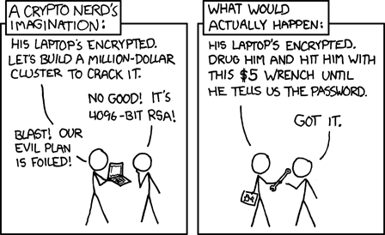
Physical Security
Protection of people, property, and physical assets from damage or unauthorized access
Threats - Theft, vandalism, fire, natural disasters, etc.,..
Often overlooked for technology focused security
Assessments can take many forms
Physical Security Assessment / Security Walkthrough
USB’s are physical devices dropped on location
Source: xkcd.com

Slide 7
Social Engineering
The art of manipulating people to divulge information or complete an action that breaks standard security practices
Baiting
Dangling something in front of a victim to act on
Phishing / Spear phishing
Acquiring sensitive information by pretending to be a trustworthy source
Water-holing
Infecting sites that the target is known to visit or trusts
Quid Pro Quo
Something for something…exchange happens and its never good for the victim (Ex. IT support)
Tailgating/piggybacking
Uses a person with legitimate access to enter into a building
Scareware/Rogueware
Fictitious threats prompting to install/purchase software that does not actually benefit the victim

Slide 8
USB Drops – A little of both worlds
What
Loading USB’s with malicious content and leaving them to be found by an unsuspecting target
Why
Introduce malicious code to the network or gain access
How
User interacts with device and it deploys malicious code
Code is automatically executed (HID) when plugged in
Phishing style attack, user is tricked into entering credentials
Assessments
Traditionally done during physical security assessments, sometimes as an add-on service
Customization = $$$

Slide 9
Why it’s important
USB drop attacks happen
Unsophisticated attack while offering great rewards to an attacker
Best defense is employee awareness and security training
Great for new and mature security programs
You can measure training effectiveness (document classification, departmental segregation)
Great to refresh people’s attention to security dangers, so reoccurring instances are helpful (at least annually)

Slide 10
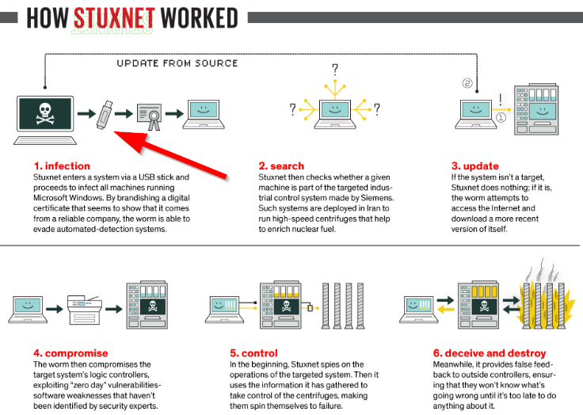
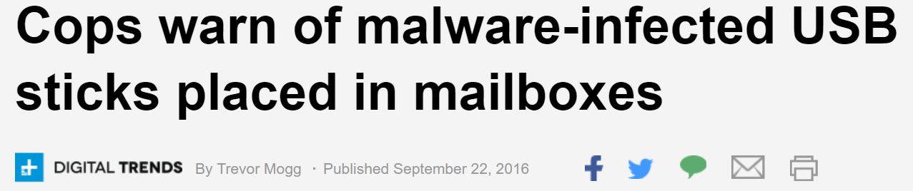
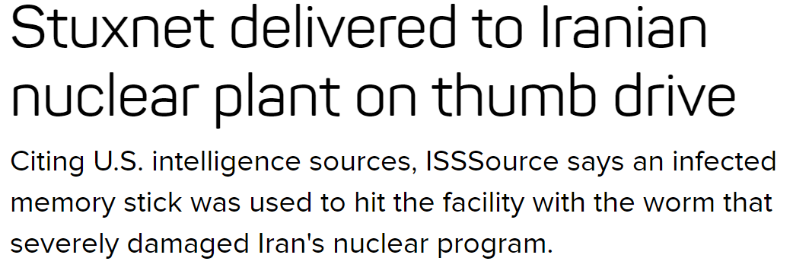
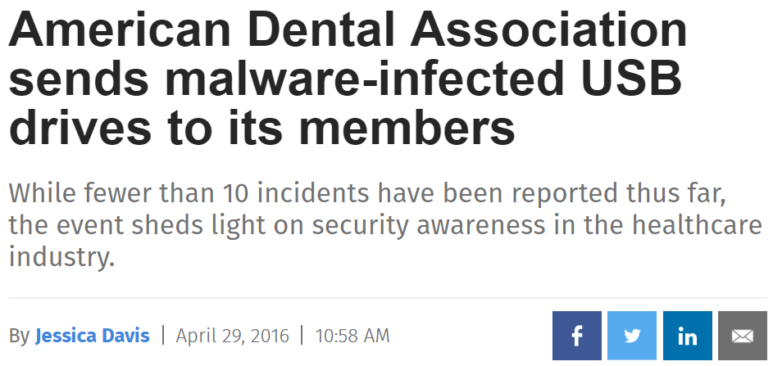
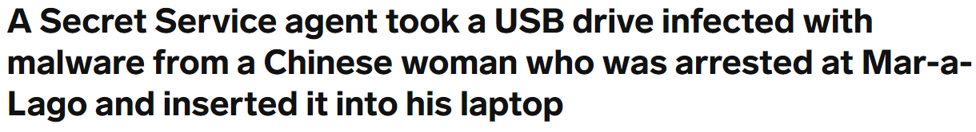

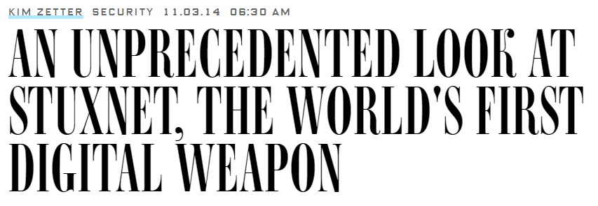
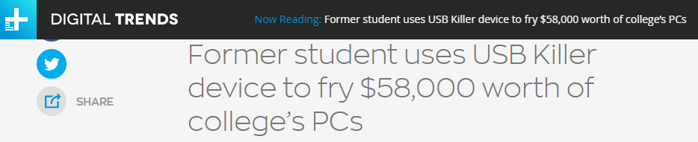
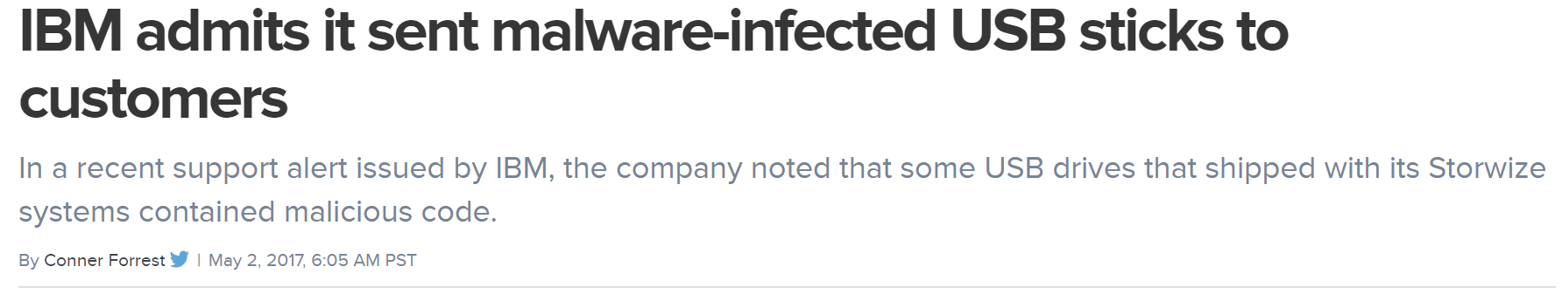
Popularity
Notes:
Convey that this happens in the real word in very serious attacks.

Slide 11
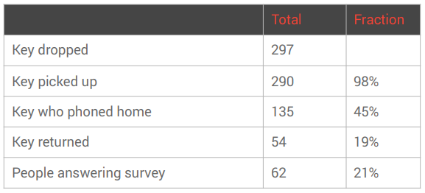
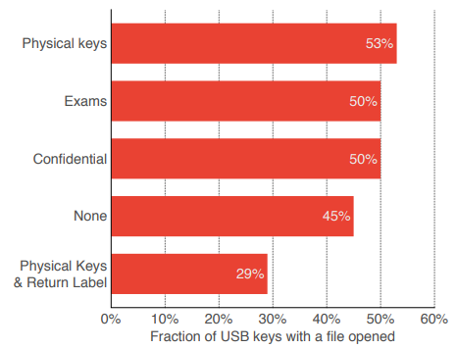
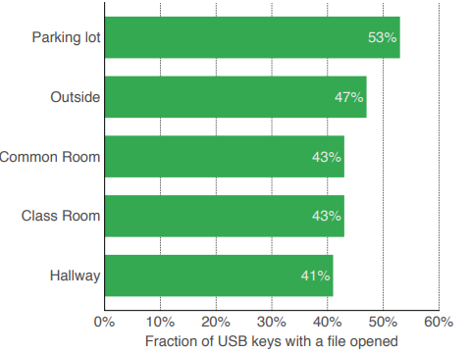
Public Research
Blackhat 2016 – Does Dropping USB Drives Really Work
Elie Bursztein - https://ly.tl/malusb
~300 USB’s dropped on campus
Included html files beaconed back home and offered an optional survey
First beacon back in 6 minutes
Source: https://ly.tl/malusb

Slide 12
My Experience
USB Drop attacks work
50-75% success rate is not uncommon on first run attempts
Each organization/industry has different cultures and security awareness levels
USB’s in trusting locations with a company or personal feel usually works
Hottest locations are lobby, turnstile, parking lot, and bathroom
Hottest files are resumes, budgets, payrolls, and “confidential”
I’ve shared tactics and techniques with students and researchers, and they’ve experienced similar results
Hit me up with your results!

Slide 13

So you want to run your own assessment?
Roadmap
Determine Goal
Obtain hardware
Modify appearance
Load software
Set up web server
Drop USB’s
Analyze Results
Take action
Rinse and repeat

Slide 14
Decisions…decisions
Your goal
How many USB’s to acquire
What they’re going to look like
Where they’re going to be dropped
What happens when they’re plugged in
Your target(s)

Slide 15
Questions to ask
What do you want to measure? Security Labels/General Awareness
Previously conducted a USB drop assessment in the past?
Want to be sneaky or obvious? Bait and switch or door in the face
How many do you want dropped?
Essentially enough for people to come across them
At least 5, can go by the amount of people (%15) or size of the facility
Do you want to target a specific role/individuals/group?
If yes, where are they located and what do you want to measure from them?
Want to obtain control over the devices or just report statistics?
What technology do your targets use?
What do you want to happen when the USB is plugged in?
Direct to company policy, fake login screen, only report, cat videos, rick-roll
What do you plan to do with the results?

Slide 16
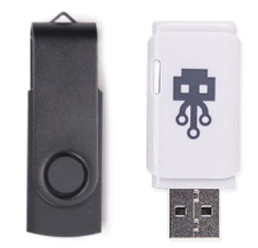
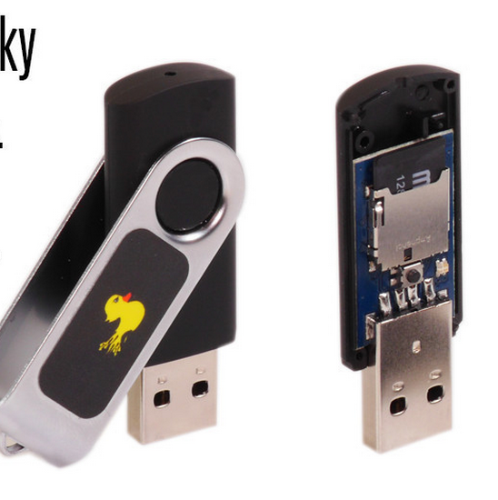
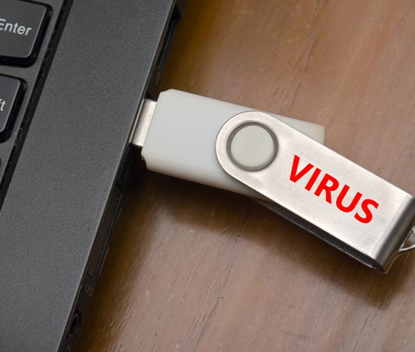
Types of Devices
What about backdoored media streaming devices
Devices
Malware enabled USB’s
HID (Human Interface Device)
USB Killers
*Other devices exist but beyond scope here (TURNIPSCHOOL, etc.)
Notes:
Discuss the 3 main devices that exist and their pro’s and con’s

Slide 17
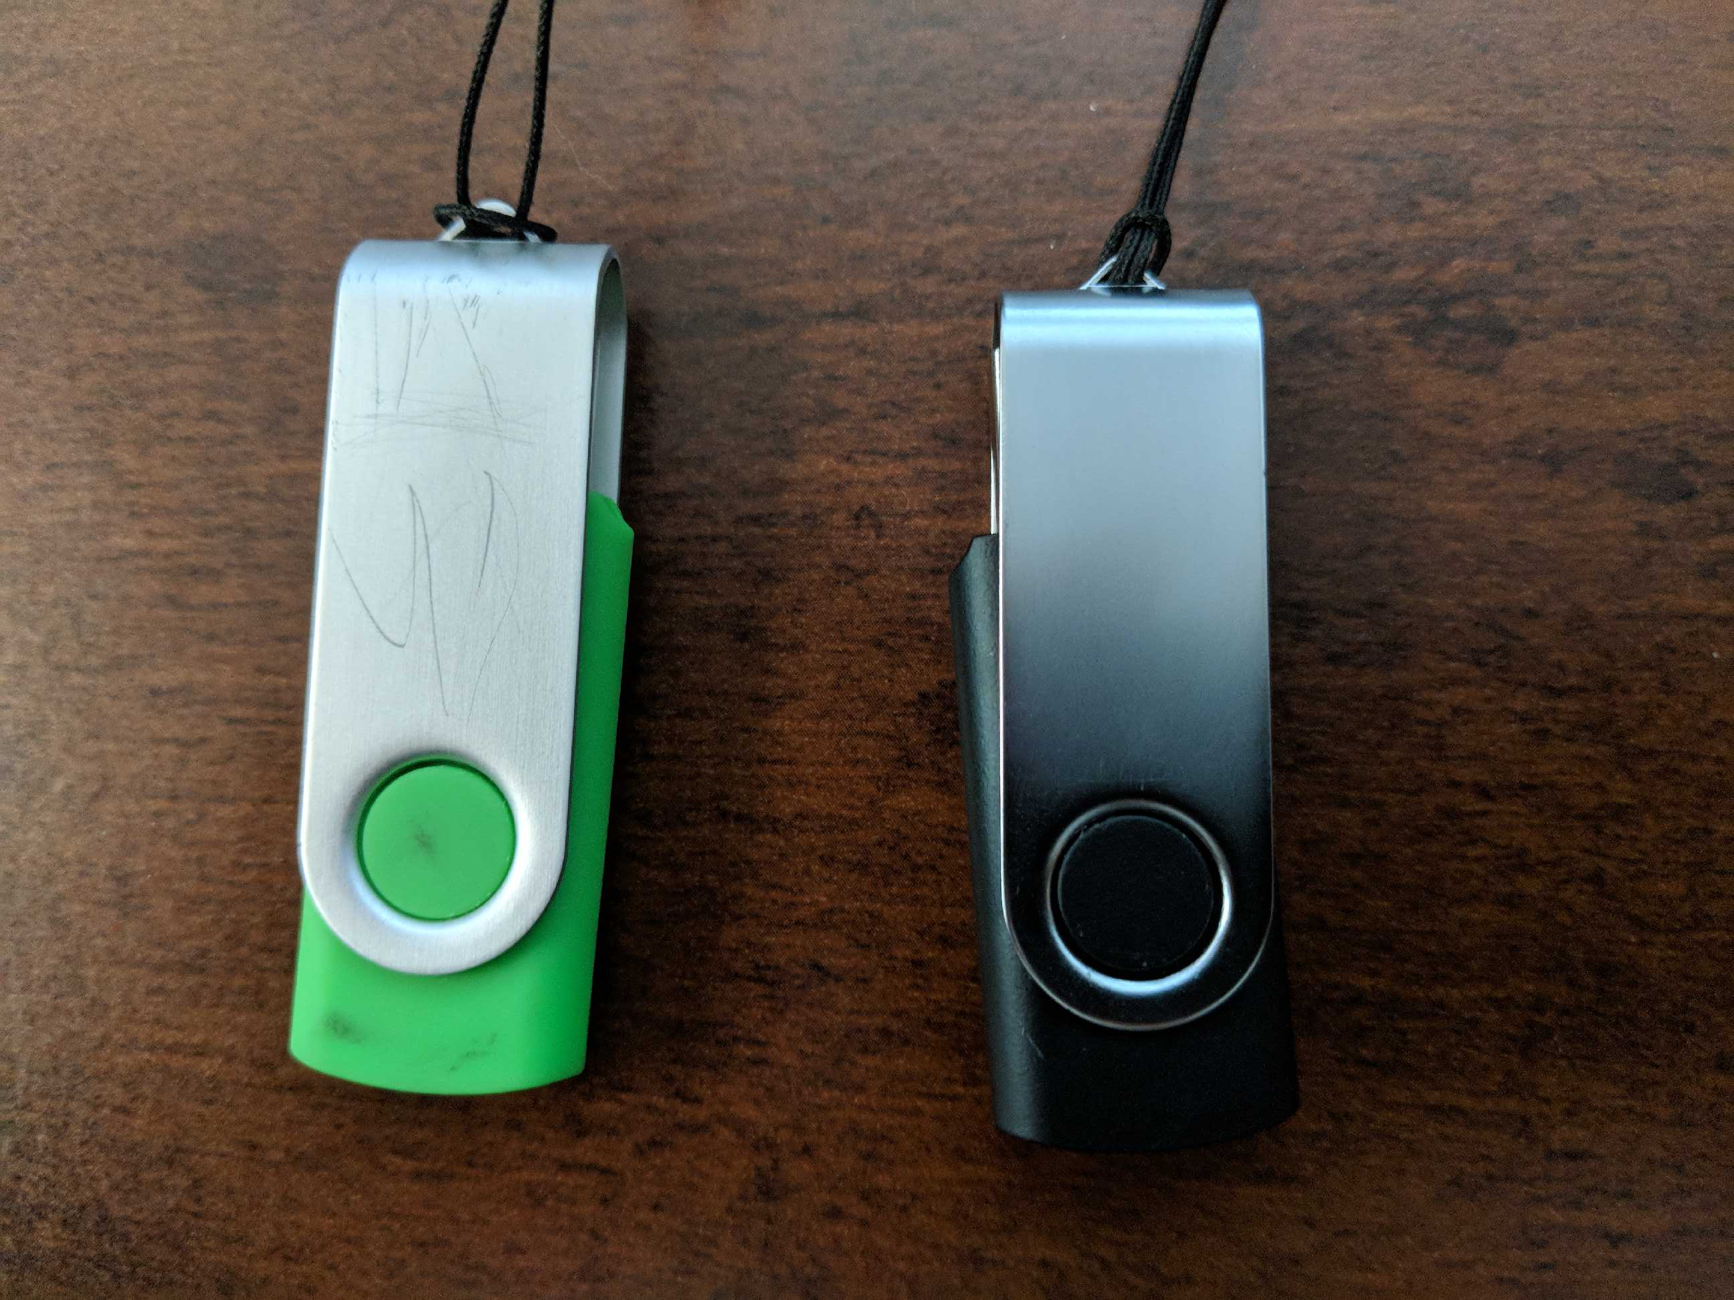
Physical Appearance - General
Wear and tear
Used USB looks more interesting
Mixed brand/styles
Some people connect the dots easily
Labeling
IT Dept, Confidential, HR, Exam Answers

Slide 18
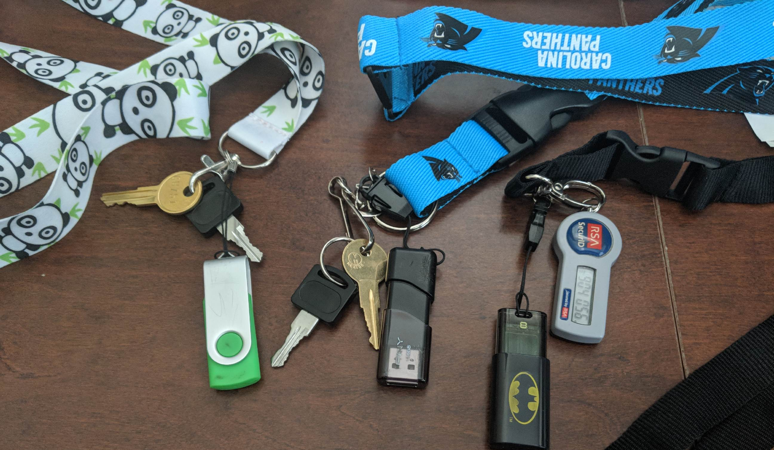
Physical Appearance – Add-ons
Accessories
Lanyards
Keys
Key-fob’s/multi-factor tokens
Club/grocery store cards

Slide 19
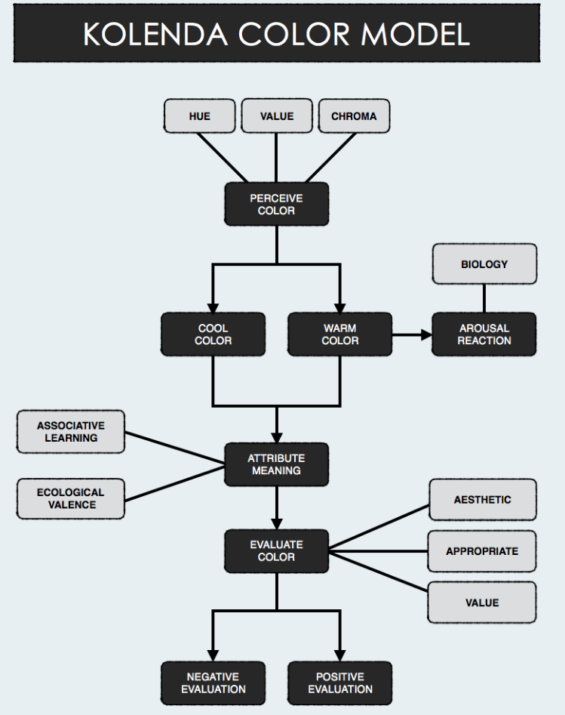
Physical Appearance - Color
Color Psychology
Blue
Positive: Intelligence, trust, calming, safe, coolness
Negative: Coldness, aloofness, sadness
Black
Positive: Sophistication, security, efficiency
Negative: Oppression, coldness, menace, heaviness
Yellow
Positive: Confidence, creativity, optimism
Negative: Caution, fear, anxiety, fragility
Notes:
Color schemes are powerful and we take into consideration this. We’ll also discuss company color schemes and local sports team and their role in our process.

Slide 20
Physical Appearance - Highlights
Personalization is key
Company brand/colors trump everything
Car keys = win
Feminine setups seem build the most trust

Slide 21

Location, location, location
Common areas
Figure out where your targets are going to be
Floors near copiers
Breakroom/printing room counters
Conference rooms
Floor near doors and turnstiles
Bathroom (highly unanticipated)
Parking lots

Slide 22

Software
Files/Software
Branding
Logo
Lingo
Color schemes
Font
Company culture
File Names
Malware.exe
2018_Q3_Budget.xls
Notes:
Go over marketing type information, get some audience interaction on comparing file names and what someone may or may not open.

Slide 23
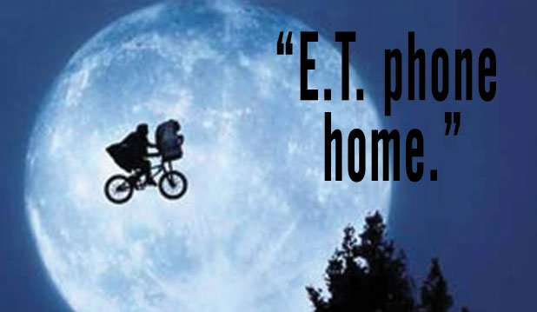
Payloads
We’re just phoning home people
Microsoft Office macro
PDF
Executables
Desktop.ini
Rubber Ducky scripts
Prebuilt scripts/payloads/kits on my blog soon
Notes:
Discuss the different payloads with emphasis on how we are just collecting information, not harming or putting the customer at risk

Slide 24
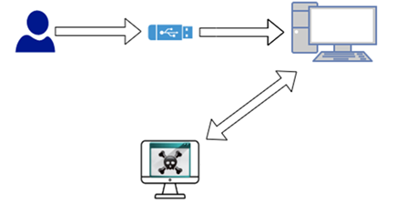
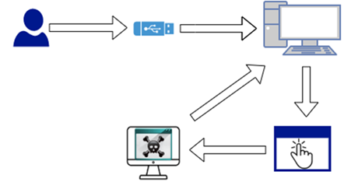
How it typically works
HID Option
User Interaction Option
Auto Runs
User Interaction
(Infected Macro)

Slide 25
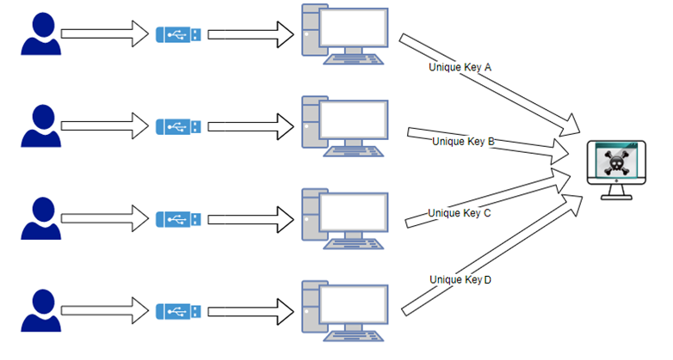
Keeping track of it all

Slide 26
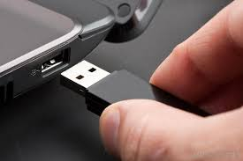
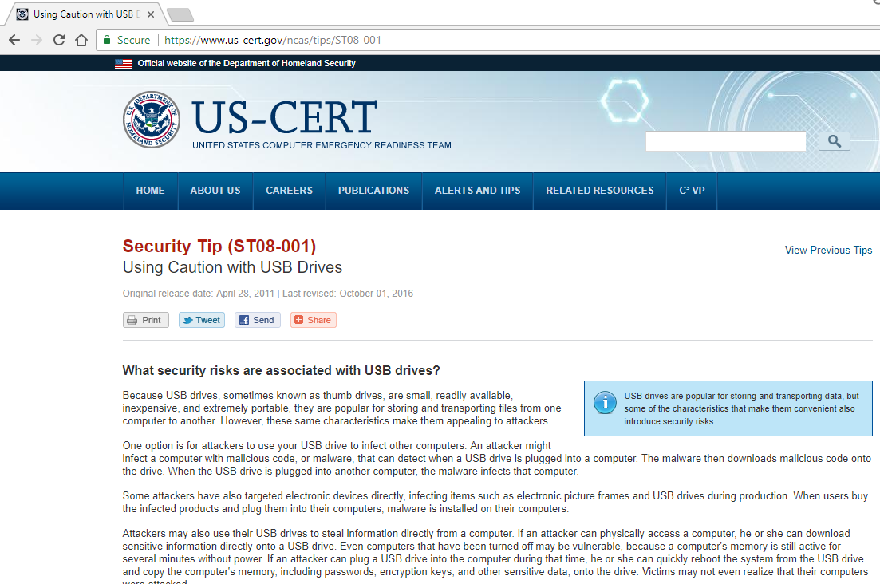
HID Script
Rubber Ducky Script
Notes:
Demo rubber ducky script

Slide 27
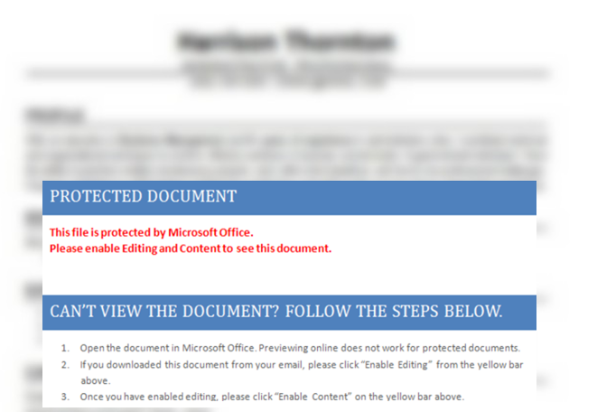
Disabling Security Features
Macro Enabled Office Word Document
Notes:
Demo word macro

Slide 28
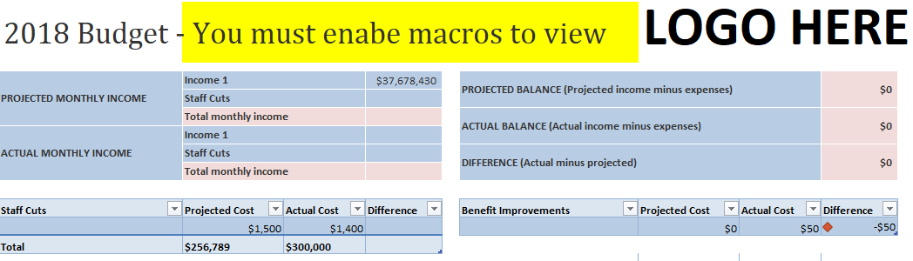
Enabling Macros
Macro Enabled Office Excel Document
Notes:
Demo excel macro

Slide 29
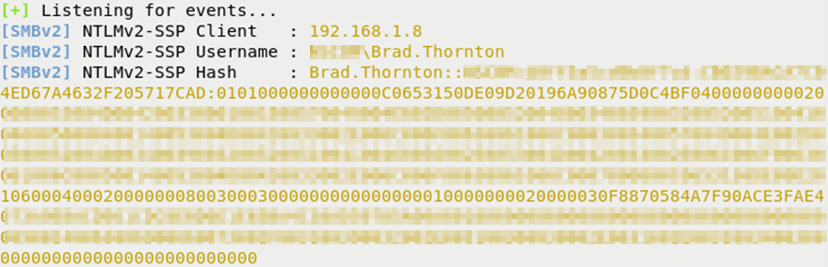

Opening a folder
Desktop.ini
Notes:
Demo desktop.ini

Slide 30
Software - Highlights
Pretend
Pretend it’s real and what it would look like
Incorporate
Incorporate what you want to train on
Mark confidential, export-controlled, private HR data
Exploit
Exploit human curiosity

Slide 31
The Results
Measure
Plugged in devices, devices handled appropriately, devices left in place, etc.
Compare to other assessments
Decide on mitigating controls and their effectiveness
Do it all over again and compare
Provide feedback/training
Don’t single out people
Praise those that act responsibly
Habitual offenders = escalate inconvenience

Slide 32
Defensive Measures
Stop it before it starts
Awareness / Training
Policy
Disable USB ports (glue?)
Containment /Mitigation
AV
Disable autorun
GPO’s
Malware scanning kiosk
only allow specific hardware ID’s, etc.,..
This one hasn’t won me over
Work arounds exist. Don’t just rely on this

Slide 33
Helpful Tips
Company policy sets the expectation
Measure your progress or lack thereof and constantly change
Some people have a tough time, make it inconvenient for them
Get crafty so each employee has a personal experience
Doesn’t have to be difficult, you can keep it simple
Rotate from various social engineering and physical assessments
With limited resources, start with people in high criticality positions first

Slide 34
Final words
USB Drops are a solid attack vector
You should be educating your employees
This doesn’t have to be a difficult task
If your hiring outside help, ensure they are putting in the effort to effectively simulate an adversary

