Slide 1

Security Mind Expansion
Chandos J. Carrow
MSIS, CISSP
VDH ISO

Slide 2


Slide 3


Slide 4
Journey
Student of cultures, religions, and life
There is no standard approach to anything
Everyone has different perspectives

Slide 5
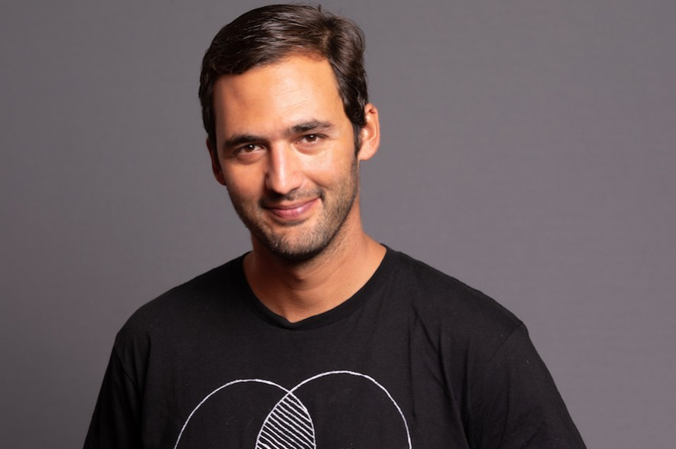

Slide 6
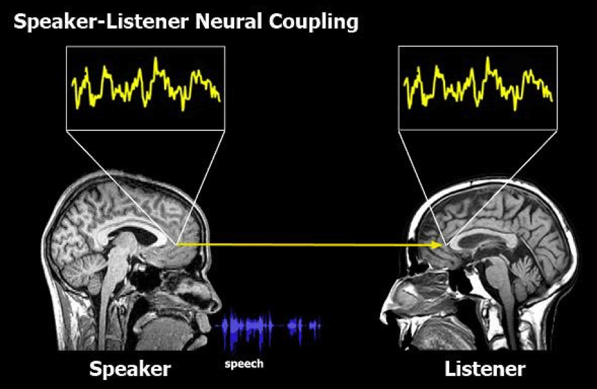

Slide 7
Ontological Design
“Just as you grow into the world, the world grows into you. Not only do you occupy a certain place, but that place, in turn, occupies you. It’s culture shapes the way you see the world, its language informs the way you think, its customs structure you as a social being.” ~Costica Bradatan

Slide 8
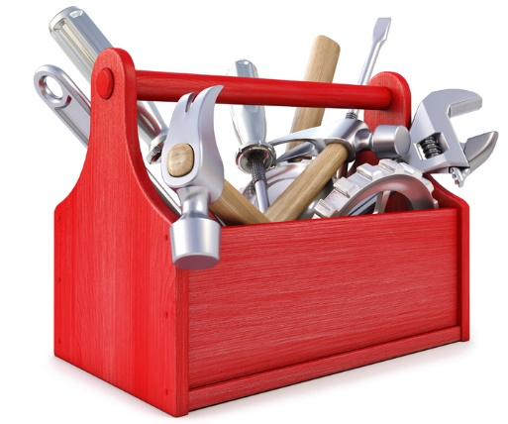
Notes:
The tools that we design/use for information security shape us and how we perceive and interact with information security

Slide 9
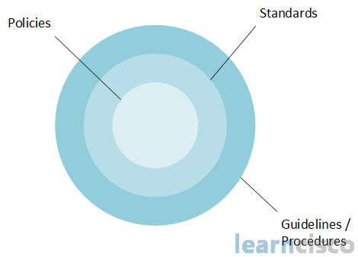
Notes:
Policies, standards, guidelines, procedures, and regulations of information security that we create/follow change the implementation of information security in our environments

Slide 10

Notes:
But are those changes, interactions, or perceptions of information security due to our current tools and edicts making us more secure?

Slide 11
Improve Security with the Looking-Glass Self Perspective
We imagine how we must appear to others.
We imagine and react to what we feel their judgment of that appearance must be.
We develop our self through the judgments of others.
Notes:
Yeung, King-To, and Martin, John Levi. "The Looking Glass Self: An Empirical Test and Elaboration."

Slide 12
“I am not who you think I am;
I am not who I think I am;
I am who I think you think I am”
~Thomas Cooley

Slide 13
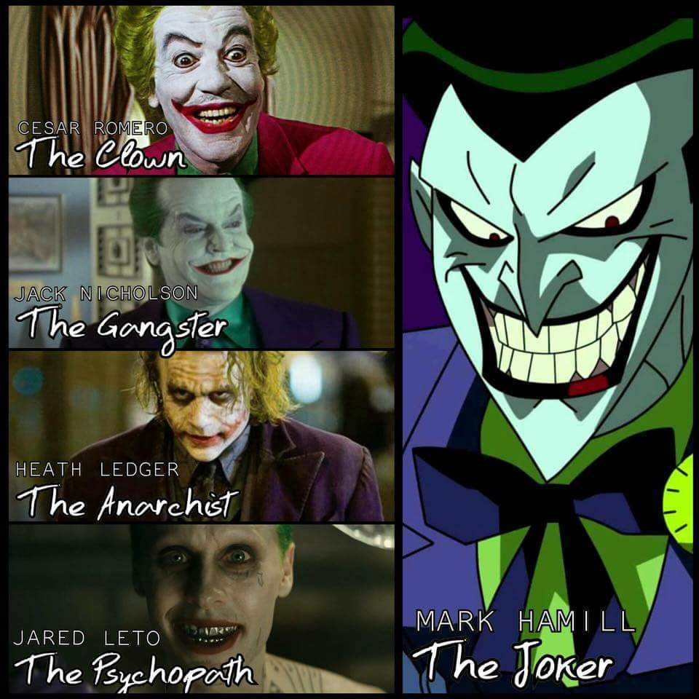
I am not who you think I am

Slide 14
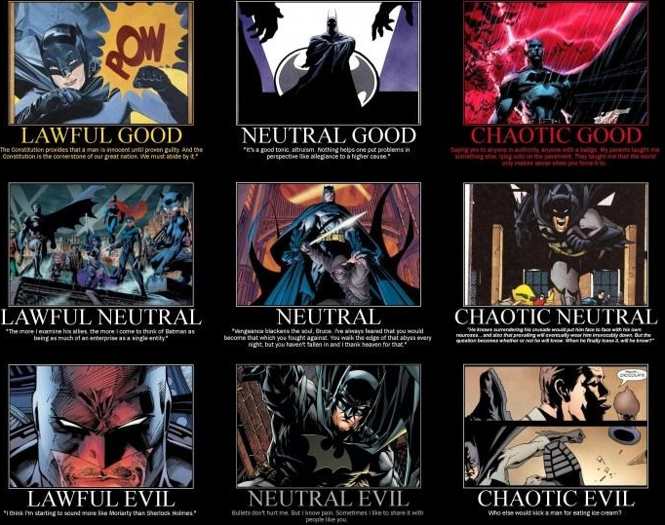

Slide 15
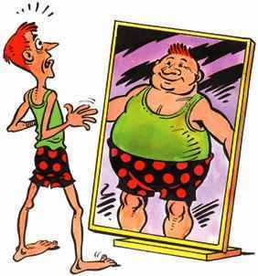
I am not who I think I am

Slide 16
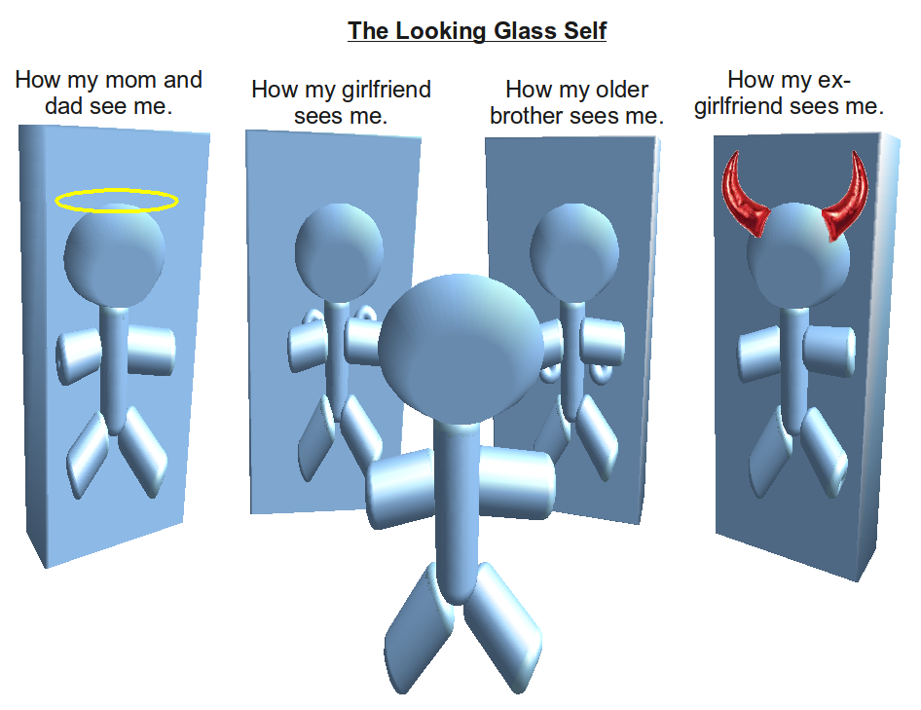
I am who I think you think I am
Notes:
The image of your company comes from what you think your customers think of you
It is what you think your customer’s perspective is that drives your company
This is an exercise every company should do internally and externally
The question you might be asking yourself is how can this improve security

Slide 17
So how?
Different perspectives
Security program
Image
Notes:
Different perspectives allow you to see how security at your company is perceived by others. In the day to day grind of our jobs we cannot see how our activities affect the business, our employees, or our customers.
We can see how our security program is being interpreted by others and possible where some gaps or workarounds exist
Improve the image of your information security department, from being the enforcers or the bad guys to being those who can help the business become more efficient. Or from a necessary evil to a welcomed practice
But how can we obtain what others think of us?

Slide 18
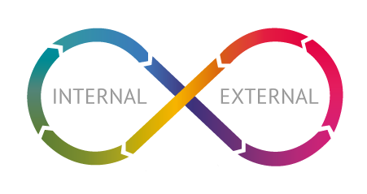
Feedback Loops
Co-author the experience
Sculpt and mold
Self-Amplifying
Optimism
Notes:
Feedback loops allow us to see how we apply information security is perceived by other internally and externally. With this process there are several benefits to be had.
They allow our users and customers to feel they are co-author how information security is applied
Provides the opportunity to sculpt and mold information security to the wants and needs of those it impacts
The power of feedback loops comes from the self-amplifying affect it has on the process itself
They also encourage an environment of optimism and positive thinking
The goal is to have these continuous feedback loops generating an optimistic culture around information security within your environment, but in order to implement these changes identified during these feedback loops we need to figure out how to optimize our resources including our time. How can we optimize our time when it’s the one resource that we are always lacking?

Slide 19

Flow State
Notes:
A typical day in the office for most information security professionals is probably very similar. We have meetings throughout the day we have to go to, emails that we have to read and respond to, auditors to answer to, random phone calls from users and sales people, run an information security program for our entire organization, and then find time to eat, spend time with friends and family, educate ourselves on new threats, techniques, and technologies, and maybe get a few hours of sleep. Doesn’t sound like we have a lot of time on our hands to complete the tasks we have to do let alone come up with new ways to improve information security.
Well lets take a page out of the professional athlete's book and put ourselves into a state of mind called flow state.
Do you think this kayaker is thinking “After this I got to answer that email from John about Monday’s meeting” or do you think when Usain Bolt is getting into the blocks he is thinking “Did I send my report to Tiffany today?” NO! They are focusing on what they are currently involved in. They are in a flow state. So what is this flow state?
It has been described as a state of virtuosity and enhanced performance where you experience a zone of transient and hyper focus

Slide 20

Standards
The catch up game
Self-reinforcing feedback loops
Natural emergence
Notes:
When thinking about how to get into a flow state I thought of my biggest headache at work and its our standards and requirements that we have to follow, and it not about meeting standards that pretty easy, but the hard part is actually trying to stay at that level.
I feel that no matter where you work that we all face the never ending game of catching up.
Lets think, what actually becomes possible if we can stop the bleeding/the never ending game of catching up? The possibilities are infinite, talk with our business units on a more regular basis, be able to identify problems before they become problems, or maybe even just be able to take a breather once in awhile.
So how can we do this? We already talked about this, but design security with positive self-reinforcing feedback loops
Make security flow as a natural emergence, make security second nature for everyone within your organization and not because they have to, but because they want to and they know its benefits
What else is interrupting us information security professionals from entering a flow state?

Slide 21
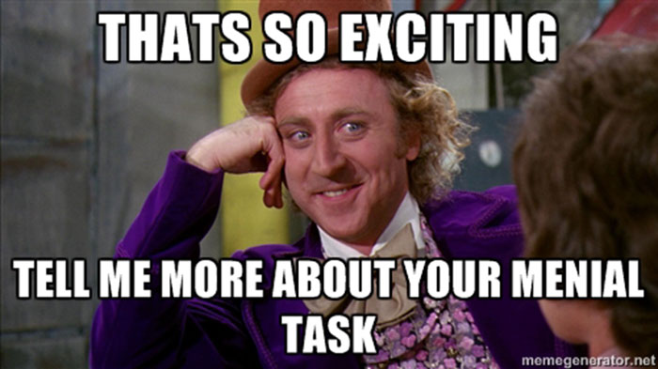
Menial Tasks

Slide 22
Design within/without
Creative and linguistic choices transform our minds from within
Of which we experience from without, ultimately influences us within
Everything is done in circularity
Our actions we do and the choices we make today matter

Slide 23
When we upgrade things we must realize that everything that we are designing is designing us back
And not just us now, but also the next generation
Policies, standards, guidelines, procedures, and regulations
Media and news reports
Applications and systems

Slide 24

Notes:
Burt Rutan – (ISC)2 1st Security Congress in Orlando, FL, said that interest in STEM from the next generation has a correlation with space exploration from Saturn V missions to the space shuttle launches. He hopes the privatization of space will encourage the next generation.

Slide 25


Slide 26


Slide 27


Slide 28

Cognitive Play
Notes:
Cognitive play – Recess
Cognitive play for ISOs will improve thought processing and thinking beyond regulations
Play with your perception
Creativity comes from the privileged perception escaping the mechanized cognition and entering something a kin to relativity
Find a way to tap into a different state of conscience
Change your mood and creativity will follow

Slide 29
Summary
Ontological design – What we design and build influences us back
Looking Glass-Self – To improve security we must look at things through different perspectives
Feedback Loops – Allow continuous change with more information
To better design new security practices we must be able to obtain a Flow State

Slide 30
Reducing menial tasks will help us achieve flow
When we design new security practices we must take in the perspective that what we design without will us design us within
Cognitive Play will allow creativity to flow

Slide 31
“Our creative and linguistic choices govern our fate…
I design, therefore I become.”
~Jason Silva

Slide 32
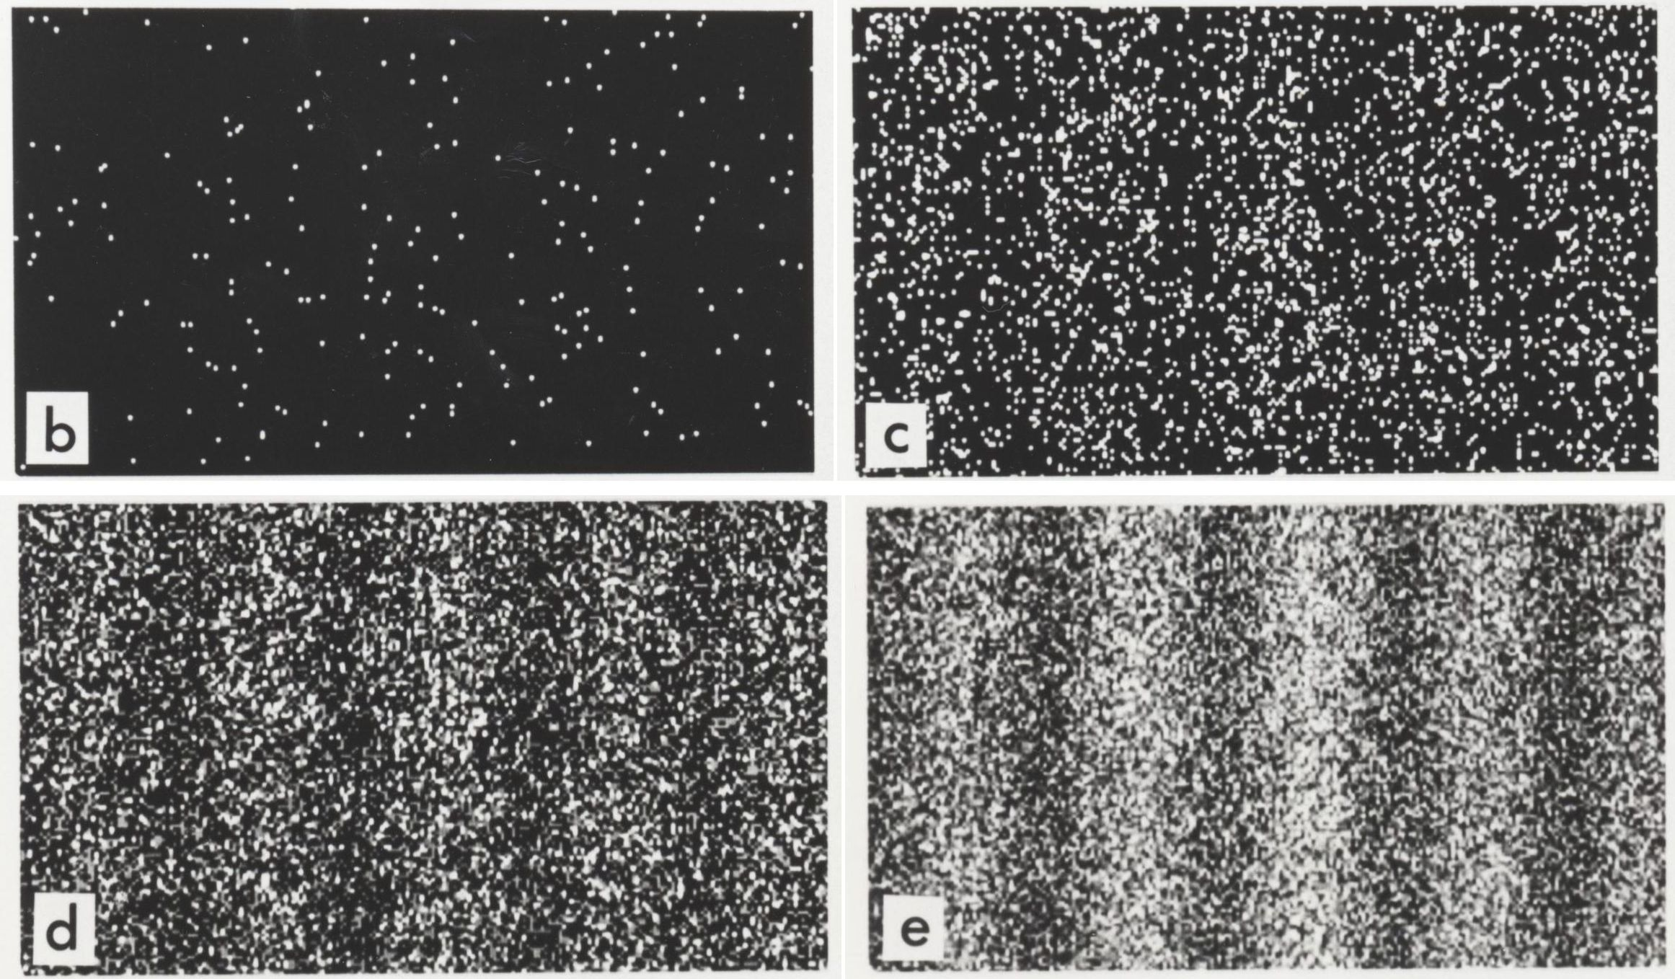
Quantum Mechanics –
Double slit experiment
By simply observing a situation it can change what occurs

Slide 33

The End

