Slide 1
Automating Information Security
Danny McCaslin
Systems Administrator
Frederick Water

Slide 2


Systems Administrator for 6 years
Recently graduated from American Public University
Summation of Graduate Thesis
Putting Theory into Practice
Twitter | @foolish_prof
Email | Danny.mccaslin[at]frederickwater[dot]com

Slide 3
The Current Attack Space
Attacks are becoming more complex
Recovery is getting harder
The stakes are higher
Security Administrators are stretched too thin
Attackers are getting more organized
Notes:
Attacks are becoming more complex. When I was a teenager getting online for the first time we had this small list of malware types that we had to worry about; viruses, trojans, the ever hungry worm. The popularity of the Internet brought with it the rise of malvertising so we had to add things like pop-up ads and keyloggers. Between the rise of Web 2.0 and Sony dropping rootkits on our computers we had to worry about sneaky add-ons and cross-site scripting and on and on and on. Now we have to have to worry about supremely finely targeted spearfishing, we have ransomware, we have new kinds of attacks that take advantage of supply chain problems to either infect updates or device hardware itself. Before the problem was script kiddies and Nigerian email scammers. Now we have Advanced Persistent Threats from all over the globe. Meanwhile we put a few members of the IT team in charge of security and let them play catchup.

Slide 4
Is Automation the Answer?
Security teams that automate lower the cost of a security breach (Pomemon, 2019)
Automation has always been a part of information security and IT as a whole
The industry as a whole is moving/has moved toward automation
Automation limits mistakes
Automation frees people up to perform higher level tasks
Notes:
It’s not just the security people who are spread thin. Automation is being adopted across the board, throughout the industry. The fascinating thing is that empirical studies show that automation helps to mitigate the cost of data breaches.
From a DevOps perspective the whole industry is moving towards automation
Automation limits the mistakes that administrators make in pursuing their duties and frees up administrators for higher level tasks.

Slide 5
Defining Automation
Fully Automated – A device takes in information from another device and performs actions based on a pre-defined set of rules
Partially Automated - A device that takes in data from human input and performs actions based on a pre-defined set of rules
Machine-Readable Data – Data that can be read and acted upon by a machine
Not Automatable – The task cannot be automated
Fully Automated – A device takes in information from another device and performs actions based on a pre-defined set of rules
Partially Automated - A device that takes in data from human input and performs actions based on a pre-defined set of rules
Machine-Readable Data – Data that can be read and acted upon by a machine
Not Automatable – The task cannot be automated

Slide 6
NIST Security Controls
NIST separates 276 security controls into 20 families in SP 800-12
All security controls in the 800-12 are tied to the security framework laid out in SP 800-37

Slide 7
NIST Control Families
AC – Access Control
AU – Audit and Accountability
AT – Awareness and Training
CA – Assessment, Authorization and Monitoring
CM – Configuration Management
CP – Contingency Planning
IA – Identification and Authentication
IP - Individual Participation
IR – Incident Response
MA – Maintenance
MP – Media Protection
PA - Privacy Authorization
PS – Personnel Security
PE – Physical/Environmental Security
PL – Planning
PM – Program Management
RA – Risk Assessment
SA – System and Services Acquisition
SC - System and Communications Protection
SI – System and Information Integrity

Slide 8
What should we automate?
Notes:
AC – Access Control
AU – Audit and Accountability
AT – Awareness and Training
CA – Assessment, Authorization and Monitoring
CM – Configuration Management
CP – Contingency Planning
IA – Identification and Authentication
IP - Individual Participation
IR – Incident Response
MA – Maintenance
MP – Media Protection
PA - Privacy Authorization
PS – Personnel Security
PE – Physical/Environmental Security
PL – Planning
PM – Program Management
RA – Risk Assessment
SA – System and Services Acquisition
SC - System and Communications Protection
SI – System and Information Integrity

Slide 9
In truth, we already automate a lot
Access control – Operating System Controls
AAA – Operating System/RADIUS
CIA – Operating System
Configuration – Group Policy, Chef, Puppet

Slide 10
Most Automatic Categories
Notes:
The Audit and Accountability and Identification and Authentication families are the most rife for full autonomy. This makes sense from the standpoint of a traditional IT infrastructure because these two families are handled by the operating system and don’t require lot of extra work.For instance, accountability on a windows system is controlled by assigning group membership and Identity and authentication is controlled by the logins themselves. Combined, these to really form the basis of the AAA Authentication, Autoirization, and Accounting triad.
Configuration management by its nature allows for a high level of full and partial automation, as the entire point is to automate the configuration of resources. Other functions such as firewalls allow for high levels of automation

Slide 11
System and Communications Protection
Protection of data at rest and in transit
Segregating functions to specific servers and subnets
Separation of User Functionality and System Management
Establish Boundaries for Public Accessibility
Monitor and Control Communications at the External Boundary

Slide 12
SC Automation
Intrusion Detection and Prevention
Firewall Rules
Policy-based Access Control
All of these can be applied at the network level and at the host level

Slide 13
System and Information Integrity
Guarding against improper modification or destruction
Ensuring non-repudiation and authenticity
Flaw Remediation
Malicious Code Protection
Non-persistence
Memory Protection

Slide 14
Automating SI
Scheduled file integrity checks
Automated Access Control and Access Logging
Virtualization
System Monitoring for Memory Protection
Spam Protection
Input Validation
Flaw Remediation

Slide 15
One thing leads to another…at least it should
Why doesn’t the discovery of a malware package on the network lead to the sending IP being blocked in the firewall?
Why aren’t clients seen communicating with known malicious IPs blocked from the network?
Why is configuration management sometimes seen as an afterthought?
Notes:
So we have all of this automation in place but we let each thing sit in its silo instead of letting one segment of the multi-layered security apparatus communicate with another. So our state-of-the-art AV solution catches a malicious software package and stops it from executing, but that’s it. Why not have the AV send a message to the firewall to block the sending IP from further traffic? Or why not blacklist the client from network access until configuration is verified (which some AV vendors are doing.) Why do we look at configuration management as an afterthought I don’t know a sysadmin who hasn’t thrown up his hands in frustration when Group Policy doesn’t work correctly.
Why do we allow software that doesn’t do what it says it will do? If AV and Endpoint Protection is supposed to keep us safe why did I just spend two months fighting to get my AV solution updated to the newest version? I once dealt with a backup solution that would lose connection with its storage server and never notify me. Literally the ONE JOB a backup solution is supposed to have is storing backups, and not only was it not doing that, but it wasn’t telling me that it couldn’t.

Slide 16
The Goal
System Health/ Security
Protection
Configuration Management
Accounting/ Access
Provisioning

Slide 17
SIEM and SOAR
SIEM solutions offer the ability to collect and manage all of an organizations security information in one location
Provides visibility and linkage between multiple events across multiple platforms
Correlates behaviors quickly for analysis

Slide 18
SIEM and SOAR
SOAR solutions provide a way for administrators to automate and orchestrate behavior across systems and tools
Automate an action based on a behavior
Orchestrate large-scale automation chains that require access to multiple systems

Slide 19
Putting this all into practice
Lessons from the trenches
Some free options are available for managing an organization’s security
Security Onion

Slide 20
Building Security Automation
Automation can be done through scripting or through the use of more complex tools
Different systems will have different levels of access allowed into that system
Start Small and work up to larger projects
Familiarize yourself with non-security centric automation platforms
Prepare to spend A LOT of time up front

Slide 21
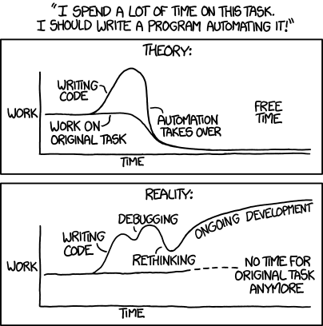
Source: https://xkcd.com/1319/

Slide 22
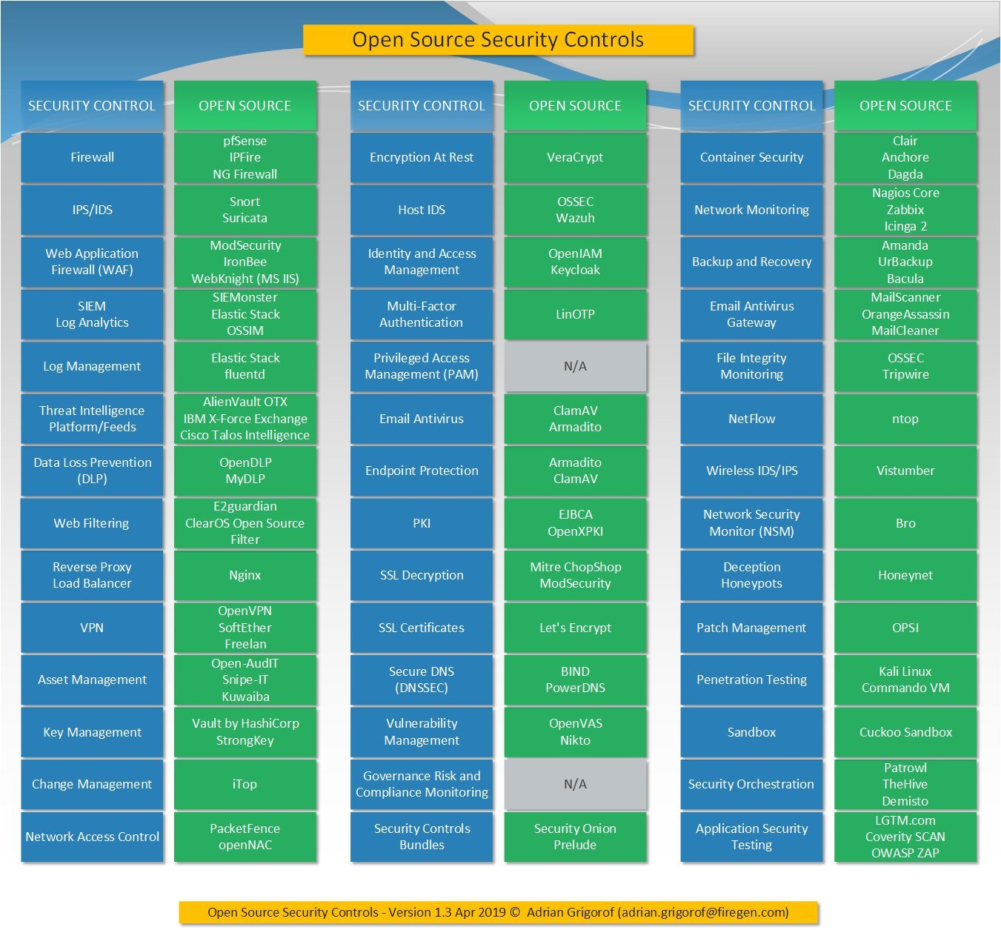

Slide 23
Pitfalls
“Our API is coming Soon™!”
“We usually market that to larger SOCs.”
“We’re sorry, but we do not currently offer this product for fewer than 1000 licenses.”
“That feature costs extra.”
Notes:
In the past three months I have spoken to at least three vendors who have given me the trademarked “Our API will be coming out soon” remark.
When looking at a SOAR solution I was told by a company that they usually only market the solution to larger SOCs. That means, in my professional experience, cha-ching!
One security solution vendor told me that they don’t sell in packages of less than 1000 licenses. Many others have told me they won’t sell less than 100.

Slide 24
Moving forward
Do business with organizations who take the idea of security automation seriously.
Treat automation as part of the security framework, not an afterthought.
Support Open-Source developers in the security automation space
Utilize available automation solutions.
Notes:
So how can we make automation easier and more common? A few things we as buyers can do include doing business with organizations that take the concept of automation seriously. Don’t buy from companies that don’t offer an API or a way to link with automated systems. We should think of automation as part of our security framework, not simply an element that we bring in afterwards. Think of security automation the same way you would think of something like RADIUS or Single Sign On. We can also support the development of open source solutions. Open source can not only be viable as a low cost solution but it also creates competition and helps grow the field. It is also important to utilize available automation solutions.

