Slide 1

Infosec 101 and Faulty Assumptions in the Field Introduction to the 101 Track
Deana Shick CERT Coordination Center (CERT/CC)

Slide 2
Copyright 2019 Carnegie Mellon University. All Rights Reserved.
This material is based upon work funded and supported by the Department of Defense under Contract No. FA8702-15-D-0002 with Carnegie Mellon University for the operation of the Software Engineering Institute, a federally funded research and development center.
The view, opinions, and/or findings contained in this material are those of the author(s) and should not be construed as an official Government position, policy, or decision, unless designated by other documentation.
NO WARRANTY. THIS CARNEGIE MELLON UNIVERSITY AND SOFTWARE ENGINEERING INSTITUTE MATERIAL IS FURNISHED ON AN "AS-IS" BASIS. CARNEGIE MELLON UNIVERSITY MAKES NO WARRANTIES OF ANY KIND, EITHER EXPRESSED OR IMPLIED, AS TO ANY MATTER INCLUDING, BUT NOT LIMITED TO, WARRANTY OF FITNESS FOR PURPOSE OR MERCHANTABILITY, EXCLUSIVITY, OR RESULTS OBTAINED FROM USE OF THE MATERIAL. CARNEGIE MELLON UNIVERSITY DOES NOT MAKE ANY WARRANTY OF ANY KIND WITH RESPECT TO FREEDOM FROM PATENT, TRADEMARK, OR COPYRIGHT INFRINGEMENT.
[DISTRIBUTION STATEMENT A] This material has been approved for public release and unlimited distribution. Please see Copyright notice for non-US Government use and distribution.
This material may be reproduced in its entirety, without modification, and freely distributed in written or electronic form without requesting formal permission. Permission is required for any other use. Requests for permission should be directed to the Software Engineering Institute at permission@sei.cmu.edu.
CERT® and CERT Coordination Center® are registered in the U.S. Patent and Trademark Office by Carnegie Mellon University.
DM19-0496

Slide 3
Agenda
Introduction
What is the Field
Compromising C,I,A
If you are just beginning…
Concluding Remarks
Questions

Slide 4
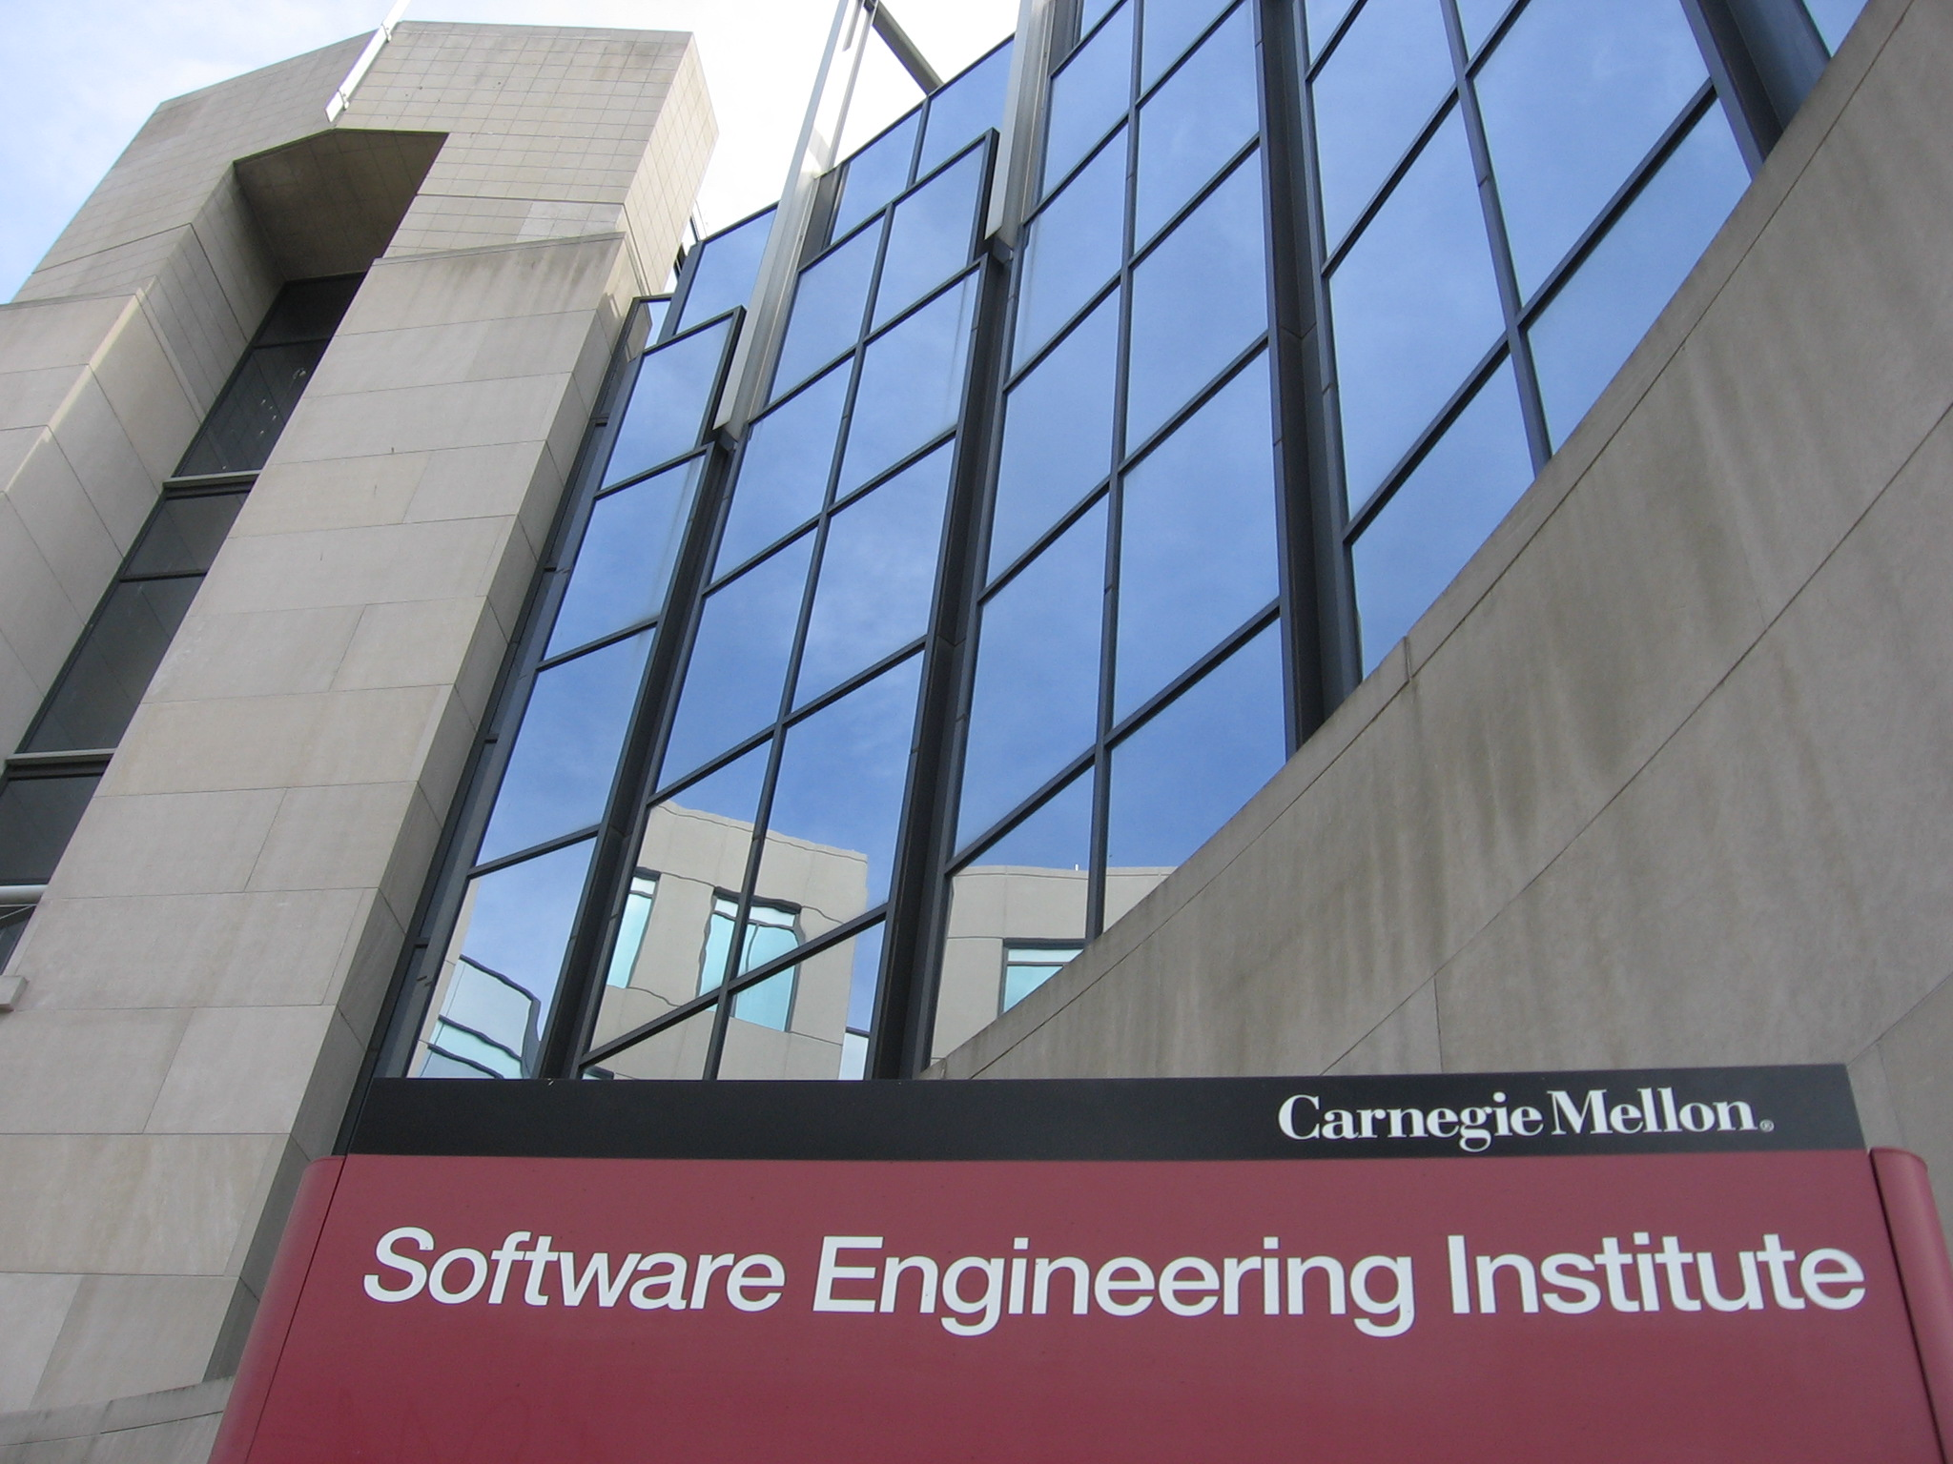
Who Are We?
Introduction
Information Security was born at the Software Engineering Institute (SEI), which is part of Carnegie Mellon University
The SEI is a Federally Funded Research and Development Center (FFRDC) as part of Carnegie Mellon University
Only FFRDC with “cyber” in the charter
Morris Worm outbreak in 1988 – birth of the CERT Coordination Center (CERT/CC)
Work with members of the Intelligence Community (IC), Computer Network Defense (CND) communities, and Law Enforcement
Spun up US-CERT at DHS post 9/11
Coordinates vulnerabilities on behalf of DHS for the general public

Slide 5
Who Am I?
Introduction
I’ve been at CERT for ~6 years
I work on the Threat Analysis team as a Vulnerability Analyst within the CERT/CC
Analyze the intersection of vuls, malware, and threat actors
CVE, Vul Severity, OASIS
Taught CERT/CC’s Vulnerability Response Capability Development class for CERT/CC
Pioneered the Information Security Program at Duquesne University in Pittsburgh
Joint program with IR and Computer Science for undergrads
Moonlighted at Carnegie Mellon’s Heinz College in their Information Security Policy and Management Master’s program

Slide 6
Infosec 101 and Faulty Assumptions in the Field
What is the Field?

Slide 7
Disclaimer
What is the Field?
This presentation is intentionally broad
It is going to be from my perspective as someone who loves, teaches, and breathes threat-stuff every day
I’m going to do a little bit of a dive into certain topics. I hope these things resonate with you.
This could be a ~3-4 hour lecture

Slide 8
Information Security
What is the Field?
“Information security, sometimes shortened to InfoSec, is the practice of preventing unauthorized access, use, disclosure, disruption, modification, inspection, recording or destruction of information. The information or data may take any form, e.g. electronic or physical.”
Surrounding the protection of information:
Confidentiality
Integrity
Availability
Non-repudiation
https://www.law.cornell.edu/uscode/text/44/3542

Slide 9
Faulty Assumption #1
What is the Field?
There is a ”right” answer to how secure you should be.

Slide 10
Faulty Assumption #1
What is the Field?
Risk tolerance
No one-size-fits-all solution
There are probably things you shouldn’t do
Sliding scale based on risk of the things you should do

Slide 11
Where do you fit in?
What is the Field?
This is not a complete list. The 101 track will cover some of these topics!
Security engineers
Network security analysis
Malware analysts
Network defenders
Risk management
Policy management
Threat and vulnerability analysis
Simulation and exercise
Penetration testers
Strategic analysis
Incident response
Lawyers
C-Suite
Insurance
Feed curation
SOC/NOC operator
Vulnerability management
Software developers
Dev Ops
Offensive Ops
Threat intelligence

Slide 12
Infosec 101 and Faulty Assumptions in the Field
Compromising C,I,A

Slide 13
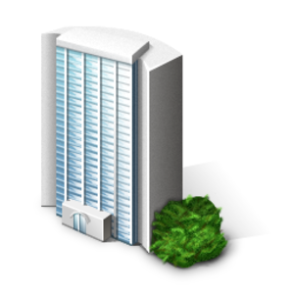

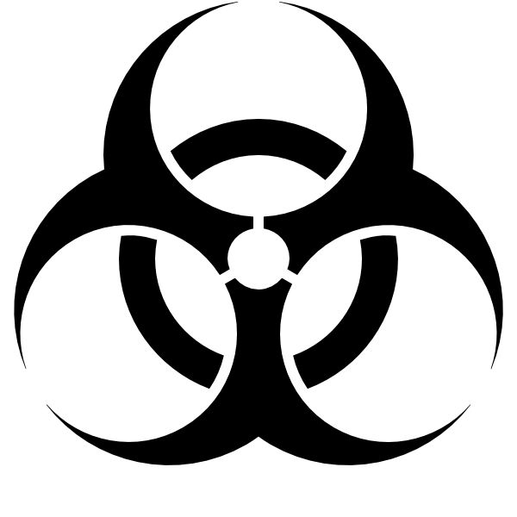

Threats
Compromising C,I,A
A lot of the field revolves around how we understand ways CIA is compromised. This means a little bit of threat analysis (also my view of the world)
People involved in this are risk management, procurement, policy creation, reverse engineering, vul management, etc.
Your C-Suite operates on information provided to them by the aforementioned parties.
P (
)
+
+

Slide 14
Actor
Compromising C,I,A
The person/s behind the keyboard perpetuating harm
The actor must have a motivation to do harm (old model)
Newbies (script kiddies), mess your day up
Hactivists, “political” agenda
Terrorists, “political” agenda
Insiders, make $$
Criminal organizations, make $$
Nation states, save $$
APT, save $$
Harm
Capability
APT
criminals
insiders
terrorist
hactivist
newbies
Intent

Slide 15
Actor
Compromising C,I,A
https://cybersecpolitics.blogspot.pt/2016/06/what-playpen-hath-wrought.html?m=1
Dave Aitel
Less sophisticated
Very sophisticated

Slide 16
Actor
Compromising C,I,A
Newbies can only operate here
APTs/NS have flexibility to be in all 3 categories
Everything else is kind of in here somewhere
Dave Aitel
https://cybersecpolitics.blogspot.pt/2016/06/what-playpen-hath-wrought.html?m=1
Less sophisticated
Very sophisticated

Slide 17
Faulty Assumption #2
Compromising C,I,A
The APT and/or Nation State is the biggest threat to me.

Slide 18
Faulty Assumption #2
Compromising C,I,A
No organization is 100% secure all of the time
It is really hard to do attribution
APTs and/or Nation States are your 1%. If they want to get in, they probably will
You have 99% of things to worry about
Shore up against those things

Slide 19
Tools
Compromising C,I,A
What the actor uses during their operations. Think of this like any other tool
Includes:
Vulnerabilities – weakness in code. “code is data and data is code”
Exploits – the code used to take advantage of a vul
Native utilities built into your OS
IP address and domain names
Delivery mechanisms – infection vectors (physical/virtual)
Malware – does and doesn’t use vuls.
Overall trickery/social engineering

Slide 20
Tools
Compromising C,I,A
Network defense operates here to protect against threat actor tools
SOC operators should pivot on these findings
Threat intelligence can also operate here
Keep in mind that tools alone are useless without an actor and target
There are a ton of sub fields in the Tooling category, so I am going to try and keep it as broad as possible.

Slide 21
Faulty Assumption #3
Compromising C,I,A
If I patch my machines, I’m definitely safe from actor tools. My scanner gave me no results, so ¯\_(ツ)_/¯

Slide 22
Faulty Assumption #3
Compromising C,I,A
There are a lot of issues with this one…so here we go…
Patching may not be the magic bullet. It certainly helps, though!
You should test patches
Prioritization is a real issue for organizations
Vulnerability scanners sometimes operate on vulnerability identification (like CVE, for example), headers, etc.
CVE is working on it, but it’s not 100% wholistic of the vuls that are out there
Not referring to only the “zero-day” either
Anti-virus isn’t perfect
TL;DR the tools you use may not be as good as you think.

Slide 23
Victims
Compromising C,I,A

Slide 24
Victims
Compromising C,I,A
The person, place, or organization where C, I, A is compromised in one way or another
C: PII, credit card numbers, super secret flight information is taken without your consent
I: an actor changes your super secret airplane schematics, financial records, or any other data without your consent
A: The system by which you process customer credit cards, or the machine you use to build your plane is down
Financial impacts of these are determined by the organization itself
A bank may have more interest in availability than an engineering firm, for example
Risk tolerance is also determined from org to org

Slide 25
Faulty Assumption #4
Compromising C,I,A
No one will target me. I have nothing to hide.

Slide 26
Faulty Assumption #4
Compromising C,I,A
Your organization has some asset you want to protect (I’d hope)
Data
Humans
Machines
You may be targeted purely as a byway for something else
Computational power – cryptocurrency mining
Insecure DNS server – hop point
Maybe you showed up on Shodan, and someone is targeting you because they can

Slide 27
Infosec 101 and Faulty Assumptions in the Field
If you are just beginning…

Slide 28
Pick something!
If you are just beginning…
You can’t be good at EVERYTHING
If you are a career changer, infosec can use your unique perspective
Pick something you really like if you are just starting out
If you are transitioning between sub fields, remember the big picture
Infosec cares about C, I, A. Figure out where you fit in.

Slide 29
Challenge Assumptions
If you are just beginning…
If you are seasoned in the field, you have probably heard the four assumptions (and then some)
Progress can be made by challenging these things
Learn from others in the field
Continue to go to these types of events!

Slide 30
Infosec 101 and Faulty Assumptions in the Field
Concluding Remarks

Slide 31
To Wrap Up
Concluding Remarks
We went over the definition of infosec and how it centers around C, I, A, and Non-repudiation
We discussed C, I, A can be impacted by discussing how threats work
Probability (Actor + Tool + Target)
We discussed four faulty assumptions in infosec that people make all of the time:
Information security is binary in terms of making “correct” decisions
I should only care about APTs
My security tools will save me
No one will target me

Slide 32
RVASec has an awesome lineup
Concluding Remarks
The 101 track is going to cover the following:
What is Cyber Insurance: Are you covered?
Vulnerability Assessments and Penetration Tests
Social Engineering, Physical Security, & USB attacks
Risk Assessments: The Heart of Risk-based Security
Network Security 101
Being Secure Doesn’t Mean You Are Managing Risk
RVASec 101 Panel

Slide 33
Contact
Concluding Remarks
Deana Shick
Member of the Technical Staff
CERT/CC
@deanashick (Twitter)
dshick@cert.org

Slide 34
Questions?

