Slide 1
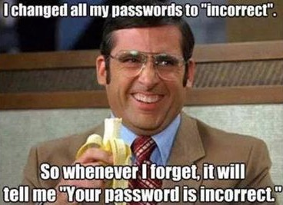
Compliance, Technical Controls and You
Derek Banks (@0xderuke)

Slide 2
About
Compliance work without enforcement through technical controls is just checking a box
Technical control systems without backing policy and management framework is just playing around with technology toys
How do either of these two areas of Infosec work to keep attackers out of a network?

Slide 3
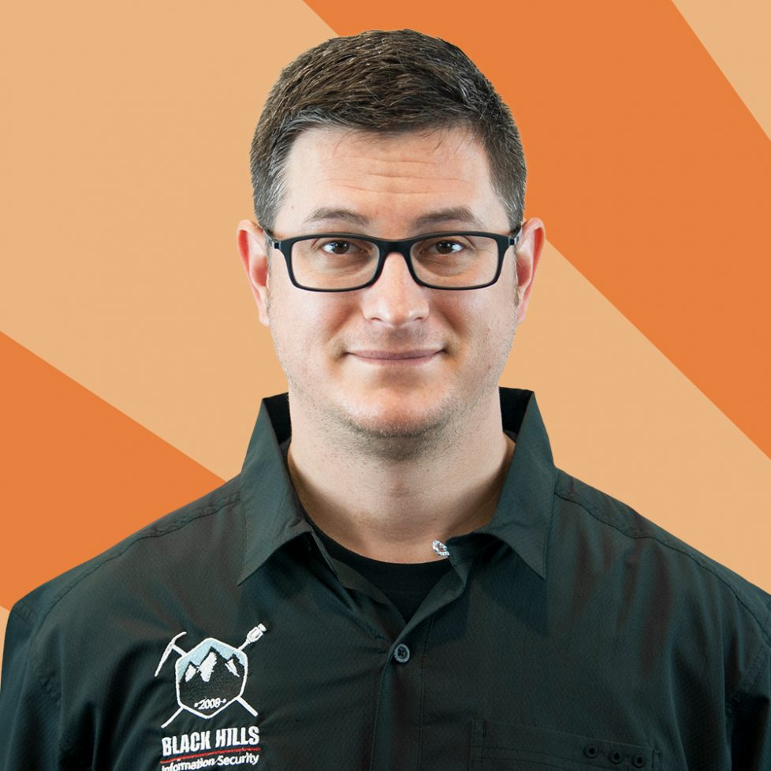
Me
Pentester / Red Team at Black Hills Information Security
GSEC, GCFA, GCIH, GPEN, GFNA, GMOB, GCIA, CISSP, ABCDEFG
CitySec Meetup Organizer
TidewaterSec – (Hampton, VA)
Avid OWA enthusiast

Slide 4
You
Two general areas of Infosec industry – Information Assurance and Technical Analysts
Information Assurance roles handle compliance and policy adherence
Analyst roles use specialized software and hardware to monitor and enforce security controls on computer systems

Slide 5
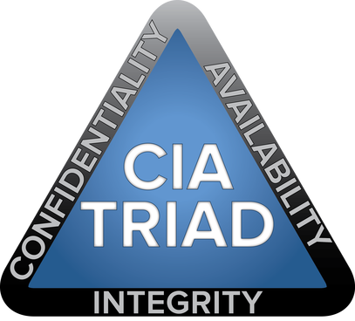
Information Security
What is the goal of information security?
Assessment of risk and to communicate that assessment to management
To support the organization’s goals
Depending on business goals, protection of:
Availability of data
Confidentiality of data
Integrity of data

Slide 6
Policy, Plan, Procedure
Policy: Strategic guidance on what will be done at a high level and has executive sponsorship
Plan: Tactical guidance on how the strategic policy goal will be met and includes identification of key roles involved
Procedures: Specific detailed series of actions taken that fulfill what is outlined in the plan

Slide 7
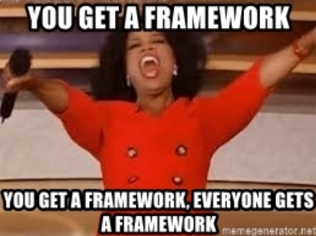
Frameworks
Risk Management Framework
NIST 800-53, NIST 800-37, and other hit singles
CIS Critical Controls
DHS CDM
ISO 27002:2005
NSA MNP, Top 10
PCI DSS 3.0
HIPAA
And many, many…. Many more

Slide 8

Crosswalk
May have to map between frameworks for multiple compliance requirements
Impossible to remember all the different controls in all the frameworks
Use a crosswalk document
https://www.auditscripts.com/wp-content/uploads/mgm/downloads/80905300.xlsx

Slide 9
On the same team
Information assurance and technical analyst roles have the same overall goal
Mitigation of risk to the IT infrastructure to ensure efficient IT operations
Information security workers have the same overall goal as the rest of IT
To ensure efficient IT operations so that the organization can meet its objectives
Too often we see unnecessary internal politics and conflict and an “us versus them attitude”
Work to defeat this

Slide 10
Common Issues
Weak Passwords
Lack of Two-Factor Authentication (2FA) on external systems
Over Privileged Users
Widespread Local Administrator Account
Lack of Egress Filtering
Unpatched Software
Lack of Effective Logging

Slide 11
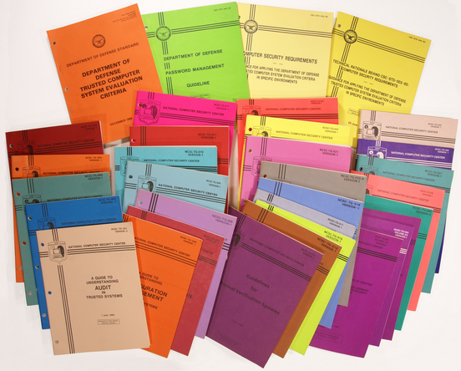
Weak Passwords
The single largest issue we see on almost all of our tests are poor password choices
Very common to find 8 character minimum, change every 90 days
Might have been ok in 1985?
Insufficient now… entire 8 character space can be brute-forced in 3 days with commodity gaming video cards
Also, likely an attacker can guess a password

Slide 12
Password Policy
Length is the most important password attribute
Policy should be set to 15 character minimum
Can alleviate operations concerns by increasing time between changes
CIS #16: Account Monitoring and Control
AC-2: Account Management
AC-3: Access Enforcement

Slide 13
Password Control Enforcement
Set password length through Group Policy Objects (GPO)
Not technically complex change
Prior to Windows Server 2012 “appeared” to be limited to 14 max in the Windows GUI
Can still be changed with ADSI or other tools
https://www.blackhillsinfosec.com/increase-minimum-character-password-length-15-policies-active-directory/
Consider additional technical controls like a password filter
https://www.blackhillsinfosec.com/the-creddefense-toolkit/

Slide 14
Password Attacks
Attacks that take advantage of poor password choices:
Password Spraying
Credential Stuffing
LLMNR & NetBIOS Poisoning
Kerberoasting
Malicious Shortcut and SMB Listener

Slide 15
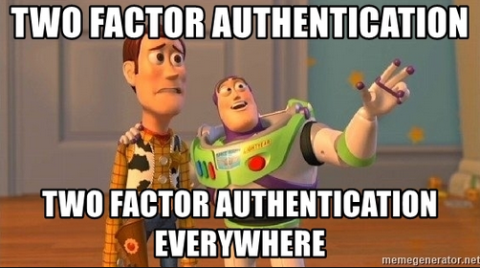
Two-Factor Authentication
All external facing systems need to be known and part of an inventory
No external user authentication without two-factor authentication
Is a significant hurdle for an attacker to overcome (but not impossible)
Multiple options
Apps
Hardware Tokens
SMS Messaging and Voice Calls

Slide 16
Two-Factor Policy
Written policy should state where and when 2FA is needed
Ensure policy addresses what circumstances allow individual 2FA can be turned off (and when it gets turned back on)
CIS #1: Inventory of Hardware
CIS #16: Account Monitoring and Control (as well as other CSC #s)
AC-2: Account Management
AC-3: Access Enforcement
Notes:
Two-factor auth is referenced in CSC:
4.4, 11.5, 12.11, 15.8, and 16.3. Might be worth it to mention that it is mentioned in several areas of the CSC.

Slide 17
Two-Factor Enforcement
Multiple options for implementation
Apps, some are even “free”
Hardware Tokens – historically most common, but falling out of favor for apps
SMS Messaging and Voice Calls
Regular analysis of border systems to ensure no unknown systems introduced

Slide 18
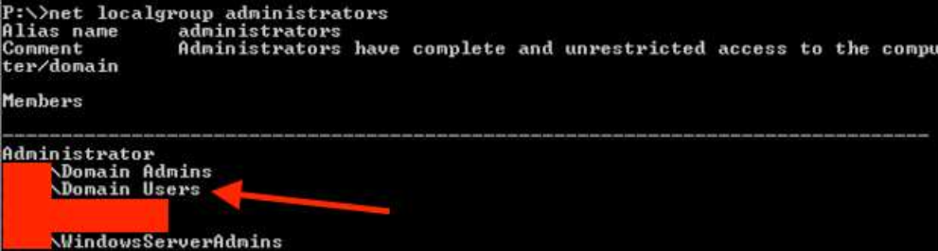
Over Privileged Users
Are all of your users local administrators on their workstations?
Sometime systems admins are under pressure to “just make it work”
Instant privilege escalation for an attacker

Slide 19
Widespread Local Admin
If you’re using one password for all local Administrator accounts, stop!
Compromise of that password will likely lead to domain compromise
Can be potentially be obtained through:
OS Deployment artifacts
Group Policy Preferences (GPP) though that’s falling out of favor
Admin access to a workstation (in NTLM hash form)
Implement Microsoft Local Administrator Password Solution (LAPS) to make workstation Administrator accounts unique

Slide 20
Administrative Rights Policy
Policy should set forth least privilege and only certain roles
Accounts with admin rights should be separate that normal user accounts
Should also not use the same password as the regular account
Only be used for admin functions from a jump workstation
They should have no direct access to the Internet or Email
Common local admin password should be banned if possible
CIS #4: Continuous Vulnerability Assessment and Remediation
CIS #16: Account Monitoring and Control
AC-2: Account Management and CA-7: Continuous Monitoring

Slide 21
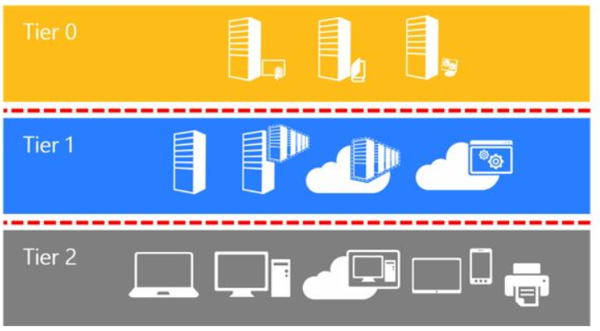
Admin Rights Technical Controls
Use the tools Microsoft gives you
Local Administrator Password Solution (LAPS)
the Microsoft Active Directory administrative tier model
https://docs.microsoft.com/en-us/windows-server/identity/securing-privileged-access/securing-privileged-access-reference-material#ADATM_BM

Slide 22
Lack of Egress Filtering
Firewalls are often only thought of for blocking inbound traffic
Outbound traffic control is important too
TCP 445 open to the Internet could allow for exfiltration hashes
Weaponzied LNK file = NetNTLM v2 hashes sent externally for an attacker to crack
Combined with a commonly used file share can lead to a lot of hashes to crack

Slide 23
Egress Filtering Policy
Overall Secure Architecture Policy should include:
All outbound ports blocked by default
All traffic should flow through an application proxy if possible
Any direct access should only be by documented exception
CSC #13: Boundary Defense
AC-4: Information Flow Enforcement
SC-7: Boundary Defense

Slide 24
Egress Filtering Implementation
No doubt its more work to implement and maintain but it’s a much more secure posture
There will be ongoing changes as changes to the environment occur
If all ports can’t be blocked outbound at a minimum TCP 445 should be
Application aware firewalls may be easier to implement this strategy

Slide 25
Unpatched Software
Patching is important – that’s been drilled into us for years
Uptick of web server and content management systems compromises as an initial infection vector
Sign up for USCERT email lists and email lists for the vendors of products you use to get notifications when vulns are realeased
Needs continuous monitoring and remediation

Slide 26
Patch Management Policy
Avoid language that puts one group in charge of all patching or groups in charge of specific systems
Patching should be an operations function that happens near automatically after patch release
Complete inventory of all software in use, do not ignore 3rd party
CSC #2: Software Inventory
CSC #3: Secure Configuration for Hardware/Software
CSC #4: Continuous Vulnerability Assessment and Remediation
CM-8: Information System Component Inventory
CM-2: Baseline Configuration
RA-5: Vulnerability Scanning

Slide 27
Patch Management Program
Group vulnerability scans by plugin, not by systems missing patches
Only deal with individual systems when there is a patching issue
Work towards immediate deployment of patches and the ability to quickly remediate an operations issue
Do not ignore Low and Informational level vulnerabilities
Annual third-party penetration test

Slide 28

Lack of Effective Logging
Mobile devices and cloud services have blurred the network boundary line
Host and network protections can (and will) be bypassed
Consolidating specific endpoint logs and alerting on actionable activity is a must
Microsoft provides some tools for this

Slide 29
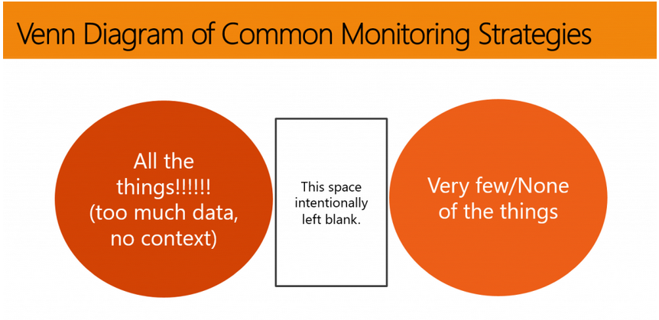
Lack of Effective Logging

Slide 30
Log File Policy
Avoid stating logs will be reviewed at a specific time interval (daily, weekly, etc) – this doesn’t work
Consolidation of logs from specific devices and specific events on servers and endpoints to provide actionable alerts
Address log retention (one year?)
CSC #4: Continuous Vuln Assessment and Remediation
CA-7: Continuous Monitoring

Slide 31
Logging Implementation
Set a foundation for centralized logging of Windows Events on Servers and Workstations
Microsoft has a free way to do this – Windows Event Forwarder (WEF) Server
Only send specific Event IDs that are actionable – log what matters
NSA Spot the Adversary list
https://www.blackhillsinfosec.com/end-point-log-consolidation-windows-event-forwarder/

Slide 32
Atomic Critical Controls
What is your password policy, specifically the minimum character length requirement?
Do you have any single factor external portals for users (or, do you use 2FA on all external access)?
Do you have a patch management program that includes third-party software?
Do you allow workstation to workstation communication?
Do you require separate administrative accounts for systems admins perform work?

Slide 33
Atomic Critical Controls
Are you using any Enterprise Detection and Response (EDR) products?
Is there a team reviewing and actively responding to alerts?
Are you collecting and consolidating Windows endpoint logs?
Are you logging network traffic and web access?
How long are these logs retained for?
Have you migrated to Windows 10 and Server 2012 (or higher)?
Do you have legacy operating systems no longer supported by the vendor?

Slide 34
Atomic Critical Controls
Have you implemented LAPS?
Are all of your users local administrators on their workstations?
Are you restricting egress traffic from your network?
Are you using any form of application whitelisting?
Do you have an inventory of all hardware and software assets?

Slide 35
How to Security?
Want to really frustrate an attacker (or pen tester)?
Long minimum character length password policy
Separation of admin accounts and all admin functions performed from a non-domain joined jump workstation
Implement Microsoft 3-tier architecture
No workstation to workstation communication (clients only talk to servers)
Implement application whitelisting
Run all Windows systems on latest version with latest patches
Do not disable Windows Defender and run UAC in Always Notify

Slide 36
How to Security?
Turns out good security is really just good systems administration backed by policy
The latest anti-APT Cyber Blinky Box Hacktron 5000 does not replace this
Implement the first CSC five controls
They support the remaining 15

Slide 37
Questions
Black Hills Information Security
http://www.blackhillsinfosec.com
@BHInfoSecurity
Derek Banks
@0xderuke

