Slide 1
Preventing the Attack – DHCP and DNS for the Win!
Presented by Jeff Cummings, CISSP, Sr. Systems Engineer for Infoblox

Slide 2

It’s coming…

Slide 3

The attacks are coming to your networks!

Slide 4

You must be ready to repel the attacks!

Slide 5
Leverage the Power of DNS and DHCP to protect your network!

Slide 6
DHCP
Dynamic Host Configuration Protocol

Slide 7
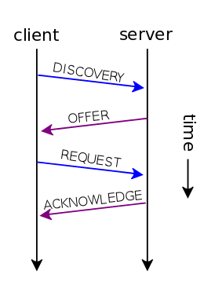
DHCP Process
You can stop this process right here!! BEFORE any address is offered.
DISCOVERY packet is the first communication from the client to the server. Broadcast to find any available DHCP servers.
OFFER packet contains an offer of an IP address for the client
REQUEST packet is client accepting the IP address offered
ACKNOWLEDGE packet is server confirming IP address for client

Slide 8
DHCP can block attacks BEFORE they occur
Devices on the network require an address BEFORE they can communicate on the network.
Typically, that address is provided by a DHCP server.
If you can prevent that address from being provided, you can prevent the client from joining the network and therefore the nefarious behavior, BEFORE it happens.

Slide 9
What to block with DHCP?
MAC address – block devices that may have been identified already
Network – Block by relay agent
Operating system – via Fingerprinting process
Ex. Don’t let Windows XP, or Linux, or X-Boxes on your network
Notes:
MAC address – known bad MAC addresses, possibly a particular vendor
Network – don’t allow certain networks
Operating system – Network of Microsoft machines, Linux client attempts to join
Time – only allow DHCP during certain times

Slide 10
DHCP – Successful prevention
Most hosts will request DHCP lease, an IP address does not have to be provided.
If no IP address is provided, you will have record of the attempt
What host, what network, what time, what operating system
This attempt can be communicated to other systems for further protective measures.
Bottom line, you have stopped a potential malicious host from joining your network BEFORE any damage can be done, AND collected some intel.

Slide 11
DNS
Domain Name System

Slide 12
DNS is the Contacts list for network devices
DNS resolution can be compared to making a call on a smart phone
Most people do not know all the phone numbers stored in their phone
To call someone, they refer to their contact list, look up the persons name, and the device dials the associated number of the contact.
DNS does the same thing
Client wants to go to a site but does not know the IP address
It requests the IP address associated with a domain name
DNS provides the translation and sends the IP address to the client
Client sends packets to the IP address

Slide 13
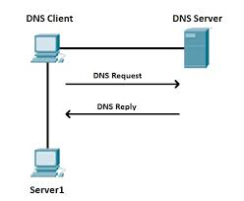
DNS can stop malicious traffic BEFORE connection
Request – client provides fully qualified domain name (FQDN), Ex. www.google.com
DNS Reply – server provides IP address of www.google.com , Ex. 234.45.88.129
If DNS does not resolve the FQDN, the client does not know where to go.
You can stop this process right here!! BEFORE any IP address is provided.

Slide 14
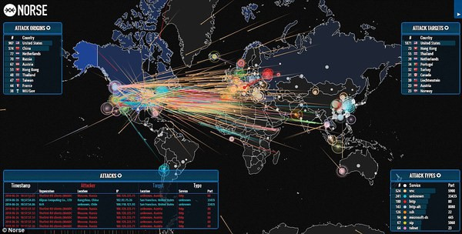
DNS has a front row view of most everything that happens on a network.

Slide 15
Why is this important?
Both protocols engage the client BEFORE other security devices
Both protocols can enforce security BEFORE other services
Faster enforcement, less chance of malicious activity
Enforcing with DNS and DHCP can take load of other security devices
The client does not attach to the network (DHCP)
The client's actions can be contained (DNS)
No traffic to proxies, firewalls, or other security products

Slide 16

Precision is important!
DNS can block specific domains, not IP addresses that may serve multiple domains.
Often multiple domains are hosted on the same device
If the IP of that device is blocked, ALL the domains are blocked.
Use the right tool for the job!

Slide 17
Response Policy Zones
A response policy zone (RPZ) is a mechanism for use by Domain Name System recursive resolvers to allow customized handling of the resolution of collections of domain name information (zones).
Part of the Bind standard since 2010
A RPZ can be used to distribute a list of malicious zones into the local DNS
Typically these zones are reputationally based

Slide 18
Threat Intelligence
Key to successful security!
Typically a team evaluating data from multiple sources and curating that data for consumption (perhaps in the form of an RPZ)
This data will contain many sites involved in malicious activity
These are the sites you can block with DNS, BEFORE any connection is completed.

Slide 19

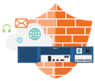

Blocking Malicious Activity with DNS
Malicious Domains
Threat Intel Data, via RPZ
Malware/APT
Client Machine
DNS Server
Notes:
For protecting against malware and APT, Infoblox offers the DNS Firewall. This is a software that can run on Infoblox appliances. It has intelligence on known malicious domains and networks.
Let me walk you through an example of how DNS Firewall works.
When an infected device is brought onto the network, it tries to communicate to its command and control site using DNS.
The infected endpoint sends a DNS query to the Infoblox DNS server and the DNS Firewall will compare the destination information with its list of known malicious destinations received from the threat-update service powered by ThreatSTOP. The threat intelligence feed is highly scalable, highly available (utilizes Anycast) and customizable. DNS Firewall leverages intelligence on the top domains that host malicious activity. After checking the query and determining it is to a bad site or IP address, DNS Firewall will then take administrator defined action such as blocking the communication of that endpoint to the known malicious destination or redirecting the traffic to a landing page or “walled garden” site defined by the network administrator.
3. DNS Firewall will also report on the malicious activity. With Infoblox Reporting, you can find out which endpoint actually tried to make the malicious communications, what is the device IP address, device MAC Address, what type of device it is. With DHCP fingerprinting, you can find out if it’s an iPad, a smart phone, a PC, or a MAC. So you get more intelligence on the infected endpoint, so you can easily go and clean it up.
DNS Firewall is updated every 2 hours with information on newly discovered malicious domain destinations, IPs, etc. It uses a regularly updated RPZ feed that is based on malware data from multiple public and private sources.
5. The DNS Firewall can also receive and act on threat intelligence from outside Infoblox. For example, it works with FireEye Adapter, a mechanism that enables intelligence from FireEye on zero day malware to be used to block with DNS Firewall. As you may know, FireEye is a sandboxing technology for detecting zero day malware, basically advanced persistent threats or APTs. If you don’t have FireEye deployed inline, the FireEye appliance would just give you alerts and you would have to go and take action on them. But with Infoblox DNS Firewall, it takes those alerts and intelligence from FireEye, and it actually takes action. It blocks and disrupts those APT communications that the FireEye detects. So it’s one step further. It’s a complete solution for APT mitigation.
Key Benefits of DNS Firewall + FireEye Adapter solution:
Blocks internet malware and internal APT DNS communications to malicious domains and networks
Automatic updates to stay protected against constantly evolving threat landscape.
Easily pinpoint infected devices based on DHCP fingerprint and lease information
Easily lookup threat severity and reputation of malware that has been blocked

Slide 20

Add Sneakers clip here.

Slide 21
It’s all about the Information!
MAC address
IP Address
Type of device (MAC, Windows, Linux, Gaming device, phone, etc)
Time host joined the network
Network the host joined (where in the enterprise)
History of when and where that host connected to the network
DNS names of the hosts
Names of ALL the network targets to which the host attempted to connect
When the attempt to connect occurred
AND WHO was logged on the host (with a little integration with the Authentication Server, Active Directory typically).

Slide 22
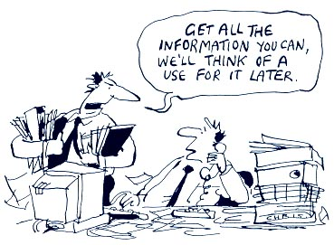
A Treasure Trove of Data for Investigations
All the data is correlated in the same system (saves time)
Available via API calls

Slide 23
Leverage the Information for Investigations
Typical alert ticket may indicate malicious activity of an IP address
The security team must dig further to determine what that IP address and more
Better with the DHCP and DNS Information, Alert ticket could contain…
Jeff is on his Macbook (jeff.company.net) connected to HQ network (10.20.30.45)
He received a DHCP address at 2:30 AM
He attempted to go to 3 sites (google.com, apple.com, and badguy.com)
He was blocked when attempting to resolve badguy.com @ 2:32 AM
With a simple query…
The last 3 times and places he connected were x, y, and z
The last 10 sites he connected to were a, b, c ...

Slide 24
Leverage this Information for Automation!
Eliminate periodic vulnerability scanning with a scan whenever a DHCP address is provided – near real time.
When issues occur…
Notify ticketing system
Notify remediation systems
Initiate transition to remediation vlan
Initiate specific firewall protection rules
For investigations
Leverage API calls to pull information on MAC, IP, Name, User, etc
Create timelines with DHCP and DNS logs

Slide 25
Leverage the tools you already have!
DHCP and DNS have a front row view of most everything that happens on a network and collect critical data for security team
Both protocols support a request from the host, BEFORE they attack
Both protocols can be leveraged to stop activity BEFORE it happens
Blocking at this point in the network is THE most accurate and efficient place for controlling what is on your network and where each host is permitted to go

Slide 26

Leverage the Power of DNS and DHCP to protect your network!

Slide 27


