Slide 1
Network Security Monitoring
Experience and Lessons

Slide 2
Jeff Tehovnik
Network IDS/IPS Administration/Engineering
CISSP, BS-IS (VCU 2012), MS-CISS (VCU 2014), PBC-Penetration Testing (SANS STI, 2018), GCIH, GPEN, GWAPT, GXPN
Ethical Hacking Connoisseur
Python Junkie
Automation & Virtualization fan boy
https://github.com/emb3r5
Family
Movies
Beach
Contact Sports
Home Improvement
Woodworking & Restoration

Slide 3
Legalese
The views expressed are solely my own and not of my employer or other organizations I am (or am not) affiliated with
…….

Slide 4

NSM Experiences and Lessons
- Quick Introduction to NSM
- My Background in NSM
- Some Challenges (and Solutions)
Architecture
Tuning
- Lessons & Conclusion

Slide 5
"Ever tried. Ever failed. No matter. Try again. Fail again. Fail better."
- Samuel Beckett
Notes:
https://www.failbetterseries.com/

Slide 6

Network Security Monitoring
Defined: NSM is the collection, analysis, and escalation of indications and warnings (I&W) to detect and respond to intrusions (Bejtlich, 2002)
It is easy to focus on a single aspect or tool, but the overall process must work efficiently and effectively by incorporating all aspects.
NSM Components: IT Infrastructure (“What” we’re monitoring), Log Management Systems, Network IDS/IPS, SIEM, Personnel, IMS, Incident Response, Forensics, etc.
Just as every organization faces unique threats and business challenges, every organization will do NSM a bit differently, if at all (Risk Transfer/Defiance/Ignorance [Hinson, 2009]). Got GRC?
Notes:
https://taosecurity.com/bejtlich_visscher_techtarget_webcast_4_dec_02.pdf Richard Begtlich Presentation on NSM
https://blog.isc2.org/isc2_blog/2009/07/treating-risks.html ISC blog post on Risk
https://www.youtube.com/watch?v=D5BwHvGxAZw&index=8&list=PLyK0rk0vIZ0cVFAeddZSBv2b69oRnfD0d RVASecBen Tomhave - How to Achieve Success with Cyber Risk Assessment and Analysis
https://www.youtube.com/watch?v=GxcX9H1iD1U&index=18&list=PLyK0rk0vIZ0cVFAeddZSBv2b69oRnfD0d RVASec Jonathan Dambrot - Third Party Risk Management and Cybersecurity

Slide 7
Scope and Coverage
Courtesy of dan Holden

Slide 8
Network Intrusion Detection System
A System that monitors/inspects network traffic for malicious activity.
Creates alerts for “hits” on signatures and/or traffic abnormalities.
Alerts are stored and/or forwarded to SIEM/Central Log Solution/Long-term Storage/etc.
SOC must respond to alerts in timely fashion for effective threat mitigation
Signature Database must remain updated

Slide 9
Network Intrusion Prevention System
In-Line Network Configuration required to actively block threats by dropping malicious traffic matching signatures (Pattern/Behavioral).
Correct Configuration is imperative to ensure the correct traffic gets blocked and legitimate traffic is not disrupted
Incident Response process remains critical as other attacks may succeed

Slide 10
IDS versus IPS
IDS
IPS
-Low/No risk of Network Disruption
-Lower Resource Requirements (May require higher Network Switch resources for SPAN port[s])
-Easier Implementation/Maintenance
-Less Critical for False-Positive Tuning
-More options
-Network Configuration and Implementation Required, including architectural design considerations.
-Resource Intensive. More Rule utilization = Increased Resource Consumption
-Higher Maintenance due to False-Positive Tuning
-Risk to Network Connectivity if device failure (various mitigations exist for this scenario)

Slide 11
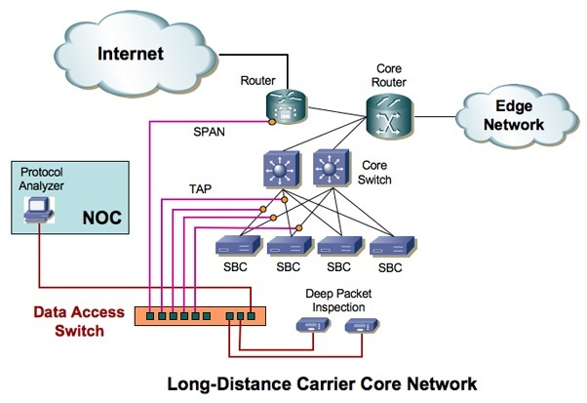
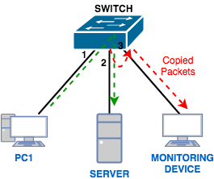
TAP or SPAN?
http://www.nextgigsystems.com/aggregation_switches/gigamon_wp_tap.html
https://www.pcwdld.com/port-mirroring-definition-and-tutorial

Slide 12
TAP or SPAN
TAP
SPAN
Additional Cost ($ and Engineering Resources)
Simple design
Passive Fiber Taps Steal Light (Shine Light through window example)
Active Taps regenerate the signal
https://www.gigamon.com/content/dam/resource-library/english/white-paper/wp-network-taps-first-step-to-visibility.pdf
Advanced features allow traffic filtering (even at Layer 7) and In-Line Bypass capabilities
Network teams highly support this method
Multiple TAPS may be aggregated to single feed. Assists with East-West Traffic monitoring
No additional $ required
Newer Switch models support different types of SPAN (RSPAN, ERSPAN, etc.)
Potential traffic feed loss due to failed device(s) or configuration change
Network teams concerned with Switch Resource Utilization

Slide 13
Open Source and Vendor Appliance Options
Open Source:
Zeek (Formerly BRO) (Wojewoda, 2016)
Troy Wojewoda’s RVA5ec Presentation
Snort
Suricata
Security Onion
Vendors:
Fortinet
Cisco
Checkpoint
Palo Alto
Juniper
Dan Holden & Elizabeth Martin RVAs3c
*5 year cycle
*Note* List is Incomplete. Many more options available

Slide 14
Open Source option considerations
Less expensive due to use of Cheap commodity hardware (including High-Performance NICs)
High Performance NICs: CSPI (Formerly Myricom), Endace, SolarFlare (Now Xilinx), Napatech
Most organizations have decommissioned servers that can serve as “kick starter” IDS boxes
Active Communities offer support, documentation, discussions
Professional Services are available
Security Onion Solutions
Value-Added Resellers: WEI, BAI, Optiv
In my experience, Open Source solutions generally require increased time and effort to implement when compared to Vendor Appliances

Slide 15
Vendor Appliance option considerations
Require an initial investment/purchase
Increased number of available options
Generally include Service and Support
Generally include Sales Rep and Engineer
Focused on IPS (even though both IDS/IPS may be supported)

Slide 16
Beyond IDS/IPS
Host Based IDS/IPS – Provides additional layer of NSM
Need both to form a layered approach. Attacker may disable/bypass one layer
Log Forwarding, Storage, Correlation, Analysis
Required by GRC
Forensics
Incident Response
Network IDS/IPS is critical to this process
Packet Capture
Network Packets don’t Lie
Packetsled, Moloch, Netsniff-ng
See “Implementing Full Packet Capture” By: Matt Koch, SANS Institute (Koch, 2019)
Forensics support
The (non-altered) Logs don’t Lie
SIEM Integration
Automated Alerting

Slide 17
My Background
2012– Security Onion Development Server Administration
2014 – Network IDS Lead Admin/Architect
2015 – Network IDS for a CSP, utilizing Automated Deployment
2017 – Lead Architect/Engineer for Network IDS/IPS at CSP
2019 – Interim Manager

Slide 18
Challenges
Confrontational Network Engineers
Budget Constraints
Scalable Solution with Automation
Administration
Backups
Central Management
Logging and Reporting

Slide 19
Solutions Designed and Implemented
- Very Large Security Onion Server (1/2 to 1 TB of RAM)
- Scaled Security Onion Deployment for Back-end protection of Cloud
-Scaled Vendor Solution
-Border Network IDS based on the LBL architecture:
http://go.lbl.gov/100g

Slide 20

Architectures

Slide 21
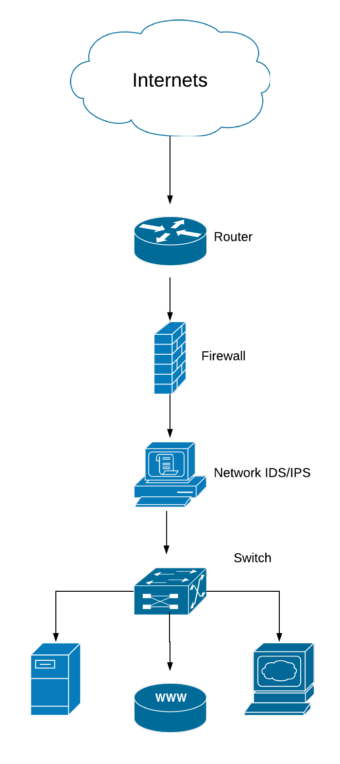

Slide 22


Slide 23
Security Onion – 1 Big Server
Advantages:
Simple Administration
Easy Backups
Easy Setup/Architecture/Configuration
Simple Budget Request(s)
Small Footprint in Data Center
Virtualizable
Dis-Advantages
In-efficient Resource Utilization
CPU pinning not done automatically and conflicted sometimes
Interface Saturations from Peaked Traffic
Single Point of Failure (not much of a concern with IDS)
Could not re-purpose old hardware (Most places don’t have beefy hardware just lying around)

Slide 24
Security Onion – 1 Big Server Lessons
Work with Seasoned System Administrators to Tune the system
May have to agree that Official Support from Administrators is not expected/required
Fun Fact – Use “Alien” to utilize RPM packages in Ubuntu
Multiple Interfaces (preferably on Multiple NICs) will prevent interface saturation
Be sure to setup Flow Hashing properly
https://suricata.readthedocs.io/en/suricata-4.1.3/performance/packet-capture.html
Read your NIC(s) Manual(s)!
Monitoring Outbound (Network Egress) communications is Important for Malware Callbacks, Data Loss, etc. (BRO really shines in this arena)

Slide 25
Security Onion with ERSPANs
Advantages:
Flexible
Agile
Virtualizable
Utilize a Backup Network IDS to ensure monitoring is not disrupted by routine maintenance or single-node failure
Disadvantages:
WTF is ERSPAN?
https://packetpushers.net/erspan-new-favorite-packet-capturing-trick/
Must be on Supported Hardware
Must have skilled Network Engineers
Reliance on SPAN ports

Slide 26
Security Onion with ERSPAN - Lessons
If on supported Appliances (Hardware/virtualized) this option is lucrative as different network segments may be sniffed and monitored by a single Network IDS deployment
Network Appliances will take a resource hit from SPAN enablement
Test as results vary from Network to Network!
Configuration Management and Version Control of Network gear are enablers of this solution
L2 Connectivity between Switches = RSPAN
L3 Connectivity between Switches = ERSPAN

Slide 27
Border Traffic Monitoring with LBL Design
Optical Taps -> Aggregation Switch -> Network IDS Cluster
Solution Scales very well
Easily add Network Links to Aggregation Switch
Easily add Network IDS nodes to cluster
Documented and Vetted Solution:
http://go.lbl.gov/100g
Easily modify design to fit organization’s needs
I.E. Utilize Snort/Suricata along with BRO

Slide 28
Border Traffic Monitoring with LBL Design - Lessons
Flood of Traffic and mostly un-interesting
Encrypted
NTP
VPN
Network Teams Love Optical Taps
Requires downtime for implementation (Generally Maintenance-Free)
Arista Switches
Are Niiiice
Full BASH implementation on Switch
Tap Agg / DANZ / other traffic manipulation capabilities
Pretty GUI available (CLI still the best place to get work done)

Slide 29
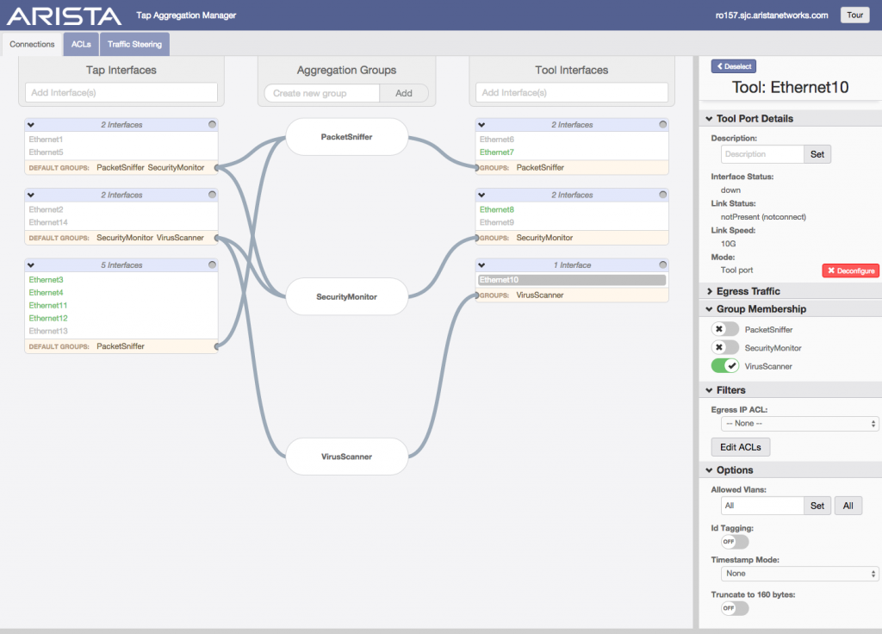
Arista Tap Aggregation GUI

Slide 30
Proprietary Appliance Deployment
Inherited Architecture during transition from SPAN/Sniffer setup to In-Line configuration
First impression was “blah”
Lots of Bells and Whistles that didn’t add value to current NSM processes/procedures
Various devices setup in various states
Switching costs were prohibitive
”Unified Threat Management” initially seemed too Salesy
In-Line configurations enabled IPS to block attacks
In-line via VLAN configurations with Network Gear
True In-line (Traffic comes in one side and out the other)
”Unified Threat Management” – Turn it into Unified Log Collection
DNS Logs
Application Logs
File Logs
Sort of like BRO, but not really

Slide 31
Vendor Appliance Lessons Learned
Leverage position with vendor to get trainings/certifications
Do a bake-off to select the solution that fits your organization.
Ensure devices are Right-Sized (this applies to Open Source solutions as well)
Network Bandwidth/Throughput (current and future growth)
Device Processing capabilities for selected rule sets (Signatures and Abnormalities)
Interface options (SFP/SFP+, Fiber, LACP capabilities)
Dashboard and Reporting Capabilities
Don’t forget the Central Management and Backups (usually requires a robust API)

Slide 32
Software Defined Data Center
The next generation of the data center requires the next generation of network security

Slide 33
VMware NSX
Distributed Firewall allows for Software-Defined Firewall rules to cover the Data Center
Software Defined Network Devices can be deployed in different configurations repeatedly
Robust and Extensive API allows for 3rd party integrations (currently, no open source NetX integrations)
Network IDS/IPS functionality achieved through Service Chaining
Alternative option:
Virtualized Tap Solution:
https://www.gigamon.com/content/dam/resource-library/english/solution-guide/sg-active-visibility-vmware-nsx-sddc-gigamon.pdf
Don’t Forget the ERSPAN configurations are supported in NSX

Slide 34
SDDC Deployment
Advantages
Disadvantages
Flexible deployment options
Defined by VNIC…VM…Switch…Data Center
Also Defined by Security Tags (Easier Automation)
Integrated HA
Scalable with SDDC capabilities
Solves the East-West Monitoring Issue
No fully Open-Source Solution (yet?).
Requires specialized knowledge
Unable to utilize Service Chaining on Switch level as that runs in the Hypervisor (may be mitigated through E/RSPAN)
Only Runs on vNIC level of VMs

Slide 35
Future Deployments
The IT Landscape is constantly evolving. Some considerations:
- Using Microservices to perform Network IDS/IPS
- Forcing IOT/SCADA (ID by MAC Address) traffic through a separate monitored point in the network (Segregated VLAN)
Enables Network IDS from any location
- A.I. fueled SMART alerting – Filtering out the noise to focus on Clear and Present threats
-Further integration of Security Products/Services to move towards a cohesive ecosystem

Slide 36
Operations
Experience and lessons in running nsm

Slide 37

Network IDS Rule Tuning
Brace Yourselves for the alert flood

Slide 38
Rule Tuning
Environment Inventory is a big key to tuning environment
Disable categories of alerts that don’t apply
I.E. Disable Solaris alert category for environment without Sun Solaris OS
I.E. Disable Apache Server alert category for environments with only IIS
Controlling the Alert Flood of False Positives
Disable Signature versus IP Address versus Combination
I.E. Normal NTP traffic fires NTP Attack signature would be candidate for disabling (Consider policy of only utilizing internal NTP servers and blocking NTP Traffic at Network Border Ingress/Egress).
Possibly disable alerting of Vulnerability Scanners. Ensure SOC knows to monitor logs for suspicious activity.

Slide 39
Network IDS versus IPS Rule Tuning Methodology
IDS (TAP/SPAN Port scenario)
Enable lots of rules. Start with a wide array and trim down false positives as the alerts come in.
Since IDS is not in-line/active, false-positives don’t hurt as much.
IPS
Start by enabling critical and high-confidence rules to protect specific assets/data (You did categorize your data and assets)
Remember, IPS will block false-positive hits that will cause:
Out(r)ages
IPS Resource (CPU/Memory) Consumption
Decayed Relationship with Network team

Slide 40
Testing/QA (Bake-off or Deployment Validation)
1. Clone Production Boxes or setup Test Boxes
2. Ensure Network IDS/IPS is configured to protect Cloned/Test Boxes
3. Request Red Team / Pen Testers to attack Cloned/Test Boxes
4. Verify expected alerts are generated, fired, and logged appropriately
5. If not, perform PCAP on various interfaces for troubleshooting
Is traffic Encrypted?

Slide 41
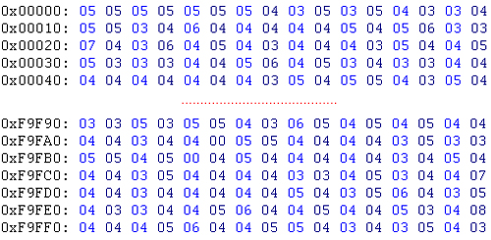
Got PCAPS?
Scalable Storage
Disk Array
I/O Speed
RAID or Not?
Incident Response Speed Advantage
S3 storage
Hybrid ✓
Disk Array for current/recent PCAPS
S3 for Long Term Storage
Retention Period?
Consult GRC team

Slide 42
SSL/TLS Inspection
Advantage
Disadvantages
Uncover attacks hiding in encrypted traffic
Resource Utilization
Privacy Concerns
Lesson from Experience:
In Corporate Network without BYOD, SSL/TLS Inspection is valuable as long as Certificates are properly managed
In any network with BYOD, SSL/TLS Inspection should either be avoided, or a mechanism for user notification needs to be abundantly clear.
Network Segmentation should be considered to implement for Server traffic and not for workstation traffic.

Slide 43
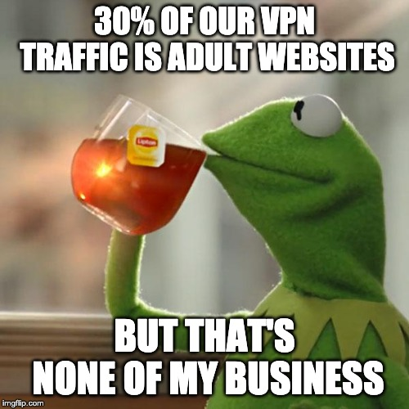
Visibility
Don’t Judge
Security != HR

Slide 44
Event Hooks and Automation
Deployment:
Script(s)
Or Script of Scripts
Infrastructure Deployment Systems
SALT
Ansible
Chef/Puppet
SDDC deployment (Automated VM deployment from image)
Backups and Version Control:
Configure Schedule in System
Scripted API calls scheduled
Test Restore Process
Ensure Backups are stored off-site and Encrypted
May integrate with Enterprise Solution
Open Source Advantage

Slide 45
Event Hooks and Automation 2
Operations:
Data Traffic Shunting
Page 16, http://go.lbl.gov/100g
Justin Azoff (NCSA) Script Dumbno:
https://github.com/ncsa/dumbno
Tool Integration
Create Network IDS Signatures from Host-based IDS alerts and Malware Samples seen in environment
Utilize Vulnerability Scan Data to Tune Rules
Enable/Disable Categories based on System Discovery (High Confidence Level Scan)

Slide 46
Logging
Enhancing Network ids/ips value

Slide 47
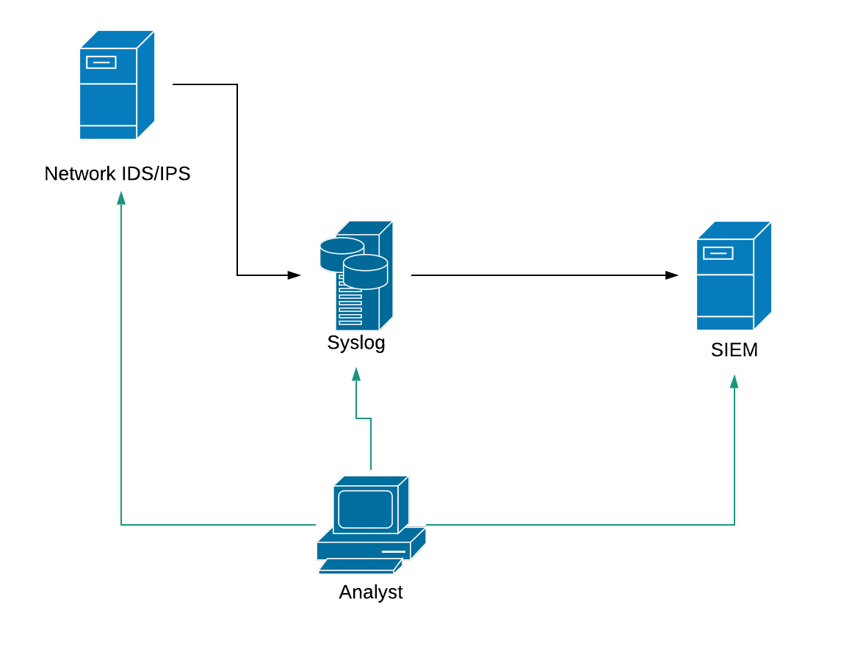
Logging Setup – Allows Analyst redundant log searching

Slide 48
Why the Intermediary Syslog Server?
- May be Faster for Incident Responders to pull logs based on Timestamp
- Command Line Searching may be preferred in some cases
grep, cut, wc, sort, etc.
zgrep - http://manpages.ubuntu.com/manpages/bionic/man1/zgrep.1.html
If none of this applies to your organization, consider a Kafka Queue:
https://kafka.apache.org/

Slide 49
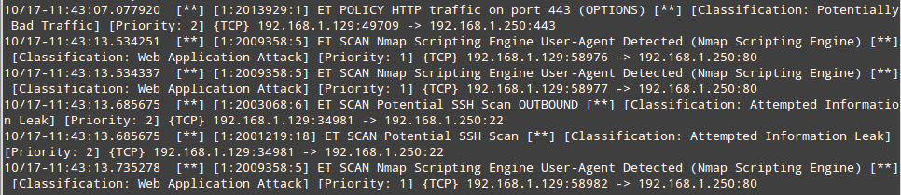
U2Boat == Tool for converting Unified2 (SNORT captures) to other files
http://manual-snort-org.s3-website-us-east-1.amazonaws.com/node21.html#SECTION00361000000000000000
u2JSON == Tool for converting Unified2 to JSON
https://idstools.readthedocs.io/en/latest/tools/u2json.html
py-idstools “a collection of Python libraries for working with IDS systems (typically Snort and Suricata).”
https://github.com/jasonish/py-idstools

Slide 50
What to Log?
- Network IDS/IPS alerts
- Files (Ingress/Egress)
- HTTP traffic on the wire
GET Requests
Error Codes
URL
Domains
- SSH Control Packets
Jeff Cumming’s DNS/DHCP Presentation
-DNS Requests/Responses
-VPN Connections
-Network Anomalies (I.E. ARP Request Collision)
-SSL/TLS Control Traffic and Certs
-Protocol Abnormalities
-Authentication (and Denials)
-Proxy Traffic
-DHCP

Slide 51
NSM in the Cloud
It’s not dead

Slide 52

NSM in the cloud
What Type of Cloud?
IaaS?
Paas?
Saas?
Two options:
Bring traffic/logs/alerts back to current NSM Ecosystem (Egress Costs?)
Stand up NSM Infrastructure and perform logging/monitoring/alerting in the cloud
Hybrid option: Perform Monitoring/Logging in Cloud and feed “Items of Interest” back to current NSM infrastructure

Slide 53
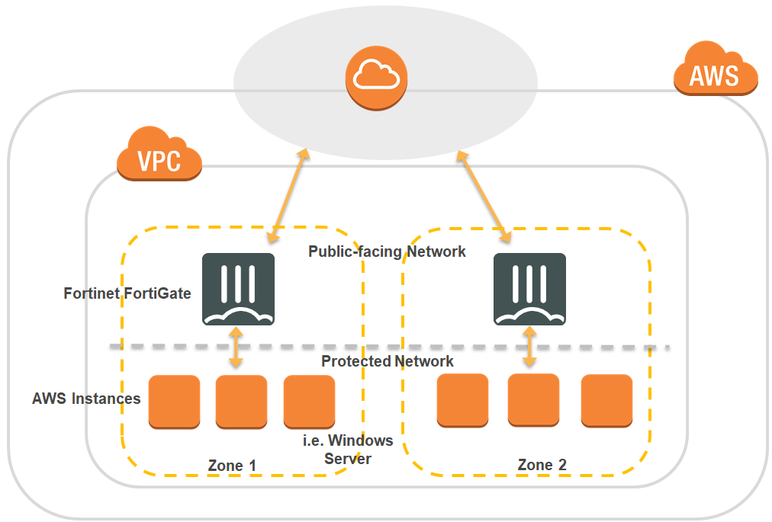
Cloud IDS/IPS
Diagram Credit

Slide 54
NSM in the Cloud
Infrastructure as a Service (DIY)
Easiest Option is to setup virtual appliance and route traffic through that appliance
Virtual TAPS/SPANS may be an option
Platform as a Service
Depending on Cloud Provider, various logging/monitoring visibility (probably not Network IDS)
Carefully scrutinize contract for security services and responsibilities
Software as a Service
Application Logs only
Provider should be responsible
Cloud Managed Security Service Provider

Slide 55

Summary

Slide 56
Summary
-Vendor Solution versus Open Source
Resource Requirements (Not Just $$$)
-Gaining Visibility
SPAN, RSPAN, ERSPAN
TAP
VLAN Routing
Virtual Wire
Appliance Gateway (Cloud)

Slide 57
Summary
-Software Defined Data Center
-Future Architecture with Microservices
-Rule Tuning
-Test/QA
-Logging
-PCAPS
-Event Hooks/API/Automation

Slide 58
Scope and Coverage
Courtesy of dan Holden

Slide 59
Thank you
Family
Friends
Colleagues
Co-Workers
Mentors
Experts in the Field
Audience

