Slide 1
5.4 Million Vulnerabilities and Counting
John Behen

Slide 2
Who am I?
25 years in IT
First adventure in VM was summer 2001
Sircam
Nimda
Code Red

Slide 3
Newport News Shipbuilding
Vulnerability Management Lead for NNS
4 team members
70-80K devices
27K direct employees
Notes:
Only maker of nuke carriers in the western hemisphere 1 of 2 makers of nuclear submarines

Slide 4

Newport News Shipbuilding
Notes:
Only maker of nuke carriers in the western hemisphere 1 of 2 makers of nuclear submarines

Slide 5
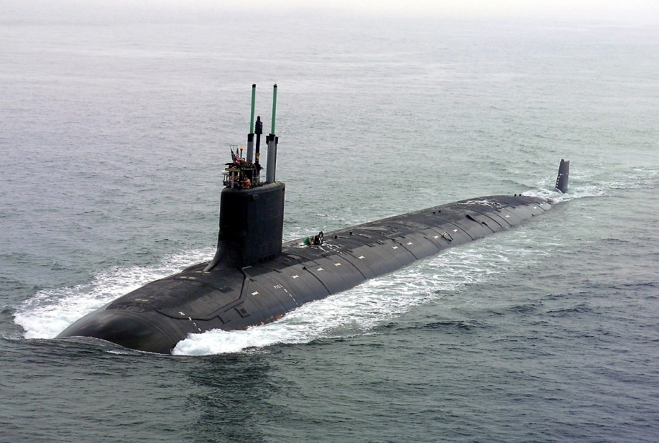
Newport News Shipbuilding
Notes:
Only maker of nuke carriers in the western hemisphere 1 of 2 makers of nuclear submarines

Slide 6
Background
2017
Notes:
Contractual obligations Scanning was far from comprehensive
Remediation was a mix of approaches with no guidance
Vulns were often secondary to operations

Slide 7
Background
2017
Increased regulation
Notes:
Contractual obligations Scanning was far from comprehensive
Remediation was a mix of approaches with no guidance
Vulns were often secondary to operations

Slide 8
Background
2017
Increased regulation
Inefficient processes
Notes:
Contractual obligations Scanning was far from comprehensive
Remediation was a mix of approaches with no guidance
Vulns were often secondary to operations

Slide 9
Background
2017
Increased regulation
Inefficient processes
Secondary priority
Notes:
Contractual obligations Scanning was far from comprehensive
Remediation was a mix of approaches with no guidance
Vulns were often secondary to operations

Slide 10
Background
2017
Increased regulation
Inefficient processes
Secondary priority
Dedicated VM team created
Notes:
Contractual obligations Scanning was far from comprehensive
Remediation was a mix of approaches with no guidance
Vulns were often secondary to operations

Slide 11
Background
2017
Increased regulation
Inefficient processes
Secondary priority
Dedicated VM team created
~300K vulnerabilities detected
~65% remediation velocity
Notes:
Contractual obligations Scanning was far from comprehensive
Remediation was a mix of approaches with no guidance
Vulns were often secondary to operations

Slide 12
Background
2018
2017
Notes:
Increase: scanning more does that
Five Guys Perfect world: learn from admins Reality: became admins
Application centric 2.4 hours per admin per week Scorpion tail = 40K overdue vulnerabilities

Slide 13
Background
2018
2017
Sudden increase in vulnerability count
Notes:
Increase: scanning more does that
Five Guys Perfect world: learn from admins Reality: became admins
Application centric 2.4 hours per admin per week Scorpion tail = 40K overdue vulnerabilities

Slide 14
Background
2018
2017
Sudden increase in vulnerability count
Timesharing to understand impact on operations and admins
Notes:
Increase: scanning more does that
Five Guys Perfect world: learn from admins Reality: became admins
Application centric 2.4 hours per admin per week Scorpion tail = 40K overdue vulnerabilities

Slide 15
Background
2018
2017
Sudden increase in vulnerability count
Timesharing to understand impact on operations and admins
Recognition of the “tail”
Notes:
Increase: scanning more does that
Five Guys Perfect world: learn from admins Reality: became admins
Application centric 2.4 hours per admin per week Scorpion tail = 40K overdue vulnerabilities

Slide 16
Background
2018
2017
Sudden increase in vulnerability count
Timesharing to understand impact on operations and admins
Recognition of the “tail”
Need to rethink how we manage vulnerabilities
Notes:
Increase: scanning more does that
Five Guys Perfect world: learn from admins Reality: became admins
Application centric 2.4 hours per admin per week Scorpion tail = 40K overdue vulnerabilities

Slide 17
Background
2018
2017
Sudden increase in vulnerability count
Timesharing to understand impact on operations and admins
Recognition of the “tail”
Need to rethink how we manage vulnerabilities
~1.2 million vulnerabilities detected
~70% remediation velocity
Notes:
Increase: scanning more does that
Five Guys Perfect world: learn from admins Reality: became admins
Application centric 2.4 hours per admin per week Scorpion tail = 40K overdue vulnerabilities

Slide 18
Background
2019
2017
2018
Notes:
Brought the team back together
Overdues reduced by 90%

Slide 19
Background
2019
2017
2018
VM team restructured
Notes:
Brought the team back together
Overdues reduced by 90%

Slide 20
Background
2019
2017
2018
VM team restructured
Focus applied to overdue vulnerabilities
Notes:
Brought the team back together
Overdues reduced by 90%

Slide 21
Background
2019
2017
2018
VM team restructured
Focus applied to overdue vulnerabilities
Knowledge base implemented
Notes:
Brought the team back together
Overdues reduced by 90%

Slide 22
Background
2019
2017
2018
VM team restructured
Focus applied to overdue vulnerabilities
Knowledge base implemented
Centralization and optimization
Notes:
Brought the team back together
Overdues reduced by 90%

Slide 23
Background
2019
2017
2018
VM team restructured
Focus applied to overdue vulnerabilities
Knowledge base implemented
Centralization and optimization
~2.6 million vulnerabilities detected
98% remediation velocity
Notes:
Brought the team back together
Overdues reduced by 90%

Slide 24
Background
2020
2017
2018
2019

Slide 25
Background
2020
2017
2018
2019
Yeah. COVID.

Slide 26
Background
2020
2017
2018
2019
Yeah. COVID.
Team 100% remote since March 13

Slide 27
Background
2020
2017
2018
2019
Yeah. COVID.
Team 100% remote since March 13
2.1 million detected
98.53% velocity

Slide 28
Background
2017
2018
2021
2019
2020

Slide 29
Background
2017
2018
2021
2019
2020
On track for 2.3 million vulnerabilities
Still maintaining 98% velocity

Slide 30
Industry Benchmarks
Edgescan (2021)
Mean time to remediate vulnerabilities is 60.3 days
NTT Data (2021)
Average remediation rate for high severity vulnerabilities is 38% in June 2021
Kenna (2019)
Investment, transportation, and oil/gas/energy led the way in the shortest time to close 75% of exploited vulnerabilities, hitting that mark in as few as 112 days

Slide 31
Framework Domains
Asset Management
Administrative Controls
Detection
Prioritization & Mitigation
Remediation
Metrics & Reporting

Slide 32
Asset Management
Asset management is the foundation for an effective program

Slide 33
Asset Management
Asset management is the foundation for an effective program
Three different asset lists
Static – talk to Finance
Dynamic – where are they coming from?
“Working”

Slide 34
Asset Management
Asset management is the foundation for an effective program
Three different asset lists
Static – talk to Finance
Dynamic – where are they coming from?
“Working”
Can be as simple as an Excel spreadsheet

Slide 35
Asset Management
Asset management is the foundation for an effective program
Three different asset lists
Static – talk to Finance
Dynamic – where are they coming from?
“Working”
Can be as simple as an Excel spreadsheet
At a minimum, needs four components
The device
What is on it
Who owns it
Who owns the stuff on it

Slide 36
Administrative Controls
Three components
Legal/Regulatory requirements
Contractual obligations
Organizational policy

Slide 37
Administrative Controls
Three components
Legal/Regulatory requirements
Contractual obligations
Organizational policy
Set policies and procedures that reflect operational realities
Might need some stretch, but should be achievable
More complex requirements will require more resources

Slide 38
Administrative Controls
Three components
Legal/Regulatory requirements
Contractual obligations
Organizational policy
Set policies and procedures that reflect operational realities
Might need some stretch, but should be achievable
More complex requirements will require more resources
Should reflect the risk exposure of the organization

Slide 39
Administrative Controls
Three components
Legal/Regulatory requirements
Contractual obligations
Organizational policy
Set policies and procedures that reflect operational realities
Might need some stretch, but should be achievable
More complex requirements will require more resources
Should reflect the risk exposure of the organization
Should include a process for accepting risk

Slide 40
Administrative Controls
Three components
Legal/Regulatory requirements
Contractual obligations
Organizational policy
Set policies and procedures that reflect operational realities
Might need some stretch, but should be achievable
More complex requirements will require more resources
Should reflect the risk exposure of the organization
Should include a process for accepting risk
“Just because you don’t want to sign off does not mean you are not accepting the risk.”

Slide 41
Detection
Complexity should evolve with the level of risk exposure

Slide 42
Detection
Complexity should evolve with the level of risk exposure
Should be at least as frequent as your SLA requirement

Slide 43
Detection
Complexity should evolve with the level of risk exposure
Should be at least as frequent as your SLA requirement
Start with patching. Seriously.

Slide 44
Detection
Complexity should evolve with the level of risk exposure
Should be at least as frequent as your SLA requirement
Start with patching. Seriously.
Pushing the patch is not successfully installing the patch

Slide 45
Detection
Complexity should evolve with the level of risk exposure
Should be at least as frequent as your SLA requirement
Start with patching. Seriously.
Pushing the patch is not successfully installing the patch
Patching is more than Microsoft, Apple, Google and Adobe

Slide 46
Detection
Complexity should evolve with the level of risk exposure
Should be at least as frequent as your SLA requirement
Start with patching. Seriously.
Pushing the patch is not successfully installing the patch
Patching is more than Microsoft, Apple, Google and Adobe
Remember that asset list?

Slide 47
Prioritization & Mitigation
“Fix whatever presents the greatest risk first.”

Slide 48
Prioritization & Mitigation
“Fix whatever presents the greatest risk first.”
Three components to evaluating risk
Severity/threat of the vulnerability
Mitigation for the device
Asset valuation

Slide 49
Prioritization & Mitigation
“Fix whatever presents the greatest risk first.”
Three components to evaluating risk
Severity/threat of the vulnerability
Mitigation for the device
Asset valuation
You may have mitigations in place that inherently reduce the risk

Slide 50
Prioritization & Mitigation
“Fix whatever presents the greatest risk first.”
Three components to evaluating risk
Severity/threat of the vulnerability
Mitigation for the device
Asset valuation
You may have mitigations in place that inherently reduce the risk
CVSS is a good start, but may not be a complete answer for you

Slide 51
Prioritization & Mitigation
“Fix whatever presents the greatest risk first.”
Three components to evaluating risk
Severity/threat of the vulnerability
Mitigation for the device
Asset valuation
You may have mitigations in place that inherently reduce the risk
CVSS is a good start, but may not be a complete answer for you
Don’t rush to prioritize away the work, until you know the risk

Slide 52
Remediation
Know your operational model
Who owns the responsibility to patch?
How about GPOs?
Device and/or registry configurations?

Slide 53
Remediation
Know your operational model
Who owns the responsibility to patch?
How about GPOs?
Device and/or registry configurations?
Automation: Friend or Foe?

Slide 54
Remediation
Know your operational model
Who owns the responsibility to patch?
How about GPOs?
Device and/or registry configurations?
Automation: Friend or Foe?
Where are the warts, and what is the plan?

Slide 55
Remediation
Know your operational model
Who owns the responsibility to patch?
How about GPOs?
Device and/or registry configurations?
Automation: Friend or Foe?
Where are the warts, and what is the plan?
Legacy systems are often the most critical AND the most vulnerable

Slide 56
Remediation
Know your operational model
Who owns the responsibility to patch?
How about GPOs?
Device and/or registry configurations?
Automation: Friend or Foe?
Where are the warts, and what is the plan?
Legacy systems are often the most critical AND the most vulnerable
Should an emergency patch be treated as an incident?

Slide 57
Metrics & Reporting
Basics
What was found?
What was due?
How many were done?
What’s left?

Slide 58
Metrics & Reporting
Basics
What was found?
What was due?
How many were done?
What’s left?
Different audiences have different interests. Give them different metrics.

Slide 59
Metrics & Reporting
Basics
What was found?
What was due?
How many were done?
What’s left?
Different audiences have different interests. Give them different metrics.
Senior management is more concerned about risk
Middle management is more concerned with efficiency
Device/application owners are more concerned with what is on their plate

Slide 60
Metrics & Reporting
Basics
What was found?
What was due?
How many were done?
What’s left?
Different audiences have different interests. Give them different metrics.
Senior management is more concerned about risk
Middle management is more concerned with efficiency
Device/application owners are more concerned with what is on their plate
Report on the SLAs established in policy

Slide 61
Metrics & Reporting
Basics
What was found?
What was due?
How many were done?
What’s left?
Different audiences have different interests. Give them different metrics.
Senior management is more concerned about risk
Middle management is more concerned with efficiency
Device/application owners are more concerned with what is on their plate
Report on the SLAs established in policy
Be able to speak to the problem areas

Slide 62
Results
NNS has maintained a 98.52% remediation velocity since implementation
All team members have been remote since March 13, 2020
The six domains are constantly being reviewed and refined

Slide 63
Questions?

Slide 64
Contact Info
John Behen
Email: john@insidethekeep.com
Twitter: @johnbehen

