Slide 1

Welcome to RVAsec!
November 4-5, 2021

Slide 2
Raising the Average
Finding and Managing Mentors

Slide 3
“You’re the average of the five people you spend the most time with.”
-Jim Rohn
Notes:
Meaning, the people you spend the most time with are the same ones that shape you in-to you. You are their average. This same relationship applies when you’re referring to mentors.

Slide 4
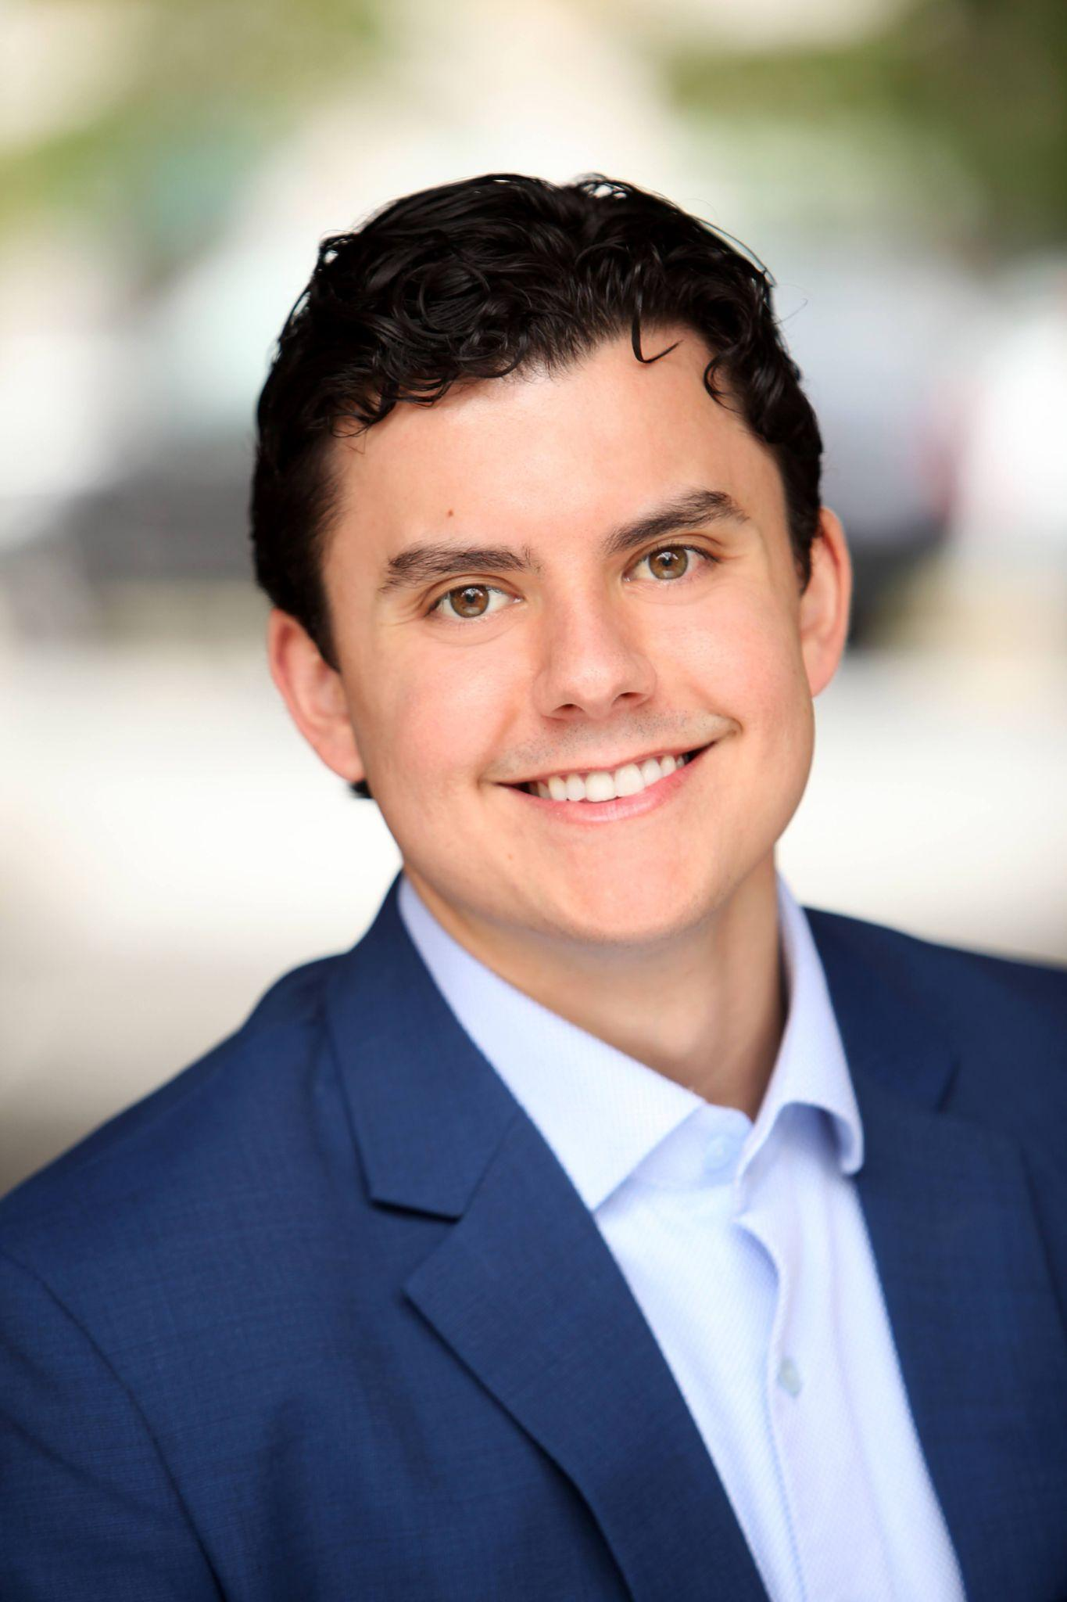
Meet Thor
Microsoft
Azure Networking Rapid Response Escalation Engineer
Trilogy Education
Instructor for the Cyber Security program
Career changer
Sales and Management
Networking mindset

Slide 5
No such thing as wasted experience
-Not Jim Rohn
Notes:
Meaning, the people you spend the most time with are the same ones that shape you in-to you. You are their average. This same relationship applies when you’re referring to mentors.

Slide 6
Agenda
Types of Mentors
Virtual Networking
The meaning of life (time permitting)

Slide 7
Be related to my dad
Notes:
Meaning, the people you spend the most time with are the same ones that shape you in-to you. You are their average. This same relationship applies when you’re referring to mentors.

Slide 8
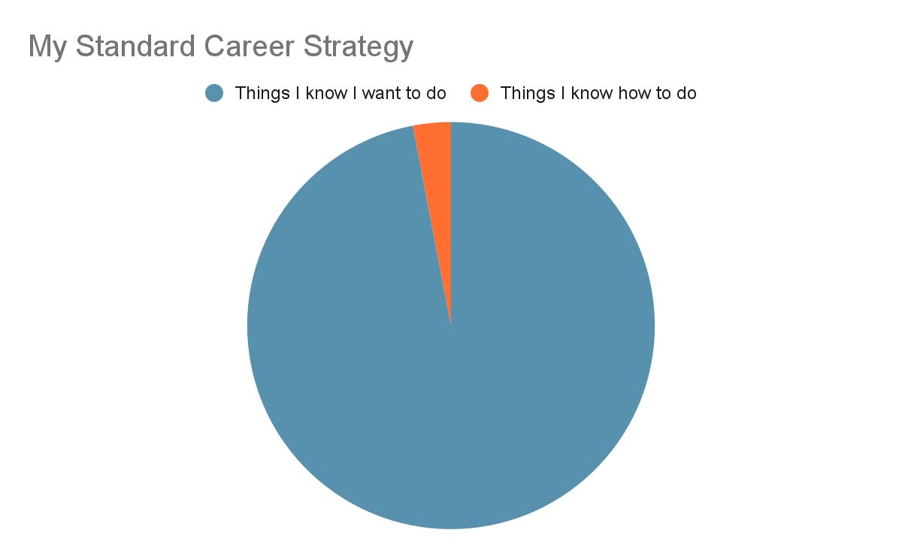

Slide 9
Types of Mentors

Slide 10
Types of Mentors
Subject Matter Experts (SMEs)
Attestors
Accountability Partners

Slide 11
Experience is the best teacher
-Stil Not Jim Rohn
Notes:
Meaning, the people you spend the most time with are the same ones that shape you in-to you. You are their average. This same relationship applies when you’re referring to mentors.

Slide 12
Nobody said it had to be your experience
-Definitely Not Jim Rohn
Notes:
Meaning, the people you spend the most time with are the same ones that shape you in-to you. You are their average. This same relationship applies when you’re referring to mentors.

Slide 13
Subject Matter Experts (SME’s)
highly knowledgeable in the field or (ideally working) in the position you want.
Notes:
The aim here is to find someone who can give you insight into how they specifically achieved their results.
I’ve found the best way to meet the SME is to search within your company first (the internal directory if your company has one) or searching for the position title on LinkedIn. This even applies to mentors I’ve found in my own company. I like reaching out on LinkedIn first. Start with a quick connection request asking to pick their brain about their career path.
I aim to set an initial meeting for 30-45 minutes. I try to provide multiple dates and times to schedule the meeting (or, if possible, I take a peek at their availability in their calendar - typically using Schedule Assistant). My goal is to make sure that this is done formally and painlessly. When accepted, I make sure to take the initiative of sending the calendar invite shortly after.
When it comes to the meeting, be sure to prepare a few questions. Be mindful of the time that you set. The aim is to stay in that window and maximize the time with that person. Your questions should be specific and aim to take away actionable items to add to your short-term goals. Be clear on where you are and share your goals. The clearer you are about where you want to go, the easier it is to give guidance.
As you wrap up the meeting, I recommend setting up a tentative follow-up range. The SMEs time is precious, so it’s best to meet with them quarterly or every 60 days. You want to make sure that you have enough time to achieve a milestone or make a significant dent towards one.
Lastly, thank them for the time and make sure that your conversations are constantly adding value.

Slide 14
My career path has been a bit unusual

Slide 15
Attestors
by definition, are people who are going to vouch for you
Notes:
. You’ll know you found a good attestor if they are willing to introduce you to their network (one membership and 13 coffees later). You’d like this person to be a banner-waver for you while being a credible source of how you can add value.
In my experience, attestors can be managers, project maintainers, or referral partners. In the tech space, it’s great to find an Attestor by contributing to a project. Generally, these mentors are a bit easier to find, but they require you to spend time between meetings to maintain effectively.
While you may be asked to contribute or volunteer outside of regular hours, I suggest asking them to set aside time to help you set goals. First, if you’re going to do something, you want to do it well. Second, you want to make sure that you give the Attestor plenty of ammunition to brag on your behalf to their network. Most meetings should be fueled by conversations about how to improve and to get direct feedback on results. Third, the frequency for meetings here should take place every 30 days. It’s normal to get reviews from your company, but I think it’s often an oversight in other settings.

Slide 16
Accountability Partners
typically a peer or someone who is slightly ahead of you in the same field.
Notes:
This is the most informal of all three relationships. It’s also your most organic and frequently spoken to. You must have an open dialogue. You’ll want to be able to talk about the struggles. Be honest about the failures. It is these mentors you’ll also keep in the loop for the wins. Celebrating these victories is encouraged, and it feels even better when you’re sharing these successes with someone.
I recommend setting time aside every two weeks, at least, to have a formal status update. The ideal relationship looks like a knowledge share. You’ll find that people grow at a much faster rate when they have to declare goals and give updates on whether you got closer or further from it.

Slide 17
Q’s without A’s
Who am I spending time with?
What am I missing by choosing to worry or be afraid?
Will this be alive time or dead time?
Notes:
Is this in my control?
To be or to do?
Am I doing my job?
What is the most important thing?
Is this who I want to be?

Slide 18
It's not what you know. It’s who you know.
Notes:
So if you're not allowed to meet people in person - how the heck do you go on meeting anyone?

Slide 19
Virtually Networking

Slide 20
Virtual Networking
Where to find people to reach out to
What to say when you're reaching out
How to set up the appointment
What to say when you're reaching out
Thank you and follow-up

Slide 21
Where to find people to reach out to
Reach out to speakers from webinars on YouTube
Experts live here
Utilize MeetUp and virtual conferences
Organizers
Jim at parties
Notes:
1. Reach out to speakers from webinars on YouTube
It seems like every company has been on an absolute blitz to put out more webinars than ever before. This is already a win-win since webinars are great resources. I recommend you pay attention to the speakers for those webinars. That person is your ideal subject matter expert. They took time to create a presentation targeted toward an audience and then later published it. I’ve had a lot of success reaching out to people to discuss their webinar. Since you’re starting with mutual interests, you get the freedom to dive into deeper questions on the topic right off the bat.
2. Utilize MeetUp and virtual conferences
Live virtual events are happening all the time, but contacting speakers can present its own challenges.
Since Meetups normally have a speaker and an event organizer, I recommend connecting with both through LinkedIn. It’s easy enough to say that you saw the event and wanted to set up a time to chat. However, you can increase your odds by being active in the chat and participating in the Q&A portions. This is a key advantage that often gets overlooked.
Virtual conferences have a similar dynamic. However, I’ve seen these opportunities wasted when they take on more of a chat-room feel. Suppose there is the option for you to turn on the mic and speak to someone directly, DO IT. Making a meaningful connection with someone is just about getting to know each other's personalities. If they like you, they’ll want more of you. If they don’t like you, they’ll want less. It’s as simple as that. It’s also a bonus when you can send a message referencing something that the person said earlier that day.

Slide 22
What to say when you're reaching out
“Hey, my name is Thor. I saw you in this YouTube video and wanted to know if I could pick your brain about the subject. I know this seems a little out of the blue, but how else are we supposed to network in a virtual world?”
Notes:
Obviously, in that, you’ll want to cater the underlined areas to something more personal. You don’t have to be an original unicorn to stand out. By making your message personal, you’ve already accomplished something easy to forget - the human element. You’re both people. It doesn’t get more rudimentary than that.

Slide 23
How to set up the appointment
Time frame
Half-hour or hour
Show up early and on camera
Notes:
Once you’ve made contact, your next objective is setting up an hour or half-hour appointment. Do your best to make this appointment on video. If they’re okay with your conversation being recorded, do that too. Utilize the tools at your disposal.
This provides you an opportunity to revisit the conversation later and better ‘pick up where you left off. Video chat will also give you a better relationship and tends to be a far more well-rounded conversation than simply audio. If video isn’t an option, an audio chat will still be better than text.

Slide 24
Thank you and follow-up
Close strong
Summarize
Thank for the time
Mention takeaways/action items
Ask to keep in touch and set a date
Notes:
This is your opportunity to close. Here is the spot where you want to thank them for their time. Then summarize what you talked about - include something that you found interesting. I use a similar template on interview follow-ups: thank them for their time, talk about what you learned or a part of the conversation that stood out, let them know if you took away any action items, reiterate how appreciative you are, and tell them if they added value.
Lastly, ask them if you can keep in touch and suggest a time in the future that they can expect you to reach out again. Ask to keep an open dialogue and tell them you achieve a milestone before reaching out again. Get to work!

Slide 25
In Summary
Types of Mentors
SMEs
Attestors
Accountability Partners
Virtual Networking
How to find people to reach out to
What to say when you're reaching out
How to set up the appointment
What to say when you're reaching out
Thank you and follow-up
Notes:
They say tell them what you are about to tell them
Tell them
And then tell them what you told them

Slide 26
Q & A
Notes:
Meaning, the people you spend the most time with are the same ones that shape you in-to you. You are their average. This same relationship applies when you’re referring to mentors.

Slide 27
“The moment you realize nobody knows anything, you can’t be an imposter.”
-Thor Draper Jr

