Slide 1
Zero Trust
The Good Parts
November 4, 2021
Evan Johnson
Director of Security Engineering
Cloudflare
Notes:
This talk should be a lot of fun, it’s kind of a braindump of something that I have been casually moving forward the last 3 years at my work.
Sometimes in big efforts of work, sometimes in small incremental improvements.
I hope you leave this talk with an understanding of some of the problems we solved.

Slide 2
Introduction to me
SECTION TITLE
Cloudflare, Director of Security Engineering.
Software Engineer who likes building Security things.
Based in Austin, Texas
Likes startups
2
Cats
>100
Open tabs at any given time
6
Average caffeinated beverages a day
Notes:
LastPass
Cloudflare security
Segment
Security for startups. Im happy to help.

Slide 3
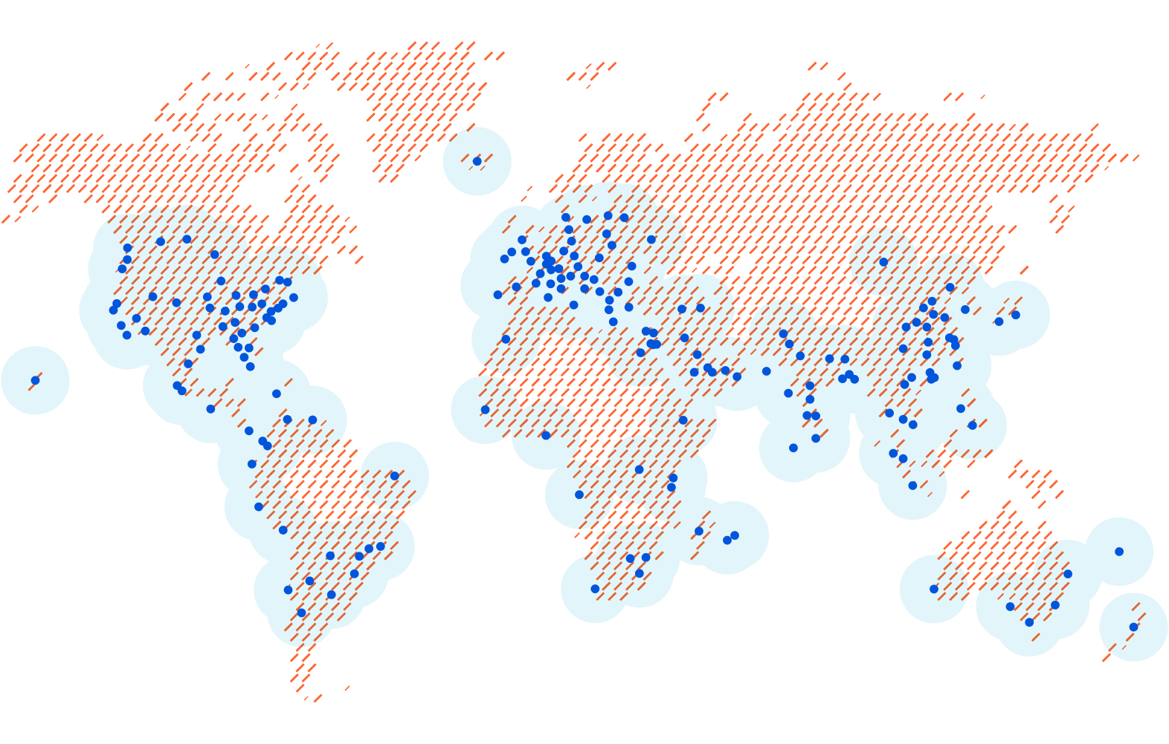
Cloudflare’s network
SECTION TITLE
Note: map data as of
Jan 15, 2020
Millions
Internet properties
250+
cities and 100+ countries
87B
cyber threats blocked each day
in Q2’21
95%
of the Internet-connected population in the developed world is located within 50 milliseconds of our network
Cloudflare city
Approximate area inside which Cloudflare’s network is reachable within 100ms via the Internet
Notes:
Cloudflare is a large network that can protect servers and infrastructure, WAF, Network DDoS protection, Authentication and authorization with Cloudflare for Teams.

Slide 4
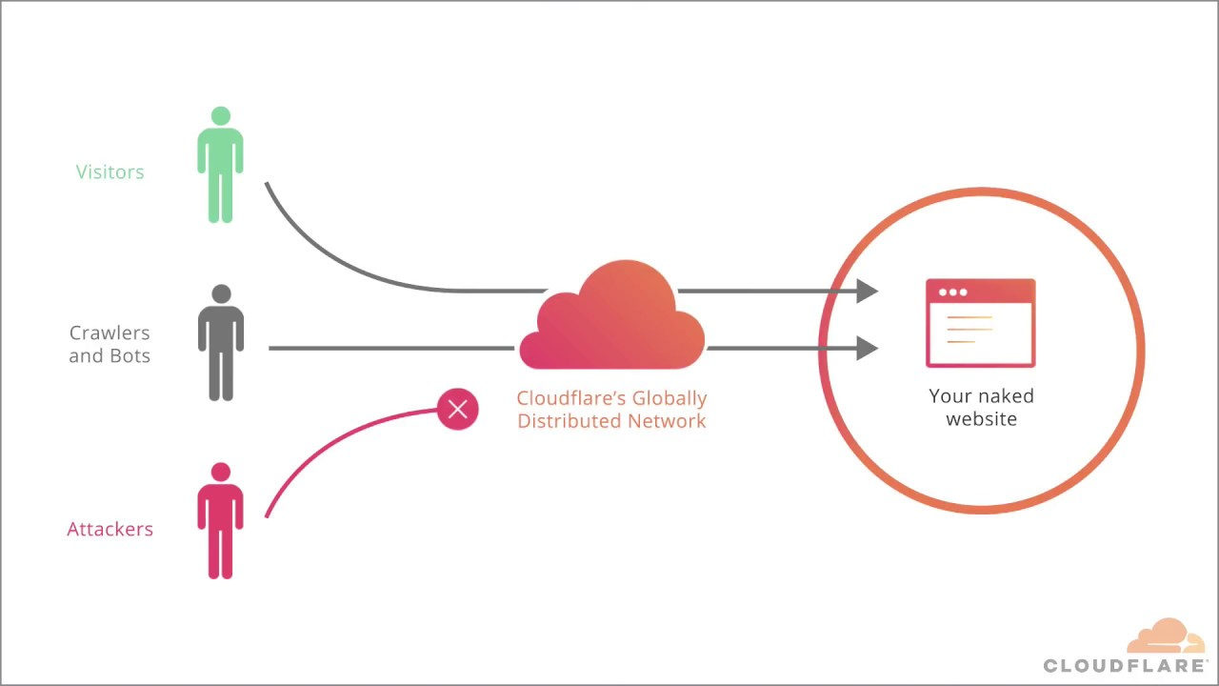
Your site
Notes:
Go over the practice of how Cloudflare works

Slide 5
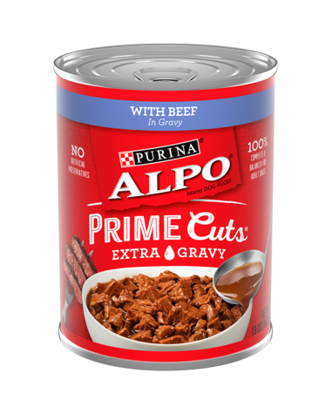
The Cloudflare Strategy - Dogfooding!
SECTION TITLE
Build products
Use them ourselves
Recognize the painpoints
and go to step 1 to fix them
Notes:
You can get an entire MBA just on this slide, save your money! Buy the innovators dilemna and read it, it’s a great book.
You can read Clay Christiansen. Innovators Dilmena. Clay was really influential for our founders.
This strategy is called dogfooding. There’s also a consistent notion of disruption and moving into spaces that are new, and figuring it out as we go.

Slide 6

What is zero trust?
SECTION TITLE
No inherent trust of devices based on a network position or IP address.
We got here because of
Cloud services
Containers and “Cattle not pets”
Stronger second factors
Web based everything / APIs
...
Notes:
Because so much of what you were trusting is suddenly outside of your network, suddenly the old model didn’t work.
You inherently trust amazon, or cloudflare, etc.
Let me talk about cloudflare’s security model
Vpn
Had some painpoints. Licenses. Sucked to use
Expensive and difficult to manage.
Application layer needed better support. VPN is only network layer.
Must move to security keys

Slide 7
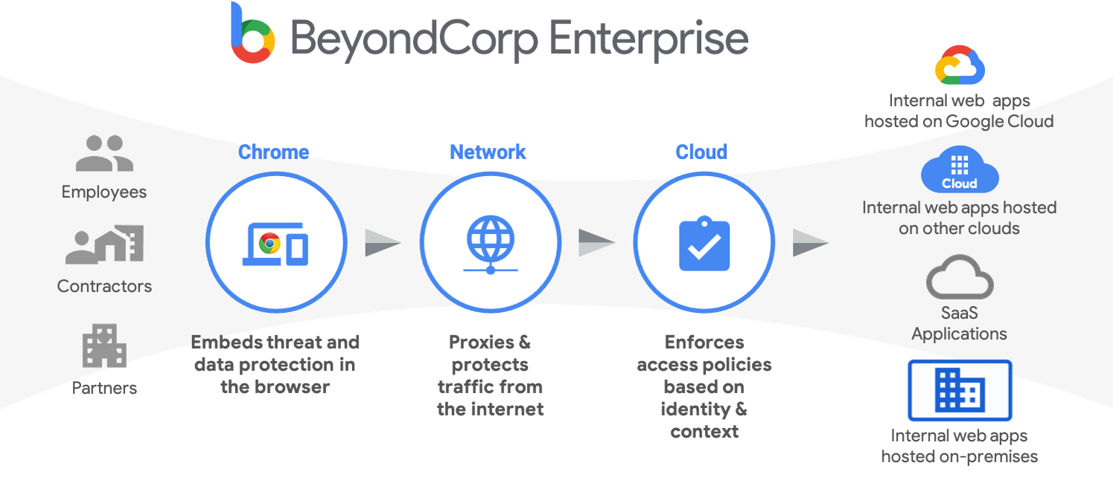
BeyondCorp
Prior Art
https://cloud.google.com/beyondcorp
Notes:
One really informative and transformative thing was Google releasing the beyondcorp papers.
There are 6 papers. You’ll notice that in order to do this successfully you really need device trust and identity while reading the papers. The entire zero trust thing is based on the beyondcorp thing, and then zero trust is a buzzword.

Slide 8
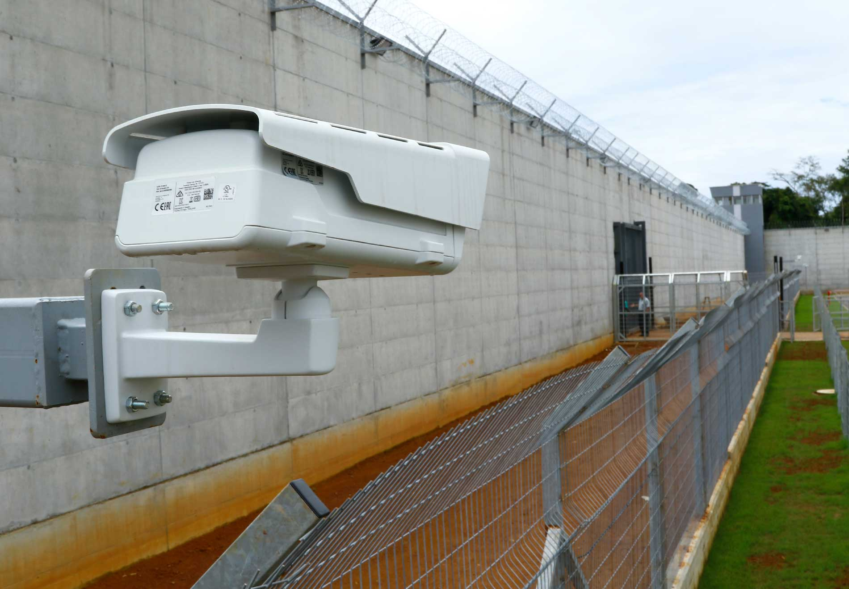
We wanted to change
Notes:
Let me talk about cloudflare’s security model
Vpn
Role Based Access Control
Had some painpoints. Licenses. Sucked to use
Expensive and difficult to manage.
Application layer needed better support. VPN is only network layer.
Must move to security keys

Slide 9
Solving for HTTP
The beginning
Prior Art
Notes:
You really should revisit security keys if it isn’t something your company is interested in.
We said “We need security keys”
Unphishable. Most secure second factor that exists.
In the past year
Support in iOS and Safari.
Support in SSH starting at openssh v8.2 which now ships in monterey

Slide 10
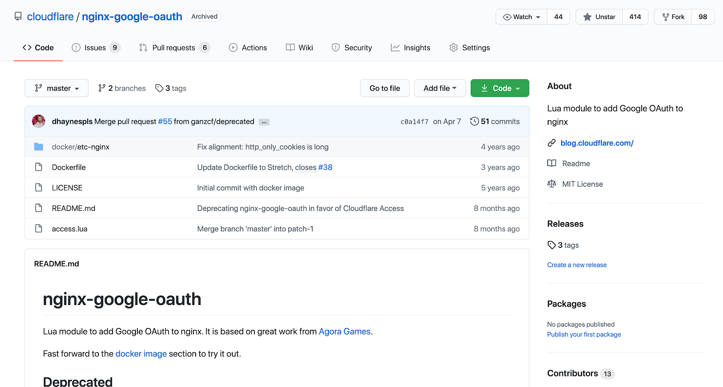
Zero Trust: Beginnings
Notes:
This github project is the very beginning of Cloudflare’s migration to zero trust.
We built a simple oauth integration.
Paved roads story.
Game changer for our operations team.
Could see metrics, task tracker on their phones without a vpn.
Just needed to log in with google.
It’s only about 150 lines, and there is a configuration footgun if you actually try to use this.
Oauth proxy by bitly is a big open source implementation of something similar.
The point though is this was the MVP and it was really easy to implement and self contained.

Slide 11
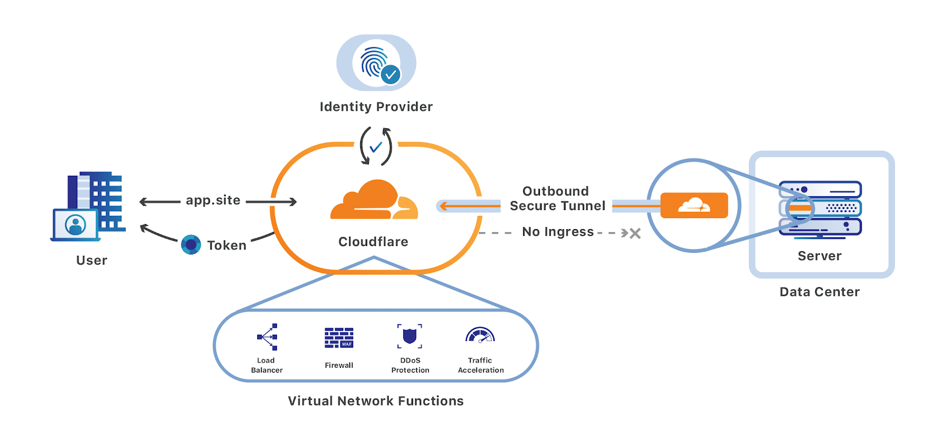
Notes:
Around 2018. We realized that we needed to lean more into Cloudflare Access.
I personally felt like we needed to put ourselves in an uncomfortable position with a new security posture in order to set us up for success in the long term.
Since our traditional VPN did not have logs at the network layer of what each person was doing, each application we built needed a sense of identity.
We had a difficult time thinking about our employees in terms of different populations.
We had hundreds of internal applications. Needed a central source of identity, authentication, and authorization. (What about an IDP?).
We purchased an IDP.
I had numerous conversations with people in the company where they said you can’t put this behind our own product for security reasons.
And I said yes we can, watch us. And many people didn’t know how to react. It was a really transformative time at the company.
At this time we established our core tenants that we were striving for.
We wanted security keys everywhere. EVERYWHERE.

Slide 12
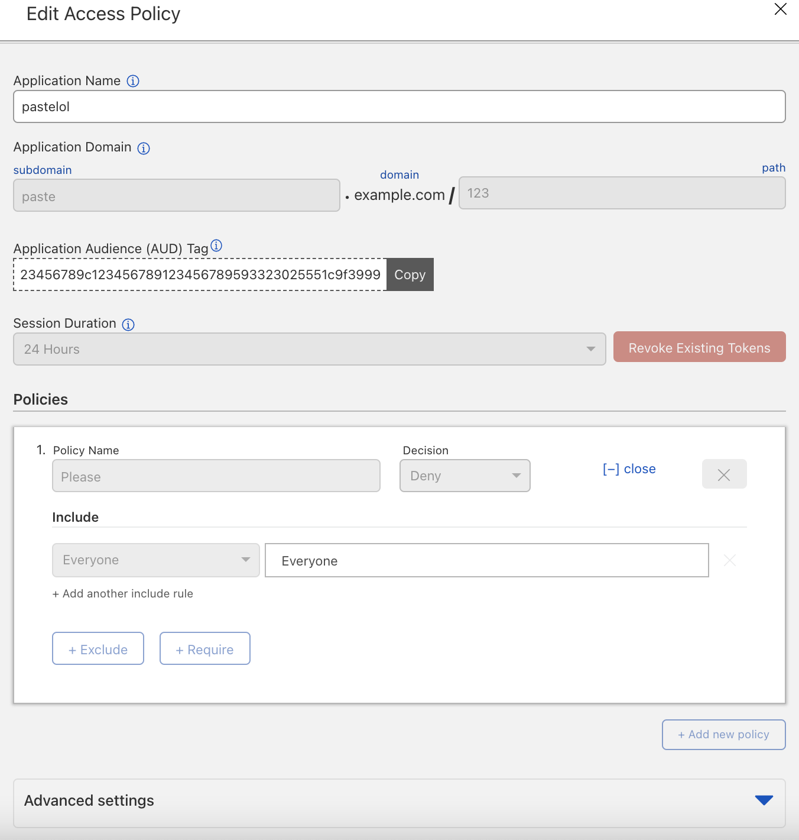
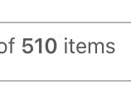

Slide 13
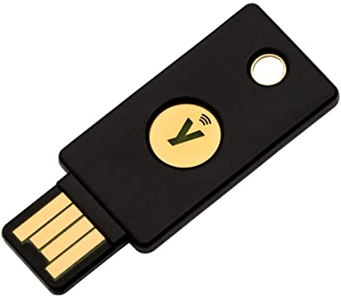
Security Keys
Prior Art
Notes:
You really should revisit security keys if it isn’t something your company is interested in.
We said “We need security keys”
Unphishable. Most secure second factor that exists.
In the past year
Support in iOS and Safari.
Support in SSH starting at openssh v8.2 which now ships in monterey

Slide 14
Notes:
Around 2018. We realized that we needed to lean more into Cloudflare Access.
I personally felt like we needed to put ourselves in an uncomfortable position with a new security posture in order to set us up for success in the long term.
Since our traditional VPN did not have logs at the network layer of what each person was doing, each application we built needed a sense of identity.
We had a difficult time thinking about our employees in terms of different populations.
We had hundreds of internal applications. Needed a central source of identity, authentication, and authorization. (What about an IDP?).
We purchased an IDP.
I had numerous conversations with people in the company where they said you can’t put this behind our own product for security reasons.
And I said yes we can, watch us. And many people didn’t know how to react. It was a really transformative time at the company.
At this time we established our core tenants that we were striving for.
We wanted security keys everywhere. EVERYWHERE.

Slide 15
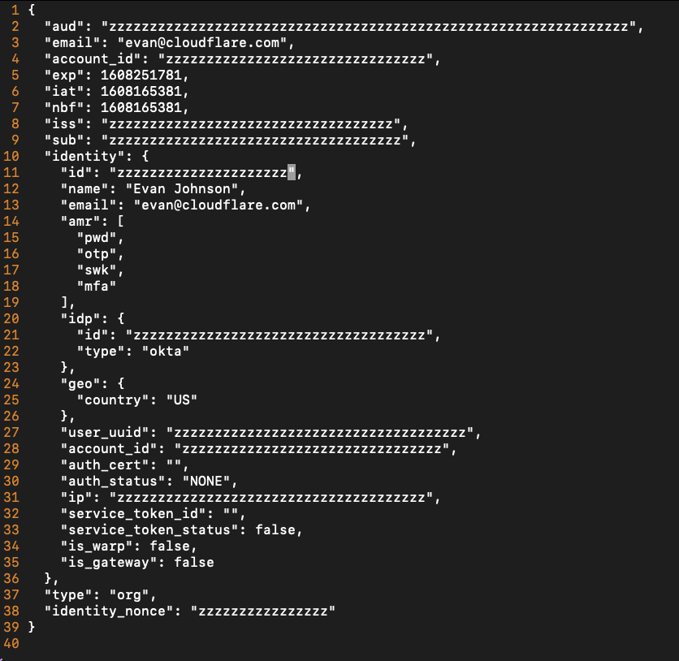
Notes:
We wanted to selectively enable it because when we started this effort, support for security keys wasn’t that great.

Slide 16
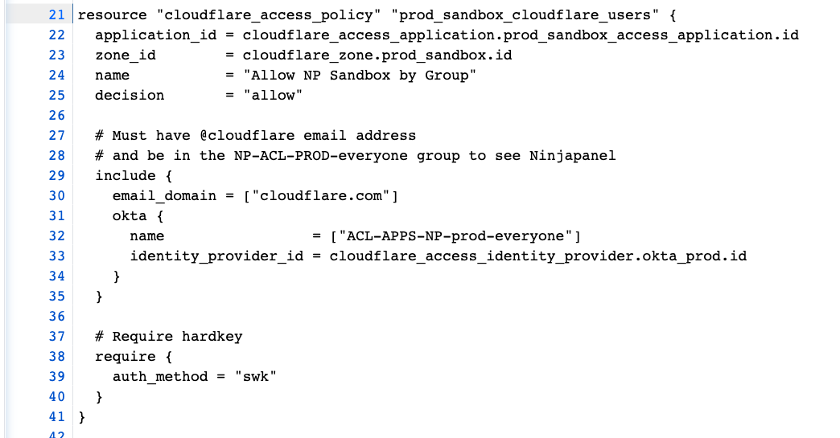

Slide 17
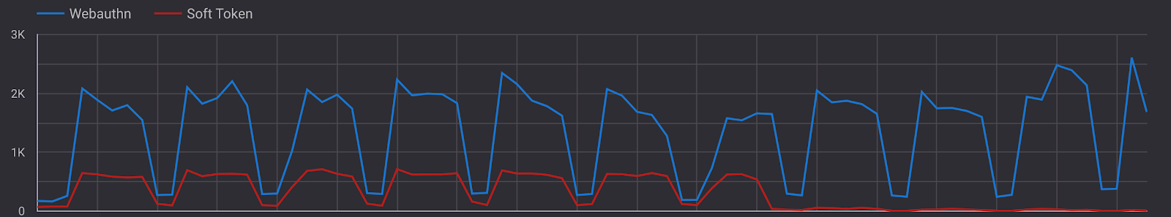
Notes:
Let me talk about the migration and how we dialed up the pressure in a positive way for security keys
We picked a few “highly sensitive” internal applications and forced a re-authentication with our security keys using our IDP.

Slide 18
Role Based Access Control
Prior Art
Notes:
You really should revisit security keys if it isn’t something your company is interested in.
We said “We need security keys”
Unphishable. Most secure second factor that exists.
In the past year
Support in iOS and Safari.
Support in SSH starting at openssh v8.2 which now ships in monterey

Slide 19
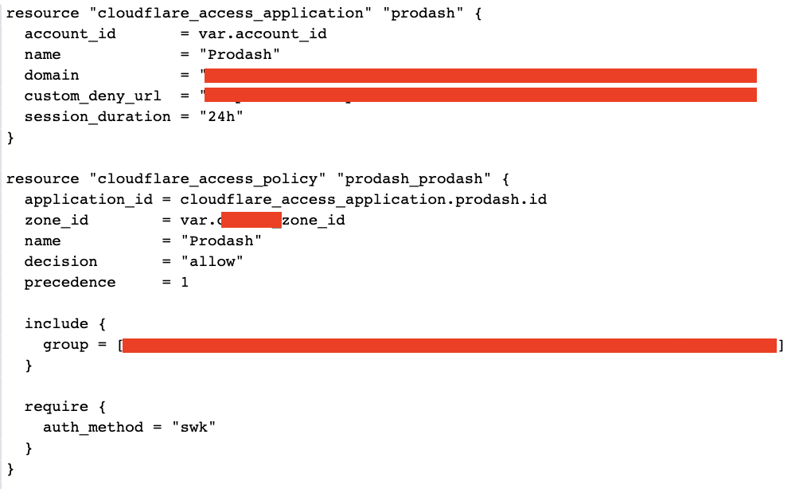
Notes:
Role based access control was a huge benefit. We were able to adopt a more devops workflow for managing our Role Based Access Control..
With terraform we make lots of groups in our identity provider and within cloudflare access itself, and then we can make policies about them.
You’ll see

Slide 20
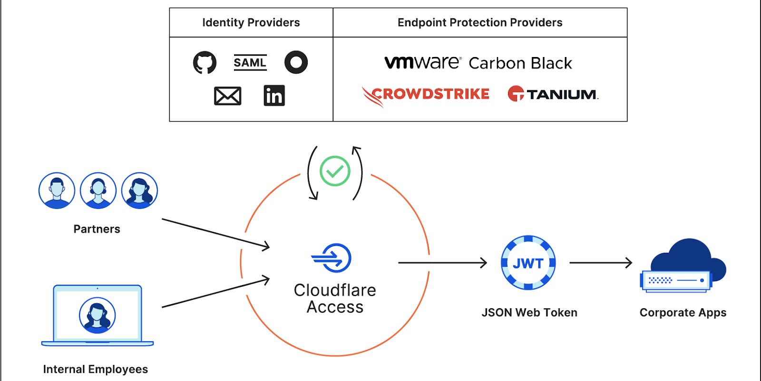
SSH
Notes:
Let me first describe the problem to you. We built an identity aware proxy for http, but ssh is something completely different. We didn’t want to just solve for ssh, we wanted to solve for all other tcp protocols.
This means everything is HTTP!
Run cloudflared on the server side.
Run cloudflared on the client side.
Easy pz! The ssh connection goes over the websocket and is fully authenticated.

Slide 21
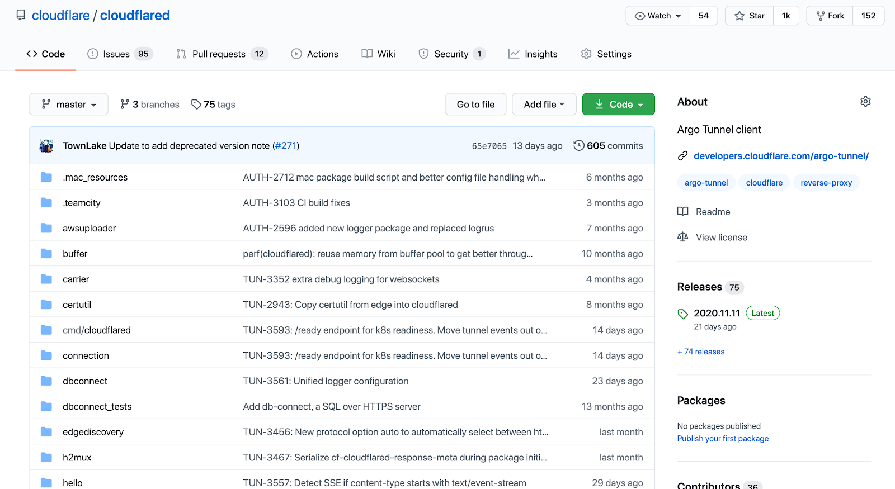
Notes:
Cloudflared is a command line tool that will create a tunnel from your command line to our edge.
The way it works is you create a tunnel and that tunnel has a name, and that name is associated with a hostname.
On the server, what do you do
The hostname gets registered with our DNS service as any other hostname in cloudflare, except connections to it are sent over the tunnel it creates to
Cloudflared reaches out to our edge via http2, authenticates as you, and then when that hostname receives a request or a connection it will be forwarded over that tunnel.
It is a little bit magic, called argo tunnel, but sometimes there can be some performance issues since all of your website’s traffic is being sent over a small number of tunnels to usually a single origin. (it has more complicated and robust setups though).
You can put access policies in front of tunnels.
One additional important piece of information. Cloudflared kinda has a lot of functionality so it can be used as a client which we will see on our next slide. As a client you can send connections over it to a specific hostname.

Slide 22
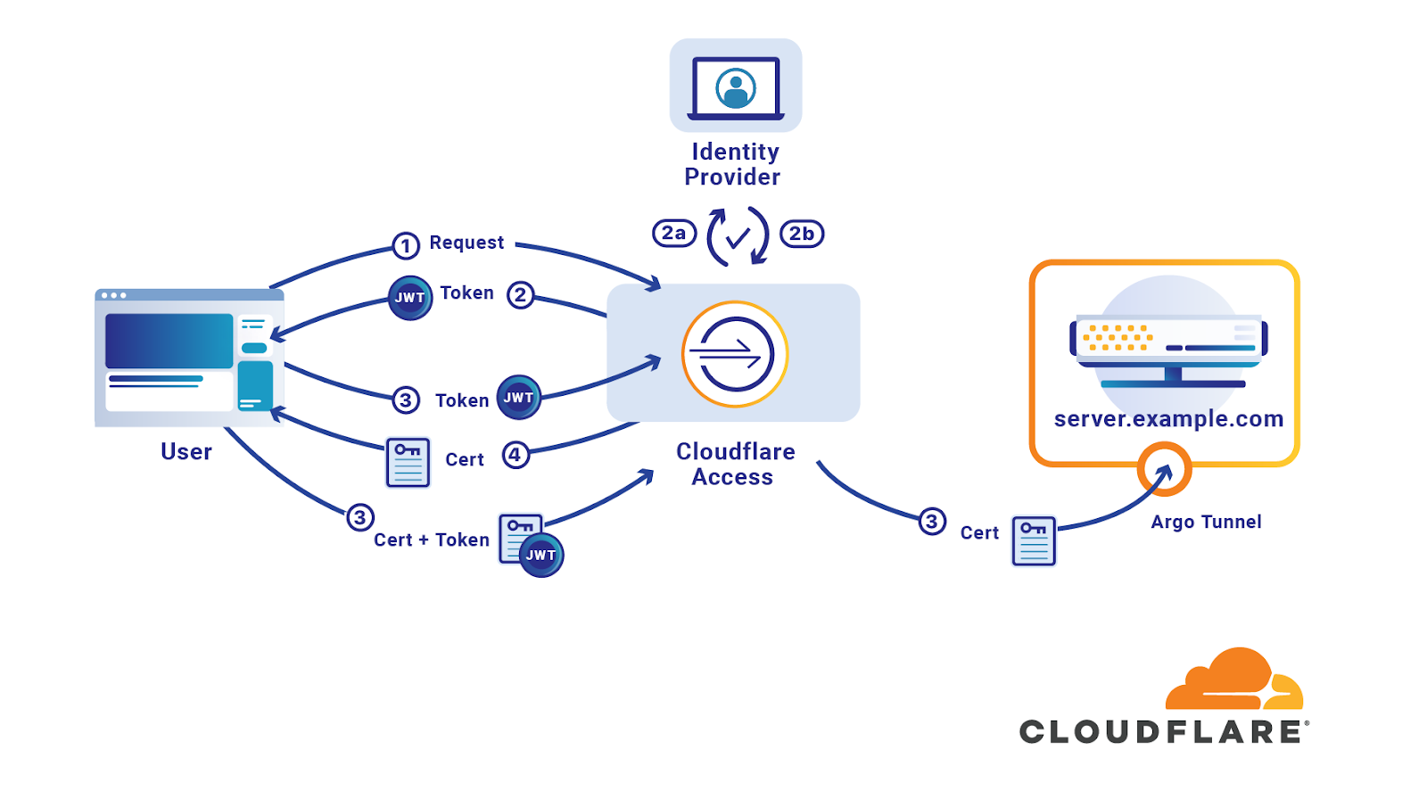
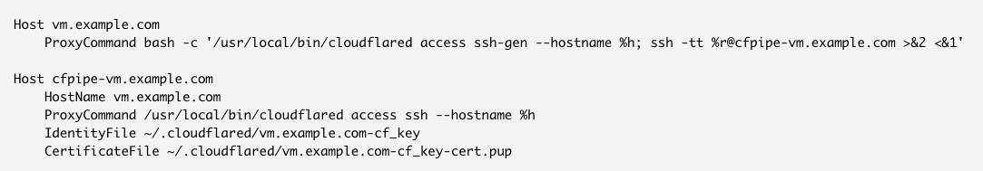
Notes:
On the client what do you do
We have the ability when you have cloudflared running on the serverside, and the clientside, to authenticate with a short lived SSH certificate.
I helped build this product and it is underappreciated.
Similar to the Netflix BleSs product.
Let me walk through every step and explain what’s happening here. We have built a lot of software and it is important to understand.
Make sure we come back to this slide in a moment.

Slide 23
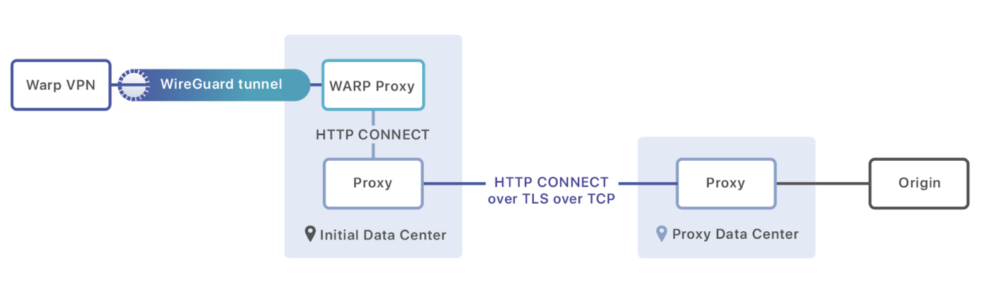
Device Identity with Wireguard
Notes:
Leads us to talking about how this could be integrated with our Warp product. We have a product called warp. You can download it on your phone.
Warp works with the wireguard protocol. There is a library we wrote called boringtun, that is open source, that you can check out on our github.
This is an architecture diagram of the way warp works.
Your identity can be connected to your connection.
And you start to go full circle here. Your entire network traffic can be encapsulated because of the way wireguard works they package up your entire IP packet into a UDP packet and send it along.
Because we have a record of each public key that can make a warp connection to us, we can connect that to an identity.
We can validate that when you log in your identity provider, your connections to our internal network are required to go through warp.
They are required to have authenticated with a security key.
They are required to have logged in with our identity provider.
And we can identify your entire IP stream.
Additionally there is the potential to rely on the security chips in the commercial off the shelf hardware that we issue our employees.
That way we can enforce that you are on the laptop we issued you and you are physically unable to take your warp private key and move it elsewhere.
In the near term
To get started we put a client certificate in every employees browser and authenticated it.
Let’s go back and put

Slide 24
Device identity with mTLS
Prior Art
https://cloud.google.com/beyondcorp

Slide 25
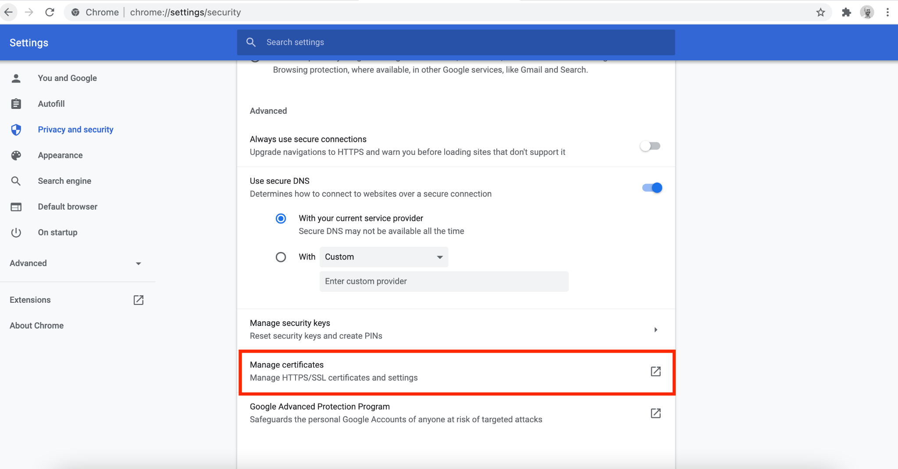
Prior Art

Slide 26
Other Device Signals
Notes:
This was game changing. Our SREs get woken up at all hours of the night 5 years ago. And they couldn’t even look at the graphs and such on their phone they had to open their laptop, connect to the VPN, and then check what was broken.
Miserable!

Slide 27
Experimentation
Notes:
I mentioned mad scientist stuff, this is even more mad scientist stuff that we are figuring out.

Slide 28
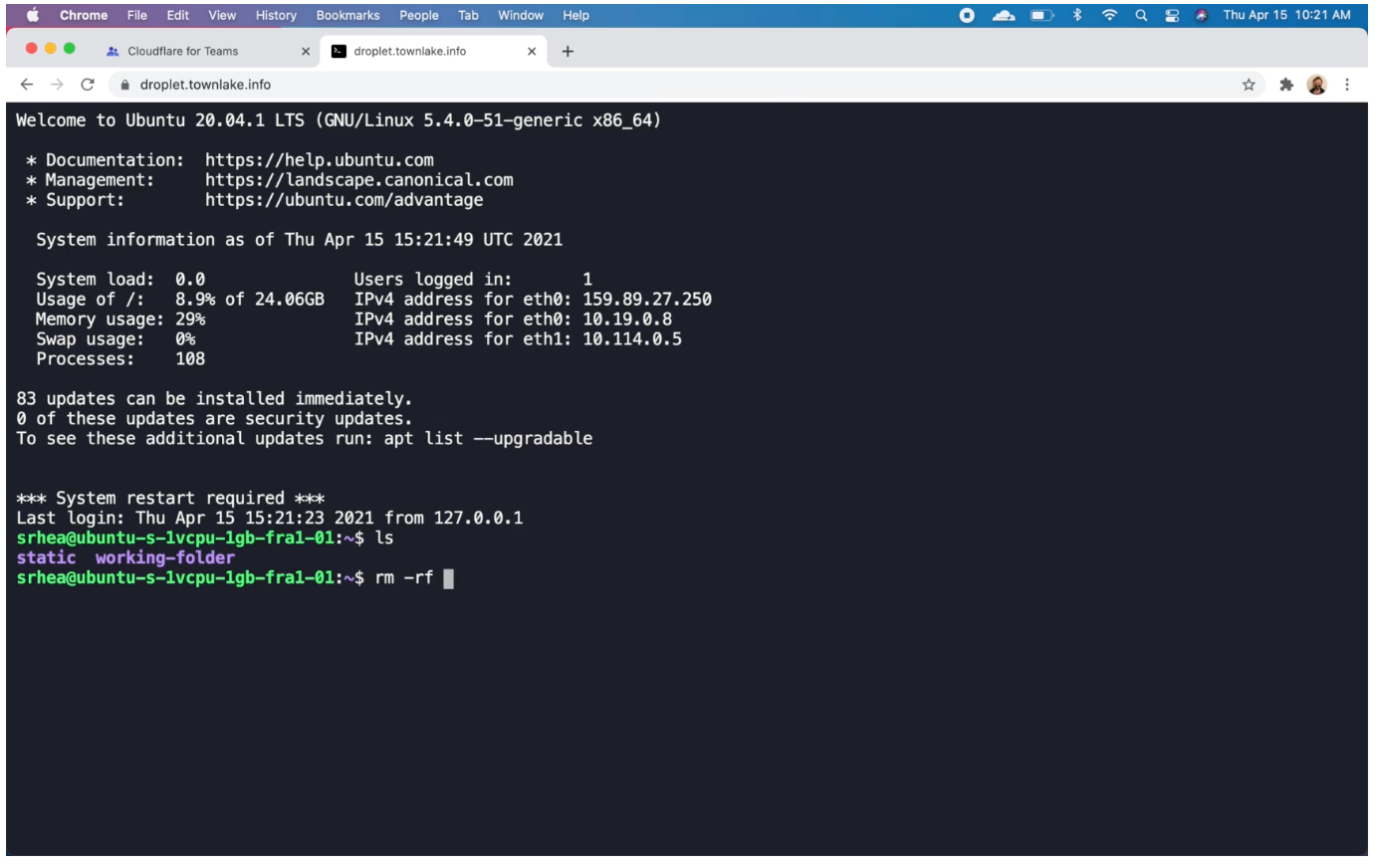
https://blog.cloudflare.com/browser-ssh-terminal-with-auditing/
Notes:
Zero Trust Apps.
Started compiling things to web assembly.

Slide 29
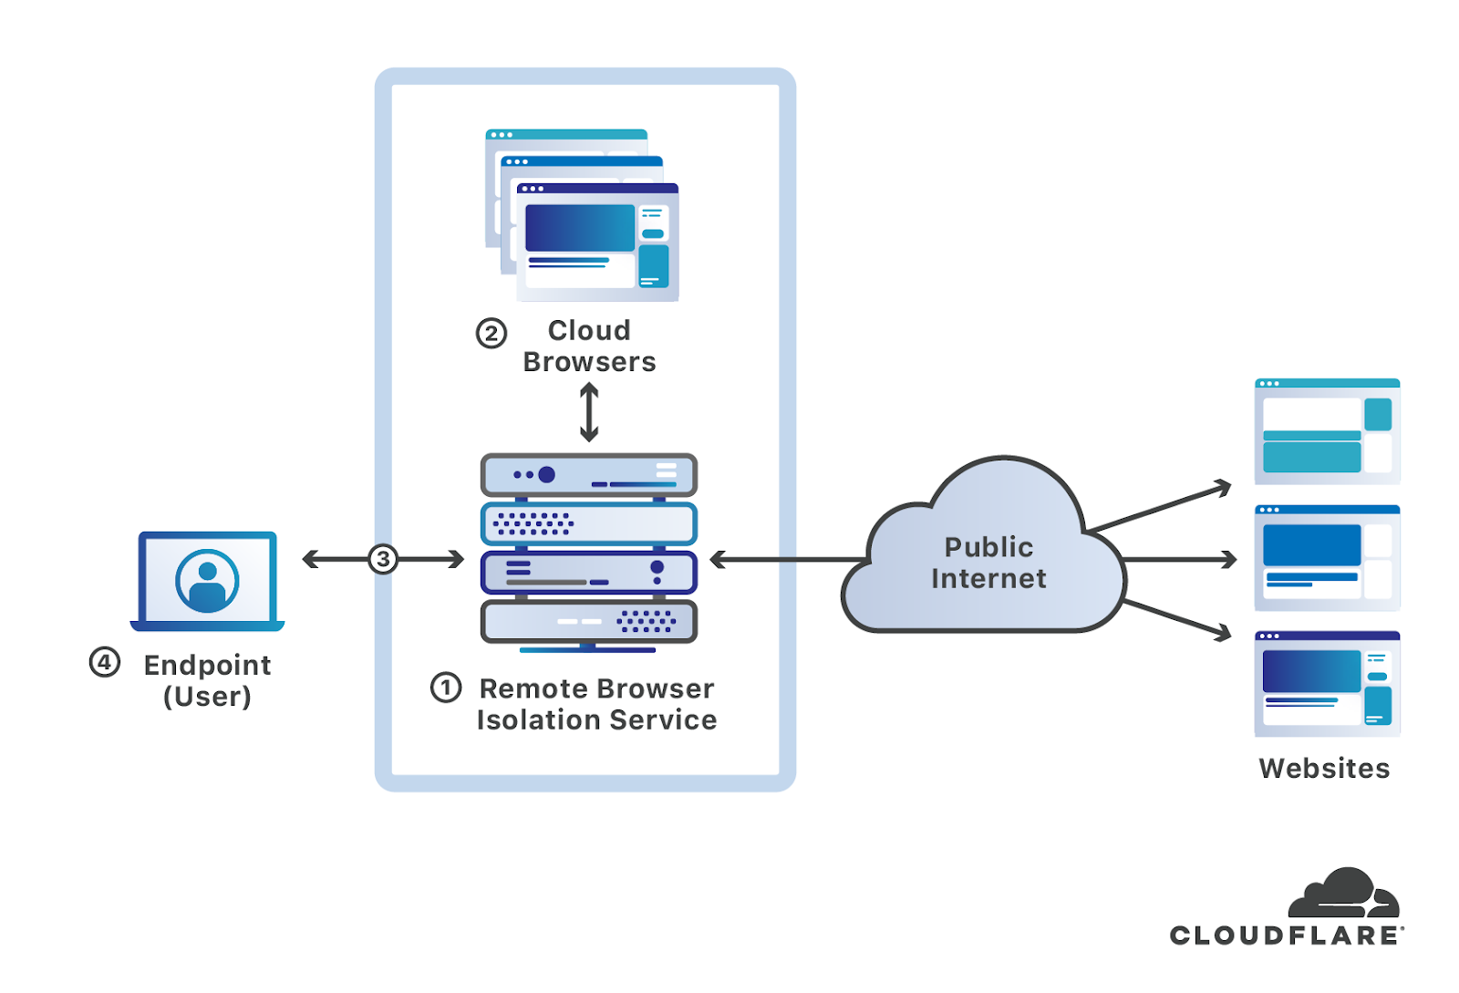
Notes:
Browser Isolation and trusted remote browsers.
Run chrome on our edge.
Use cases:
Enforce some websites can only be run in the cloud
Enforce no downloading from certain websites.
Block downloads and scan them

Slide 30
Conclusions
What is zero trust
Some of the problems you’ll encounter (http, device identity, non-http)
Some ideas about solving them

