Slide 1


WHY I LOVE PURPLE TEAMS - EVEN THOUGH THEY DO NOT EXIST
Anthony Switzer
Notes:
Pretty Click baity title...
Who's here due to the title?
Who just didn't have a better option?

Slide 2

CONTENT
OVERVIEW
1 / My Story
2 / Cybersecurity
3 / There are different teams?
4 / Which team is better?
5 / How did this divide happen?
6 / Oraganizational structure
7 / Back to the basics
8 / So what about that Purple Team

Slide 3

MY STORY
Purveyor of Cybersecurity
GIAC Global Security Expert (GSE) #251
Offensive Security Certified Professional (OSCP)
GIAC Penetration Tester certification (GPEN)
GIAC Mobile Device Security Analyst (GMOB)
GIAC Web Application Penetration Tester (GWAPT)
GIAC Certified Detection Analyst (GCDA)
GIAC Critical Controls Certification (GCCC)
GIAC Certified Incident Handler (GCIH)
Notes:
Important to share my story to inspire others.

Slide 4



MY STORY
Notes:
How the world see's pentesters..

Slide 5
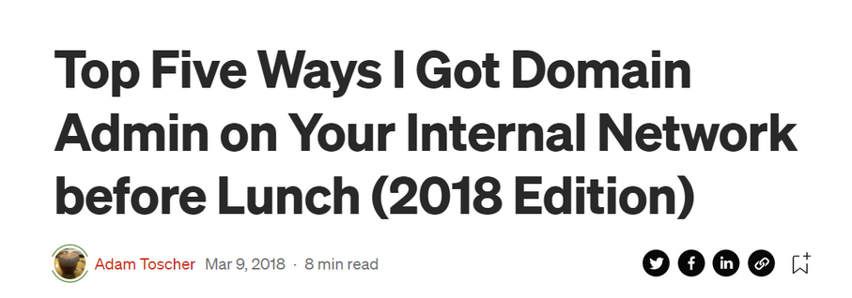
WHY IS THIS STILL A THING?
Notes:
This shows there are still issues with cyber security that are not being raised to the top executive

Slide 6
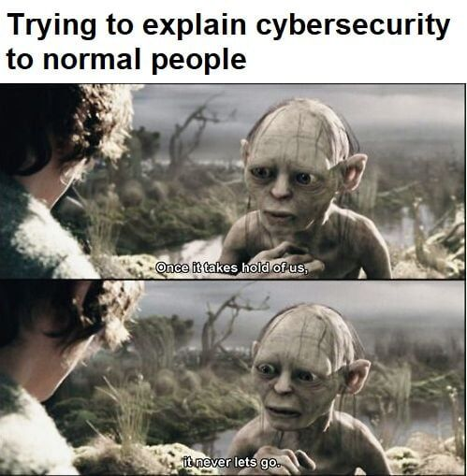
HOW WE LOOK TO THE BUSINESS SEES US...

Slide 7

MY STORY
Back to the books with an EMBA
Notes:
Why this?
Went on a quest to solve this issue. This is my solution to understand what how and why.
We need to reach out to other sources to solve our problems.
We need better communication, and that starts with knowing their language.

Slide 8
WHAT IS
CYBER SECURITY?
The practice of protecting a business from digital risks that can cause an organization to have lower profits or fail
Notes:
We have to define what we are doing first.

Slide 9
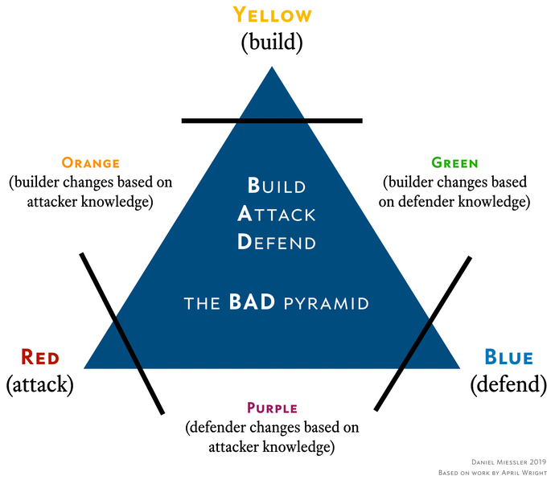
CYBER SECURITY TEAMS?
https://danielmiessler.com/images/BAD-pyramid-miessler.png

Slide 10
WHICH TEAM IS BETTER?
Blue Team
Purple
Team?
Red Team

Slide 11
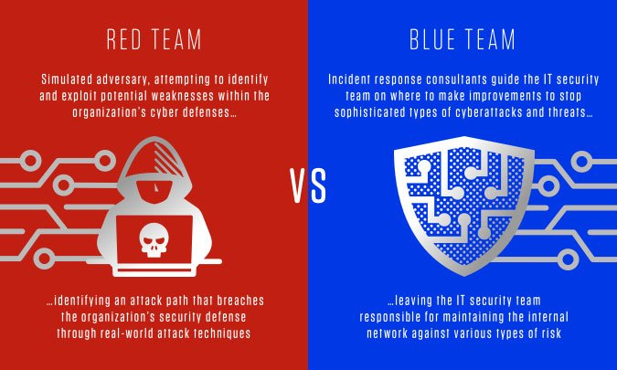
HOW DID THIS DIVIDE HAPPEN?
https://www.crowdstrike.com/wp-content/uploads/2020/09/cs-101-red-team-blue-team-defined.jpg

Slide 12
BACK TO THE BASICS
CYBERSECURITY
BLUE TEAM
RED TEAM
The practice of protecting a business from digital risks that can cause an organization to have lower profits or fail
Responsible for responding to or defending the organization from risk
Responsible for identifying , exploiting, and informing the business about weaknesses in defenses designed to protect the organization from risk

Slide 13
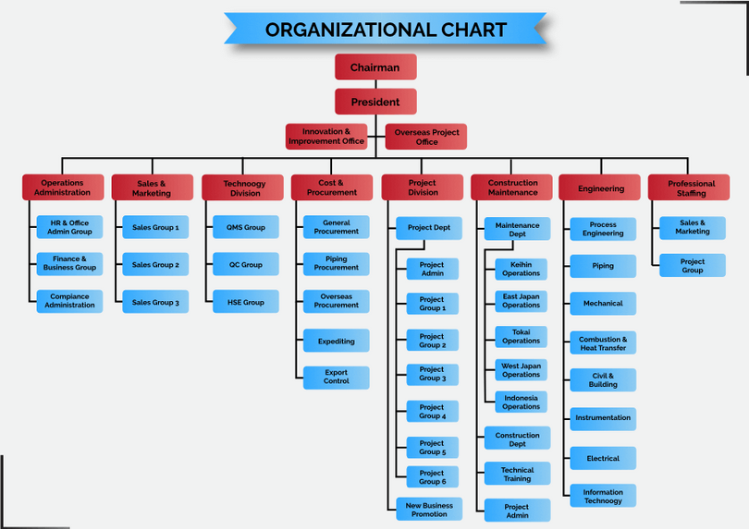
WHAT IS A SILO ORGANIZATION STRUCTURE

Slide 14
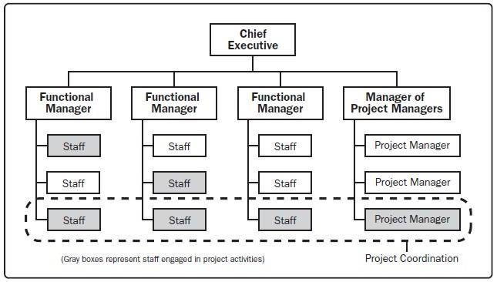
WHAT IS A MATRIX ORGANIZATION STRUCTURE

Slide 15
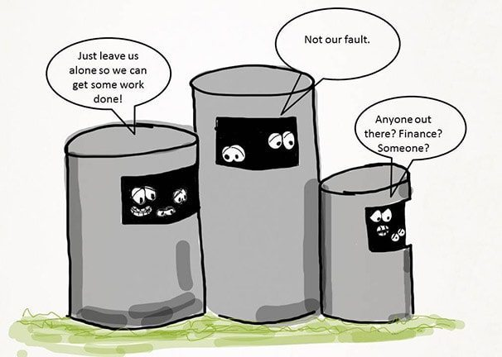
ORGANIZATIONAL STRUCTURE
Silo organizational structures can limit the communication between teams causing communication issues.
However, silo's also permit the growth of highly technical skills.
https://focusu.com/wp-content/uploads/2010/12/workplace-silos-1.jpg
Notes:
This has happened in Water and Waste Utilities.
Engineering firms.
Silos cause problems primarily because they focus on fulfilling a function rather than on achieving a process outcome. A water utility's objective is to safely and reliably deliver clean water to customers. No single department can achieve this outcome on its own in isolation from the rest of the utility. Delivering safe, reliable service involves many departments.

Slide 16
Are purple teams worth implementing or should organizations just address the root causes between red and blue teams, such as lack of communication, siloed organizational structures, and lack of sharing institutional knowledge?
SO WHAT IS THE BOTTOM LINE ISSUE?
Notes:
Communication is key inside and outside of our industry

Slide 17

SO WHAT ABOUT THAT PURPLE TEAM
A purple team is an attempt to solve an organizational structure issue in which a two teams (Blue/Red) are not communicating effectively to protect the business from risks.
Interal to an organization, this issue can be solved through several ways, which can include the restructuring of organizational silo's to enable communication or training.
Additionally, an organization can bring in outside expertise to help enhance the protection of the organization from risk through knowledge sharing of a different skill set.
Notes:
Let's talk in their language.
Do we need a brand new team?

Slide 18
THANKS FOR
YOUR TIME!

