Slide 1
Infrastructure as code
Theory and Concepts
Notes:
Good Afternoon! Thank you for attending RVAsec 2021. I hope everyone’s having a great time! It’s my pleasure to present ”Infrastructure as Code: Theory and Concepts”.

Slide 2
Mindful minute
Chrome Timer Link
Notes:
Let’s kick things off with a Mindful Minute. If you’re new to this concept, don’t worry, it’s easy. Just relax your gaze, focus on deep breathing and be present in the moment.

Slide 3
#whoami
Rackspace Government Solutions Senior NetSec Product Engineer
Python Practitioner
AWS Practitioner
DevOps Fan
Security Connoisseur
Family
Hockey Fan
Woodworking
Avid Bookworm
Notes:
Please allow me to introduce myself.
Product Engineer (I develop Network Security Solutions for customers) – most recently focused on our FedRAMP AWS platform offering
Many of the references in this presentation are based on AWS & Python simply because I know them best and use them frequently.

Slide 4
Preamble
This is not prescriptive. The goal is to present thought-provoking ideas
There are lots of links throughout the presentation. The audience is encouraged to visit reference pages to gain more insights and reference material.
*This is not a Security-Focused Presentation. That is tomorrow at 1:00 ☺
Notes:
My goal for this presentation is to get your wheels turning when thinking about Infrastructure as Code. Please click on links that make you curious and seek out more information on subjects that intrigue you.

Slide 5
Contents
Terminology and Definitions
Theory
Principles and Concepts
Pseudo Code
Patterns
Modelling Complex Information Systems
(Cloud) Configuration Management Tools
Moving on to CI/Cd & DevOps
Notes:
This presentation will cover the contents listed. Particularly note that I am not covering specific end-to-end use-cases. Implementing the topics discussed will vary based on the needs of the implementation.

Slide 6
In a Nutshell Start with why
Why Infrastructure as Code?
Save Time Deploying
No More Clicking ”Next Next Next Done”
Shorten RTO with DR Events
Consistent Deployment (Control Drift from the start)
Maintain Compliance and Auditable Environment
Increased and Easier Security!
Rollbacks with Version Control
Levelling UP
Leveraging the DRY principle with OOP
Tags! You’re IT!
Abstraction
Speed
Leveraging Patterns to extend capabilities
Would you like a side of GUI to go with that code?
Notes:
This is the presentation in condensed form. Why use Infrastructure as Code, How to leverage it, and how to Level up.
Bridging Infrastructure as Code to use Object Oriented Programming

Slide 7
Terminology and Definitions
Level Set
Notes:
So we’re on the same page and understand each other, let’s look at some terminology and definitions

Slide 8
Terminology and Definitions
Infrastructure - Information technology (IT) infrastructure are the components required to operate and manage enterprise IT environments. IT infrastructure can be deployed within a cloud computing system, or within an organization's own facilities. (Red Hat)
Routers, Switches, Firewalls, Network IDS/IPS, Windows Servers, Linux Servers, IoT Devices, Kubernetes Nodes, Application Service Container, Database Service
Infrastructure as Code - Infrastructure as Code (IaC) is the managing and provisioning of infrastructure through code instead of through manual processes. (Red Hat).
Object Oriented Programming – OOPs is a style of computer programming which represents concepts as objects that have state and behavior. (w3spoint) (*Note: Link has comparison Table)
Example from w3schools: https://www.w3schools.com/python/python_classes.asp
Program Object – An instance of a Class that contains properties and Methods (w3schools)
Program Function – A block of code that runs (probably with data parameters passed to it) when called. (w3schools)
Program Class - A Class is like an object constructor, or a "blueprint" for creating objects. (W3schools)
Program Language Library – A collection of modules for use in that language (I.E. Python Library)
Notes:
What is Infrastructure? Seriously, it can be obvious – Network Firewall, Database Server, etc. Infrastructure may also include non-obvious IT, such as IoT (SMART devices, embedded technology, etc.).
Note that Red Hat is heavily invested in DevOps – They acquired Ansible, they have OpenShift Container Platform, and sponsor series discussing The Phoenix Project.
This presentation was alternatively titled “Development Concepts for System Engineers”

Slide 9
Theory
What’s the big idea here?
Notes:
Why use Infrastructure as Code?

Slide 10
Obvious Added Value and Advantages – Making the Business Case for IaC
Save Time Deploying
No More Button Clickers: ”Next Next Next Done”
Shorten Recovery Time Objective (RTO) with Disaster Response Events
Consistent Deployment (No SnowFlakes = Less Management Overhead)
Increased and Easier Security
Increased and Easier Compliance with Code Repo and Version Control
Audit Logs of Code Changes (Who changed What and Why)
Writing code to deploy and manage infrastructure pays vast dividends
Notes:
Infrastructure as Code sells itself. Making the business case can be tricky if assuming costs of infrastructure (Code Repos, etc.), however, the operational efficiencies easily offset these costs.
Consistent Deployments will save Operational Management in the long run. This can be hard to quantify but easy to understand.
Compliance teams will enjoy the benefits of the rich logging IaC provides from Code Repositories and Version Control. Keep in mind you will need to use best-practices, such as Peer Reviewed Pull Requests.

Slide 11
Not-So-Obvious Benefits
Code as Infrastructure Documentation
“As you can see in the xyz class, subnets are deployed in abc configuration”
Rollbacks & Version Control
Use Package Version Control to prevent “A 3rd party package update cause a failure”
Reliable and Repeatable Manual Process to Deploy and Manage Infrastructure
Not quite DevOps, yet.
Enables more Business Process Automations (via Tagging, etc.)
I.E. “Query all infrastructure tagged ’dev’ to help gather development costs)
Deploy Infrastructure in a Process-Oriented Manner
Notes:
The Code becomes documentation – no more separate steps for Build and Document. Comments in IaC enhance this capability
Rollbacks are easier with Version Control. Note that Package & Dependency Stickiness will prevent failures from 3rd party package updates that break code
Reliable and Repeatable process lessens anxiety

Slide 12
Principles and Concepts
Build I.T. better
Notes:
Now that our Infrastructure is Code -> We now need to follow coding best practices.

Slide 13
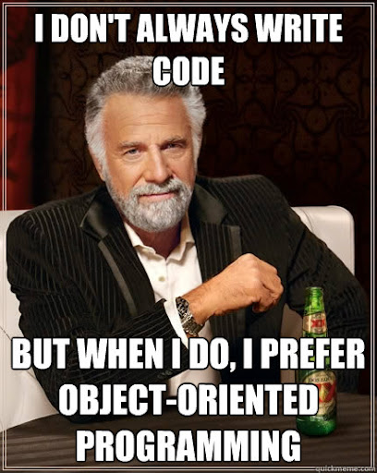
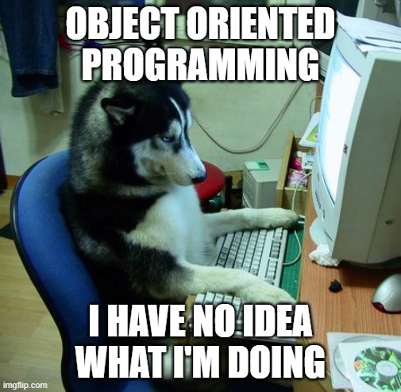
What’s wrong with my 2,000-Line script? - Nothing. There’s a better way. Linkedin Learning class A Cloud Guru class
Notes:
The ”One Big Script to Rule them All” approach is limited to simple environments with a specific set of variables that must be defined.
This works well for Light Deployments
Object Oriented Programming has a learning curve. There are layers, as well as choices to make

Slide 14
If you like your CloudFormation template, you can keep your CloudFormation template

Slide 15
DRY & SRP Principles
Don’t Repeat Yourself (DRY)
Code should be re-usable (Deploy Infrastructure Repeatably)
Use OOP to for Code Re-Use
Document Code Libraries/Packages for others to leverage
Single Responsibility Principle (SRP) & Keep It Simple, Stupid (KISS)
A Class is responsible for one thing (single-purpose class)
I.E. Subnet Class
Methods to Create/Retrieve/Update/Delete
Notes:
The Most important Concept of Programming, especially for IaC, is the DRY principle. Code must be re-usable, generally with OOP.
Document Code so that others may avoid “Re-inventing the Wheel”
SRP and KISS assist with code readability management.

Slide 16
Difference between oop and scripting (w3spoint.com)
Procedural Programming
Object Oriented Programming
1. In Procedural Programming a program is created step by step instructional format and instructions are executed in order. 2. Follow top-down approach. 3. Less secure because it does not have any proper way of data hiding. 4. Does not provide code re-usability feature. 5. Doesn’t provide ability to simulate real-world event much more effectively. 6. Slow development.
1. In Object Oriented Programming a program is created in a way as real world works.
2. Follow bottom to top approach. 3. Secure because it have proper way of data hiding. 4. Provide code reusability feature. 5. Provide ability to simulate real-world event much more effectively. 6. Fast Development.
Notes:
Scripting is a step-wise, Top-Down approach. Does not “hide” data with classes and private variables. No code re-use. Hard to do Test/QA against. It is slower to develop.

Slide 17
Mapping OOP concepts to Infrastructure as code
High level
Low level
DRY
Code should be re-usable and abstract
I.E. Use cloud-specific connection class -> creates object that can be passed to other objects for authn/authz
Loose Coupling & SRP
If a part of infrastructure fails, the rest of the infrastructure should be minimally affected.
Infrastructure should not depend on other infrastructure.
Classes (connection class for re-using connection to infrastructure manager). A class delivers a component of the infrastructure (SRP Principle)
Inheritance from Parent Classes – Write the code once and let other Classes inherit.
I.E. VM class can inherit Network Interface class.
Pass Objects between Main and Classes to use results of previous code run (I.E. Network Subnet when creating Network Interface).
Getters and Setters (Different for Python). (GeeksforGeeks)
Notes:
If we look at the DRY concept, we can see that our code should be usable for different infrastructure deployments.
Loose Coupling and SRP come into play when working on the various parts of infrastructure. One part of the infrastructure should be loosely-coupled with all other parts.
Classes can be mapped to infrastructure pieces (many options, I.E. VPC SuperClass with specific use-cases as SubClasses). Developer’s Choice that we’ll explore later.
Pass Objects between classes.

Slide 18
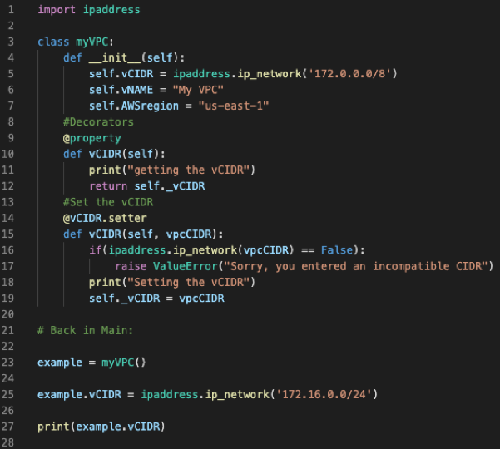
Python Decorators Example
Notes:
Code Step Through:
- import ipaddress module to use package
- Define myVPC class and init with default values
- Use Decorators for “Getting” and “Setting”
Main (could be a separate file)
Create Object, Set vCIDR, and Get(print) vCIDR

Slide 19
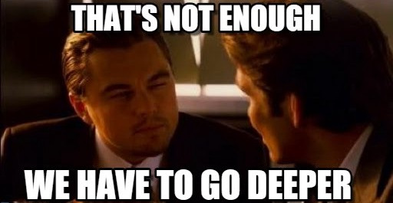
Patterns
How are you modelling your infrastructure code?
https://refactoring.guru/design-patterns/python
Notes:
There are quite a few patterns available for use. We’ll discuss 2 of them in the following slides. This is a rabbit hole worth falling into.

Slide 20

Gang of Four – Design Patterns: Elements of Reusable Object-Oriented Software
Notes:
For Historical Context, this book changed Object-Oriented Programming by introducing the concept of Patterns in Software.

Slide 21
Factory Pattern
https://realpython.com/factory-method-python/
Creational Design Pattern
Common interface
Create Infrastructure with common interface regardless of unique characteristics of the infrastructure
Easy pattern to use when migrating from a Scripted Build
Notes:
Customer Customizations are a part of business. Customers have unique requirements, and the Infrastructure Code must be able to account for it.

Slide 22
Builder Pattern
Useful when code doesn’t require a common interface
For Infrastructure-as-Code, possibly used when doing non-standard builds
One build may require infrastructure parts abc
Another build may require infrastructure parts xyz
Imagine Infrastructure Parts (Subnets, Database Servers, etc.)
Different parts for standardized or customized builds
More than just optional arguments, but is a full-tilt Pattern Necessary? (Link)
Notes:
This is one of those rabbit holes. Refactoring Guru gives a great example of a builder pattern that can easily be translated to IaC: Standard Infrastructure Option A might consist of parts 1,2,3,4,5, Standard Infrastructure Option B might consist of parts 6,7,8,9, and Custom Infrastructure might consist of parts 2,4,6,8.
Python Patterns stipulates the Builder Pattern is rare in Python due to the built-in capabilities of the language – that a series of method calls is merely for convenience. This is a very different representation than Refactoring Guru

Slide 23
Modelling Complex information systems
Leveraging code to manage infrastructure
Notes:
Up Next we will look at some tools and tactics for leveraging Infrastructure as Code

Slide 24
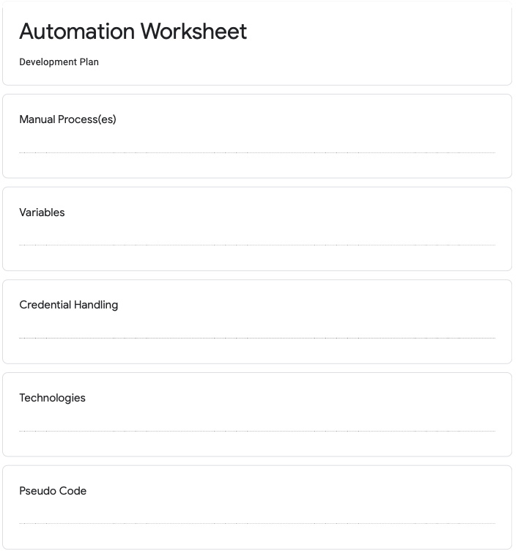
Link to PDF
For IaC, consider also adding:
- Dependencies (I.E. Work Ticket)
- Modules (for import)
- Existing Classes (from Pseudo Code)
- Additional Resources
- Warnings/Known Issues or Gotchyas
Notes:
This form is to aid in the Requirements Gathering step. While initially conceived for assisting with automation efforts, we can re-purpose for IaC efforts with some modifications.

Slide 25
Pseudo Code
Example
Import Modules
Define Class
Initialize with Defaults: CIDR, Name, AWS Region
Decorators for the CIDR
Main:
Create Object from Class
Set CIDR to Network Range of ipaddress.ip_network type
print CIDR Range

Slide 26
Writing Code
Infrastructure Operations
Create
Create a piece of Infrastructure
(I.E. Create Subnet, Create Firewall Rule, etc.)
Read/Retrieve
Obtain value of existing infrastructure
Update
Modify a piece of existing infrastructure
Delete
Delete a piece of existing infrastructure
*Upsert
(Ensure an object exists with these parameters)
Notes:
Pulling a page out of our Database Administration playbook, we simplify Infrastructure Operations into the following code operations

Slide 27
HTTP -> CRUD restapitutorial.com
HTTP Verb | CRUD | Entire Collection (e.g. /customers) | Specific Item (e.g. /customers/{id})
POST | Create | 201 (Created), 'Location' header with link to /customers/{id} containing new ID. | 404 (Not Found), 409 (Conflict) if resource already exists..
GET | Read | 200 (OK), list of customers. Use pagination, sorting and filtering to navigate big lists. | 200 (OK), single customer. 404 (Not Found), if ID not found or invalid.
PUT | Update/Replace | 405 (Method Not Allowed), unless you want to update/replace every resource in the entire collection. | 200 (OK) or 204 (No Content). 404 (Not Found), if ID not found or invalid.
PATCH | Update/Modify | 405 (Method Not Allowed), unless you want to modify the collection itself. | 200 (OK) or 204 (No Content). 404 (Not Found), if ID not found or invalid.
DELETE | Delete | 405 (Method Not Allowed), unless you want to delete the whole collection—not often desirable. | 200 (OK). 404 (Not Found), if ID not found or invalid.
Execution with
API Calls
Infrastructure Automation relies on a series of steps that can be boiled down to one of these operations
Notes:
The easiest and most frequently used call is “GET” as code may utilize it for pre-requisite filling and post-execution validation (did my POST command work like I wanted it to?).

Slide 28
Postman (Link)
Postman Format for AWS (Set AWS Environment)
https://{{service}}.{{region}}.amazonaws.com/?Action={{action}}{{version}}
SNOW – How-To
AWS Collection
AWS Docs
Notes:
Postman is a pretty great tool released by Google. Postman simplifies API Call development.
Build API call piece-by-piece

Slide 29
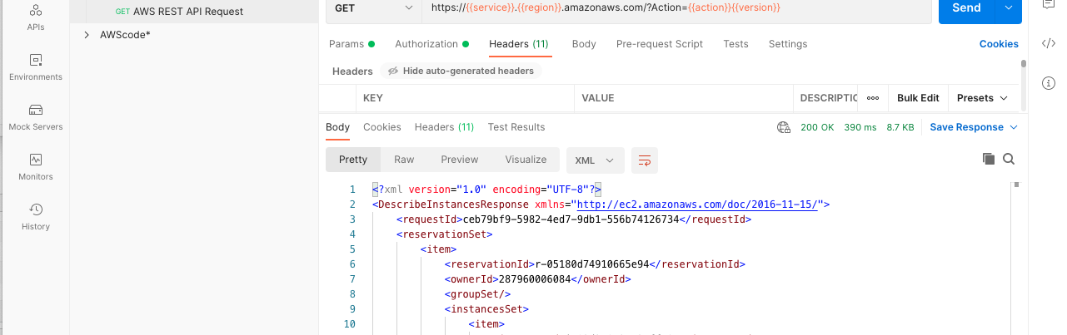
Postman Example
Notes:
In this example I’m calling the AWS Ec2 “Describe Instances” API.

Slide 30
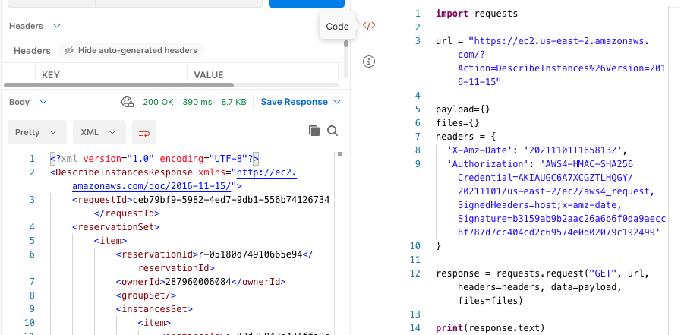
Postman Trick
Notes:
One of the nifty features of Postman is the automatic code creation. As you can see, using API calls will generate a lot of lines of code.

Slide 31
Software development kit (SDK)
Cloud-dependent
Flexible
Cleaner, Simpler, and Easier-to-Read
Cloud Vendors generally good with Documentation
Boto3 (AWS) Azure Libraries GCP vSphere NSX-T
Notes:
SDK’s are a cleaner approach to IaC, allowing developers to leverage existing code.
DRY Principle of leveraging existing code.

Slide 32
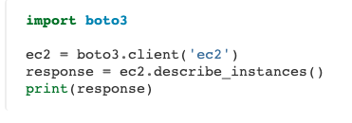
Python SDK Example
Reference Link
Notes:
This is a very simple way to execute an operation with the BOTO3 SDK.

Slide 33
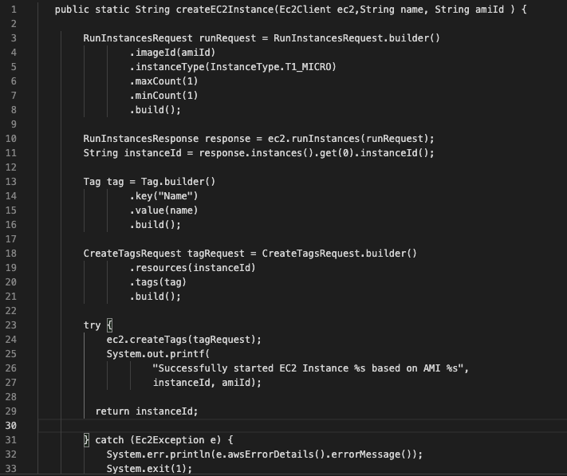
Java SDK Example
Reference Link
Reference Link
Notes:
Not as clean and concise as the Python SDK, but much more native way of writing code.

Slide 34
SDK compared to api calls
SDK
API calls
Object-Oriented, with Pre-Built Methods and Classes
Easier to read in Native Code Language
Developed in IDE (I.E. VisualStudio Code)
Produced by Cloud Provider
Everything is an API Call
One-for-One with CRUD Operations
Maintain Logic across Cloud Platforms
(I want to do xyz with these API calls)
Flexible and language independent
Postman
Notes:
API is a simple way to interact with Platforms in our Code. SDK’s provide a native way to leverage OOP to interact with Infrastructure.
Note that API calls can generally be “swapped” on one-to-one basis depending upon the specific infrastructure (Create a VM in Azure vs. Create an instance in AWS)

Slide 35
(Infrastructure) configuration management tools
Define your cloud
Notes:
Leveraging Code to Centrally Manage Infrastructure.

Slide 36
Cloud Agnostic & cloud specific
Terraform
Ansible
Chef
SALT
AWS CloudFormation
AWS CDK
Azure Resource Manager Templates
Google Cloud Deployment Manager
Vmware vRealize Orchestrator
Beware of State Tracking and Drift
Notes:
Cloud Agnostic Tools still rely on platform-specific code but can manage multiple platforms from a single place.
Cloud Template Tools are not flexible, and can take a long time to deploy (compared to SDK). State Tracking becomes an issue if anything modified outside the Template.

Slide 37
Templates
# Basic provisioning example
- amazon.aws.ec2:
key_name: mykey
instance_type: t2.micro
image: ami-123456
wait: yes group: webserver
count: 3
vpc_subnet_id: subnet-29e63245
assign_public_ip: yes
Reference: docs.ansible.com
Specify cloud infrastructure
Notes:
Here is a template to deploy an EC2 Instance. As you can see, changing these values outside of the template will cause drift that must be handled.

Slide 38
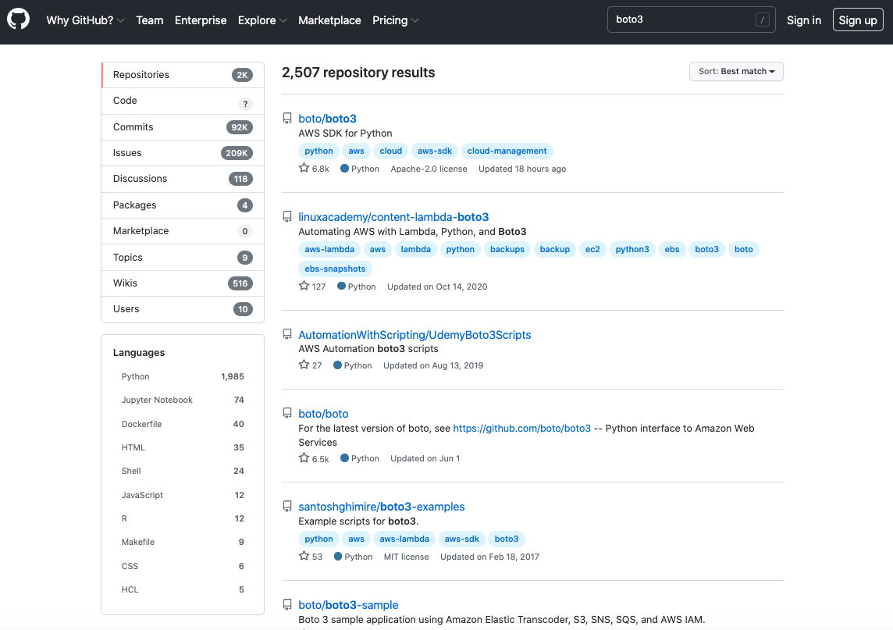
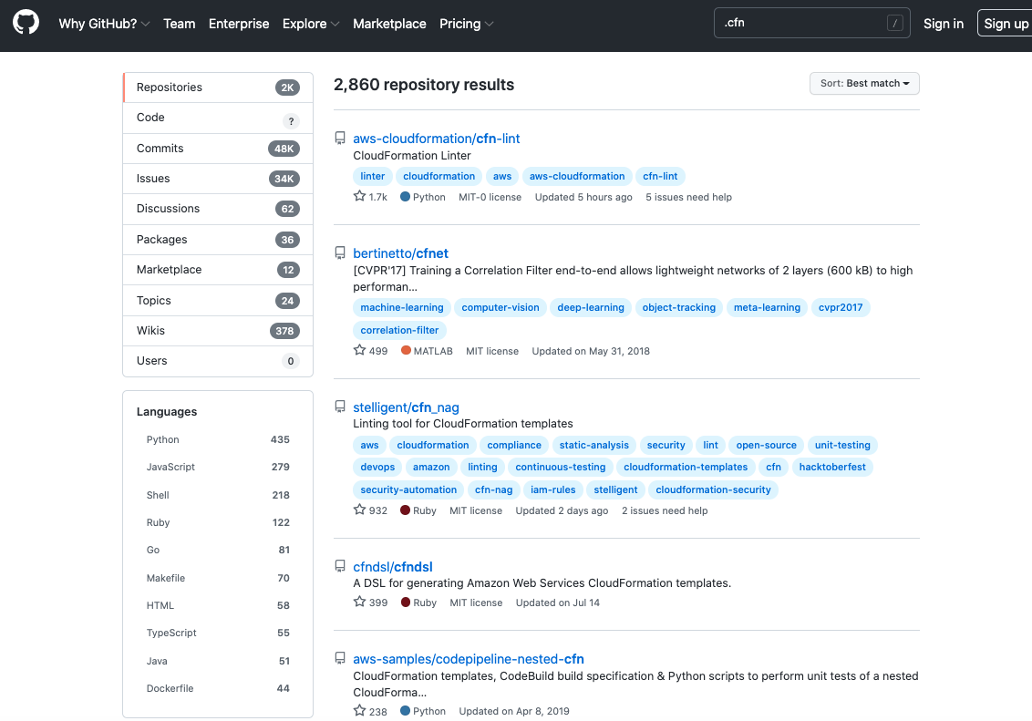
Where are we? Github search
Boto3 (2,507 Repos, 92K Commits)
CloudFormation (2K Repos, 48K Commits)
Notes:
A very crude way to research what the industry is using.
Remember BOTO3 is only the Python SDK, there are other languages.

Slide 39
IaC -> CI/CD
Infastructure as Code is the First Step towards CI/CD.
Infrastructure Code – Networks, VM’s/Instances, DB, etc.
Pipeline Code – Orchestrate CI/CD
Build – Compile, integrate variables
Test – See what happens when code is used to execute
Test Environments, Run Tests on code with tools, etc.
Deliver or Deploy (Delivery implies Manual Final Step)
Once all checks pass the gate, roll out to Production
Lots of opportunity for automation
Tickets and Approvals are events that can kick-off automations
Start small and get quick wins
Security Benefit:
Audit Logs of Infrastructure Changes (via Code Runs – When and Where did the Change Take Effect?)
SANS Sec540 – Cloud Security and DevSecOps Automation
On the path to DevOps
Notes:
CI/CD builds on IaC. The Pipeline takes the IaC code and builds it. Then, QA Testing is performed to ensure the code works as-intended. Security Testing should also be done in the Pipeline

Slide 40
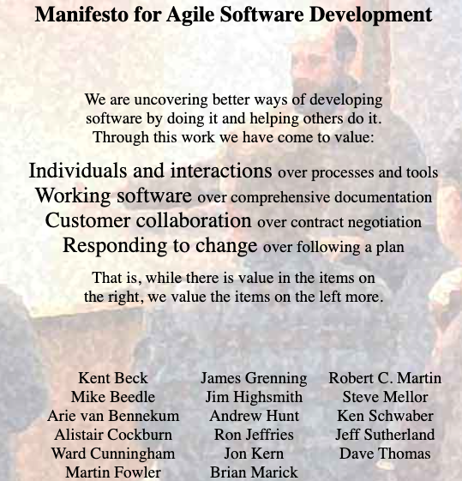
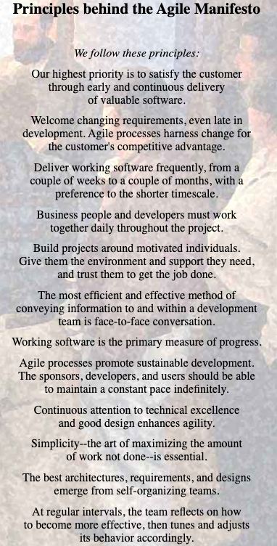
CI/CD -> DevOps. Agile Manifesto
DevOps is a Culture
- Cannot be changed overnight
- Needs Support at All levels of Org.
- Includes all parts of Org.
Notes:
Review the Agile Manifesto for some insights into how DevOps is successful in Organizations. Notice the focus on People & Culture.
DevOps is NOT a Tool or Technology that can be bought and implemented. *Tools exist to assist with DevOps, such as Kanban boards and Collaboration Tools.

Slide 41
Review
Terminology and Definitions
Theory
Principles and Concepts
Pseudo Code
Patterns
Modelling Complex Information Systems
(Cloud) Configuration Management Tools
Moving on to CI/Cd & DevOps

Slide 42
Thank you!
Notes:
Thank you for attending my presentation today. I will be around for a few minutes, as well as tomorrow.

