Slide 1

Three Worlds of Application & Cloud Security Wait.. Is this stuff all connected?
Richard Thayer
Saturday, October 30, 2021
© 2021 ePlus inc. Confidential and Proprietary.

Slide 2
Things to Discuss
World Views
World One (Go Left!)
Secure Coding, DevOps / CICD, DevSecOps
World Two (Go Native!)
FW, AG, NSG/ASG, LB, Key Vaults, K8s, Policy, IAM, WAF
Wizard of Oz!
World Three (Instruction manual!)
GRC, Security Policies, Security Frameworks, Process & Procedures
Conclusion – Pointing Fingers

Slide 3
NOTICE!!! **Disclaimer** NOTICE!!!
Application Security covers any program or automation that creates, consumes or manipulates data; and how the application itself is secured when used…
Application Security does not cover the DATA itself, or the Infrastructure.

Slide 4
World One – GO LEFT
SSDLC – It means more than DEV / Test / QA / Staging / Production
Secure Coding Practices - 5 Principles that start the software journey
Vulnerabilities – Low through Critical / What’s the Risk?
Security Testing – SCA / SAST / DAST / IAST / RASP / Regression / Smoke / Integration / QA / UA
DevSecOps – 5 Security Phases to enforce ”DiD” before Production
Notes:
Every phase of the SSDLC should have Security involved
Secure Coding Practices – Authentication, Authorization, Cryptography, Validation, Session Management
Vulnerabilities – Weighted scale. How many Mediums equal a High? (Scale is based on Risk)
Security Testing (List Excludes Internal / External PenTests)
DSO a process defined by toolsets and Need

Slide 5
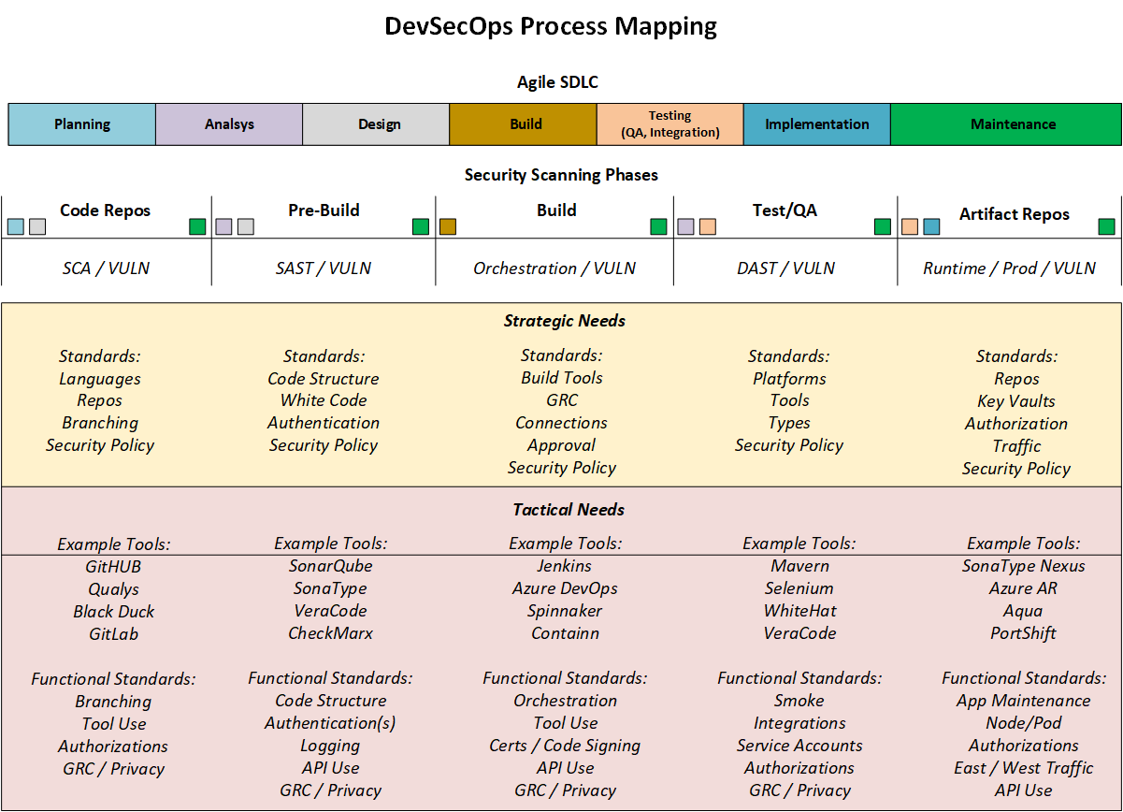
Notes:
Notice the SDLC mapped to the DSO phases
There are strategic and tactical needs for each stage to be successful. Building requirements is needed according to each company.

Slide 6
World Two – GO NATIVE!
Firewalls
Application Gateways
Load Balancers
Web Application Firewalls (WAF)
NSGs / ASGs
RBAC / ABAC / OBAC
Key Vaults / Key Stores
Paper Policy / Cloud Policy
Containers / Kubernetes
Log Analyzers / Monitoring
Notes:
What does native mean?
Why are all these important?

Slide 7
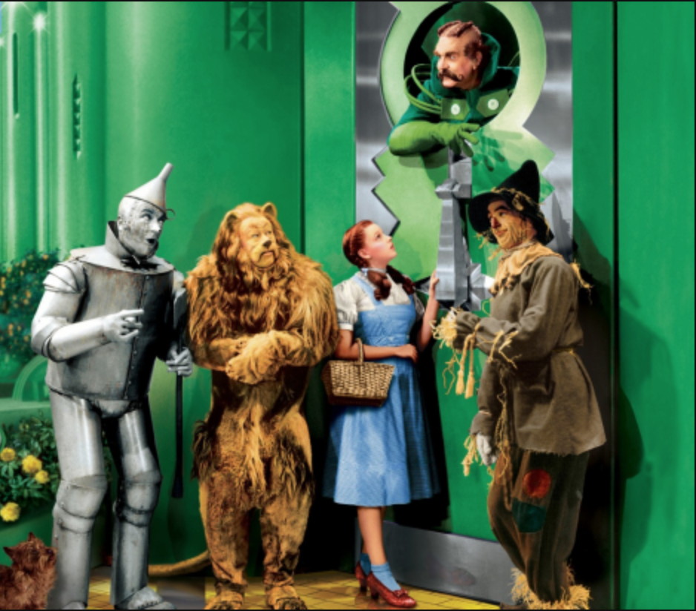
Notes:
Who we have to watch out for
Two famous quotes

Slide 8
Lions & Tigers & Bears, Oh My!

Slide 9
Lions & Tigers & Bears, Oh My!
Hackers & Employees & Consultants, Oh My!
Notes:
We need to look at their INTENT

Slide 10
Lions & Tigers & Bears, Oh My!
Hackers & Employees & Consultants, Oh My!
Malicious & Accidental & Side Stepping, Oh My!
Notes:
Intent will always be caused by human emotion.

Slide 11
Security Gate Keeper ->
Doesn’t Care
Side Stepper
Good Employee
Un-Educated
<- Malware
Notes:
Only two statics in this picture.
How do we model against this, and the overall application environment?

Slide 12
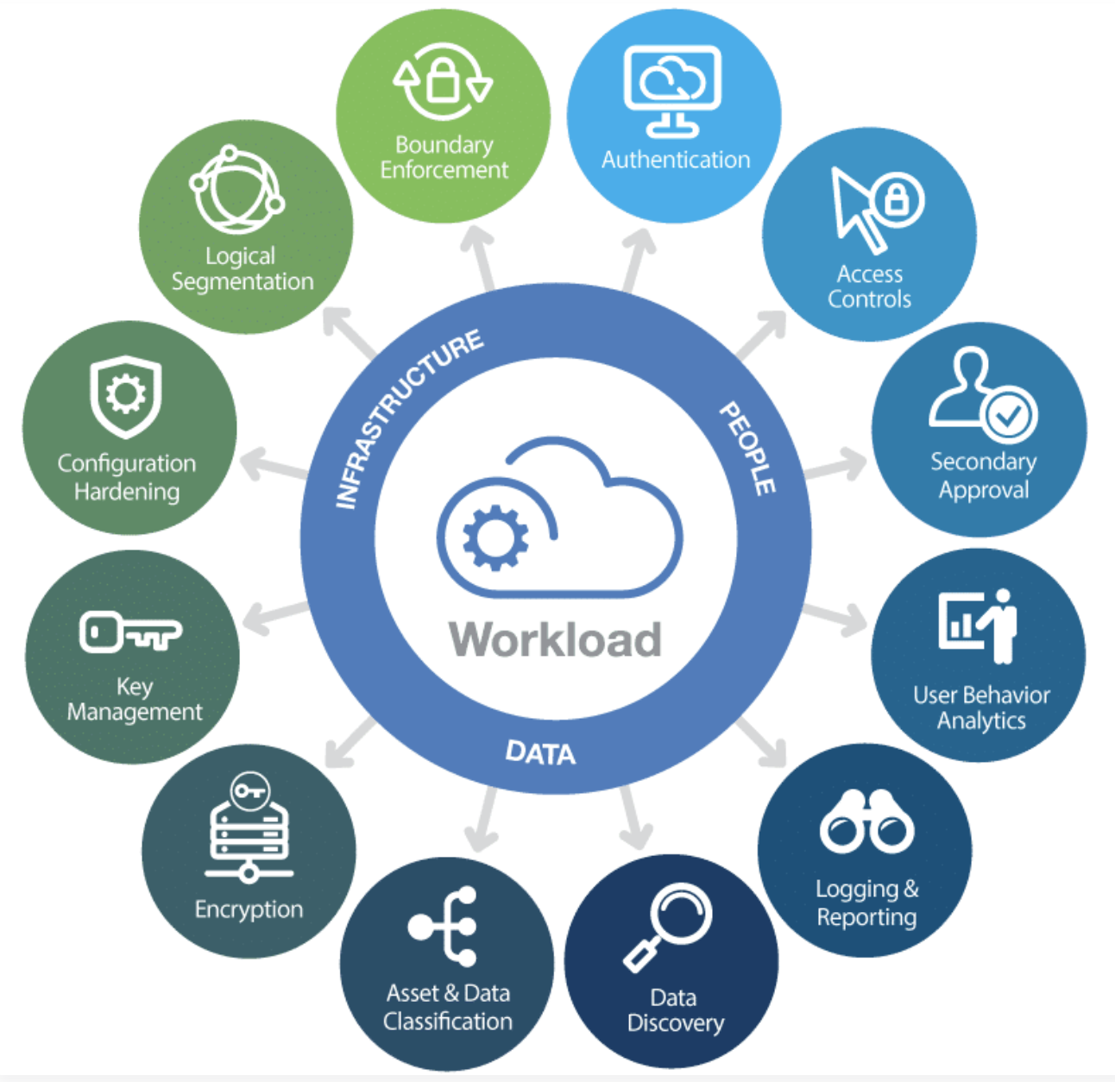
Disclaimer:
Grievously Horked from the Internet
a.k.a Plagiarized
Notes:
NOTICE the data!
Intent on the people side.
Even APPs need to be verified
Behavior is based on use

Slide 13
World Three – INSTRUCTION MANUAL!
Security Policies
Security Frameworks
Policies and Procedures
Governance, Risk & Compliance (GRC)

Slide 14
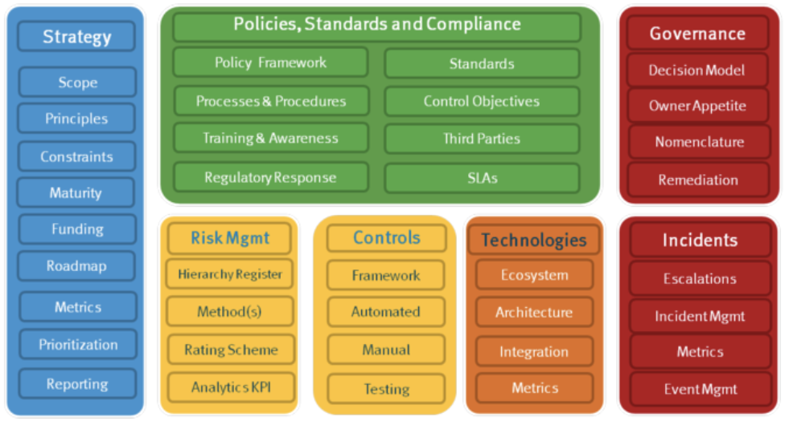
Disclaimer:
Grievously Horked from the Internet

Slide 15

Conclusion – Pointing Fingers!
Disclaimer:
Grievously Horked from the Internet
Notes:
Look around you. Everyone is responsible.

Slide 16
Thank you

