Slide 1

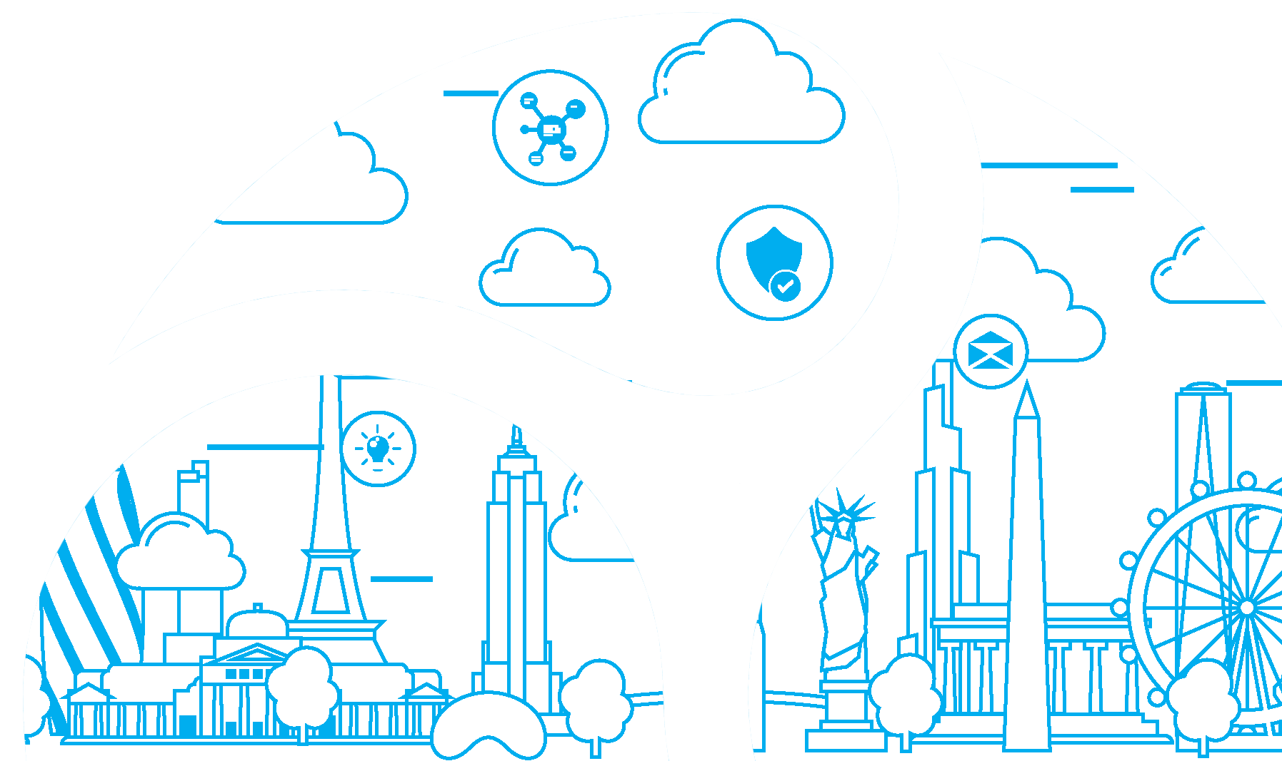
I ❤️ My Password
Adrian Amos – ahamos@synergy-technical.com
Notes:
Good morning and welcome! I really appreciate you taking the time to join my session this morning, and before I even get started I want to tell you a little story about the history of this talk. I first wrote a draft for this back in late February, and that draft was almost purely theoretical. It was going to be a high-minded thought-experiment around what should be possible with identity and access management solutions: some sort of ability to recognize users where they are on their identity and authentication journey, grant hesitant users access to only the controls they need, and use access policies to limit their blast radius should something go terribly wrong.
But February was a million years ago, and most of what I was going to focus on as a human-centric discussion has now been reduced to a checkbox in Azure AD’s Conditional Access policies, so as of June 1 this transitioned into a product announcement.
But then in testing the limits of that checkbox I found that it’s a pretty aspirational checkbox, so there’s still some room for growth.
So today we’re going to discuss the challenges with identities, the ways we’ve tried to address them, and how we can keep our businesses safe while identity continues to evolve.

Slide 2





About Us
Founded in 2011
Headquarters in RVA
Offices in Raleigh, Atlanta, DC, New York City
Staff in USA, Canada, India
M365 Security Deployment Partner of the Year
Modern Endpoint Management Jumpstart Program
Surface Device Partner
Gold Certified – FastTrack, PIE, ECIF
Featured in Microsoft Case Studies 7 times in 3 years
Productivity Solutions
Security Solutions
Managed Services
Licensing & Hardware
3M+ Cloud Users
Experience in 70+ Countries
Companies of all sizes & industries
Notes:
One of – if not the - First Born in the Cloud partner
Excel in securely enabling a productive workforce and have been recognized as such
Less than 20 worldwide
Azure – Teams/SharePoint/OneDrive and Power Automate – Zero Trust
Proud to be part of an exclusive group of Modern Endpoint Management Jumpstart partners and MS Surface partners

Slide 3

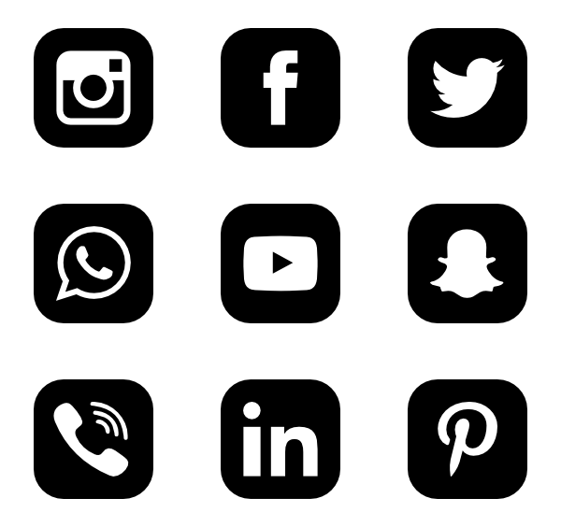
About Me!
Mac-free since 1998
MCSE for Windows NT 4.0, 1999
7 years contracting @ DoD
First technical hire at Synergy
BPOS/O365 since 2010
Intune since 2011
MS Ignite presenter 2018 & 2019
twitter.com/ahamos
youtube.com/ahamos
www.linkedin.com/in/adrianamos/

Slide 4
What is Identity?
username
llllllll
Your Identity
>
App(username, password)
Notes:
First let’s talk very high-level about what identity even is. We’ve gotten very accustomed to the idea that it’s a credential pair, one half of which is generally exposed, and the other half hidden. A username and a password.
But identity also means more than that, and its meaning has evolved over thousands of years.

Slide 5
Evolution of identity
Ancient Civilizations: Visual identification / jewelry / tattoos
Babylon: Census data
Rome: deeds, birth certificates, citizenship records
Renaissance: passports
Victorian Era: personal numbers, photographs, fingerprints
1936: US distribution of SSN cards
Post WWII: widespread use of photo ID cards
1977: US digitization of paper records
1980’s: Automated Fingerprint ID System (international)
2000’s: EIAM / CIAM; cloud identities
Ancient Egypt: wooden locks & keys
11th C BCE: Shibboleth Passwords
6th C BCE:
Iron & bronze locks & keys
Rome: watchwords with daily rotations
Victorian Era: invention of the modern flat key
WWII: Enigma machines & Code Talkers
1961: first digital password @ MIT
1974: first password hashing in Unix
1983: Patent issued for RSA cryptosystem
1993: release of Kerberos 5
10th C CE: First recorded use of all-metal locks
Notes:
A few years ago, when Microsoft first entered the compliance management market, I hosted a webinar in which I talked about how identity itself has evolved since the dawn of recorded history as a form of attestation between people, governments, and businesses.
In the earliest identification schemes, jewelry and fabrics determined identification. Think of kings & queens wearing crowns, or bishops in their miters & robes. The Maori used tattoos to tell stories of ancestry and achievements. Tartans represented clan membership in the British isles.
Babylon added census data, which is remarkably impressive considering they did it without a numerical system.
Rome added paper to the mix, with the first detailed representations of life events.
Things didn’t really change on a substantial level until the advent of the photograph and fingerprint in the Victorian era, which also ushered in numbering systems for records. But even those advances took almost 100 years to fully penetrate the global markets, and it wouldn’t be until 70’s and 80’s that global identification data went digital.
[click]
The concept of passwords and access controls is almost as old as identity itself. As humans have decided there are things worth protecting, we’ve evolved our security mechanisms with language, codes, locks, identification, and all other sorts of mechanisms. Whether it’s physical access to a space like a home, office, or even protection behind a castle wall; access to information; or even presentation of identity; humanity has experimented with everything from speak-easy passphrases to cereal-box ciphers, from wooden locks in the ancient world to the Victorian invention of the modern physical key to today’s cryptographic security keys.
There are examples as old as the 11th century BCE in the Bible’s Book of Judges, in which warring factions with different dialects used differing pronunciations of the word ‘shibboleth’ to identify, and ultimately massacre, their enemies. The technique is now referred to as a “shibboleth password,” its own type of linguistic authentication.
The Romans had a system of watchwords with daily rotations that were issued from commanders on wooden tablets and distributed to field officers. There’s no chance Han, Luke, and Leia would have made it to Endor even with primitive Roman security, so I guess they benefit from having at least been in a galaxy far far away.
1961 saw the first use of a digital password at MIT, and within 13 years password hashing was a part of the 6th edition of Unix. Another 9 years later and RSA cryptosystem received its patent, and not long after that we got our first globally-exportable ticket-issuing authentication protocol for non-secure networks in the form of Kerberos 5.
And honestly, everything was kind of fine then. In 1993 Windows 3.1 was a pretty neat idea. Mac users were happily feeding System 7 disks into their Quadra 610’s, and my dorm-mates and I thought it was wildly cool that we managed to network a couple of Mac’s with AppleTalk connectors over RJ-11 phone cables.
GOPHER was the internet browsing protocol of choice, if you weren’t into AOL.
We weren’t so terribly concerned about digital passwords. Most people who owned a computer were the sole users of those devices, or they were simple family-share machines for writing & printing book reports.

Slide 6
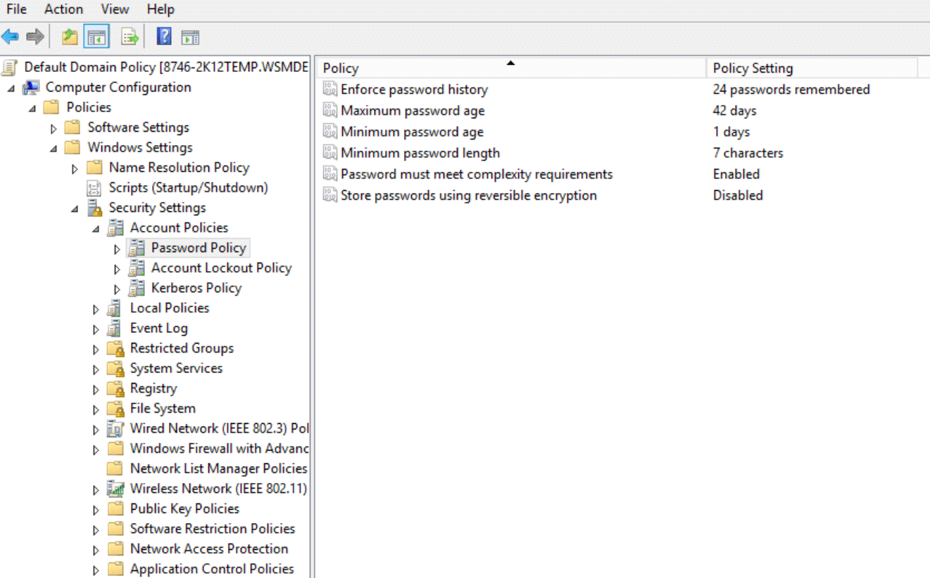
Notes:
When we did start worrying about password policies a few years later, for most of us the story was pretty common: Active Directory was new and shiny and came out-of-the-box with canned password policies that in retrospect weren’t very good. I still see pristine, largely-unmodified, 20+ year-old “default domain policies” to this day, and admins struggling to impose order on compromised, replicated hybrid accounts, and often blaming the cloud for exposing the problems.
Incidentally, bit of AD password trivia: You’ll note that the minimum length in a Windows 2000 Default Domain Policy specifies 7 characters, but do you know why 7, and why 8 was the recommended minimum? Passwords are hashed in 7-character chunks, so adding just one extra character functionally doubled the difficulty of cracking it. This is also why a lot of organizations adopted 15-character admin passwords: just to get one extra hash into the mix.
So we turned on Active Directory 23 years ago and just…let it run. That was, even at that low bar, the first disruption. Some who tried to impose tighter restrictions succeeded, while others had to walk them back. Others still made no efforts at all, and like I said you can still find plenty of those environments today, often with the sole exception being that passwords last a lot longer than 42 days.
But then, many years after we finally got users to put a special character in their daughter’s name, and a 1 on the end…

Slide 7
NIST 800-63B, Appendix A
A.1 Introduction
Despite widespread frustration with the use of passwords from both a usability and security standpoint, they remain a very widely used form of authentication. Humans, however, have only a limited ability to memorize complex, arbitrary secrets, so they often choose passwords that can be easily guessed. To address the resultant security concerns, online services have introduced rules in an effort to increase the complexity of these memorized secrets. The most notable form of these is composition rules, which require the user to choose passwords constructed using a mix of character types, such as at least one digit, uppercase letter, and symbol. However, analyses of breached password databases reveal that the benefit of such rules is not nearly as significant as initially thought, although the impact on usability and memorability is severe.
[…]
A.2 Length
Password length has been found to be a primary factor in characterizing password strength. Passwords that are too short yield to brute force attacks as well as to dictionary attacks using words and commonly chosen passwords.
[…]
Users should be encouraged to make their passwords as lengthy as they want, within reason. […]
A.3 Complexity
As noted above, composition rules are commonly used in an attempt to increase the difficulty of guessing user-chosen passwords. Research has shown, however, that users respond in very predictable ways to the requirements imposed by composition rules [Policies]. For example, a user that might have chosen “password” as their password would be relatively likely to choose “Password1” if required to include an uppercase letter and a number, or “Password1!” if a symbol is also required.
Users also express frustration when attempts to create complex passwords are rejected by online services. Many services reject passwords with spaces and various special characters. […]
Highly complex memorized secrets introduce a new potential vulnerability: they are less likely to be memorable, and it is more likely that they will be written down or stored electronically in an unsafe manner. While these practices are not necessarily vulnerable, statistically some methods of recording such secrets will be. This is an additional motivation not to require excessively long or complex memorized secrets.
Notes:
In June of 2017, NIST, the National Institute of Standards and Technology, that arm of the Department of Commerce that has driven more compliance work in the past 5 years with 800-53 and 800-171 than SarbOx ever did, released Special Publication 800-63B, Digital Identity Guidelines for Authentication and Lifecycle Management.
This document received little fanfare when it was first released, but it contained an appendix with some pretty jaw-dropping recommendations around password management, namely that complexity doesn’t matter, and that password lengths should be much longer. Essentially this document argued that a multi-word passphrase of all lower-case text was stronger than the leetest leet-speak password, and would be less likely for a user to write down on a sticky note and leave in plain sight.

Slide 8
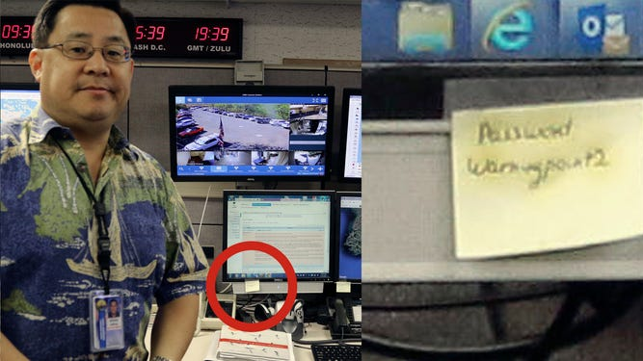
Notes:
…like this guy, who on January 13, 2018, had a bad day. He pushed a no-no button that caused Hawaii to believe they were under imminent missile attack.
And then his day got a little worse when a file-photo of him from 2014 revealed the dreaded sticky-note of security nightmares. At least there was probably a password expiration policy in place though, right?

Slide 9
Why are we removing password-expiration policies?
First, to try to avoid inevitable misunderstandings, we are talking here only about removing password-expiration policies – we are not proposing changing requirements for minimum password length, history, or complexity.
Periodic password expiration is a defense only against the probability that a password (or hash) will be stolen during its validity interval and will be used by an unauthorized entity. If a password is never stolen, there’s no need to expire it. And if you have evidence that a password has been stolen, you would presumably act immediately rather than wait for expiration to fix the problem.
If it’s a given that a password is likely to be stolen, how many days is an acceptable length of time to continue to allow the thief to use that stolen password? The Windows default is 42 days. Doesn’t that seem like a ridiculously long time? Well, it is, and yet our current baseline says 60 days – and used to say 90 days – because forcing frequent expiration introduces its own problems. And if it’s not a given that passwords will be stolen, you acquire those problems for no benefit. Further, if your users are the kind who are willing to answer surveys in the parking lot that exchange a candy bar for their passwords, no password expiration policy will help you.
Our baselines are intended to be usable with minimal if any modification by most well-managed, security-conscious enterprises. They are also intended to serve as guidance for auditors. So, what should the recommended expiration period be? If an organization has successfully implemented banned-password lists, multi-factor authentication, detection of password-guessing attacks, and detection of anomalous logon attempts, do they need any periodic password expiration? And if they haven’t implemented modern mitigations, how much protection will they really gain from password expiration?
The results of baseline compliance scans are usually measured by how many settings are out of compliance: “How much red do we have on the chart?” It is not unusual for organizations during audit to treat compliance numbers as more important than real-world security. If a baseline recommends 60 days and an organization with advanced protections opts for 365 days – or no expiration at all – they will get dinged in an audit unnecessarily and might be compelled to adhere to the 60-day recommendation.
Periodic password expiration is an ancient and obsolete mitigation of very low value, and we don’t believe it’s worthwhile for our baseline to enforce any specific value. By removing it from our baseline rather than recommending a particular value or no expiration, organizations can choose whatever best suits their perceived needs without contradicting our guidance. At the same time, we must reiterate that we strongly recommend additional protections even though they cannot be expressed in our baselines.
Security baseline (FINAL) for Windows 10 v1903 and Windows Server v1903
05/23/2019
Dropping the password expiration policies.**
There’s no question that the state of password security is problematic and has been for a long time. When humans pick their own passwords, too often they are easy to guess or predict. When humans are assigned or forced to create passwords that are hard to remember, too often they’ll write them down where others can see them. When humans are forced to change their passwords, too often they’ll make a small and predictable alteration to their existing passwords, and/or forget their new passwords. When passwords or their corresponding hashes are stolen, it can be difficult at best to detect or restrict their unauthorized use.
Recent scientific research calls into question the value of many long-standing password-security practices such as password expiration policies, and points instead to better alternatives such as enforcing banned-password […] and multi-factor authentication. While we recommend these alternatives, they cannot be expressed or enforced with our recommended security configuration baselines, which are built on Windows’ built-in Group Policy settings and cannot include customer-specific values.
[…] the small set of ancient password policies enforceable through Windows’ security templates is not and cannot be a complete security strategy for user credential management. Removing a low-value setting from our baseline and not compensating with something else in the baseline does not mean we are lowering security standards. It simply reinforces that security cannot be achieved entirely with baselines.
https://learn.microsoft.com/en-us/archive/blogs/secguide/security-baseline-final-for-windows-10-v1903-and-windows-server-v1903
Notes:
…or maybe not.
There is a *lot* of great text on this slide, and I highly encourage you to go read the original article because whoever wrote it was given a loooong leash and was clearly tired of having to make this argument, but in May 2019, almost 2 years after NIST said length is better than complexity, Microsoft removed password expiration recommendations from the security baselines for Windows Server.
I just want to read a little bit from the 2nd column, because the author captures my whole soul with this:
Periodic password expiration is a defense only against the probability that a password (or hash) will be stolen during its validity interval and will be used by an unauthorized entity. If a password is never stolen, there’s no need to expire it. And if you have evidence that a password has been stolen, you would presumably act immediately rather than wait for expiration to fix the problem.
If it’s a given that a password is likely to be stolen, how many days is an acceptable length of time to continue to allow the thief to use that stolen password? The Windows default is 42 days. Doesn’t that seem like a ridiculously long time? Well, it is, and yet our current baseline says 60 days – and used to say 90 days – because forcing frequent expiration introduces its own problems. And if it’s not a given that passwords will be stolen, you acquire those problems for no benefit. Further, if your users are the kind who are willing to answer surveys in the parking lot that exchange a candy bar for their passwords, no password expiration policy will help you.

Slide 10
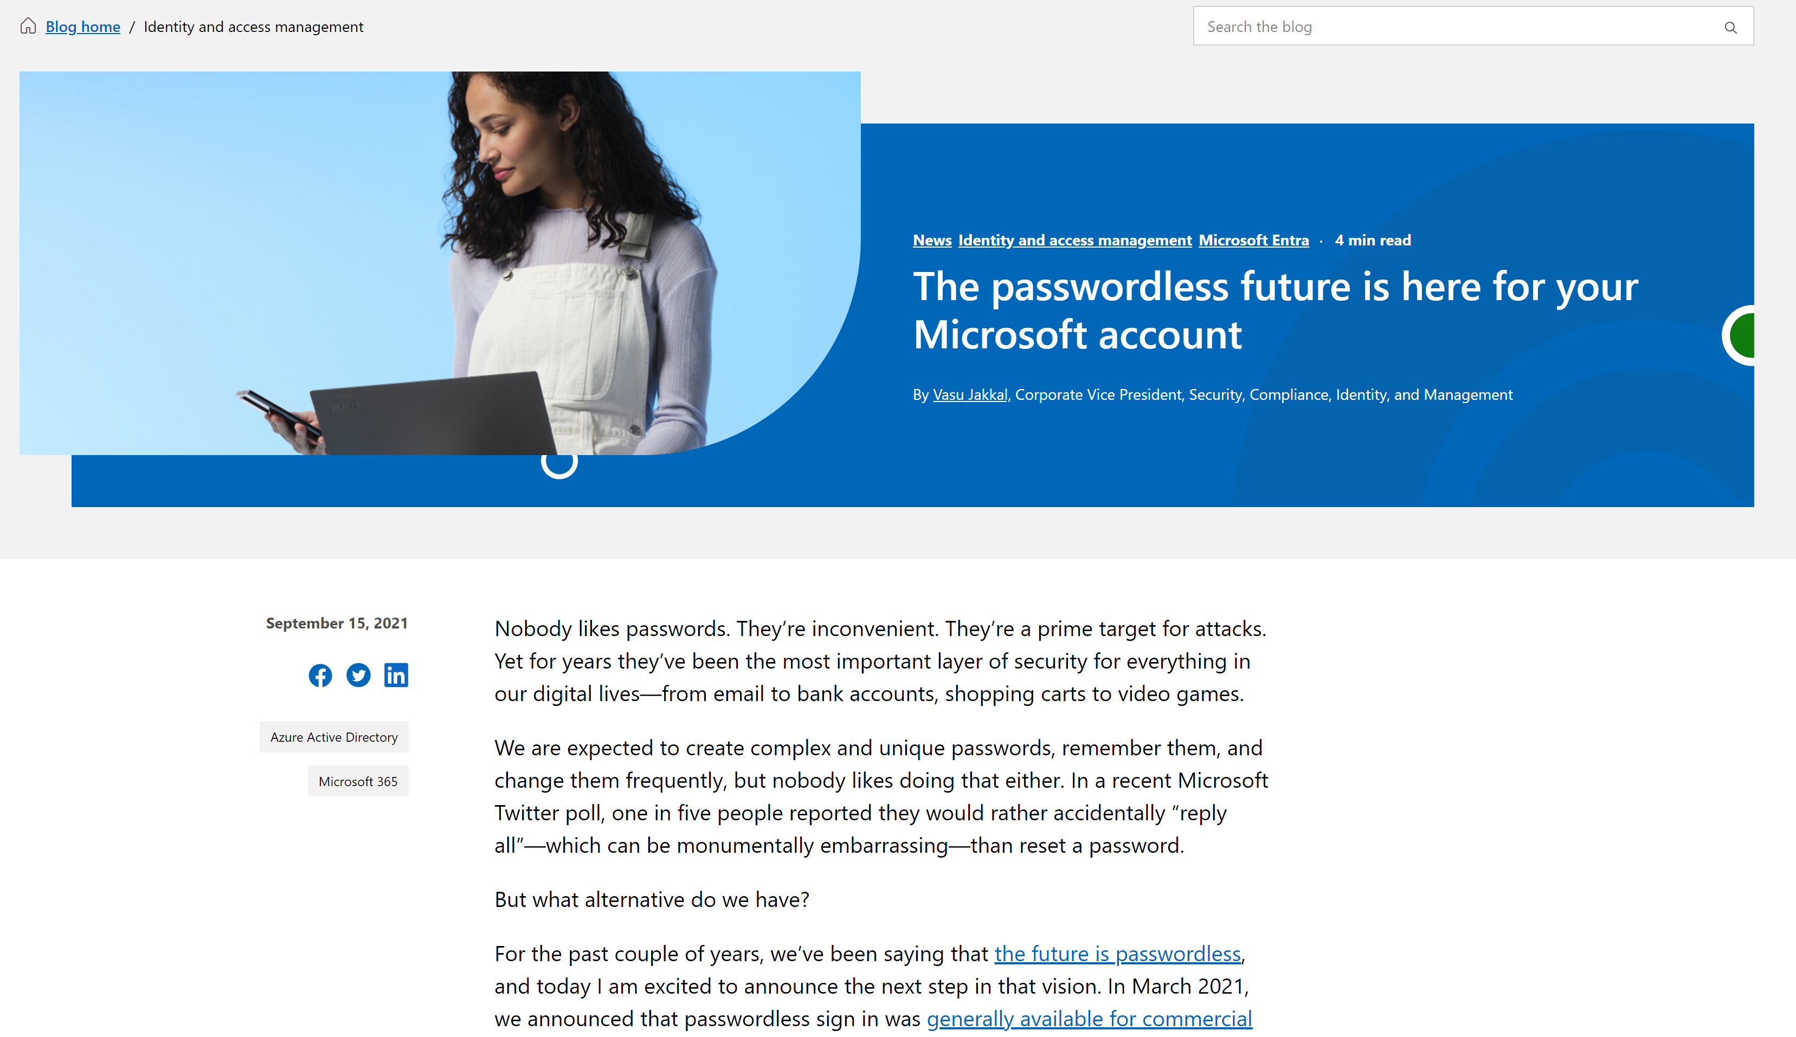
True actual passwordless?!?
Notes:
And then in 2021 Microsoft took the huge, but ultimately kind of meaningless leap, of eliminating passwords from Microsoft accounts. Huge because for the first time in the history of credential management, we’d eliminated the back half of the traditional “credential pair”. It was just gone: the attribute itself no longer exists for these accounts.
Except not for corporate customers. The commercial implementation of this still has a password: users just never interact with it except when it expires.
Which you’d think wouldn’t happen because it had been over 2 years since Microsoft suggested torching password expiration…but customers with government-imposed compliance regulations know they can’t do.

Slide 11
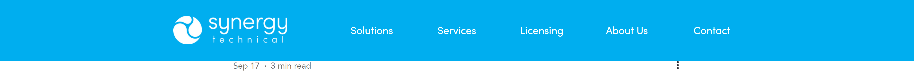
Azure AD Passwordless Authentication vs. the AD SCRIL bit
I've been using passwordless authentication in Microsoft 365 and Azure since it was first announced years ago (2? 3? Does time even work the same way any more?), and I've dragged a bunch of coworkers and peers along with me. Because we don't have an Active Directory domain behind our cloud accounts, I'd never had to wonder how to secure on-prem accounts against brute-force password attacks. Well it turns out there's a way, and it's part of Microsoft's published best practices for securing hybrid identity, and it's been in Active Directory for 20 years (give or take because what even is time now??). I'm talking about the SCRIL bit. Smart Card Required for Interactive Logon. Did you know it had a cool name? Have you ever called it the 'SCRIL bit'? You should: you'll sound awesome at identity & access management parties.
The SCRIL bit does something pretty cool in Active Directory: it makes a regular user account behave like a managed service account in that it allows Active Directory to roll the password on the account daily with enormous random values. This doesn't eliminate the password attribute, but since you can't just go around invalidating the AD schema for one user at a time, it renders the password attribute's value irrelevant. The user doesn't know it, and even a full SAM dump won't compromise it. The net result to using it is that the user can't manage an interactive logon without presenting a physical token. This can have some very interesting implications if the user NEEDS interactive logon and you don't provide them a token: they're not going to be very successful, but we'll come back to that.
Azure AD supports passwordless authentication options natively. The attribute continues to exist, and there may be some legacy workloads where it still gets requested, but 99% of the time I'm able to authenticate with a user account and an approval. I manage mine through the Authenticator App, but I could also use FIDO2 security keys or even text messages if that suits a business requirement (in most cases it won't).
And passwordless in Azure AD even supports temporary access passes for newly-created accounts, so the new user never even has an opportunity to set a password.
But Azure AD also supports password synchronization with AD, and this is where things get a bit tricky. We can do password hash sync (PHS), pass-through authentication (PTA), and password writeback with Azure AD Connect. We're not talking about ADFS here because that's no longer recommended by Microsoft. You probably knew that already, but you might not know that AAD Connect synchronizes passwords every 2 minutes, while PTA and writeback both use service queues in the cloud to stage requests that are retrieved and processed by on-prem components.
So what happens to a replicated account that has the SCRIL bit set on-prem, but is still using a password in the cloud? You'd think the user in the cloud would have some crazy random value imposed on their account and that password writeback would panic and the user would be forced to go home early. But fortunately somebody thought of that scenario, and while AD does perform the reset and timestamps it in the logs, AAD Connect does not detect or transmit the metadata and allows the cloud identity to keep on rollin.'
But the good news is that, since you're in the process of rolling out passwordless to your cloud users anyway, they probably won't ever need to worry about what happens to the password when you flip the SCRIL bit, and now you know a cool new term.
Notes:
I wrote a blog about how Azure AD Passwordless authentication worked when it was first introduced, and its relationship with the on-prem equivalent: the SCRIL bit. Smart Card Required for Interactive Logon basically parks the on-prem account while keeping it active—AD rolls the password daily with enormous values and the user can’t access the account if there’s no card to present, but setting the SCRIL bit to enabled DISABLES password hash sync for the user. So if you’re struggling with legacy user accounts in AD that only serve to prop up productive users in Azure AD, flick on the ol’ SCRIL bit and move on to the next worry.

Slide 12
3000+ years of cultural messaging:
30 years of “you’re doing it wrong”:
Passwords are super awesome and clever ways to maintain secure access to things you care about.
Your password is hot garbage and what are you even doing??
Use passwords 8+ characters
Change your password every 60 days
Use security questions
Use password complexity (1337 speak!)
SoMe ChArAcTeRs ArE pRoHiBiTeD
Use 2FA
Use PINs
Use Biometrics (except not THAT one)
Use long passphrases & ditch complexity
Only change your password if it’s busted
Notes:
Back to our story, though…
So we have 3000+ years of cultural messaging that passwords are incredibly powerful, they’re awesome, and since they only live in your head they’re incredibly secure, fighting against 30-ish years of exactly the opposite messaging.
We’ve told users to use 1337 speak, then not to, to use special characters that are seemingly different in every system, then told to use big long passphrases and only change them upon indication of compromise, but we haven’t taught them what compromise looks like. And while all that’s happening we’re also telling them to use PIN’s on their mobiles and flaky biometrics on their computers and honestly? We end up looking like we have no idea what we’re talking about. We’ve told them 25 different ways to stay safe and offered contradictory evidence at every turn.
I was at DoD in 2001 when the first CAC-card rollout happened. If you haven’t done government, CAC cards, or Common Access Card Cards were an early smart-card implementation. We deployed a massive server infrastructure of Certificate Authorities and responders and all sorts of stuff and issued cards from a central office. You’d stick the card in the desktop or PCMCIA card-reader (or Blackberry reader if you were REALLY important), enter your PIN, and log on to your AD account. Every 6 months you’d have to go to the central office and reset your PIN, which in this system was stored centrally and NOT local to the device. PINs were 6 – 8 character numeric values. Every time I’d go to the office to do a PIN-reset, there would be a line because nobody could think of a number. But the poor frazzled folks running the system always had the same advice: just use your phone number—it’s what we all do. So all the amazing complexity and cost that had been involved to move beyond passwords was basically invalidated. If you could find an unmonitored CAC on a desk (and you often could), a quick glance at a phone book would be all you’d need to get in.
And we use the same terminology today: the mighty PIN—as a primary authentication mechanism for mobile devices and Windows Hello for Business. That PIN is device-specific and not stored with your cloud identity—but do users know that? And would it matter anyway if they’re all using the same PIN across all their devices?
And in all that time, they’ve gotten pretty good at believing the ONLY thing they have control over, that sacred password that they still have to use anyway in almost every single authentication, is the one thing that hasn’t been superceded. The result is a sort of cognitive bias that’s held irrespective of intelligence or training, and it’s made it very difficult for users to continue to accept change.

Slide 13
Terrifying 2023 password statistics from around the web
30% of internet users have been breached due to weak passwords (GoodFirms)
13% of Americans recycle the same password across all accounts (Google, Harris Poll)
The most common passwords are keyboard runs (1-6, qwerty, etc.) and ‘password’ (Cybernews)
59% of US adults use birthdays, names (spouse, child, pet, own) in passwords (Google, Harris Poll)
<35% of US employees use the company name in work passwords (Keeper Security)
>30% of US adults use a RNG to create new passwords (Security.org)
46% of IT pros use 2FA to access work accounts (Ponemon)
Password-based attacks are the primary method by which accounts are compromised.
100% of all human operated ransomware attacks include stolen credentials.
Notes:
In fact, these are some pretty alarming statistics on the state of passwords & password hygiene in 2023.
Those passwords that people believe are so secure are mostly keyboard runs, their spouse’s and children’s names and birthdays, or the name of the company they work for and the current month, and we’re recycling them all over the place, including a whole mess of admins who use the exact same passwords across both their regular and elevated accounts.
The last two on the list come from my favorite bit of annual light-reading: the Microsoft Digital Defense Report. It’s a great rehash of trends and investments of the prior 12 months and shows both high-level and granular statistics on common attack vectors, protections & mitigations, and helps remind us of where we need to focus our efforts in both the short and longer terms.

Slide 14
99.9%
of attacks can be blocked with multifactor authentication
Notes:
So now after multiple rounds of disruption, we’re asking them to do it all again, this time promising numbers that sound too good to be true.
The one number that gets repeated all across the Microsoft identity space, is this guy.
99.9% of attacks can be blocked with multifactor authentication. That is a big, bold, frankly crazy number both in terms of scope and the fact that it’s mid-2023 and we’re still trying to push what—to us—feels like a basic idea of security.

Slide 15
Top issues reported in cyber risk engagements
Notes:
Another set of statistics from that annual Digital Defense report was this list of top-reported issues in Microsoft’s “cyber risk engagements”.
The findings suggest that while we’ve covered big gaps in system monitoring, endpoint protections, and backups, we still have huge gaps in identity, with 98% of customers still supporting legacy authentication protocols and excessive admin assignments, and similarly high values of unenforced or bypassable MFA.
You’ll notice that admins don’t get off cleanly, either.
Every day I see red-teamers and pen-testers sharing stories online about the dangers of replicating on-prem admin accounts to the cloud. With password hash-sync, on-prem password rules beat cloud policies, and I’ve worked with more than a few domain admins who 1: use the same password across their standard & admin accounts (maybe they add a ‘1’ or an exclamation point), and 2: know how to reset their password to its current value, meaning there are very likely domain admin accounts in your domains right now that have functionally never had a password change.

Slide 16
Azure AD usage of strong auth / time
“…we are seeing steady growth in adoption of strong authentication amongst the [Azure AD] enterprise customer base. For Azure AD, strong authentication monthly active users (MAU) grew from 19 percent to 26 percent in the last year, while strong authentication MAU for administrative accounts grew from 30 to approximately 33 percent.”
Notes:
Admins continue to out-perform standard users in Microsoft’s enterprise customers, but not by much. Even with MFA enabled by default for admins, use of strong authentication had only risen 3% over the course of a year, from 30% in 2021 to 33% in May of last year, and while numbers for this year haven’t been published, I’m hearing it’s still below 40%.
I’ve also seen stats from other identity providers that show slightly higher adoption rates for admins, but consistently they’re still below 50%.

Slide 17
Auth Method | Single-Factor | Multi-Factor | Passwordless MFA | Phish-resistant MFA
Windows Hello for Business |  | ⬤ | ⬤ | ⬤
FIDO2 Security Key |  | ⬤ | ⬤ | ⬤
Certificate-based authentication (MFA) |  | ⬤ | ⬤ | ⬤
Microsoft Authenticator (Phone Sign-in) |  | ⬤ | ⬤
Temporary Access Pass (1-time & multi-use) |  | ⬤
Password +
Authenticator (Push Notification) |  | ⬤
OATH token |  | ⬤
SMS |  | ⬤
Voice |  | ⬤
Federated Multifactor |  | ⬤
Federated Single factor +
Authenticator (Push Notification) |  | ⬤
OATH token |  | ⬤
SMS |  | ⬤
Voice |  | ⬤
Certificate-based authentication (single factor) | ⬤
SMS | ⬤
Password | ⬤
Federated Single factor | ⬤
Notes:
As a result of all this growth and change, we’re supporting no fewer than 18 different authentication mechanisms in Azure AD today, just for users. Many of those mechanisms have multiple sub-types, with the idea that we can support pretty much whatever needs an organization may have, but it ultimately just results in more confusion and slower adoption.
There’s a term that’s been famously researched with a supermarket jam study: choice overload. In the study, researches set up a sampling table in a grocery store with various flavors of jam. On some days, there would be 6 flavors to try. On others, 24. The researchers got more interest on days with 24 flavors, but sold fewer jars of jam.
The unexpected practical security result of this choice overload has been to see organizations struggle to solve perceived roadblocks by designing their own complicated and expensive solutions that in many cases are both unnecessary and may be inappropriate for their long-term security goals. Basically they throw up their hands and say, “to heck with it I’ll build it myself with tools I understand,” which when you think about it isn’t really that much different from the user reluctance to accept more change.
So let’s and talk about what’s preventing us from moving from the left-hand column to the right-hand column.

Slide 18
Barriers to implementation
System Side:
Workloads designed in disparate/legacy systems
Access to security devices
Cost
Technical debt
Human Side (admins)
My users would revolt
We haven’t found the MFA method that works for all our systems
Analysis Paralysis
Human Side (users)
You can only put apps on my phone if you pay for it
No access to smart phone
Notes:
While the messaging around authentication has changed over time, so too have the workloads we support. I’m fortunate to work for a company that was “born in the cloud” and has no legacy identity systems, but I’ve seen organizations with hybridized cloud identities enforcing 6-character non-complex passwords because they still have a 20+ year-old AS-400 and a corporate policy mandating standardized logons.
I’ve also spent a fair amount of time in orgs where unified identity management was an after-thought, at best, or where an Identity solution was purchased and found to be inadequate, but there’s still months or years left on a contract, so to avoid penalty payments it’ll be a priority when that contract comes up for renewal.
And last year I attended an identity & access mgmt. group meetup where a CISO boasted that he had 17 separate sources of identity across his customer and enterprise IAM solutions, and a former colleague once told me she’d tallied up all the credentials she was responsible for managing and it was over 50 separate accounts.
I can’t tell you how many times I’ve been brought in to review a proposed Active Directory Federation Services environment just before a client was ready to order equipment, but I can tell you I’ve removed more ADFS environments than I’ve installed.
But this belief in the strength of complexity persists, and results in analysis paralysis as IT teams struggle to find the “perfect” authentication solution that works equally for all workloads.
Let me save you the trouble: there isn’t one, there may never be one, and that absence cannot be used as an abdication of responsibility for protecting what we can, how we can.
And then, finally, there’s the user barrier of access to the item in their pocket. It’s hard to believe that we’ve only had smartphones for about 15 years, but what’s harder for some folks to believe is that there are still some people who don’t have them at all. They’re real—I’ve seen them! But there are also people whose jobs prohibit access to mobile devices, and I know you’ve all faced pushback from users about installing any corporate app, or pushing any corporate access code, to a personal device. That shiny new mid-year model update isn’t going to pay for itself, and neither is its data plan!

Slide 19
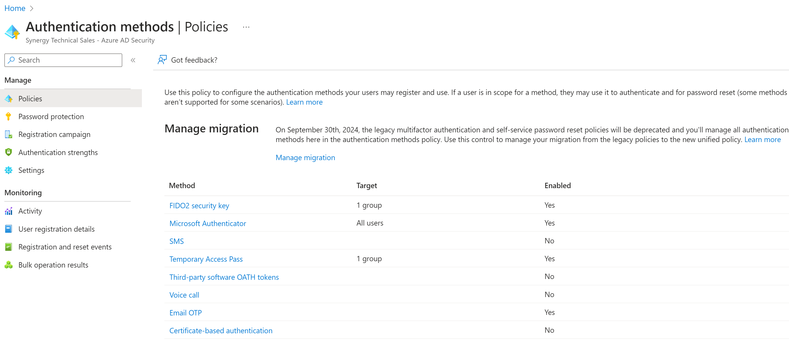
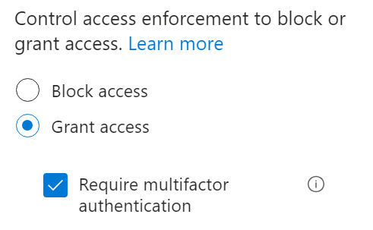
Authentication Methods in Azure AD
Notes:
While the right solution may not exist globally, we’ve had the ability for some time to define and assign various passwordless authentication methods from within Azure AD, but that was kind of it. This list originally had only 2 or 3 options, and it’s grown steadily. You can assign your favorite methods to all users, a subset of groups, and you could allow overlaps such that all users could do both a FIDO2 key and use SMS, but there weren’t really any controls around *how* to enforce one or the other. [click] Conditional Access policies allowed you to grant access and require MFA, but that was it.
So that’s where we were in February. We had burnt out users, the ability to assign authentication methods, and a little-understood new capability around “authentication contexts” that will come back to bite us later.

Slide 20
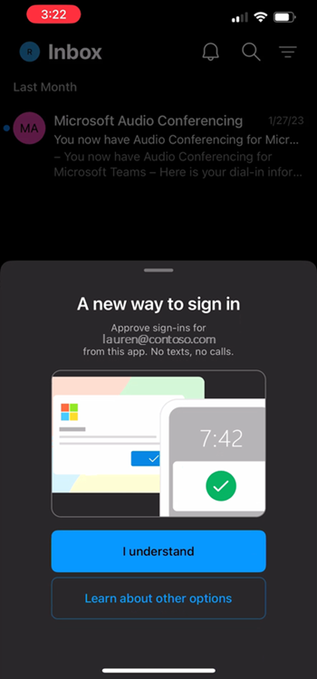
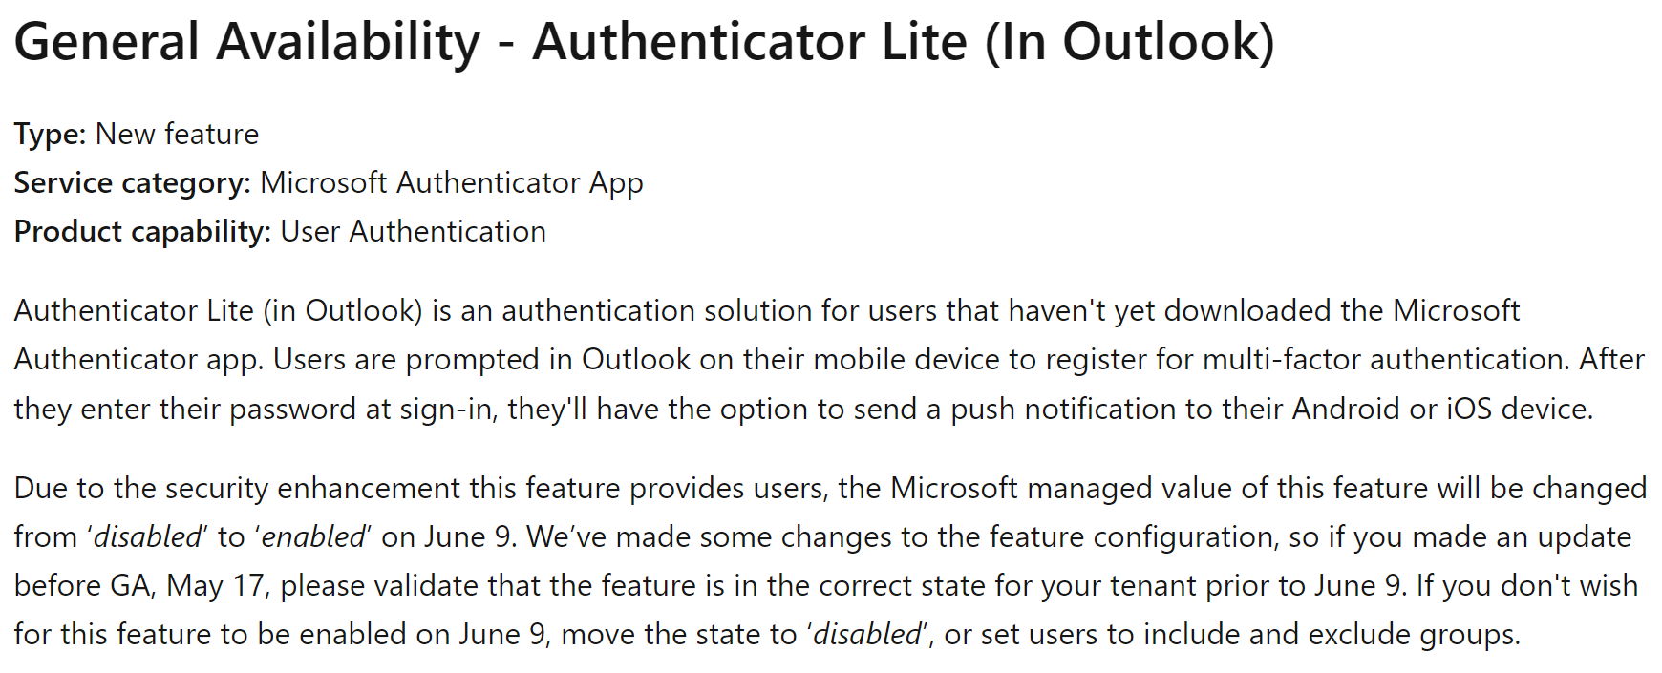
Authenticator Lite is GA
Notes:
But a few things have changed—and some rather significantly—since I submitted my talk.
The first was Microsoft’s Authenticator Lite, and this was the first play directly at the “you’re not putting anything on MY phone” user. After years of trying to get people to use Microsoft Authenticator to protect personal apps and accounts while also trying to shake the long-standing “big brother” image, Microsoft introduced an in-line—or rather in-app—solution for users who may have already installed Outlook Mobile on their devices. This new app feature allows users to still say “no more apps!” but deliver the same authentication experience as those using the full Authenticator app. It’s also a solid play for frontline workers who only periodic access to email, and while it was announced in March, it became generally available in May and was transitioned to ‘default: on’ just last week.

Slide 21
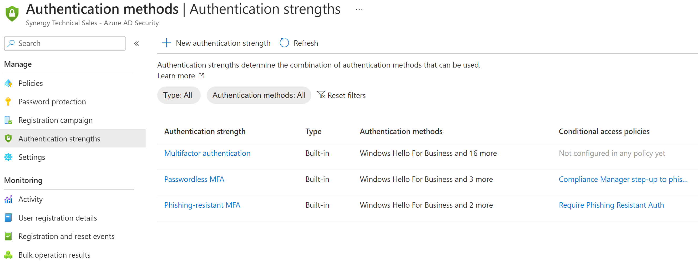
Authentication Strengths in Azure AD
Notes:
Then, introduced in the shortest preview window I think I’ve ever seen, Authentication Strengths in Azure AD allow you to leverage pre-canned classifications of multifactor authentication strengths and see if you’re using them in Conditional Access policies.
This became generally available on June 1, and it allows you to also create up to 15 custom authentication strengths to meet the needs of both your workloads and your workforce.

Slide 22
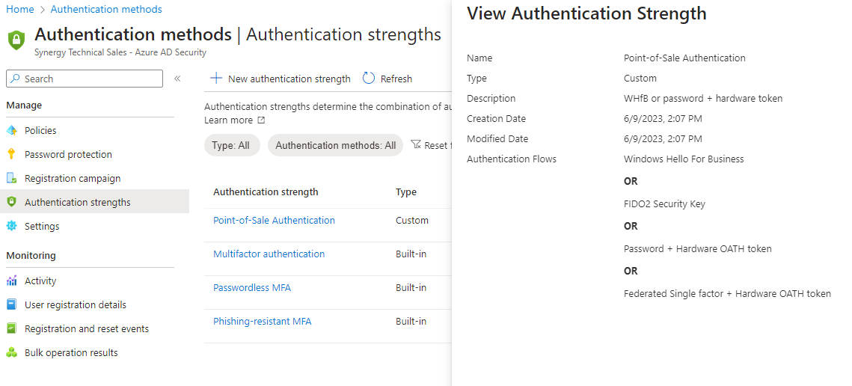
Custom Authentication Strength
Authentication Strengths in Azure AD
Notes:
Creating them is super straight-forward and allows you to pick from that great big long list of 18 different authentication mechanisms, irrespective of their relative strengths, and bundle them together as a single unit, which you can then target directly with conditional access policies.

Slide 23
Auth Method | Single-Factor | Multi-Factor | Passwordless MFA | Phish-resistant MFA
Windows Hello for Business |  | ⬤ | ⬤ | ⬤
FIDO2 Security Key |  | ⬤ | ⬤ | ⬤
Certificate-based authentication (MFA) |  | ⬤ | ⬤ | ⬤
Microsoft Authenticator (Phone Sign-in) |  | ⬤ | ⬤
Temporary Access Pass (1-time & multi-use) |  | ⬤
Password +
Authenticator (Push Notification) |  | ⬤
OATH token |  | ⬤
SMS |  | ⬤
Voice |  | ⬤
Federated Multifactor |  | ⬤
Federated Single factor +
Authenticator (Push Notification) |  | ⬤
OATH token |  | ⬤
SMS |  | ⬤
Voice |  | ⬤
Certificate-based authentication (single factor) | ⬤
SMS | ⬤
Password | ⬤
Federated Single factor | ⬤
Notes:
As a reminder, that means you can put single-factor SMS and “Password + SMS” and something exotic like a FIDO2 security key with a custom approved-cert list into a single authentication strength. You probably shouldn’t do that, but you can.

Slide 24
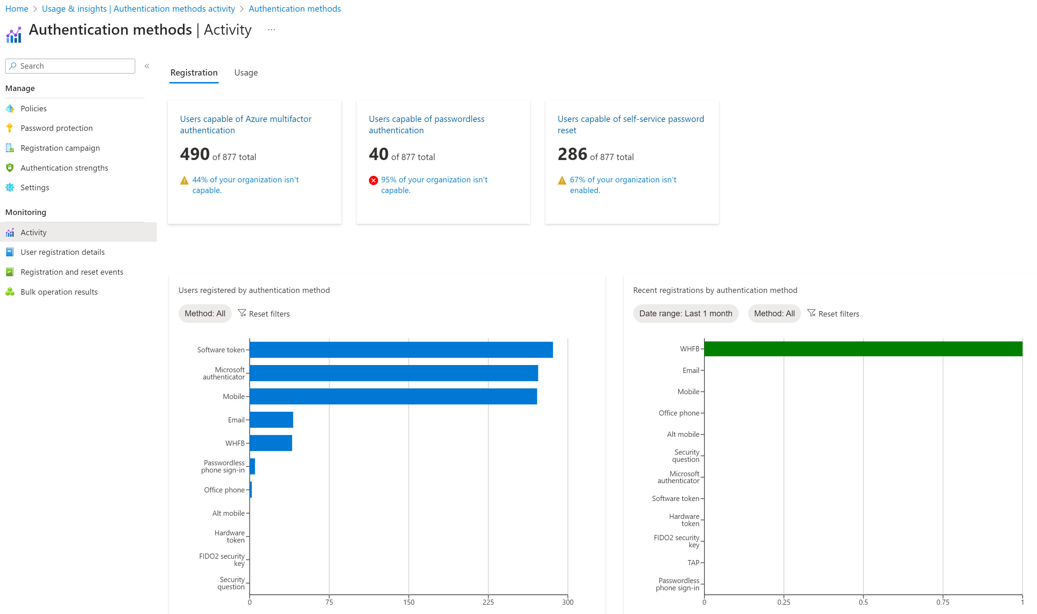
Azure AD Usage & Insights
Notes:
You can also now track authentication activity by methods and see both usage and registration details, including getting specific lists of users who can’t use any of the cool new toys.

Slide 25
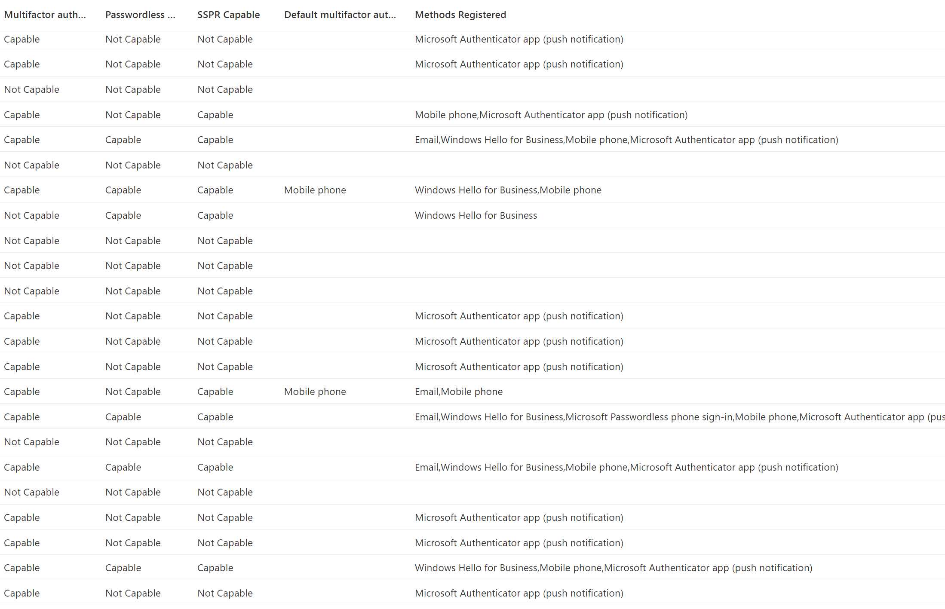
Azure AD User Registration Details
Notes:
This information is incredibly powerful, but interestingly can’t be used to populate membership in a dynamic user group.

Slide 26
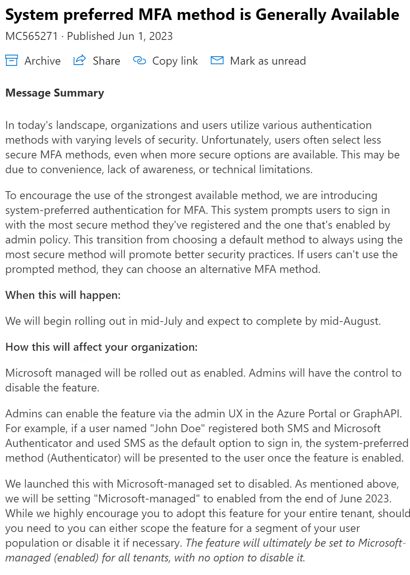
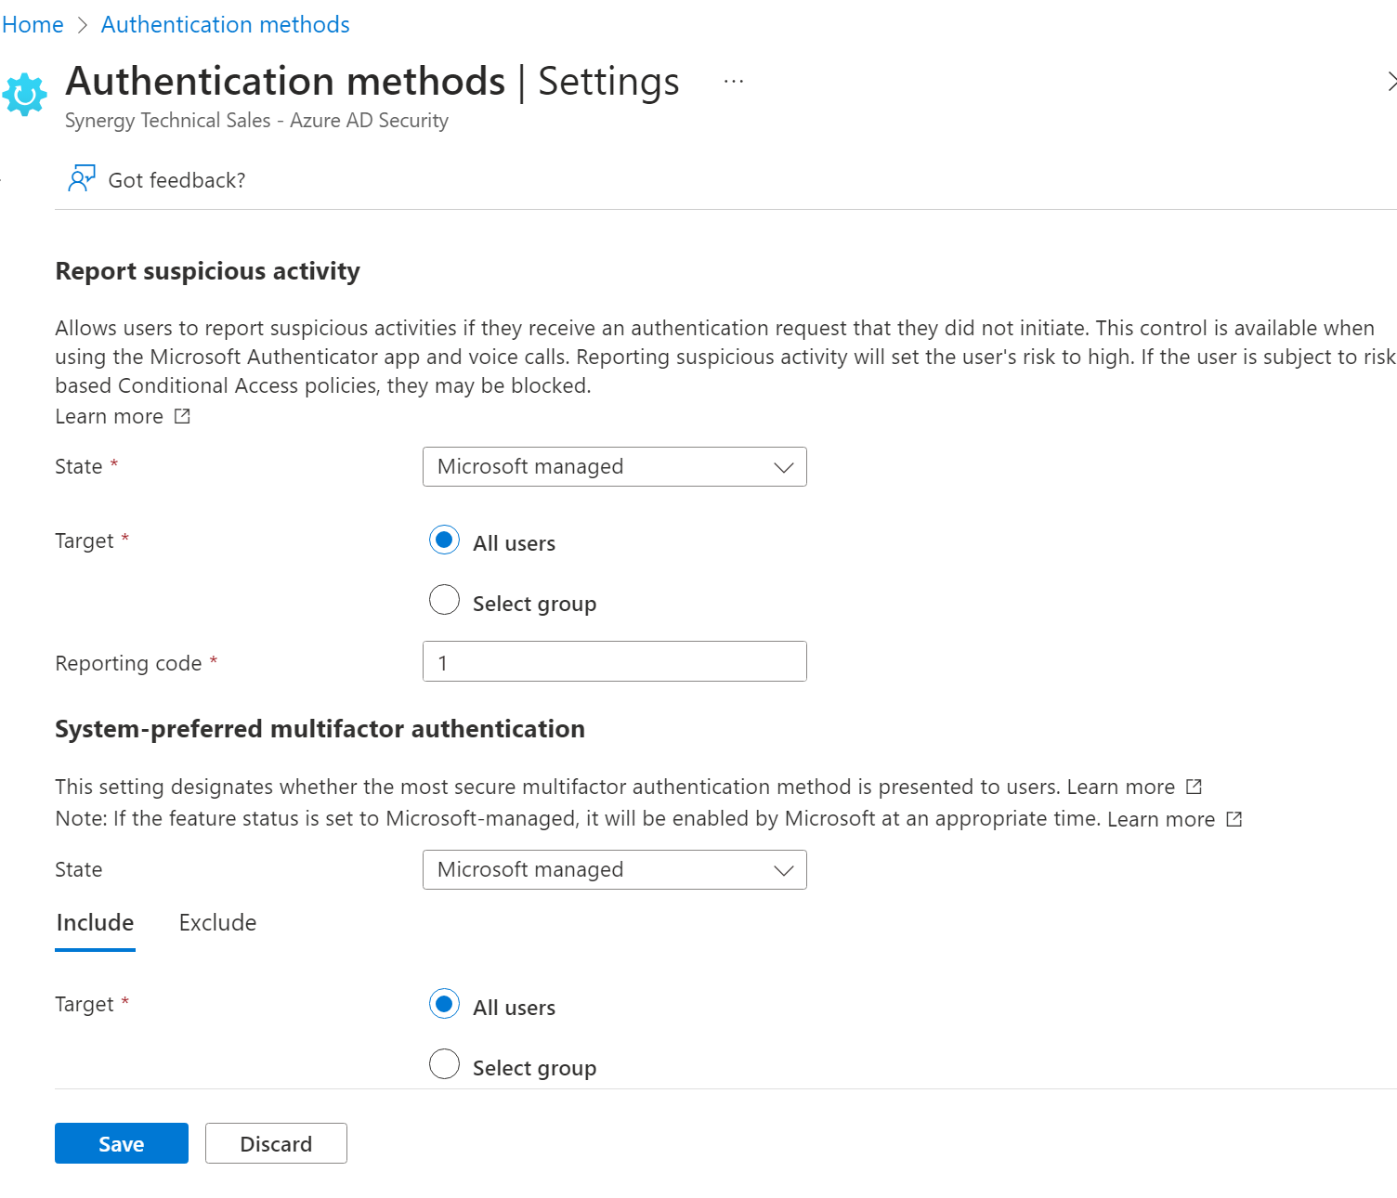
System-preferred MFA
Notes:
And at the same time, system-preferred MFA also came out of preview! [click]
This control is going to be imposed default-on by the end of this month, with Microsoft removing the ability to control the setting by mid-August. That’s probably the most aggressive change I’ve seen them make around identity & access, but it has the potential to resolve some of the analysis paralysis naturally, and it turns identity protection into a core service as fundamental as hosted email.

Slide 27
Microsoft made Passwordless free for all enterprise customers with Authenticator (& Lite)
 | Azure AD Free | Azure AD Basic (Office 365) | Azure AD Premium
Mobile app as a second factor | ⬤ | ⬤ | ⬤
SMS as a second factor | ○ | ⬤ | ⬤
Admin control over verification methods | ○ | ⬤ | ⬤
Remember MFA for trusted devices | ○ | ⬤ | ⬤
Phone call as a second factor |  | ⬤ | ⬤
Fraud alert |  |  | ⬤
Trusted IPs |  |  | ⬤
MFA for on-premises applications |  |  | ⬤
Conditional access |  |  | ⬤
Risk-based conditional access |  |  | ◐
⬤ - Available for all users
○ - Available for Global Admins only
◐ - P2 offering
Notes:
But that’s not all, because enabling that feature would put every Azure AD Free customer on the planet into immediate licensing violation, so [click] they also removed the restriction for only global admins to use the mobile Authenticator app for free. Now, as in now-now, all users can use the Authenticator and Authenticator Lite experiences for free.

Slide 28
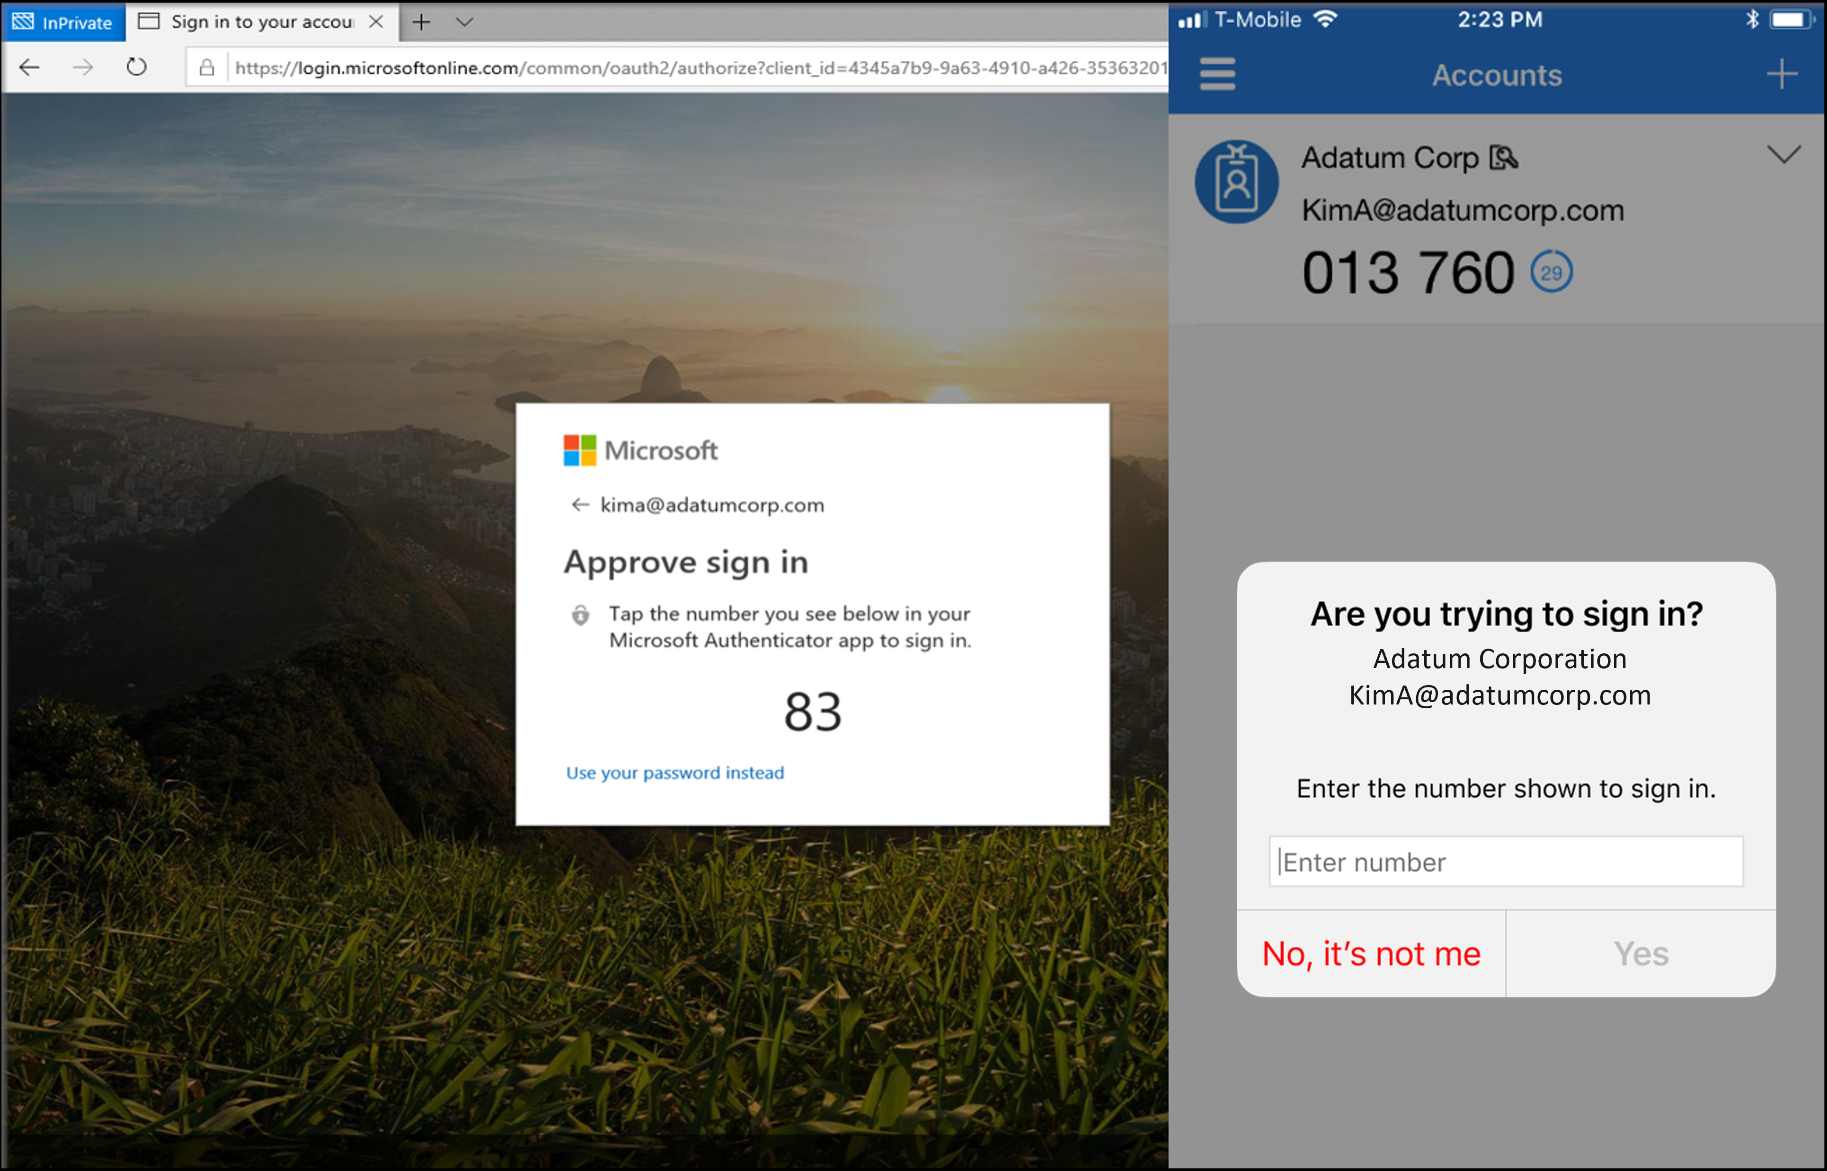
Number Matching in Azure AD MFA
Beginning May 8, 2023, number matching is enabled for all Authenticator push notifications. As relevant services deploy, users worldwide who are enabled for Authenticator push notifications will begin to see number matching in their approval requests. Users can be enabled for Authenticator push notifications either in the Authentication methods policy or the legacy multifactor authentication policy if Notifications through mobile app is enabled.
Notes:
And they changed push notifications to number-matching on May 8 to reduce the likelihood of users falling victim to push-fatigue.
So now, with manageable authentication strengths, free passwordless number-matching baked into the Outlook app, and Microsoft managing the levers of what’s today’s preferred MFA mechanism, we can enact actual controls to protect corporate workloads from MFA-resistant users.

Slide 29
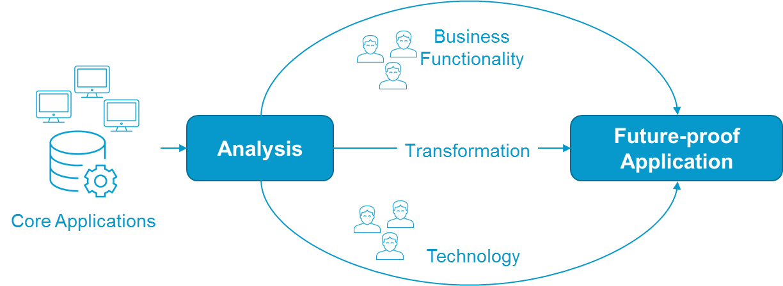
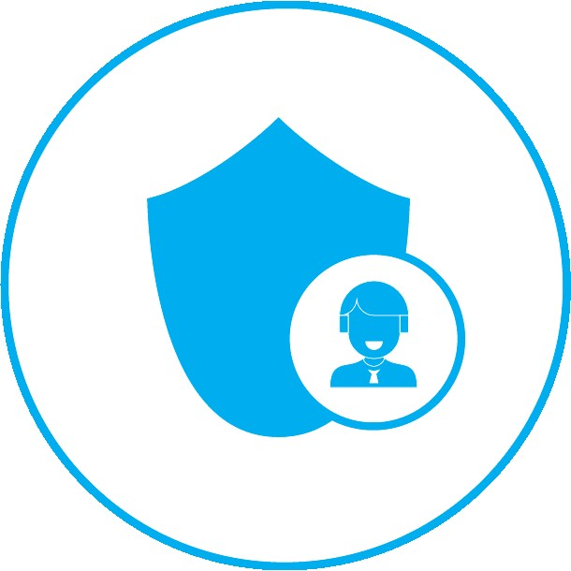

Identify MFA-resistant users
Limit Access with Conditional Access Policies
x
x
Identify their current auth capabilities
Identify the apps they need to work
Isolate access to reduce risk
Notes:
To do that, we’re going to need to identify them and group them logically. As mentioned, the current capability is to report on them, not add them to a group, so there’s still some automation work to be done.
That grouping, in my belief, should identify whether they’re technology-resistant or simply do not possess the requisite hardware, because the approach to addressing those is fundamentally different.
IT will need to conduct routine assessments of the systems those users need to access, and what level of access is appropriate for the authentication levels they can meet
And IT will have to very carefully balance the risk of any access against any risk of the blast radius of a lower-tier authentication mechanism.

Slide 30
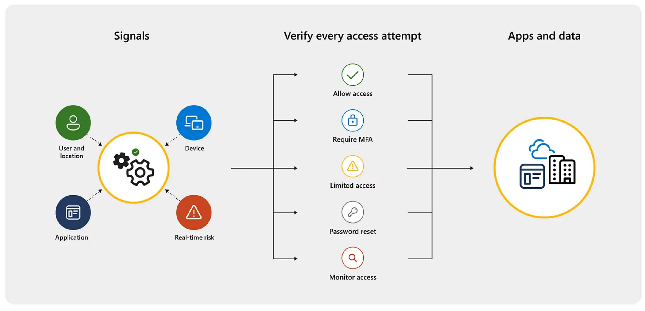
Workloads have different needs
Back-end/IP should have highest protections
Front-end may require proof of location (phone call to desk phone)
Bypass MFA from trusted locations
Evaluate other signals for conditional access controls
Notes:
The good news is that those requirements dovetail nicely with what’s possible in Azure AD Conditional Access policies today.
We’re already accustomed to creating policies based on access from trusted locations and managed devices, and while there are licensing implications to it, we can always lean on user-risk to monitor for exposed credentials.
We’ve even actually seen where a call to a physical phone was used to ensure users were onsite during business hours. A bank wanted to ensure tellers weren’t able to check email after hours and claim overtime for it, so they imposed a call to a desk phone that couldn’t be satisfied from outside the building. There are different ways to solve the MFA requirement.

Slide 31
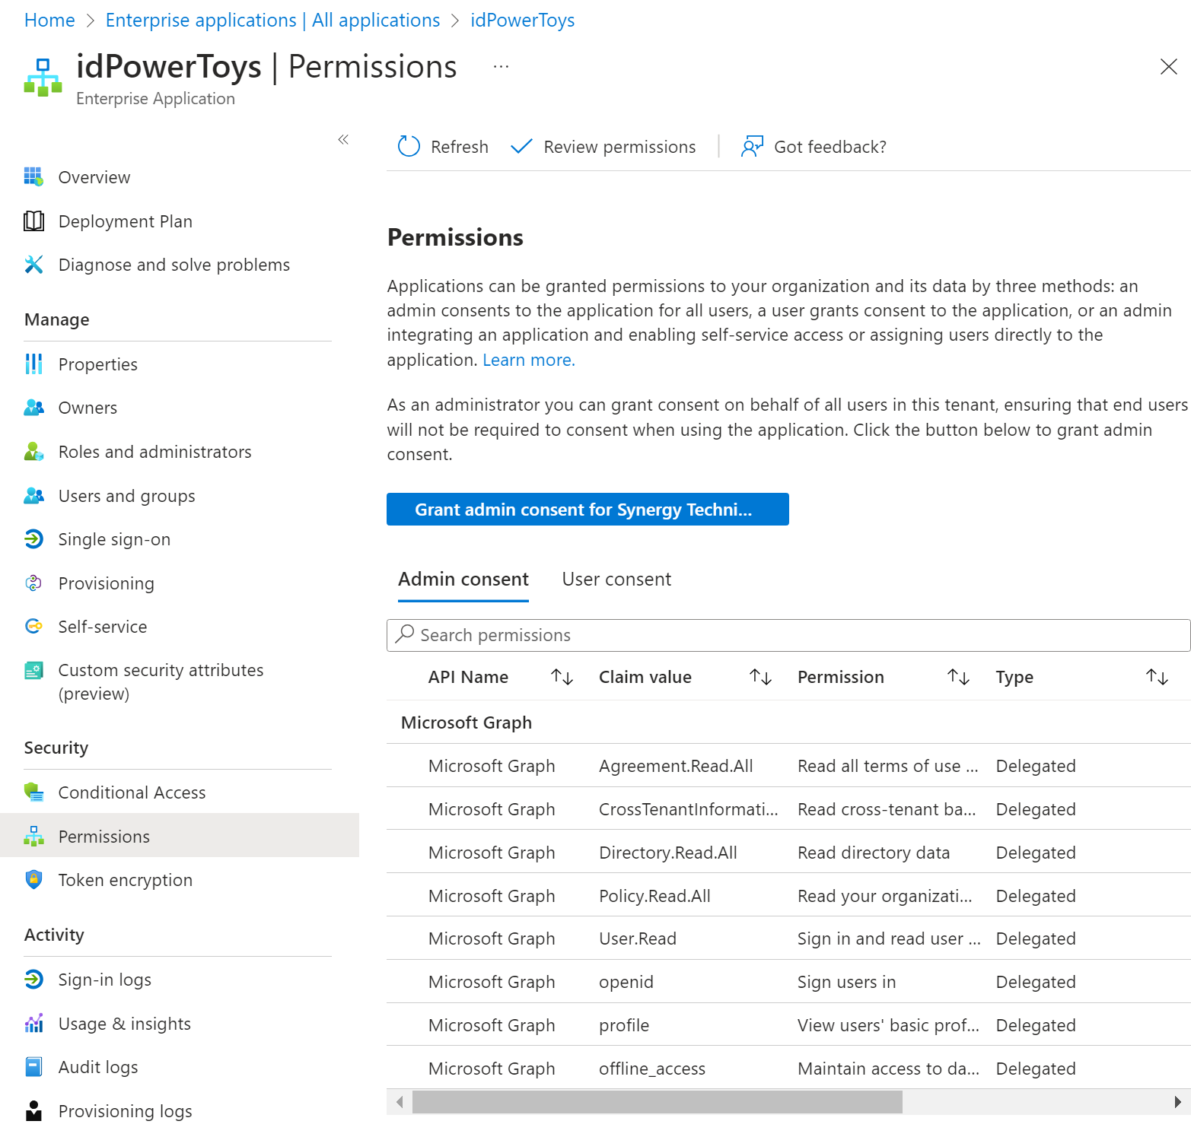
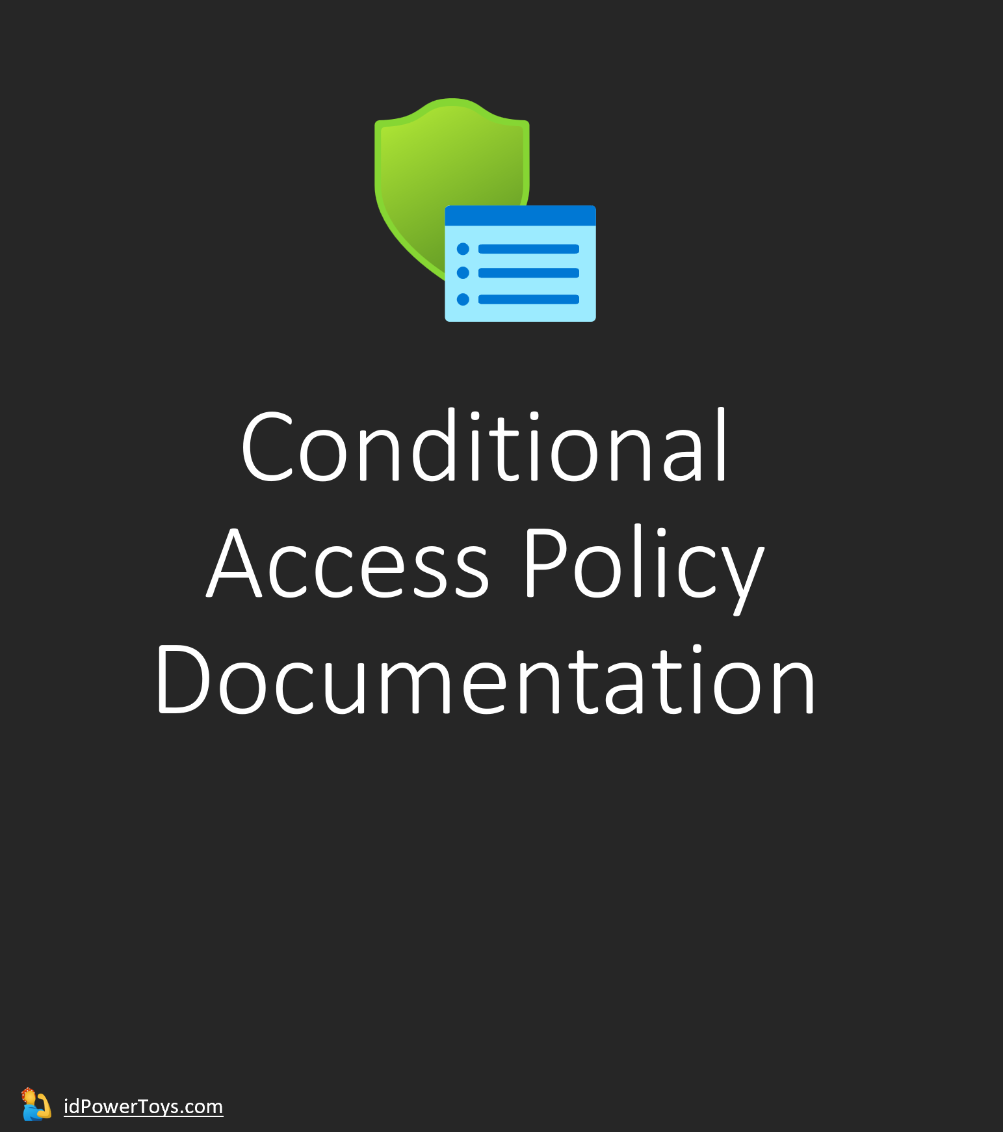
Notes:
And what that’s going to look like in practice is more Conditional Access policies. For these views I’m using exports from ID Power Toys, a side-project of a Microsoft identity project manager. You can add it as an enterprise app in Azure AD and generate reports that make Microsoft CA policies much more readable.

Slide 32

























Frontline Access - MFA Positive
Policy Enabled
Risk
Device platforms
Client apps
Filter for devices
Locations
Not configured
Not configured
Not configured
Not configured
Not configured
Conditions
Users
Grant access
Selected cloud apps
Grant Controls
Session Controls
✅ Include:
Users
- All
🚫 Exclude:
Groups
- MFA Hesitant Users (5)
Multifactor authentication
✅ Include:
- ClipTraining
- Netsuite
- SAP HANA
App enforced restrictions
Auth strength:Phishing-resistant MFA
Conditional Access App Control
App Control Policy
Compliant device
Sign-in frequency
Hybrid Azure AD joined device
Periodic reauthentication
Approved client app
Persistent browser session
Always persistent
App protection policy
Continuous access evaluation
Strictly enforce location policies
Change password
Disable resilience defaults
Custom authentication factor
Token protection for session
Terms of use
Notes:
In this first case, I’m creating an end-goal state for authentication into my core frontline apps, which include a training app, NetSuite, and SAP HANA. These are all just examples.
My policy grants access for all users except the “MFA Hesitant Users” group, which you can see currently has 5 users, so long as they meet the pre-canned “Phishing-resistant MFA” authentication strength.
It’s a great start, but now I need to create its inverse.

Slide 33
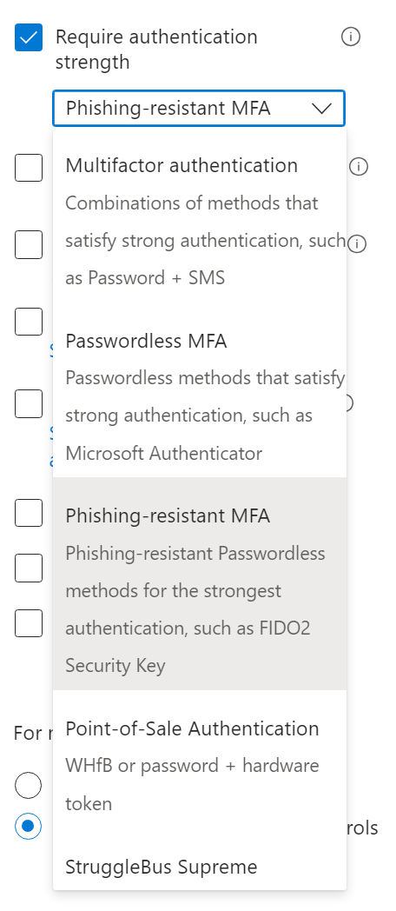
Frontline Access - MFA Hesitant
Policy Enabled
Risk
Device platforms
Client apps
Filter for devices
Locations
Not configured
Not configured
Not configured
Include when
device.trustType -eq "AzureAD"
✅ Include
- Richmond Office (HQ)
- Raleigh Office
Conditions
Users
Grant access
Selected cloud apps
Grant Controls
Session Controls
✅ Include:
Groups
- MFA Hesitant Users (5)
Multifactor authentication
✅ Include:
- ClipTraining
- Netsuite
- SAP HANA
App enforced restrictions
Auth strength:Point-of-Sale Authentication
Conditional Access App Control
App Control Policy
Compliant device
Sign-in frequency
Hybrid Azure AD joined device
Periodic reauthentication
Approved client app
Persistent browser session
Always persistent
App protection policy
Continuous access evaluation
Strictly enforce location policies
Change password
Disable resilience defaults
Custom authentication factor
Token protection for session
Terms of use
Notes:
This policy, also enabled, captures ONLY the 5 MFA Hesitant Users, targets the same apps, and forces them to use the “Point-of-Sale Authentication” strength. More on that in a moment, but in this case, these users are only able to leverage this auth strength if they are also in the Richmond or Raleigh physical locations AND are using an Azure AD-joined device.
[click] One thing to note about how authentication strengths are woven into CA policies is that they’re single-selection. You cannot choose POS and MFA. So this is still a little bit raw, because the goal is to move users out of this mechanism, and like I said there’s no evaluable attribute surfaced into a dynamic group membership rule that would cause a user to magically move out of the “MFA hesitant” group. And selecting just one option means that option currently has to cover EVERY possible authentication scenario for that user.

Slide 34
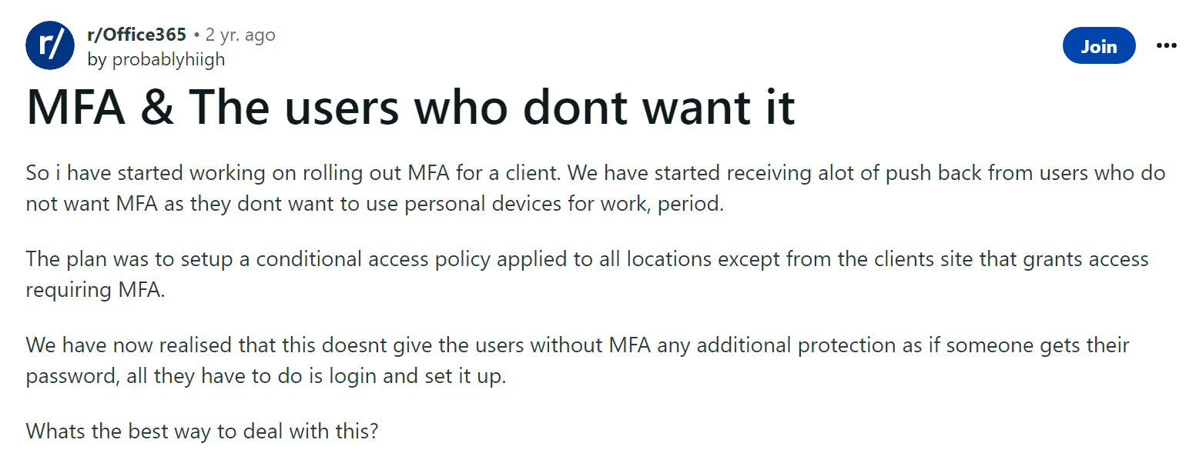
Notes:
So I want to be very clear here and say that this is a burden IT must bear. We know MFA is more secure than passwords, but we’re fighting 3000 years of culture with rules that change as quickly as fashion, and it makes us adversarial with the people we have to support. Remember that first of all, these are real people who are already burdened with doing the job they were hired to do. Some of them do not have the necessary hardware, some are not allowed access during working hours to that hardware, some are concerned about giving up personal freedoms to corporate oversight without compensation, and some have simply reached their elastic limits for accepting change, in much the same way that some people still ardently believe Pluto is a planet.
Matthew Inman, author and illustrator of The Oatmeal, wrote a spectacular comic about the “Backfire Effect” that details this. Things that feel like they are core to who we are, whom we perceive ourselves to be, or that tie us to places and times that we felt safe, take on an importance that, when challenged, are often rejected—even in the face of overwhelming evidence.

Slide 35
Overcoming resistance to change
1. Communication and education
People will only accept change if they believe the risk of doing nothing is higher than the risk of changing direction. Similarly, if people don’t understand why change is needed, they will question why you are changing something that they believe works well.
2. Participation
[…] when people aren’t consulted and change is forced upon them, there is likely to be more resistance.
A collaborative effort will engage people in the change, and in the identification of potential issues and solutions. People are far less likely to resist change that they have helped to create.
Another participative strategy is to employ socialization, putting people before practice
3. Support
Even if people appear to be accepting of change, it may be that they are simply resigned to it. They must be given the support needed to enable new skills to be developed and ensure that change burnout does not become a reality.
Support requires managers to develop their emotional intelligence and connect with their people.
4. Agreement
Resistance to change is also precipitated when people feel they will be negatively affected by its consequences.
To combat this type of resistance to change, an organization may consider offering incentives. Such incentives may include extra pay, improved benefits, or offering structured career plans. This strategy requires negotiation to reach agreement. The drawback is that such agreements can be expensive and do not guarantee engagement with change.
5. Co-opting
People become connected to the way that things have always been done.
One strategy is to co-opt those who may be most resistant to change into central roles in the implementation of change initiatives. This can gain the support of would-be resistors relatively cheaply, though it does come with a caveat – placing people who are deemed to be resistant to change in such positions could give them a position from which to influence greater resistance across a wider audience.
6. Coercion
Sometimes it is necessary to coerce people into accepting change. This is often the case where people feel they cannot learn the new skills needed or if they feel that change is a temporary fad that will be reversed.
Techniques for implementing change include wielding the threat of disciplinary action while insisting that people fall into line with required behaviors and actions.
A major drawback of this strategy is that it does not remove resistance to change, which may continue to bubble under the surface and result in a destructive atmosphere.
https://primeast.com/us/insights/leadership-development/7-strategies-for-overcoming-resistance-to-change-in-the-workplace
Notes:
So as we work in parallel to both provide secure access to critical business resources AND move users forward on a never-ending security journey, we need to ensure that our methods align with established practices for overcoming resistance to change.
We must meet users where they are. We have to first educate them that the risk of resisting MFA is high, own our confused and often contradictory messaging of the past 30 years, and get them on board with the idea that this will continue to change, in much the same way that tooling for their own jobs change over time. We find better ways, as do the bad guys.
We have to get users involved and not just ask, but actually listen and respond to their concerns about HOW we implement MFA. Are there socio-economic impositions we’re expecting users to shoulder on our behalf?
We have to support users and create agreement on ways forward. There may be some users who simply will not ever be reached, but there may be others who will be incentivized by the prospect of career paths that can only become possible with a secure authentication mechanism. “We’d love to give you more access and more responsibilities, but the challenges to protecting the data you’d be accessing are too great.”
And while there’s risk, finding reluctant users and making them champions is so rewarding on both a corporate and personal level, I’d highly encourage trying the co-opting route.
But while all of those strategies are great, all too often we hear management extol the virtues of communication & education, of support and agreement, but in practice the strategy goes straight to [click] coercion, which becomes immediately reflected in the attitudes of both IT support staff and the userbase.
And the insights in this blog post that I cherry-picked from primeast.com couldn’t be more spot-on: “where people feel they cannot learn the new skills needed or if they feel the change is a temporary fad that will be reversed.” Sounds familiar.

Slide 36
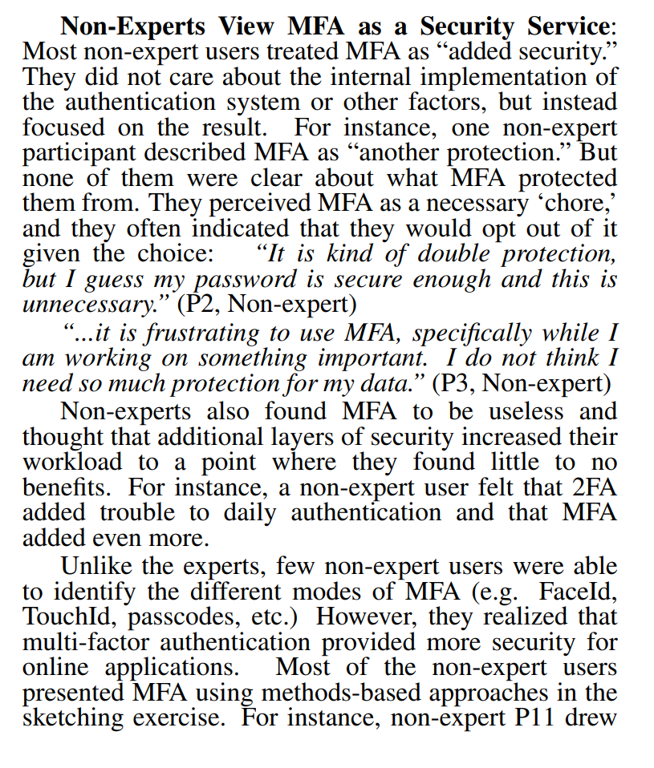
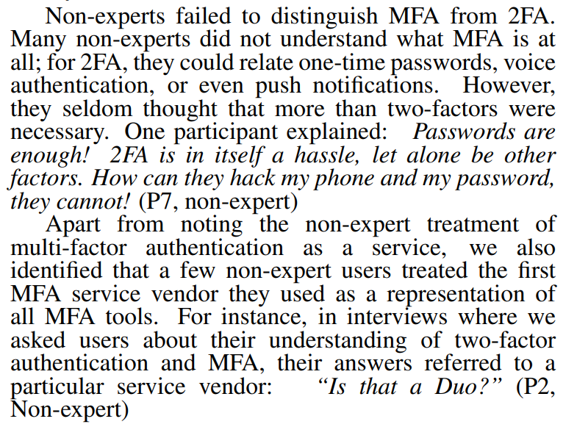
MFA is A Necessary Chore!: Exploring User Mental Models of Multi-Factor Authentication Technologies
https://scholarspace.manoa.hawaii.edu/items/cd1bd19d-89b3-470c-8062-8332412d8bdd
Notes:
The University of Hawaii at Manoa conducted a survey on this exact topic just a couple years ago. While they had a very small sample-size of less than 30 people
Respondents were broken into two categories: security experts and non-experts. Non-experts comprised something like 70% of the survey group, and had generally-negative attitudes around MFA, calling it a necessary chore, “specifically while […] working on something important. I do not think I need so much protection for my data.” And “my password is secure enough and this is unnecessary.”
However, when accessing online services and applications, the same users generally acknowledged that MFA provides more security, although they often didn’t fully understand what was being secured from what threats.
When it’s their own personal data, users are more likely to see the value in simply having additional protections. When it’s corporate data, they don’t see their own contribution as being as important. That’s a key to understanding how to improve users’ relationships with security integrations: they must feel that what they do is a vital contribution to the company.
Non-IT experts tend to conflate the experience of their first 2FA/MFA service with all MFA providers, so if their first experience is challenging, they are more likely to resist future implementations.

Slide 37
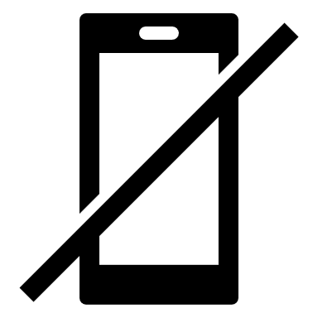

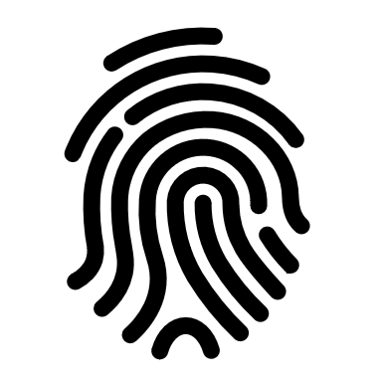
“Current MFA technology often comes with duplicated factors. Despite the fact that the factor of possession (phone) has already been verified when a user logs in to a site via their phone’s browser, MFA implementations send requests to the phone for confirmation.”
Additional recommendations to improve MFA User Experience
Users like the perceived simplicity of security keys
Users had a general distrust of biometrics
Notes:
What I to be the most interesting finding was the suggestion that current MFA technology is too dependent on the mobile device, often resulting in a self-confirming feedback loop. I have the phone in my hand, but to access this site I have to approve the authentication…with this same device? To the user, that’s a ham-fisted implementation, even if it makes total sense based on the technology. But there’s definitely room for usability improvements, and that goes back to communication, education, and support.
And we’re not stuck with phones-or-nothing. Hardware security-key vendors have plugged critical gaps in available technologies, such that FIDO2-compliant keys are cheap, readily available for a wide range of platforms, and easy to replace if lost.
And I’ll leave you with one final anecdote about biometrics. So users generally indicated a relative distrust of biometrics, and from what I’ve heard when talking about biometrics, it makes sense: people are afraid their faces, fingerprints, and irises are being captured and written to the cloud in much the same way as PINs in the early CAC Card implementations. They’re not, and we know they’re not, but there are differences in the quality of a given biometric. Google’s Android SDK’s give depth to classifying different biometrics based on their relative strengths, and we know that some weaker implementations have been fooled by simple printed pictures. But not to be deterred, researchers have continued the quest for the perfect biometric, which would have to meet the following requirements: it would have to be unique, it would have to be generally kept out of sight, but displayable on command, and crucially it would have to not violate any laws to display it on demand. While I haven’t seen any production implementations…yet…there’s only one body part that’s been floated to meet these requirements. I won’t ask for guesses from the crowd: it’s your tongueprint.
Researchers have legitimately tested the global uniqueness of a tongueprint, finding it roughly equivalent to irises and fingerprints. Critically your tongue, even when you speak, isn’t generally visible, so it’s hard to duplicate.
Now nobody is suggesting you walk up to a door and lick it to gain access, but with advances in AI, deepfakes, voice-copying (now an iPhone feature!) and the ability to “lift” and synthesize a fingerprint, I wouldn’t be surprised to see hard-rolling IT dudes sticking their tongues out like grade-schoolers to get in to the datacenter.

Slide 38
Notes:
And with that I’m happy to open it up to any questions. I hope you enjoyed it, and I hope you have a great rest of your day and event!
Thanks so much!

