Slide 1
Attacking & Defending ServiceNow
A Hands-on Lab for Red & Blue Teams

Slide 2
whoamwe
popovich
bailey
US Army Veteran - Signal Corps
Founder and Principal Hacker at Rotas Security – rotassecurity.com
Former Practice Director for Large Consultancy’s Attack & Pen team
Also spent time as a senior operator for a fortune 500’s Red Team
Career IT who jumped to security
Spent most of his time as a senior operator for various financial firms Red Team
Gets a kick out of building massive labs
Unapologetic Taylor Swift Fan

Slide 3
REFERENCED WORK
We Stand on the Shoulders of Giants

Slide 4
REFERENCES
MDSec
https://www.mdsec.co.uk/2025/03/red-teaming-with-servicenow/
The Streets
Did this live for first time in 2021, (felt cool).

Slide 5


Slide 6
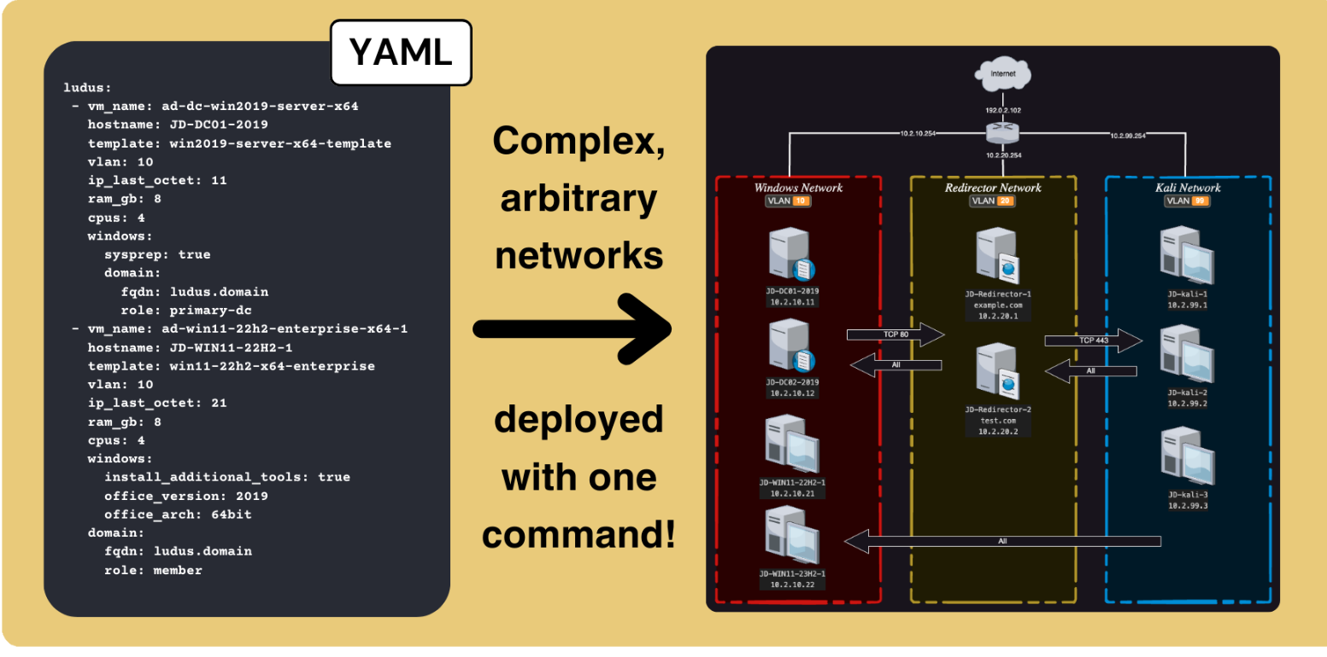

Slide 7
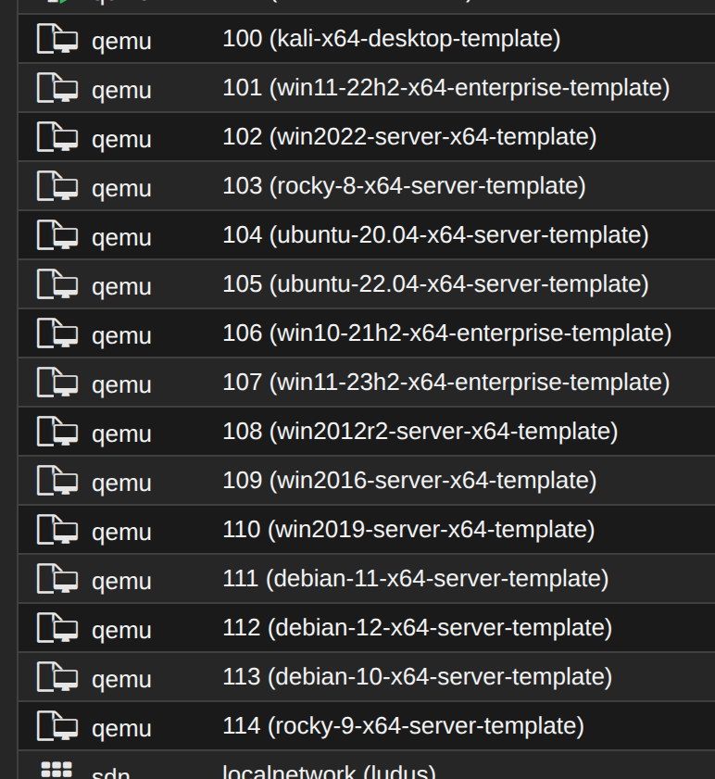

Slide 8
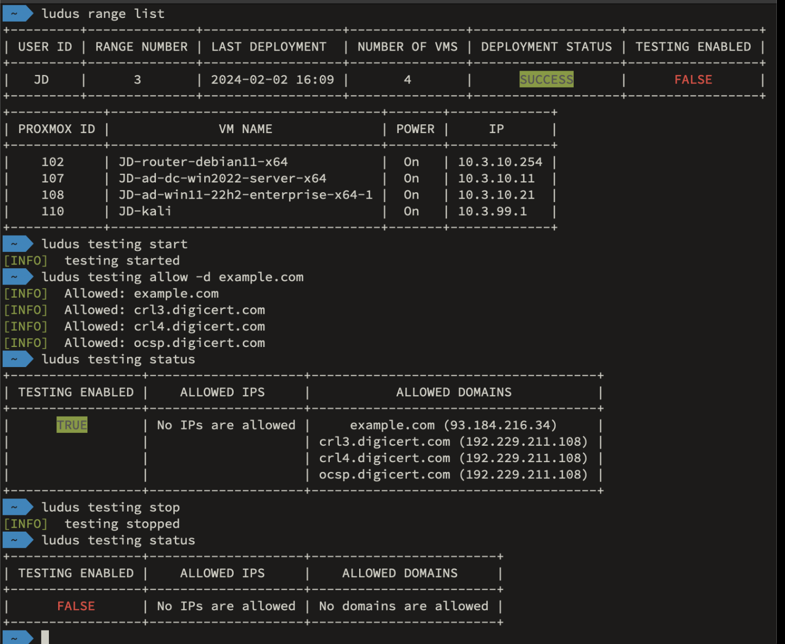

Slide 9
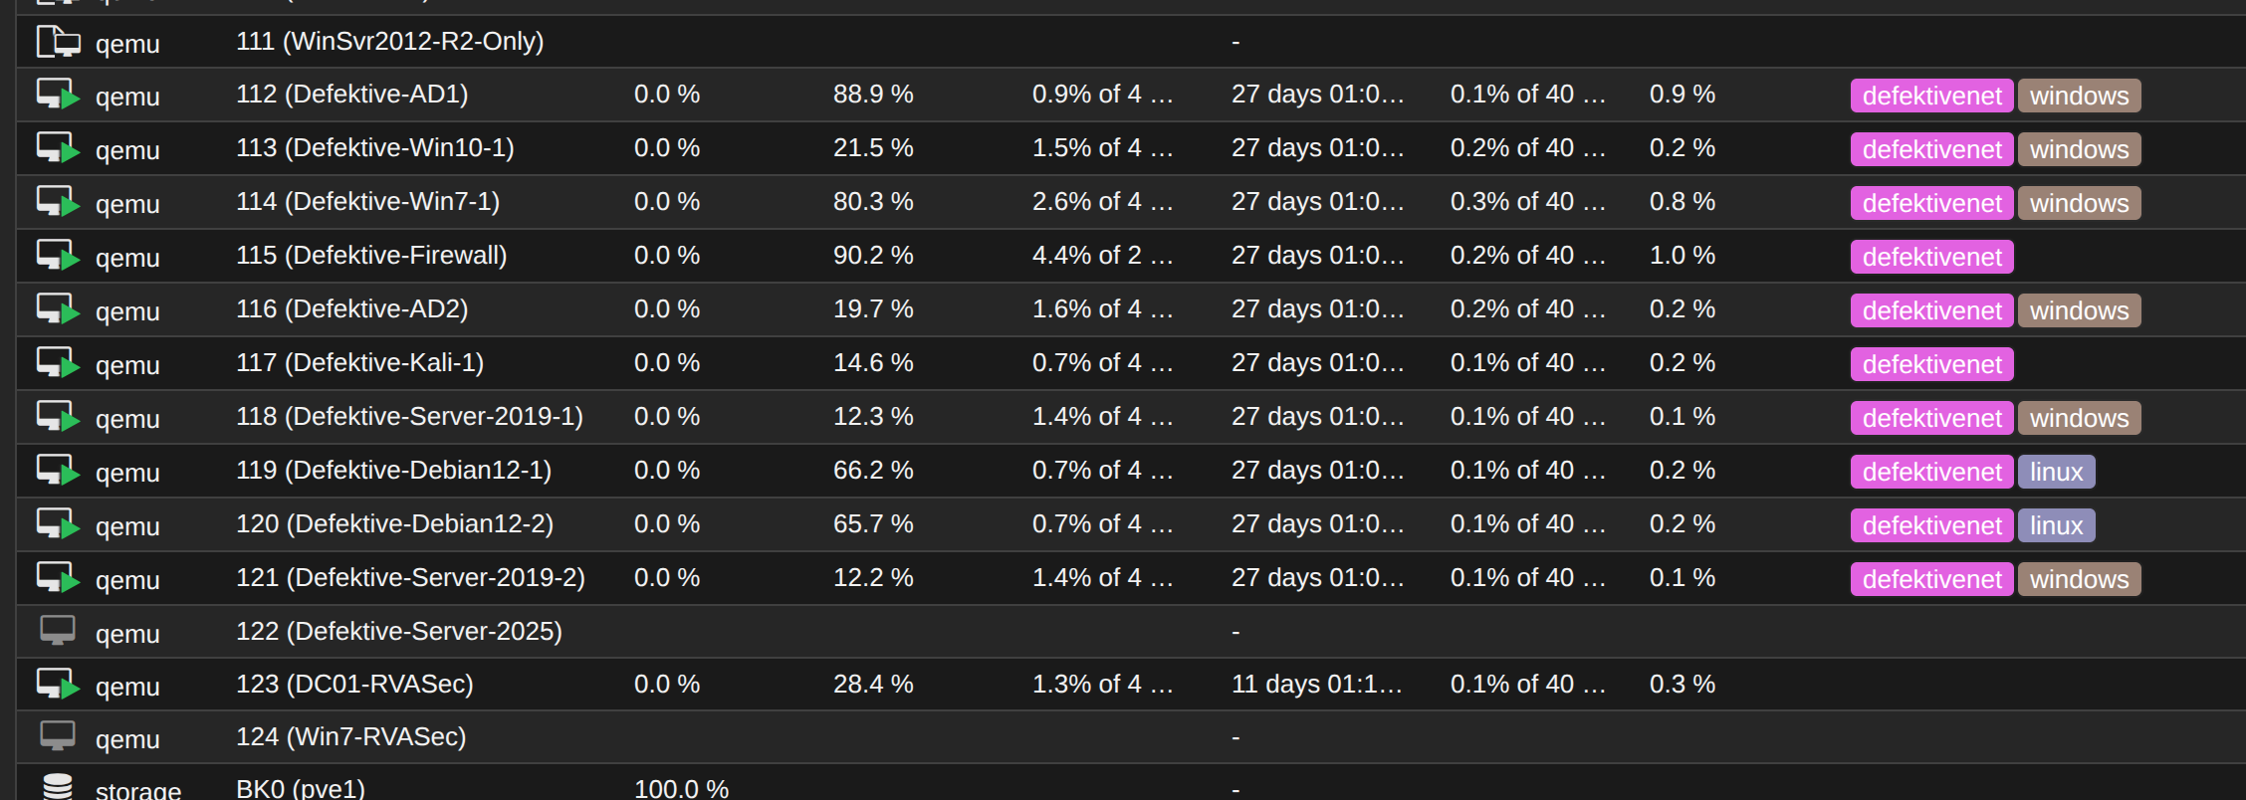

Slide 10
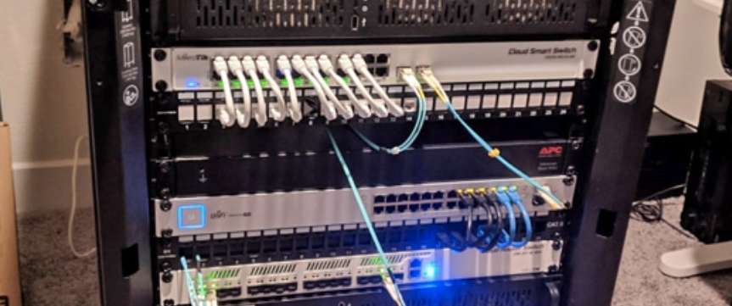

Slide 11
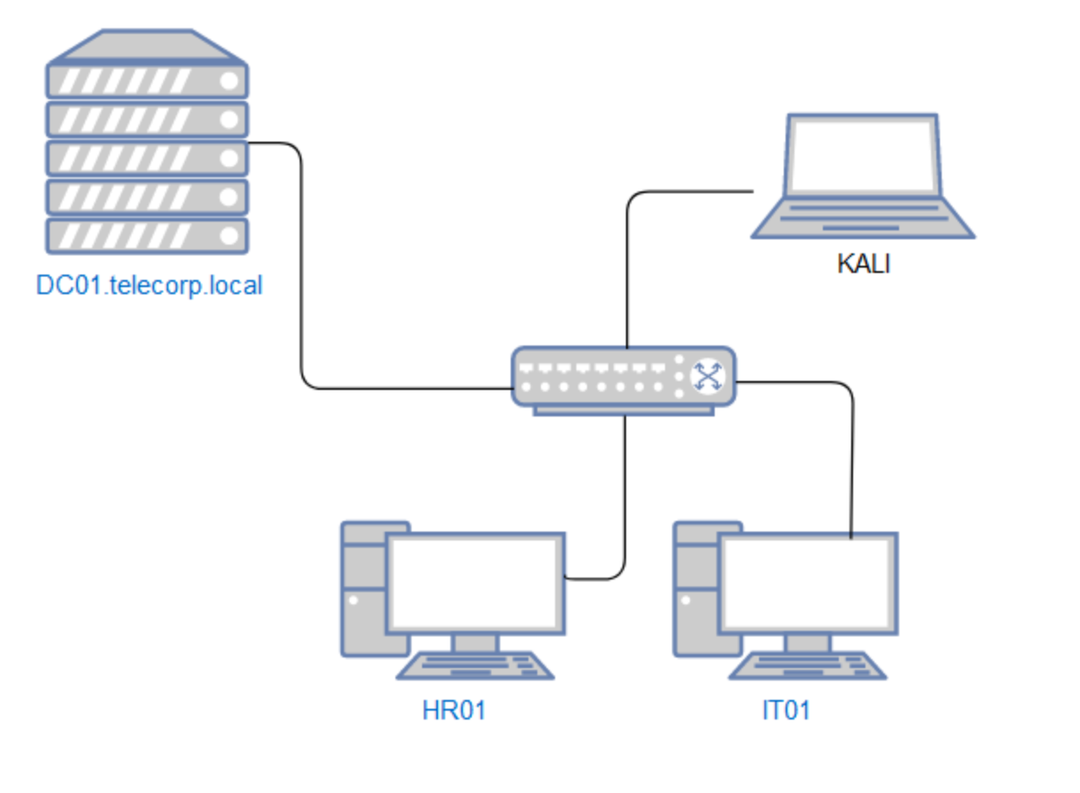

Slide 12
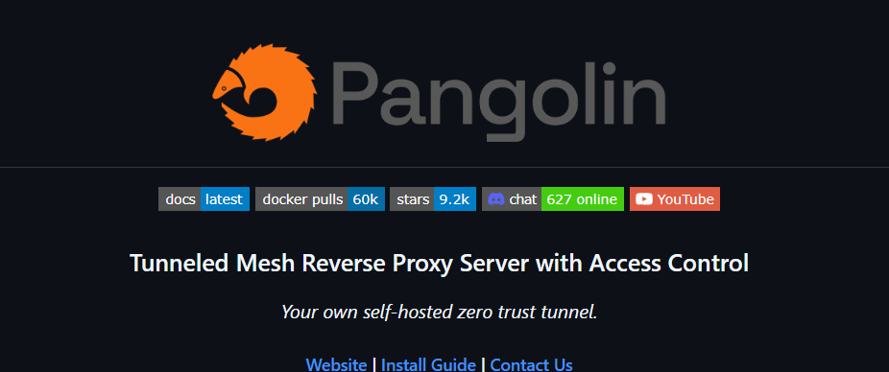

Slide 13
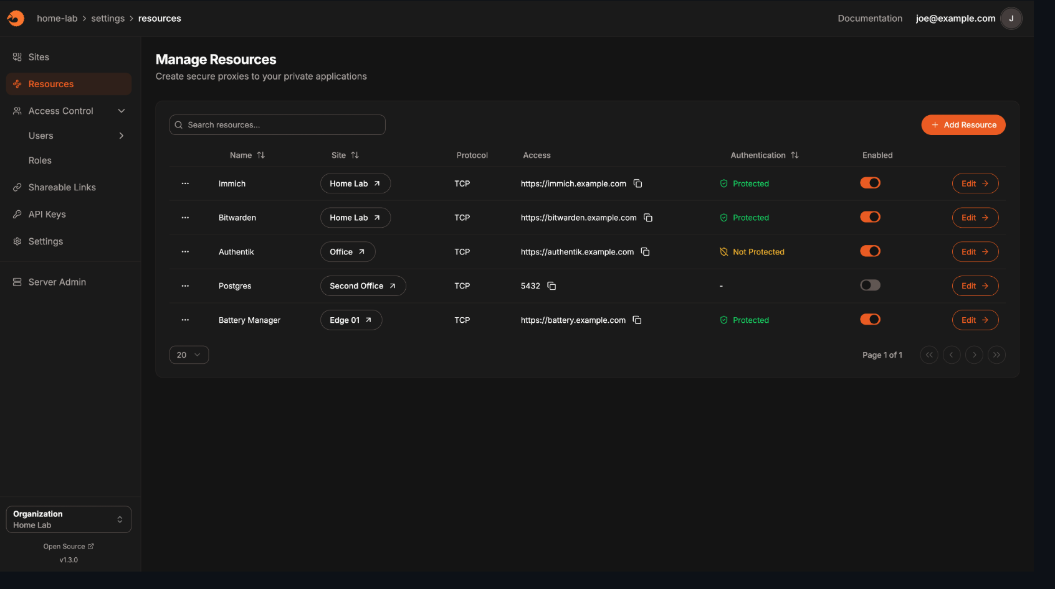

Slide 14
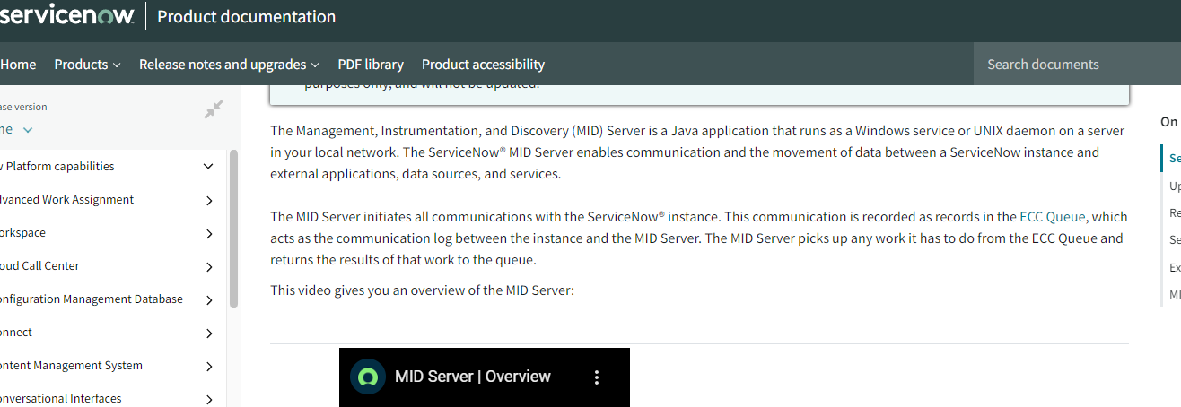
PRACTICAL EXAMPLE – ServiceNow

Slide 15
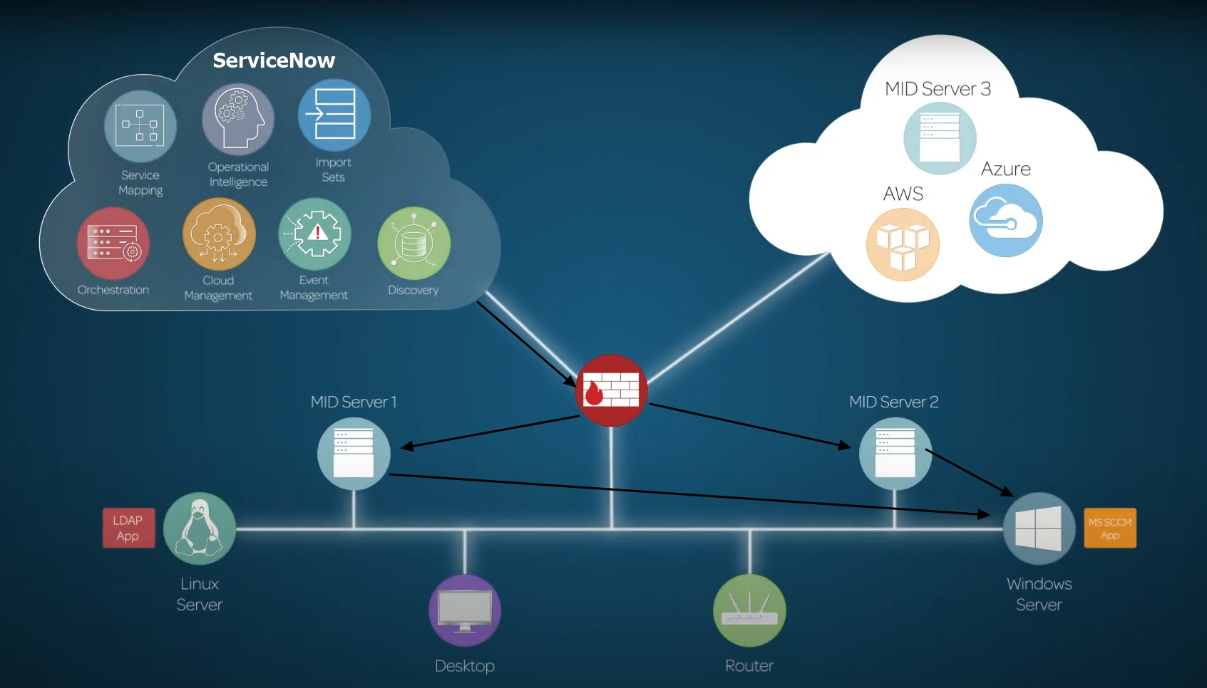
PRACTICAL EXAMPLE – ServiceNow

Slide 16
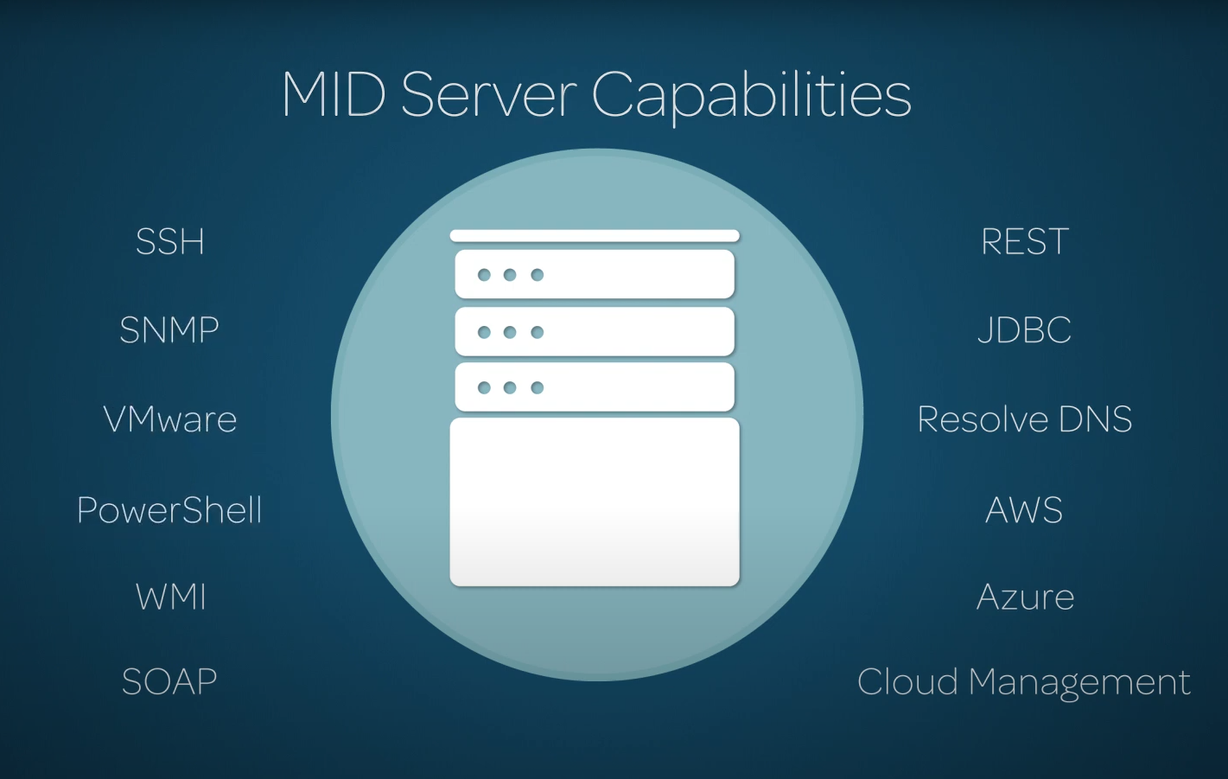
PRACTICAL EXAMPLE – ServiceNow

Slide 17
PRACTICAL EXAMPLE – ServiceNow
1. Create a PowerShell script that contained the PowerShell to be run. (POST /api/now/table/ecc_agent_script_file)
2. Create an ECC Queue task with ‘topic’ set to ‘Powershell’, ‘agent’ set to the name of the MID Server, ‘Source’ set to ‘127.0.0.1’, and ‘payload’ referencing the previously created script file. (POST /api/now/table/ecc_queue)
3. Retrieve the results in the corresponding ECC input queue task. (GET /api/now/table/ecc_queue)
4. Delete the 2 ECC Queue tasks. (DELETE /api/now/table/ecc_queue/<ID>)
5. Delete the PowerShell script. (DELETE /api/now/table/ecc_agent_script_file/<ID>)

Slide 18
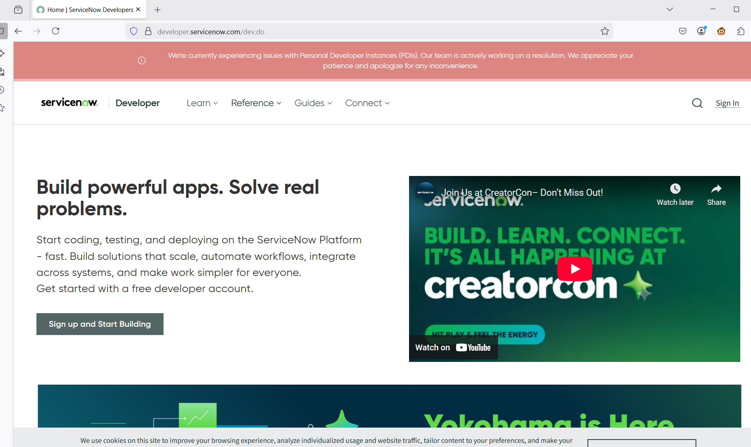

Slide 19
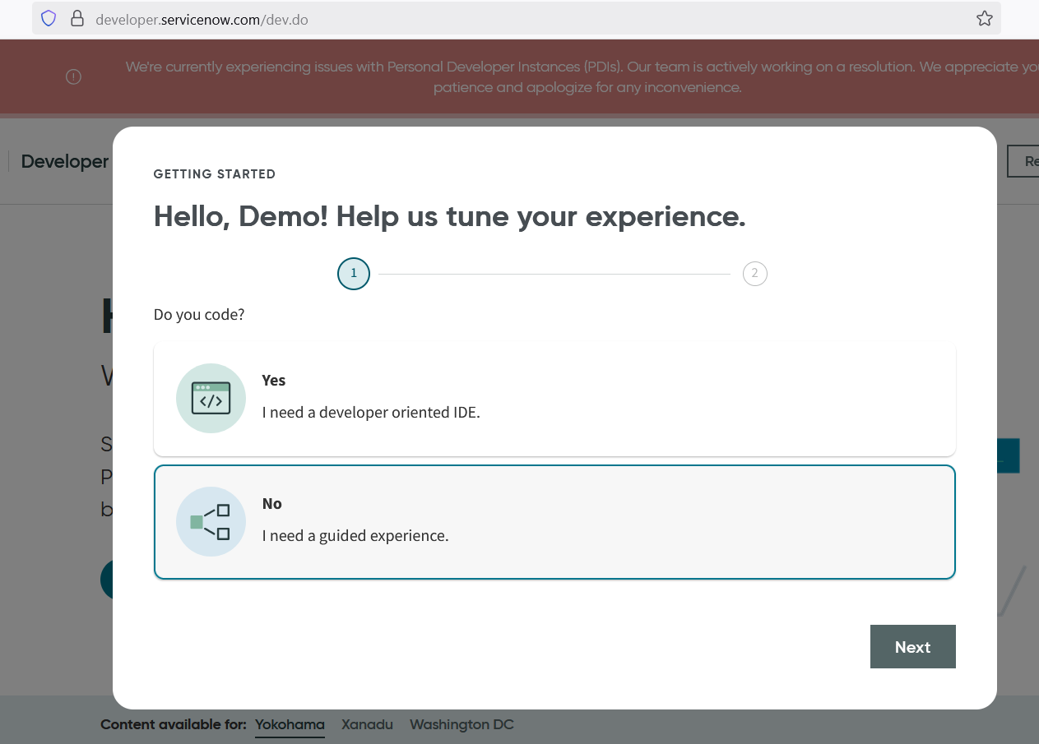

Slide 20
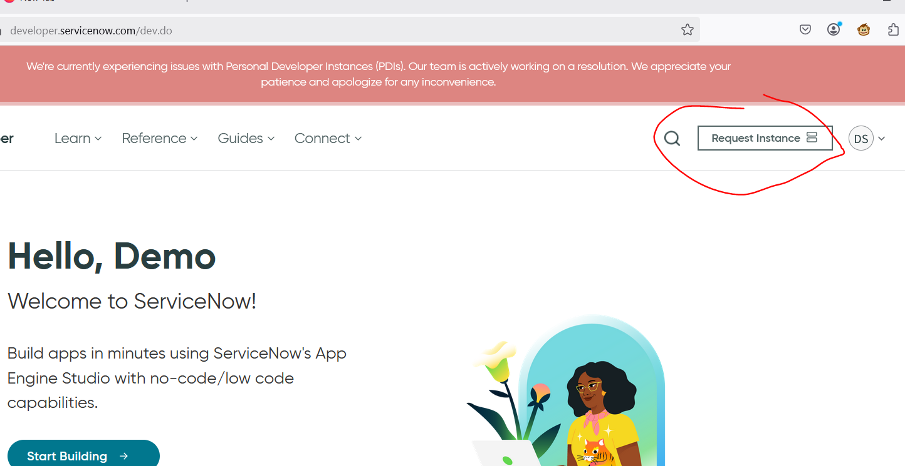

Slide 21
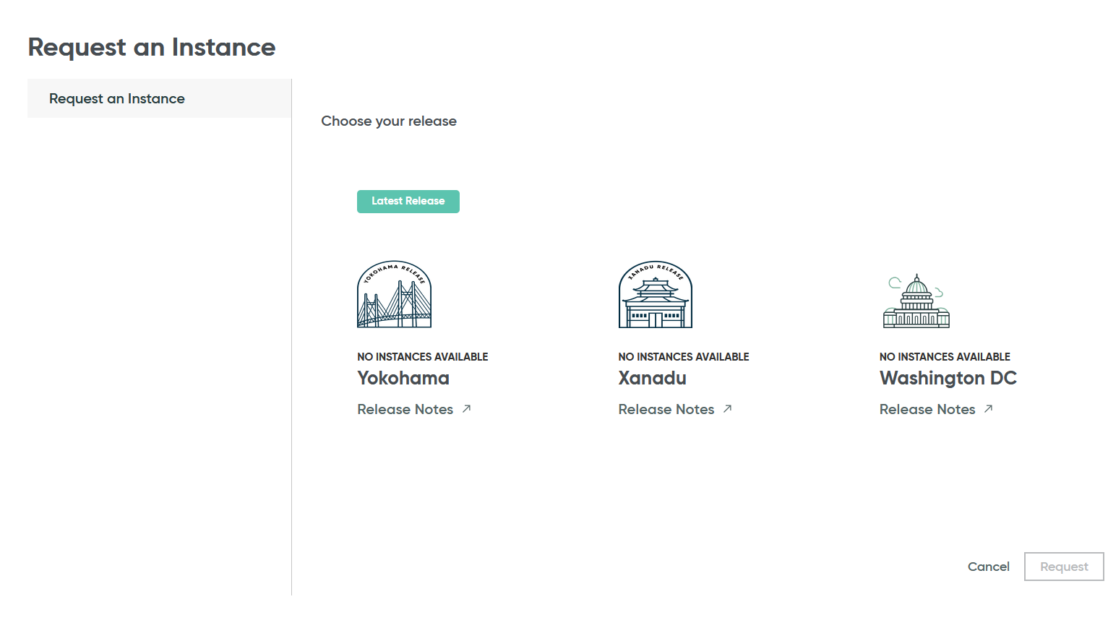

Slide 22
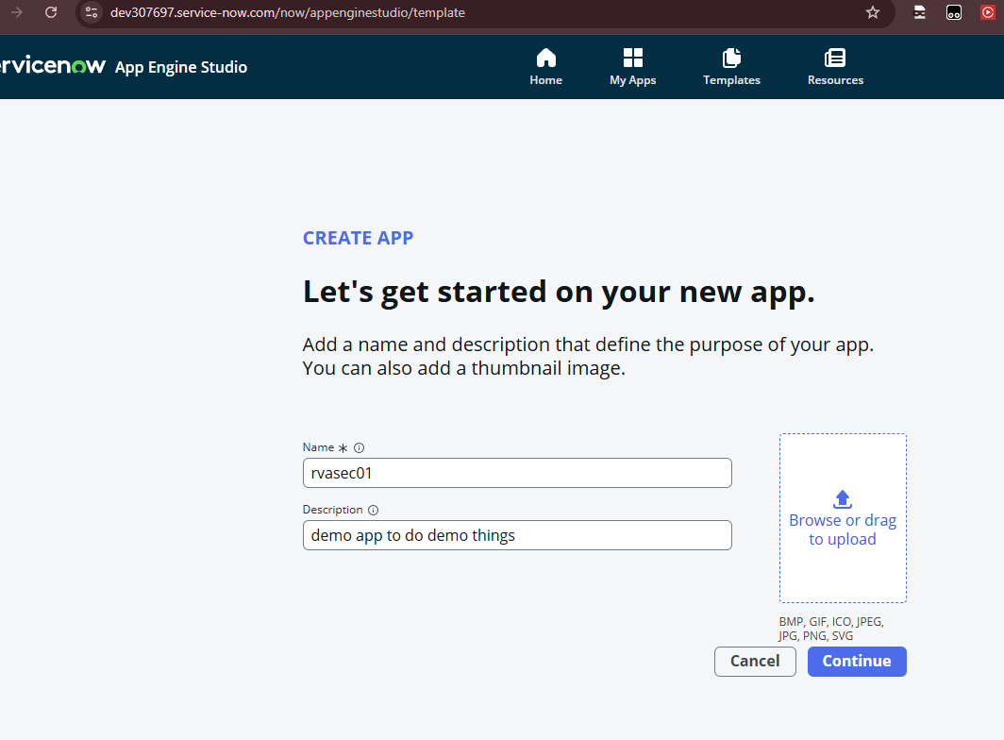

Slide 23
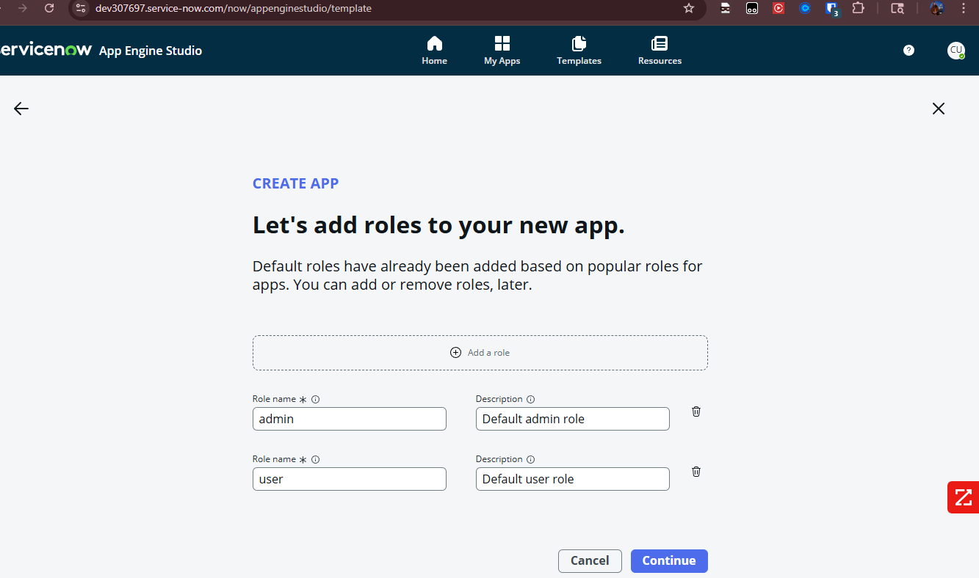

Slide 24
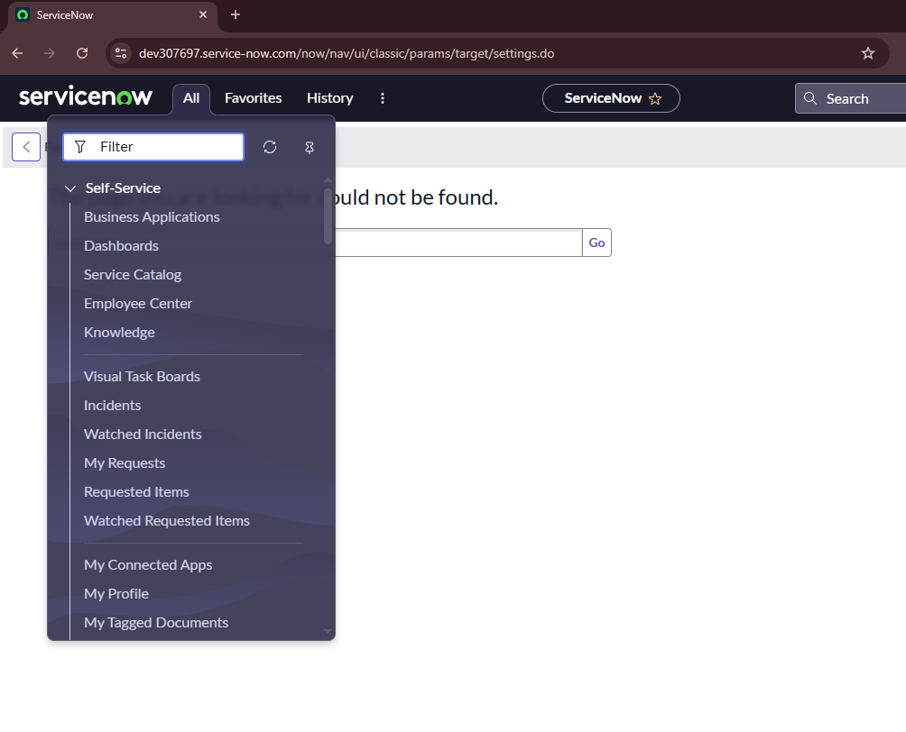

Slide 25
Endpoint | Description
/sys_db_object_list.do | Lists all tables (enumerate what data exists)
/sys_dictionary_list.do | Lists all fields in all tables (discover sensitive fields)
/table.do?SCHEMA=true&name=... | Schema browser for any table
/<table_name>_list.do | Direct browse to records in table (e.g., /incident_list.do, /sys_user_list.do)

Slide 26
Table Name | What it might contain
sys_user | Usernames, roles, email addresses
sys_user_role | Role mappings (who is admin?)
sys_properties | System config, passwords, URLs, debug toggles
ecc_queue | MID server task queue (can leak IPs, creds, scripts)
sys_script | Business rules, might contain hardcoded logic or keys
sys_email | Email logs; exfil or alert suppression insight
sys_attachment | Attached files; might include creds, exports
cmdb_ci | Core CMDB; see asset inventory for lateral ideas
sc_req_item / sc_request | Service Catalog history (can reveal access requests, PII)

Slide 27
https://<your-instance>.service-now.com/textsearch.do?sysparm_search=<your+search+term>
https://<your-instance>.service-now.com /global_search.do?sysparm_search=incident+printer
https://dev307697.service-now.com/$sn_global_search_results.do?sysparm_search=c3Zj*

Slide 28
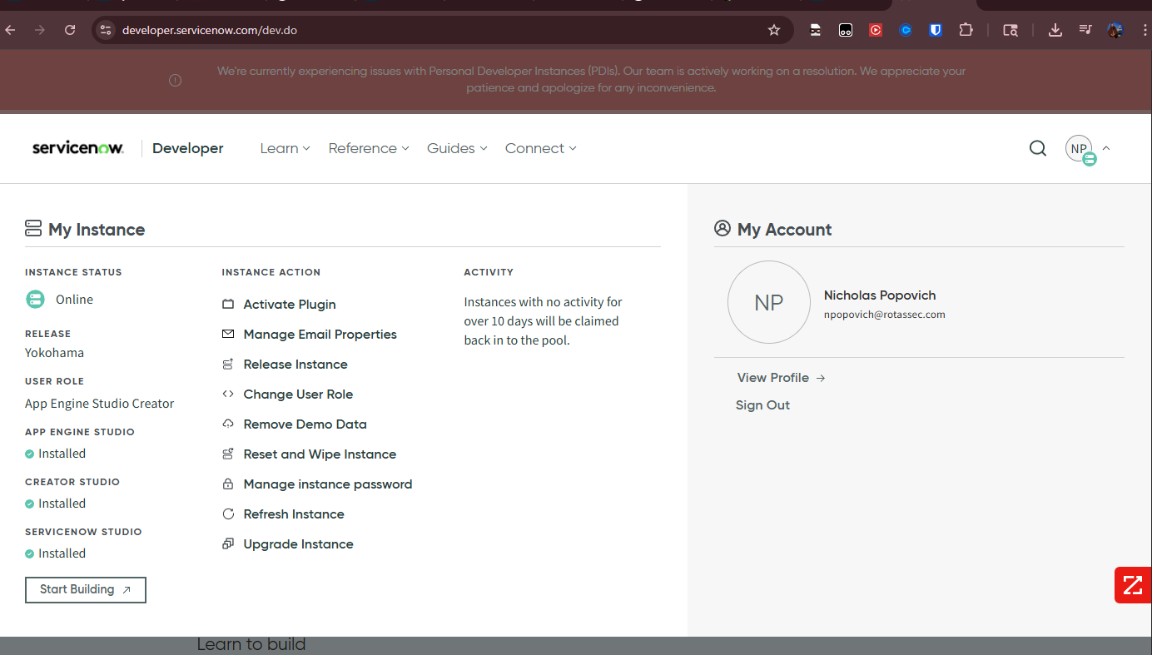

Slide 29
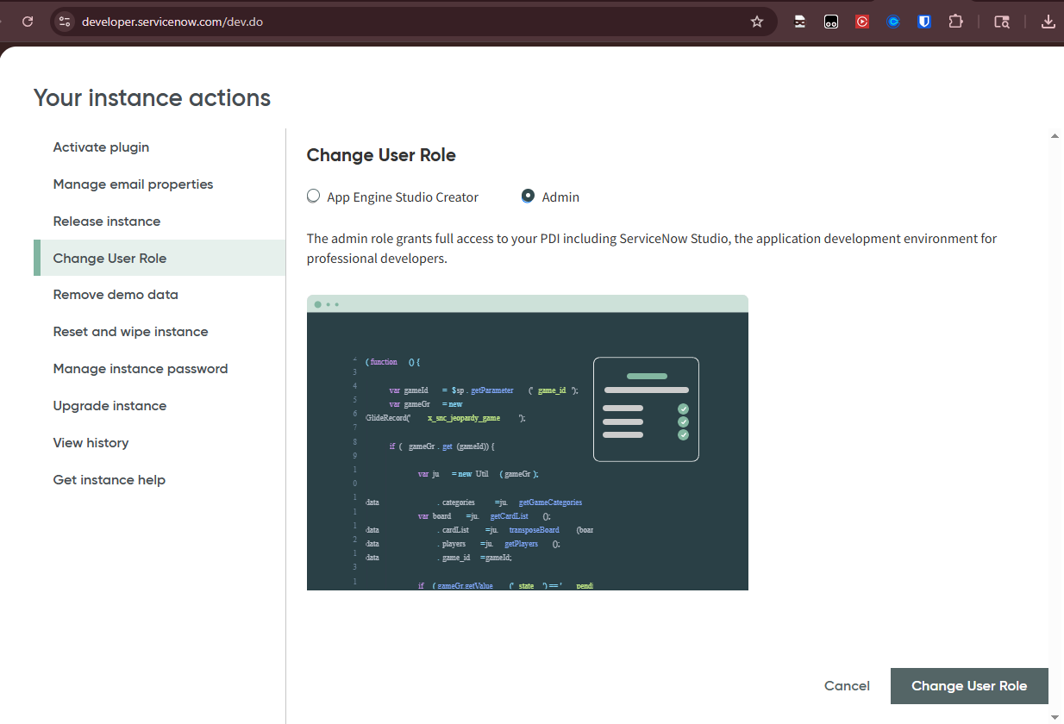

Slide 30
midserver
https://www.servicenow.com/docs/bundle/washingtondc-servicenow-platform/page/product/mid-server/task/use-mid-server-guidedsetup.html

Slide 31
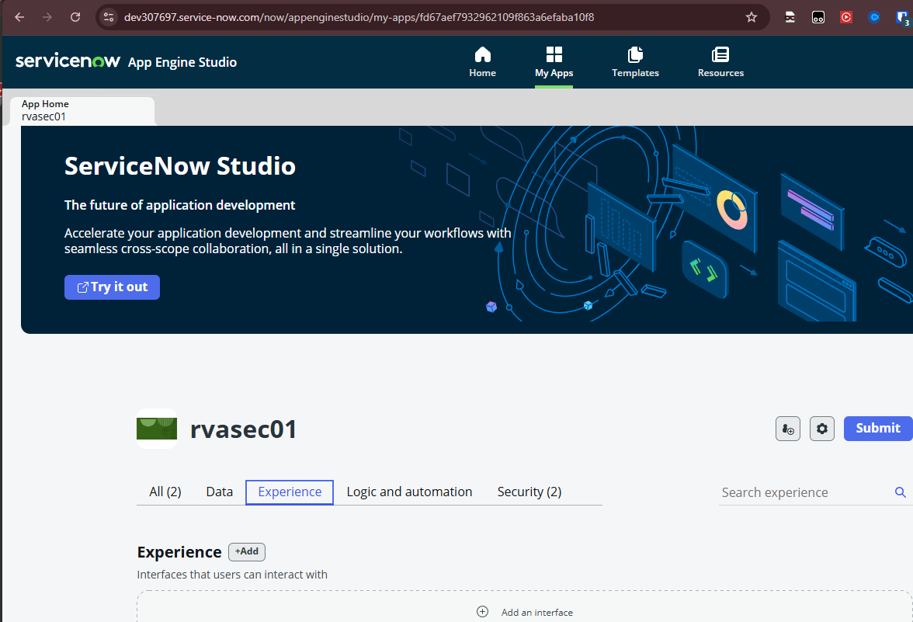
Add experience

Slide 32
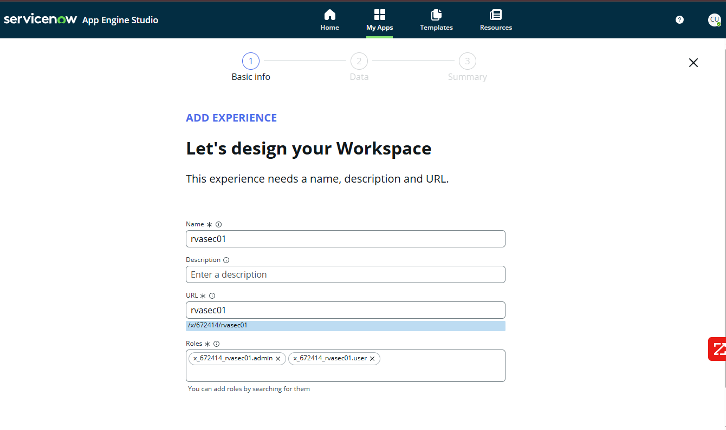
Add experience

Slide 33
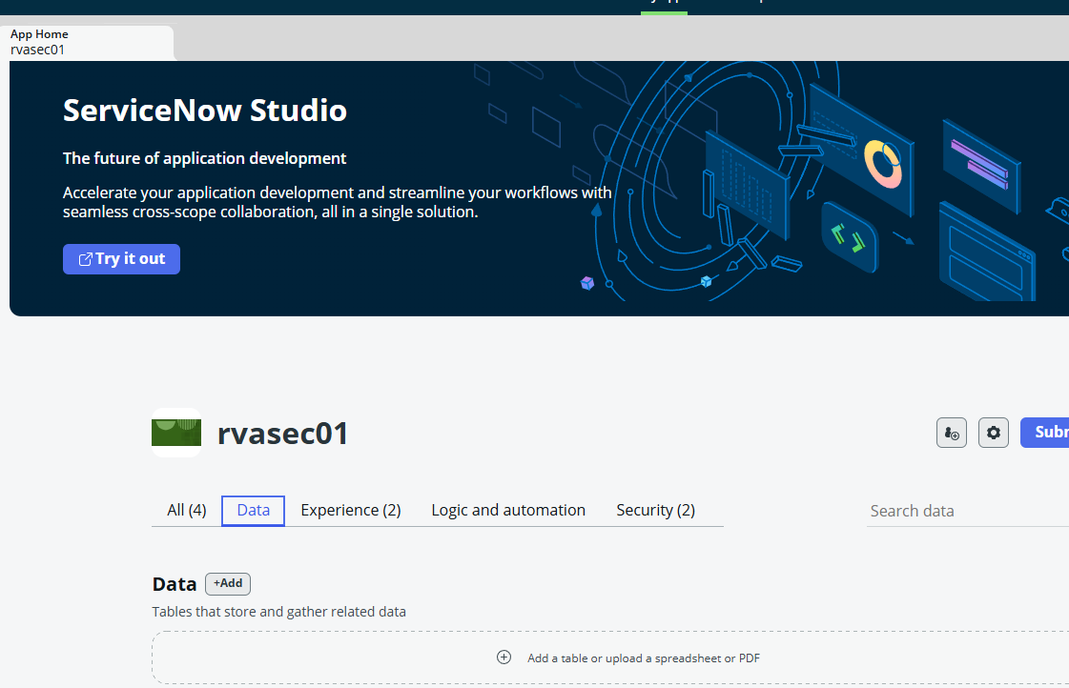

Slide 34
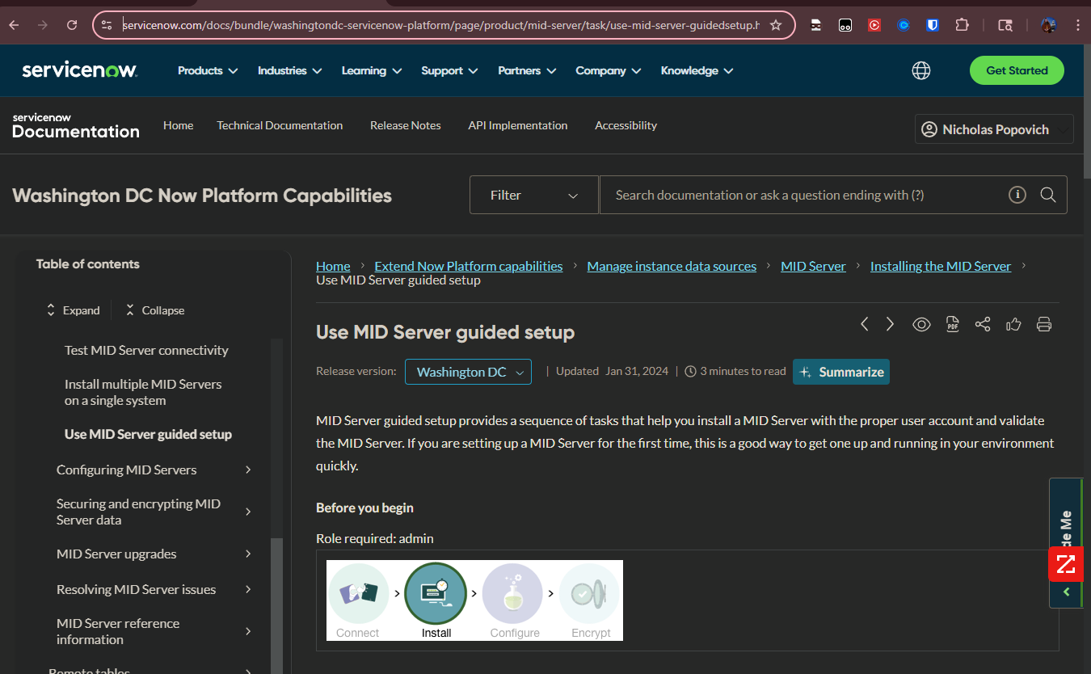
midserver

Slide 35
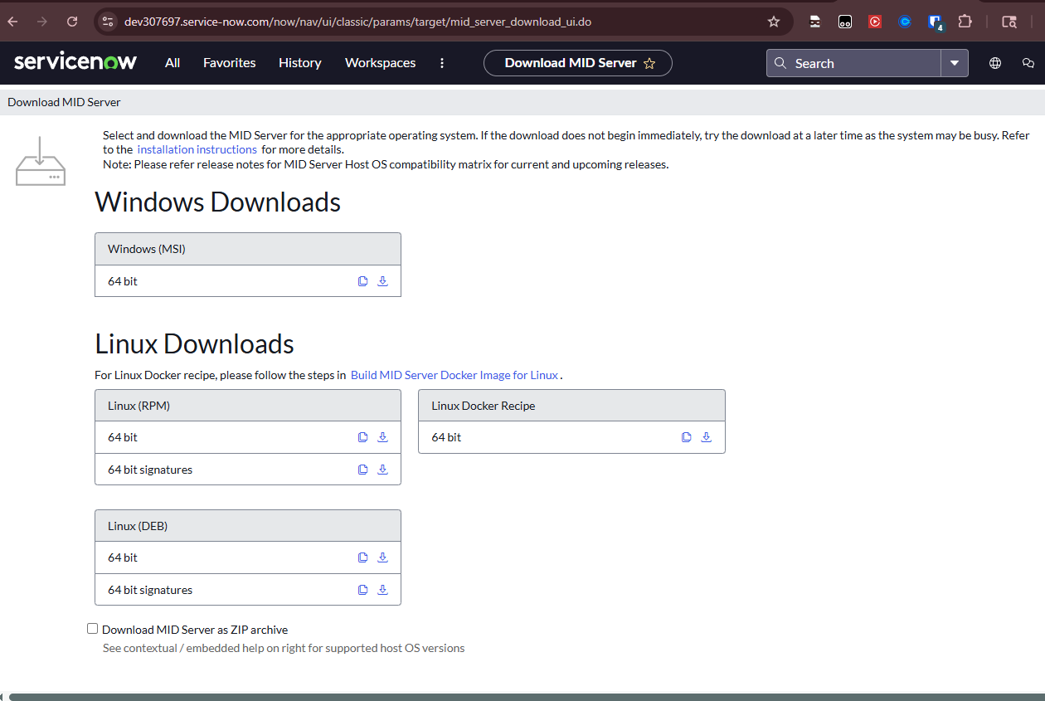

Slide 36
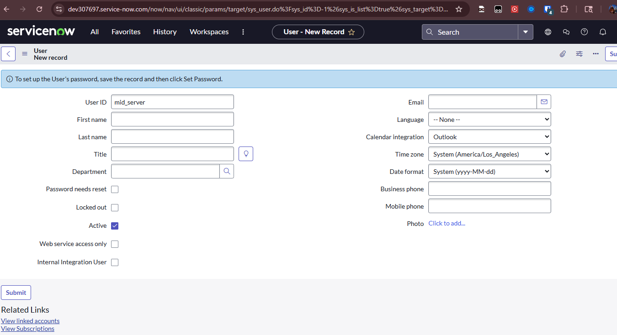

Slide 37
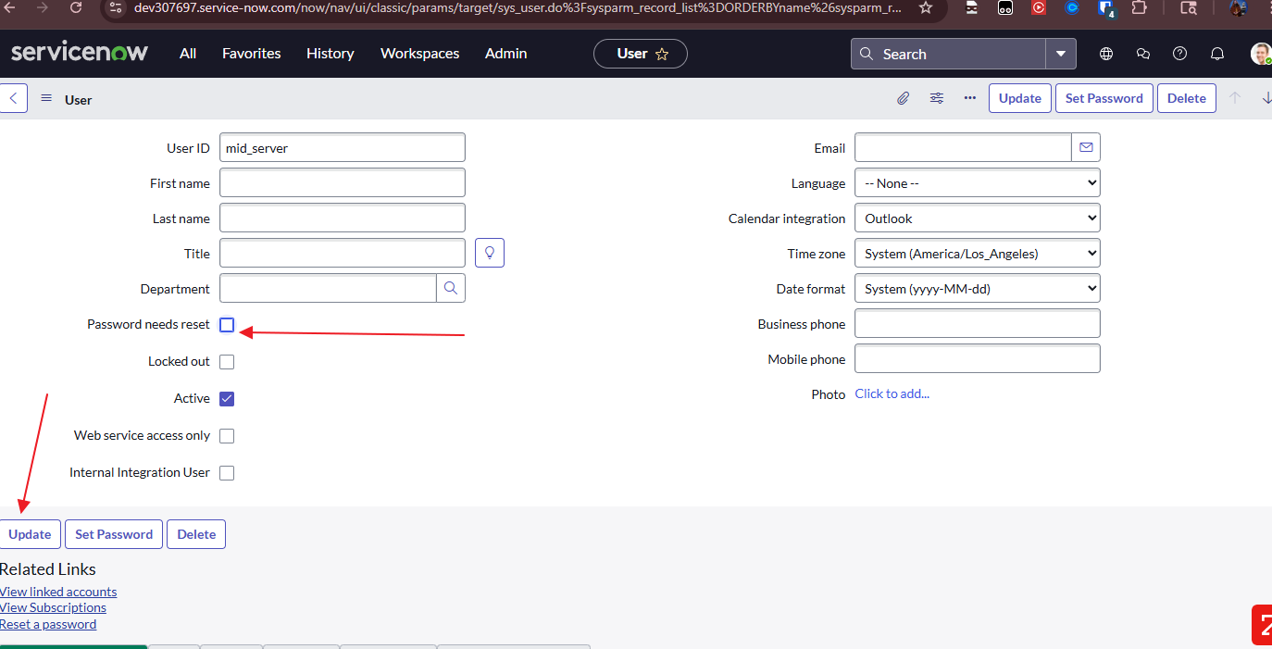

Slide 38
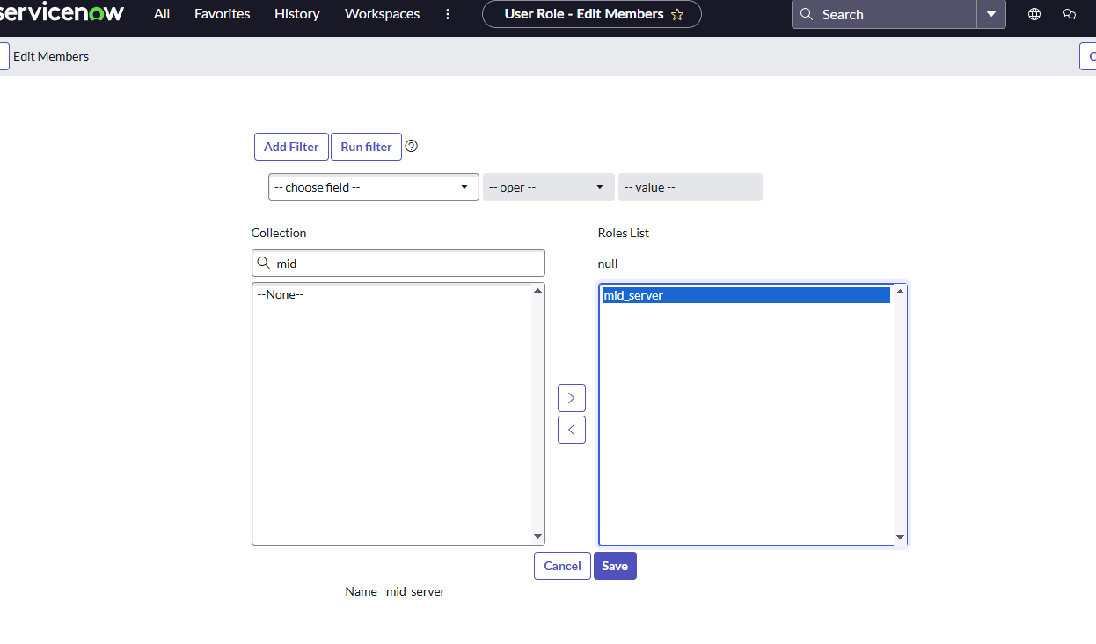

Slide 39
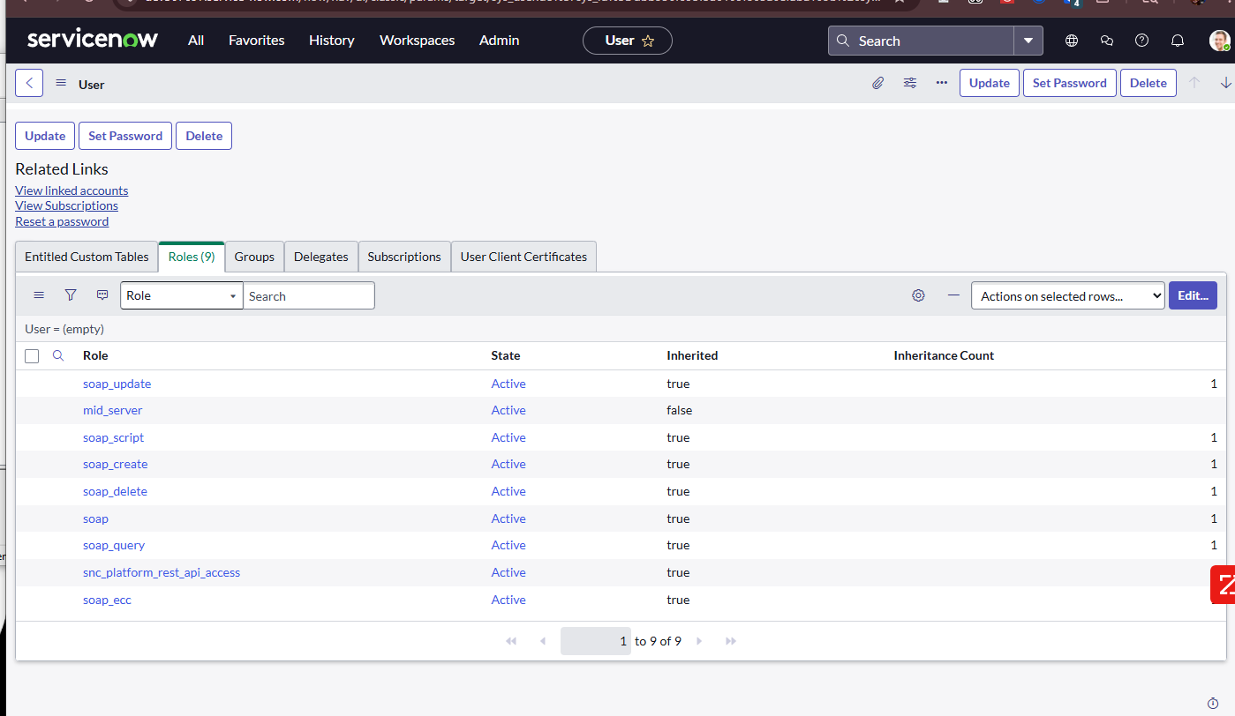

Slide 40
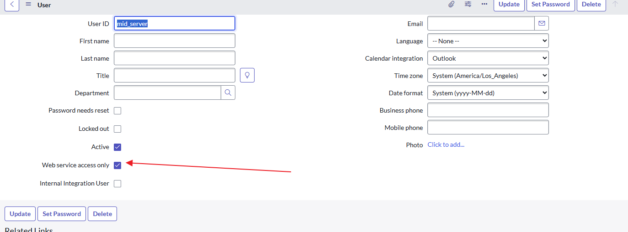

Slide 41
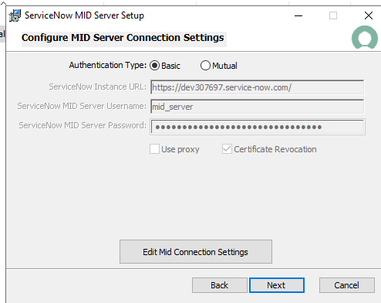

Slide 42
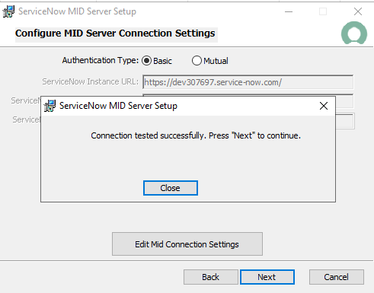

Slide 43
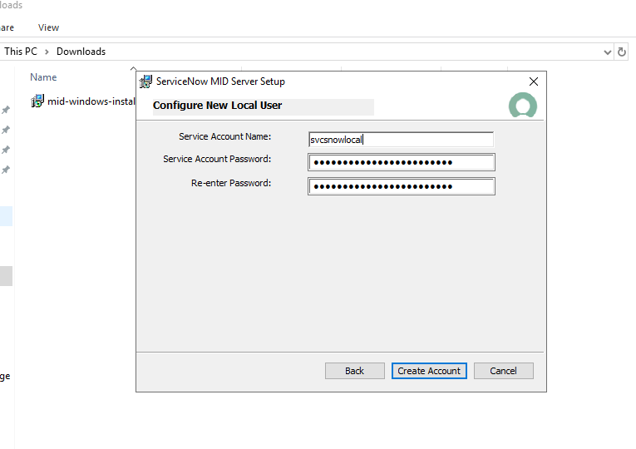
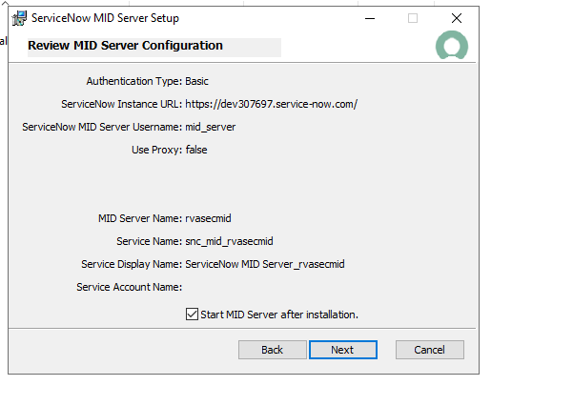

Slide 44
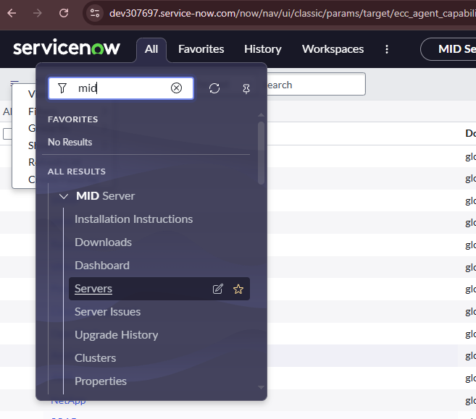
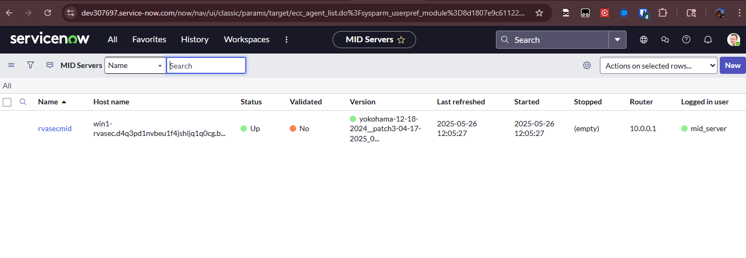

Slide 45
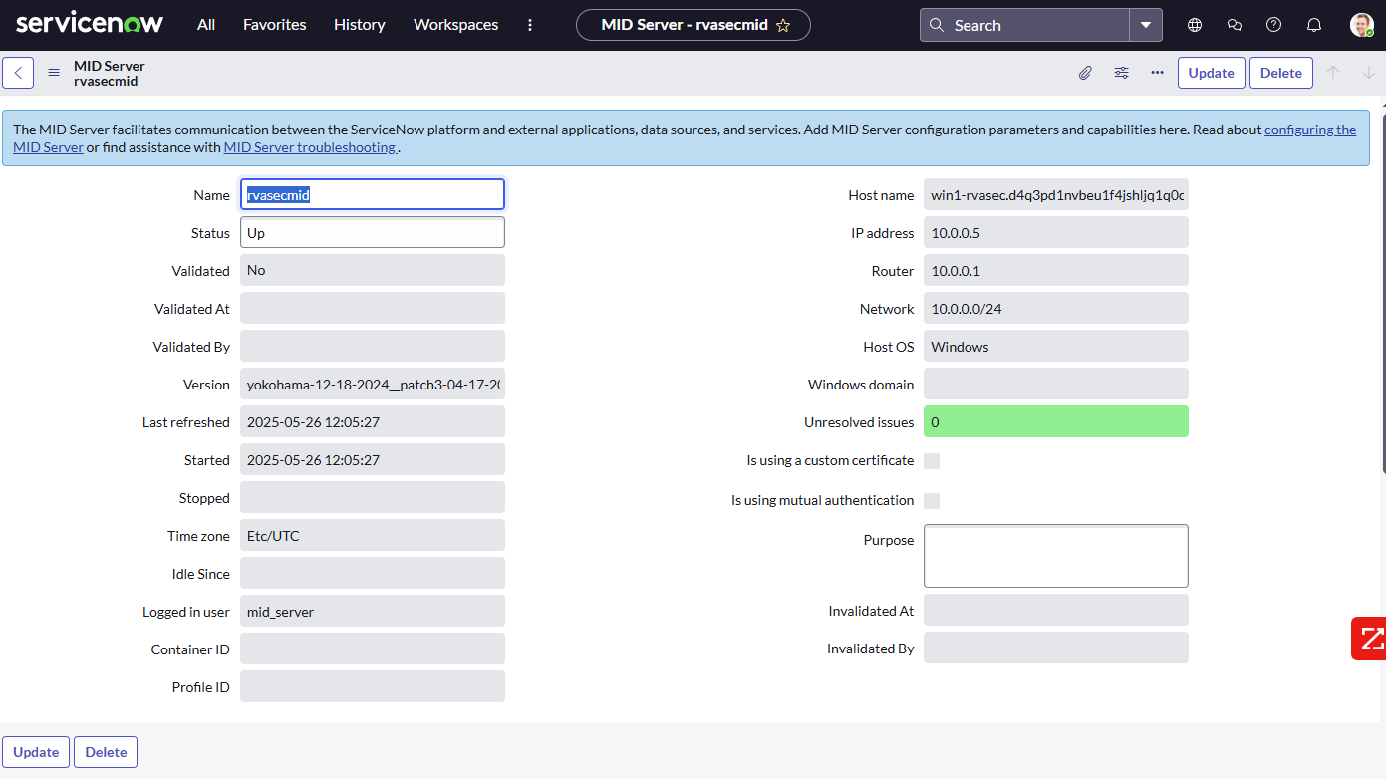

Slide 46
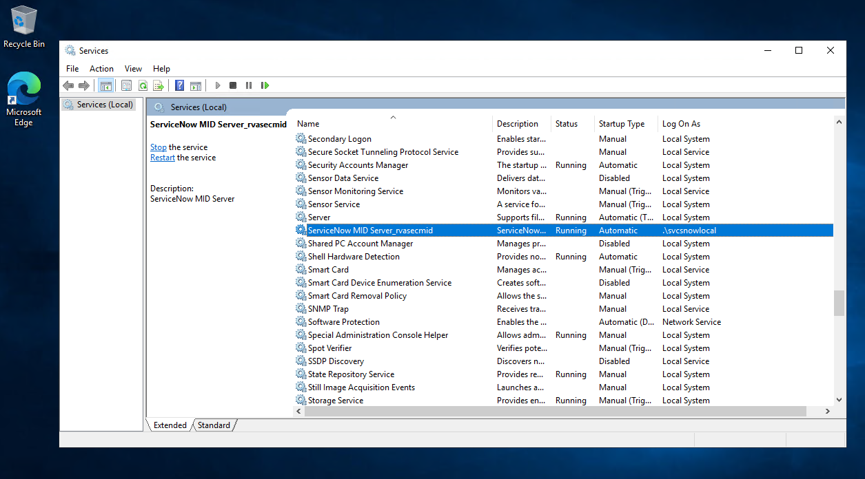

Slide 47
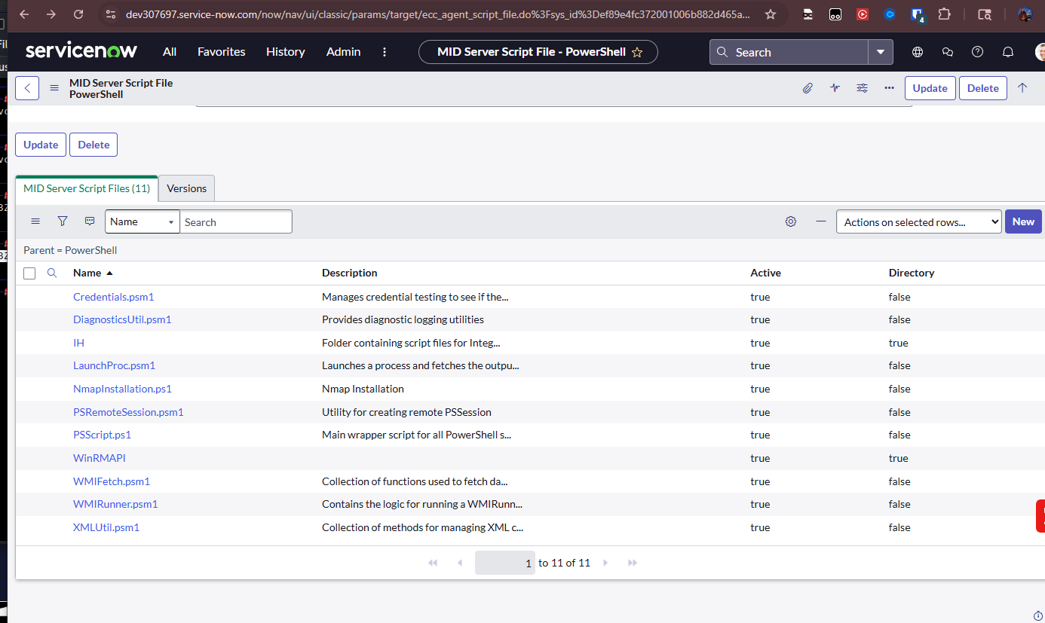

Slide 48
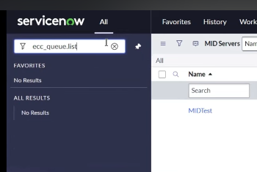

Slide 49
https://www.servicenow.com/docs/bundle/washingtondc-servicenow-platform/page/product/mid-server/concept/ecc-queue-mid-server.html

Slide 50
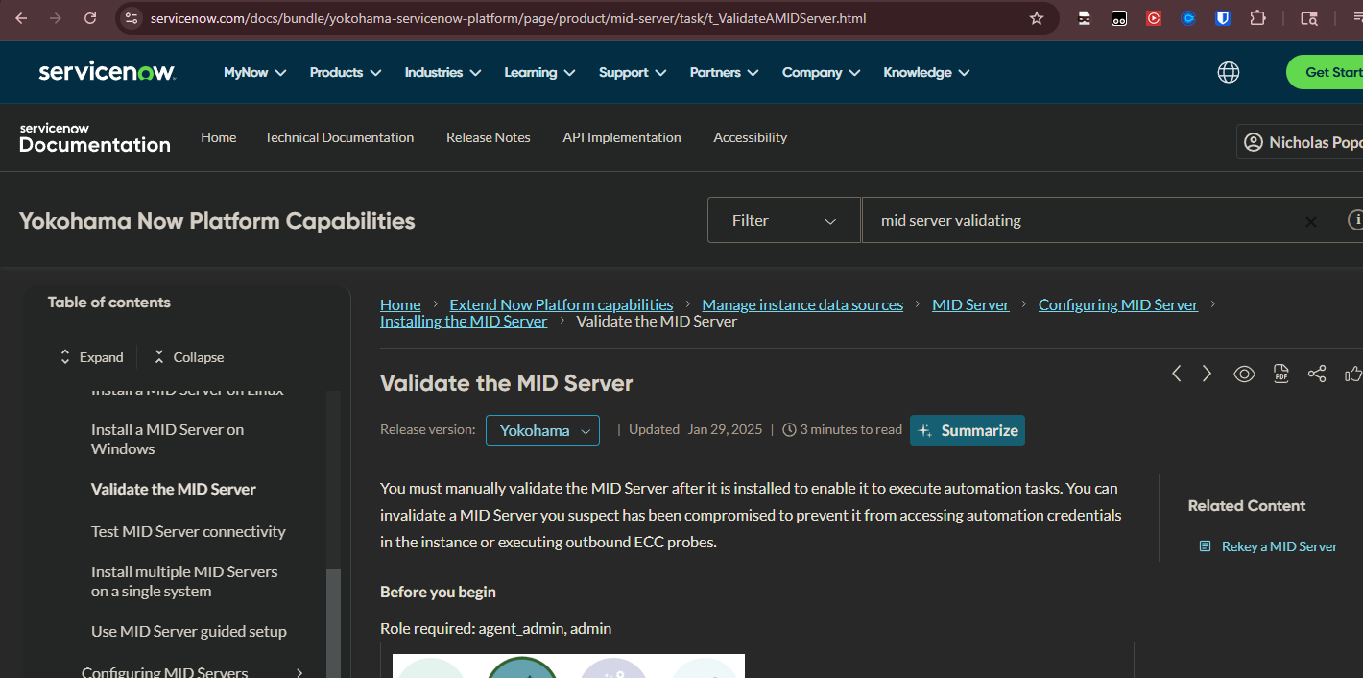

Slide 51
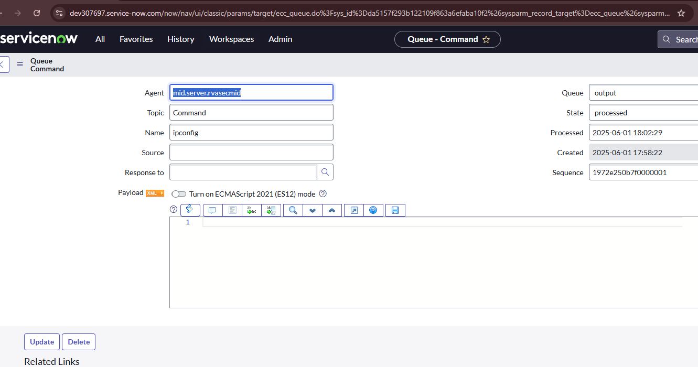

Slide 52
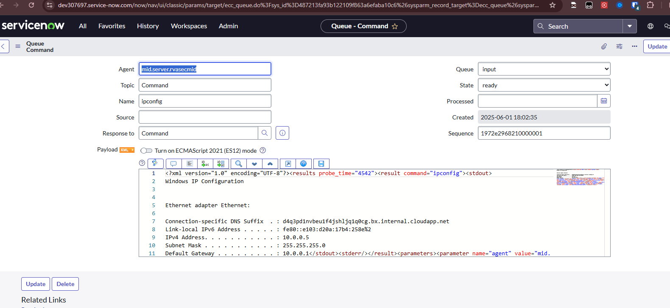

Slide 53
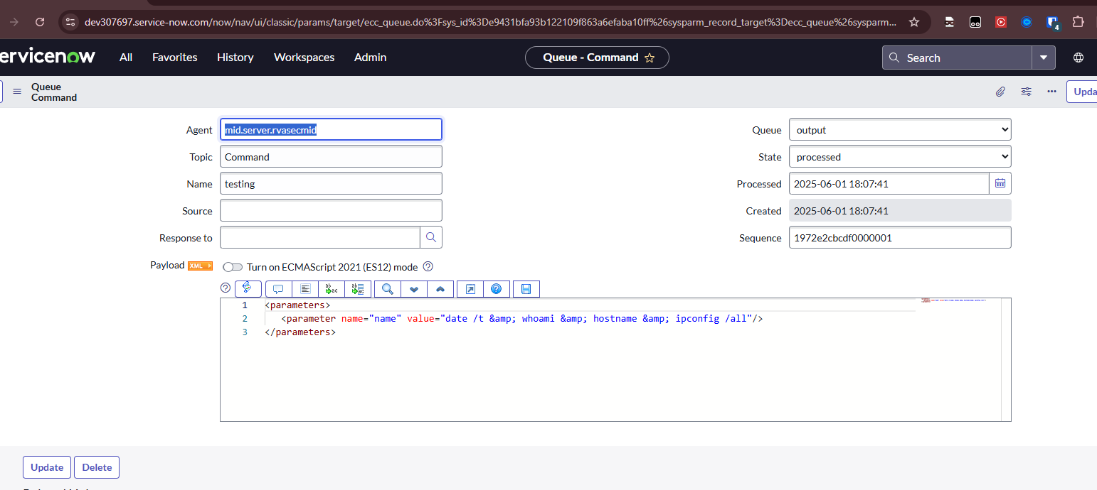

Slide 54
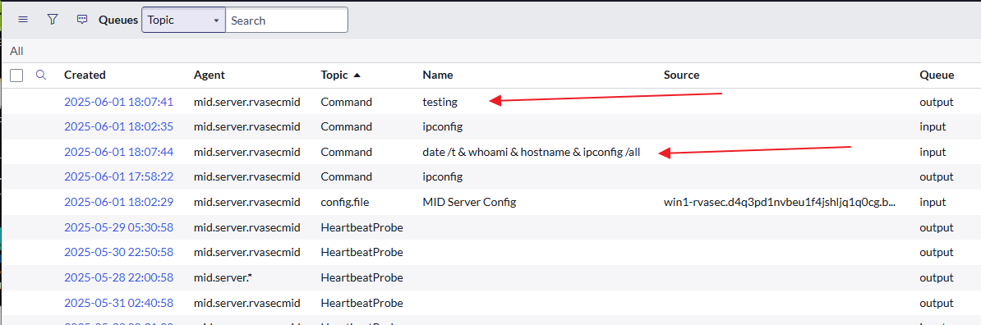

Slide 55
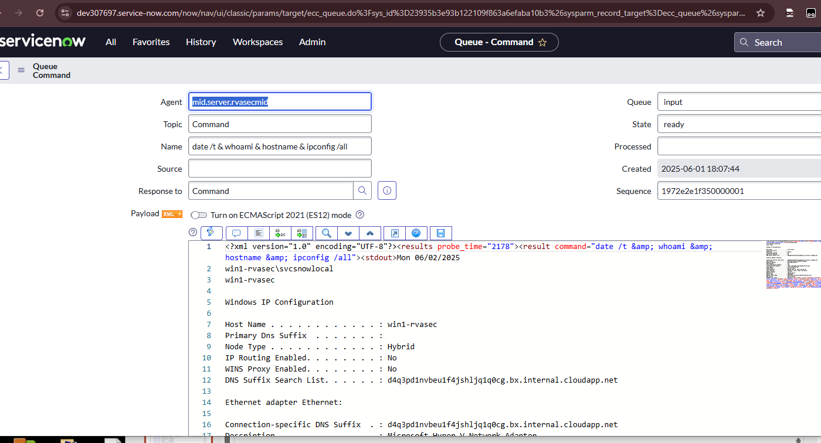

Slide 56
QUESTIONS AND WRAP-UP
Email: npopovich@rotassec.com
Web: https://rotassecurity.com
Twitter: @pipefish_

