Slide 1
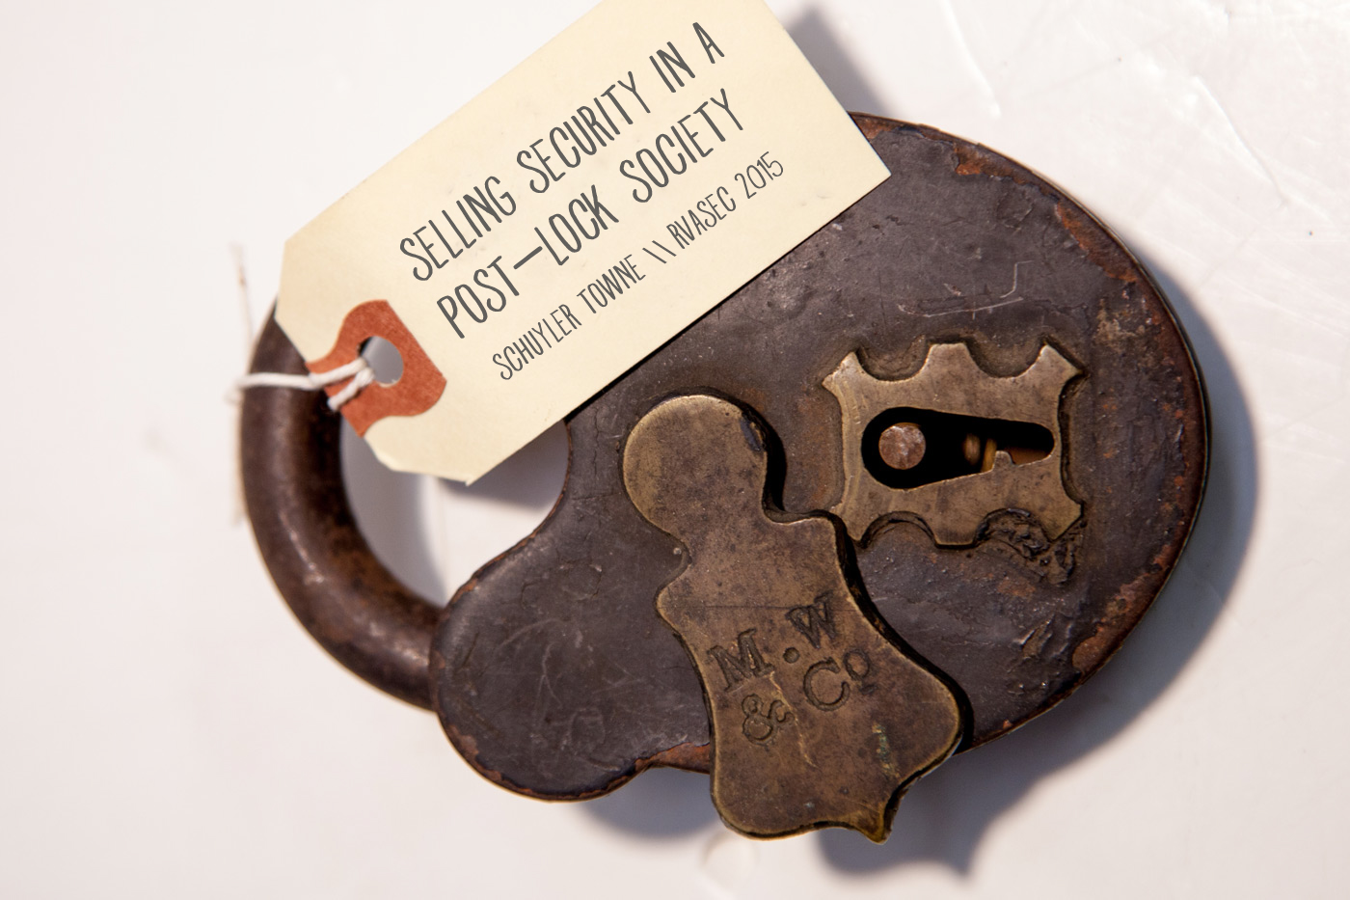

Slide 2
Previously at RVASec
2012 | “Why do you lock your door?”
2013 | “Vulnerability Research circa 1851”
2014 | “How to Make a Lock”

Slide 3

1: Community is Security

Slide 4
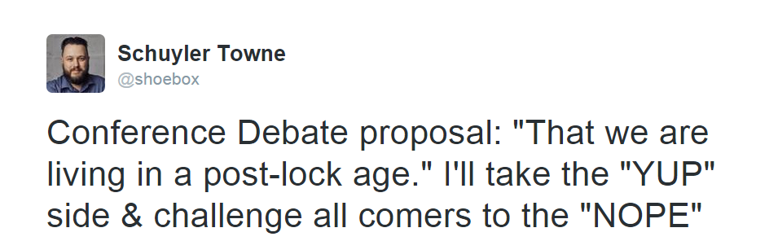

Slide 5
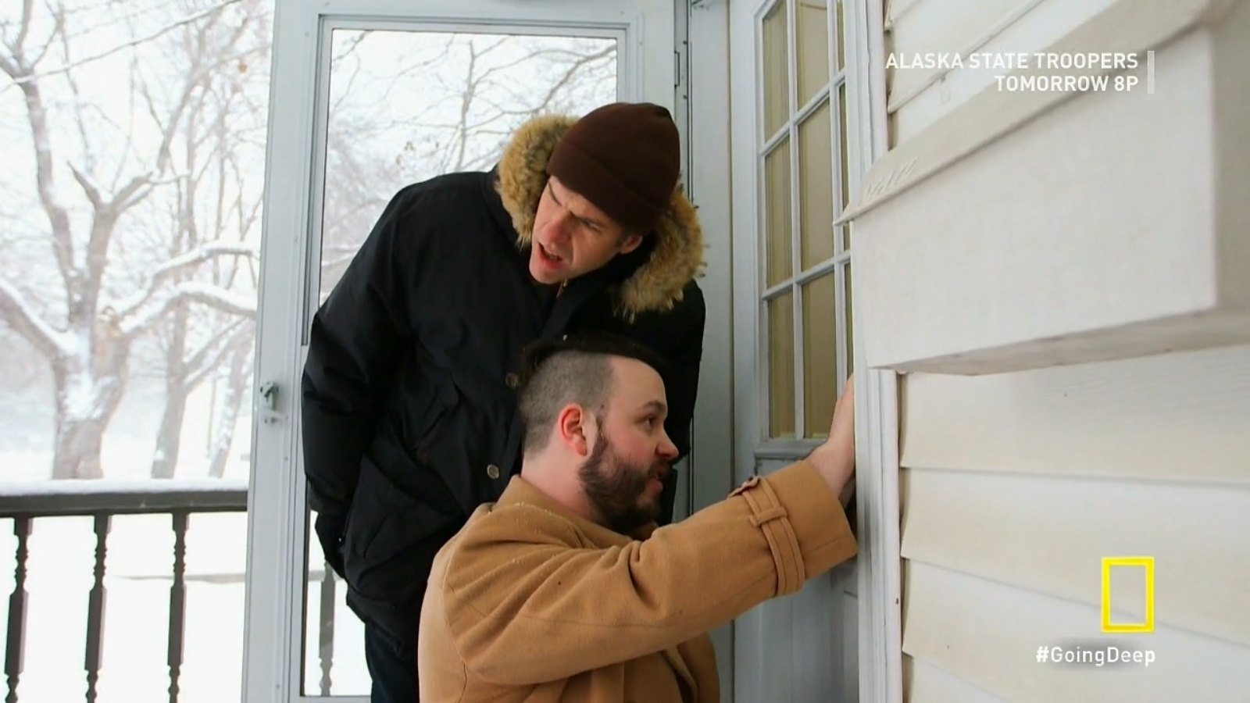
Going Deep w/ David Rees

Slide 6
“I could feel safe
without locks at all.”
3%-7%

Slide 7
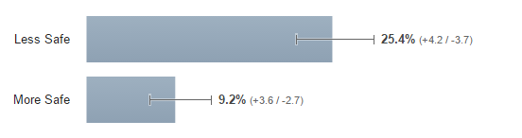

Slide 8
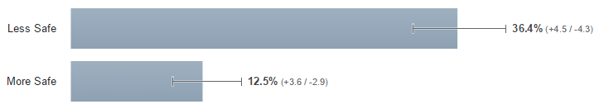

Slide 9
Interviews: “Less Safe”
“I feel like I would have to keep a constant eye on their house.”

Slide 10
Interviews: “More Safe”
“It has to be better for me if there is an easier target.”

Slide 11
Interviews: “Neutral”
“Security is an Illusion”

Slide 12
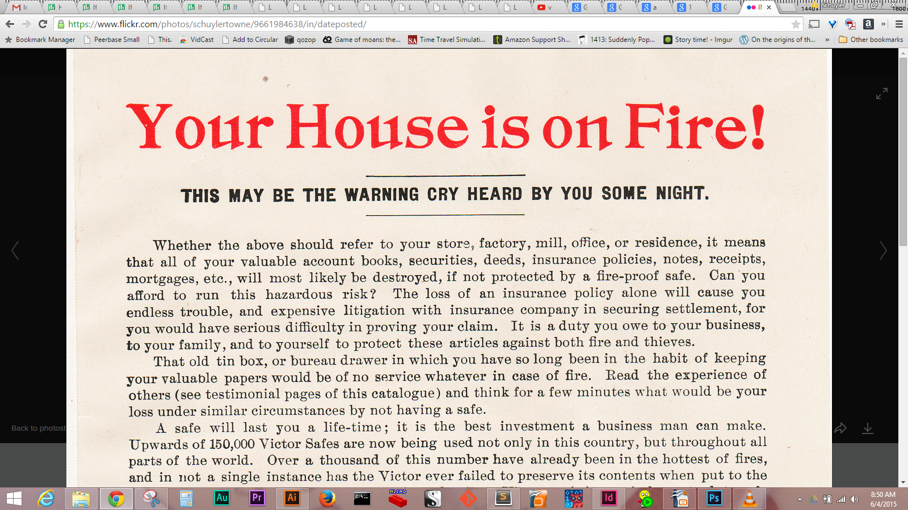

2: We Have Nothing to Fear

Slide 13
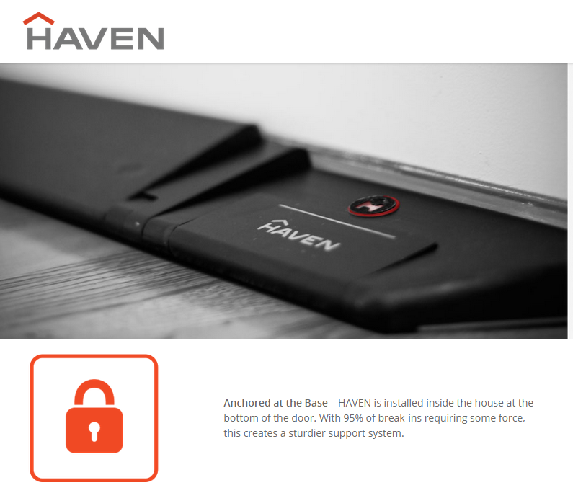
Unless You Lie To Us...

Slide 14
"Walls are designed to keep people out. Locks are there to decide who you let in."
—Paul Gerhardt
"Walls are designed to keep people out. Locks are there to decide who you let in."
—Paul Gerhardt
Notes:
...deceiving his mistresses for his masters, he was 'fishing out' State secrets in the most frequented alcoves. Adaptable, discreet and cunning in this extremely difficult role, he made himself liked everywhere and by everyone.

Slide 15
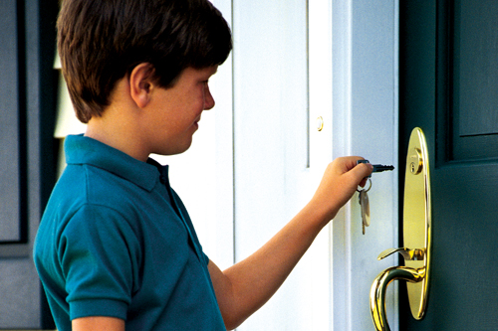
Notes:
"Denon’s 32-page novella on genteel seduction and tables-turned role-playing is of exquisite delicateness."
- Sasha Martinez

Slide 16
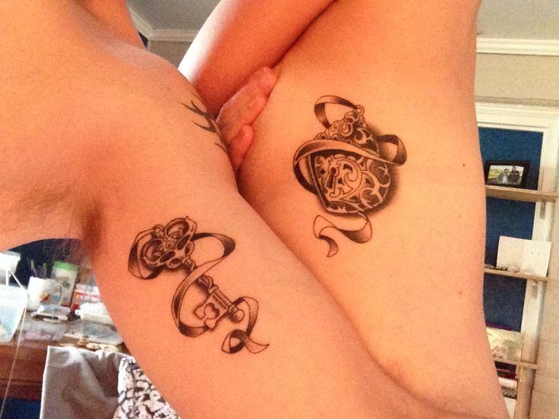

Slide 17


Slide 18
“Who will you let in?”

Slide 19
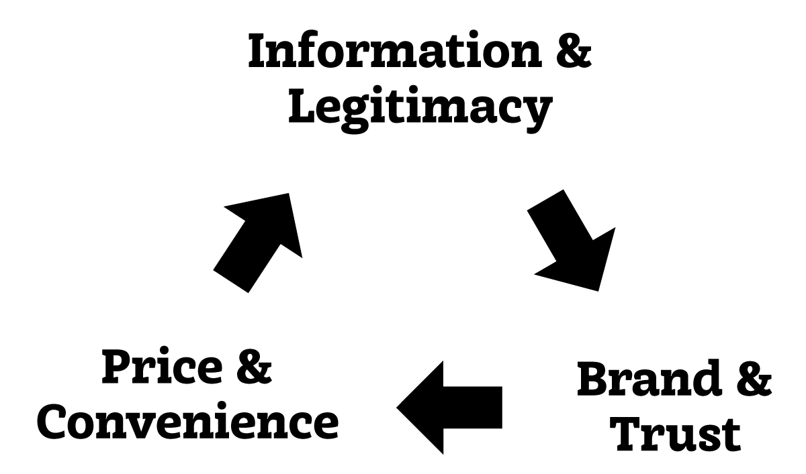
3: Let Them Eat Info

Slide 20
Information Is Coming Back
Popular Mechanics Circulation circa 1982:
1.6 Million
Views of 1
Bosnian Bill Video:
2.1 Million

Slide 21
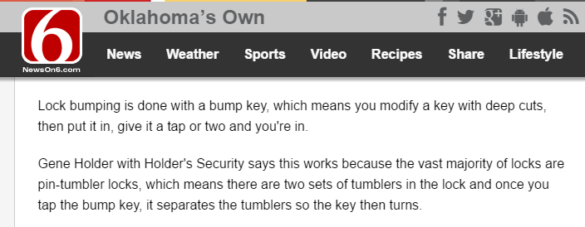

Slide 22


Slide 23
4: We Crave Convenience
1964 | Kwik-See Packaging
1998 | Remote Keyless Entry
2002 | Kwik-Install
2007 | Biometrics & Smart Key
2009 | Smartcode Home Automation

Slide 24
4: We Crave Convenience
1964 | Kwik-See Packaging
1998 | Remote Keyless Entry
2002 | Kwik-Install
2007 | Biometrics & Smart Key
2009 | Smartcode Home Automation

Slide 25
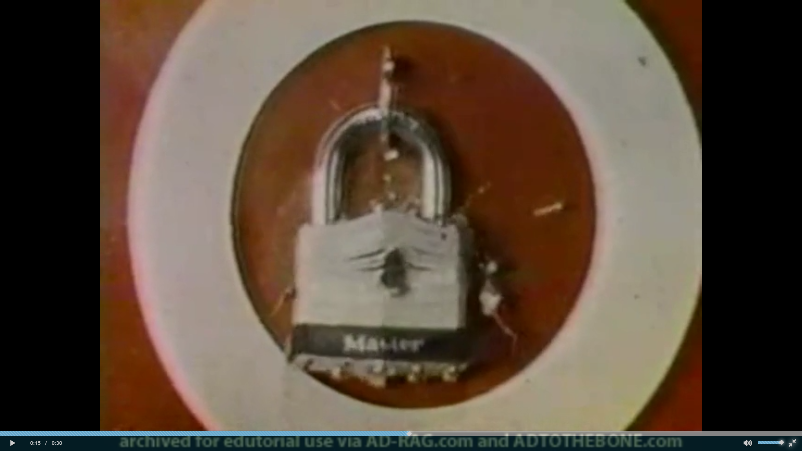

Slide 26
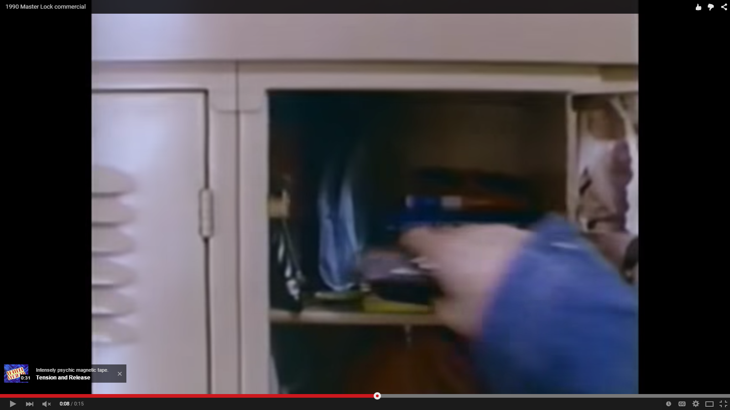

Slide 27
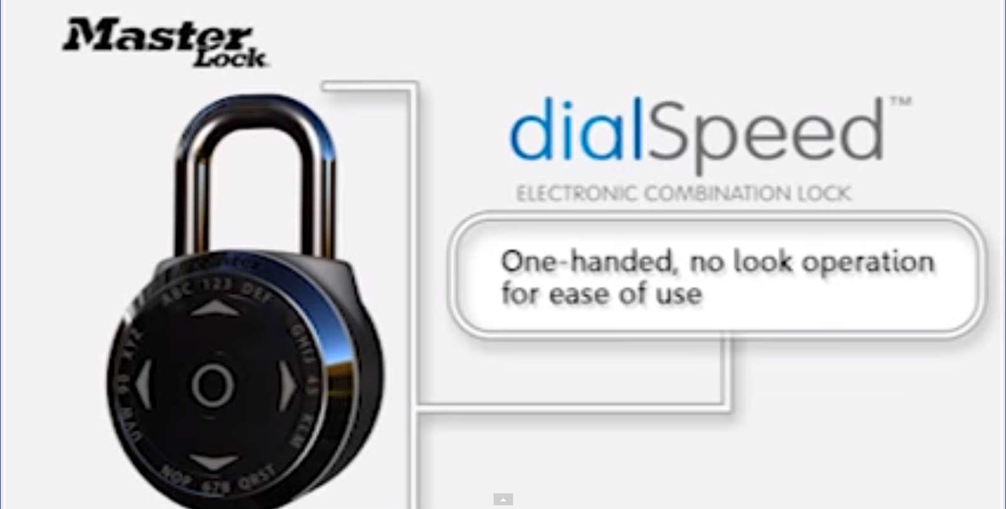

Slide 28
Convenience & Security
are not a dichotomy

Slide 29
Inconvenience Invites Insecurity

Slide 30
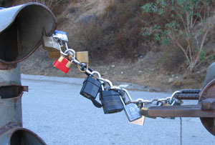

Slide 31
Good Examples!
Kwikset Smart Key
Wordlock
Residential Keypad Locks

Slide 32
1: Community is Security
2: We Have Nothing to Fear
3: Let Them Eat Info
4: We Crave Convenience

Slide 33
How to Sell to Me

Slide 34
Schuyler Towne
@Shoebox
Lock.gd
Notes:
Large axes were sharpened in front of Ur. The spears, the arms of battle, were prepared. The large bows, throw-sticks and shields gathered together to strike. The barbed arrows covered its outer side like a raining cloud. Large stones fell toegether with great thuds. Daily the evil wind returned in the city. Ur, confident in its own strength, stood ready for the murderers, but its people, oppressed by the enemy, could not withstand their weapons.
In the city, those who had not been felled by weapons succumbed to hunger. Hunger filled the city like water, it would not cease. This hunger contorted people's faces, twisted their muscles. Its people were as if drowning in a pond; they gasped for breath. Its king breathed heavily in his own palace.
The glory of the palace, which was once so lovely, was extinguished. Like a storm that fills all the lands, it was built there like twilight in the heavens; its doors adorned with the heavenly stars. Its Great bronze latches were torn out. Its hinges and fittings wept bitterly like a fugitive. The bolt, the holy lock and the great door were not fastened. The noise of the door being fastened had ceased; there was no one to left lock it.

Slide 35
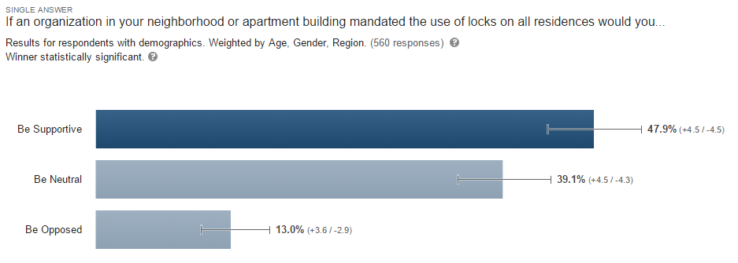
5: Be Careful with Legislation

Slide 36
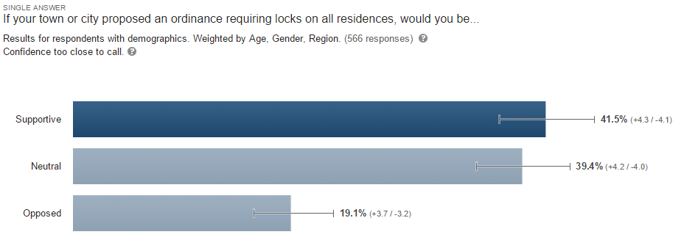

Slide 37
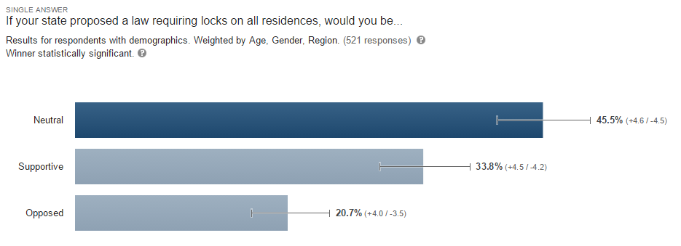

Slide 38
Schuyler Towne
@Shoebox
Lock.gd
Notes:
The glory of the house, once so lovely, was extinguished. Like a storm that fills all the lands, it was built there like twilight in the heavens; its doors adorned with the heavenly stars, its Great bronze latches were torn out. Its hinges and fittings wept bitterly like a fugitive. The bolt, the holy lock and the great door were not fastened. The noise of the door being locked had ceased; there was no one left to lock it.

