Slide 1
Trust No 1

Slide 2
Background
Phishing
Definition(s): A technique for attempting to acquire sensitive data, such as bank account numbers, through a fraudulent solicitation in email or on a web site, in which the perpetrator masquerades as a legitimate business or reputable person.
- NIST SP 800-12 Rev. 1 under Phishing from IETF RFC 4949 Ver 2
Common guidance on identifying phishing:
Urgent call to action or threats
First time or infrequent senders
Generic greetings
Mismatched email domains
Suspicious links or unexpected attachments
Microsoft https://support.microsoft.com/en-us/windows/protect-yourself-from-phishing-0c7ea947-ba98-3bd9-7184-430e1f860a44
Some stats pulled from the Anti-Phishing Working Group:
Phishers themselves register more than half of the domain names on which phishing occurs.
Sixty-five percent of maliciously registered domain names are used for phishing within five days of registration.
- https://apwg.org/phishing-landscape-2020-a-study-of-the-scope-and-distribution-of-phishing/

Slide 3
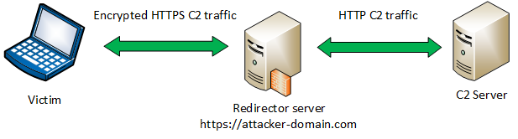
Background
Command and Control(C2 or C&C)
Definition(s): A command-and-control [C&C] server is a computer controlled by an attacker or cybercriminal which is used to send commands to systems compromised by malware and receive stolen data from a target network.
TrendMicro https://www.trendmicro.com/vinfo/us/security/definition/command-and-control-server
- Image from: https://payatu.com/redteaming-from-zero-to-one-part-1

Slide 4






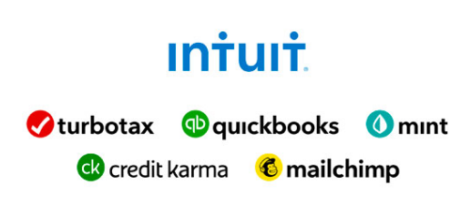


Background
Organizations have steadily transitioned to relying on third-party entities to provide many common services to employees.

Slide 5
Living Off Trusted Sites (LOTS)
https://lots-project.com/ - https://twitter.com/mrd0x

Slide 6
Groundback
Phishing
Definition(s): A technique for attempting to acquire sensitive data, such as bank account numbers, through a fraudulent solicitation in email or on a web site, in which the perpetrator masquerades as a legitimate business or reputable person.
- NIST SP 800-12 Rev. 1 under Phishing from IETF RFC 4949 Ver 2
Common guidance on identifying phishing:
Urgent call to action or threats
First time or infrequent senders
Generic greetings
Mismatched email domains
Suspicious links or unexpected attachments
Microsoft https://support.microsoft.com/en-us/windows/protect-yourself-from-phishing-0c7ea947-ba98-3bd9-7184-430e1f860a44
Some stats pulled from the Anti-Phishing Working Group:
Phishers themselves register more than half of the domain names on which phishing occurs.
Sixty-five percent of maliciously registered domain names are used for phishing within five days of registration.
- https://apwg.org/phishing-landscape-2020-a-study-of-the-scope-and-distribution-of-phishing/

Slide 7
Don’t Put It Down, Put It Away
habituation
Definition(s): decrease in responsiveness upon repeated exposure to a stimulus
- https://www.merriam-webster.com/dictionary/habituation

Slide 8
Crash Course: Setup Up a Phishing/C2 Domain
Acquire Domain
Categorize Domain
Establishing DNS Records (MX/SPF/DMARC/DKIM)
Email Warm Up

Slide 9
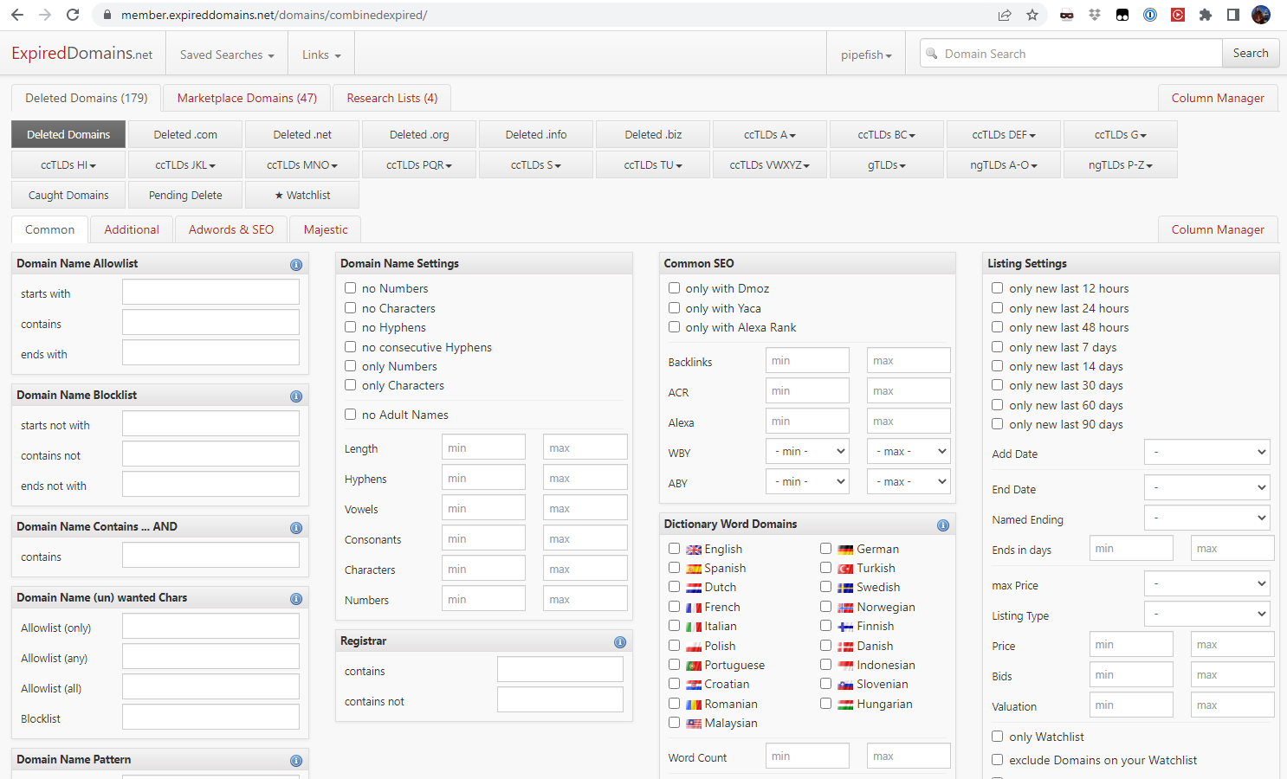
Acquire Domain
An expired domain with history is ideal (e.g. expireddomains.net)

Slide 10
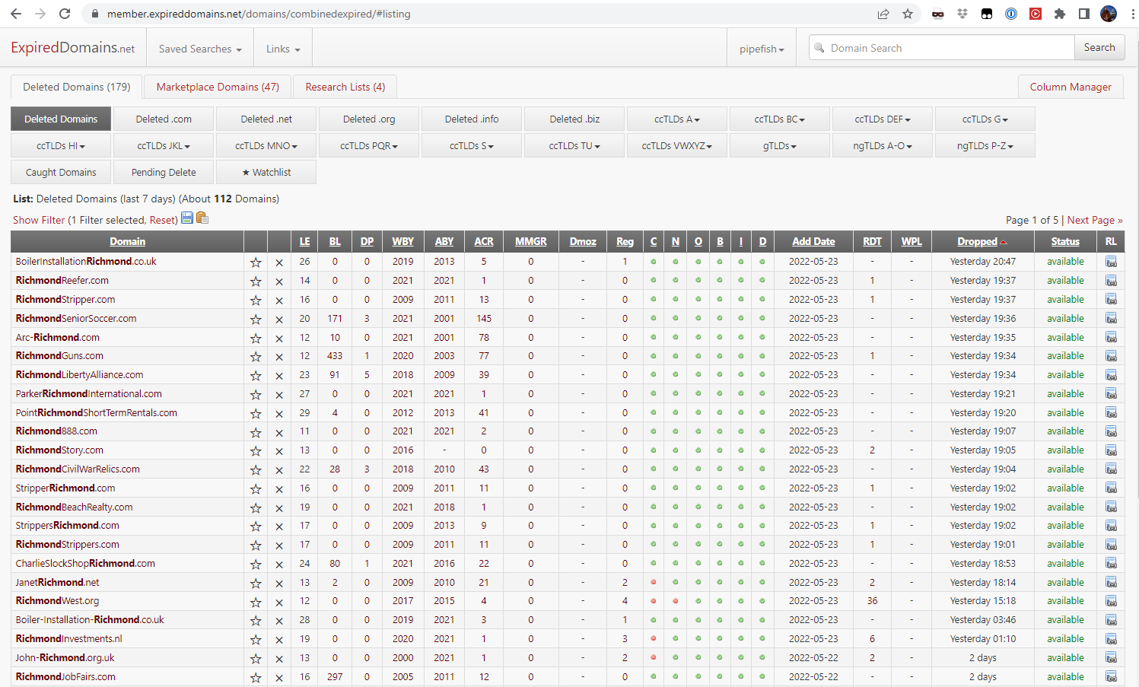
Acquire Domain

Slide 11
Categorize Domain
If you’re domain is already categorized because you grabbed an expired domain: BONUS
Need to get domain categorized to add legitimacy for emails AND for egress filtering
https://sitereview.bluecoat.com
https://urlfiltering.paloaltonetworks.com/
http://cfssupport.sonicwall.com/Support/web/eng/newui/viewRating.jsp
http://www.brightcloud.com/tools/url-ip-lookup.php
http://www.cyren.com/url-category-check.html
http://fortiguard.com/iprep?data=www.medforms.info#submit_form
http://csc.cyberoam.com/cyberoamsupport/webpages/webcat/webcathome.jsp
http://url.fortinet.net/rate/support.php?ref=nrt
https://global.sitesafety.trendmicro.com/
http://www.trustedsource.org/en/feedback/url?action=checksingle
http://www.barracudacentral.org/report/website-category/https://www.checkpoint.com/urlcat/main.htm

Slide 12
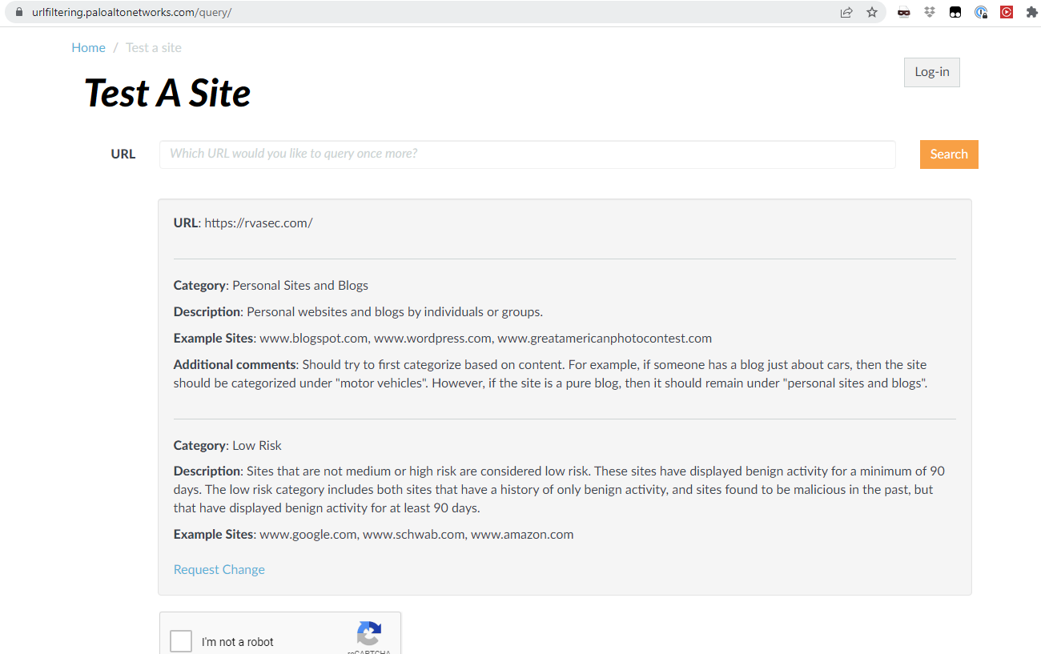
Categorize Domain

Slide 13
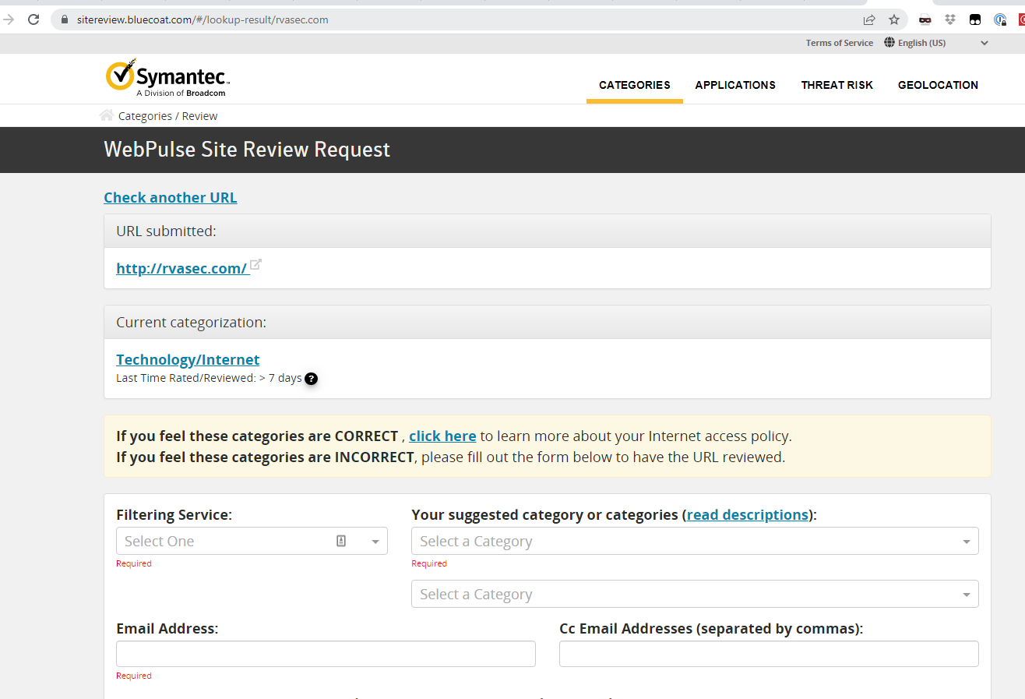
Categorize Domain

Slide 14
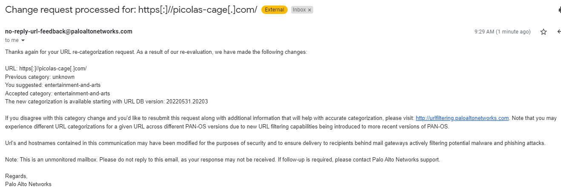
Categorize Domain

Slide 15
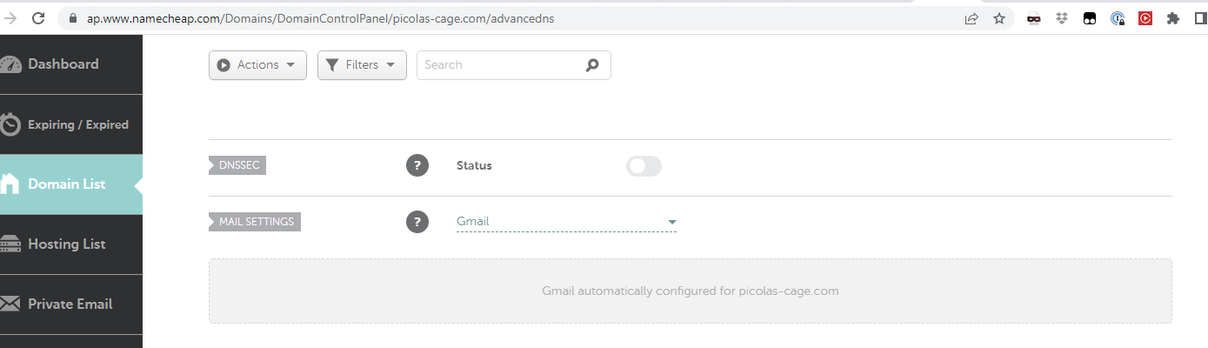
Establishing DNS Records (MX)

Slide 16
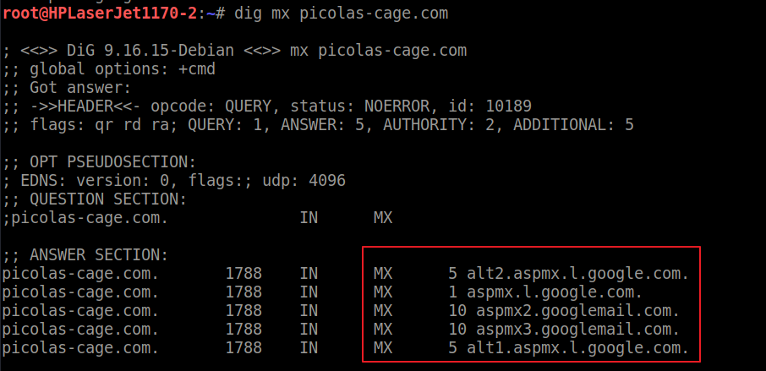
Establishing DNS Records (MX)

Slide 17
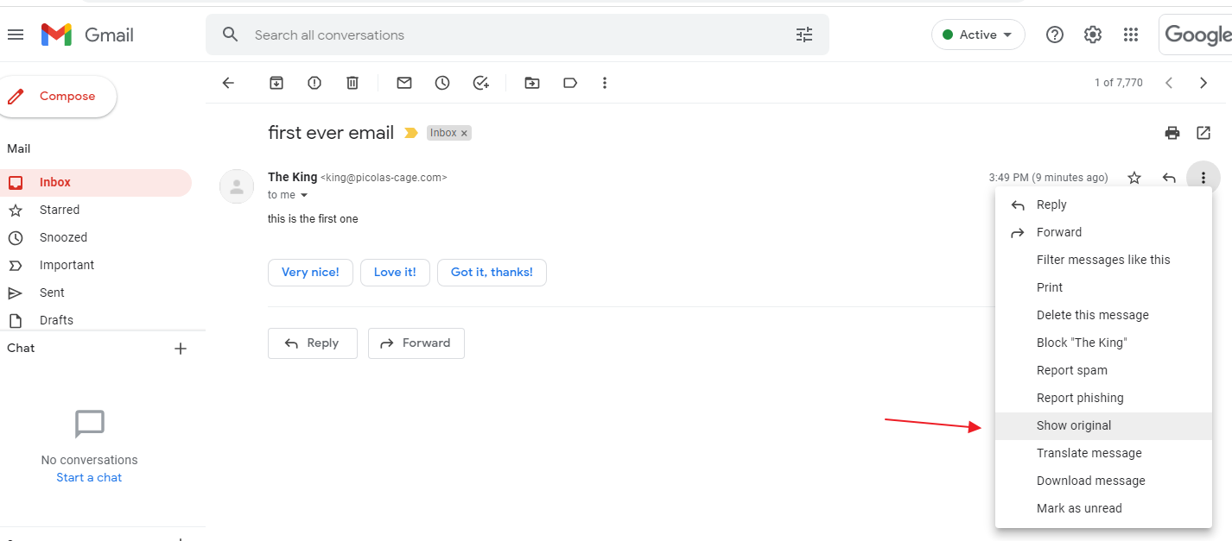
Establishing DNS Records (SPF)

Slide 18
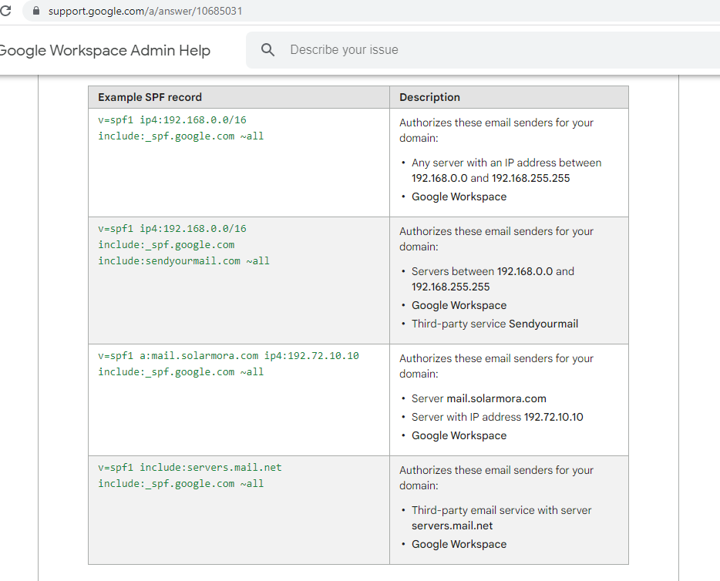
Establishing DNS Records (SPF)
SPF = Sender Policy Framework. DNS record that shows which entities are allowed to send emails for your domain

Slide 19
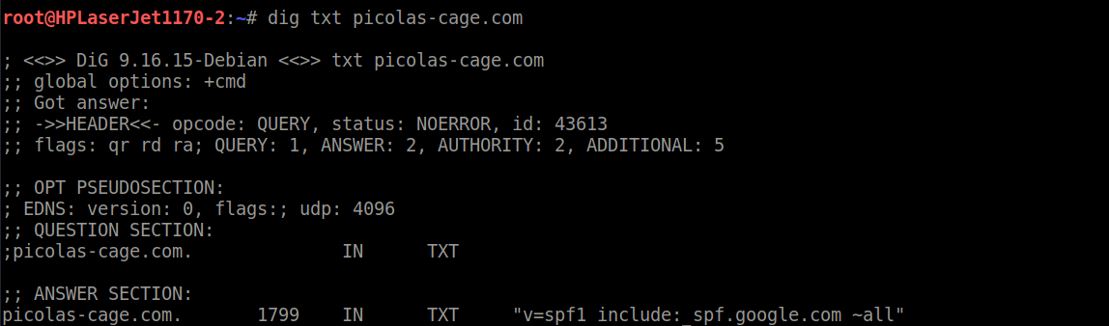
Establishing DNS Records (SPF)

Slide 20
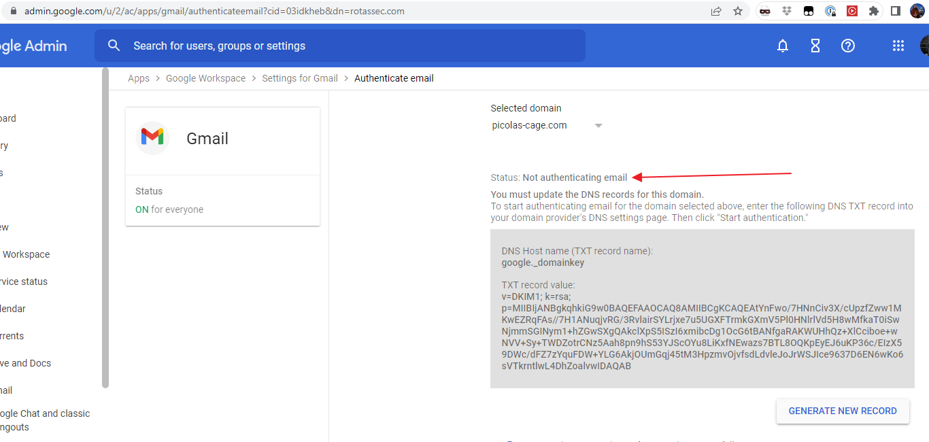
Establishing DNS Records (DKIM)
DKIM = DomainKeys Identified Mail: Email system signs header with private key, public key is published to DNS to validate signature.

Slide 21
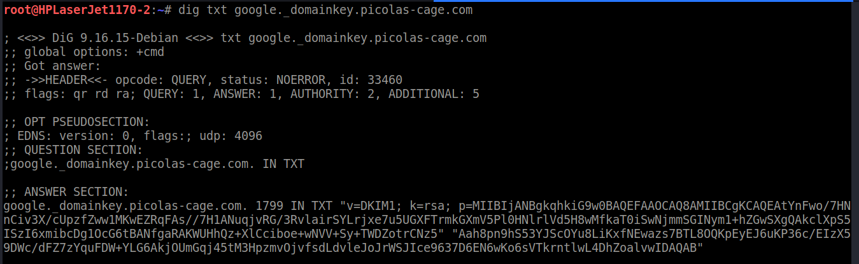
Establishing DNS Records (DKIM)

Slide 22
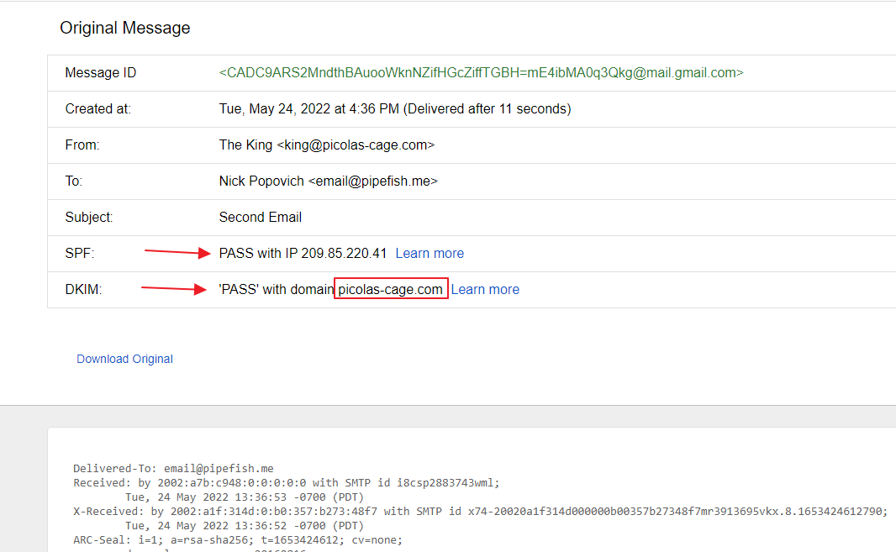
Establishing DNS Records (DKIM)

Slide 23
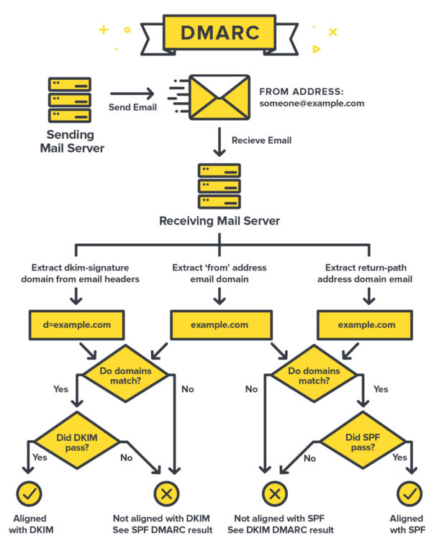
Establishing DNS Records (DMARC)
DMARC= Domain-based Message Authentication, Reporting & Conformance
TL;DR DNS TXT record that specifies a policy on what to do with emails from sources you don’t trust, based on result of SPF and DKIM. Reject, quarantine, etc…
Image from https://postmarkapp.com/guides/dmarc

Slide 24
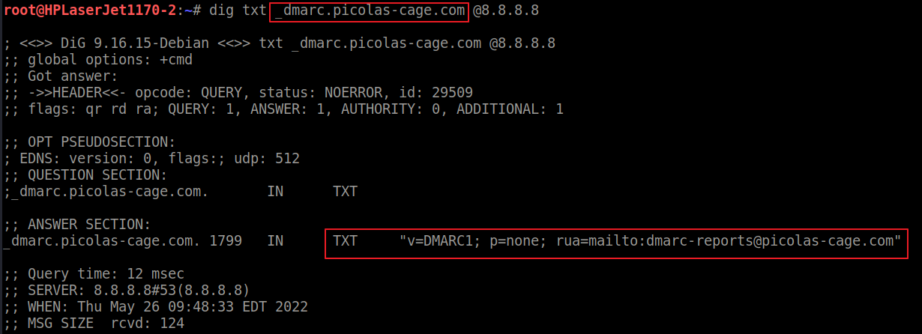
Establishing DNS Records (DMARC)

Slide 25
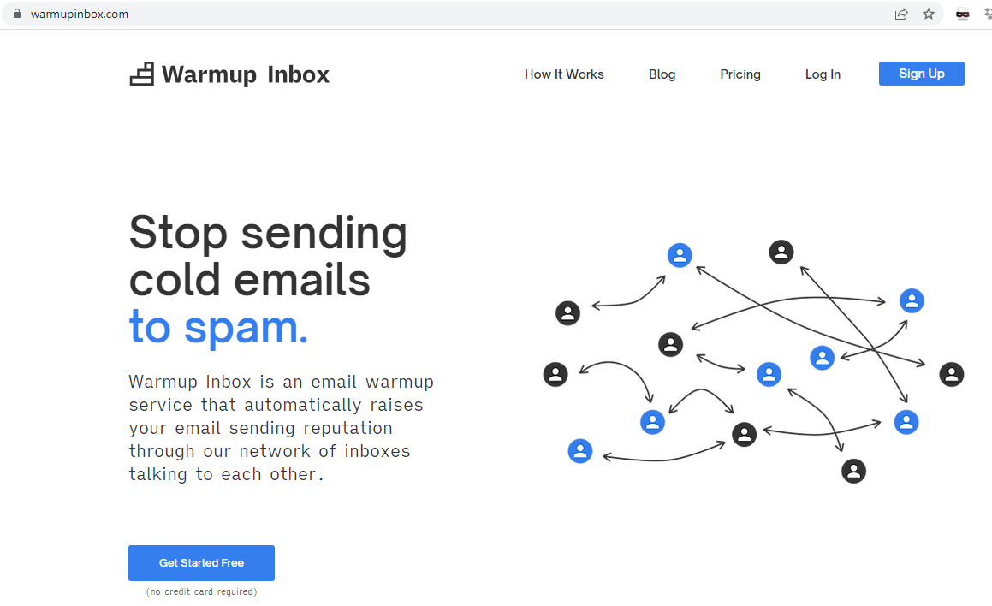
Email Warm Up

Slide 26
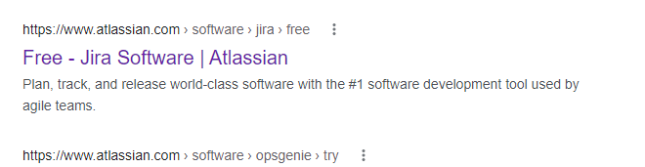
Atlassian Confluence/Jira

Slide 27
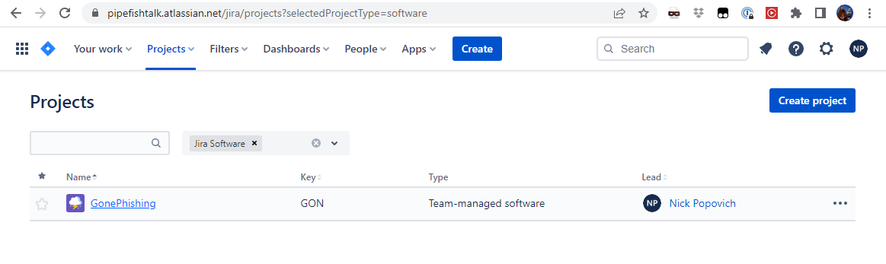
Atlassian Confluence/Jira

Slide 28
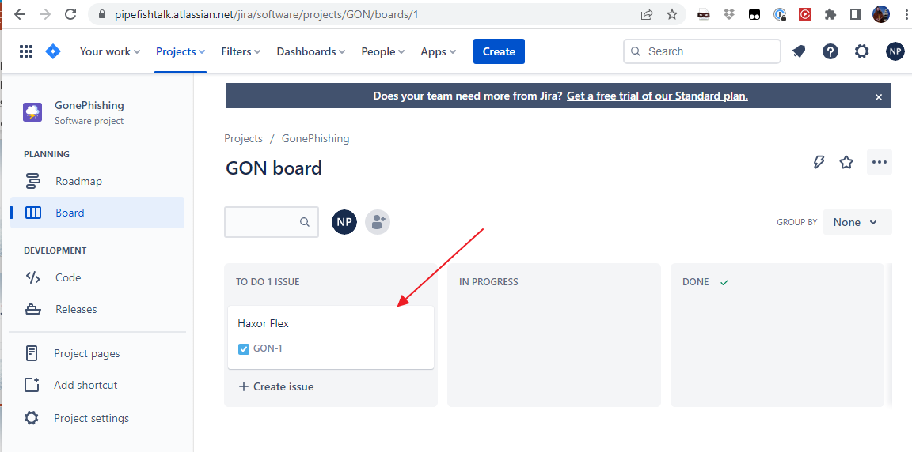
Atlassian Confluence/Jira

Slide 29
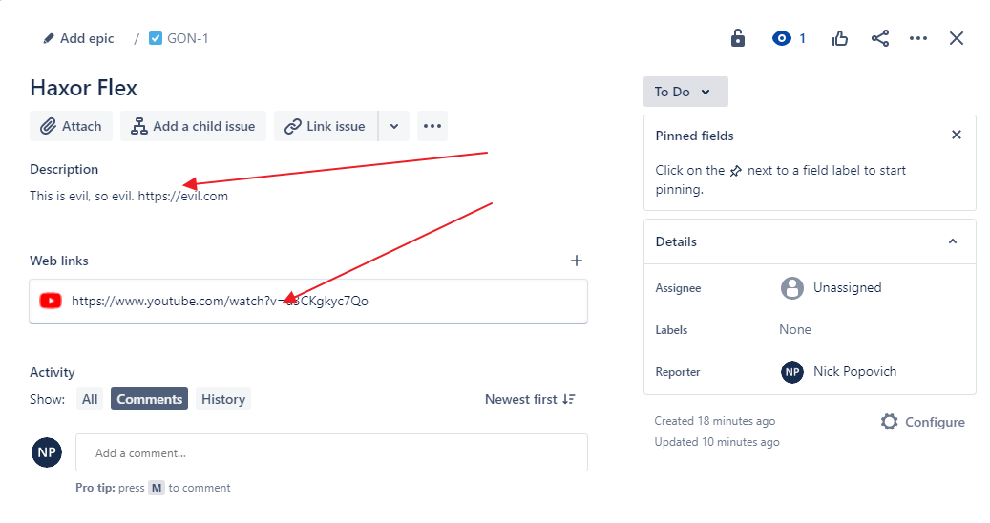
Atlassian Confluence/Jira

Slide 30
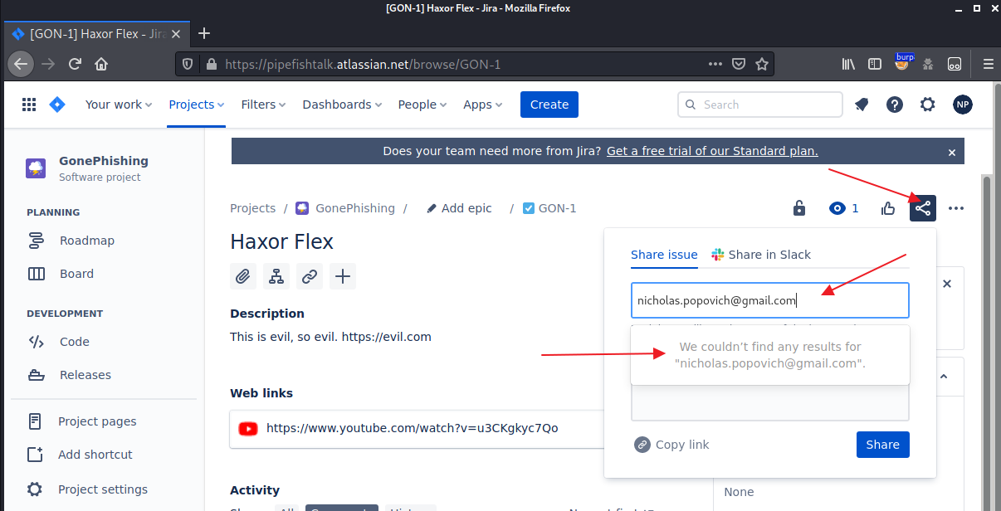
Atlassian Confluence/Jira

Slide 31
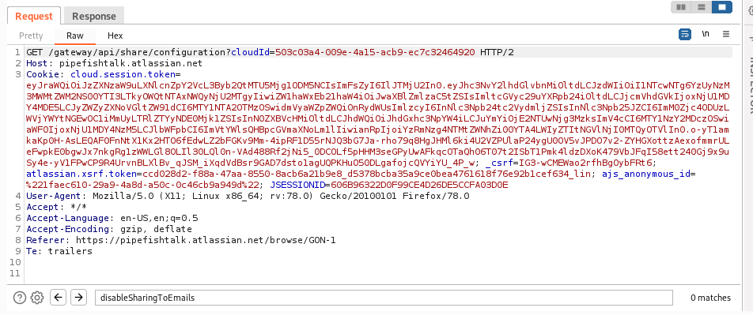
Atlassian Confluence/Jira

Slide 32
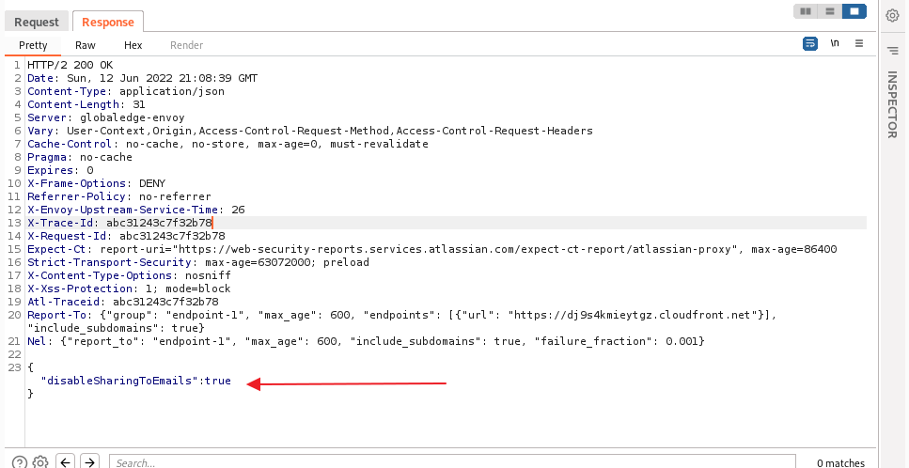
Atlassian Confluence/Jira

Slide 33
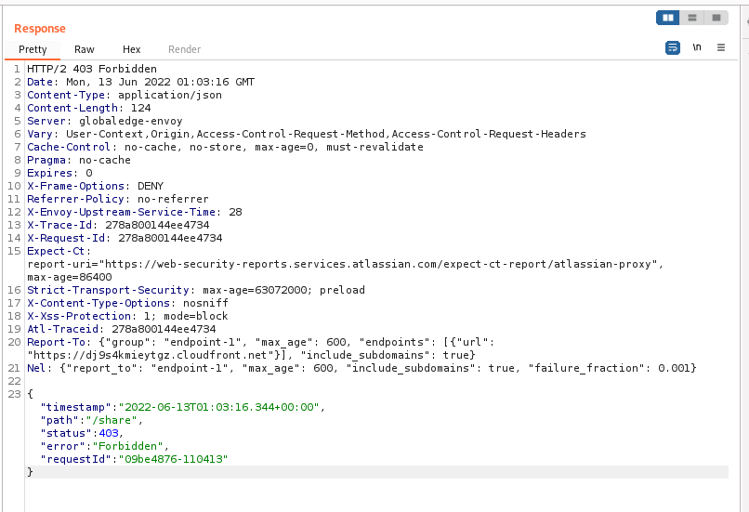
Atlassian Confluence/Jira

Slide 34
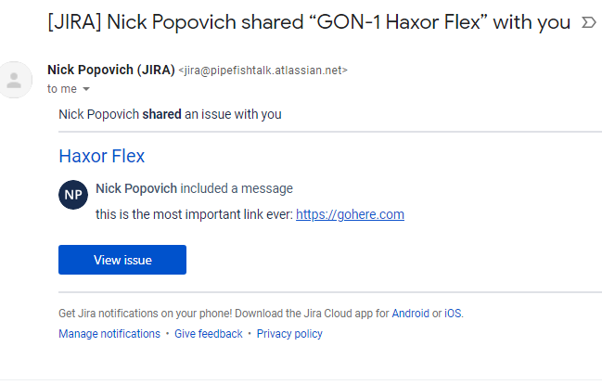
Atlassian Confluence/Jira

Slide 35
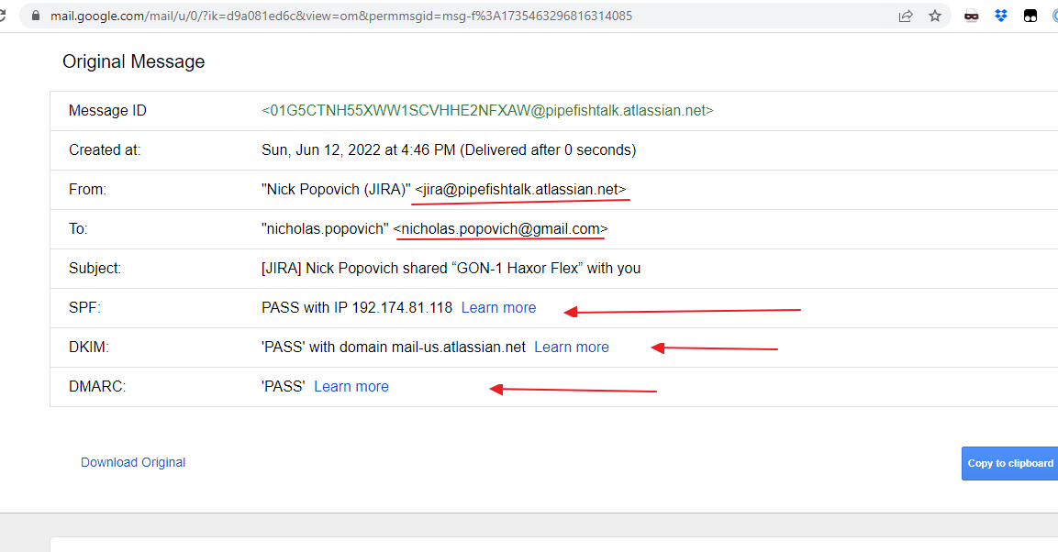
Atlassian Confluence/Jira

Slide 36
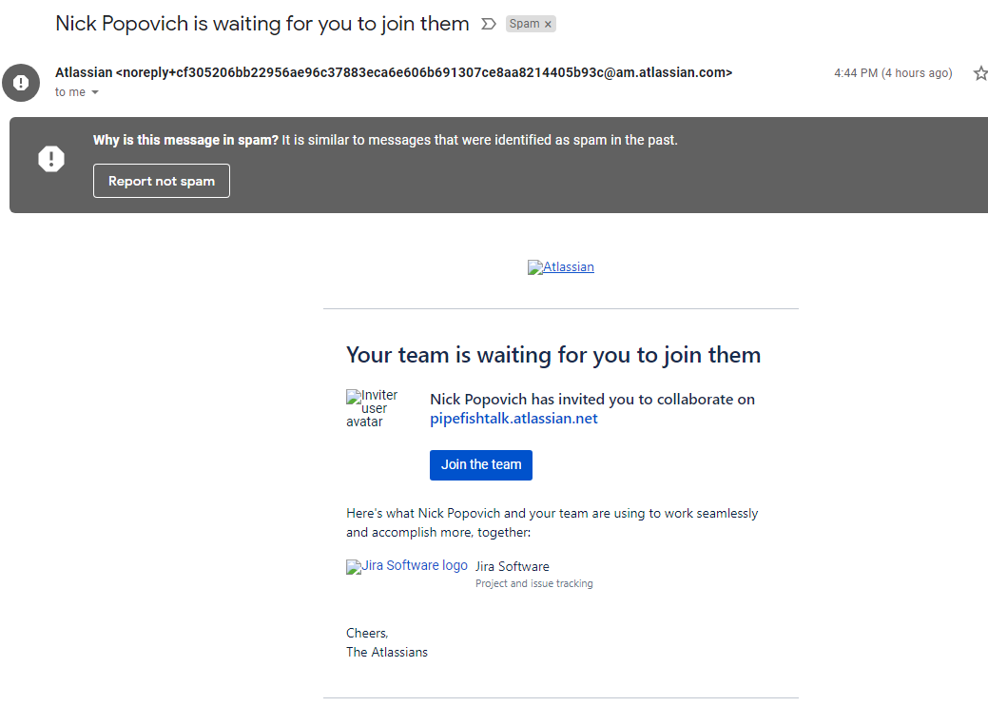
Atlassian Confluence/Jira

Slide 37
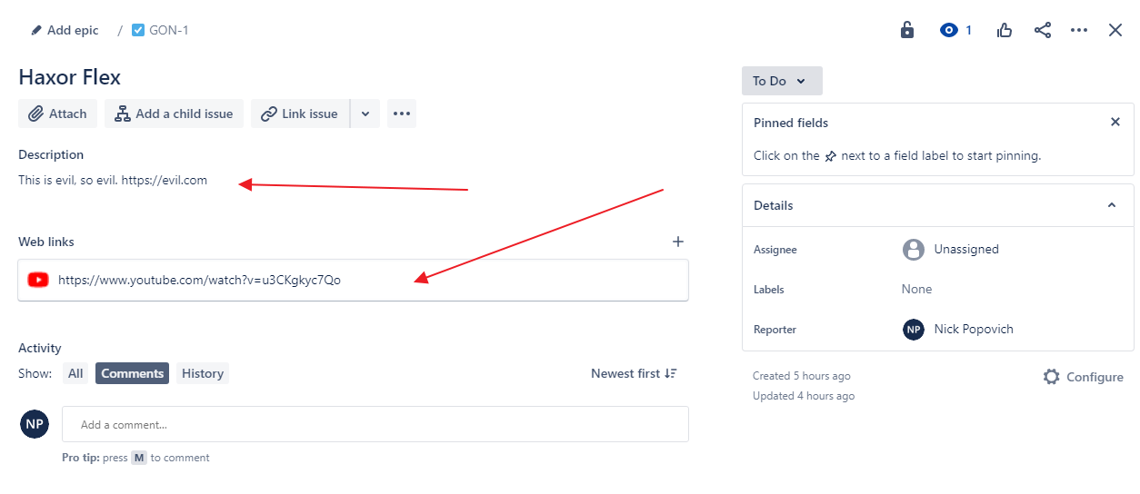
Atlassian Confluence/Jira

Slide 38
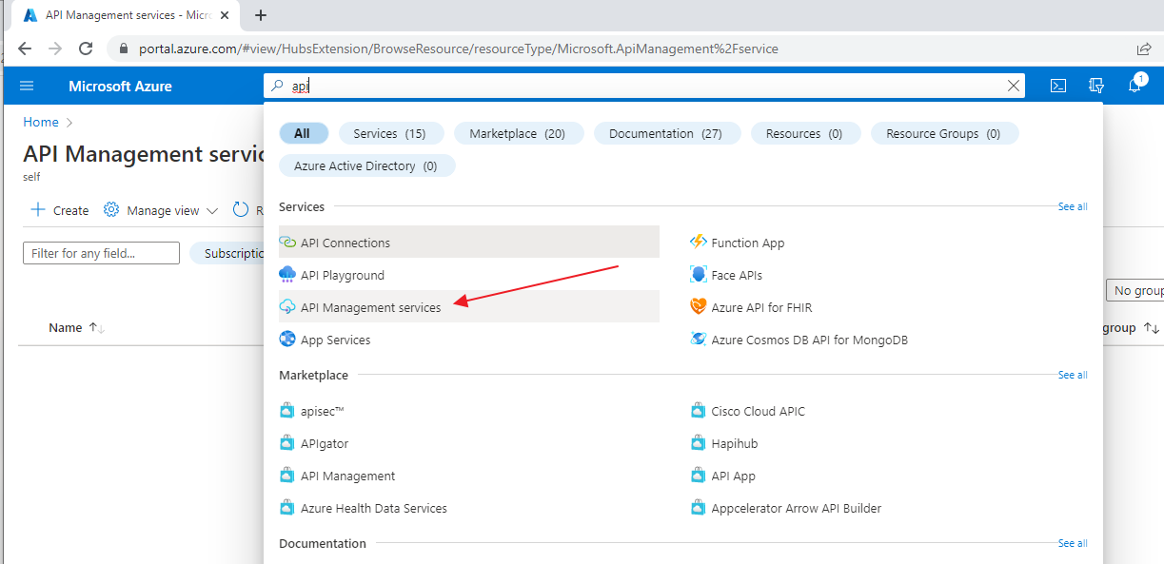
Azure API Mgmt Service

Slide 39
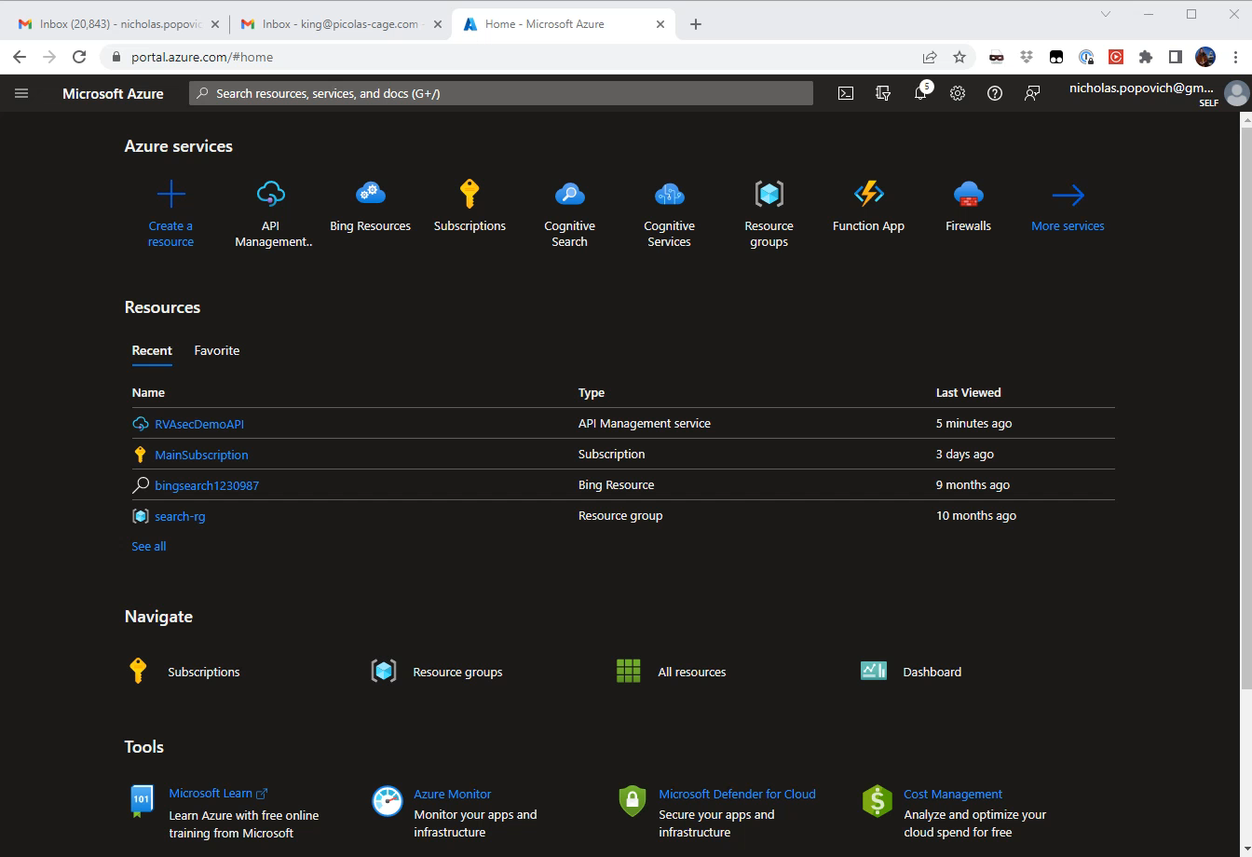
Azure API Management

Slide 40
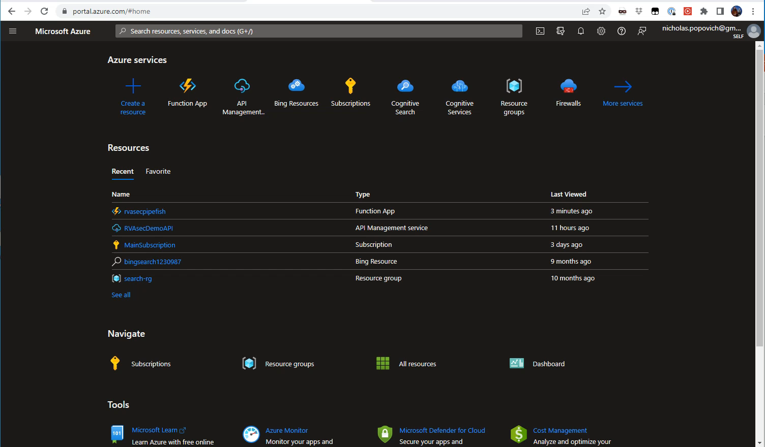
Azure Function Proxy for C2/Redirector

Slide 41
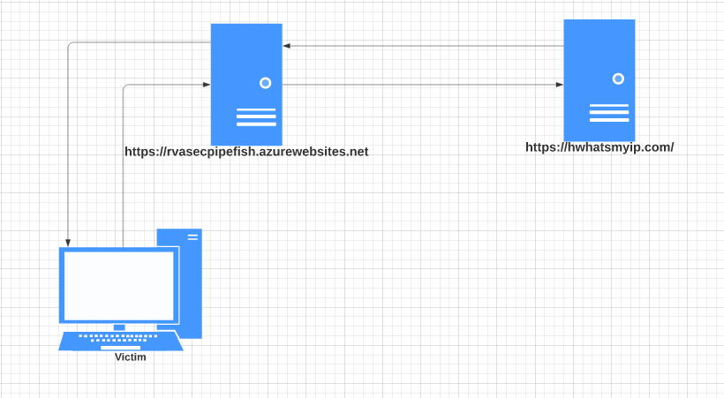
Azure Function Proxy for C2/Redirector

Slide 42
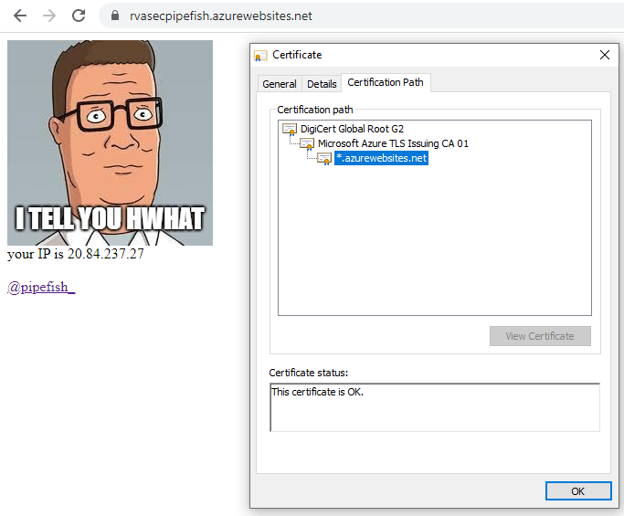
Azure Function Proxy for C2/Redirector

Slide 43
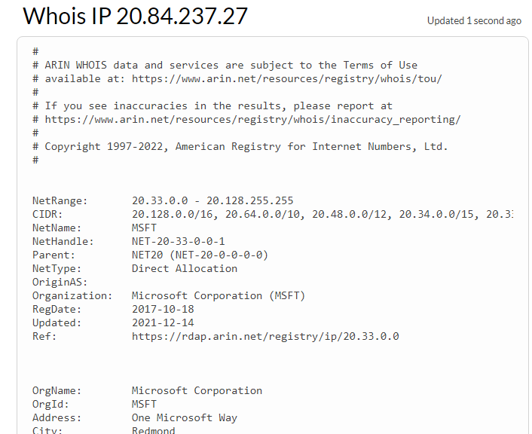
Azure Function Proxy for C2/Redirector

Slide 44
Remediation/Mitigation Thoughts
SaaS Sends Email from Org’s domain?
Encourage use of company portal?
Prepare users’ for the emails?
Notes:
Example: 2016 hours at bill rate of 230 (cogs estimate $115) revenue = 1803200 GP = 901,600

