Slide 1
Threat Intelligence 2022, Actionable?
By: Peter Partyka
SVP Engineering Flashpoint, Flashpoint.io

Slide 2
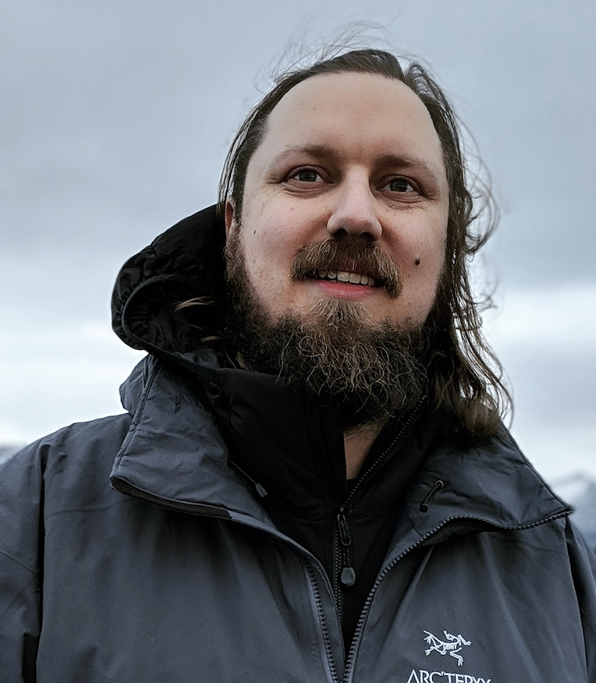
> Whoami?
16 Years in Security / Engineering
Helpdesk -> Web Design
NYC Hedge Fund Space
Red Teaming / Application Security
Security Consulting
NYU SPS: Advanced Hacking, Defending Cyber Assets
SVP Engineering Flashpoint Intelligence
61 73 6B 20 6D 79 20 68 61 6E 64 6C 65 73 20 69 6E 20 70 65 72 73 6F 6E

Slide 3


> Disclosures
RVAsec 2018: Mark Arnold: Hacking Intelligence
I work for a Threat Intelligence Vendor
Privileged: Engineers and Makers Orgs
57 65 20 61 72 65 20 61 6C 73 6F 20 68 69 72 69 6E 67 21

Slide 4
Defining Threat Intelligence in 2022
“Threat intelligence is evidence-based knowledge, including context, mechanisms, indicators, implications and action-oriented advice about an existing or emerging menace or hazard to assets. This intelligence can be used to inform decisions regarding the subject's response to that menace or hazard.” — Gartner
Intelligence allows you to take rapid, informed actions to mitigate risk everywhere. Intelligence is everywhere you need to be, around the clock. You need to have targeted, automated collection systems capturing the data from OSINT sources that matter most to you, whether social media, chat services, foreign-language forums, illegal marketplaces, paste sites, or the deep and dark web.
— Flashpoint
43 68 65 63 6B 20 6F 75 74 20 47 61 72 74 6E 65 72 27 73 20 6E 65 77 20 72 65 70 6F 72 74 20 61 62 6F 75 74 20 4F 70 65 72 61 74 69 6F 6E 61 6C 69 7A 69 6E 67 20 54 49

Slide 5
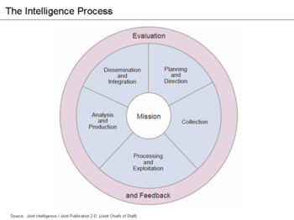
Obligatory Concepts #1 (The Diagram)
The Intelligence Cycle:
The Intelligence cycle describes how intelligence is ideally processed in civilian and military intelligence agencies, and law enforcement organizations. It is a closed path consisting of repeating nodes, which (if followed) will result in finished intelligence. - Wikipedia
Planning and Direction
Collection
Processing and Exploitation
Analysis and Production
Dissemination and Integration
Evaluation and Feedback

Slide 6
Obligatory Concepts #2 (The Equation)
Threat x Vulnerability = Risk
Threat x (Likelihood x Vulnerability) x Impact = Risk
Threat - Is a potential action or event that can take place against your assets
Vulnerability - A known or unknown point of exposure to your assets.
Likelihood - Is the credible possibility that a given vulnerability can be acted on, taking into account mitigating factors and controls.
Impact - Is the measure of loss that the business may suffer in the event of Risk.
Risk - Is what happens with threats act on vulnerabilities with an effect on your assets.

Slide 7

Shall we play a game?
Our Information Security Program
Firewalls (NextGen, UTM: Built in IDS, IPS, Webfiltering, Sandbox etc.)
Palos, Fortinet, Checkpoint
Endpoint AV Agent
Symantec, McAfee, etc.
Vulnerability Scanner
Tenable, Rapid7, Qualys
===========================================
SIEM
Splunk, ESM, Qradar, ArchSight
Threat Intelligence c.2012
All the feeds, IOCS, Hashes, Yara, Surricata
Emails
Call me maybe is the summer jam.
Personel
Including yourself you have +1 staff and you also change printer ink, and turn computers off and on again.
We’re in good shape but can’t afford, a soar, tip, professional service hours, Or any sidecar products to live in our kube clusters.
Endpoint Asset Management
Tanium…
Endpoint EDR
Crowdstrike, Intercept X, Carbon Black
DLP
Digital Guardian, DLP
Mail Gateway
Mimecast, Proofpoint
Web Application firewall
Akamai, Cloudflare, Imperva
Repository Compliance and Security
Gitlab Ultimate / Github Enterprise
69 6E 66 6F 72 6D 61 74 69 6F 6E 20 73 65 63 75 72 69 74 79 20 69 73 20 61 20 70 72 6F 63 65 73 73 20 6E 6F 74 20 61 20 70 72 6F 64 75 63 74 20 2D 20 42 72 75 63 65 20 53 63 68 6E 65 69 65 72

Slide 8
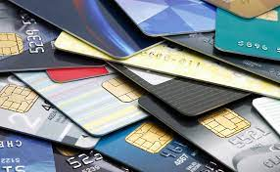
Shall we play a game?
Our Business
We Issue Credit Cards

Slide 9
Audience Participation
I am going to show you a piece of threat intelligence. And we are going to determine whether it is actionable or not actionable.
Wait for Prompt! AYE or NAY!
Let’s start with an easy one:

Slide 10
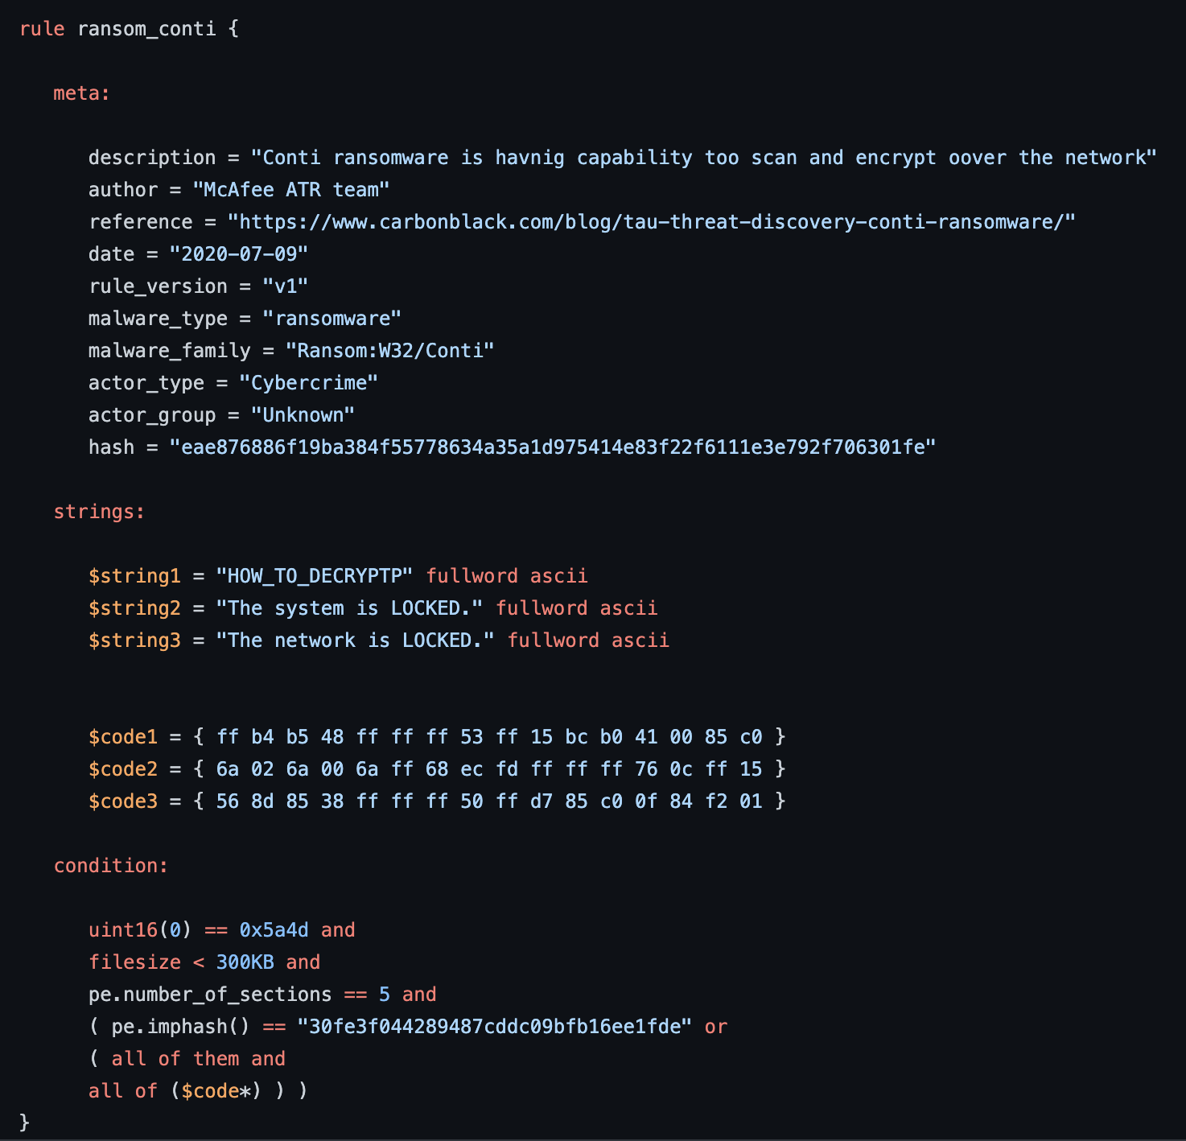

Slide 11
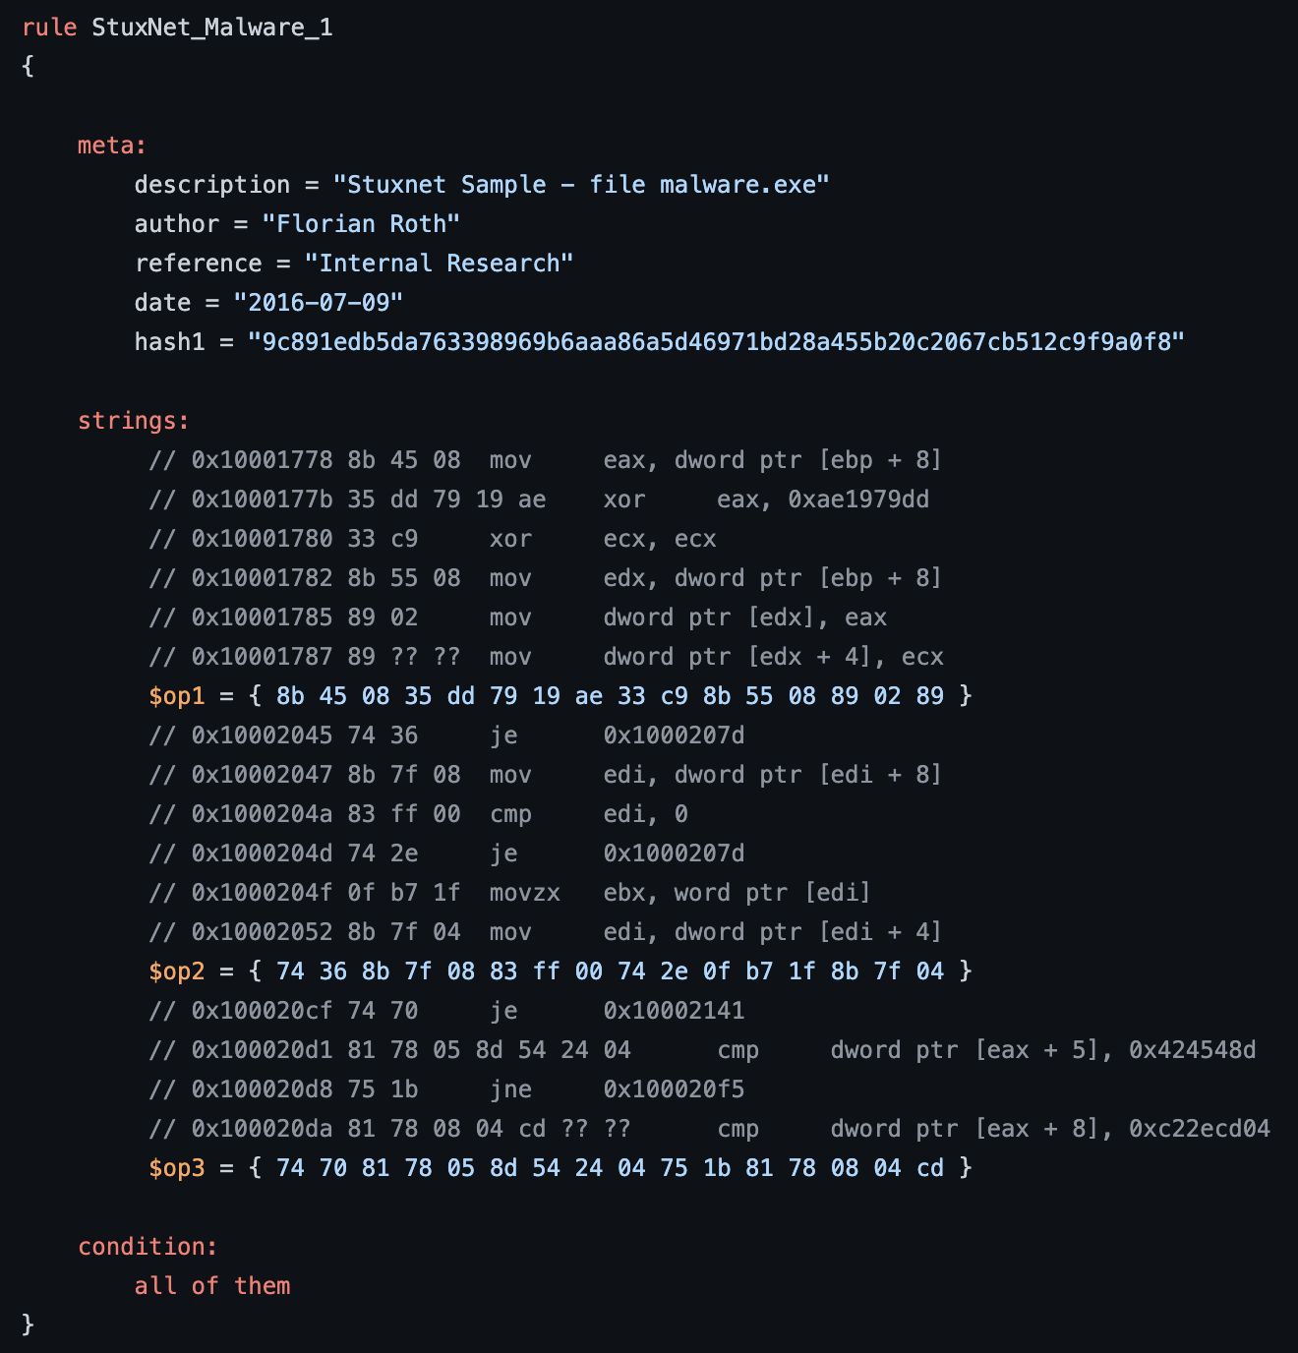
Relevant?

Slide 12
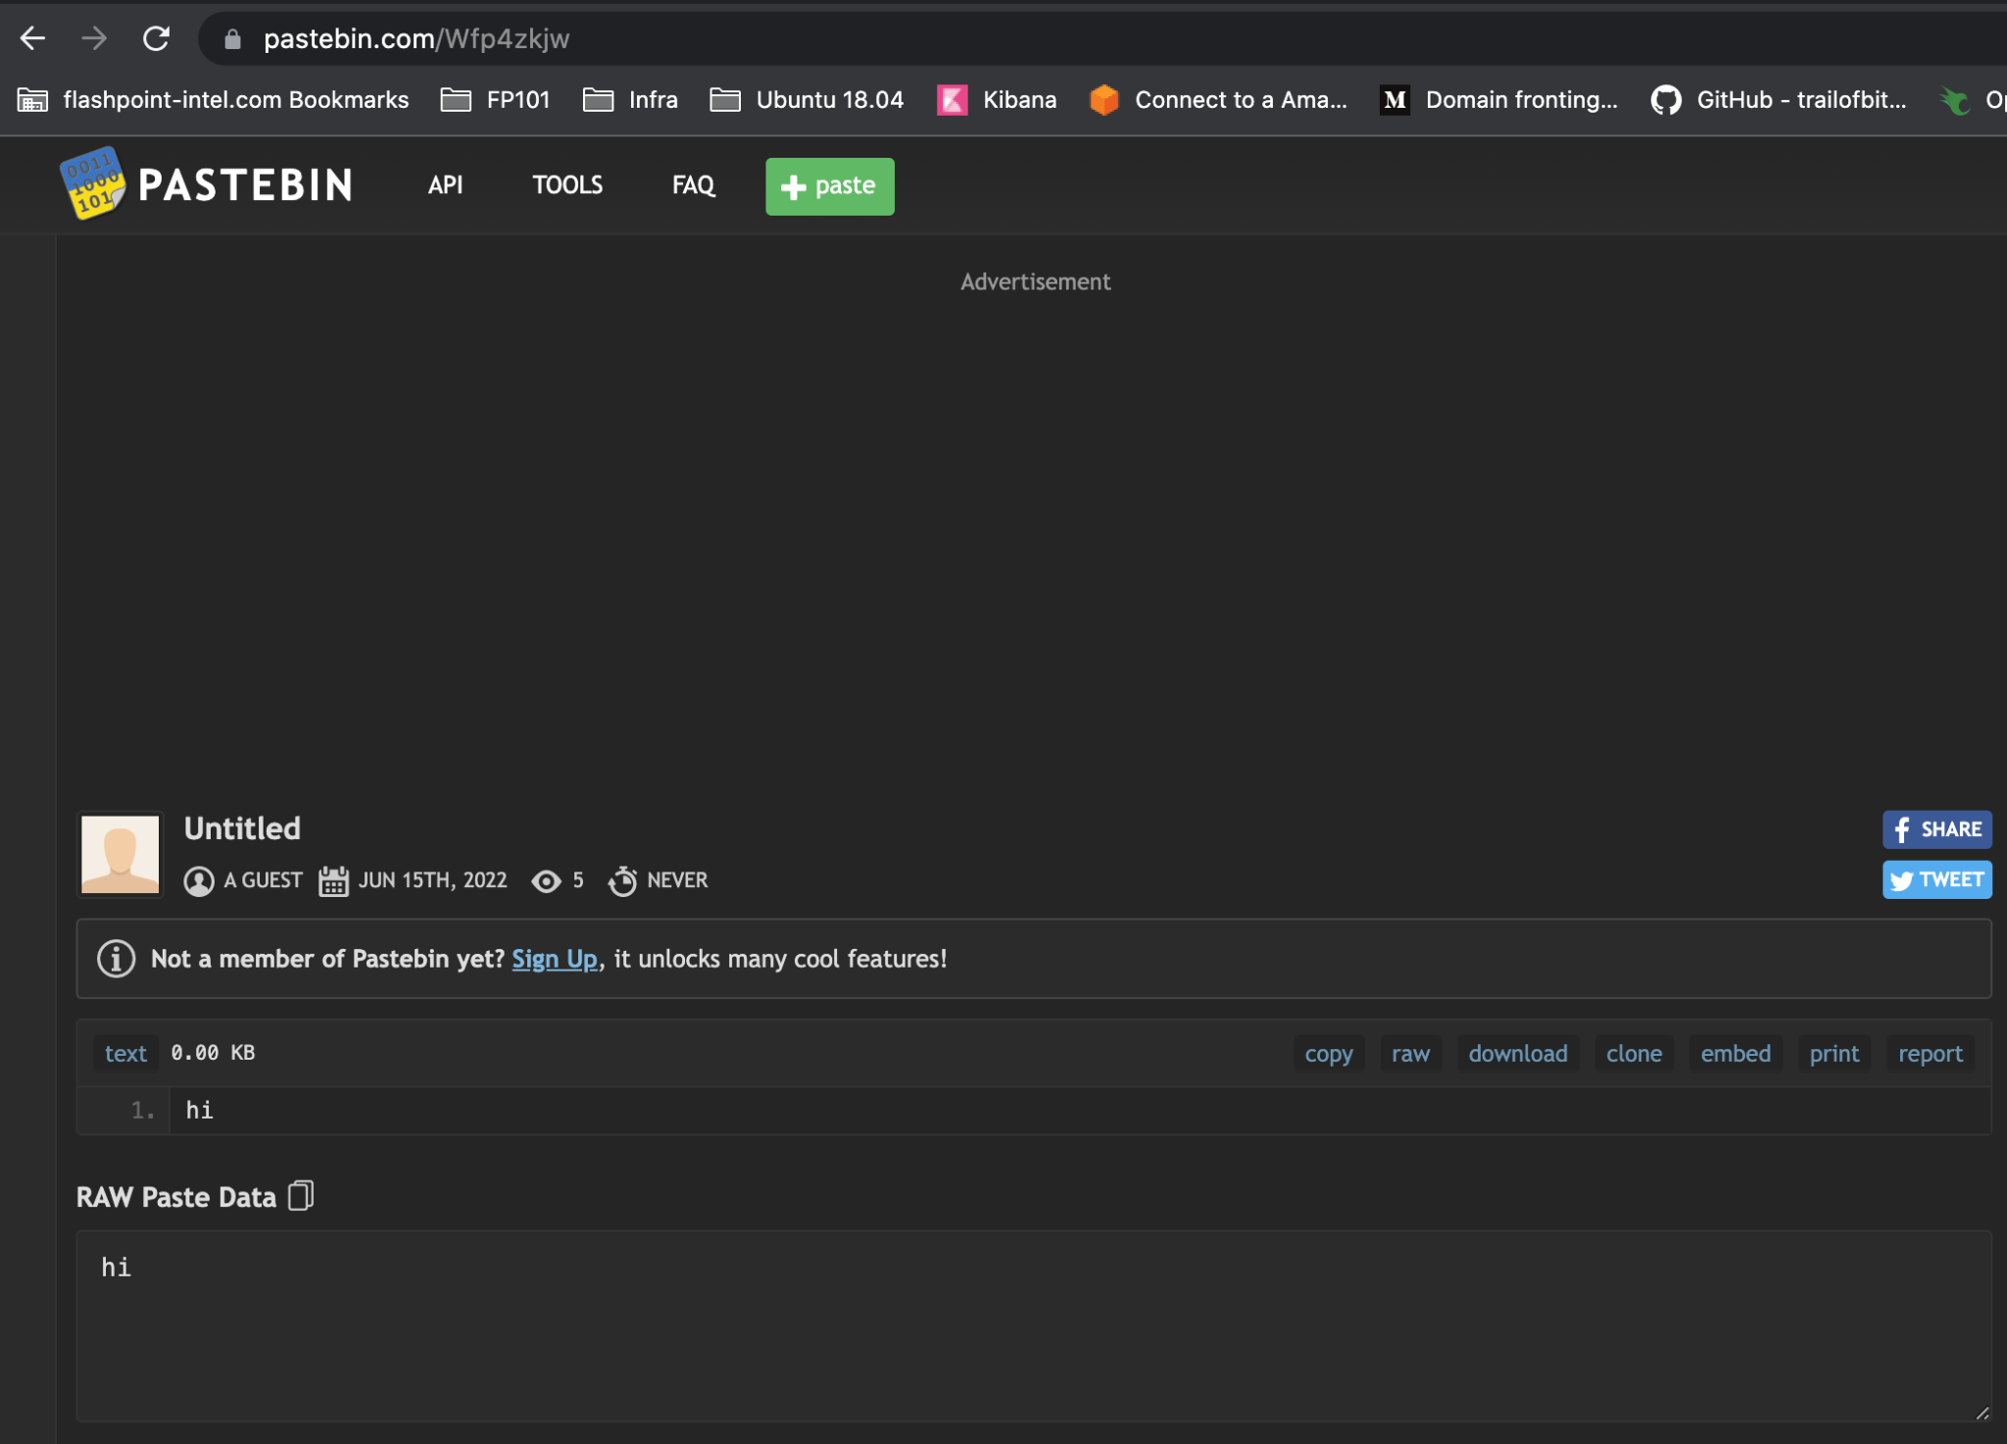

Slide 13
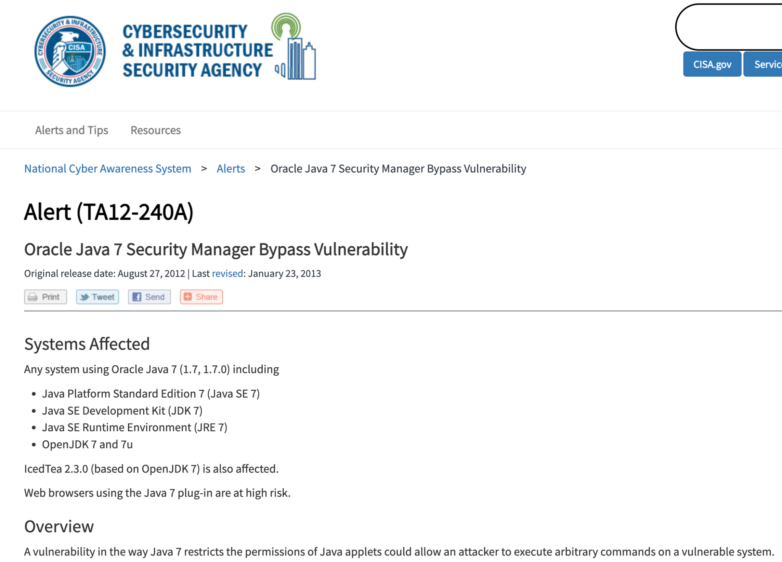

Slide 14
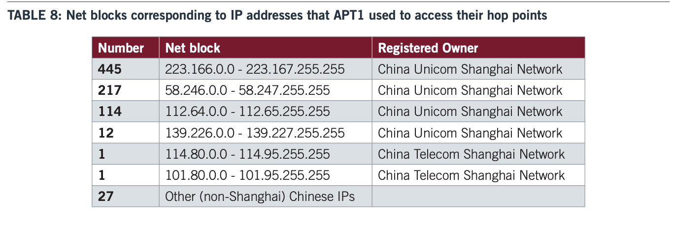
58.246.2.34
October 25th, 2004

Slide 15
8.8.8.8
88.4.4
1.1.1.1
1.0.0.1
4.2.2.2
57 68 6F 20 72 65 6D 65 6D 62 65 72 73 20 34 2E 32 2E 32 2E 32 3F

Slide 16


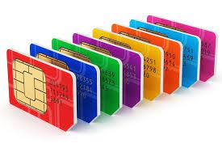
Ok, let’s fast forward to 2022
Threat Intelligence c.2022
Flashpoint, RBS, and others.
Topping the charts: Running up that hill by Kate Bush?
We finally got our SIEM configured
Yay for professional service hours.
We invested in hardware tokens and the PIV protocol
Duo, Okta, w/e
Low Code Automation
Flashpoint Automate, maybe Tines, and other.
And we now sell SIM cards!
41 6E 79 6F 6E 65 20 65 6C 73 65 20 68 65 72 65 20 61 20 44 6E 44 20 6E 65 72 64 3F

Slide 17
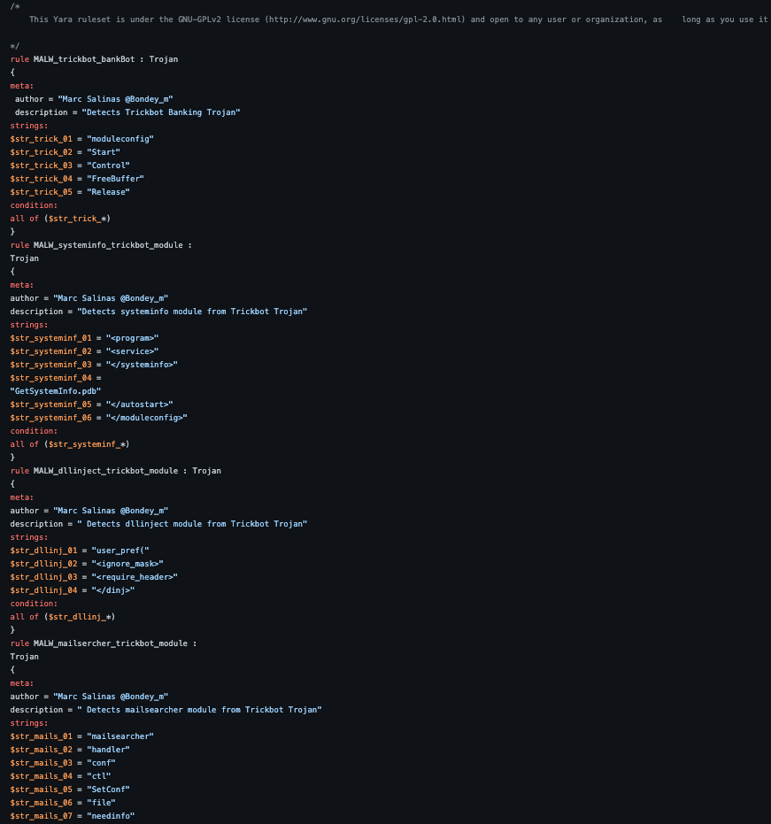

Slide 18
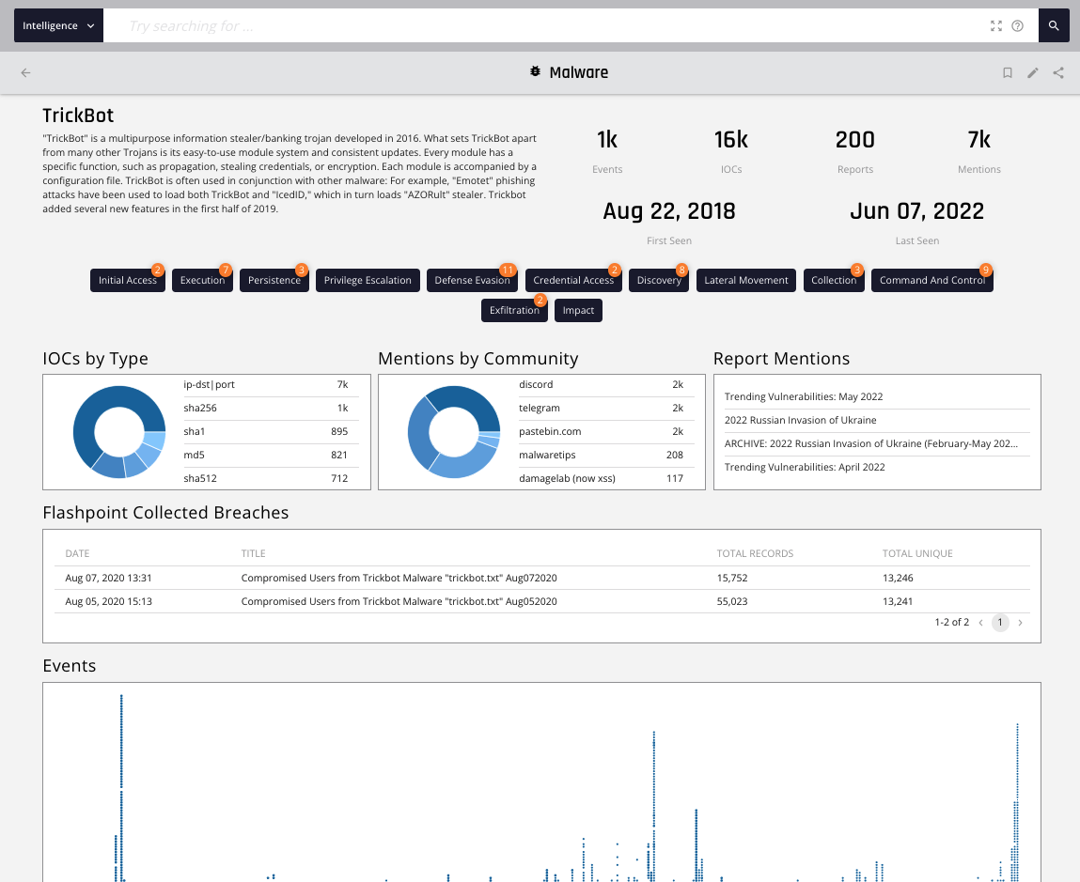

Slide 19
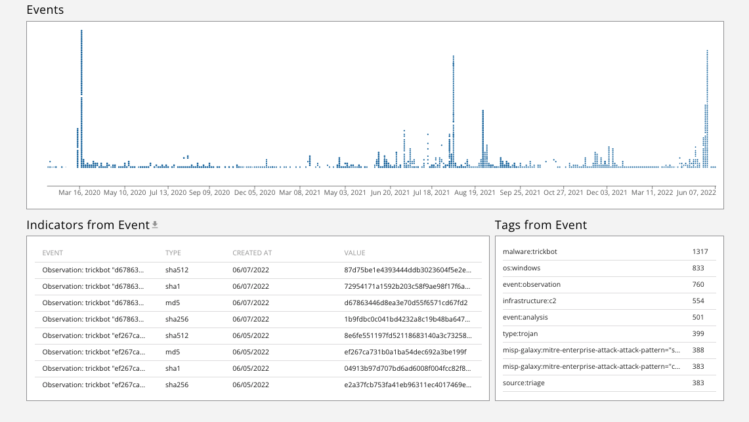

Slide 20
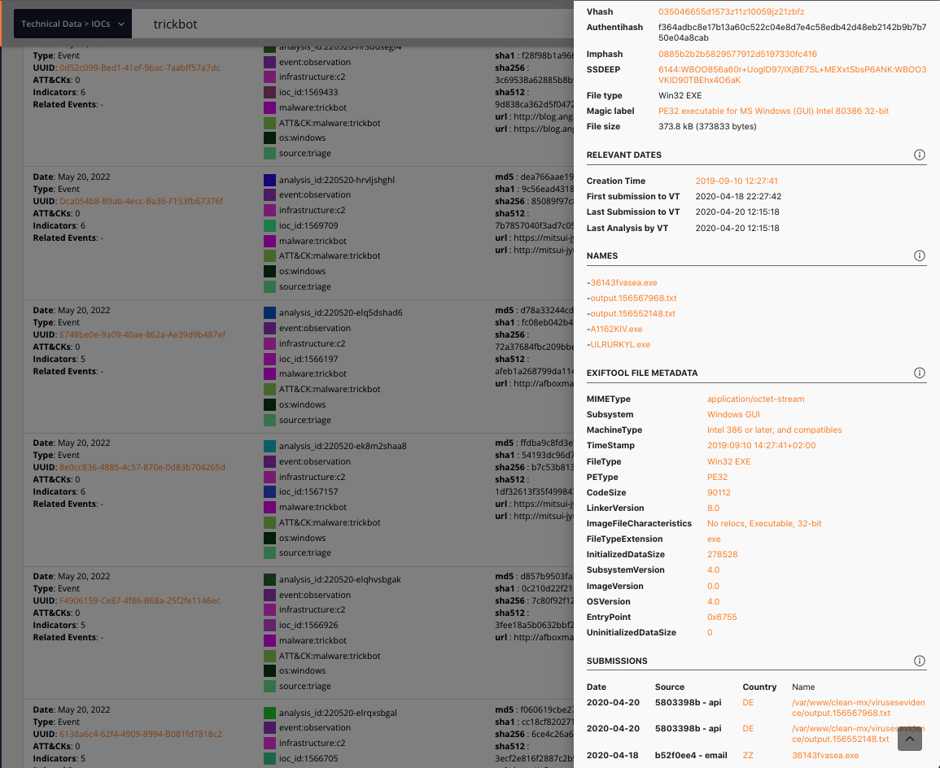

Slide 21
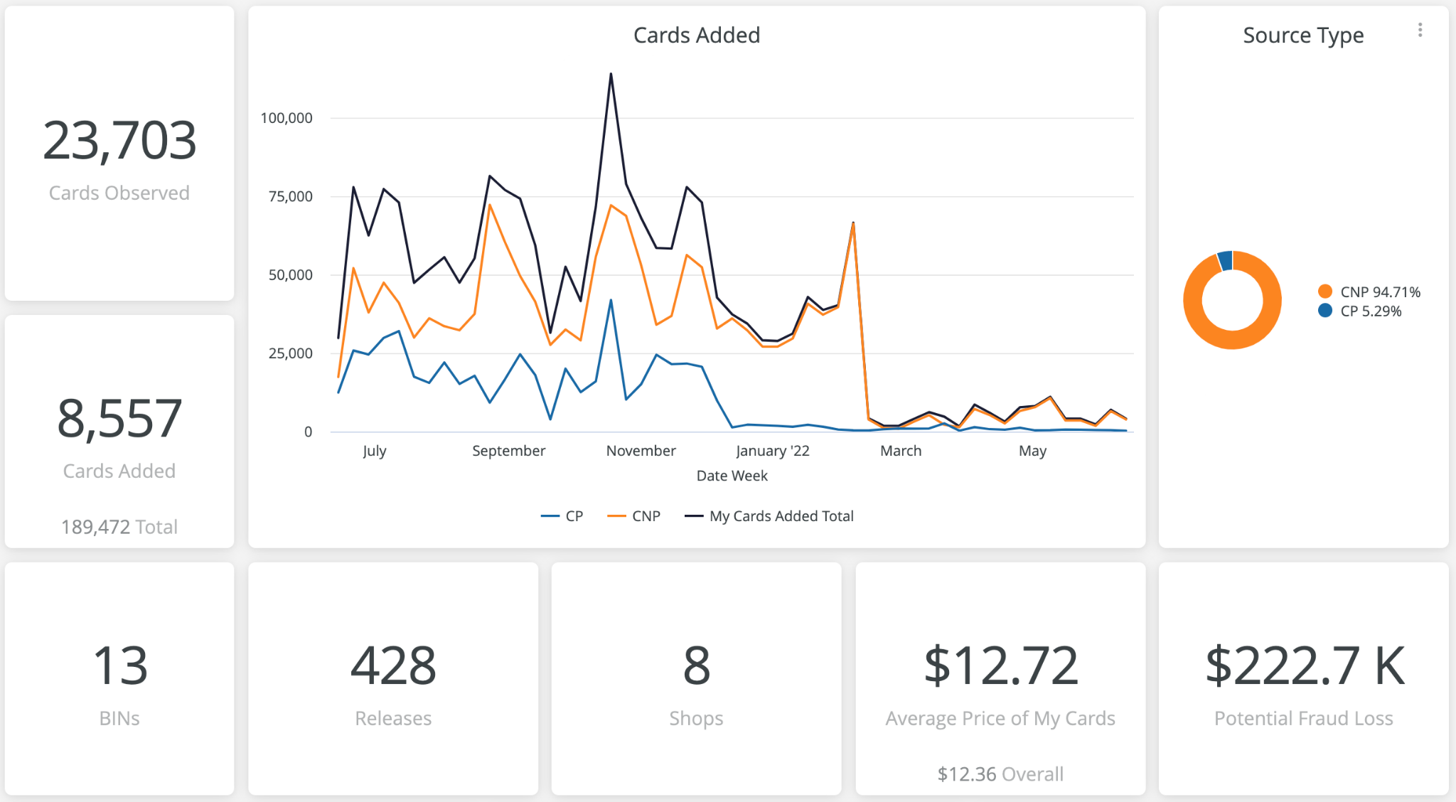

Slide 22
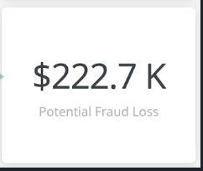
Wait a minute… What just happened? What changed?
Perimeter

Slide 23
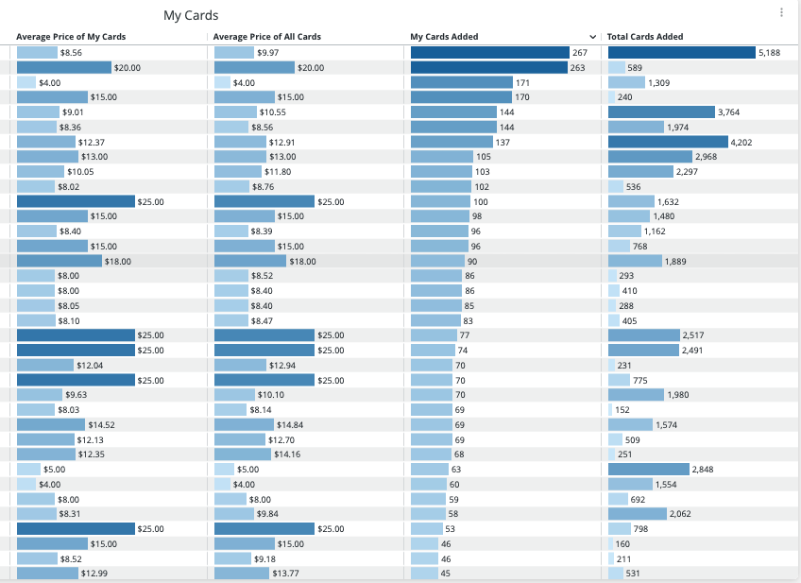

Slide 24
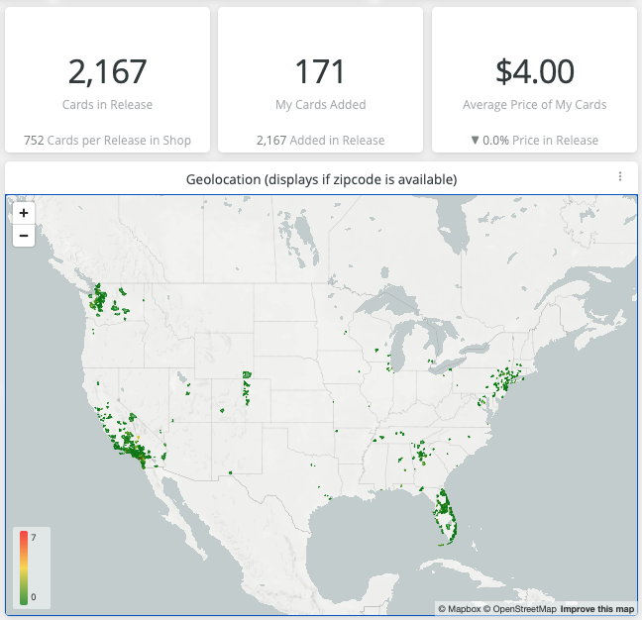
57 68 6F 20 72 65 6D 65 6D 62 65 72 73 20 34 2E 32 2E 32 2E 32 3F

Slide 25
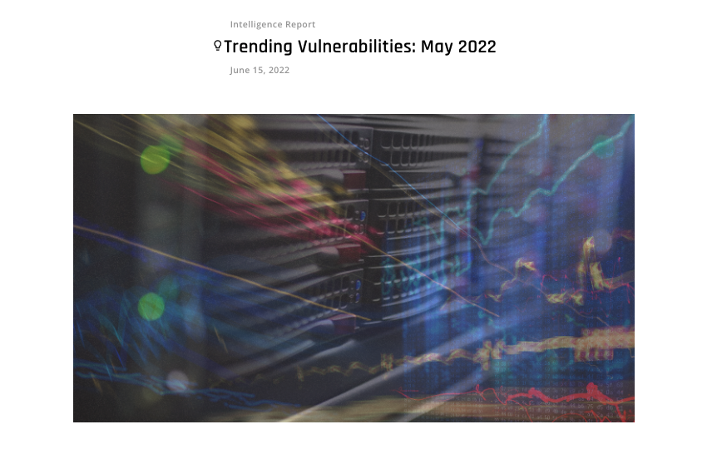

Slide 26
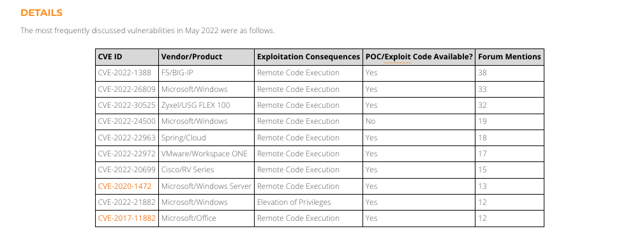

Slide 27
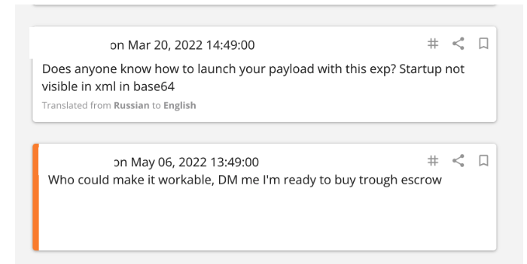
48 61 63 6B 20 74 68 65 20 50 6C 61 6E 65 74 3F

Slide 28
“inny”
Insider

Slide 29
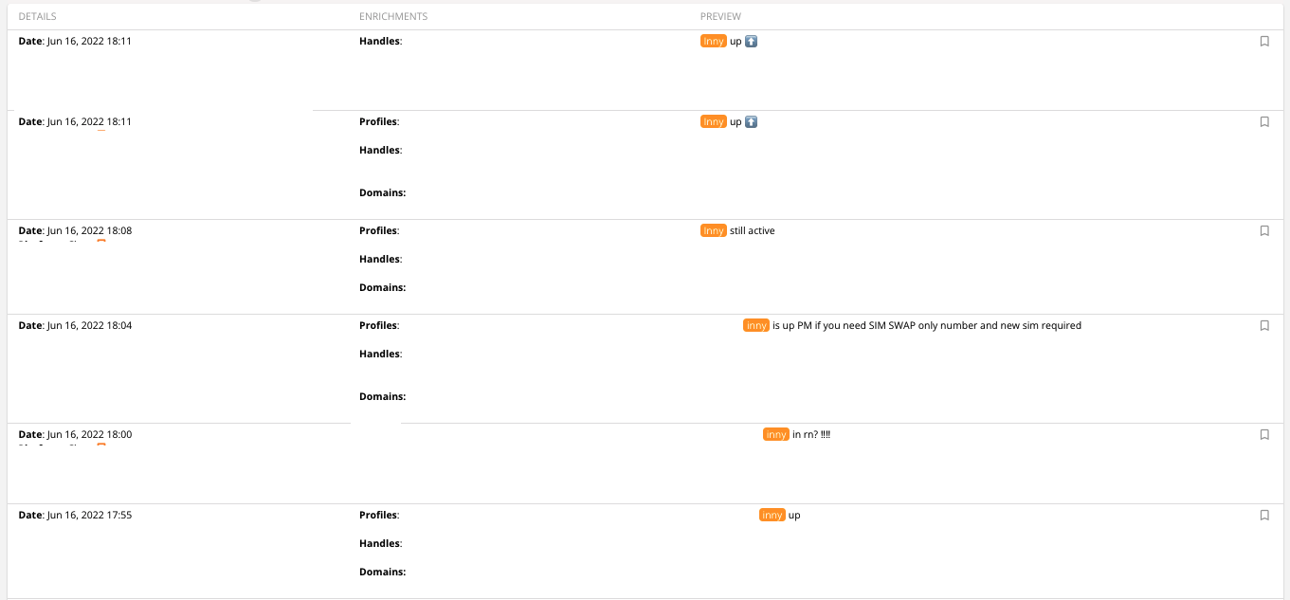

Slide 30
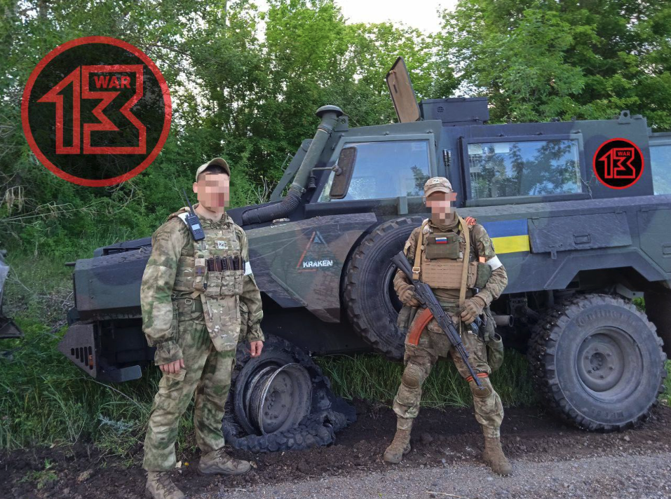

Slide 31
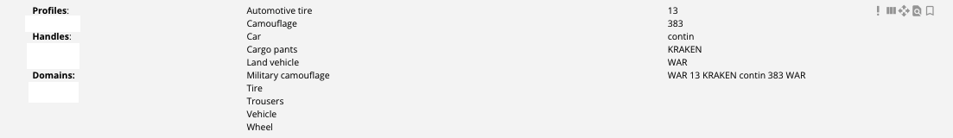

Slide 32
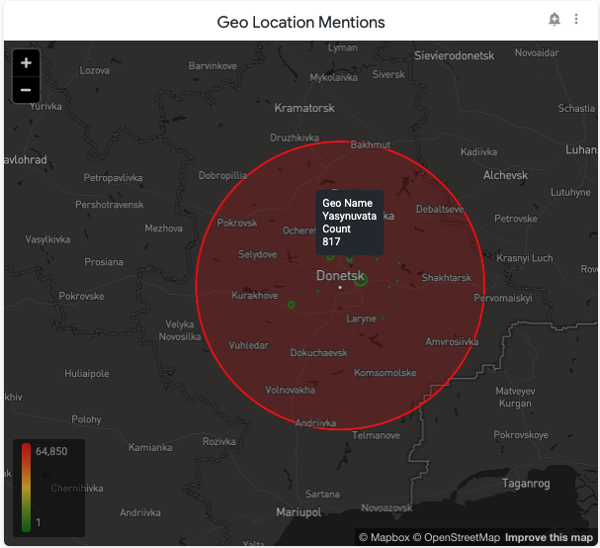

Slide 33
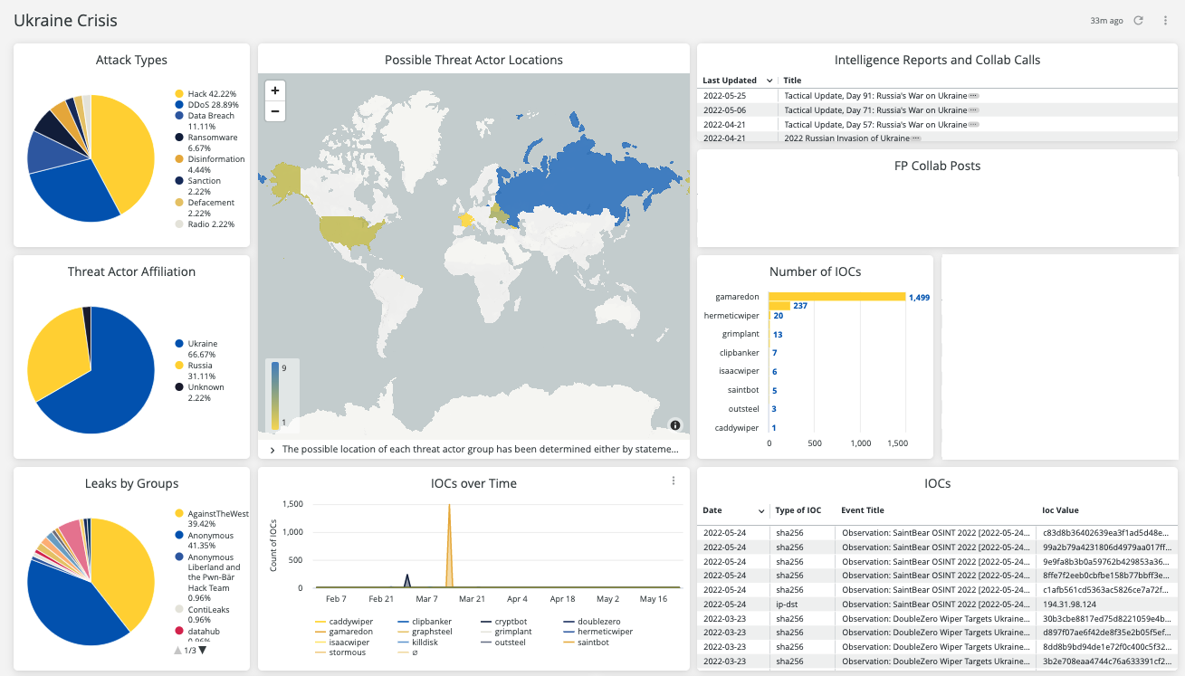

Slide 34

How about Identity Management?
We enforce, strong usernames and passwords
We have MFA on all our webapps
We use PIV MFA to for laptop access
=========================================
What about that web application that someone signed up for with the corporate card that IT doesn’t know about and doesn’t have MFA?

Slide 35
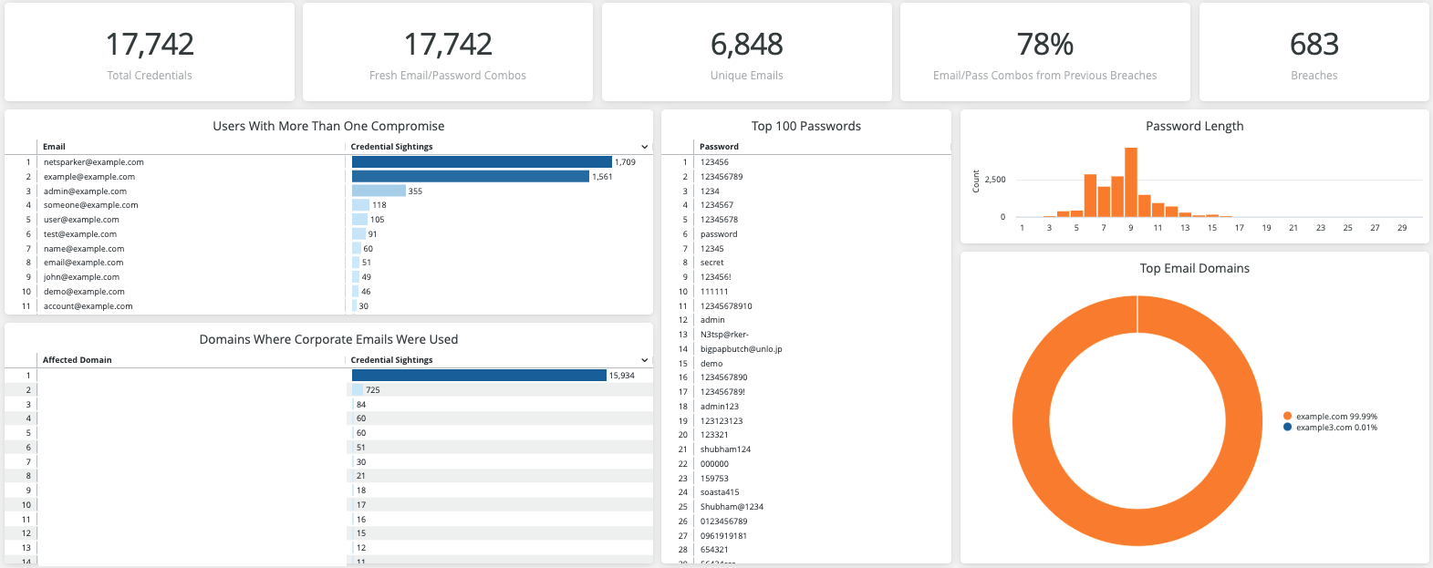

Slide 36
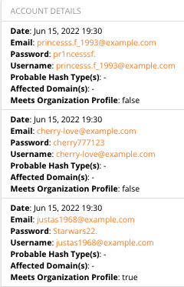

Slide 37
How about Indirect Matches?

Slide 38
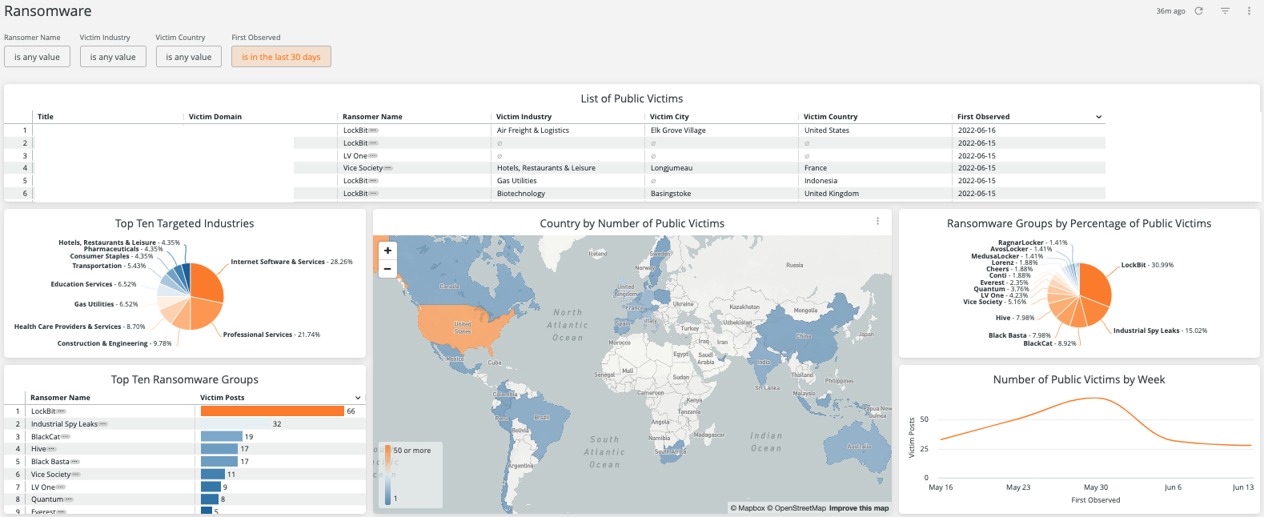
How about that Supply Chain?

Slide 39


What if I told you that there are 3 vulnerabilities in your supply chain that don’t have CVE’s and 1 of them is an RCE

Slide 40
Understanding “INT”
“INT” has evolved.
In 2018 Mark Arnold called out the “INT” disciplines that guided the start of “Threat Intelligence”: HUMINT GEOINT MASINT OSINT SIGINT TECHINT CYBINT/DNINT FININT
While there is significant overlap, those do not always apply to our world. We have to rethink this ontological framework.

Slide 41
Our Ontologies have to change:
Threat Intelligence
OSINT
Deep and Dark Web Intelligence
Vulnerability Intelligence
Breach Intelligence
Identity Intelligence
Attack Surface Intelligence
Financial Intelligence
Geo Political / Geo Spatial Intelligence
Security Community Intelligence

Slide 42
Is intelligence
Actionable?

Slide 43
Peter Partyka, SVP Engineering
Flashpoint.io
Thank You!

