Slide 1
Grain Quality
Rajan Vatassery

Slide 2
Data Analysis Fundamentals
Assumptions:
Winter crop is only dependent on weather from days 0-180 in calendar year
Winter crop doesn’t depend on previous year’s weather
Zip code-to-county correlation used was only 2013’s
Precipitation is all rain
Unmatching data removed (about 0.5% yield information lost)

Slide 3
Critical Trends
Protein 12 is strongly influenced by sunlight (positively) and precipitation/humidity (negatively)
Moisture is driven by humidity and precipitation most strongly
Falling No appears to have a “sweet spot” parabolic correlation with the derived independent variable “normRainT” which appears to support intuition that Falling number is highest when moisture and temperature are “just right.”
Many trends are close to qualitative
This data set shows that there is a need for a comprehensive model to predict the dependent variables
ML model may provide some utility here, but fundamental understanding is important as well

Slide 4
Data Slides - Explanations
normRainT is a derived quantity that is obtained by normalizing the data range of both the aggregate total of met_p_mm and the mean of met_avg_t, then adding these two together.
The darker line is a linear fit
The lighter line is a 2nd order polynomial fit
The Y axis is incorrectly labeled “Moisture” on all graphs. This can be ignored, and is largely cut off by the plotting of xmgrace.

Slide 5
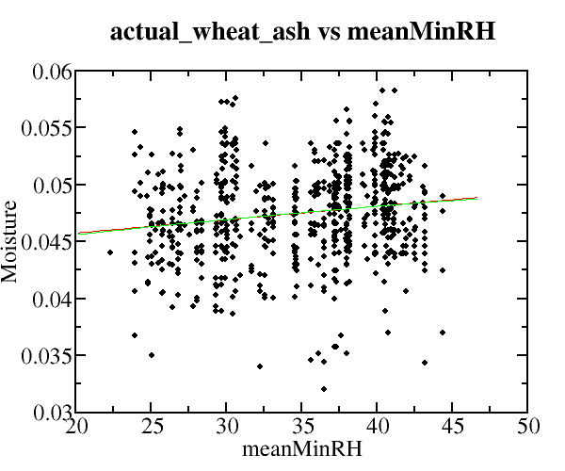
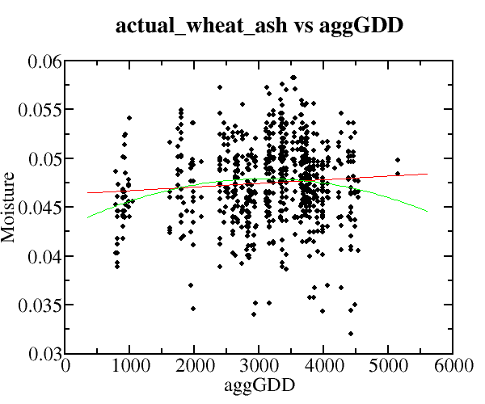
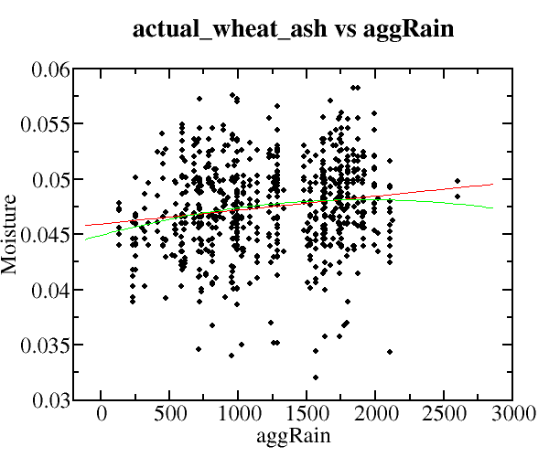
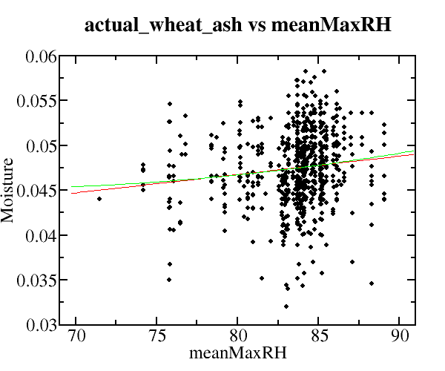
Actual Wheat Ash

Slide 6
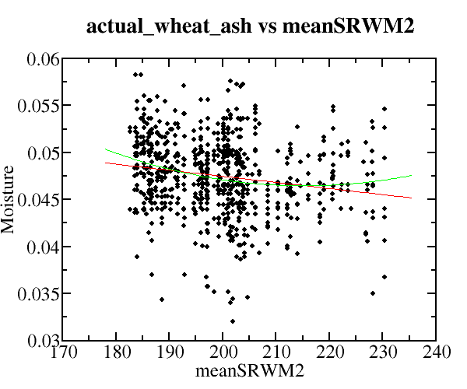
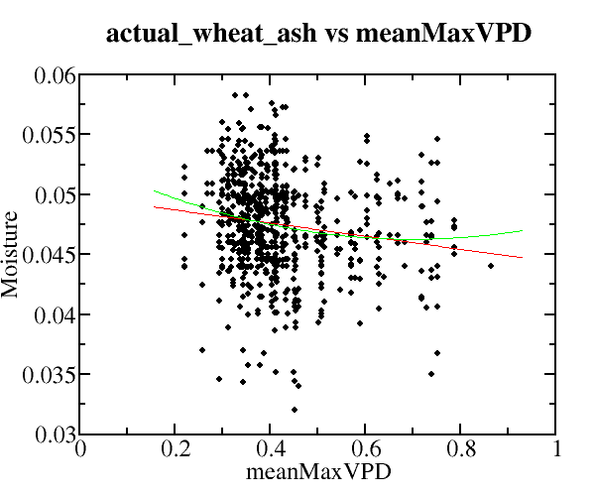
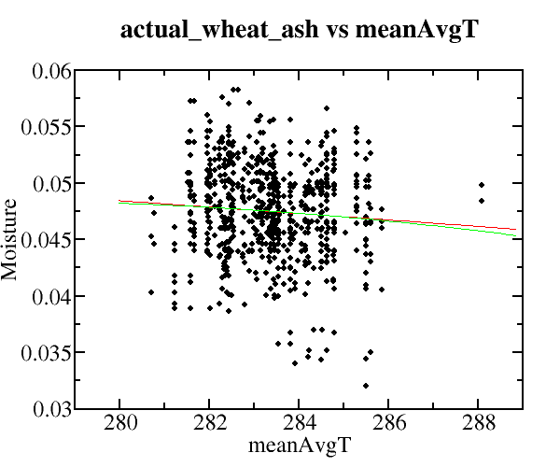
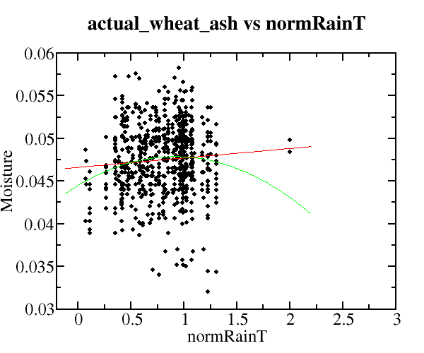
Actual Wheat Ash
normRainT = total precip normalized + avg rain normalized
Normalization consists of reducing a variable’s range to (0 → 1)

Slide 7
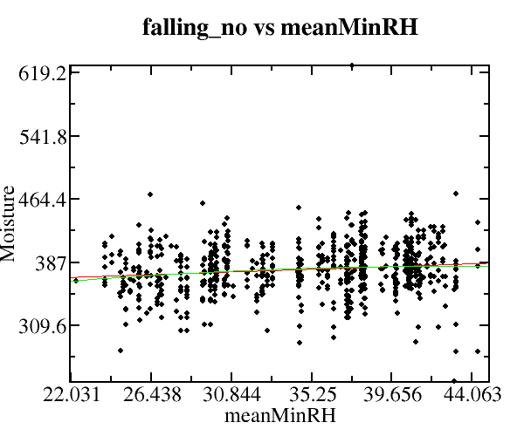
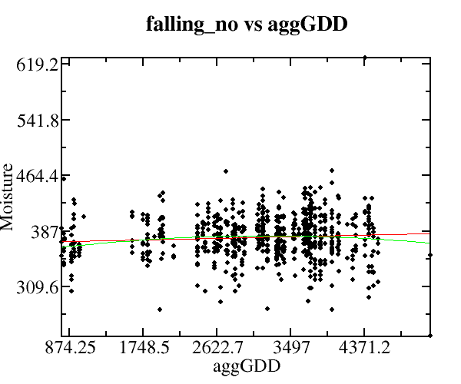
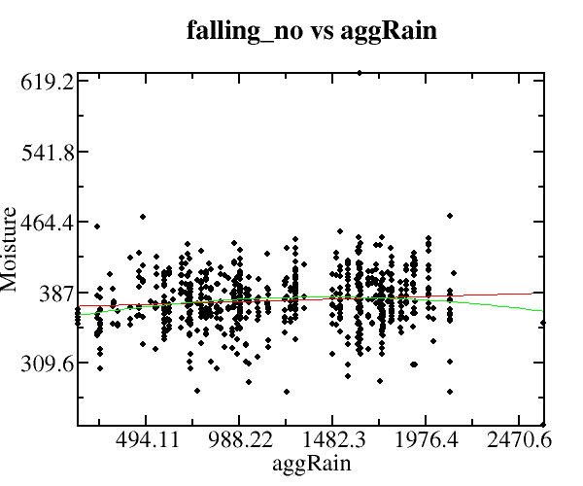
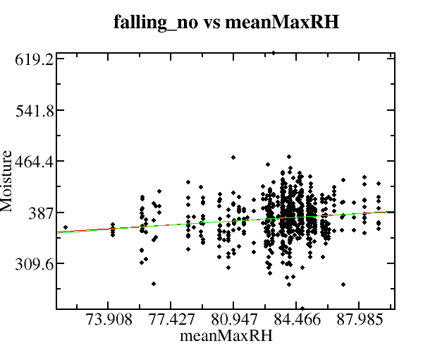
Falling Number

Slide 8
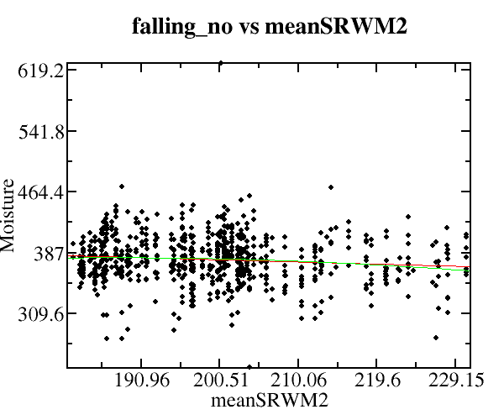
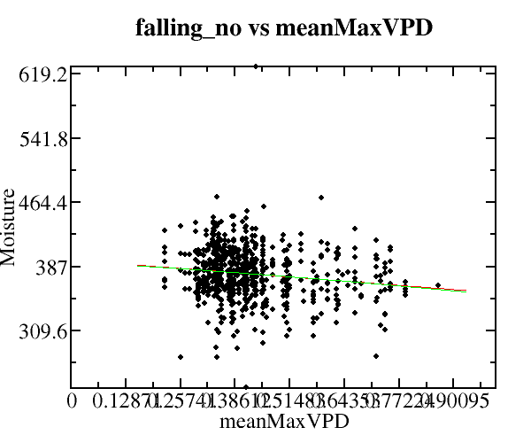
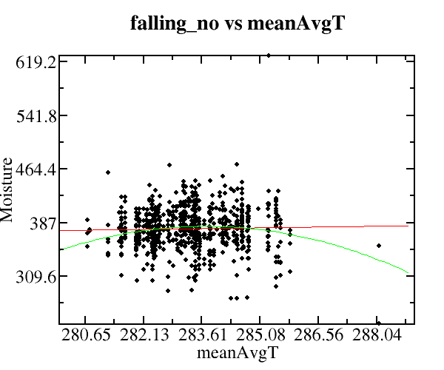
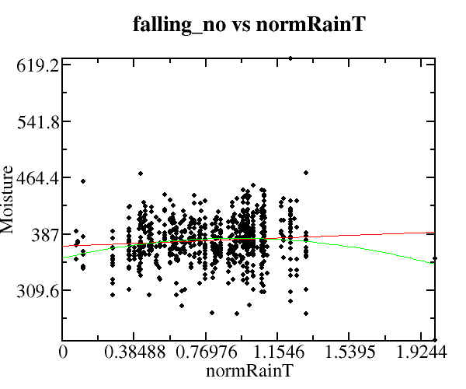
Falling Number
normRainT = total precip normalized + avg rain normalized
Normalization consists of reducing a variable’s range to (0 → 1)

Slide 9
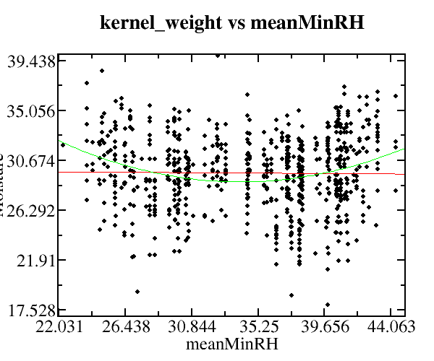
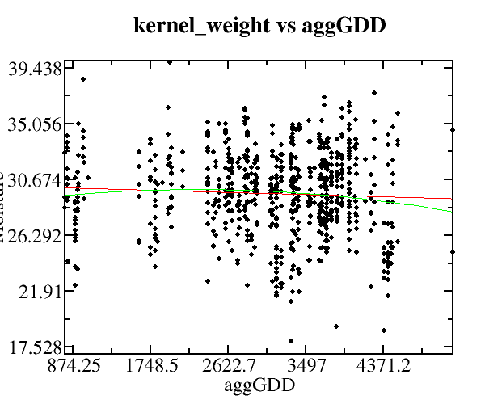
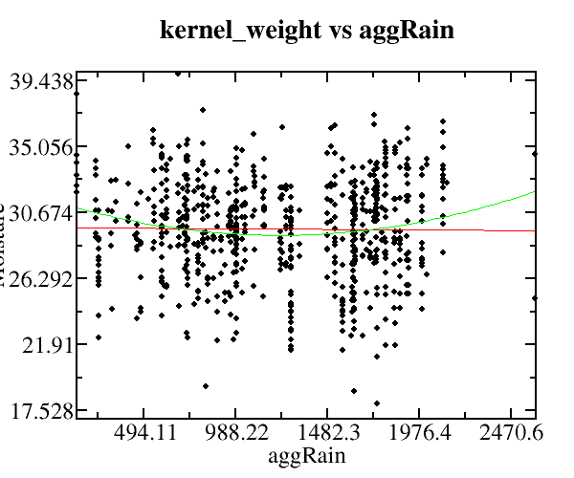
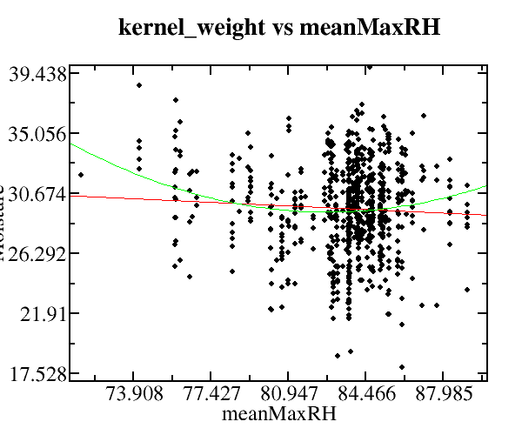
Kernel Weight

Slide 10
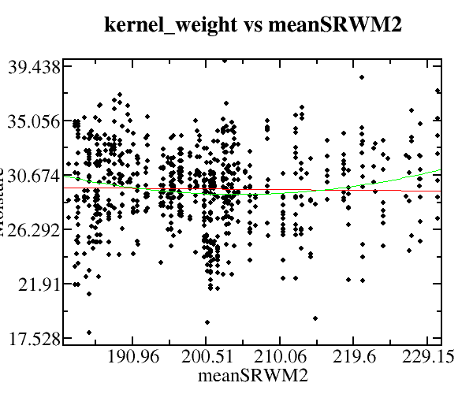
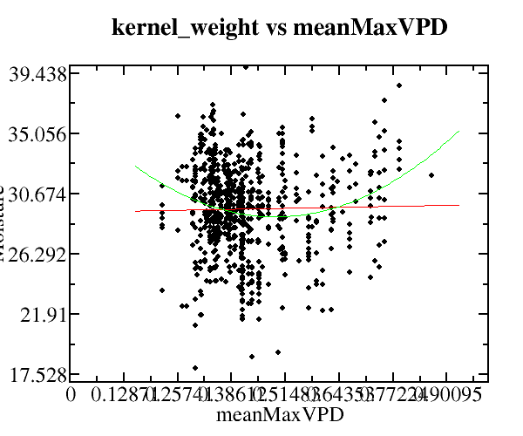
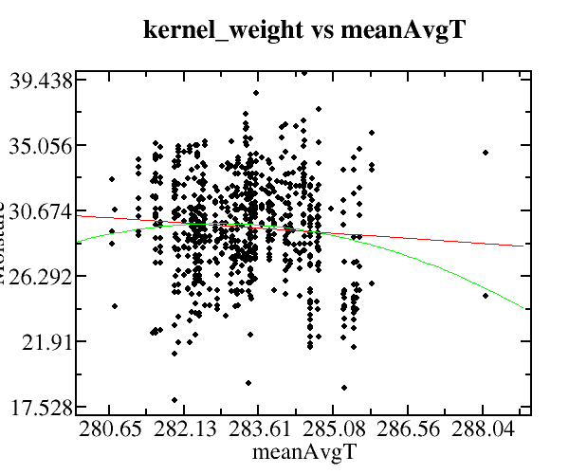
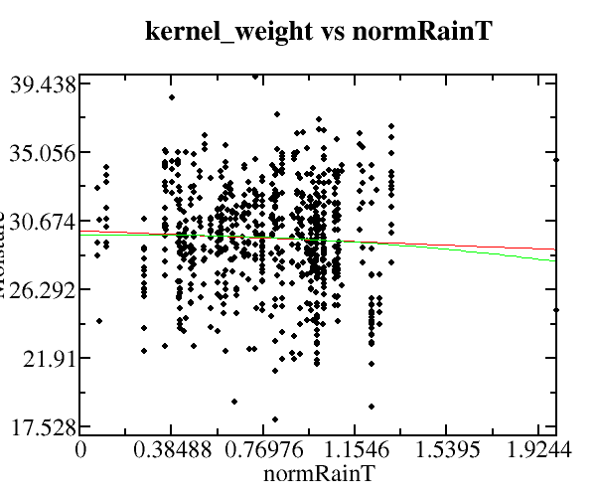
Kernel Weight
normRainT = total precip normalized + avg rain normalized
Normalization consists of reducing a variable’s range to (0 → 1)

Slide 11
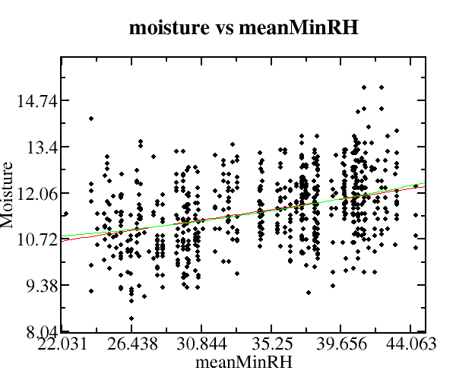
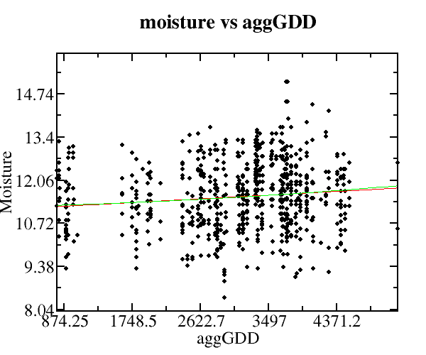
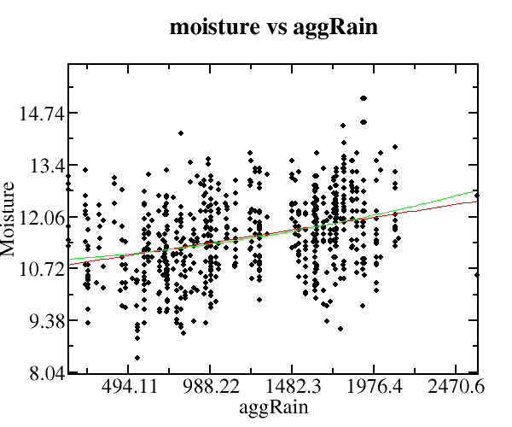
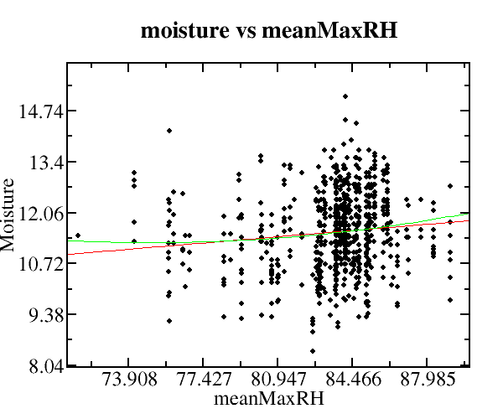
Moisture

Slide 12
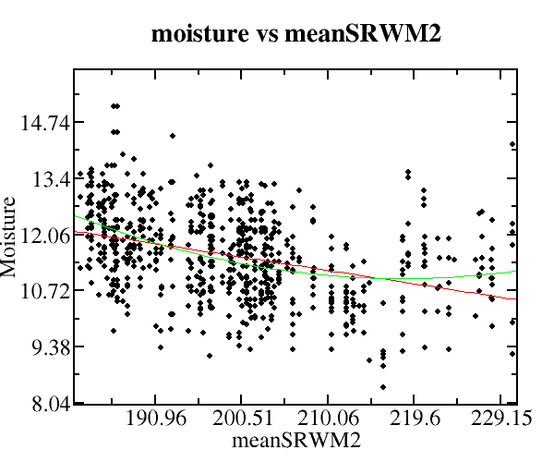
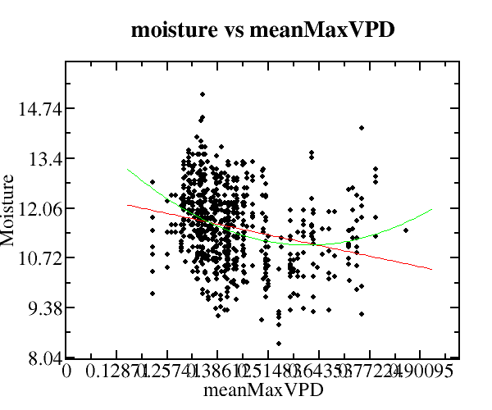
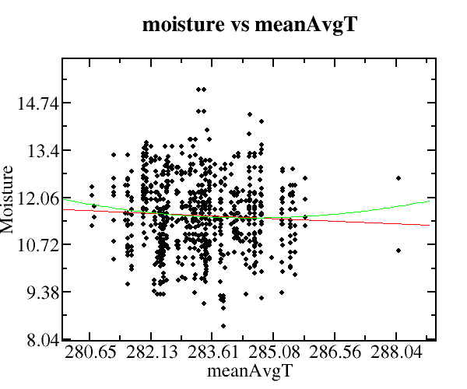
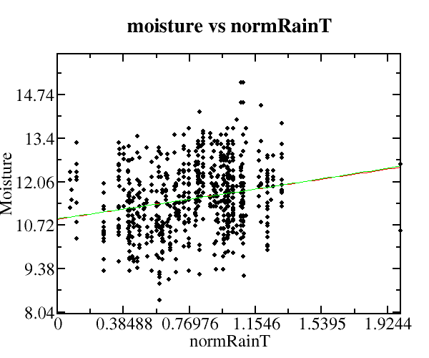
Moisture
normRainT = total precip normalized + avg rain normalized
Normalization consists of reducing a variable’s range to (0 → 1)

Slide 13
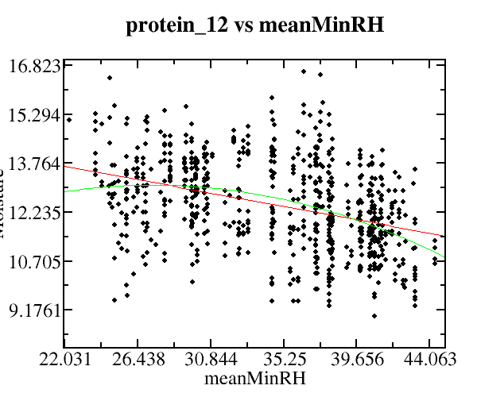
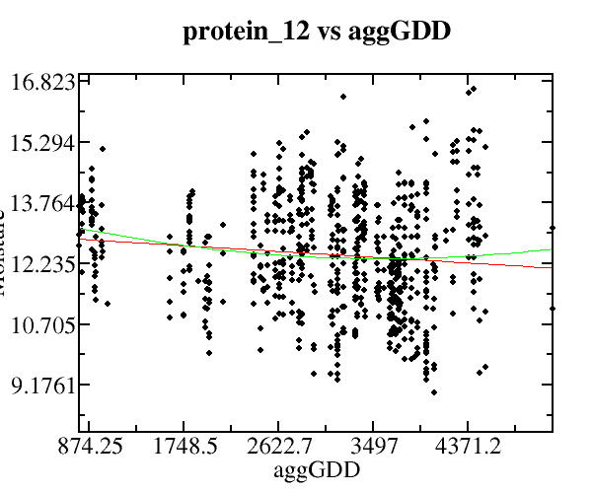
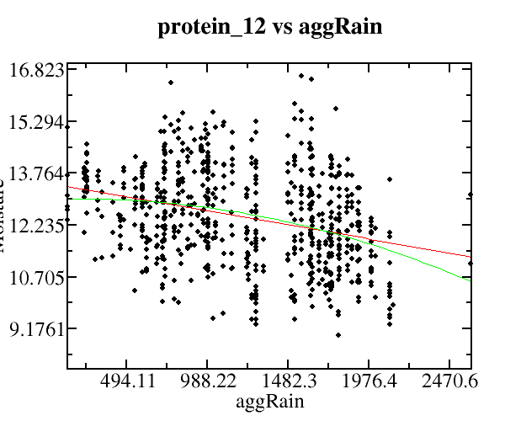
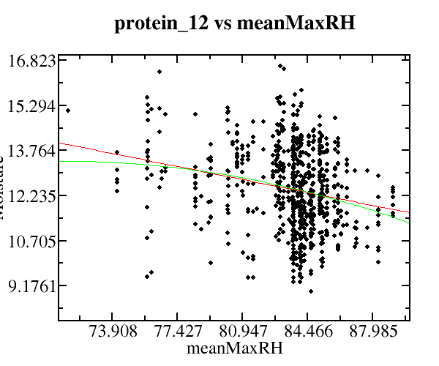
Protein 12

Slide 14
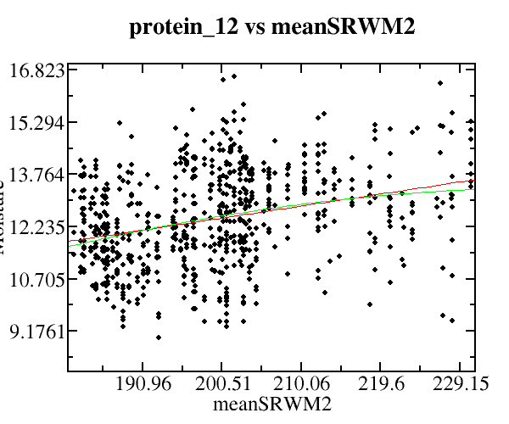
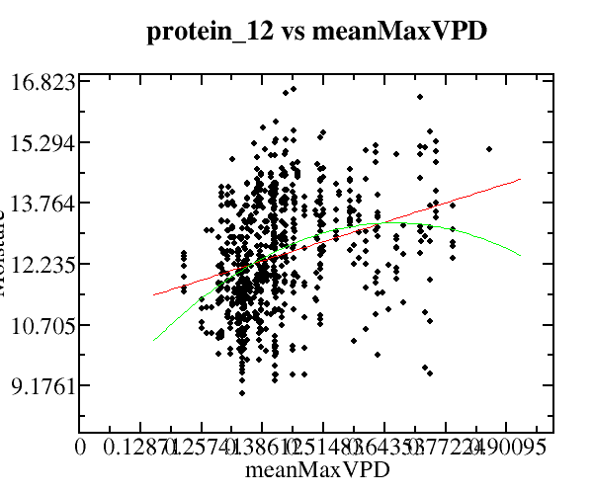
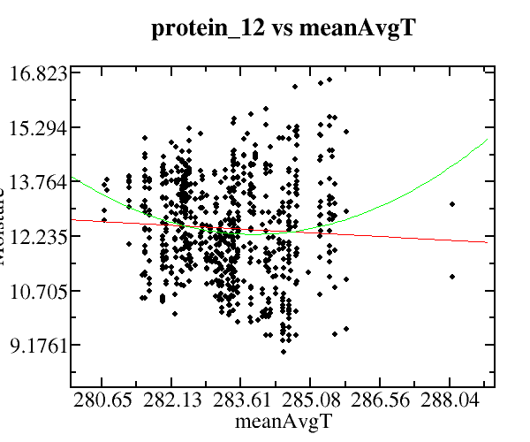
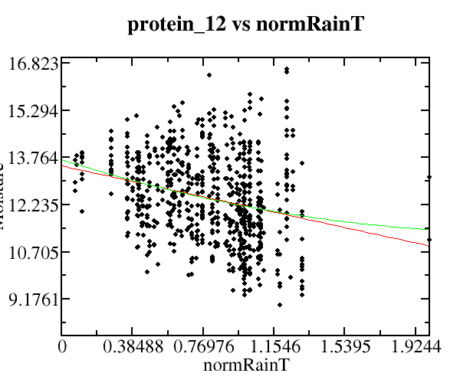
Protein 12
normRainT = total precip normalized + avg rain normalized
Normalization consists of reducing a variable’s range to (0 → 1)

