Slide 1
Google 100 Billionth User Distributed Counter
Design a system such that 100 billionth visitor on Google, gets a prize in raffle
i.e. when you think about it, you realize that they are looking for a good method of counting in a distributed manner.
Distributed counting is a hard problem. Not hard as in not solvable, but hard as in "I didn't realize it can become so complicated just to count!" hard.
Solution by Rahul Vats

Slide 2
Clarifying Questions
Discuss with Interviewer(Clarifying Questions To Ask):
Functional Assumptions:
Do I count request to Gmail/Google/Youtube together or separately? Are we going to do count my transaction or IP address?
Functional Requirements:
Increment a counter structure atomically
Consume Request (Visitor) from a message queue on an Aggregator machine
Retrieve counter value
Design constraints:
Rate of incoming Requests (Visitor)
10s to 1000s of requests per second
{Google handles 60000 searches per second, each search resulting in increment request}
* - Rate of retrieval of the counter

Slide 3
Micro Services
What Services We Need:
Remember Microservices and SOA:
Microservices Architecture Pattern:
Publisher-Subscriber for request event collection
Services We should create:
Counter Service:
1) Ingests and takes count of Requests from Publisher-Subscriber (From All Servers), Increments counter
2) Handles retrieval requests - Retrieve Counter Value
Additionally we may need to have a service for Raffle Generation and Intimation

Slide 4
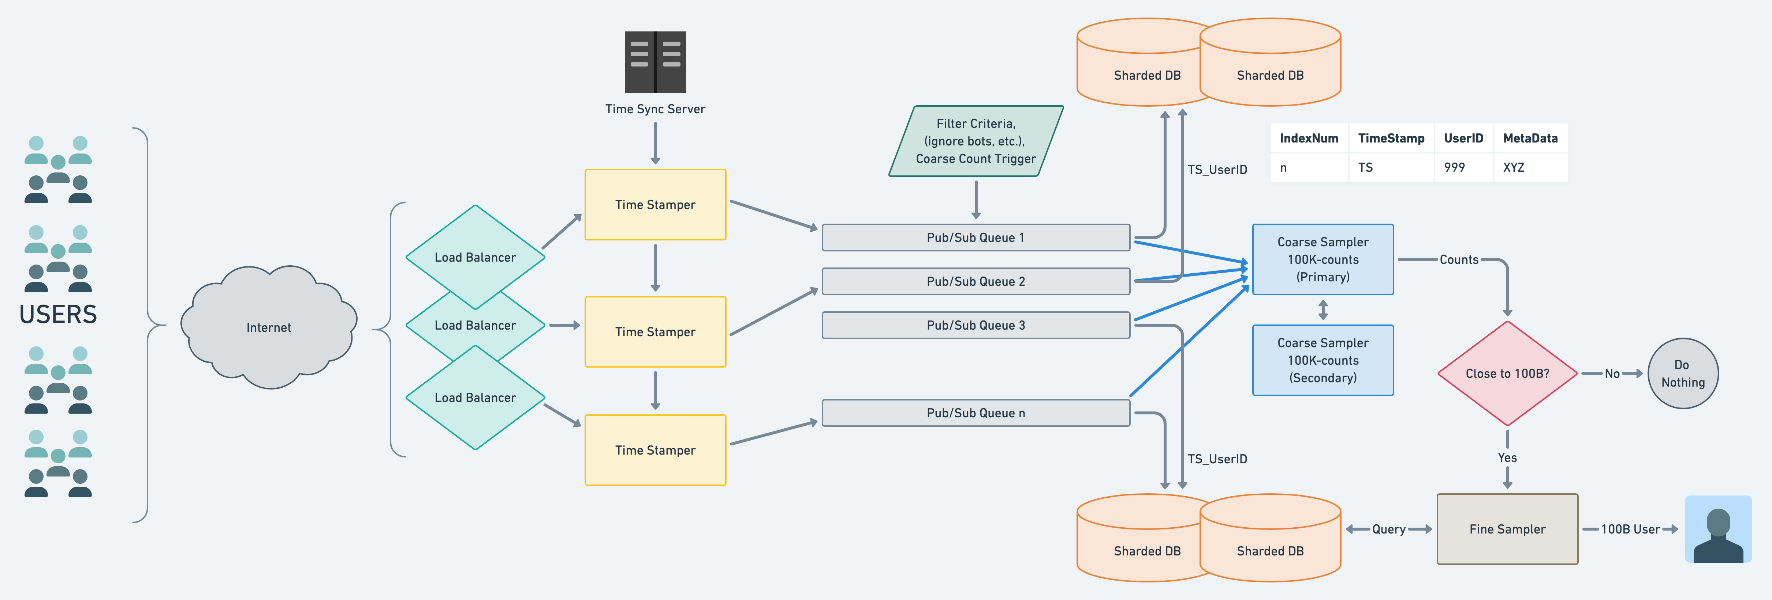
Server Architecture

Slide 5
Logical Architecture
Node1
+2
+2
C1=5
C1=7
Node2
C2=3
Node3
+3
+3
C3=6
C3=9

Slide 6
Solution
Application Server will use In Memory Storage
Data Model: Counter id (K): Single Variable (Approach 1) or List of integers (V) (Approach 2)
Storage System: In point memory storage with checkpoints occasionally for disaster recovery
APIs
All APIs are handled through in-memory storage. API Signature
IncrementCounter: Hash on one of the entries in the list and increment (Single Variable is simple)
ReadCounter: Sum total of integer entries in the list
Thoughts on Scalability
Need to scale for API parallelization – Yes Read is an O(N) algorithm Need to scale for throughput – Yes Need to scale for API parallelization – No Availability – yes Geo-distribution - N/A

Slide 7
Conflict Free Related Data Type
Each replica maintains a vector of counts Let’s assume there are 7 replicas
Replica A: [its own counter][counter from replica B][C][D][E][F][G]
Replica B: [counter from replica A][its own counter][C][D][E][F][G]
B:[3][4][1][0][0][23][1]
From A: [5][1][7][0][0][24][2]
B:[5][4][7][0][0][24][2]
Whenever a write is applied to any replica
It increments its own counter and broadcasts the full vector to other replicas
On receiving a message from other replica
The replica compares each entry in its own vector with that in the message
For (i = 0; i < 7; ++i)
If (ownvector[i] < messagevector[i]) ownvector[i] = messagevector[i]; Very easy to resolve conflict using the above function
Counters will always increment. If a counter from another replica is larger than the same counter in my replica, the other counter is more current, because counters are temporally incremental
Which is why, it is called Conflict-Free Replicated Data Type

Slide 8
Scaling Proposed Solution
Similar to an analytics problem
Bottleneck is the size of the list
O(N), where N is the size of the list
Shard the list
Since list is the value, vertical sharding
Each increment is forwarded to a single shard
Scatter gather to retrieve global value of the counter
Scatter gather is a throughput killer
So cache the global count and perform scatter gather in regular intervals
AP system

Slide 9
CP or AP systems
Depending on the application, you may have to build CP or AP system
CP nearly infeasible in both approaches described
For example, in the billionth car problem
Follow either proposal 1 or proposal 2 (AP) for 99.9x% of increment requests
Then switch logic to CP
In proposal 1, start using one counter for increments
In proposal 2, start using one shard for increments

