Slide 1
SignalForge
Local intelligence.
Deterministic financial truth.
A private research desk built on AMD Radeon and ROCm
Local core + optional
Radeon API specialists
AMD AI DevMaster Hackathon · Track 2: Agentic AI

Slide 2
THE PRODUCT DECISION
A serious investor needs a process, not another answer
Public information is abundant.
Evidence discipline is not.
UNDERSTAND
Business model and financial quality
CONNECT
Economic variables through explicit mechanisms
SignalForge turns filings, investor-relations material, macro series, and market observations into a research case the user can inspect and challenge.
VALUE
DCF, multiples, sensitivity, and assumptions
CHALLENGE
Counterevidence and thesis invalidation
No price prediction · No trade execution · No personalized investment instruction
SignalForge · AMD AI DevMaster Hackathon · Track 2
02

Slide 3
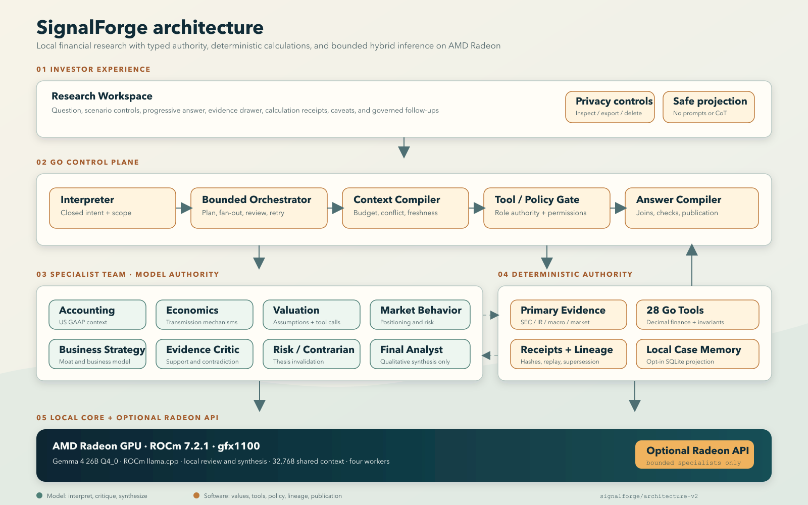
THE AUTHORITY MODEL
THE AUTHORITY MODEL
Models interpret; software owns financial truth
Local Gemma reviews and synthesizes; optional Radeon API specialists add bounded context; Go owns values, tools, evidence, lineage, and release.
SignalForge · AMD AI DevMaster Hackathon · Track 2
03
Notes:
Explain the authority boundary: local Gemma owns review and synthesis; optional Radeon API specialists contribute bounded context; deterministic Go engines own calculations and release policy.
[Sources]
- docs/architecture.svg
- docs/track2-compliance.md
- evidence/sprint36-radeon-hybrid-journey.json
[/Sources]

Slide 4
AGENT COMPLETENESS
All five Track 2 capabilities are visible in one journey
01
Local retrieval
Point-in-time primary evidence with citations
11
80
02
Tool invocation
logical roles
deterministic tools
80 role-authorized deterministic operations
03
Multi-step planning
31/31
Typed fan-out, two critics, one synthesizer
released claims approved by both critics
04
Local memory
Governed follow-ups and opt-in case retention
05
Permission + privacy
3/3
Read-only model authority and safe projection
governed follow-ups preserved scope and lineage
SignalForge · AMD AI DevMaster Hackathon · Track 2
04

Slide 5
RADEON OPTIMIZATION
Four workers cut p50 by 64.37% without weakening the gate
2.78×
aggregate local4 speedup
8 / 8
contracts passed in each
public development mode
Hybrid4 also achieved 2.08× aggregate speedup with 20 accepted Radeon API calls and one locally recovered remote failure.
Source: evidence/sprint33-latency-tournament.json
SignalForge · AMD AI DevMaster Hackathon · Track 2
05
Notes:
This is a bounded development tournament, not a universal benchmark. Each compared mode contains eight public non-sealed journeys using the same Gemma 4 26B A4B QAT Q4_0 model class.
[Sources]
- evidence/sprint33-latency-tournament.json
- evidence/public-claims.json
[/Sources]

Slide 6
RELEASE DISCIPLINE
Built to fail closed,
not confidently wrong
8/8
8/8
1
0
local4 contracts
hybrid4 contracts
API loss recovered
answers on model loss
Primary evidence · deterministic receipts · independent review · explicit fail-closed release
Bounded, non-sealed development evidence; no universal accuracy or throughput claim.
github.com/rvbernucci/signalforge
A private, inspectable research process on AMD Radeon and ROCm.
Notes:
Close on verifiability: exact public artifacts demonstrate contract preservation, local recovery from Radeon API loss, and zero released answers when the local model is unavailable.
[Sources]
- evidence/sprint36-radeon-resilience.json
- evidence/sprint36-radeon-local-journey.json
- evidence/sprint36-radeon-hybrid-journey.json
[/Sources]

