Slide 1

Book Recommendation System using Hybrid Filter

Slide 2


Group Details
Name – Veerraju Chowdary Rimmalapudi
700# - 700731964
CRN - 22037

Slide 3
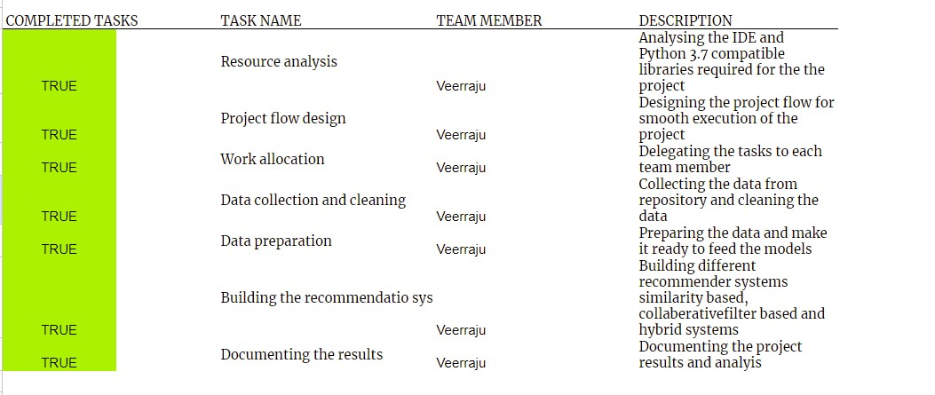
Contribution
This table consists of contributions made to this project.

Slide 4
Motivation
In the past shopping used to happen in physical stores. Users must select the products which are available in the store.
Nowadays shopping is no longer a mundane task with the advent of internet shopping including personal preferences that can be personal brands or choices people are preferring more personalized products to be reviewed.
This case is applicable to food, beauty and many more.
Recent applications of recommendation systems help industries to send the recommendations to customers with the history of the customer behavior.

Slide 5
Book Recommendation System using Hybrid Filter Objectives
There are two main objectives:-
Content based filtering methods work on the history of the users with the item, but it lacks user’s personal information.
The collaborative filtering model generates recommendations based on the personal info, but this lacks the recommendations based on the history of the item.
FYI - Both the methods have their own limitations.
Building a hybrid recommender system that combines the results of the existing methods.
Main features of the project are:
1) Building a hybrid recommender system to meet the reader criteria using mixed hybrid recommendation technique
2) Main advantage of using mixed type of hybrid recommendation system is it generates the candidates simultaneously and trains to the best model for better performance.

Slide 6
Book Recommendation System using Hybrid Filter Related Work
Book recommendation system is a modern solution to the library management system.
In this paper we are proposing a new recommendation system to recommend the books based on the user preferences and the factors could be number of pages, book genre and so on.
This helps the librarians and the readers to select the books of the choices. This system is implemented using various recommendation systems. With the recommended books we calculate the number of pages and copy number. This system helps the bibliographic systems to select the best books for the readers choice.
Nowadays the recommendation system has huge demand in various applications. This recommended system is used in e-commerce sites to recommend the products of various categories apparels, electronics and books.
These categories are the top 3 categories which use the recommendation system in the e-commerce site. In the existing system the algorithms are content based filtering and collaborative filtering methods.
But these methods have several disadvantages.
To mitigate these problems, we have implemented the Hybrid recommendation system. Generally, hybrid recommendation systems use the combination of both content-based filtering and collaborative filtering.

Slide 7
Book Recommendation System using Hybrid Filter Problem Statement
Recommendation systems are the current popular methods to provide data to the users based on their preferences.
Applications for these recommendation systems are Amazon’s Alexa, Spotify for generating recommendations for music lovers.
These recommendations are generated based on different techniques mainly there are content based recommendations, collaborative recommendation and hybrid systems.

Slide 8
Book Recommendation System using Hybrid Filter Proposed Solution
In this method we are proposing a model that overcomes the limitations of both the methods collaborative and content-based filtering's.
We are proposing a hybrid model which solves the above problems and makes the recommendations more personalized.
One way of implementing the hybrid model is to combine the predictions of both the models:-
first, we need to implement the content-based filtering to draw predictions from the model.
Second, implement the collaborative filtering and draw predictions from this model.
In the end we need to ensemble the predictions.

Slide 9
Book Recommendation System using Hybrid Filter Proposed Solution
Implementation of book recommendation systems is divided into stages:
1) data cleaning 2) data preparation 3) building recommendation systems.
Since the dataset consists of 3 files of information each file needs to be cleaned separately.
Data cleaning includes removing the null values, examining the distribution numerical columns to check any abnormalities in the data.
In this stage we retain the necessary features and remove the unnecessary features.
At the stage of data cleaning, we have identified some abnormal values in age and publishing year columns.
After the data preparation various recommender systems are built on the final data.
The first method is popularity-based recommendation system: All the ratings are summed up and based on the user preference top n number of books are displayed the popular books to read.
Similar author recommendation system displays the books of same authors from the popular books.
Correlation based recommendation system recommends the books based on the Pearson’s correlation.
Hybrid recommender system recommends the list of books by combining content-based filtering and collaborative filtering suggestions.

Slide 10
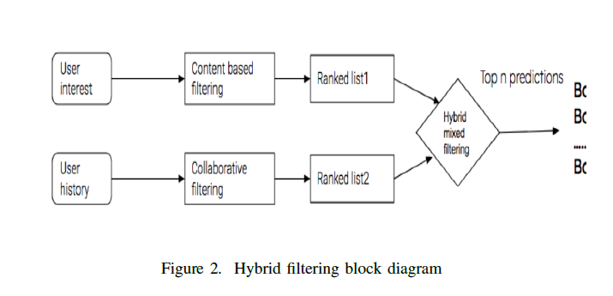
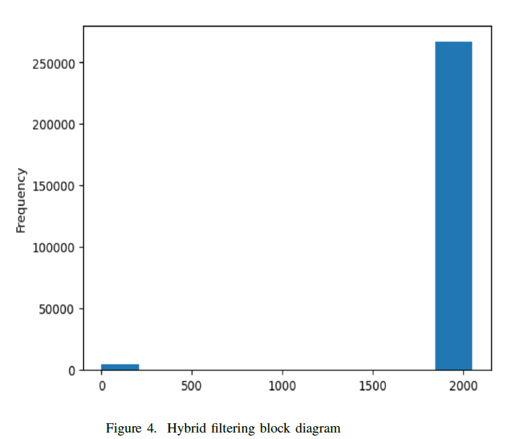
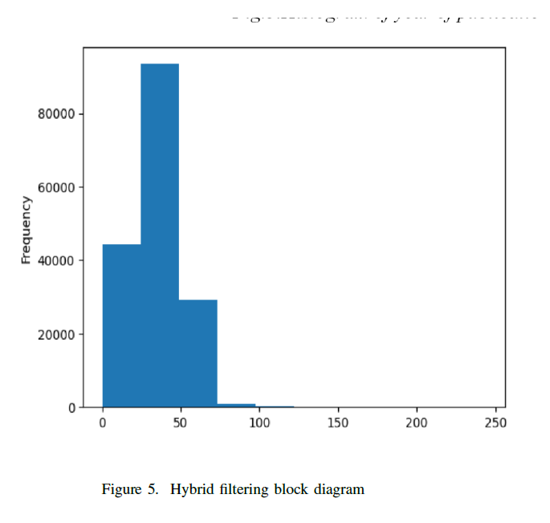
Book Recommendation System using Hybrid Filter Proposed Solution
Hybrid Filtering:

Slide 11
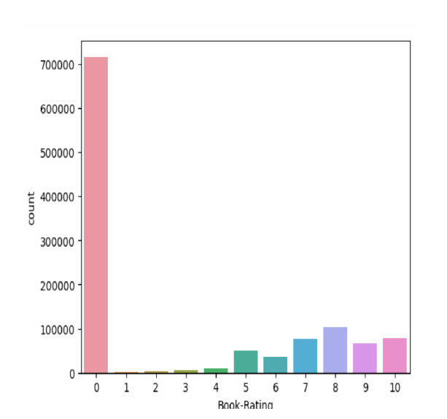
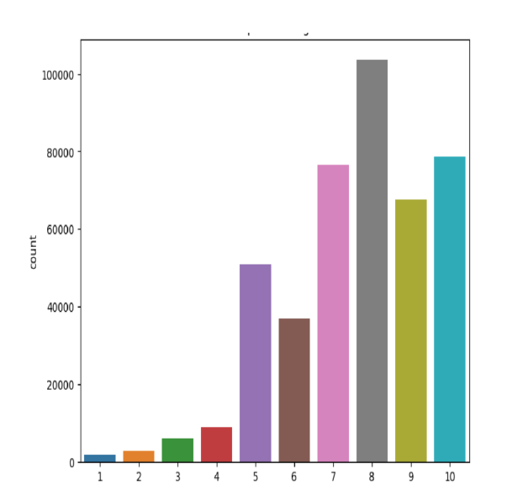
Book recommendation System using Hybrid Filter Results Analysis
Content based filtering: In our project content-based filtering is applied to get the top n recommendations of authors , publishers and highest ratings books. These recommendations are suggested based on the we used matplotlib and seaborn to plot the graphs.

Slide 12
Book recommendation System Results Analysis
Collaborative filtering Collaborative filtering is applied to find the user-item based filtering and correlation-based filtering.

Slide 13
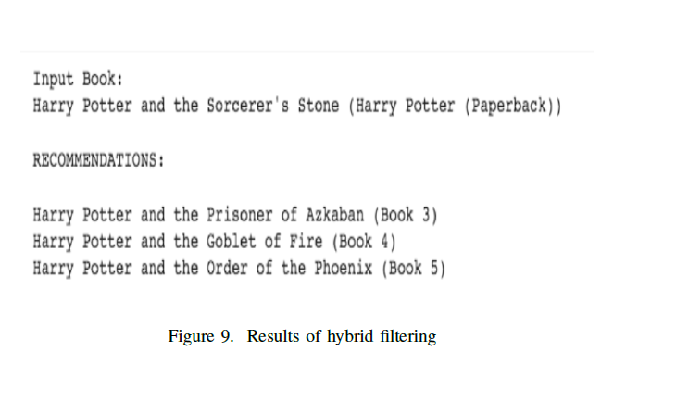
Book recommendation System using Hybrid Filter Results Analysis
Hybrid Filtering:

Slide 14
Book recommendation System References
[1] Pitiwat Arunruviwat and Veera Muangsin. A hybrid book recommendationsystem for university library. In 2022 26th International Computer Science and Engineering Conference (ICSEC), pages 291–295, 2022.
[2] Binge Cui and Xin Chen. An online book recommendation system based on web service. In 2009 Sixth International Conference on Fuzzy Systems and Knowledge Discovery, volume 7, pages 520–524, 2009.
[3] I. Nyoman Pande Wahyu Dharmawan and Riyanarto Sarno. Book recommendation using neo4j graph database in bibtex book metadata. In 2017 3rd International Conference on Science in Information Technology (ICSITech), pages 47–52, 2017.
[4] Qiyuan Fu, Jinmin Fu, and Disheng Wang. Deep learning and data mining for book recommendation: Retrospect and expectation. In 2022 14th International Conference on Computer Research and Development (ICCRD), pages 60–64, 2022.
[5] Angel L. Garrido, Maria Soledad Pera, and Sergio Ilarri. Sole-r: A semantic and linguistic approach for book recommendations. In 2014 IEEE 14th International Conference on Advanced Learning Technologies, pages 524–528, 2014.
[6] Salil Kanetkar, Akshay Nayak, Sridhar Swamy, and Gresha Bhatia. Web-based personalized hybrid book recommendation system. In 2014 International Conference on Advances in Engineering Technology Research (ICAETR - 2014), pages 1–5, 2014.
[7] Madhuri Kommineni, P. Alekhya, T. Mohana Vyshnavi, V. Aparna, K Swetha, and V Mounika. Machine learning based efficient recommendation system for book selection using user based collaborative filtering algorithm. In 2020 Fourth International Conference on Inventive Systemsand Control (ICISC), pages 66–71, 2020.

Slide 15
Book Recommendation System
Thank You

