Slide 1

Project 0
Custom Banking Application
Robert Chhoeut

Slide 2

Overview
Tools and Processes
Requirements
Data Model
Security
  Access to the Org
  Access to Objects
  Access to Fields
  Access to Records
Apex Functions and Demo

Slide 3
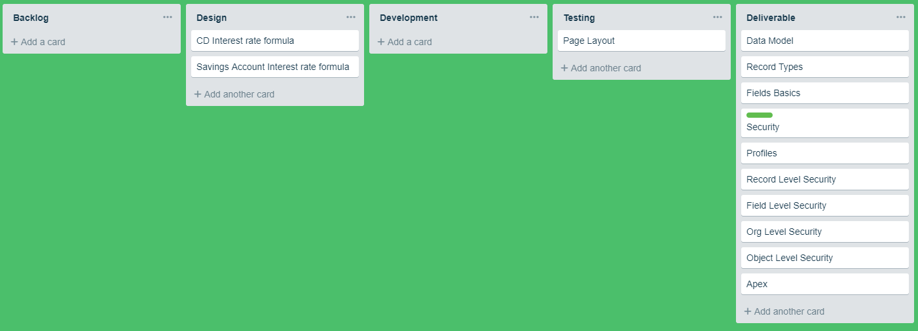
Tools and Processes
Trailhead Playground
Trello

Slide 4
Project Requirements
Track Accounts
See Transactions
See Loan Applications Approved/Denied
Joint and Single Account types
Security for Org
Apex
  Overdrawn
  Create Transaction
  Update Account to show Balance

Slide 5
Data Model
Transactions
CD
M
M
Checking
M
M
Account
Contact
Loan Applications
M
L
L
Savings
M
User

Slide 6
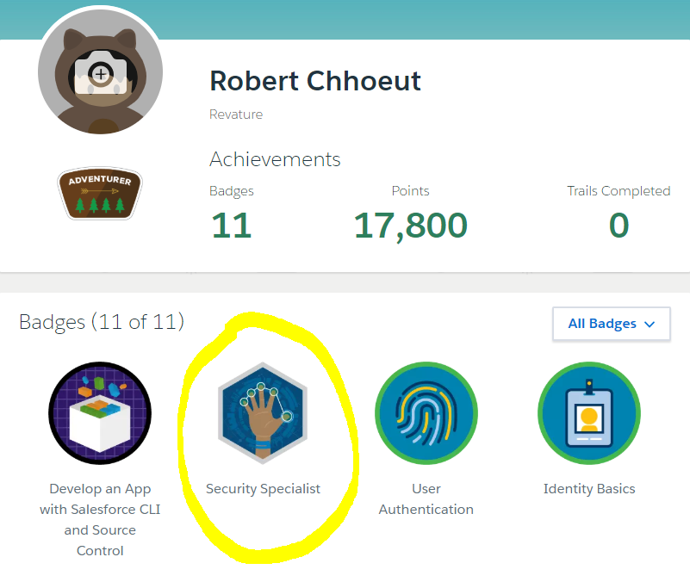
Security

Slide 7
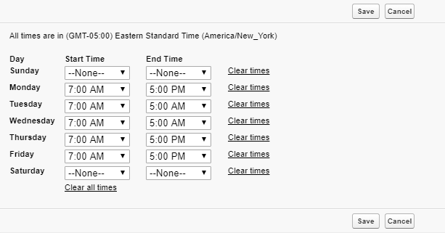
Access to the Org
Bank User
Standard License

Slide 8
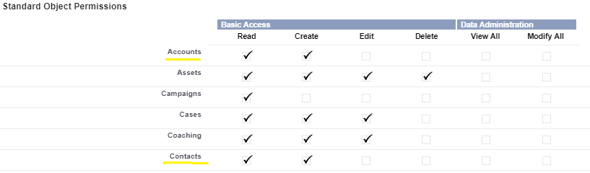
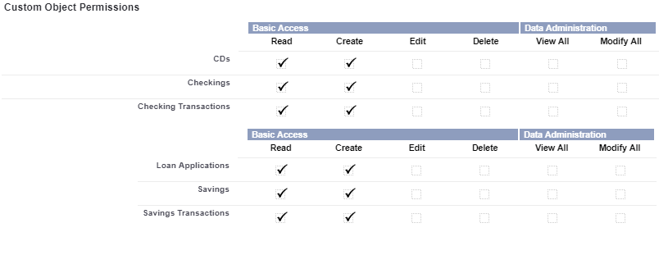
Access to Objects

Slide 9
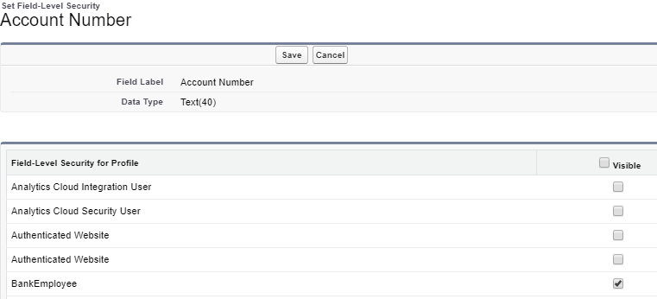
Access to Fields
View most fields

Slide 10
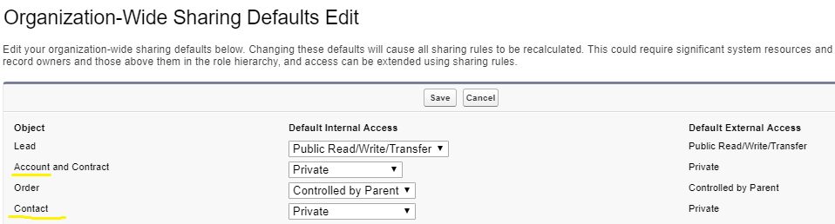
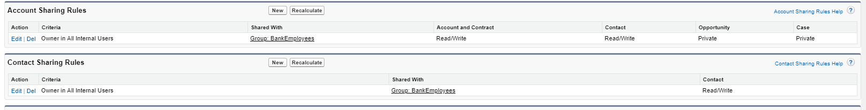
Access to Records
Banker Role

Slide 11
Apex
Check if Overdrawn
Create a New Transaction
Update account Total balance

Slide 12
Demo

