Slide 1
breedbase_slides
Solveig Hanson and Ryan Crawford

Slide 2
Why?
Store observations at the touch of a button via BrAPI
From phone (via FieldBook or Excel) to BreedBase
Observations are standardized and organized
Observations may contain timestamps/ other metadata
(Underrated but) plays nicely with Excel
Platform agnostic

Slide 3
What is it good for?
Clearly defined traits
Clearly defined trials
ALT’s
Lots of potential for expansion

Slide 4
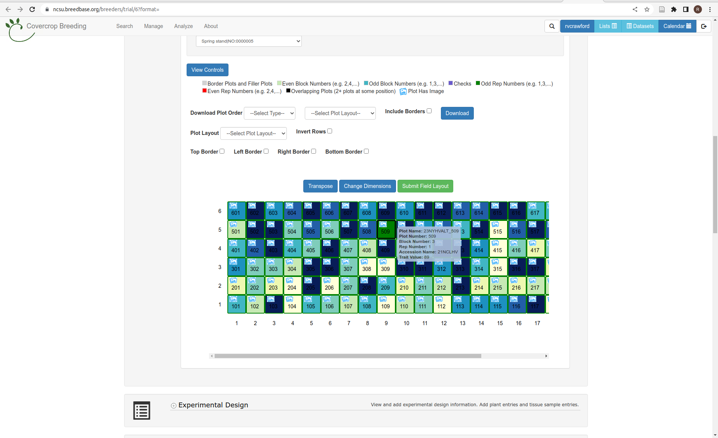
2023 NY Hairy Vetch Spring Stand

Slide 5
What isn’t it good for?
On-the-fly observations/ traits
Repeated measurements (may change)
Non-standard variables between sites

Slide 6
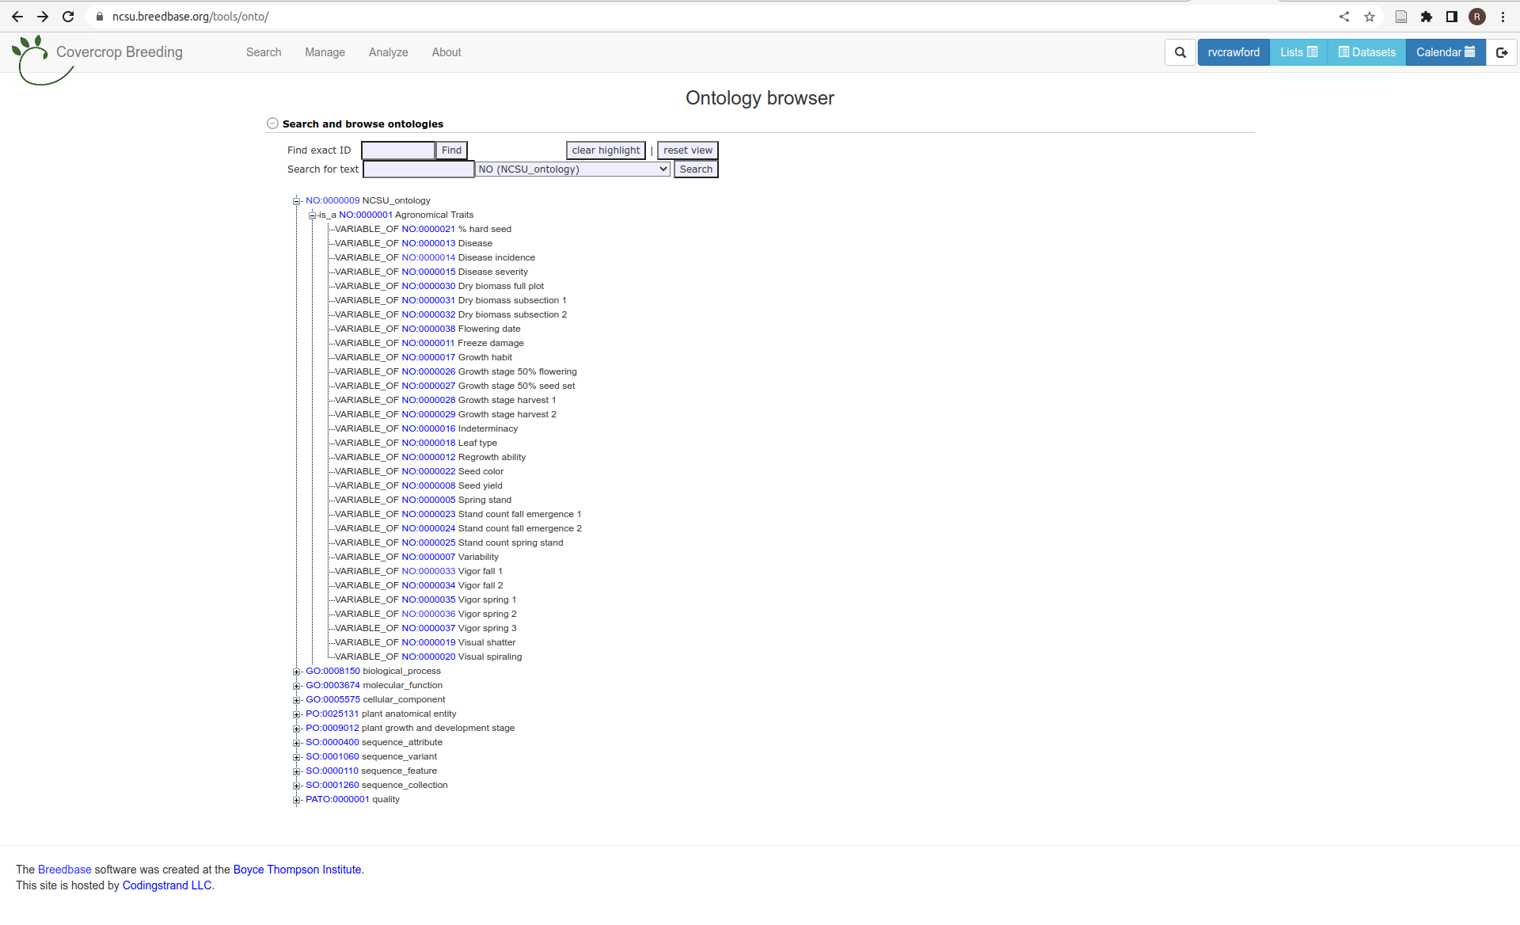
CCB trait ontology

Slide 7
Other (minor) hassles
Configuring devices (setting up BreedBase login in FieldBook)
Passing data in can be finicky (for example, planning a trial)
IMO these things can be dealt with but take some patience
Nomenclature issues: row - column, not range - row, block vs. replication

Slide 8
Possibilities
Data set creation across years and sites
Accession searching

Slide 9
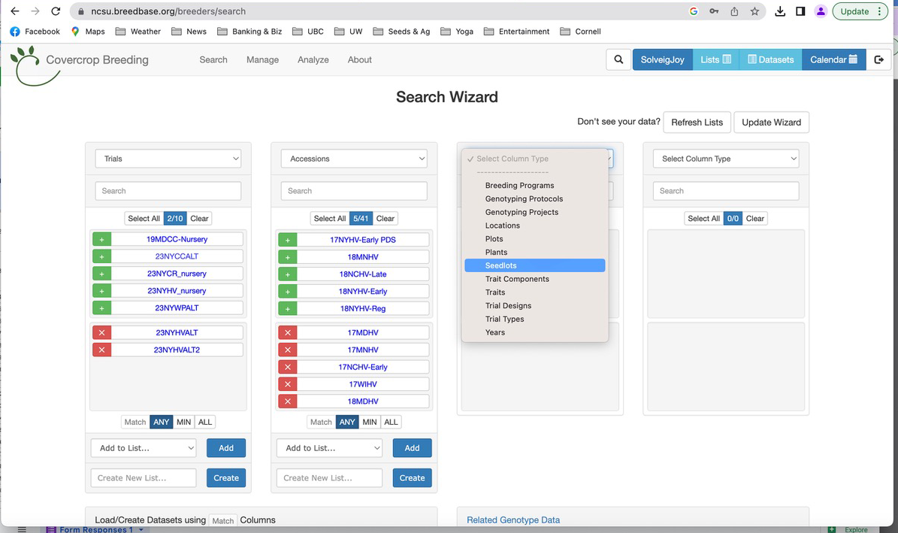
BreedBase Search Wizard

Slide 10
Even more possibilities
Seedlot tracking
Breeding nursery/ pedigree data
Genomic data
Soil/ weather data

