Slide 1

Taking Off: Investigating Flight Delays
Blue Group 4:
Sarah Arnold, Sterling Hayden,
Marie Bennett, Rohan Venkatraman,
Fred Lindsey

Slide 2



Insights
3 key variables:
Airline ​
Time of day ​
Day of Week
46% of flights were delayed

Slide 3

Agenda
Background
Airline vs Delays
Day of Week vs Delays
Time of Day vs Delays
Takeaways

Slide 4

Background

Slide 5
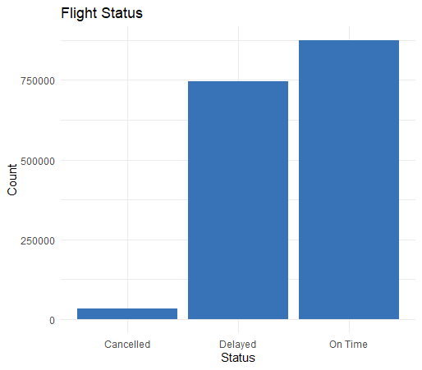

Background
1.6 million observations
46% delayed
Background
Airline
Day of Week
Time of Day
Takeaways
Notes:
Talk about our subset of data

Slide 6
Background
1.6 million observations
46% delayed
Customer impact
Airline impact
15/30 "rule"
Background
Airline
Day of Week
Time of Day
Takeaways
Notes:
Talk about our subset of data

Slide 7










Delays by Airline

Slide 8
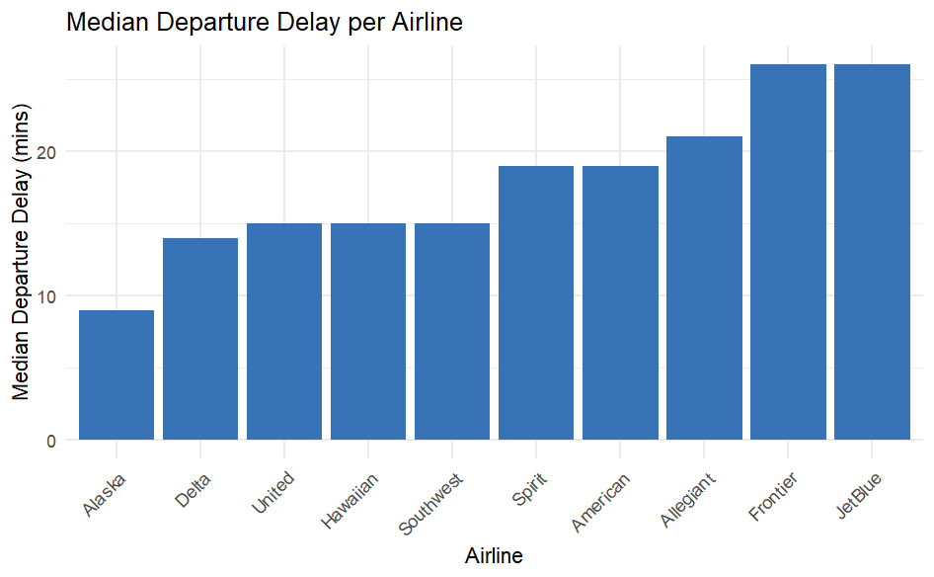
Delays by Airline
Background
Airline
Day of Week
Time of Day
Takeaways

Slide 9
Delays by Airline
15 min delay
Background
Airline
Day of Week
Time of Day
Takeaways

Slide 10
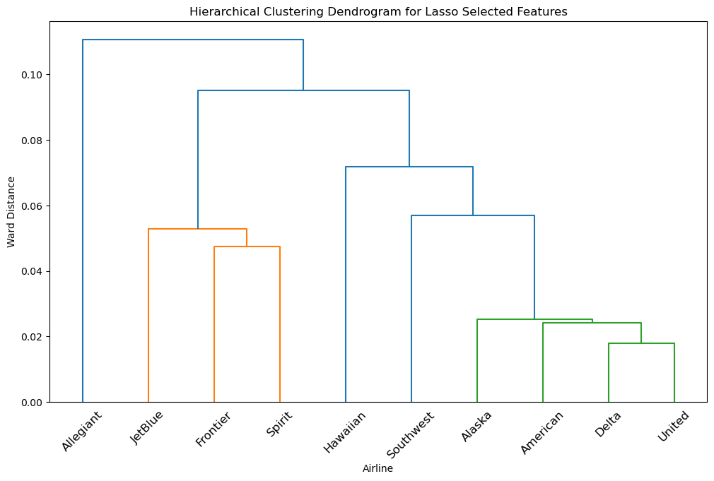
Airline Comparisons
Background
Airline
Day of Week
Time of Day
Takeaways

Slide 11
Airline Comparisons
Background
Airline
Day of Week
Time of Day
Takeaways

Slide 12
Airline Comparisons
Background
Airline
Day of Week
Time of Day
Takeaways

Slide 13
Airline Comparisons
Background
Airline
Day of Week
Time of Day
Takeaways

Slide 14
Airline Comparisons
Background
Airline
Day of Week
Time of Day
Takeaways

Slide 15
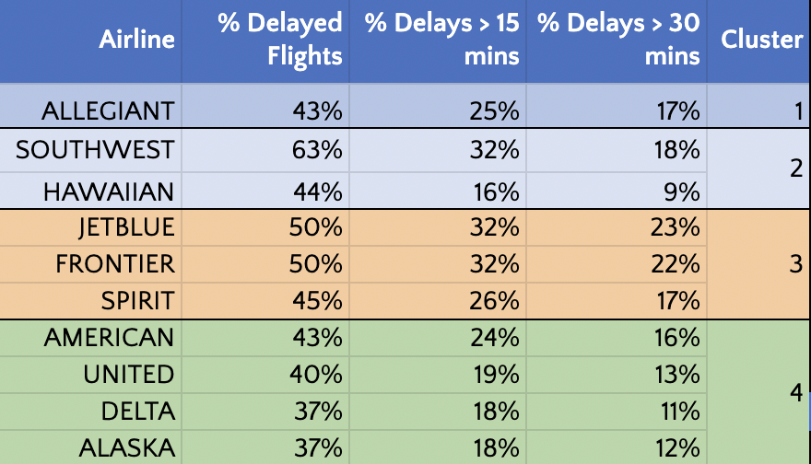
Airline Delay Statistics
Background
Airline
Day of Week
Time of Day
Takeaways

Slide 16

Delays by Day of Week

Slide 17
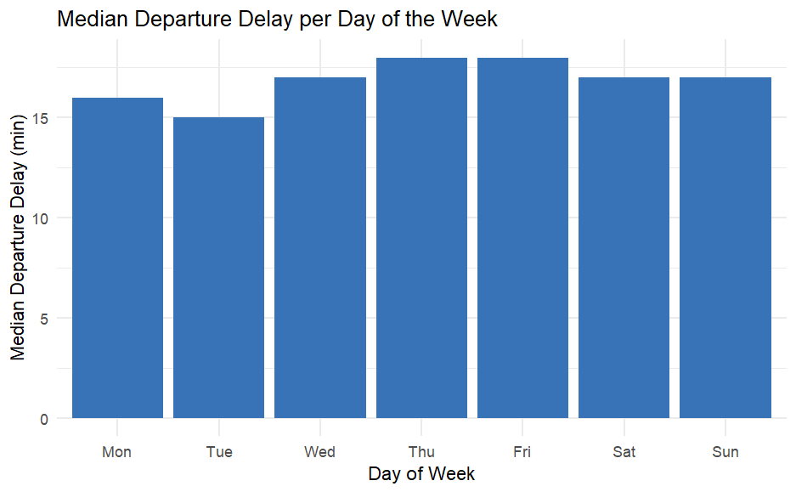
Delays by Day of Week
Background
Airline
Day of Week
Time of Day
Takeaways

Slide 18
Delays by Day of Week
15 min delay
Background
Airline
Day of Week
Time of Day
Takeaways
Notes:
Tuesdays had significantly lower median delay times than all other days.

Slide 19
Delays by Day of Week
Background
Airline
Day of Week
Time of Day
Takeaways
Notes:
Mondays had significantly lower median delay times than all days except Tuesdays

Slide 20
Delays by Day of Week
Background
Airline
Day of Week
Time of Day
Takeaways
Notes:
Fridays had significantly higher median delay times than all days except Thursday.

Slide 21
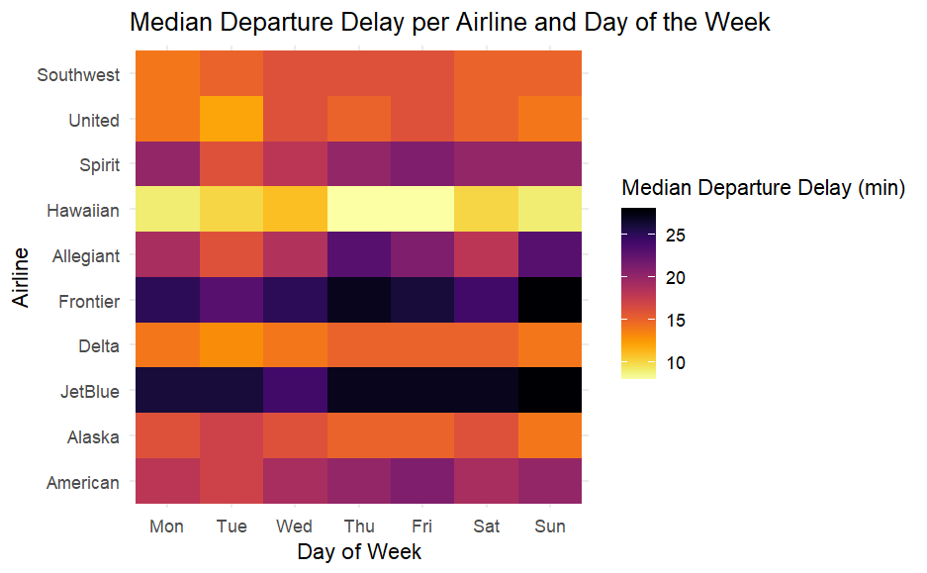
Delays by Airline & Day of Week
Background
Airline
Day of Week
Time of Day
Takeaways

Slide 22
Delays by Airline & Day of Week
Background
Airline
Day of Week
Time of Day
Takeaways
Notes:
Tuesdays had lighter colors meaning the median delay times were lower even across airlines.

Slide 23
Delays by Airline & Day of Week
Background
Airline
Day of Week
Time of Day
Takeaways
Notes:
Even within airlines with consistently higher delays such as Spirit and Frontier, Tuesdays had lower delay times.

Slide 24
Length of Delay by Airline & Day of Week
Background
Airline
Day of Week
Time of Day
Takeaways

Slide 25
Delays by Airline & Day of Week
Background
Airline
Day of Week
Time of Day
Takeaways
Notes:
High delayed airlines: Spirit, Frontier, and JetBlue were clustered similarly.

Slide 26

Delays by
Time of Day

Slide 27
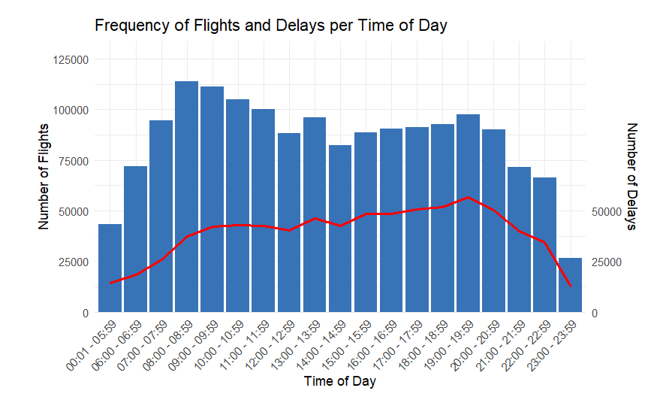
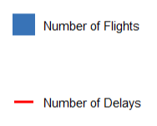
Peak Flying Hours
Background
Airline
Day of Week
Time of Day
Takeaways

Slide 28
Peak Flying Hours
7am - 10am
6pm - 11pm
Background
Airline
Day of Week
Time of Day
Takeaways
Notes:
2 peak travel periods
Rush hour times with early morning and evening flights
Accordian effect where less volume of travel during the middle of the day
End of day less flights because there is a hard cutoff with airports closing roughly around 1am, whereas morning flights can afford to have flights moved if necessary

Slide 29
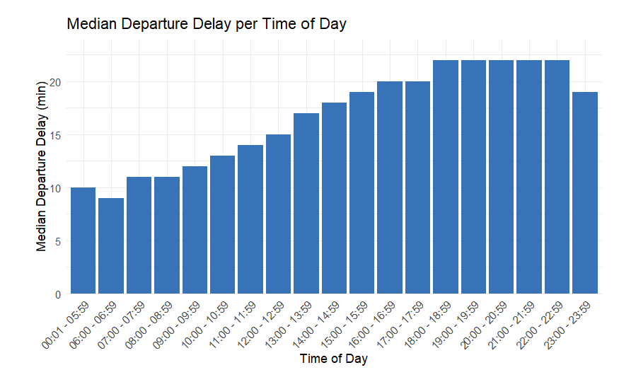
Length of Delay by Time of Day
Background
Airline
Day of Week
Time of Day
Takeaways

Slide 30
Length of Delay by Time of Day
15 min delay​
Background
Airline
Day of Week
Time of Day
Takeaways

Slide 31
Length of Delay by Time of Day
7am - 10am
6pm - 11pm
Background
Airline
Day of Week
Time of Day
Takeaways

Slide 32
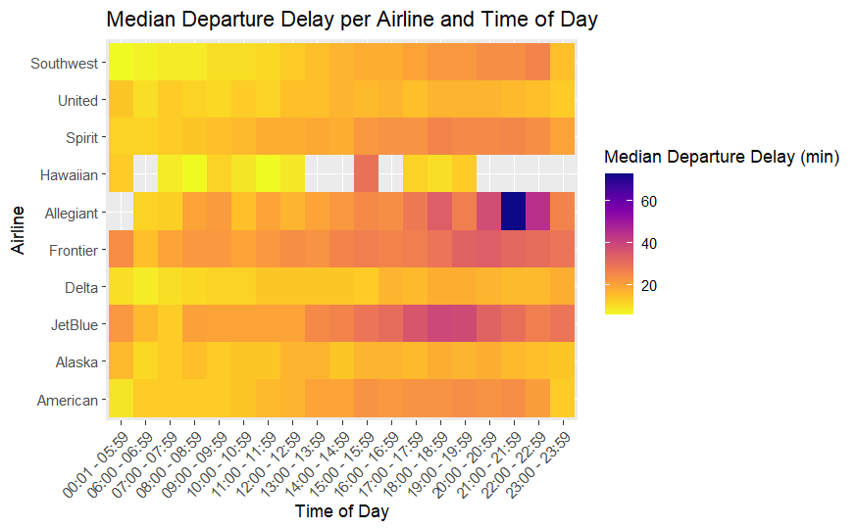
Length of Delay by Airline & Time of Day
Background
Airline
Day of Week
Time of Day
Takeaways

Slide 33
Length of Delay by Airline & Time of Day
Background
Airline
Day of Week
Time of Day
Takeaways

Slide 34
Length of Delay by Airline & Time of Day
Background
Airline
Day of Week
Time of Day
Takeaways

Slide 35
Length of Delay by Airline & Time of Day
Background
Airline
Day of Week
Time of Day
Takeaways

Slide 36
Takeaways

Slide 37
Summary
2 major performance groups
Background
Airline
Day of Week
Time of Day
Takeaways
Notes:
Performance group 1: Alaska, American, Delta, United > high performers
Performance group 2: Jetblue, frontier, spirit > low performers

Slide 38
Summary
2 major performance groups
Tuesday is least delayed
Friday is most delayed
Background
Airline
Day of Week
Time of Day
Takeaways

Slide 39
Summary
2 major performance groups
Tuesday is least delayed
Friday is most delayed
Delays are amplified by TOD
Background
Airline
Day of Week
Time of Day
Takeaways

Slide 40
Recommendations
3 dimensions:
Airline Performance
Time Blocks
Day of Week
Re-evaluate
Connection
Time
Guidance
Background
Airline
Day of Week
Time of Day
Takeaways
Notes:
Our recommendation is for a re-evaluation of guidance for Minimum Connection Times. The current rule of thumb from the IATA is for 30 minute buffers from domestic flights, and 1 hour for international flights

Slide 41
Now that we have landed ... any questions?

Slide 42

Appendix

Slide 43
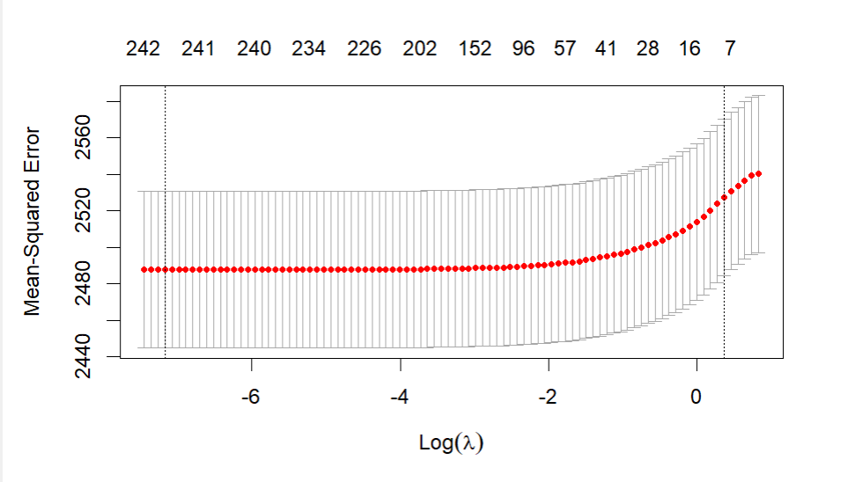
Airline - LASSO Lambda

Slide 44
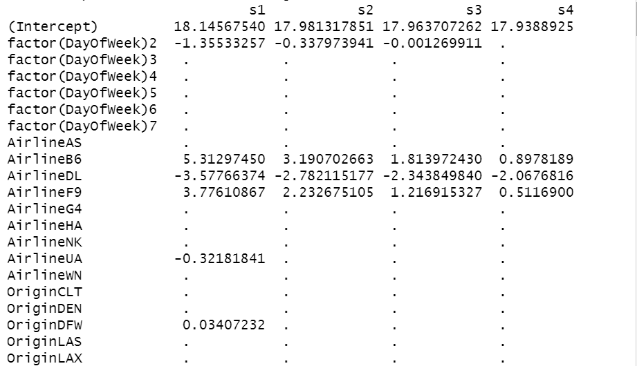
Airline - LASSO Output

Slide 45
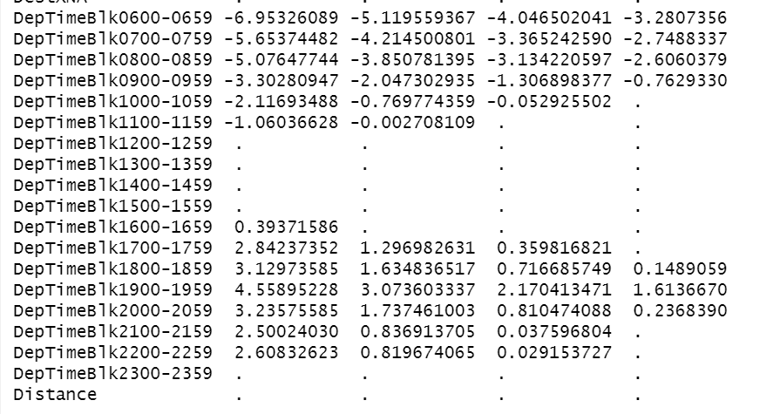
Airline - LASSO Output

Slide 46
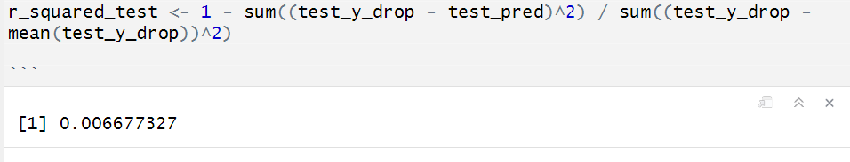
Airline - Model R²

Slide 47
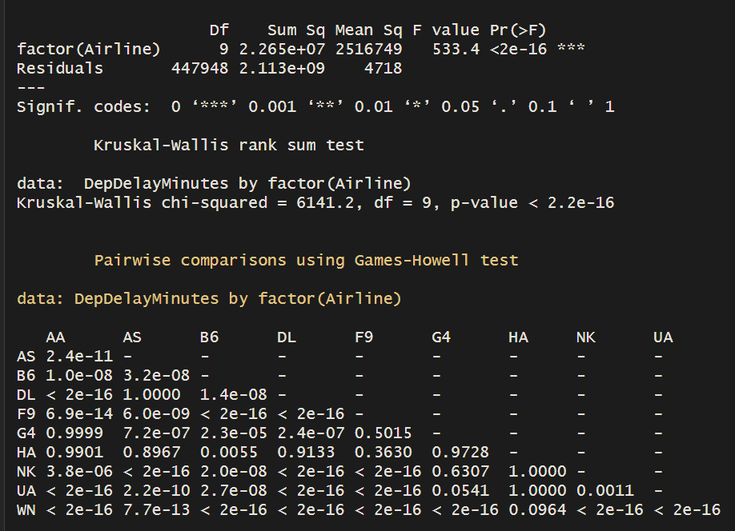
Airline - ANOVA & Post Hoc of Delay

Slide 48
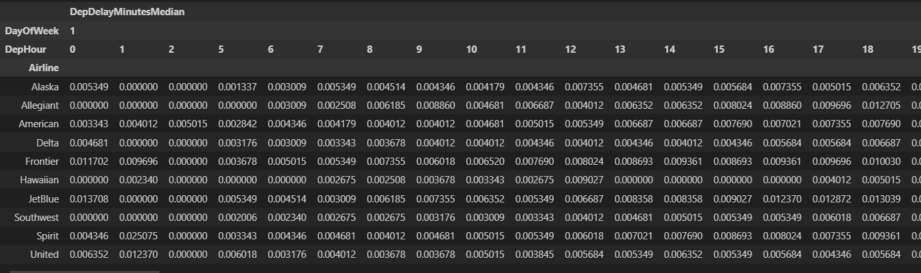
Airline - Dendrogram Input

Slide 49
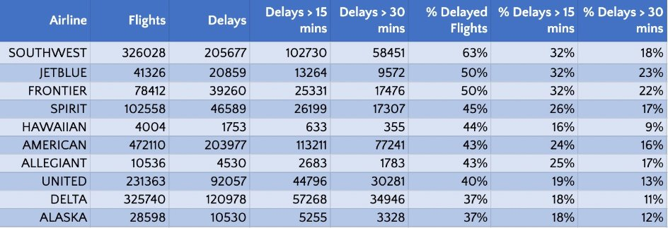
Airline - Delay Numbers

Slide 50
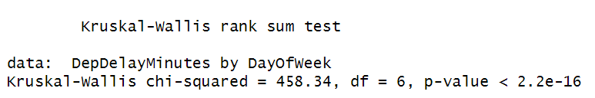
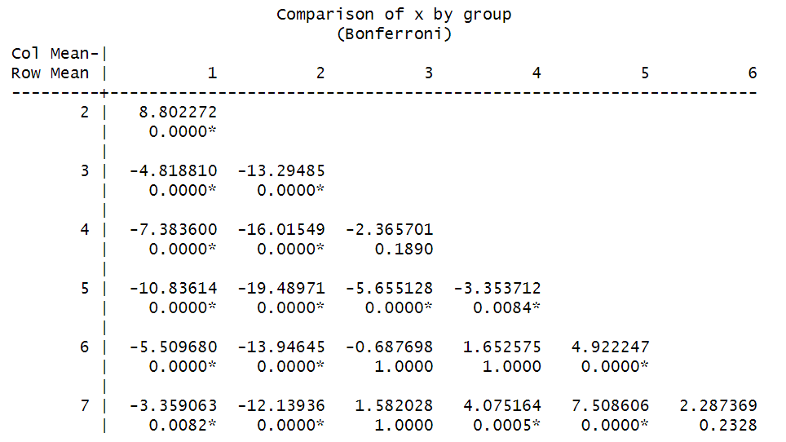
Day of Week - Kruskal Wallis

Slide 51
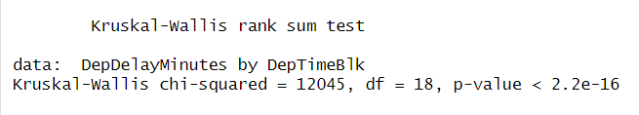
Time of Day - Kruskal Wallis

