Slide 1
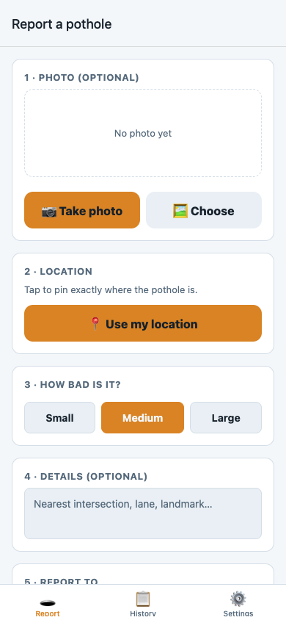
PotholePal STL
Report a St. Louis pothole in 15 seconds
Snap a photo, pin the spot, and PotholePal routes it to the right
agency with a report ready to send.
Congressional App Challenge · React Native / Expo / TypeScript

Slide 2
The problem
Potholes wreck tires and cause crashes — and in St. Louis, reporting one is
weirdly hard. Road responsibility is split across THREE agencies by who owns
the road, and none of them has a real mobile app:
• MoDOT (state highways) — a long web form with a CAPTCHA, or a phone line
• City of St. Louis — Citizens’ Service Bureau web form + phone
• St. Louis County — a separate phone line
So a resident has to guess which agency owns the road, find the form, and
describe a location from memory. Most people just don’t — and the pothole stays.

Slide 3
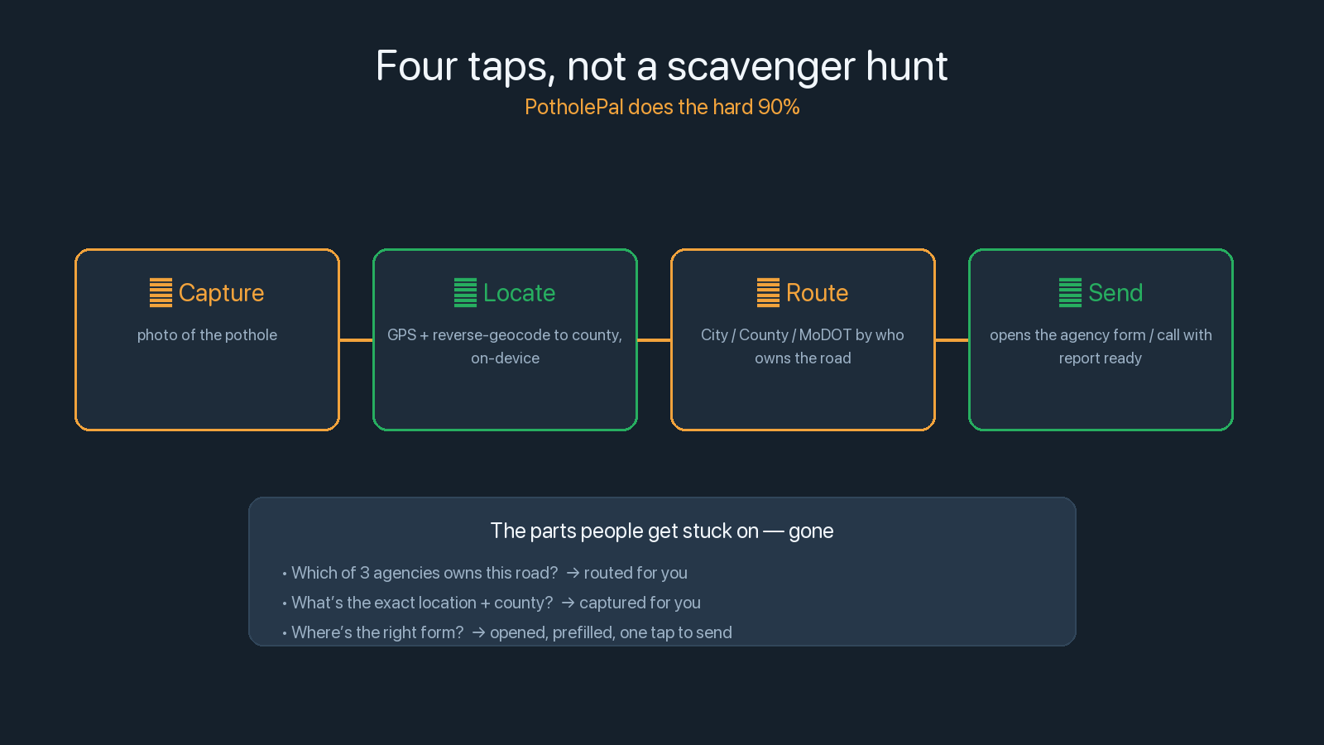

Slide 4
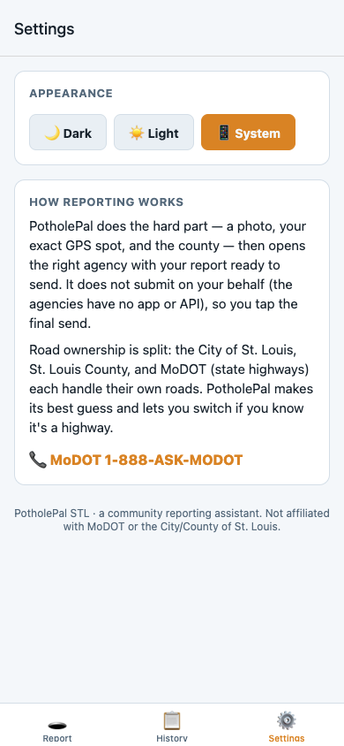
What it does
Capture · locate · route
Theme · how it works

Slide 5


Slide 6
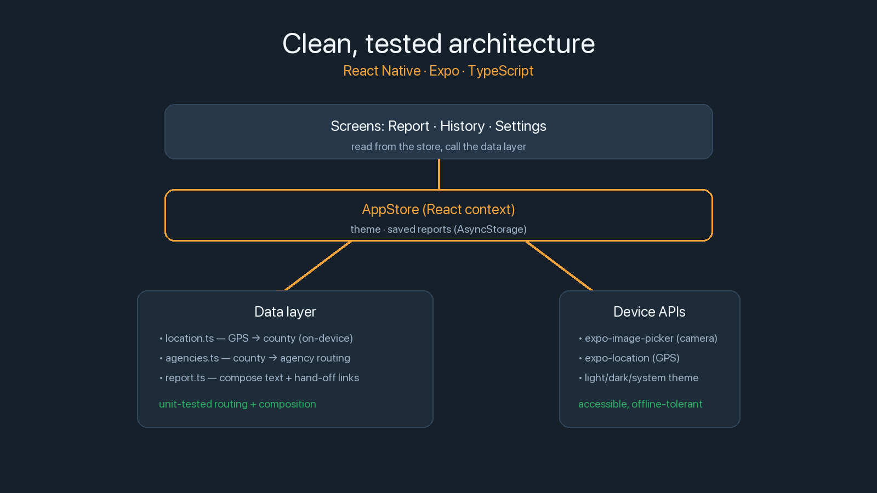

Slide 7
Make reporting so easy people actually do it
A real, installable app that turns a multi-step scavenger hunt into four taps.
Next: a roads dataset for exact per-street routing, status follow-up, and other
hazards — downed signs, broken lights, missing curb cuts.
A community reporting assistant. Not affiliated with MoDOT or the City/County.

