Slide 1
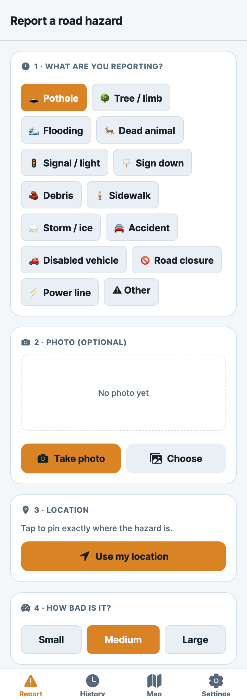
HazardHub STL
Report any St. Louis road hazard in 15 seconds
Snap a photo, pin the spot, and HazardHub routes it to the right
agency with a report ready to send.
Congressional App Challenge · React Native / Expo / TypeScript

Slide 2
The problem
Potholes wreck tires and cause crashes — and in St. Louis, reporting one is
weirdly hard. Road responsibility is split across THREE agencies by who owns
the road, and none of them has a real mobile app:
• MoDOT (state highways) — a long web form with a CAPTCHA, or a phone line
• City of St. Louis — Citizens’ Service Bureau web form + phone
• St. Louis County — a separate phone line
So a resident has to guess which agency owns the road, find the form, and
describe a location from memory. Most people just don’t — and the pothole stays.
(Same friction for a downed tree, flooding, a dead deer, or a dark signal.)

Slide 3
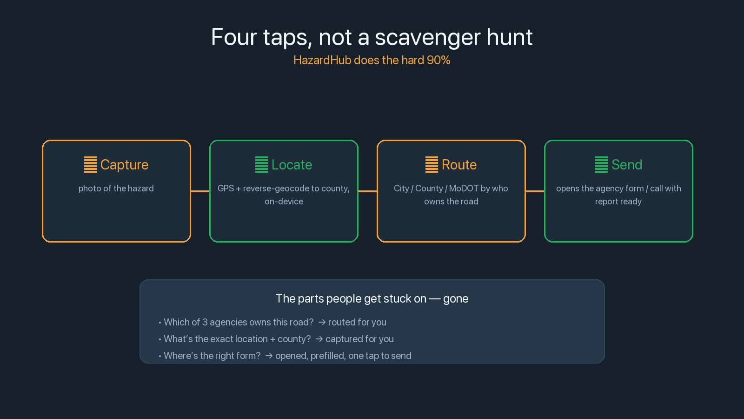

Slide 4
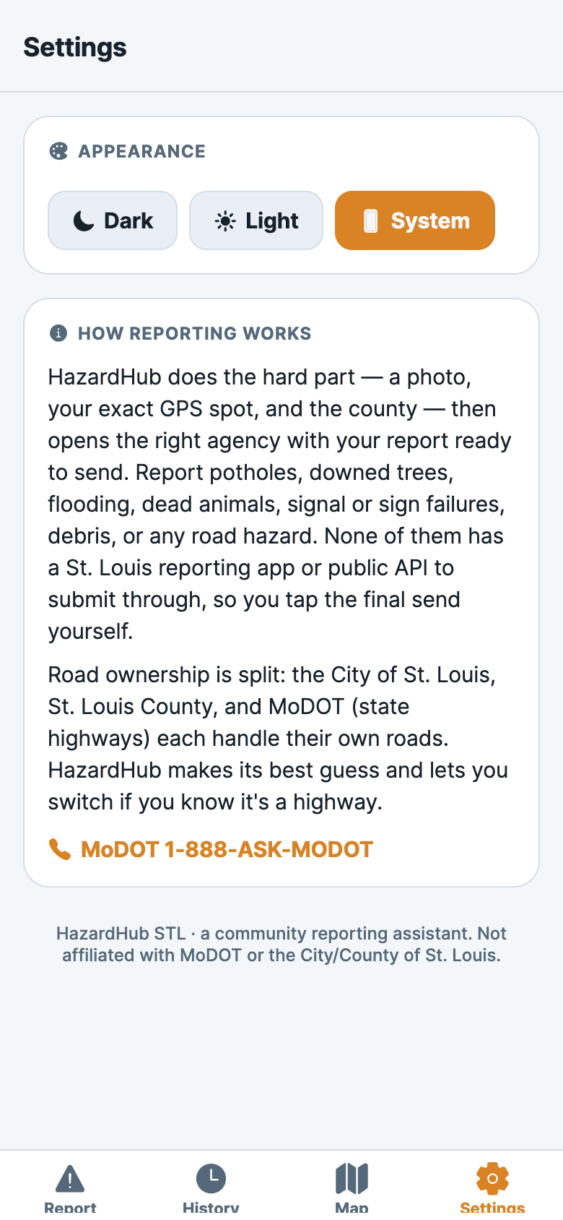
What it does
14 types · on-device AI suggestion · one-tap routing · hazard map
14 types · capture · route
Theme · how it works

Slide 5
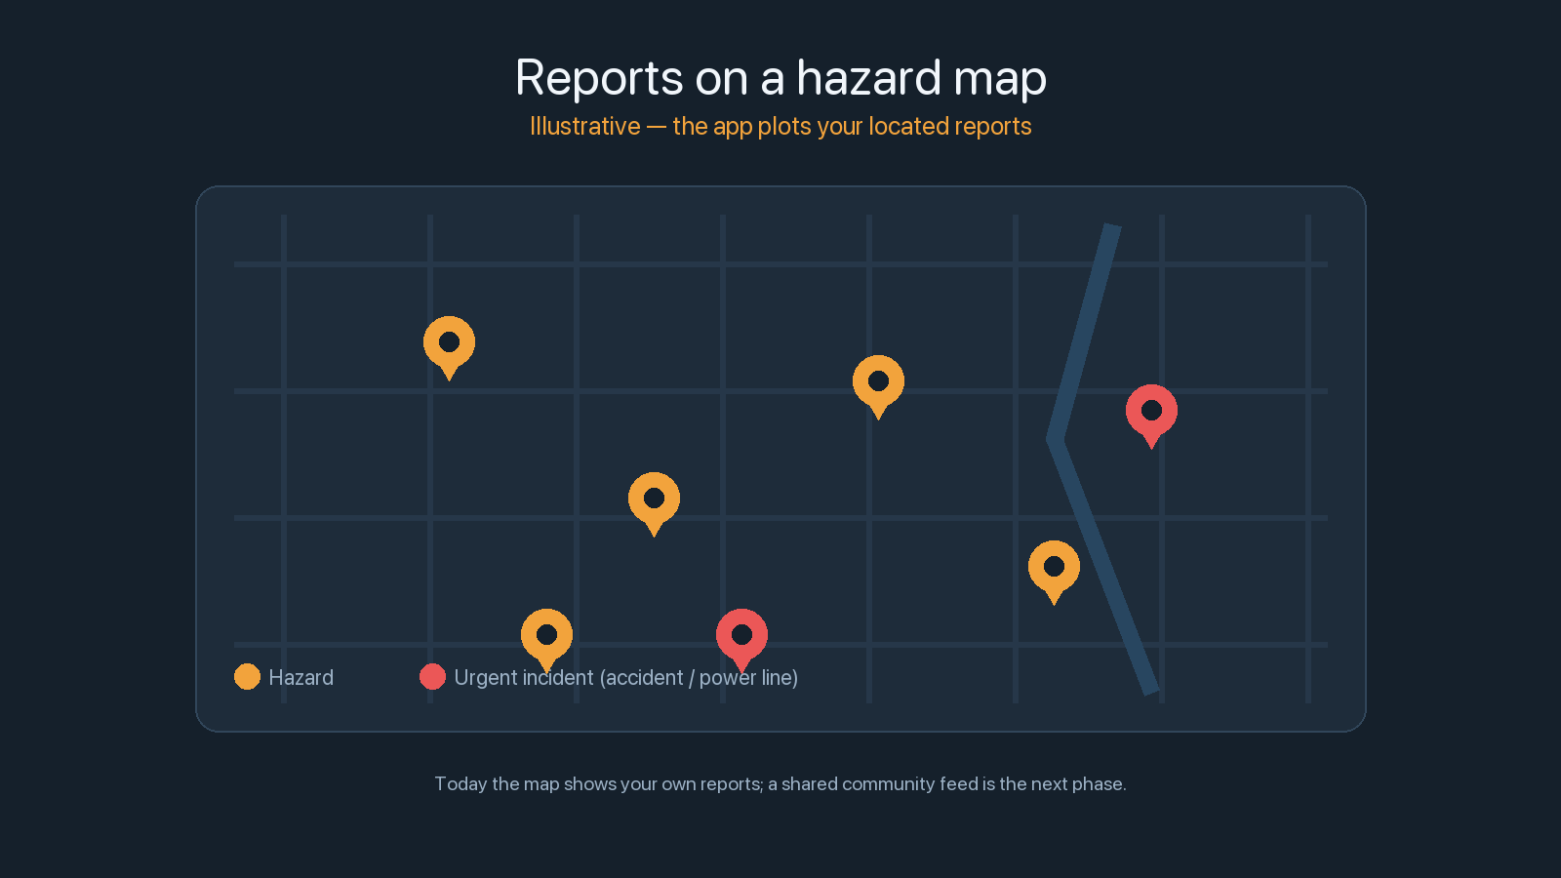
More than potholes
One capture → locate → route → compose flow,
now across 14 types:
• Maintenance hazards: potholes, trees,
flooding, dead animals, signal/light,
signs, debris, sidewalk, storm/ice
• Incidents: accidents, disabled vehicles,
road closures, downed power lines
Life-safety cases show a warning + one-tap
Call 911 — the app says plainly it does
NOT dispatch help itself.

Slide 6
AI that suggests — honestly
Take a photo → an on-device model suggests the hazard type with a confidence %.
• A model I trained on Google’s Teachable Machine — so it learns the actual
classes (pothole, flooding, tree…), which a generic model can’t recognize.
• Runs on-device with TensorFlow.js (pure-JS backend). I switched to it after the
usual RN ML library turned out incompatible with Expo’s New Architecture.
• It’s a SUGGESTION with a visible confidence score that the user confirms or
overrides — and it says so. An AI that silently mislabels a downed power line
as a pothole would be worse than no AI.
The honest, debuggable version of the feature — not a magic “detect anything” badge.

Slide 7
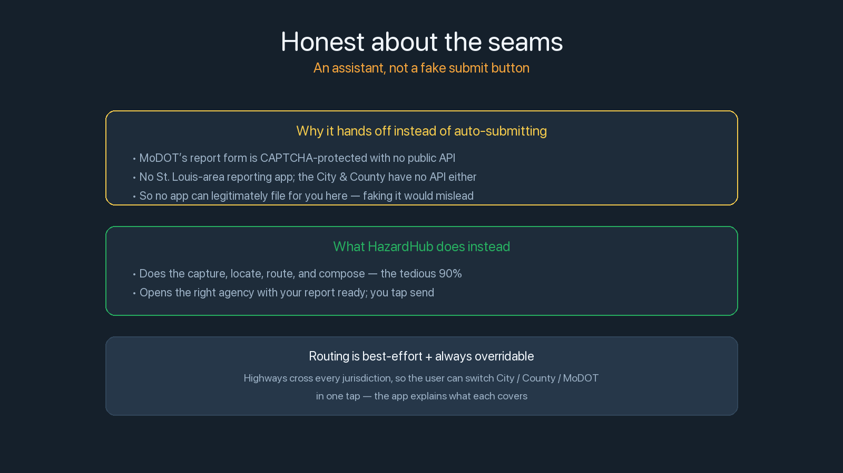

Slide 8
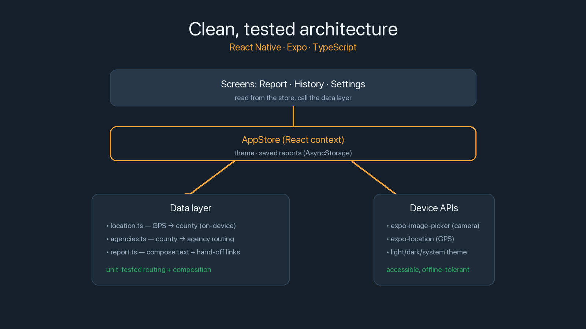

Slide 9
Make reporting so easy people actually do it
A real, installable app that turns a multi-step scavenger hunt into a few taps —
across 14 hazard and incident types, with an on-device AI suggestion and a map
of what’s been reported.
Next: train the model on more photos for sharper suggestions, a roads dataset for
exact per-street routing, and a shared backend so the map goes community-wide
with a municipal dashboard for faster agency response.
A community reporting assistant. Not affiliated with MoDOT or the City/County.

