Slide 1
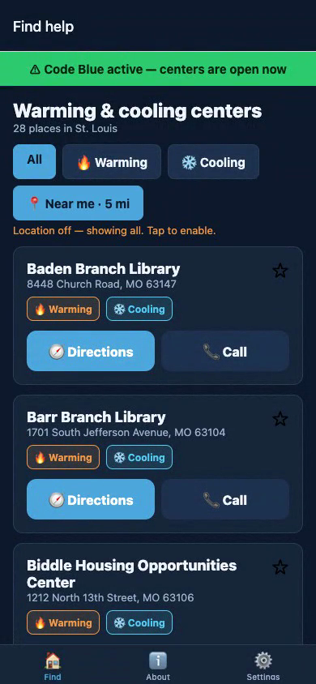
SafeHaven STL
Find a warming or cooling center — fast, offline, when it matters
Every St. Louis warming & cooling center in one place.
Nearest first. One tap to directions or a call. Built for a crisis.
Congressional App Challenge · React Native / Expo / TypeScript

Slide 2
The problem
When St. Louis hits dangerous cold or heat, the City opens warming and cooling
centers to protect people — the City’s own words: those experiencing
homelessness, the elderly, and people with disabilities.
But that information is scattered across separate web pages, PDFs, press
releases, and a phone line. The people who need a safe place most are the
same people least able to dig through government websites to find one.
In extreme weather, that gap isn’t an inconvenience. People die of exposure.

Slide 3
Not another directory
Broad services directories exist (findhelp, CompassionSTL). SafeHaven is
different — narrow, local, and built for the moment of crisis:
• No single St. Louis app aggregates the warming/cooling centers — SafeHaven does
• LIVE cooling data from the Missouri DHSS feed + an "open now" filter —
so you don’t set out for a center that’s already closed
• The others assume a connection; SafeHaven works OFFLINE on a curated fallback
• Built for the person outside with a dying phone — two giant buttons, no typing

Slide 4
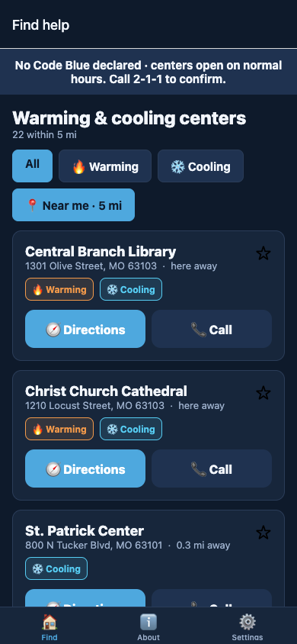
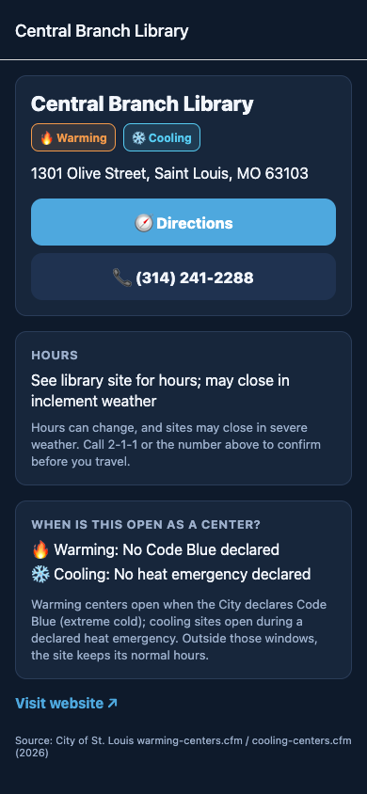
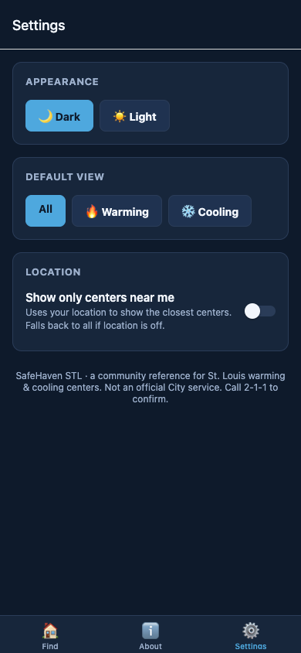
What it does
Find + emergency banner
Near me, nearest first
Directions & call
Theme · offline

Slide 5
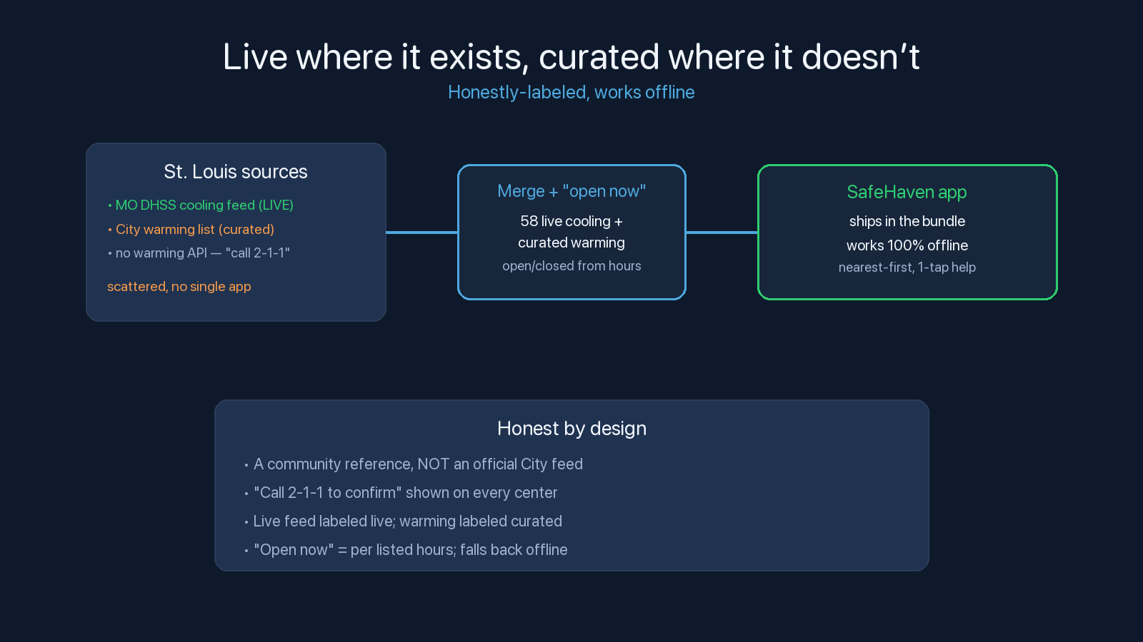

Slide 6
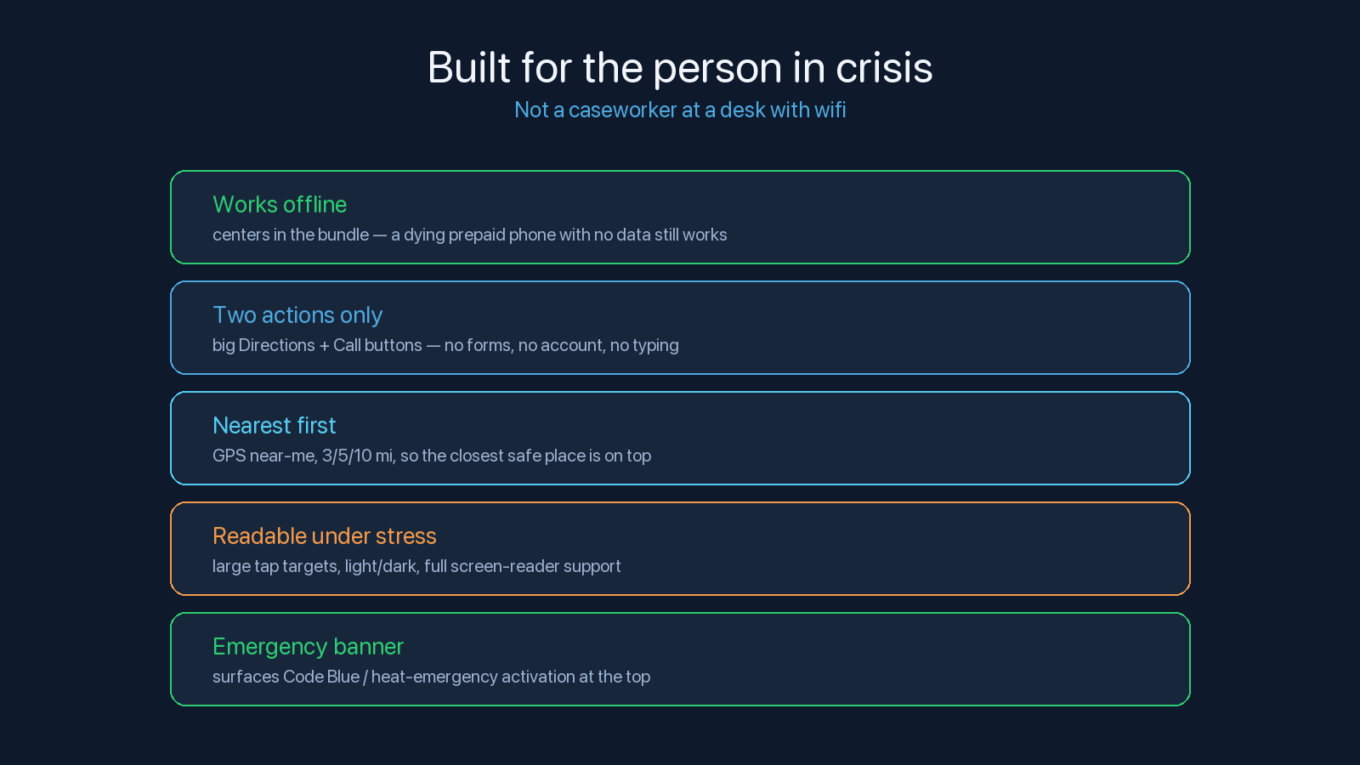

Slide 7
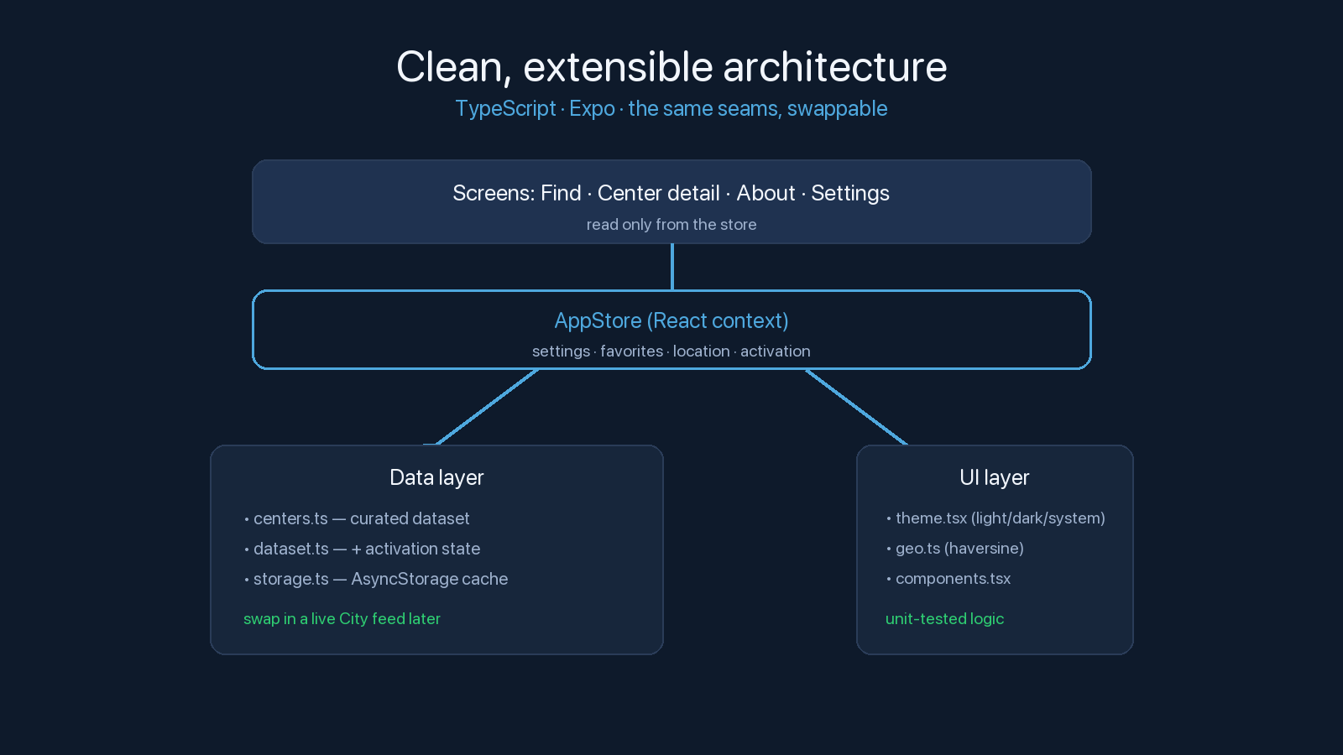

Slide 8
Help, in seconds — for the people who need it
A real, installable app: live Missouri DHSS cooling data, an "open now" filter,
and a curated offline fallback — working on any phone, in any weather.
Next: live warming activation (Code Blue), community hour corrections, nearby
food + overnight shelters, and multilingual support.
A community reference, not an official City service. Call 2-1-1 to confirm.

