Slide 1

A Presentation On…
Enhancing Direct Marketing Campaigns for Term Deposits
By
Ranjith Babu Vennam Deepa Biswas Sai Anvesh Marupeddi Suvishal Kalakoti

Slide 2
Contents:
Business Problem and Motivation
Prior Knowledge
Data Mining Process
Business Questions
Data Description
Clean the data
Collect the Data
Preprocess the data
Exploratory Data analysis
Models used
Results and Recommendations

Slide 3

Business Problem:
The primary business problem is to increase the number of term deposit subscriptions for a bank. The goal of this analysis is to predict whether a client will subscribe to a term deposit ("yes" or "no"). To achieve this goal, we will use a variety of input variables that encompass information about the bank clients, their interactions, and other attributes related to the marketing campaigns. By developing predictive models based on this dataset, we aim to enhance the effectiveness of the marketing campaigns and increase the number of term deposit subscriptions.

Slide 4

Motivation
The motivation behind this analysis and predictive modeling project is to improve the effectiveness of the bank's marketing campaigns. Here are the key motivations for this initiative:
Revenue Generation
Customer Engagement
Cost Reduction
Competitive Advantage
Risk Management
To address these motivations, the bank intends to build predictive models using the provided dataset.

Slide 5

Prior Knowledge
To understand what others have done in the past with respect to solving the problem of increasing term deposit subscriptions in a banking context, we conducted a comprehensive review of existing literature, industry case studies, and publicly available data.
Examined research papers, reports, and articles related to banking and marketing analytics. Some of the research papers include:
"Bank marketing analytics"
"Customer segmentation in banking"
"Predictive modeling for term deposit subscriptions"

Slide 6
Data Mining Process:
Observe the reality, formulate the hypothesis
Establish a goal
Collect the data
Clean the data
Preprocess the data
Build the model
Evaluate the results
Backtest/Validate/Verify

Slide 7

Business Questions
1. How do the outcomes of previous marketing campaigns (poutcome) influence the success of the current campaign?
2. Do customers with different average yearly balances (balance) respond differently to marketing campaigns, and can we tailor strategies for each group?
3. How does the presence of credit defaults, housing loans, or personal loans impact customer responsiveness and campaign success?

Slide 8

Dataset Description
Dataset used = “bank-full.csv”
This dataset contains 17 attributes. (16 input variables and 1 output variable)
The dataset consists of various attributes related to individuals and their interactions in a marketing context.

Slide 9

Input Variables:
Age (Numeric)
Job (Categorical)
Marital (Categorical
Education (Categorical)
Default (Binary)
Balance (Numeric)
Housing (Binary)
Loan (Binary)
Contact (Categorical)
Day (Numeric)
Month (Categorical)
Duration (Numeric)
Campaign (Numeric)
Pdays (Numeric)
Previous (Numeric)
Poutcome (Categorical)
Output Variable:
Y (Binary):
The target variable indicates whether the client subscribed to a term deposit. It's binary with values "yes" or "no."
)

Slide 10
Clean the data
Address missing data. (Remove null values/Impute with mean)
Remove Outliers

Slide 11

Preprocessing the data:
Data Transformation
Encode categorical variables.
Scale or normalize numeric features
Attribute/Dimension Reduction

Slide 12
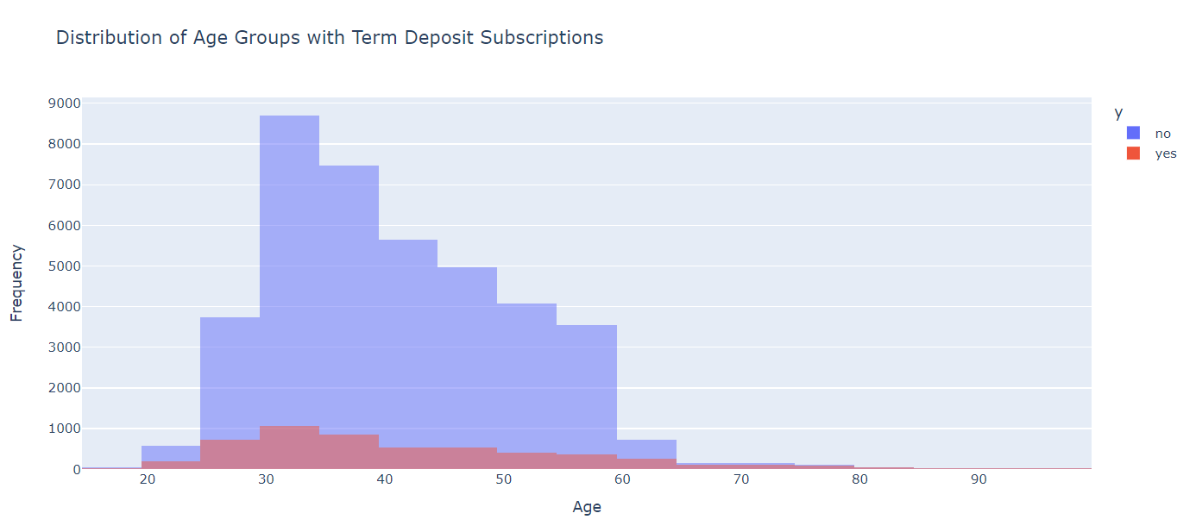
Exploratory Data Analysis

Slide 13
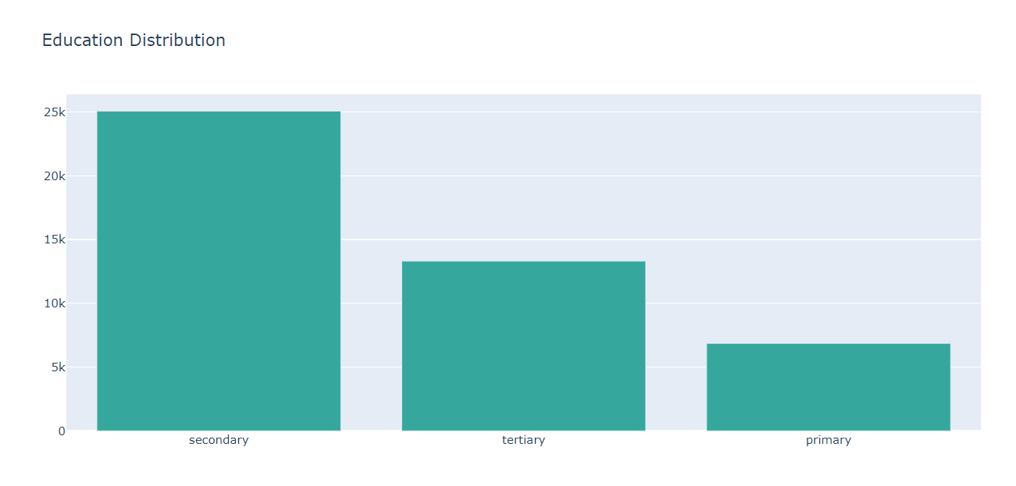
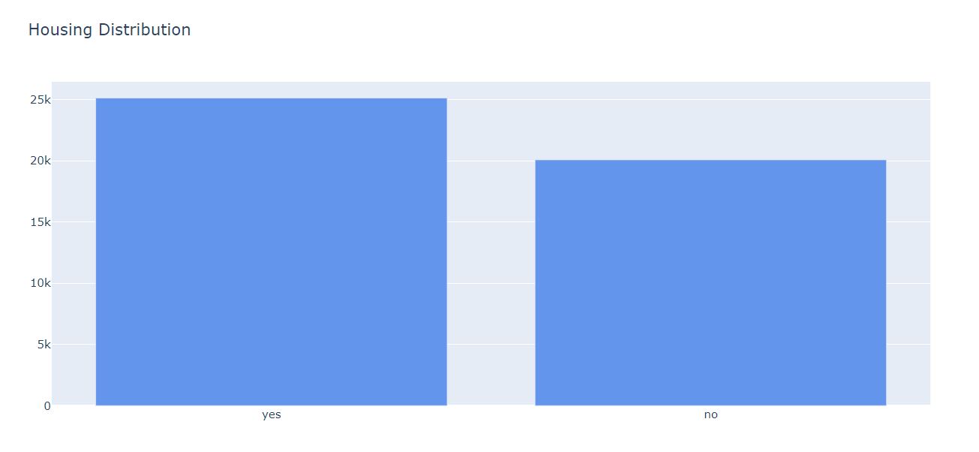
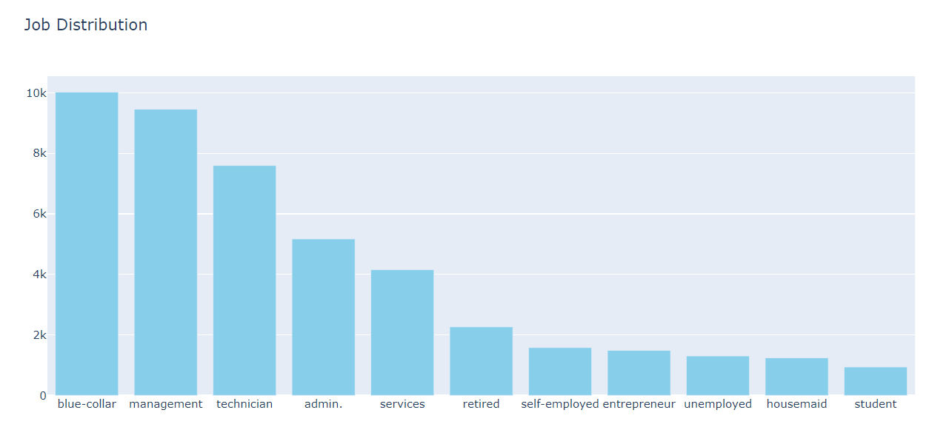
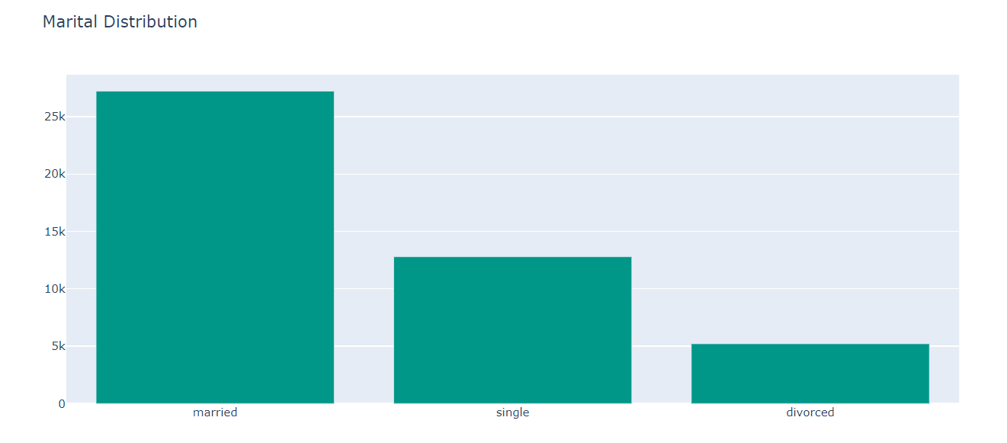

Slide 14

Models Used
Decision Tree
Random Forest
XGBoost

Slide 15
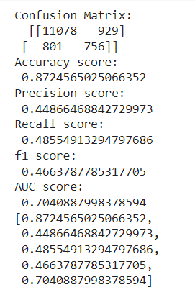
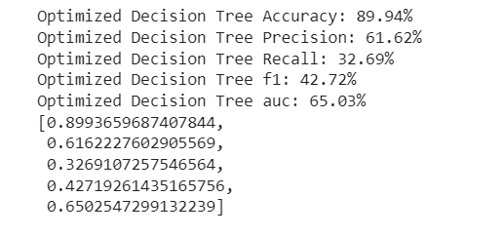
Decision Tree

Slide 16
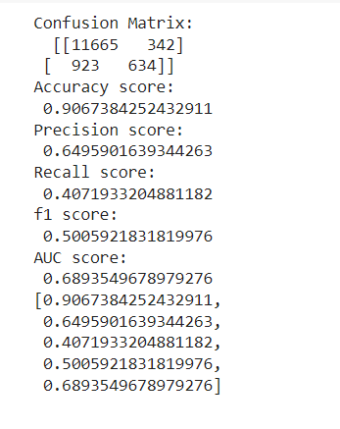
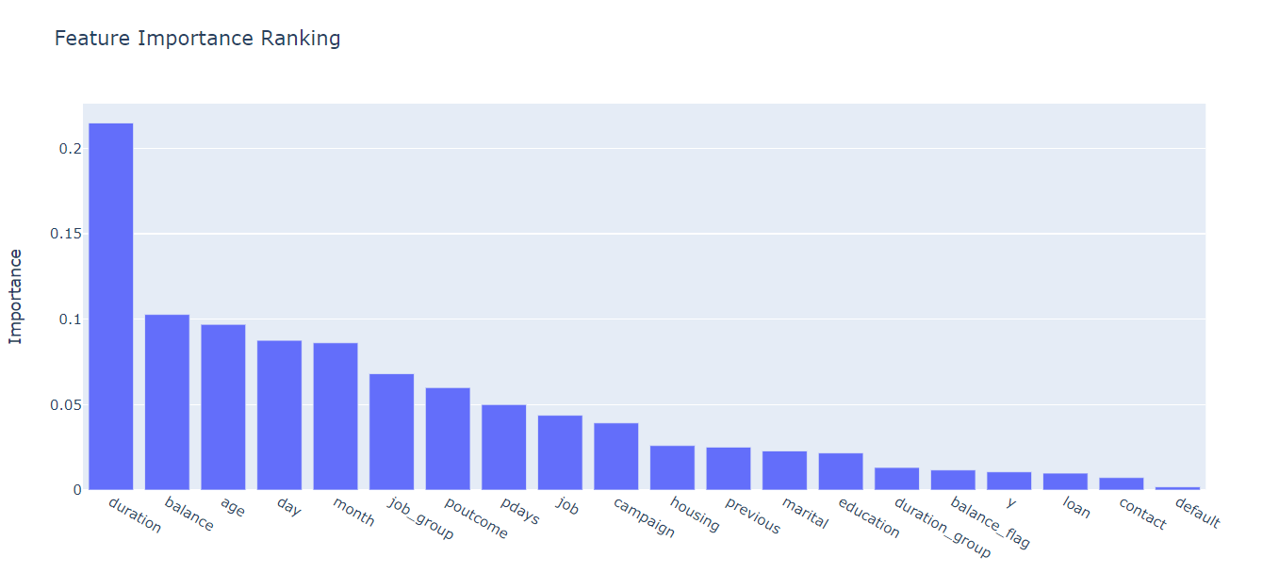
Random Forest

Slide 17
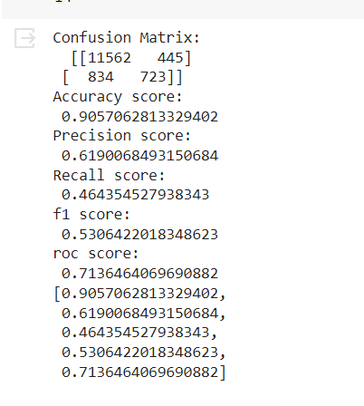
XGBoost

Slide 18
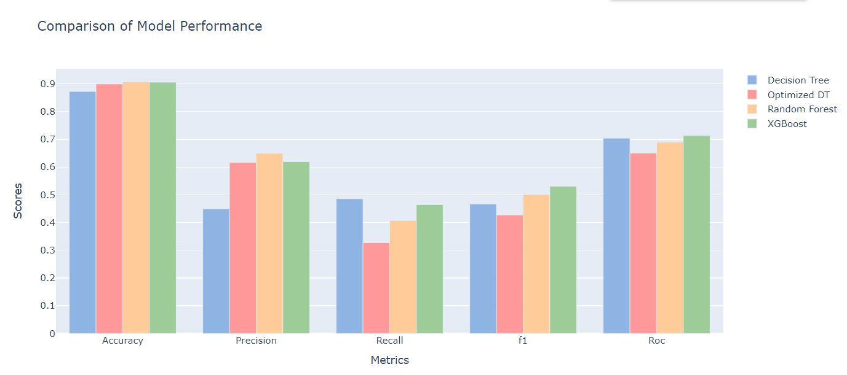

Slide 19
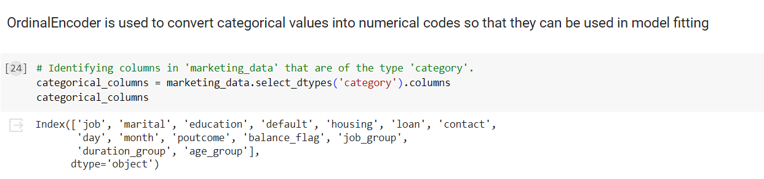
Recommendations:
As shown by the results, it can be said that those included features contribute a great deal to model accuracy.
We can recommend that if a person has age in between 27 & 52, is married, has primary/secondary education, under the job group 1, has housing loan, has no personal loan, maintains atleast 1000 balance in their account is more likely to subscribe to the fixed deposits.
In order to obtain more subscriptions, the Bank should reach out to customers who have such features.

Slide 20

Thank You

