Slide 1
DepTeam Workshop Short Course - Part 2

Slide 2
Basic Linux Commands

Slide 3
Linux Command
ls
List files and directories in the current directory
“man ls” for documentation

Slide 4
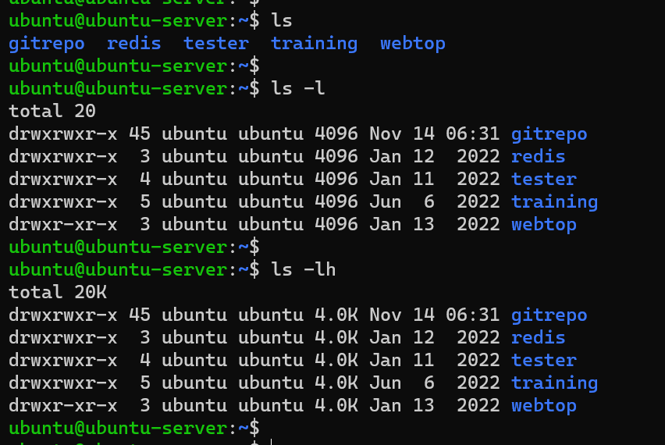

Slide 5
Linux Command
cd
change directory

Slide 6
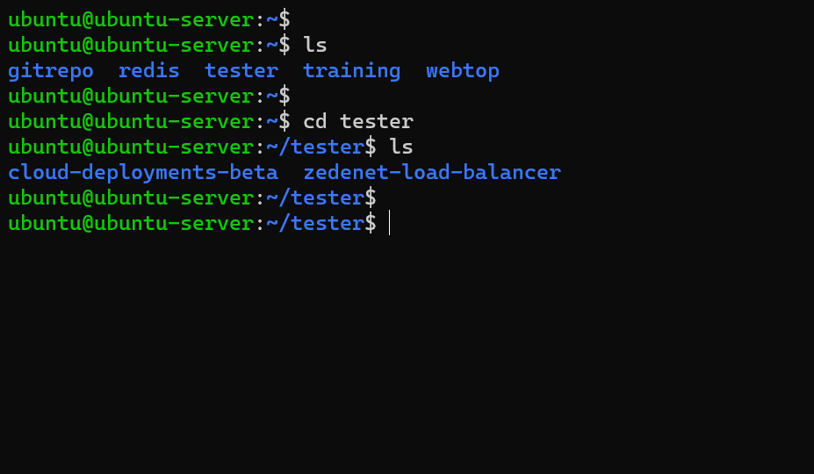

Slide 7
Linux Command
pwd
Print working directory
“man pwd” for documentation

Slide 8
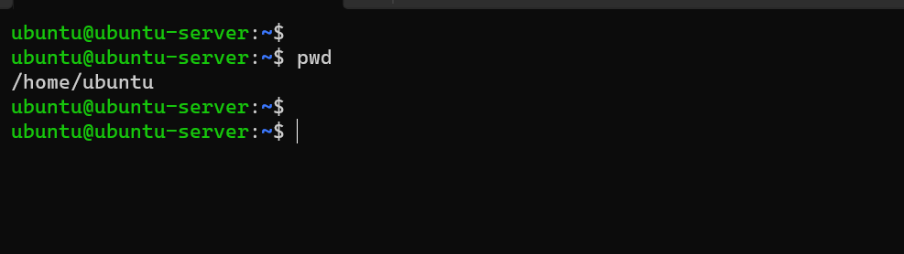

Slide 9
Linux Command
mkdir
Make a new directory
“man mkdir” for documentation

Slide 10
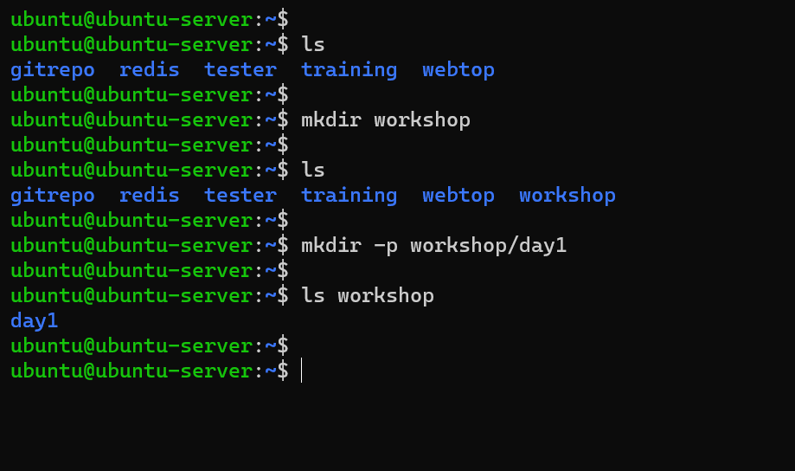

Slide 11
Linux Command
touch
Create a new file
“man touch” for documentation

Slide 12
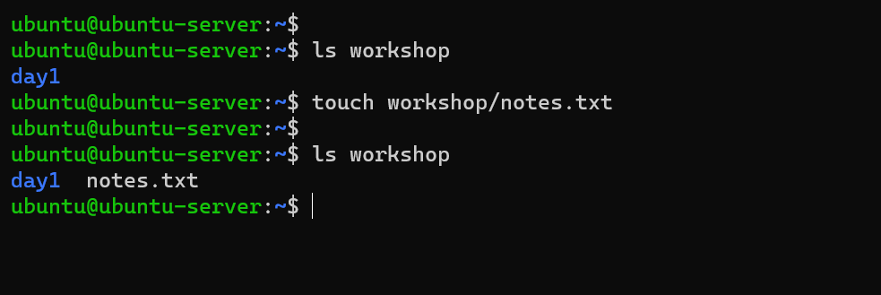

Slide 13
Linux Command
rm
Remove a file
“man rm” for documentation

Slide 14
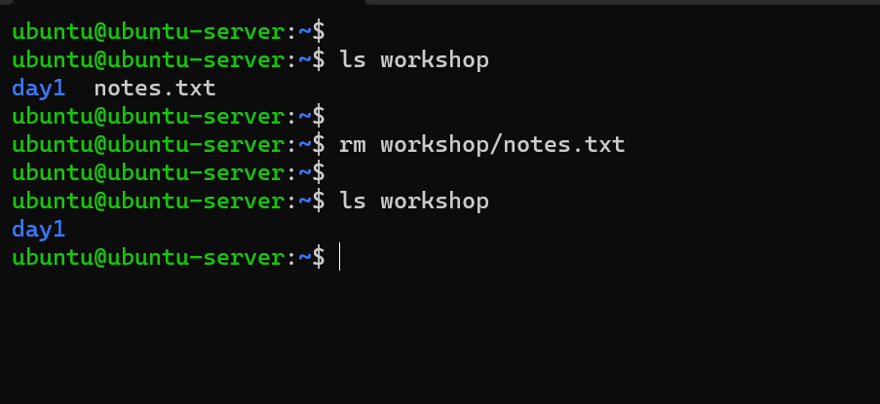

Slide 15
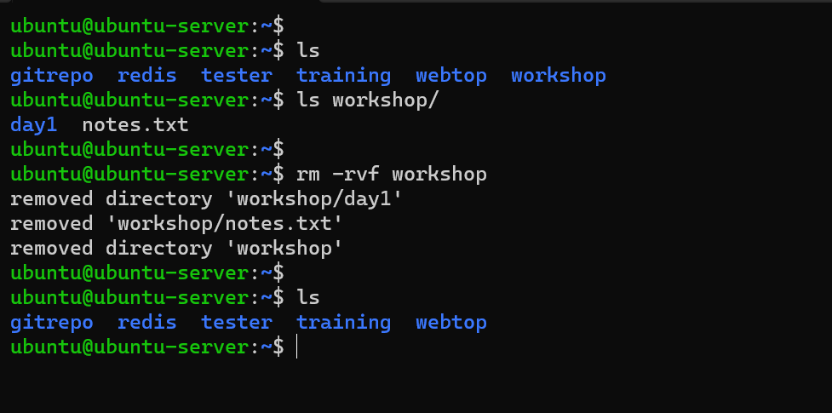

Slide 16
Linux Command
cp
Copy a file or directory
“man cp” for documentation

Slide 17
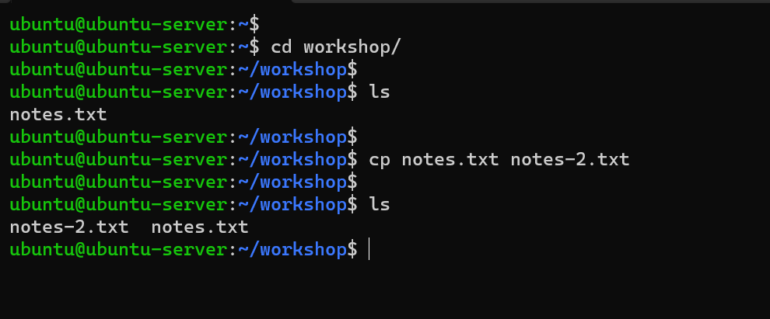

Slide 18
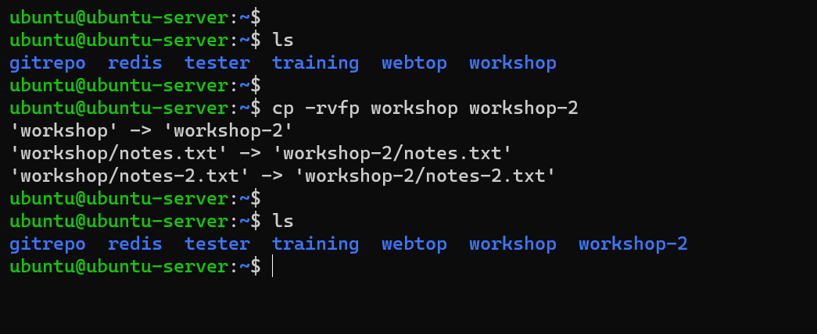

Slide 19
Linux Command
mv
Move a file or directory
Rename a file or directory
“man mv” for documentation

Slide 20
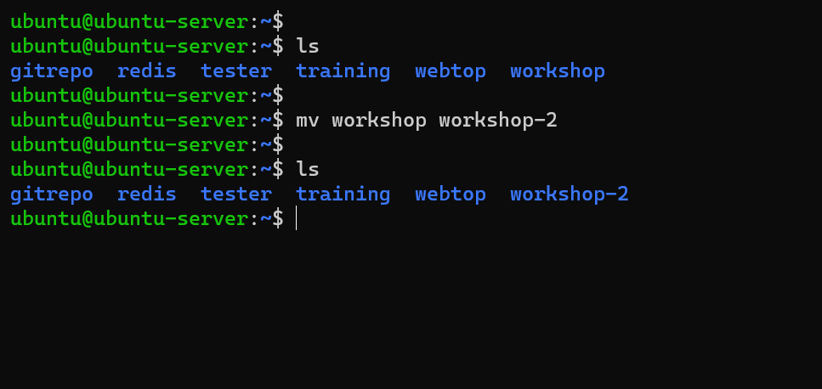

Slide 21
Linux Command
cat
Print the contents of a file in the terminal
“man cat” for documentation

Slide 22
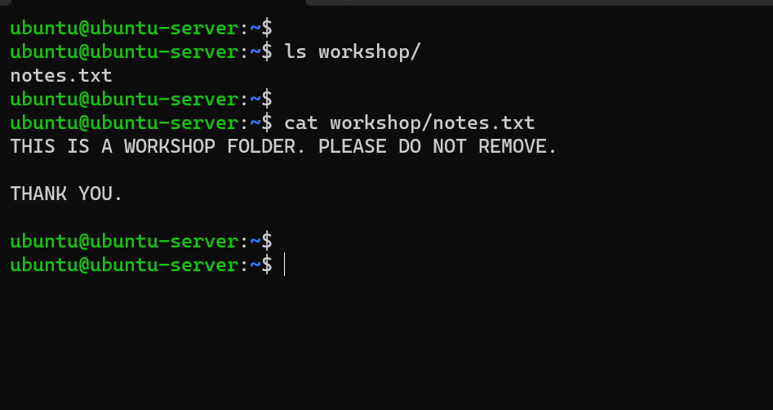

Slide 23
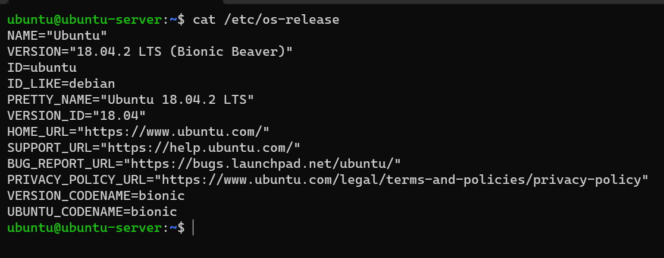

Slide 24
Linux Command
df
Check disk space
“man df” for documentation

Slide 25
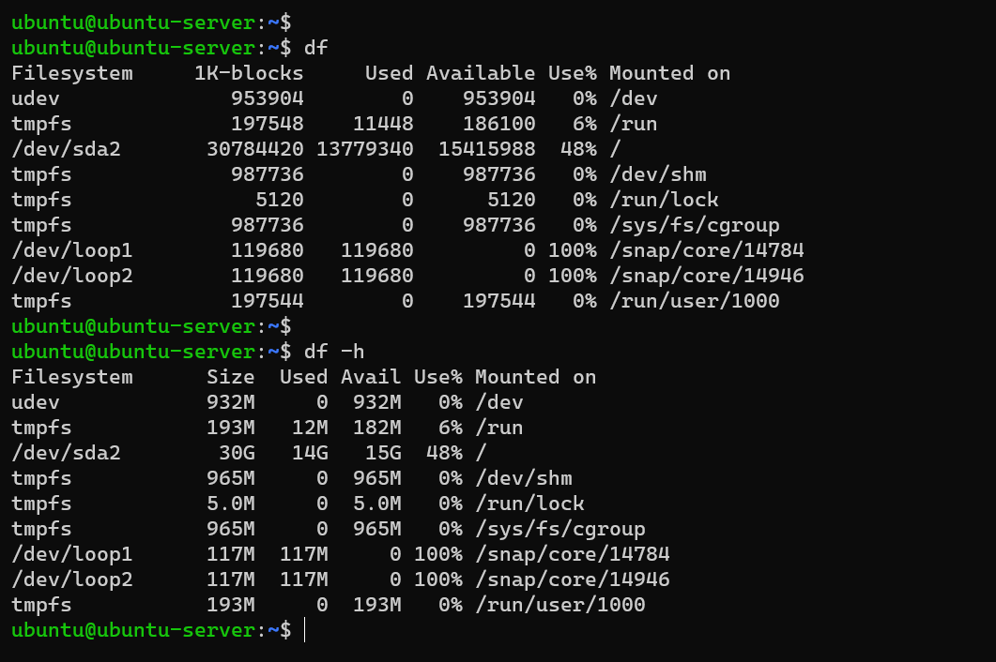

Slide 26
Linux Command
free
Display amount of free and used memory in the system
“man free” for documentation

Slide 27
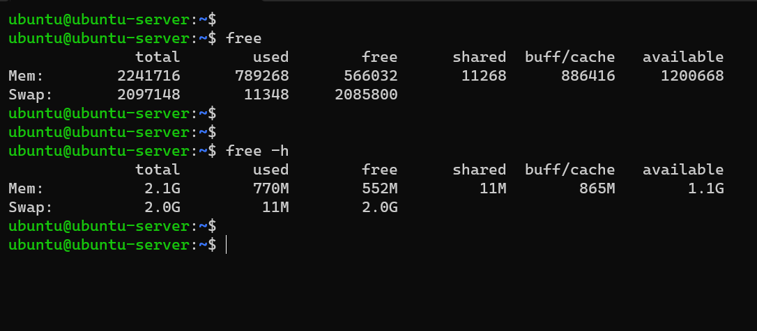

Slide 28
Linux Command
ps
Report a snapshot of the current processes
“man ps” for documentation

Slide 29
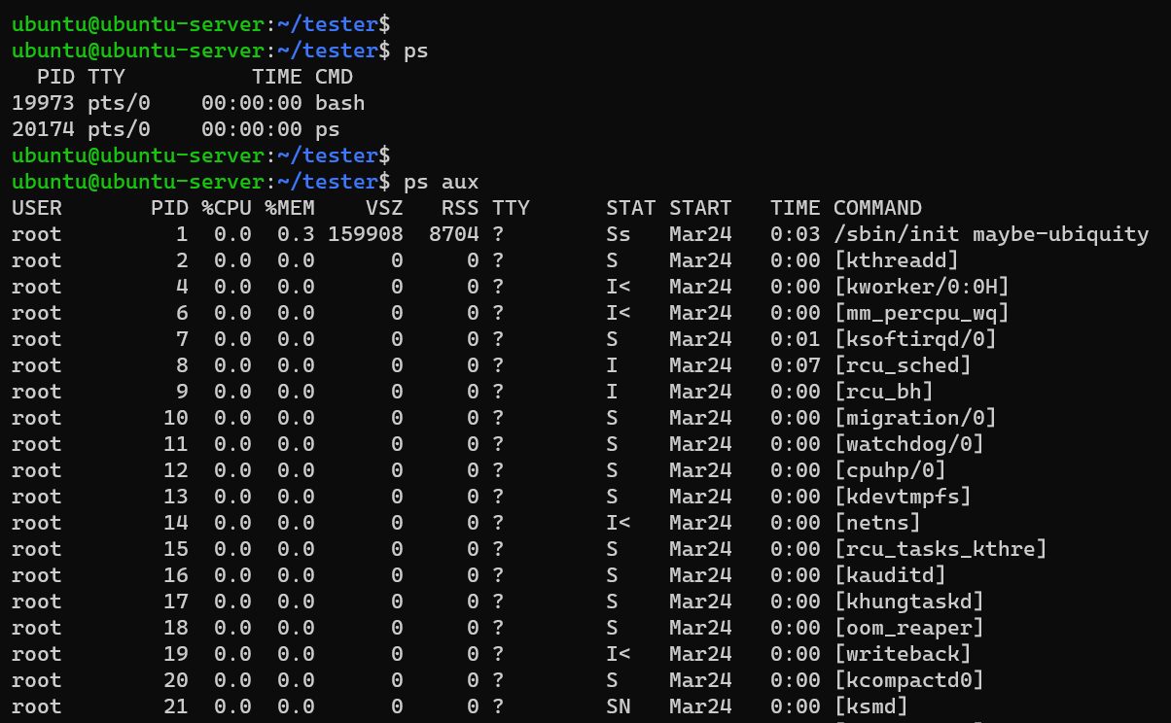

Slide 30
Linux Command
grep
Print lines matching a pattern
“man grep” for documentation

Slide 31
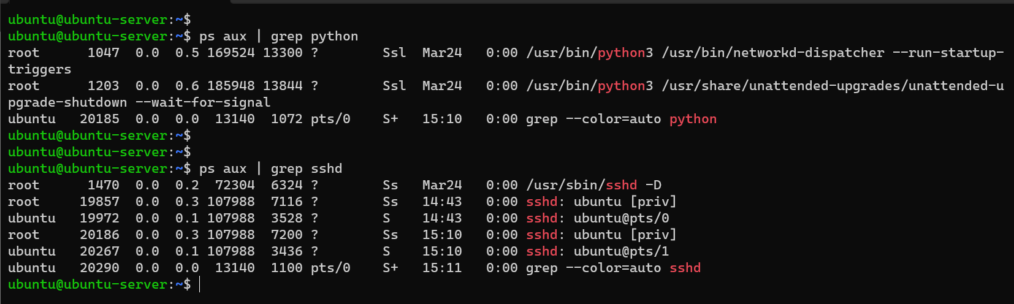

Slide 32
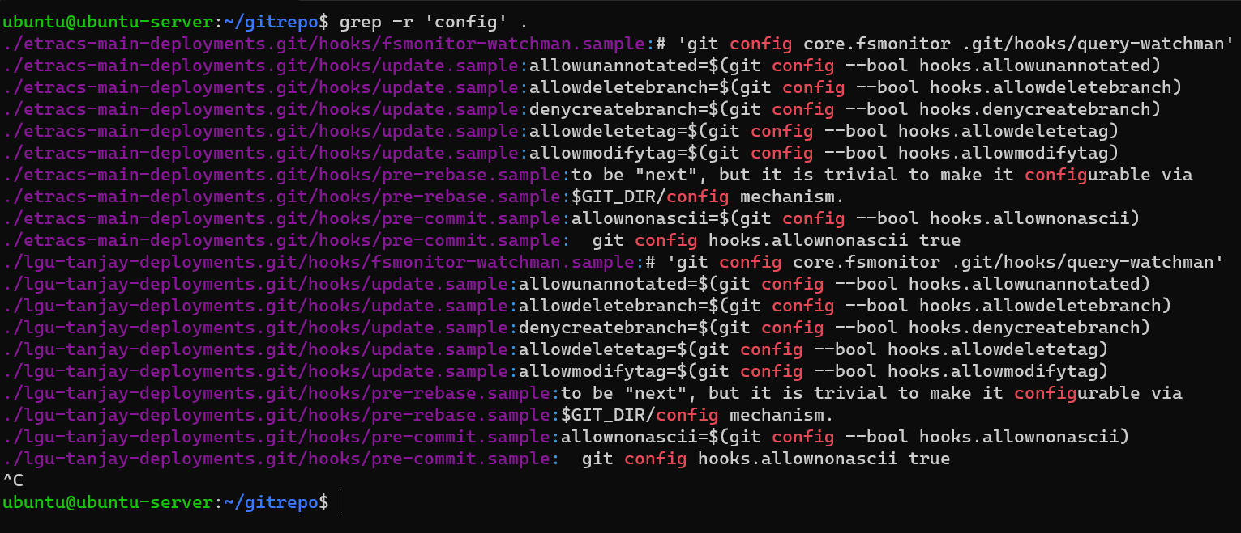

Slide 33
Linux Command
uname
Print system information
“man uname” for documentation

Slide 34
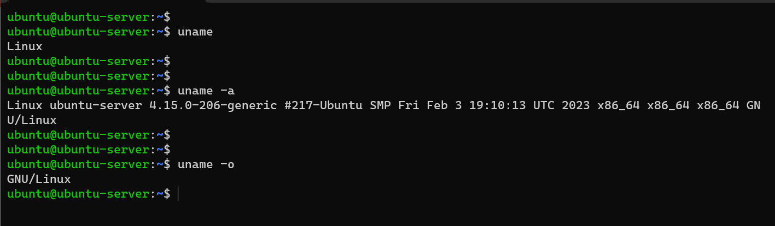

Slide 35
Linux Command
ping
send ICMP ECHO_REQUEST to network hosts
“man ping” for documentation

Slide 36
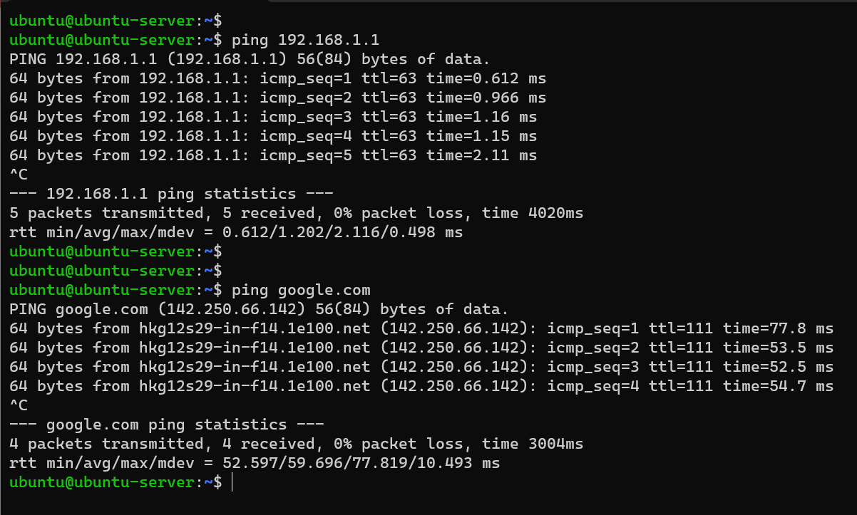

Slide 37
Linux Command
top
Display Linux processes
“man top” for documentation

Slide 38
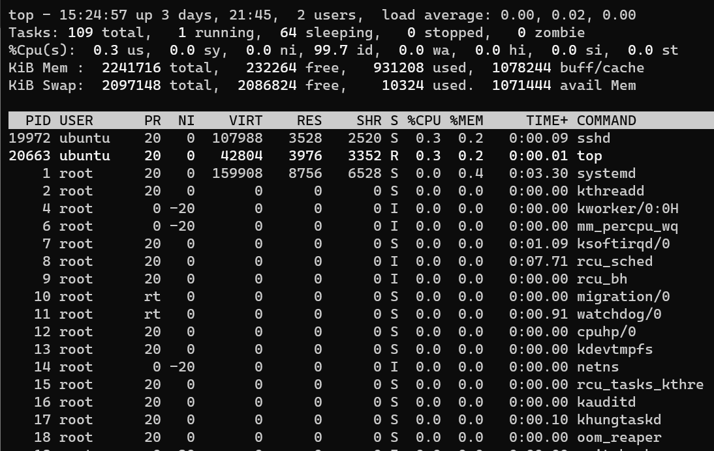

Slide 39
Linux Command
htop
Interactive process viewer
“man htop” for documentation

Slide 40
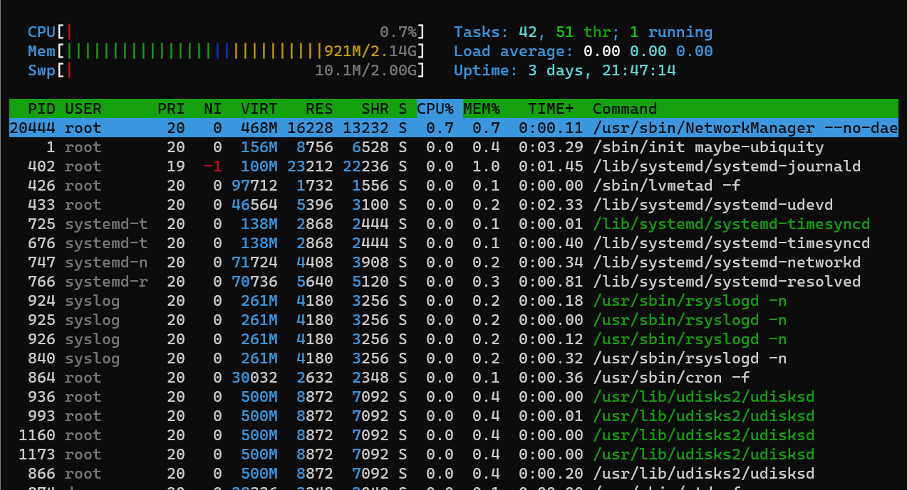

Slide 41
Linux Command
sudo
Execute a command with administrative privileges
“man sudo” for documentation

Slide 42
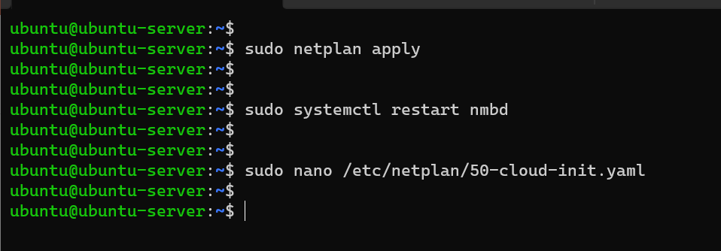

Slide 43
Linux Command
apt
A command-line utility used in Debian-based Linux distributions, such as Ubuntu, to manage software packages.
The apt command is a front-end to the Advanced Packaging Tool (APT) package management system, which provides a simple and consistent interface for installing, updating, and removing software packages on the system
“man apt” for documentation

Slide 44
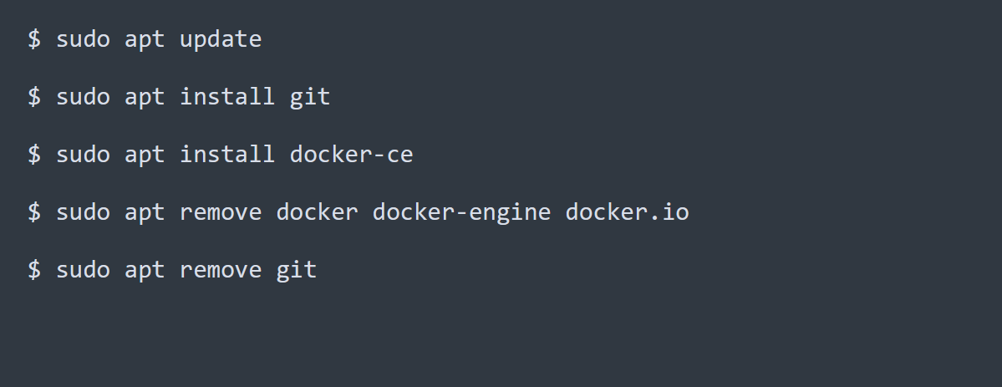

Slide 45
Linux Command
chmod
A command-line utility used in Linux and Unix-based operating systems to change the permissions of files and directories.
It is used to specify who can read, write, or execute a file or directory, and is a critical tool for managing file and directory permissions on Linux systems
“man chmod” for documentation

Slide 46
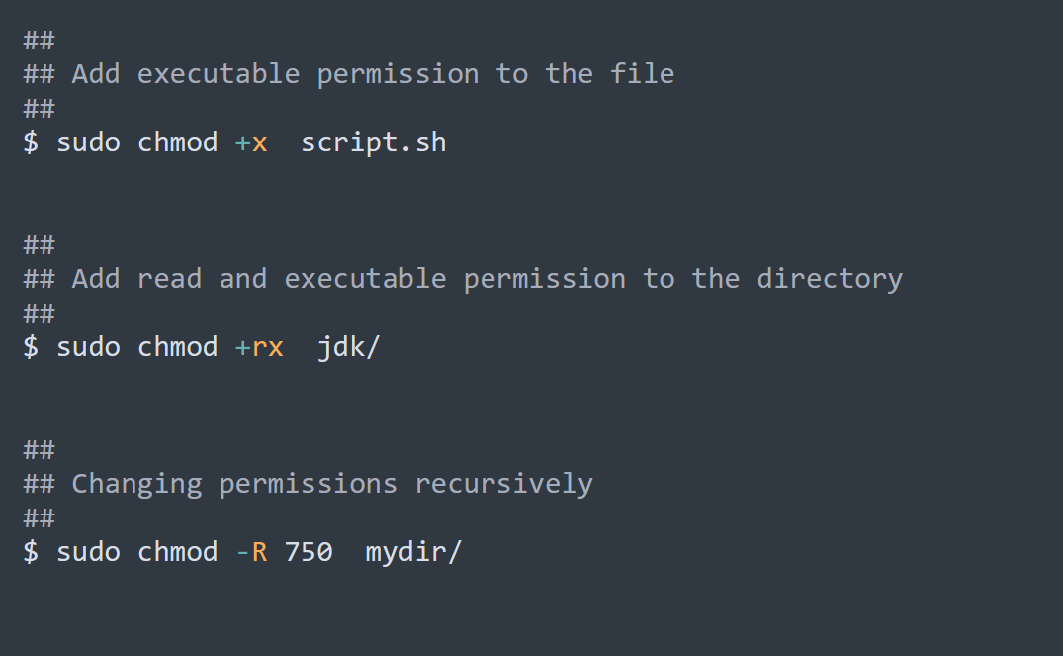

Slide 47
Linux Command
usermod
A command used to modify an existing user account
“man usermod” for documentation

Slide 48
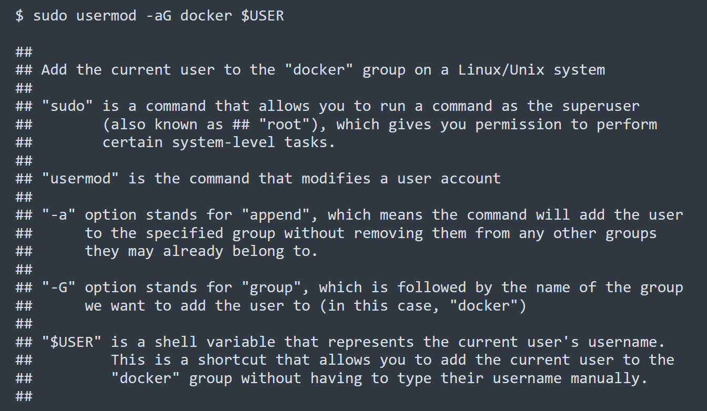

Slide 49
Linux Command
history
A built-in command in Linux that displays a list of the commands executed in the current terminal session, with the most recent commands listed first.
“man history” for documentation

Slide 50
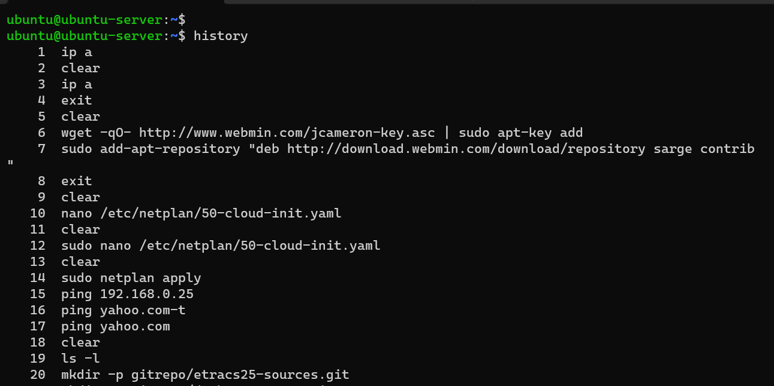

Slide 51
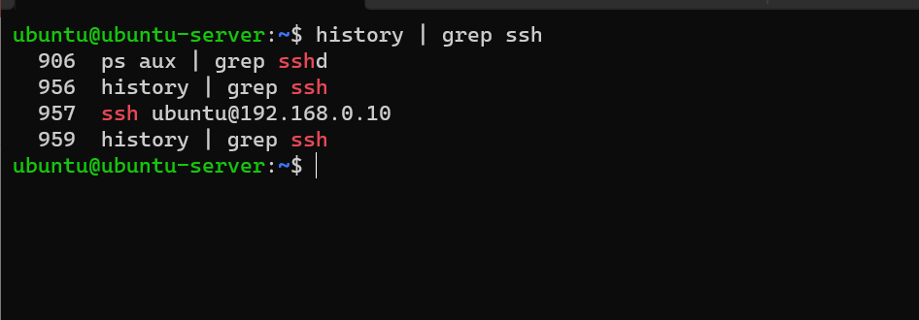

Slide 52
Linux Command
head
A command that allows you to display the first few lines of a text file or output of a command on the terminal. By default, it shows the first 10 lines of the file or output.
“man head” for documentation

Slide 53
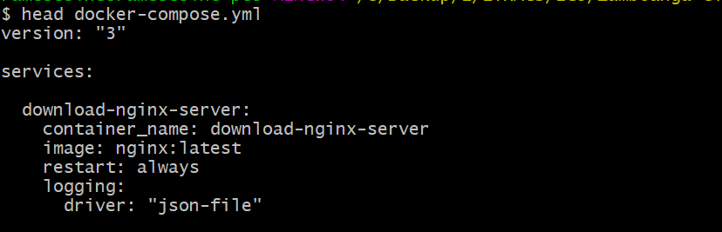

Slide 54
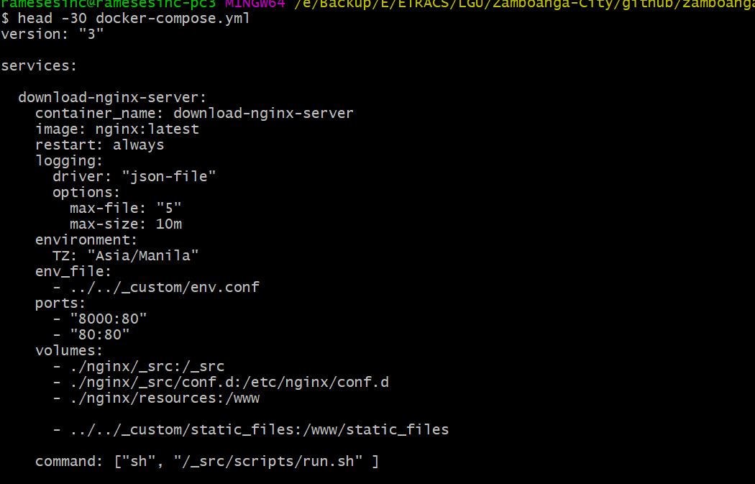

Slide 55
Linux Command
tail
A command that allows you to display the last few lines of a text file or output of a command on the terminal. By default, it shows the last 10 lines of the file or output
“man tail” for documentation

Slide 56
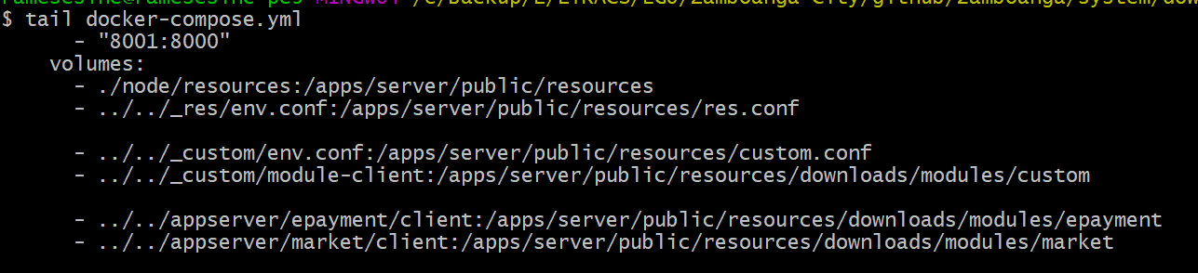

Slide 57
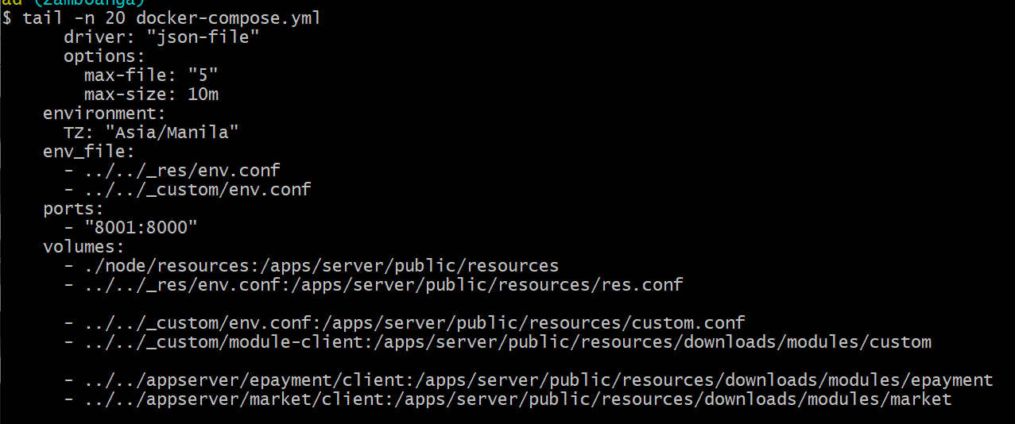

Slide 58
Linux Command
nano
A command-line text editor that provides basic editing features in a user-friendly interface
“man nano” for documentation

Slide 59
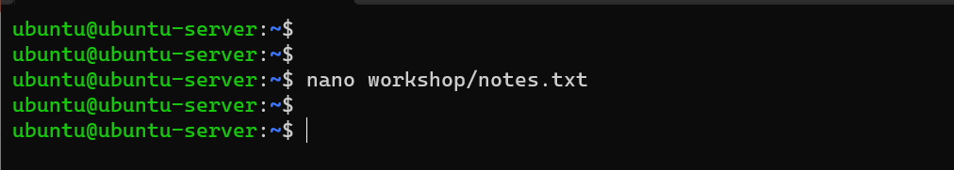
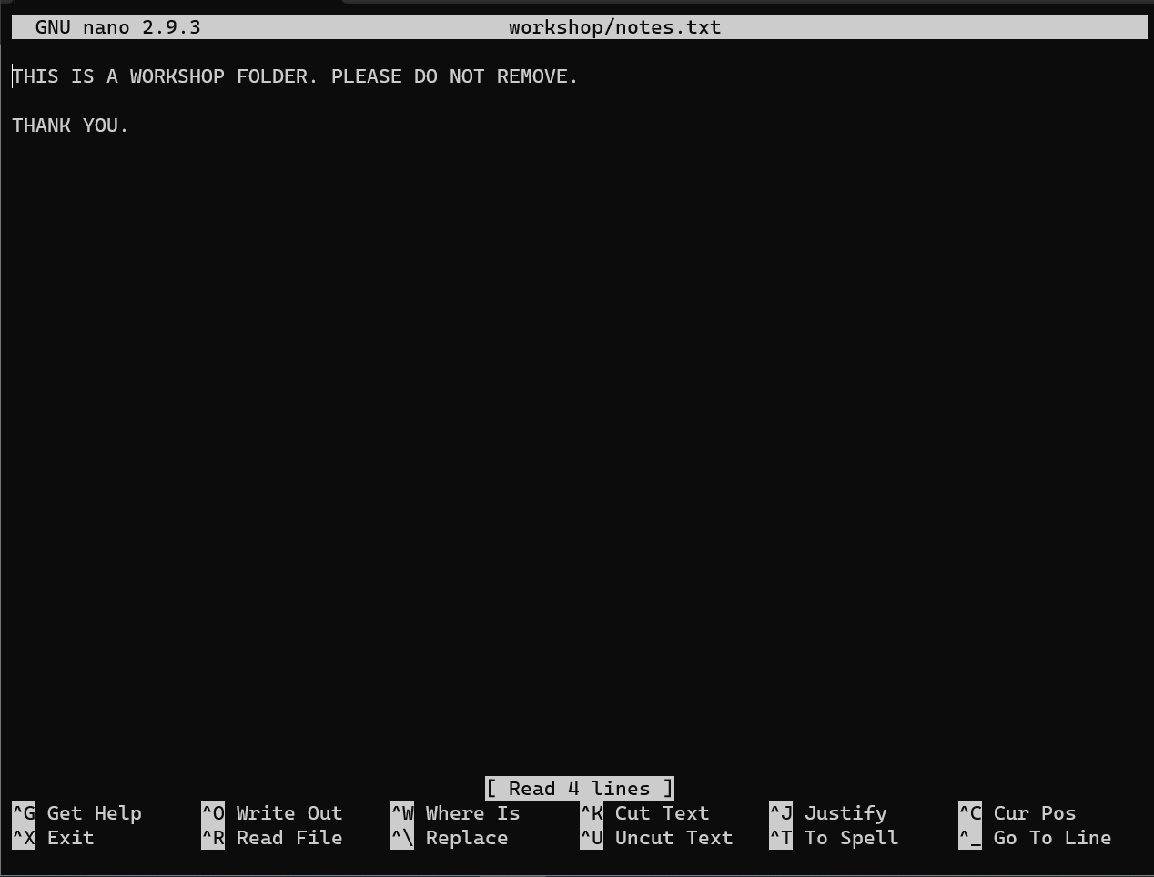

Slide 60
Linux Command
ifconfig
A command-line utility in Linux used to display information about the network interfaces on a system. It is used to configure, manage, and troubleshoot network interfaces.
“man ifconfig” for documentation

Slide 61
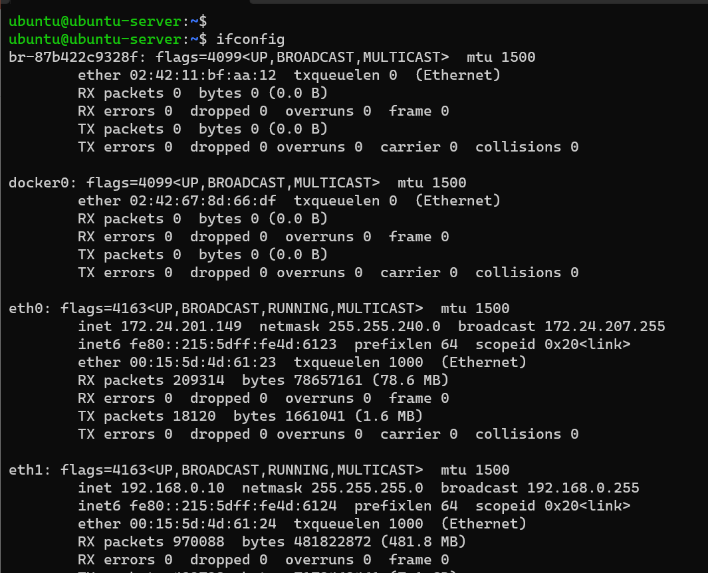

Slide 62
Linux Command
a simple command-line utility that clears the terminal screen. When you run the clear command, it erases all of the previous output in the terminal window, leaving you with a clean and empty screen
a simple command-line utility that clears the terminal screen. When you run the clear command, it erases all of the previous output in the terminal window, leaving you with a clean and empty screen
clear
A simple command-line utility that clears the terminal screen. It erases all of the previous output in the terminal window, leaving you with a clean and empty screen.
“man clear” for documentation

Slide 63
Linux Command
a simple command-line utility that clears the terminal screen. When you run the clear command, it erases all of the previous output in the terminal window, leaving you with a clean and empty screen
a simple command-line utility that clears the terminal screen. When you run the clear command, it erases all of the previous output in the terminal window, leaving you with a clean and empty screen
poweroff
A command-line utility used to power off a Linux system.
“man poweroff” for documentation

Slide 64
Linux Command
a simple command-line utility that clears the terminal screen. When you run the clear command, it erases all of the previous output in the terminal window, leaving you with a clean and empty screen
a simple command-line utility that clears the terminal screen. When you run the clear command, it erases all of the previous output in the terminal window, leaving you with a clean and empty screen
reboot
A command-line utility used to reboot a Linux system.
“man poweroff” for documentation

Slide 65
Linux Command
a simple command-line utility that clears the terminal screen. When you run the clear command, it erases all of the previous output in the terminal window, leaving you with a clean and empty screen
a simple command-line utility that clears the terminal screen. When you run the clear command, it erases all of the previous output in the terminal window, leaving you with a clean and empty screen
exit
A command-line utility used to exit the current shell session in Linux.
“man exit” for documentation

Slide 66
Linux Command
a simple command-line utility that clears the terminal screen. When you run the clear command, it erases all of the previous output in the terminal window, leaving you with a clean and empty screen
a simple command-line utility that clears the terminal screen. When you run the clear command, it erases all of the previous output in the terminal window, leaving you with a clean and empty screen
ssh
A command-line utility used to securely connect to a remote server or device over a network.
It uses the Secure Shell (SSH) protocol to establish a secure, encrypted connection between the local and remote hosts, and allows you to execute commands on the remote host as if you were sitting at its terminal.
“man ssh” for documentation

Slide 67
