Slide 1
DepTeam Workshop Short Course – Part 3

Slide 2
Docker
( Play Video 02 )

Slide 3
What is Docker ?
Docker is a tool which is used to automate the deployment of applications in lightweight containers so that applications can work efficiently in different environments
Docker is an OS-level virtualization software platform that enables developers and IT administrators to create, deploy and run applications in a Docker Container with all their dependencies
Container is a software package that consists of all the dependencies (frameworks, libraries, etc…) required to execute and run an application

Slide 4
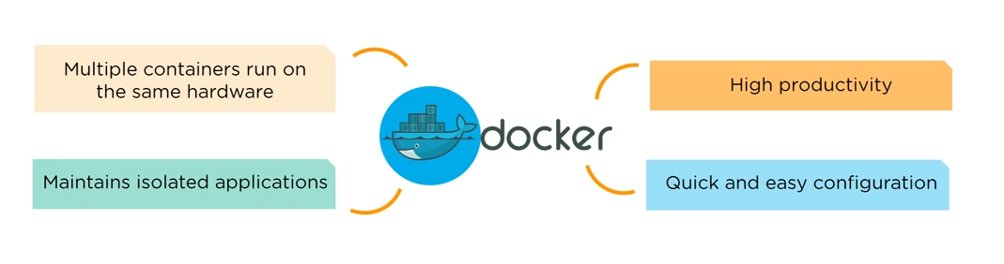
What is Docker ?

Slide 5
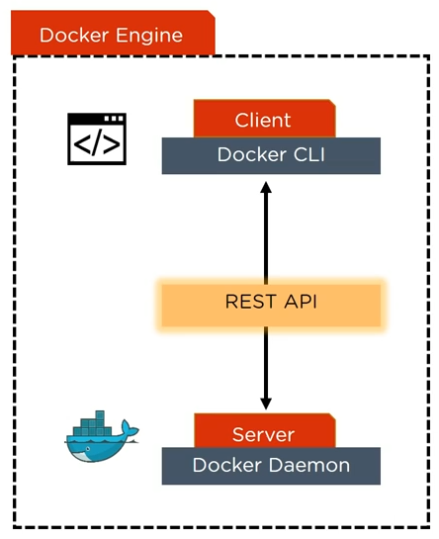
How does Docker work ?
Docker Engine or Docker is the base engine installed on your host machine to build and run containers using Docker components and services
It uses a client-server architecture
Docker Client and Server communicates using REST API

Slide 6
How does Docker work ?
Docker Client is a service which runs a command, and is translated using REST API, and is sent to the Docker Daemon ( server )
The Docker Daemon check the client request and interacts with the operating system in order to create or manage containers

Slide 7
Components of Docker

Slide 8
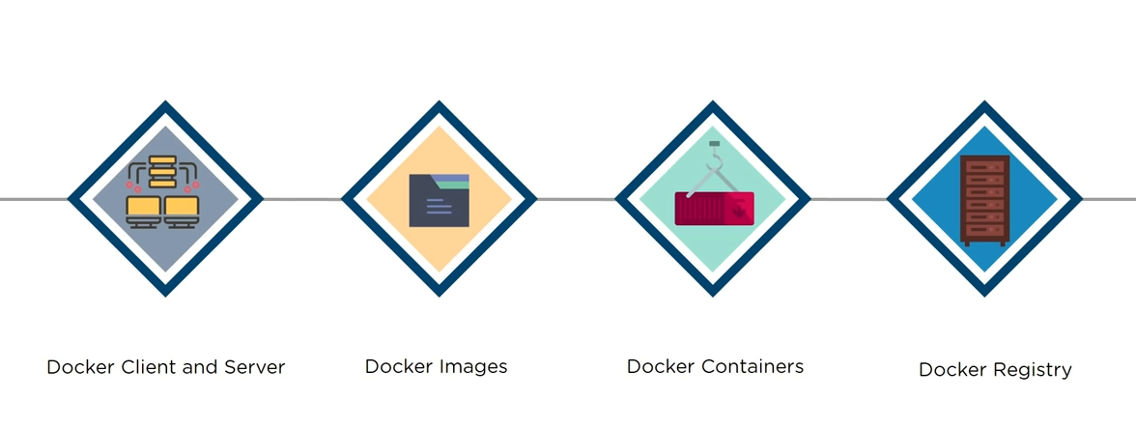
Components of Docker

Slide 9
Components of Docker - Docker Client and Server
Docker Client is accessed from the terminal and a Docker Host runs the Docker Daemon and registry
A user can build Docker Images and run Docker Containers by passing commands from the Docker Client to the Docker Server

Slide 10
Components of Docker - Docker Image
Docker Image is a template with instructions, which is used for creating Docker Containers
A Docker Image is built using a file called Docker File
Docker Image is stored in a Docker Hub or in a repository

Slide 11

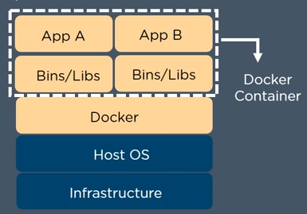
Components of Docker - Docker Container
Docker Container is a standalone, executable software package which includes applications and their dependencies

Slide 12
Components of Docker - Docker Container
Numerous Docker Containers run on the same infrastructure and share operating system (OS) with its other containers
Each application runs in isolation

Slide 13
Components of Docker - Docker Registry
Docker Registry is an open source server-side service used for hosting and distributing images
Docker also has its own default registry called Docker Hub
Images can be stored in either public or private repositories
Pull and Push are the commands used by users in order to interact with a Docker Registry

Slide 14

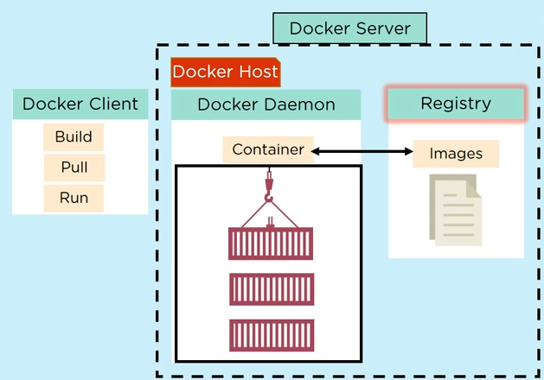
Components of Docker - Diagram

Slide 15
Components of Docker - Recap
Docker File creates a Docker Image using the build command
A Docker Image contains all the project's code
Using Docker Image, any user can run the code in order to create Docker Containers
Once a Docker Image is built, it's uploaded in a registry or a Docker Hub
From the Docker Hub, users can get the Docker Image and build new containers

Slide 16

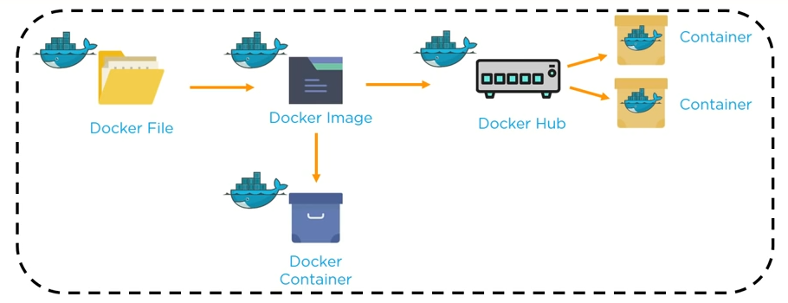
Components of Docker - Recap

Slide 17
Advanced Concepts in Docker
Docker Compose
Docker Swarm

Slide 18
Docker Compose
Compose is a tool for defining and running multi-container Docker applications as a single service
Compose files are very easy to write in a scripting language called YAML, which is an XML-based language that stands for Yet Another Markup Language

Slide 19
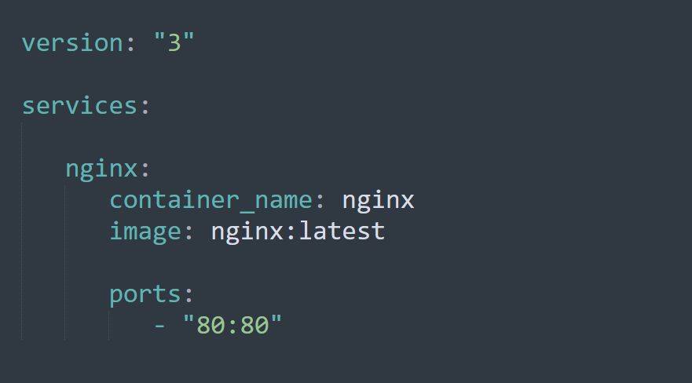
Docker Compose – YAML file

Slide 20
Benefits of Docker-Compose
Single host deployment
Quick and easy configuration

Slide 21
Basic Docker Commands

Slide 22
Basic Docker Commands
docker -v
docker --version
Used to get the installed version

Slide 23
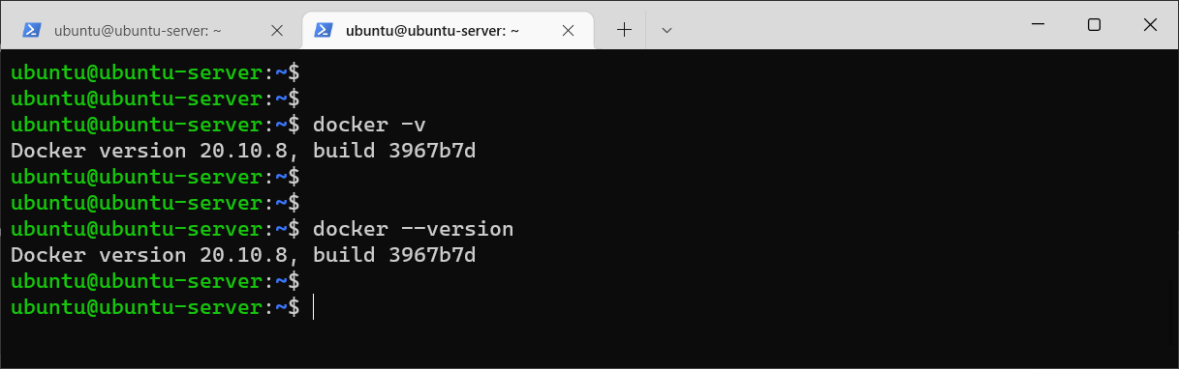
Basic Docker Commands
docker -v
docker --version

Slide 24
Basic Docker Commands
docker --help
docker [COMMAND] --help
Used to get help information

Slide 25
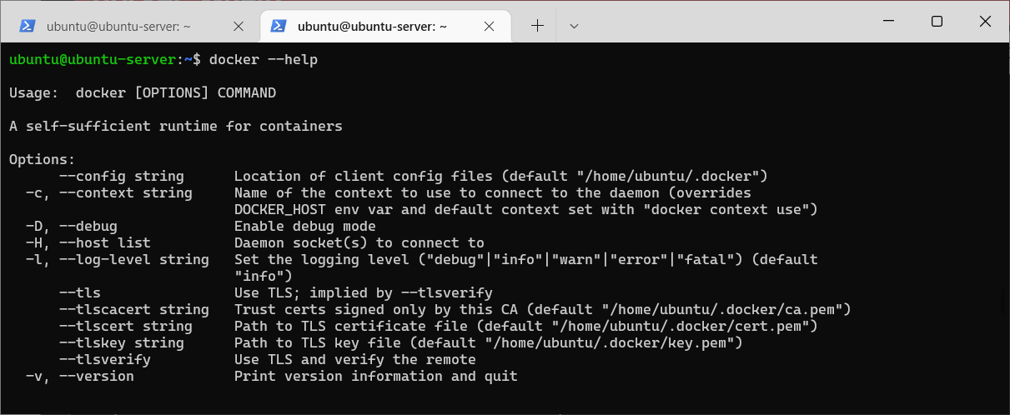
Basic Docker Commands
docker --help

Slide 26
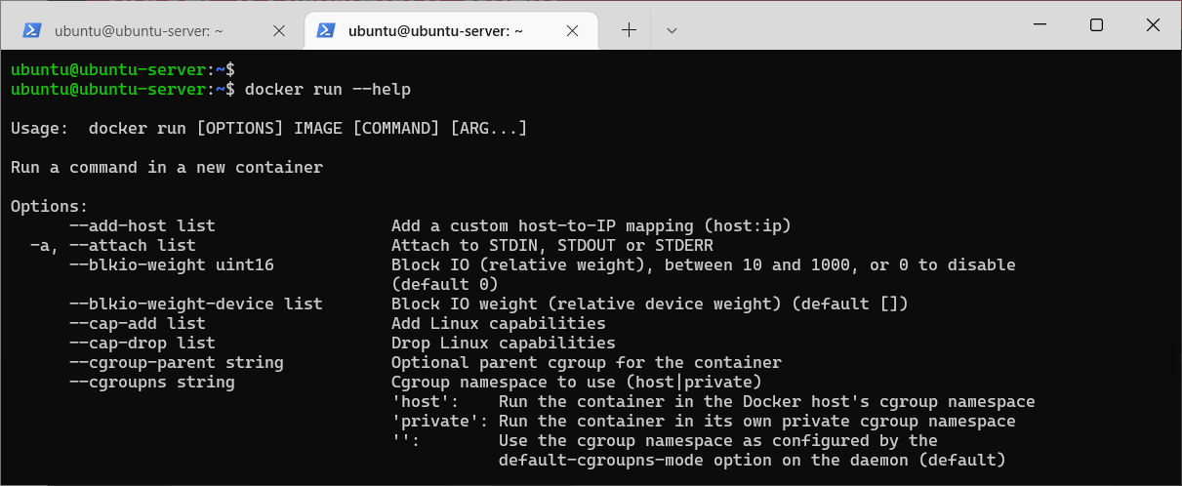
Basic Docker Commands
docker [COMMAND] --help

Slide 27
Basic Docker Commands
docker pull <image_name>
Used to pull images from the docker repository ( hub.docker.com )

Slide 28
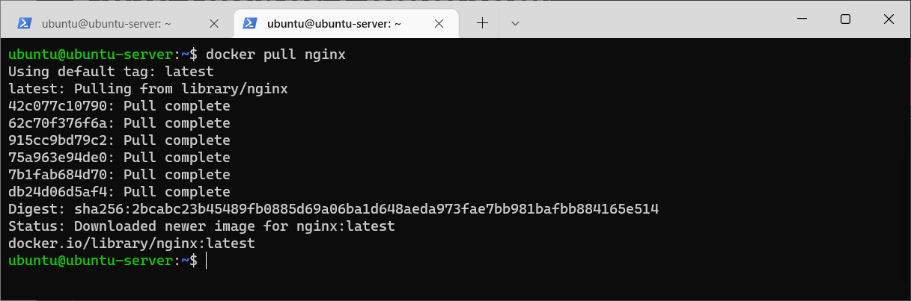
Basic Docker Commands
docker pull <image_name>

Slide 29
Basic Docker Commands
docker run
Used to create a container from an image

Slide 30
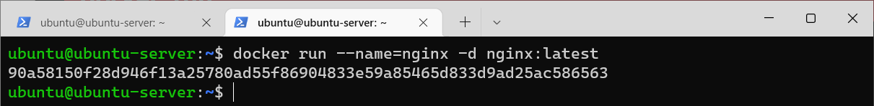
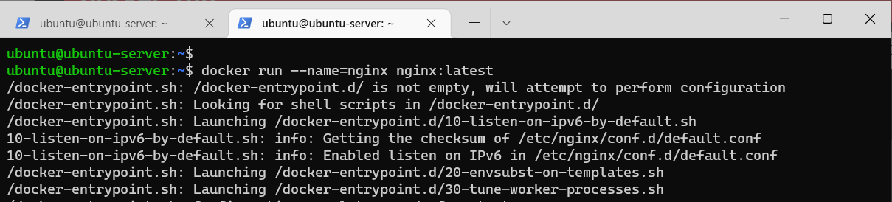
Basic Docker Commands
docker run

Slide 31
Basic Docker Commands
docker ps
Used to list the running containers

Slide 32
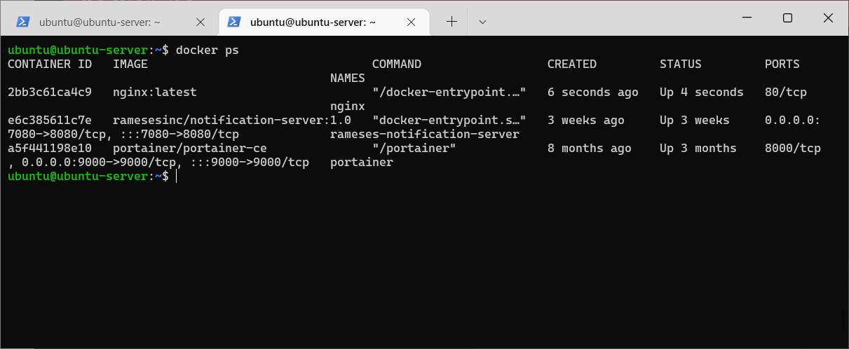
Basic Docker Commands
docker ps

Slide 33
Basic Docker Commands
docker ps -a
Used to show all the running and exited containers

Slide 34
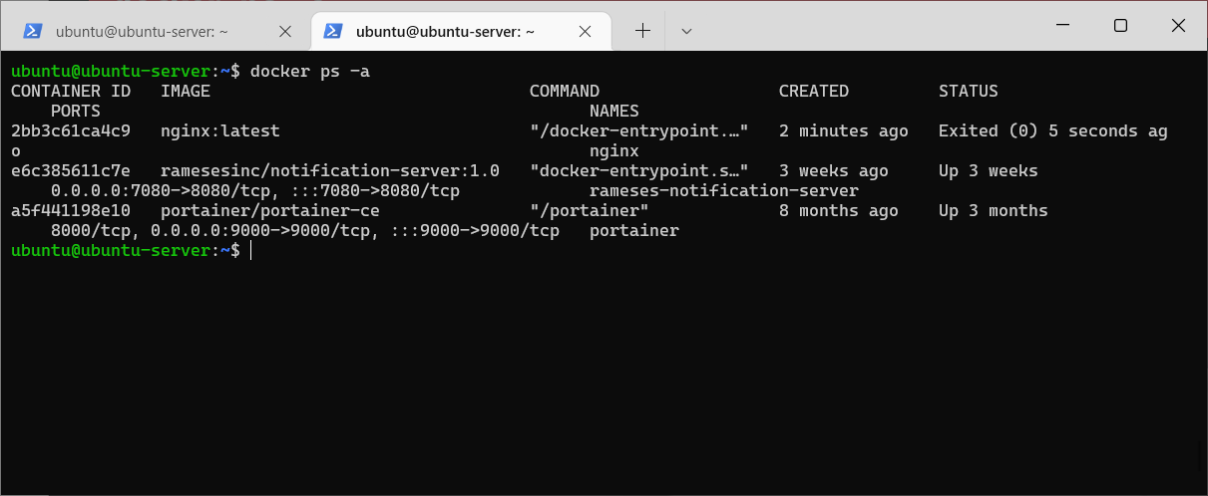
Basic Docker Commands
docker ps -a

Slide 35
Basic Docker Commands
docker exec
Used to access the running container

Slide 36
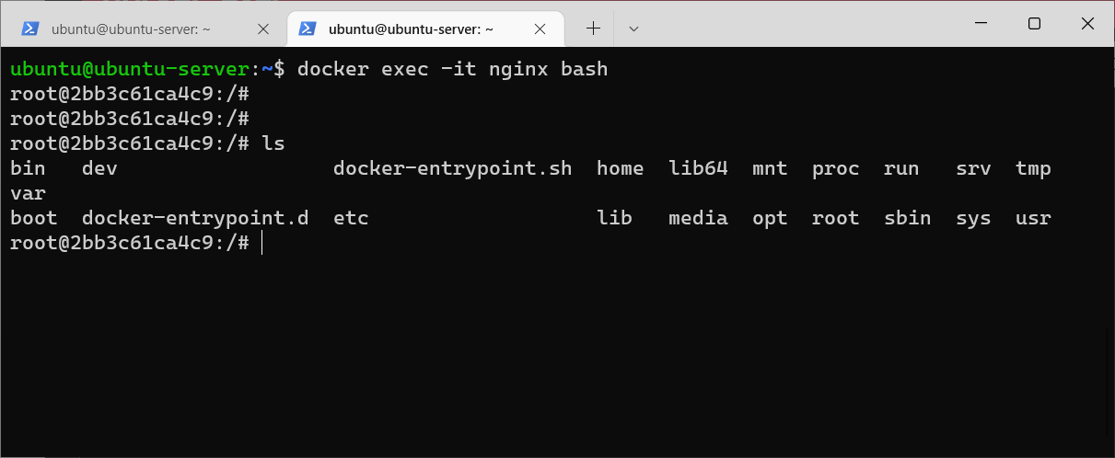
Basic Docker Commands
docker exec

Slide 37
Basic Docker Commands
docker logs
Fetch the logs of a container

Slide 38
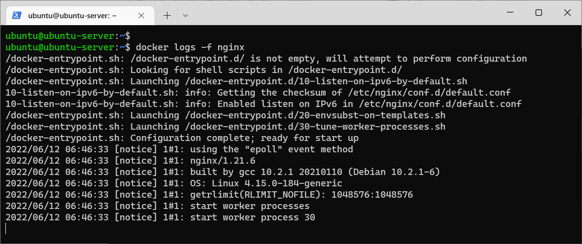
Basic Docker Commands
docker logs

Slide 39
Basic Docker Commands
docker stop
Used to stop a running container

Slide 40
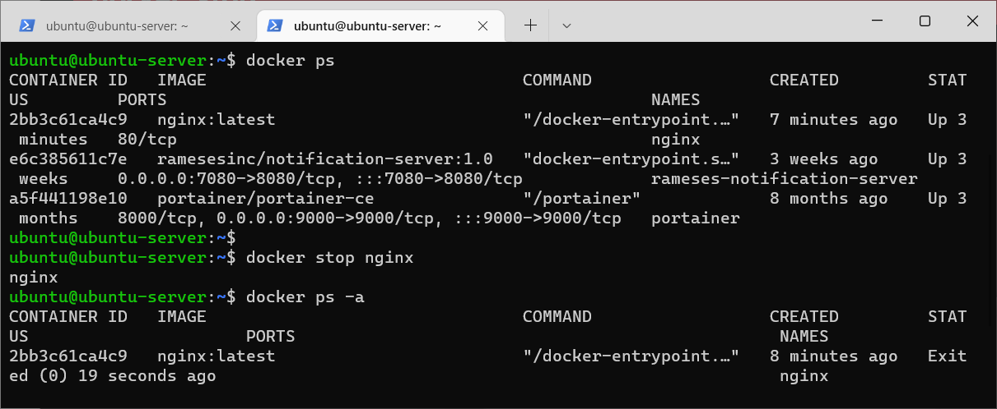
Basic Docker Commands
docker stop

Slide 41
Basic Docker Commands
docker rm
Used to delete or remove a stopped container

Slide 42
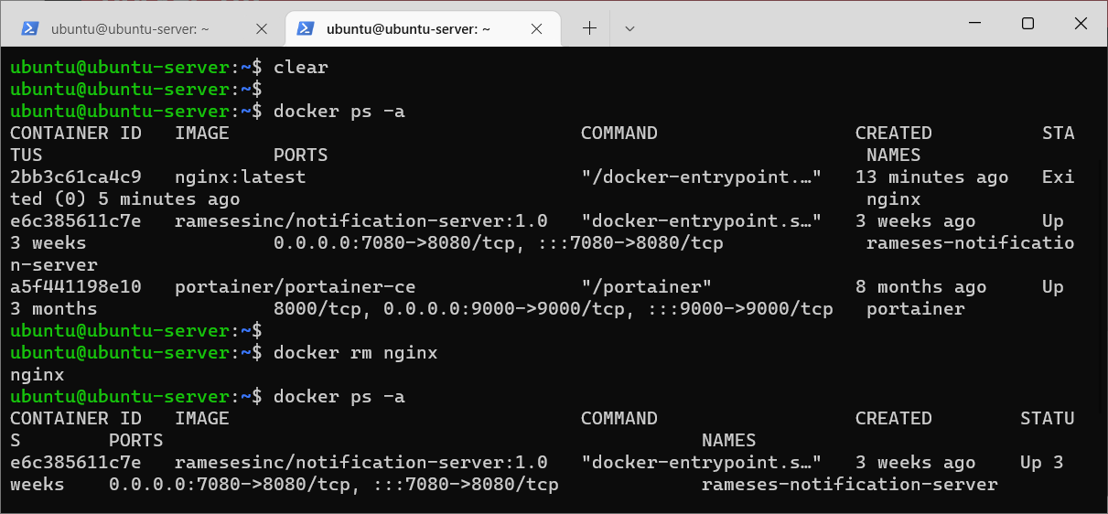
Basic Docker Commands
docker rm

Slide 43
Basic Docker Commands
docker kill
This command kills the container by stopping its execution immediately.
The difference between ‘docker kill’ and ‘docker stop’ is that ‘docker stop’ gives the container time to shutdown gracefully

Slide 44
Basic Docker Commands
docker commit
This command creates a new image of an edited container on the local system

Slide 45
Basic Docker Commands
docker images
Used to lists all locally stored docker images

Slide 46
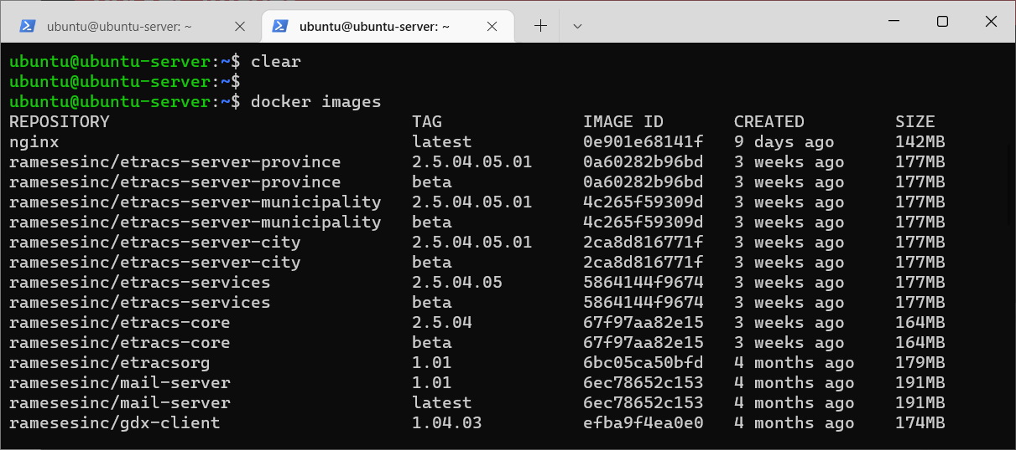
Basic Docker Commands
docker images

Slide 47
Basic Docker Commands
docker save
Save one or more images to a tar archive

Slide 48
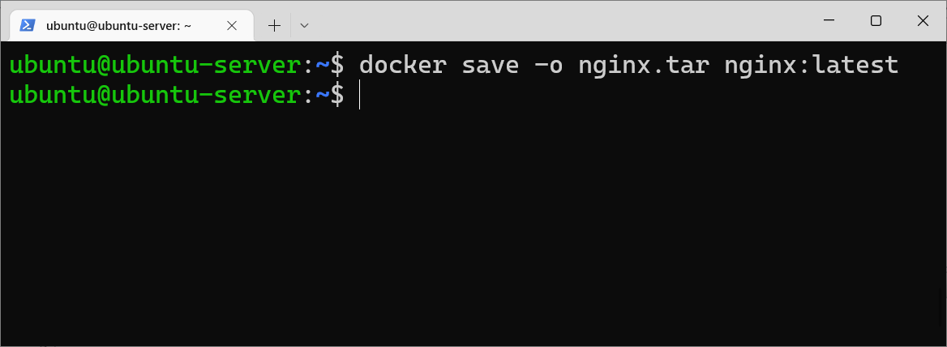
Basic Docker Commands
docker save

Slide 49
Basic Docker Commands
docker load
Load an image from a tar archive

Slide 50
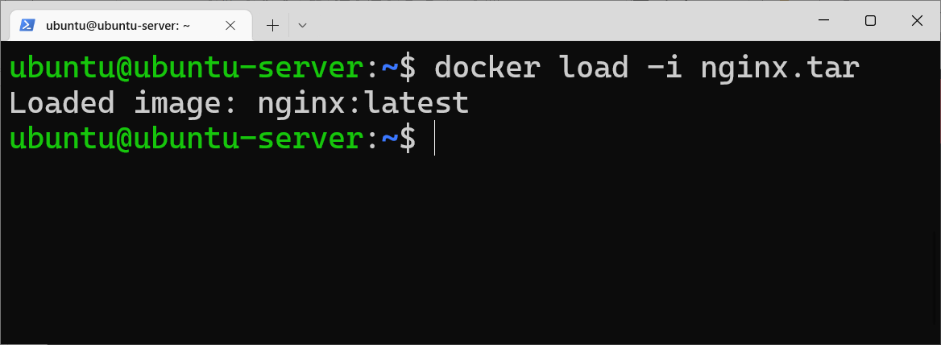
Basic Docker Commands
docker load

Slide 51
Basic Docker Commands
docker rmi
Used to delete an image from local storage

Slide 52
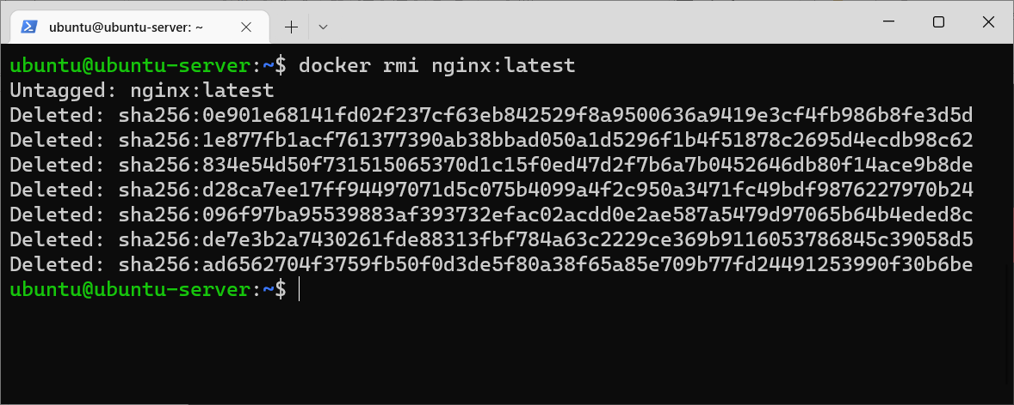
Basic Docker Commands
docker rmi

Slide 53
Basic Docker Commands
docker login
Used to login to the docker hub repository

Slide 54
Basic Docker Commands
docker logout
Used to logout from a Docker registry

Slide 55
Basic Docker Commands
docker push
Used to push an image to the docker hub repository

Slide 56
Basic Docker Commands
docker build
Used to build an image from a specified docker file

Slide 57

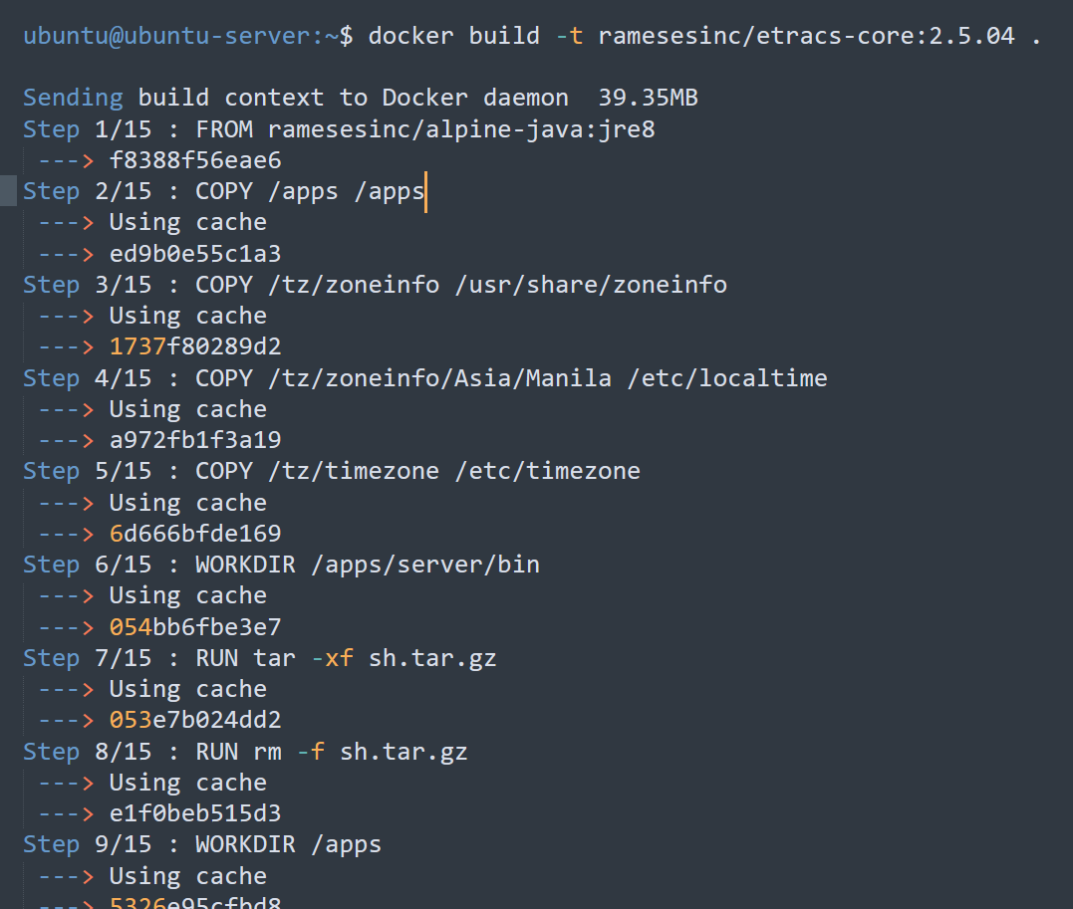
Basic Docker Commands
docker build

Slide 58
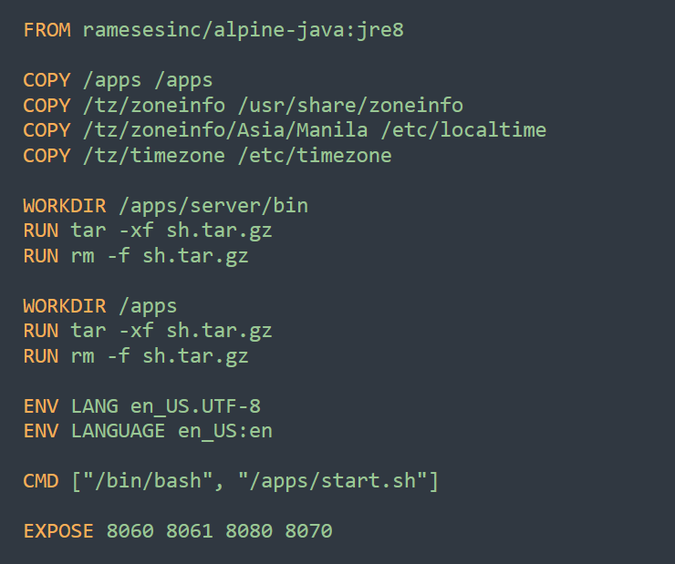
Dockerfile

Slide 59
Docker Compose

Slide 60
What is Docker Compose ?
Compose is a tool for defining and running multi-container Docker applications.
Use a YAML file to configure your application’s services.
Create and start all the services from your configuration

Slide 61
How does Docker Compose works ?
Define the services that make up your app in a file called docker-compose.yml , so they can be run together in an isolated environment
Run ”docker-compose up” to start and run your entire app

Slide 62
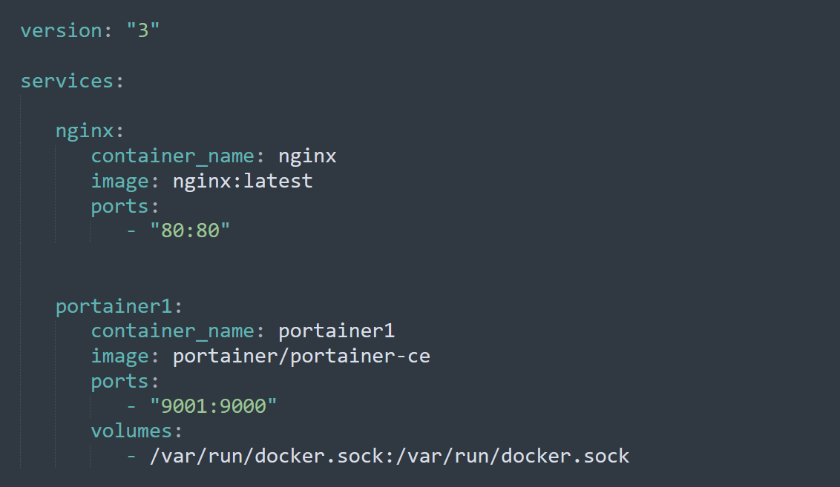
docker-compose.yml

Slide 63
Docker Compose Commands

Slide 64
Docker Compose Commands
docker-compose --version
Used to check a version

Slide 65
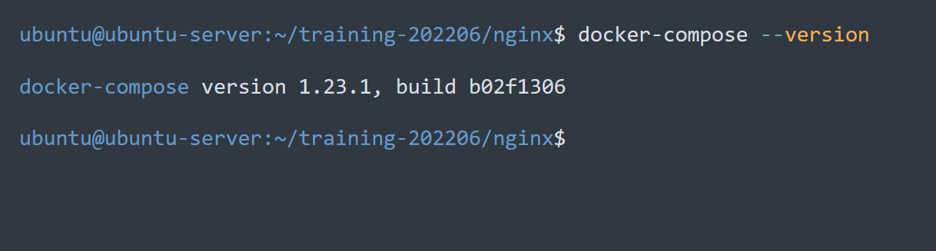
Docker Compose Commands
docker-compose --version

Slide 66
Docker Compose Commands
docker-compose up
Used to start all services
docker-compose up -d
Used to start all services in the background and leave them running

Slide 67
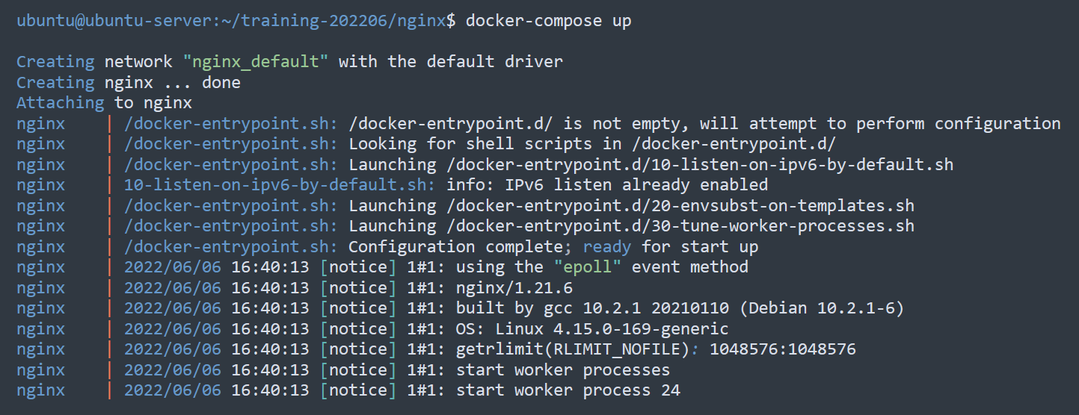
Docker Compose Commands
docker-compose up

Slide 68
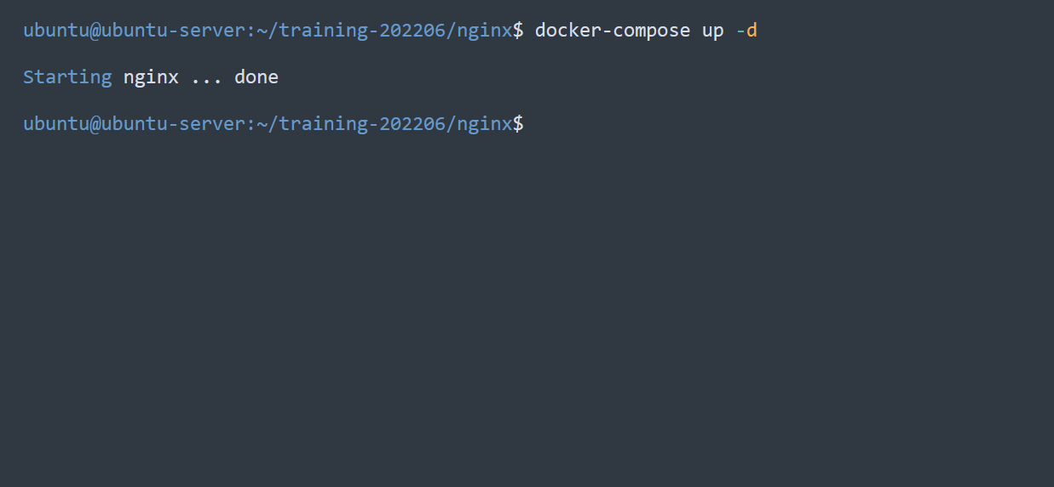
Docker Compose Commands
docker-compose up -d

Slide 69
Docker Compose Commands
docker-compose down
Used to stop all services

Slide 70
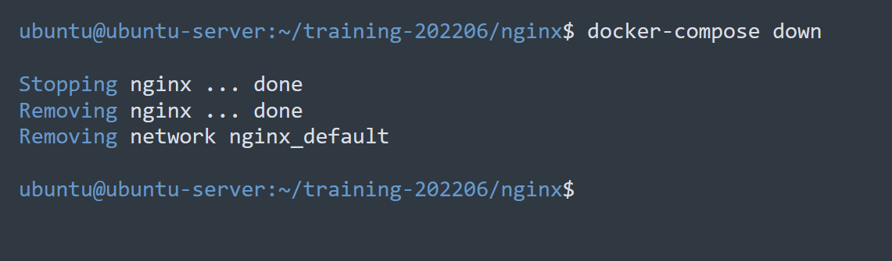
Docker Compose Commands
docker-compose down

Slide 71
Docker Compose Commands
docker-compose logs
View output from containers

Slide 72
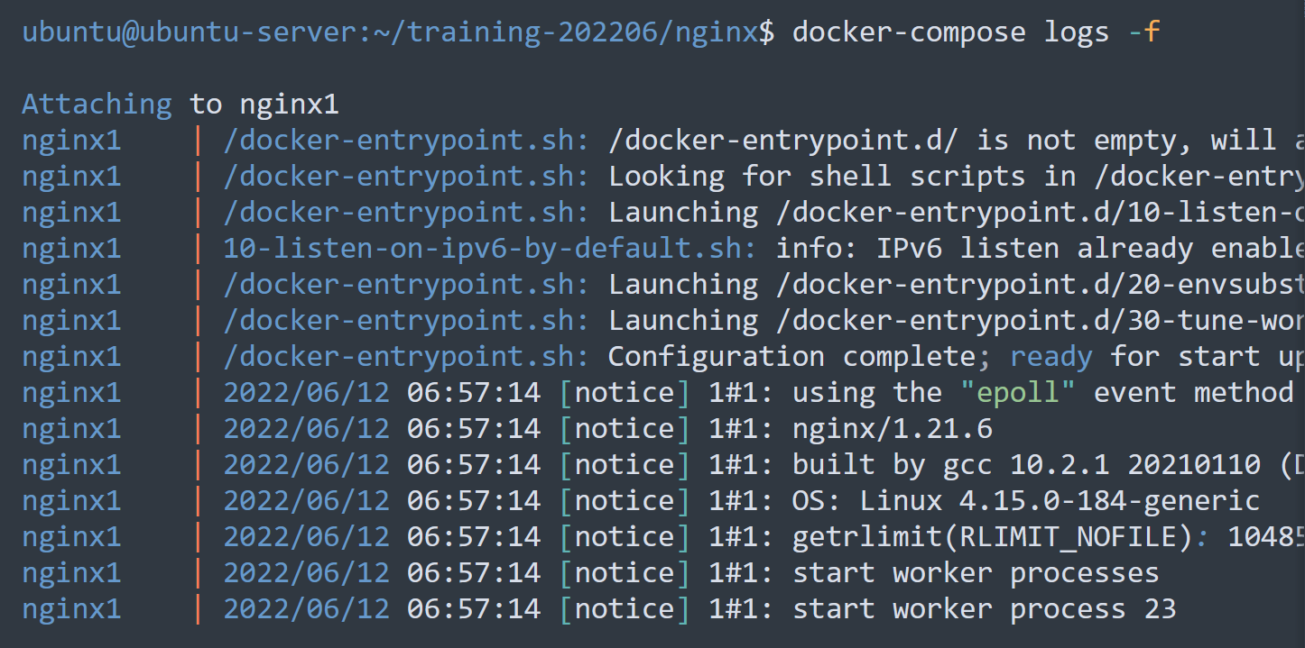
Docker Compose Commands
docker-compose logs

Slide 73
Demo and Exercises

Slide 74
Portainer

Slide 75
What is Portainer ?
Portainer is a container management tool
Allows you to easily manage your different Docker environments (Docker hosts or Swarm clusters) using a lightweight management UI
Allows you to manage all your Docker resources
Containers
Images
Volumes
Networks
And more…

Slide 76
Access Portainer UI
Open a web browser ( Chrome, Mozilla, Microsoft Edge, etc… ) and go to this link: http://localhost:9000
Set the login credentials to :
Username: admin
Password : p@ssw0rd1234
Click the “Create User” button to continue
Select “Docker”, then click the “Connect” button

Slide 77
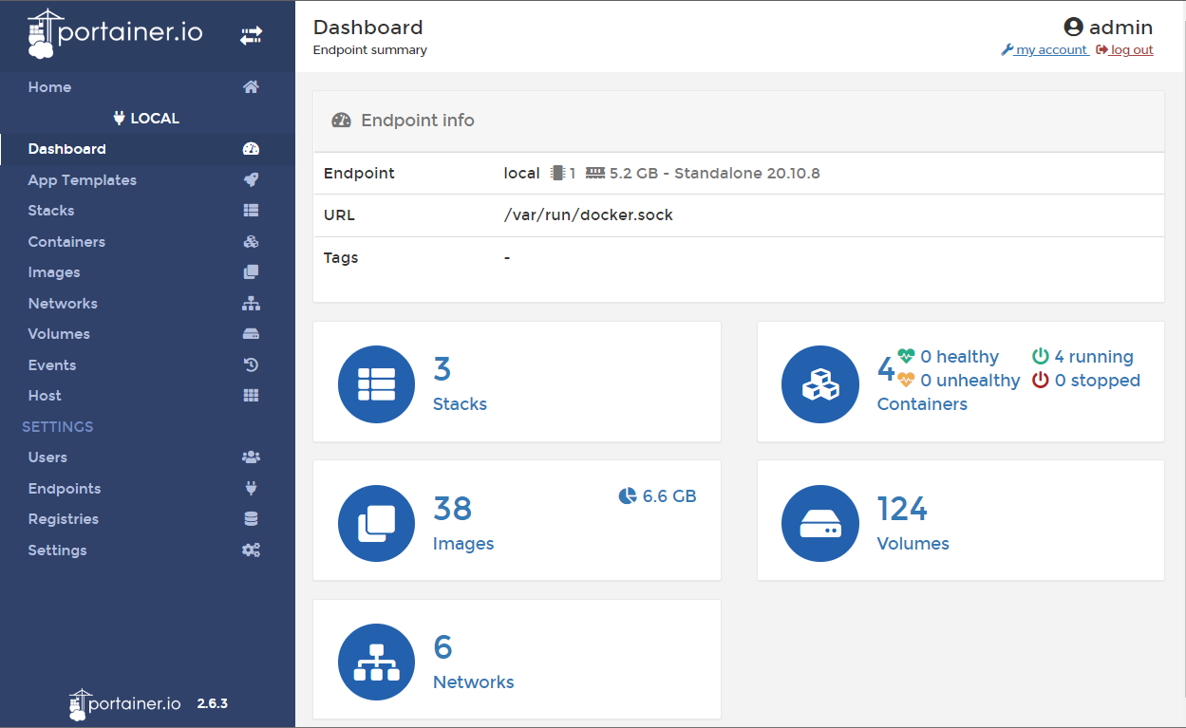
Portainer Dashboard

Slide 78
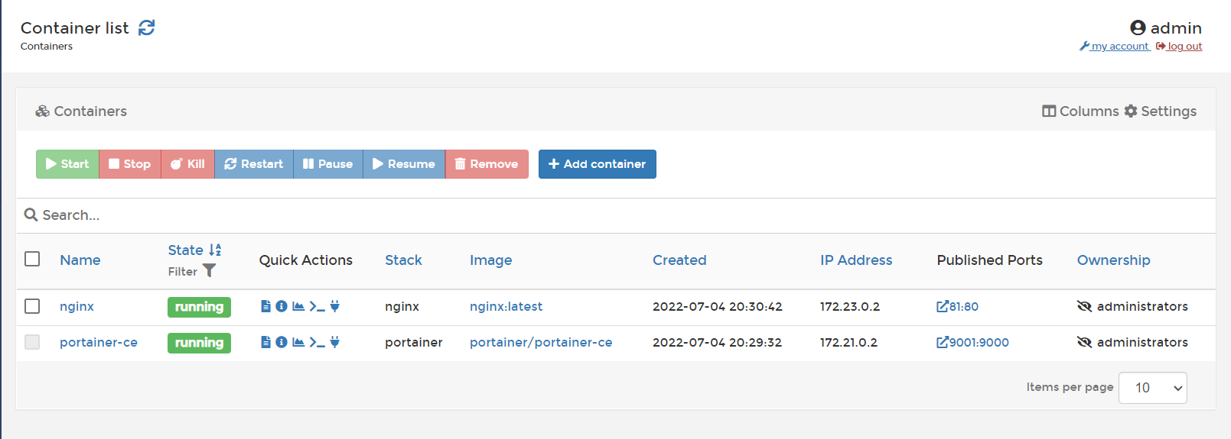
Container List
View Logs

