Slide 1
Ubuntu Server 18.04 Setup Guide (Bare)

Slide 2
About
This document will guide you in setting up the Ubuntu Server 18.04 on bare metal.
Please pay attention to the setup details provided in this document to avoid resource conflicts, specifically in partitioning your hard drive if necessary that may result to system crashes.

Slide 3
Contents
Software Downloads
Introduction on Etcher.io
Create Bootable USB Flash Drive
Boot from USB Flash Drive

Slide 4
Software Downloads

Slide 5
Software Downloads
Ubuntu Server 18.04 LTS
https://releases.ubuntu.com/18.04/ubuntu-18.04.6-live-server-amd64.iso
or click this link https://releases.ubuntu.com/18.04/ for more info.
Etcher.io
https://www.balena.io/etcher/
This is used to create a Bootable-USB flash drive for your Ubuntu operating system.

Slide 6
Introduction on Etcher.io

Slide 7
Introduction on Etcher.io
Etcher (also known by its full name, balenaEtcher) is a free,
and open-source image flasher.
A utility for creating bootable SD cards or USB flash drives from .img and .iso files.
Simple and user-friendly.

Slide 8
Create Bootable USB Flash Drive

Slide 9
Create Bootable USB Flash Drive
Download the executable file (balenaEtcher-Portable-1.7.9.exe) from the Software Downloads section
Run the executable file (balenaEtcher-Portable-1.7.9.exe)
Continue to the Next Page …

Slide 10
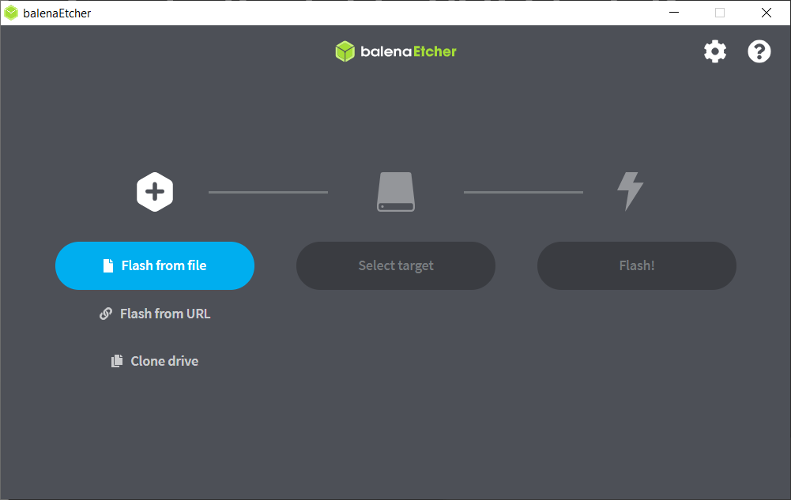
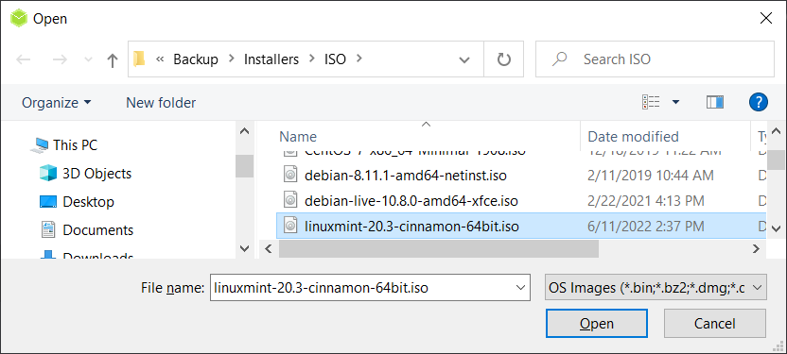
Create Bootable USB Flash Drive
Click the “Flash from file” button, and select the ISO file
ubuntu-18.04.6-live-server-amd64.iso, then click the “Open” button

Slide 11
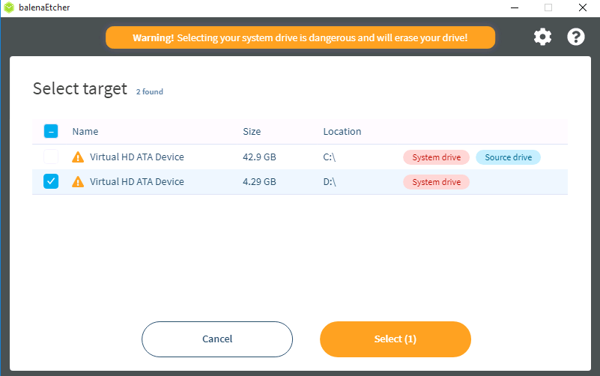
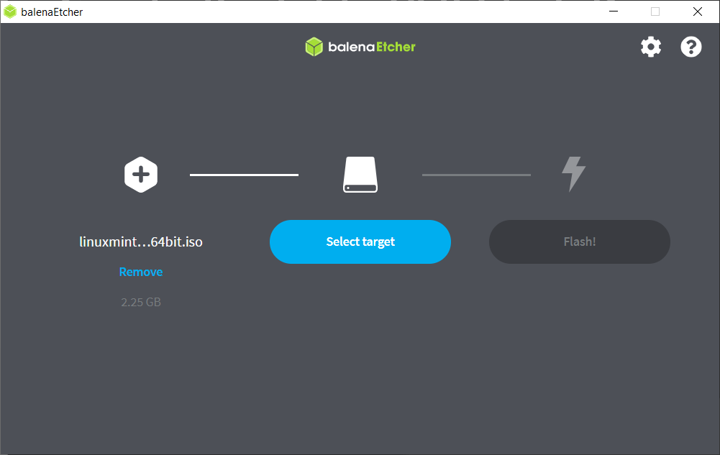
Create Bootable USB Flash Drive
Click the “Select target” button, and choose the correct flash drive, then click the “Select(1)” button

Slide 12
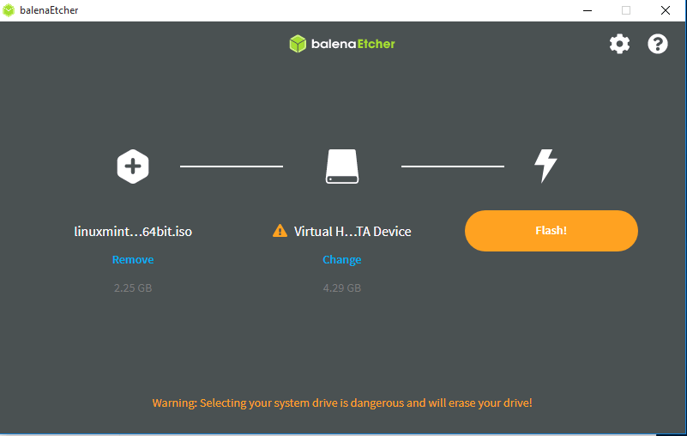
Create Bootable USB Flash Drive
Click the “Flash” button, and when prompted, click “Yes, I’m Sure” button

Slide 13
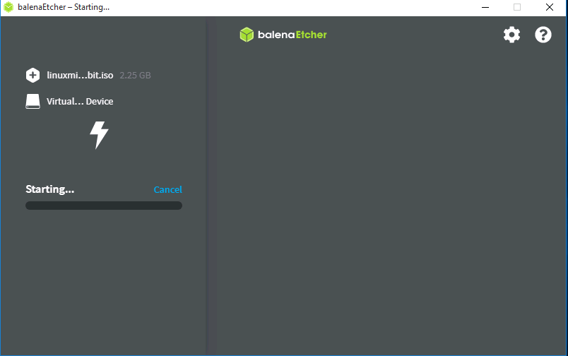
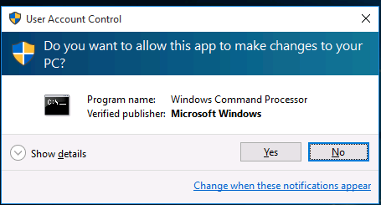
Create Bootable USB Flash Drive
Please wait until the process is finish. When you are prompted by the User Access Control dialog, please click the “Yes” button to proceed

Slide 14
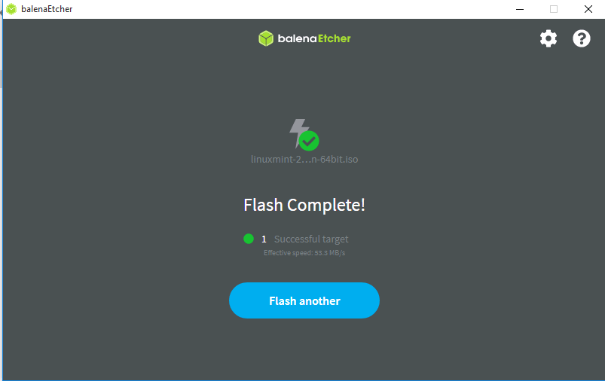
Create Bootable USB Flash Drive
Close the dialog when the process has been completed.

Slide 15
Boot from USB Flash Drive

Slide 16
Boot from USB Flash Drive
Restart PC or Laptop, and go to your BIOS setting
Set your USB device boot priority as the first in line
Restart again to apply the changes
USB device will now boot first and ready for the Ubuntu Server installation. Make sure that your computer is connected to the internet to have a successful installation.

Slide 17
Installing Ubuntu Server 18.04

Slide 18
Minimum Installation Requirements
2 GB RAM
2 Ghz Dual Core processor
25 GB of Hard Disk space
Installation Media ( Either DVD / USB drive)
Internet Access for downloading necessary updates

Slide 19
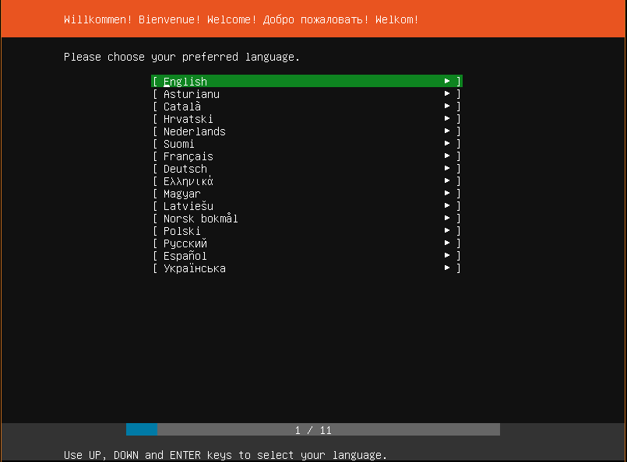
Installing Ubuntu Server
Choose the Language
Once the system starts, you ‘ll be presented with this screen. Choose your preferred language and Hit ENTER.

Slide 20
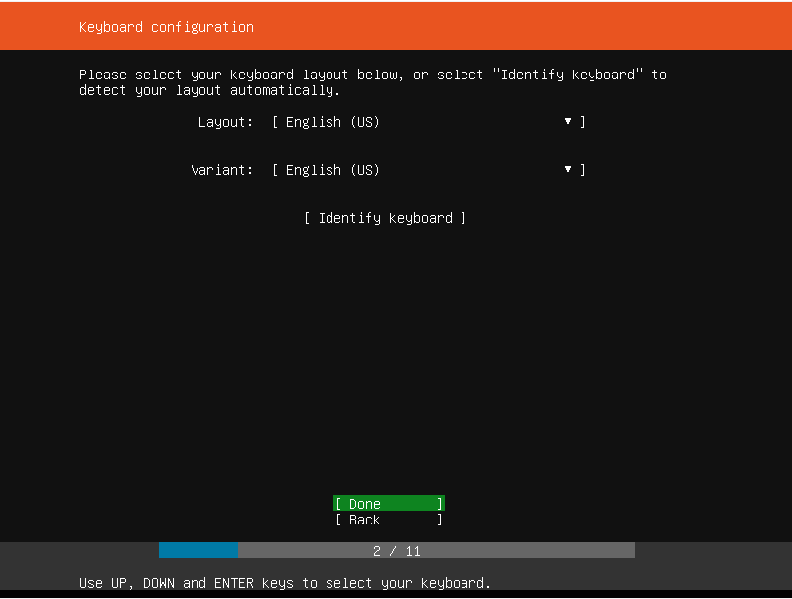
Installing Ubuntu Server
Select keyboard layout
The next screen will prompt you to select the keyboard layout of your choice. After making your choice, hit ENTER.

Slide 21
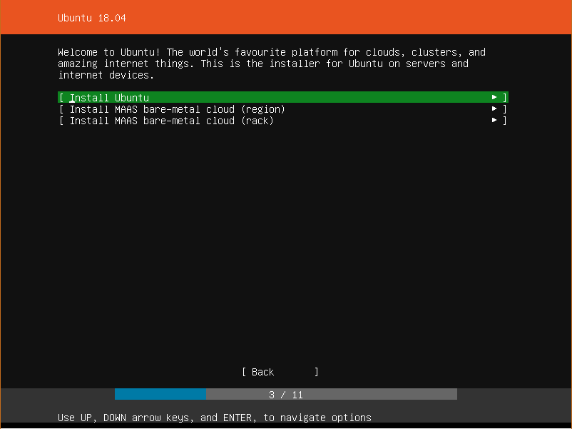
Installing Ubuntu Server
Select Ubuntu
You will then have a list of various platforms to install Ubuntu. You can select the first choice which is to install Ubuntu normally on a PC or server.
Select the first choice and hit ENTER.

Slide 22
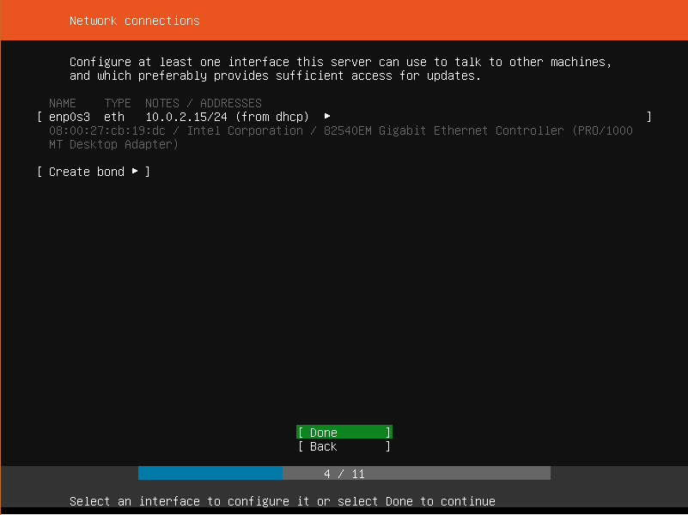
Installing Ubuntu Server
Network Settings
At this point, select the network adapter and accept the IP address if your system is in a network with a DHCP server.
Alternatively, you can choose to manually configure the IP address. In this example, the server has obtained IP 10.0.2.15 from a DHCP server using the network adapter enp0s3

Slide 23
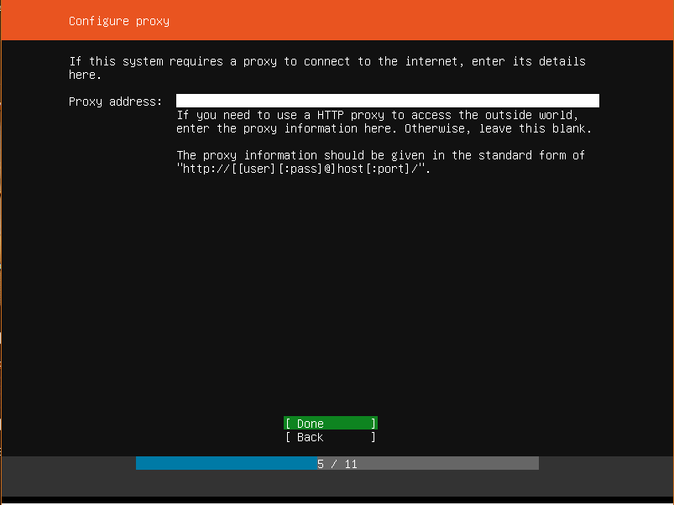
Installing Ubuntu Server
Proxy Settings
The next screen will require you to input your proxy server address. If none is available, Hit ENTER to move to the next step

Slide 24
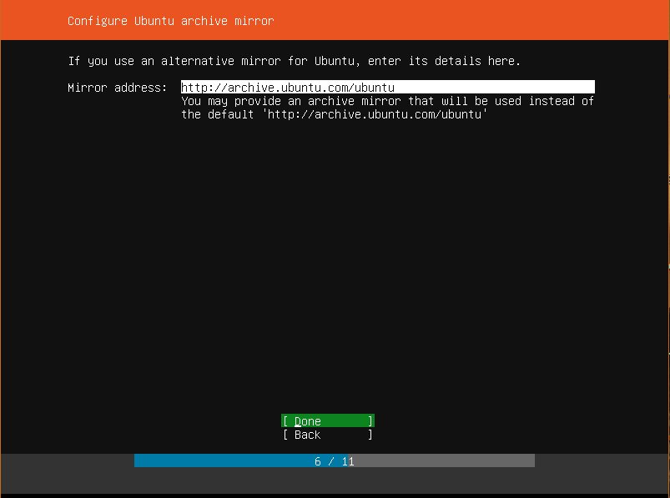
Installing Ubuntu Server
Select network mirror
You can leave the default mirror selected or if you wish, you can change to your preferred choice

Slide 25
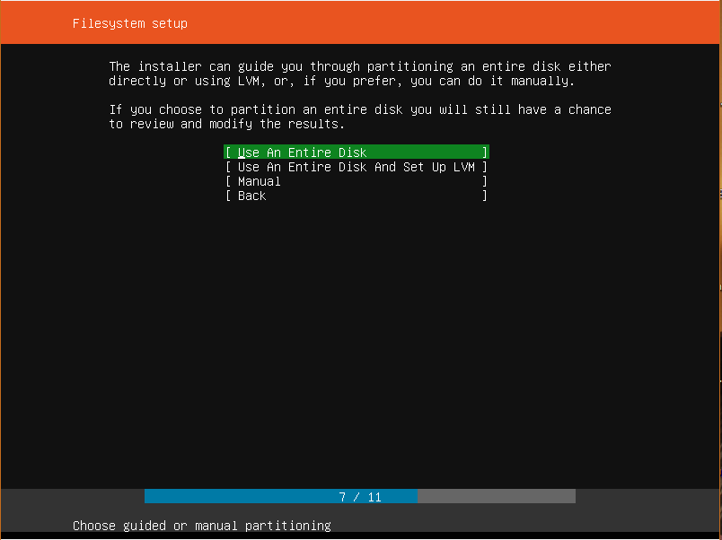
Installing Ubuntu Server
Hard Disk Setup
This section prompts you on how to use your hard disk during the installation.
You can choose to use the entire disk if no other operating system is installed or you can opt to configure manually and make a few adjustments.

Slide 26
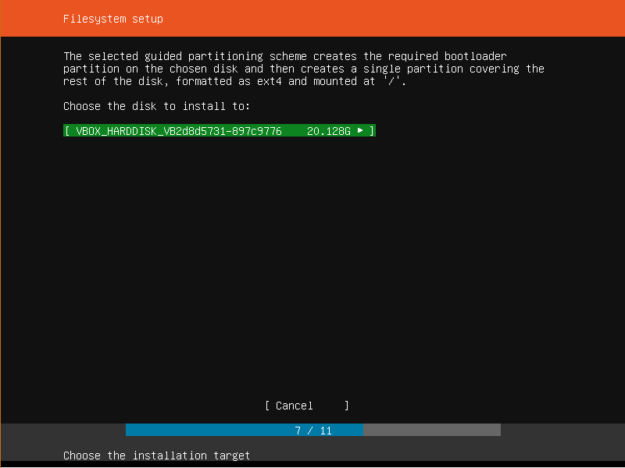
Installing Ubuntu Server
Choose Hard Disk to Install
Next, select the hard disk you are going to install Ubuntu Server 18.04 on.
If you have multiple hard drives, they will be listed for you to select.

Slide 27
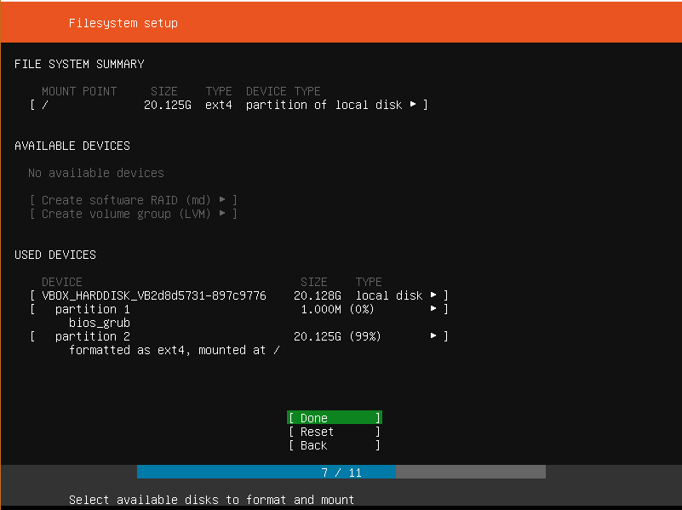
Installing Ubuntu Server
File System Summary
Verify that everything is OK and click Done.
If you noticed that you made a mistake and need to make further adjustments, hit ‘Back’.
If you want to start all over with the disk setup and partitioning, hit ‘Reset‘

Slide 28
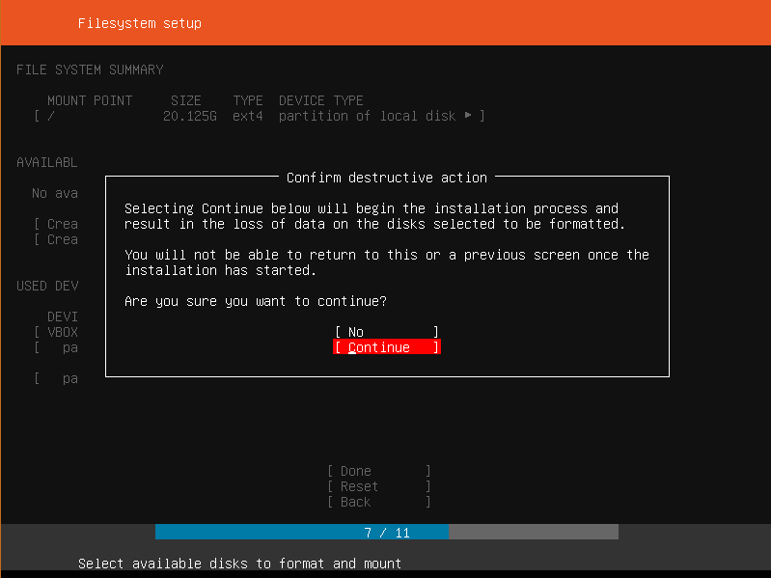
Installing Ubuntu Server
Confirm changes
To confirm changes made to the hard disk, hit ‘CONTINUE’.
This action will mark the beginning of the installation process.

Slide 29
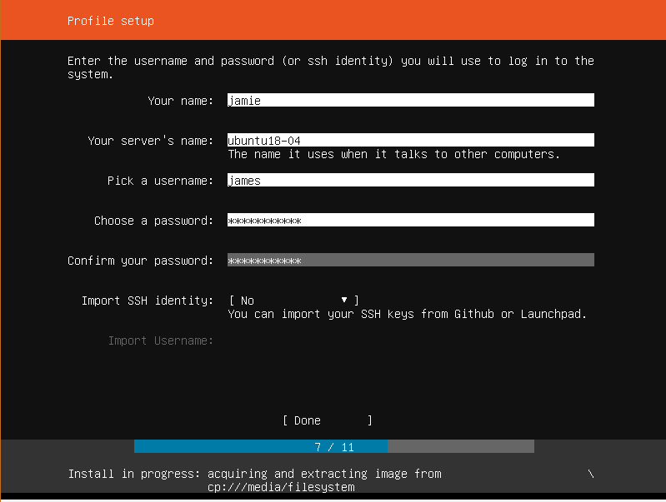
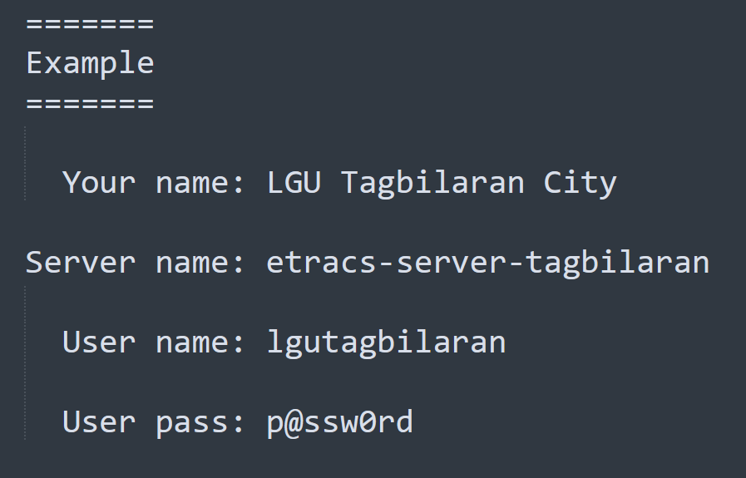
Installing Ubuntu Server
Provide User Login credentials
Provide the necessary login credentials and hit ‘DONE‘

Slide 30
Installing Ubuntu Server
Install OpenSSH Server
Enable the option to install also the “OpenSSH Server” and hit ‘DONE‘

Slide 31
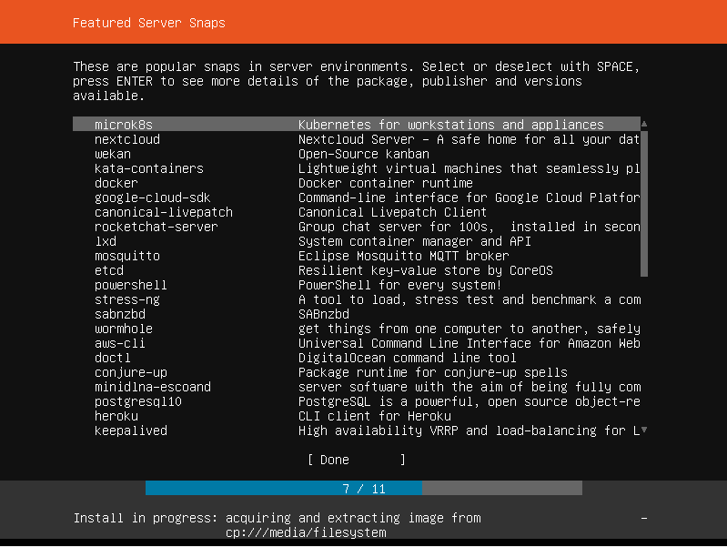
Installing Ubuntu Server
Select server snaps
This is a new step in the installation of Ubuntu Server.
This step allows you to choose from a list of selected Server snaps. What this means is that you can choose to have a pre-configured server.
Do not do anything, just hit Done

Slide 32
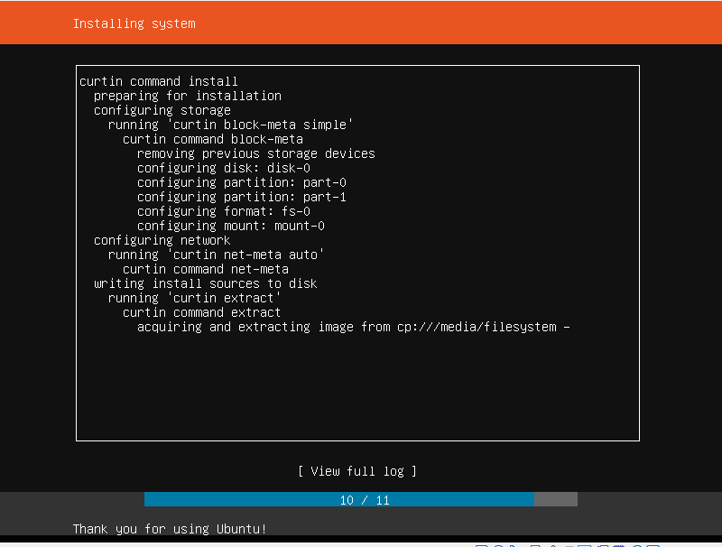
Installing Ubuntu Server
Installing system
The installation process will begin. This will take about 10 minutes although it also depends on the RAM and CPU of your server.

Slide 33
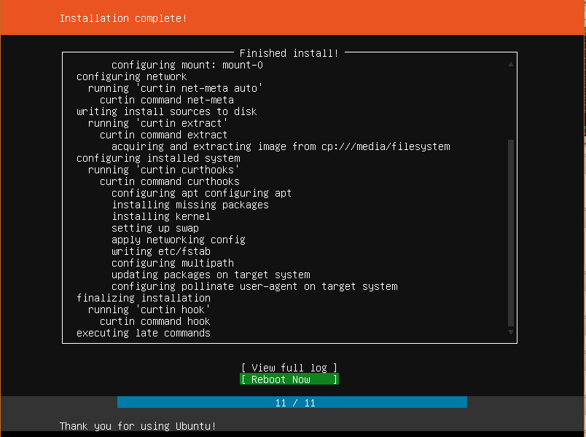
Installing Ubuntu Server
Complete the installation
Finally, the installation will wrap up and you will be prompted to reboot your server! Hit ‘REBOOT‘ and remove the installation media.

Slide 34
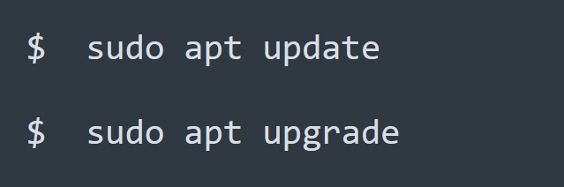
Installing Ubuntu Server
Log in to the server
A black console will appear prompting for your username and password. Provide the credentials you created earlier.
Thereafter, update and upgrade the repositories to their latest definitions.

Slide 35
We have finally installed, updated and upgraded the Ubuntu Server 18.04 Thank You!

