Slide 1

ETRACS v255 Administration and Users Training
March 11 – 22, 2024
One Central Hotel
Cebu City, Philippines

Slide 2
Training Staff
Rojan Paican
ETRACS Deployment Team
Vince Escoreal
ETRACS Deployment Team

Slide 3
Purpose of this Training
A walkthrough and get oriented to the following:
Features of all installed modules in the system
Features hosted in Filipizen and how it is handled on the LGU level
To know its objectives

Slide 4
Training Timeline
DATE | ACTIVITY | ATTENDEES
Day 1 March 11, 2024 | Introduction to the E-TRACS v2.55 Administration (Users, Roles, Orgs, etc…) Taxpayer Profiling Financial Master Files Treasury Master Files Accountable Form Transactions | Personnel from the Treasury, IT offices
Day 2 March 12, 2024 | Collection (AF 51, 52, 54, etc…) Remittance Liquidation Deposit Report Management Handling of Sub-Collectors and Field Collections Batch Collection, Cash Ticket, and Remote Collection | Personnel from the Treasury, IT offices

Slide 5
Training Timeline
DATE | ACTIVITY | ATTENDEES
Day 3 March 13, 2024 | Introduction to Business Permit Master File Management Introduction to Rule Authoring Capturing of Business Applications Capture Assess and Post Payment feature | Personnel from the Treasury, BPLO, IT offices
Day 4 March 14, 2024 | New/Renewal of Business Applications Business Collection (AF 51) Issuance of Business Permit Add/Retire LOB – Business Application Retire Business Report Management | Personnel from the Treasury, BPLO, IT offices
Day 5 March 15, 2024 | Preview: Online Business Applications Preview: Online Business Payment Open Forum/Q&A/ Clarifications | Personnel from the Treasury, BPLO, IT offices

Slide 6
Filipizen Connectivity Diagram

Slide 7



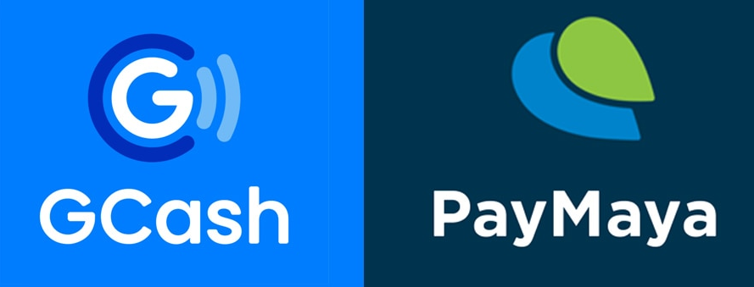


Filipizen Connectivity Diagram
F
LGU-1 Docker Server
LGU-2 Docker Server
Taxpayers

Slide 8
LGU Connectivity Diagram

Slide 9

LGU Connectivity Diagram
F
ETRACS Docker Server
Database Server
Users

Slide 10
Why Upgrade to Docker ?

Slide 11
Reasons for Upgrading
Deployment
Portability
Maintenance and Monitoring
Micro-Container Services
Supports Clustering
Easy to setup

Slide 12
Hardware Requirements ( Linux Host )
Server Grade Machine (Entry-Level or High-End)
Intel Xeon processor with minimum of 8 Cores
At least 16GB of RAM for a Linux host setup
At least 500GB storage if use as an application server only or at least 1TB storage if use as an application server and a database server in 1 machine
At least 2 LAN Ports ( 1 for Local, 1 for Internet )

Slide 13
Hardware Requirements ( Windows Host )
Server Grade Machine (Entry-Level or High-End)
Intel Xeon processor with minimum of 8 Cores
At least 32GB of RAM for a Windows host setup and requires at least Windows Server 2012 or higher
At least 500GB storage if use as an application server only or at least 1TB storage if use as an application server and a database server in 1 machine
At least 2 LAN Ports ( 1 for Local, 1 for Internet )

Slide 14
Objectives

Slide 15
Objectives
To fully automate all revenue generation activities of the LGU
Real Property
Business Permit
Miscellaneous and other fees
Economic enterprises
Shares from collection
Other sources of income and funds, etc…

Slide 16
Objectives
Increase revenue through efficiency
Paperless
Better transparency
Design based on best practices
Automate assessments thru formula and rules
Conform to the national standards (Compliance)
Full support for DTI unified form
CMCI

Slide 17
Objectives
Modernize LGU with latest technologies
Barcode and QRCode Support
eSignature Device
SMS
Email
Cloud connectivity
Municipality to Province
Province to Municipality
Filipizen

Slide 18
Users

Slide 19
Users
End-Users
Developers/Administrators
Novice
Intermediate
Advanced
Executive

Slide 20
Version History

Slide 21
Version History
ETRACS v1.8 --- 2008
ETRACS v2.0 --- 2010
ETRACS v2.2 --- 2012
ETRACS v2.54 --- 2014
ETRACS v2.55 --- 2019

Slide 22
Who Uses ETRACS

Slide 23
Who Uses ETRACS
More than 180 LGUs
Provinces
Aklan
Albay
Bohol
Bukidnon
Davao Del Norte
Davao De Oro
Davao Oriental
Guimaras
Ilocos Norte
Lanao Del Norte
Sarangani
Surigao Del Norte
Etc...

Slide 24
Who Uses ETRACS
Cities
Iligan
Puerto Princesa
Legazpi
Tagbilaran
San Carlos
Bayawan
Tanjay
Dapitan
Oroquieta
General Santos
Iriga
Naga
Danao
Sorsogon
Zamboanga
Masbate
Etc..

Slide 25
Who Uses ETRACS
Municipalities
Municipalities of Aklan
Municipalities of Albay
Municipalities of Bohol
Municipalities of Camarines Sur
Municipalities of Catanduanes
Municipalities of Davao Del Norte
Municipalities of Davao De Oro
Municipalities of Guimaras
Municipalities of Ilocos Norte
Municipalities of Lanao Del Norte
Municipalities of Bukidnon
Municipalities of Misamis Oriental
Municipalities of Misamis Occidental
Municipalities of Nueva Ecija
Municipalities of Nueva Vizcaya
Municipalities of Palawan
etc…

Slide 26
Terms Of Use

Slide 27
Terms Of Use
Free (including source code)
Membership (for sustainability)
Software can only be distributed through
Grants
LGU to LGU
Direct Membership
RAMESES has copyright
Nobody can sell the software or provide commercial services or bundle ETRACS with other vendor’s products

Slide 28
Member Benefits

Slide 29
Member Benefits
Upgrade and assistance
Discount on trainings, plugins and services
Free special products
Queueing System
Kiosk System
Cloud Applications
SMS
Email
LGU to LGU connectivity
Municipality-Province
Province-Municipality

Slide 30
Member Benefits
Online Transactions for Taxpayers
Online Billing
Business
Real Property Tax
Payment Order
Waterworks
OSCP
Online Payment ( GCASH, PayMaya, LandBank, DBP )
Online Renewal of Business
Online Registration of Business

Slide 31
Core Modules

Slide 32
Core Modules
Administration
Taxpayer Profiling (Entity)
Financial
Treasury
BPLS
RPT
Other Modules or Plugins
Queueing

Slide 33
Up Next Installation

