Slide 1
Taxpayer Profiling Module

Slide 2
Features
Manage Individual Taxpayers
Manage Juridical Taxpayers
Manage Multiple Ownerships
Manage Duplicate Entries
Generate Encoding Statistics Report

Slide 3
Roles
ENTITY.MASTER
ENTITY.APPROVER
ENTITY.ADMIN

Slide 4
Manage Individual Taxpayers
Create, Update, Activate/Deactivate Taxpayer
Location:
Home-> Taxpayer Entities-> Individual

Slide 5
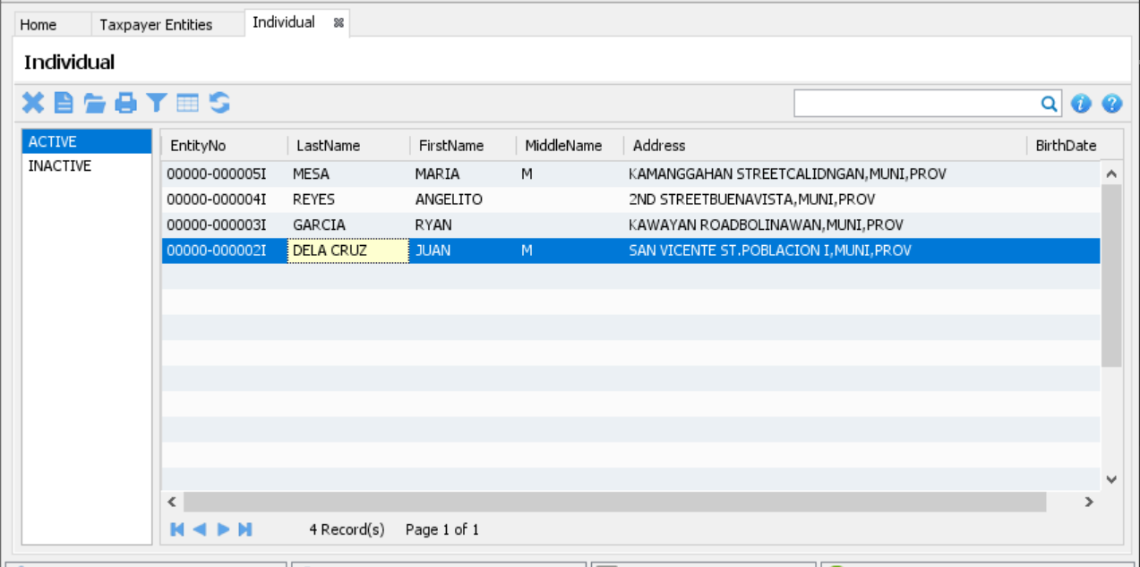
Manage Individual Taxpayers

Slide 6
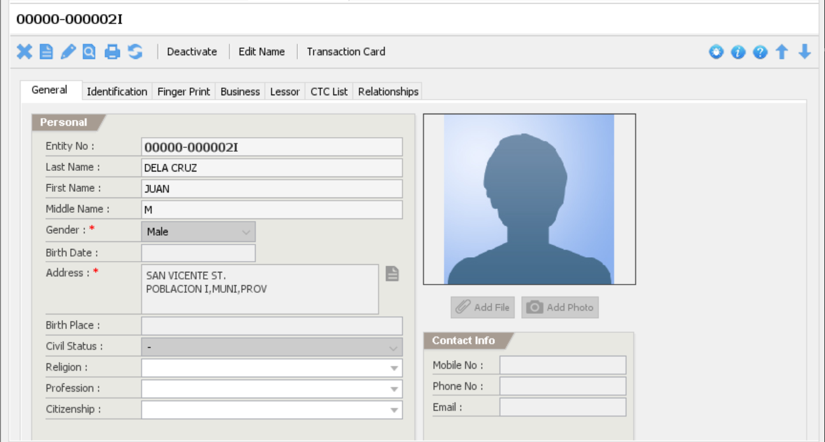
Individual Taxpayer

Slide 7
Manage Juridical Taxpayers
Create, Update, Activate/Deactivate Taxpayer
Location:
Home-> Taxpayer Entities-> Juridical

Slide 8
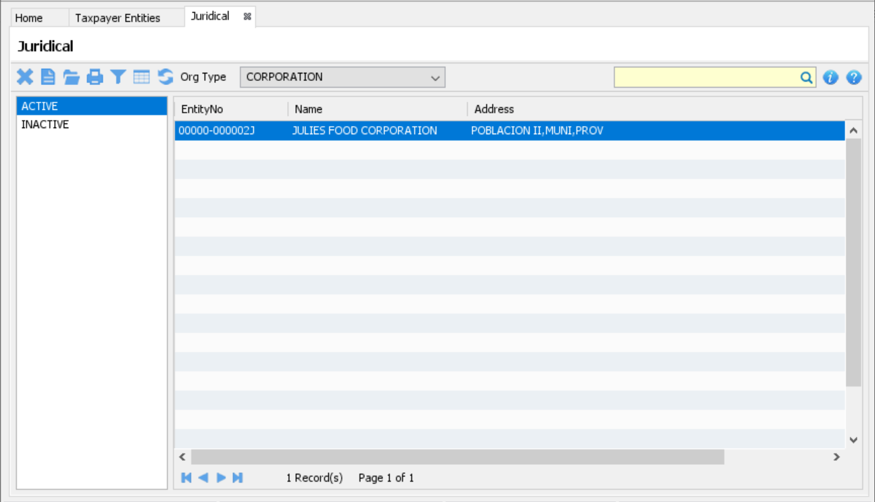
Manage Juridical Taxpayers

Slide 9
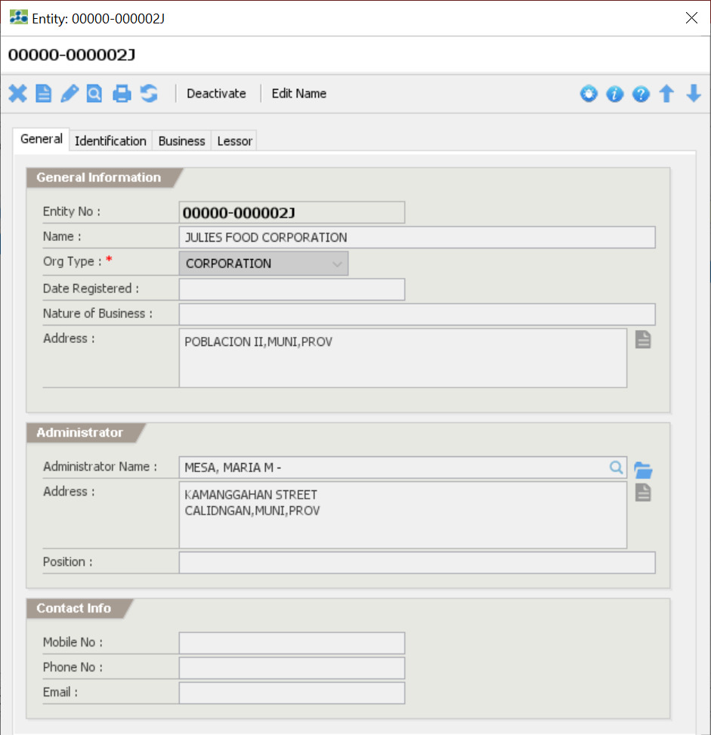
Juridical Taxpayer

Slide 10
Manage Multiple Taxpayers
Create, Update, Activate/Deactivate Taxpayer
Location:
Home-> Taxpayer Entities-> Multiple Ownership

Slide 11
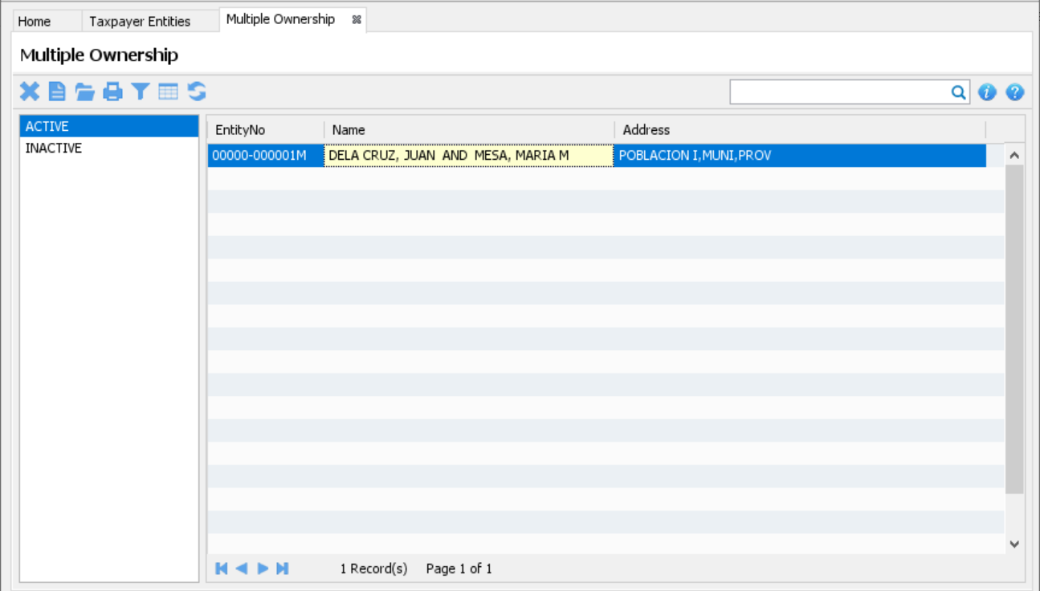
Manage Multiple Taxpayers

Slide 12
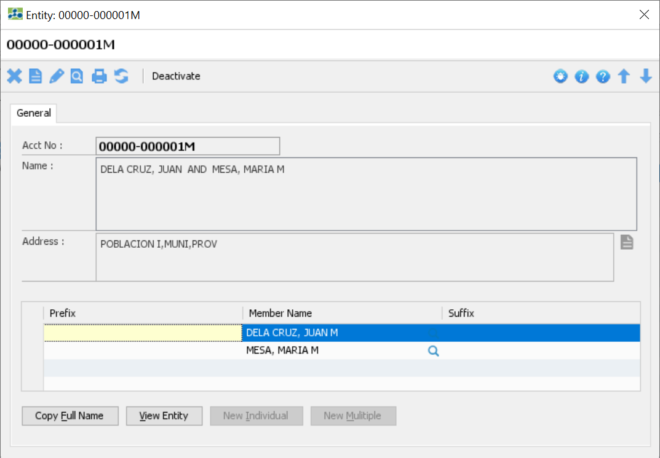
Multiple Taxpayer

Slide 13
Encoding Monitoring Report
Generate Report for Monitoring
Location:
Main Menu-> Reports-> Entity-> Entity Encoding Monitoring

Slide 14
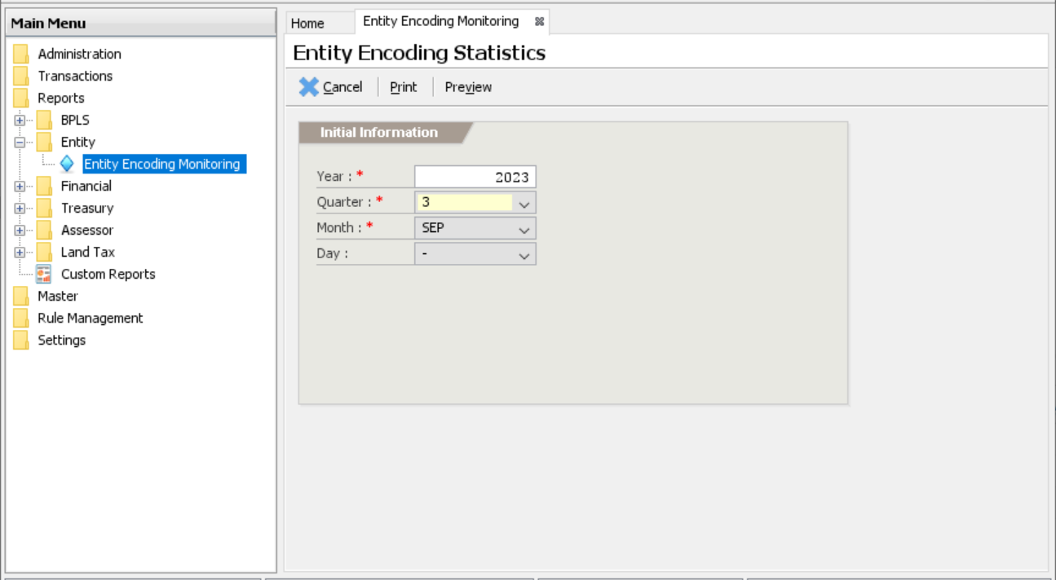
Encoding Monitoring Report

Slide 15
Up Next Financial

