Slide 1
Treasury Module

Slide 2
Features
Manage Master Data
Requisition and Issuance Slip
Collections
Online
Offline
Batch Capture
Remittance
Liquidation
Deposit
Reports

Slide 3
Roles
TREASURY.MASTER
TREASURY.AFO
TREASURY.COLLECTOR
TREASURY.LIQUIDATING_OFFICER
TREASURY.CASHIER
TREASURY.SHARED
TREASURY.SUBCOLLECTOR
TREASURY.REPORT
TREASURY.RULE_AUTHOR

Slide 4
Roles
TREASURY.ADMIN
TREASURY.AFO_ADMIN
TREASURY.COLLECTOR_ADMIN
TREASURY.LIQ_OFFICER_ADMIN
TREASURY.RIS_APPROVER
TREASURY.MANAGER
TREASURY.PO_MASTER

Slide 5
Collection Process Flow
AFO
COLLECTOR
LIQUIDATING OFFICER
CASHIER
Issue AF
Prepare RIS
Prepare
Liquidation
Prepare Deposit
Collect
Post
Liquidation
Post
Deposit
Purchase Request (AF)
Remit
Purchase Receipt (AF)
JEV
JEV
End

Slide 6
Master Data
AF Type
AF Unit
AF Allocation
Required Role:
TREASURY.AFO

Slide 7
AF Type
Supports Standard Accountable Forms
51, 52, 53, 54, 56, 57, 58
0016, 0017, 907
Cash Tickets (1, 2, 5, 10)
Location:
“Main Menu-> Master-> Treasury-> AF Types”

Slide 8
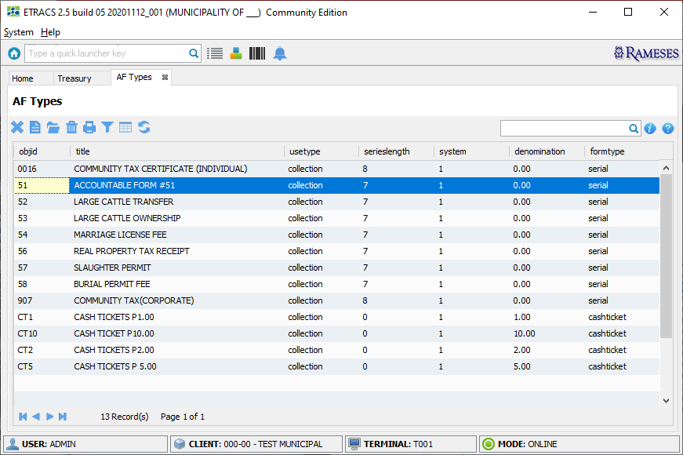
AF Types Screen

Slide 9
AF Unit
Accountable Form Unit Settings
Location:
“Main Menu-> Master-> Treasury-> AF Units”

Slide 10
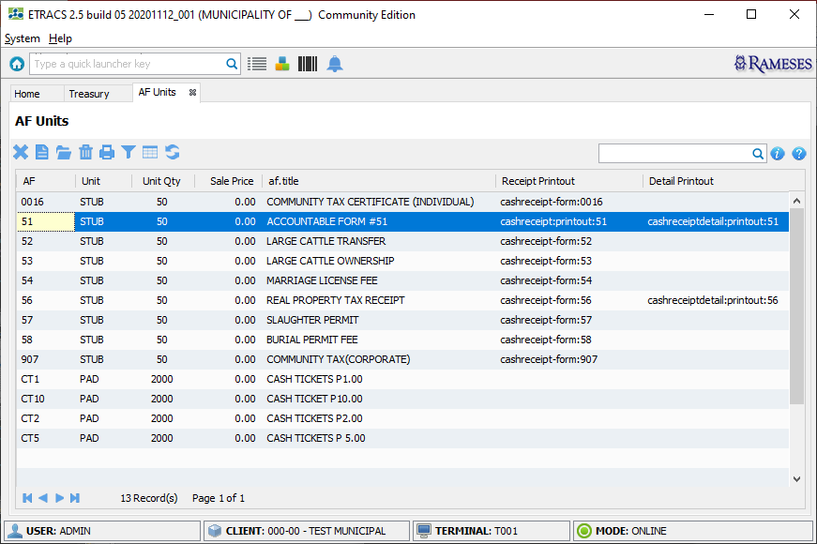
AF Units Screen

Slide 11
AF Allocation
Separate AF Inventory
Location:
“Main Menu-> Master-> Treasury-> AF Allocation”

Slide 12
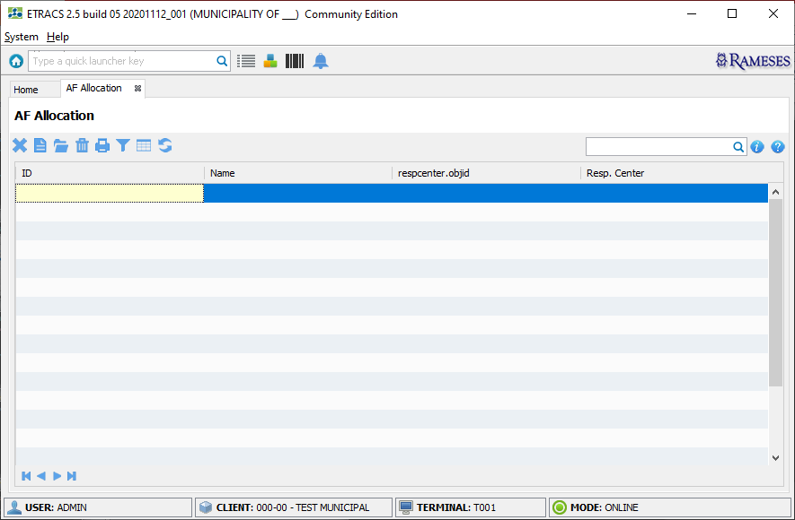
AF Allocations Screen

Slide 13
Master Data
Collection Type
Collection Group
Barcode Launcher
Payment Order Type
Required Role:
TREASURY.MASTER

Slide 14
Collection Type
Facility to control accounts for collection
Simplifies collection process
Location:
“Main Menu-> Master-> Treasury-> Collection Types”

Slide 15
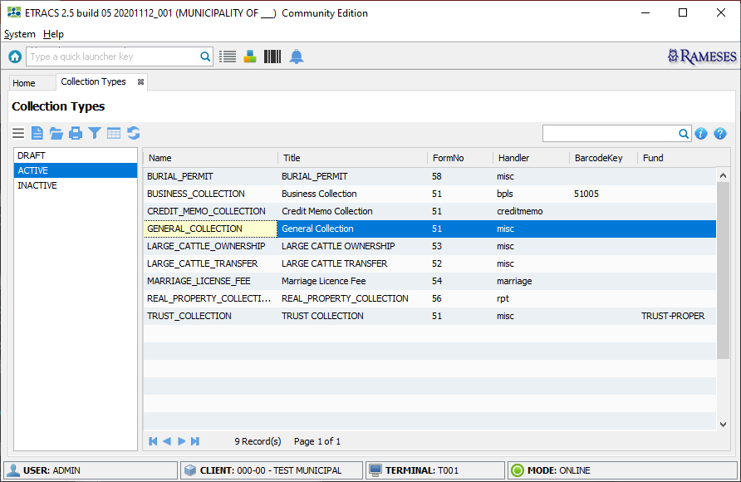
Collection Types Screen

Slide 16
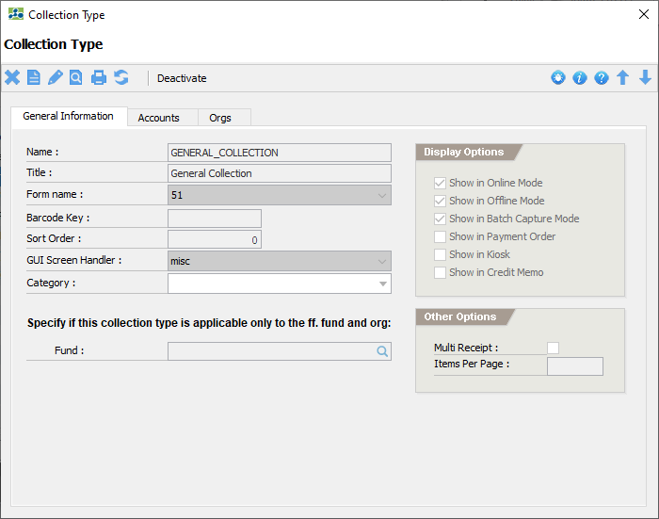
Collection Type Screen

Slide 17
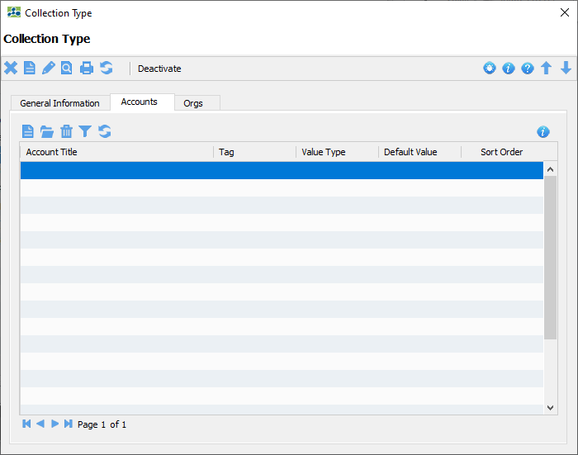
Collection Type Screen

Slide 18
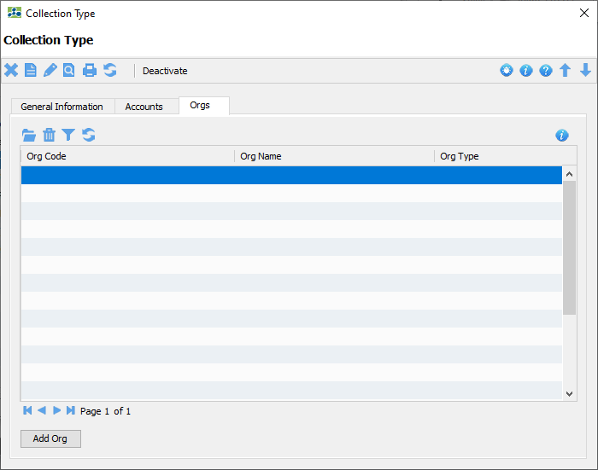
Collection Type Screen

Slide 19
Collection Group
Simplify collection for a group of item accounts
Location:
“Main Menu-> Master-> Treasury-> Collection Groups”

Slide 20
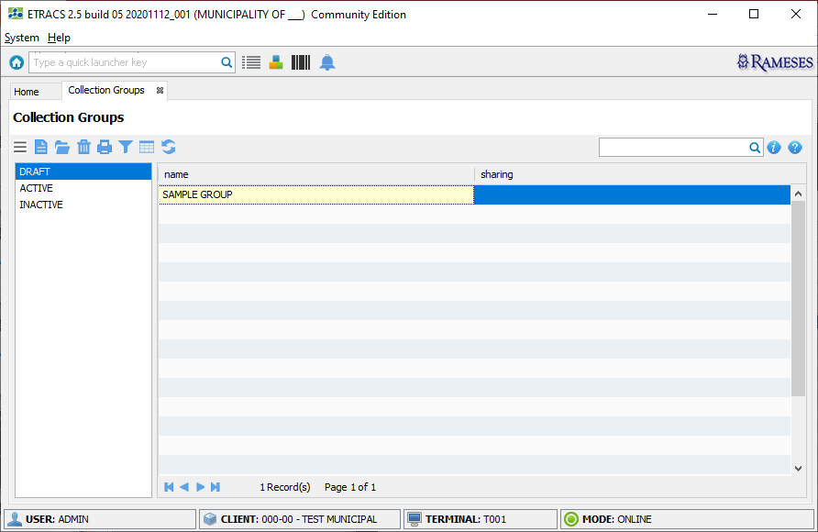
Collection Groups Screen

Slide 21
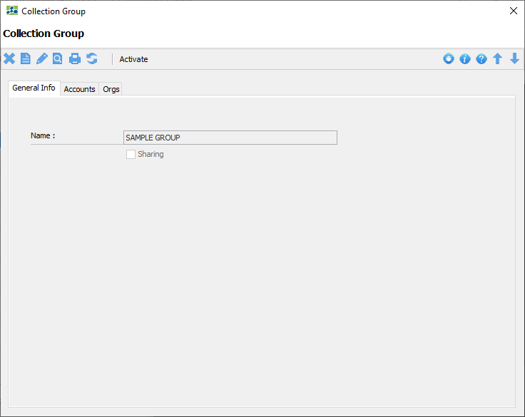
Collection Group Screen

Slide 22
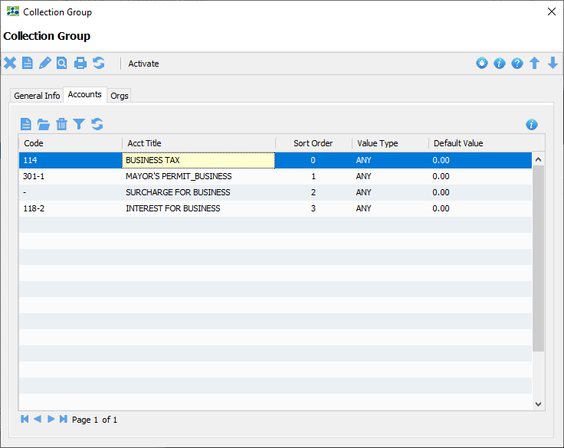
Collection Group Screen

Slide 23
Barcode Launcher
To manage unique barcode keys
Collection Type binding for non-payment order setting
Location:
“Main Menu-> Master-> Treasury-> Barcode Launchers”

Slide 24
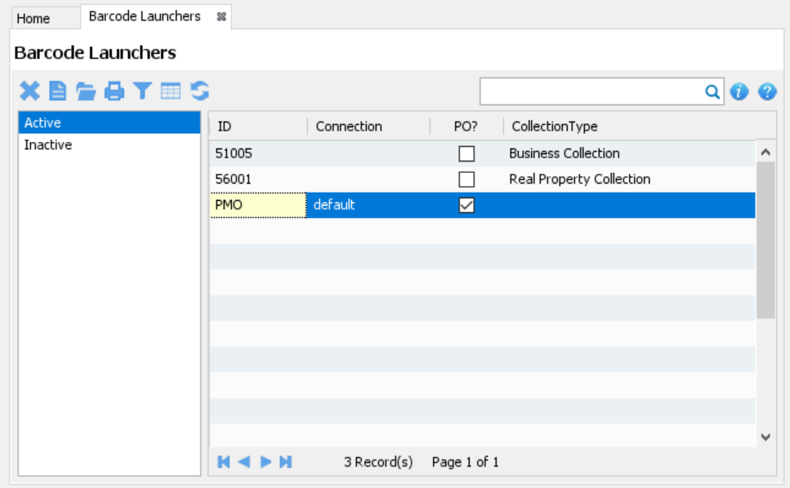
Barcode Launchers Screen

Slide 25
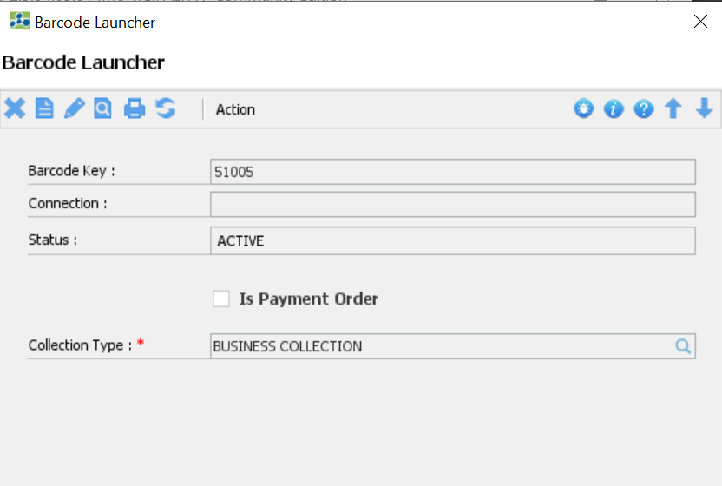
Barcode Launcher Screen
* With Collection Type binding

Slide 26
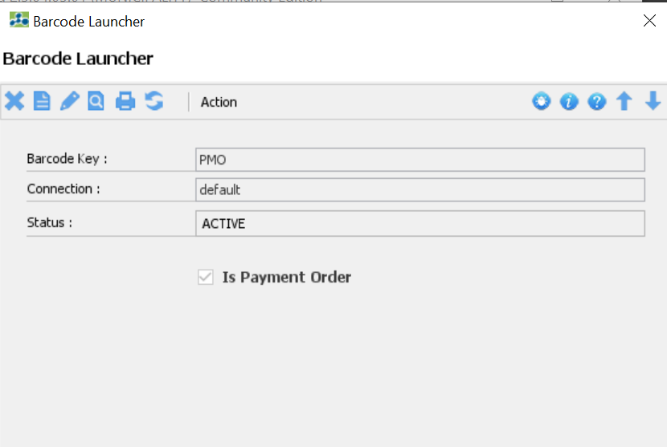
Barcode Launcher Screen
* Enabling the Payment Order option

Slide 27
Payment Order Type
Facility to control the Item Accounts in creating a Payment Order
Simplifies collection process
Location:
“Main Menu-> Master-> Treasury-> Payment Order Types”

Slide 28
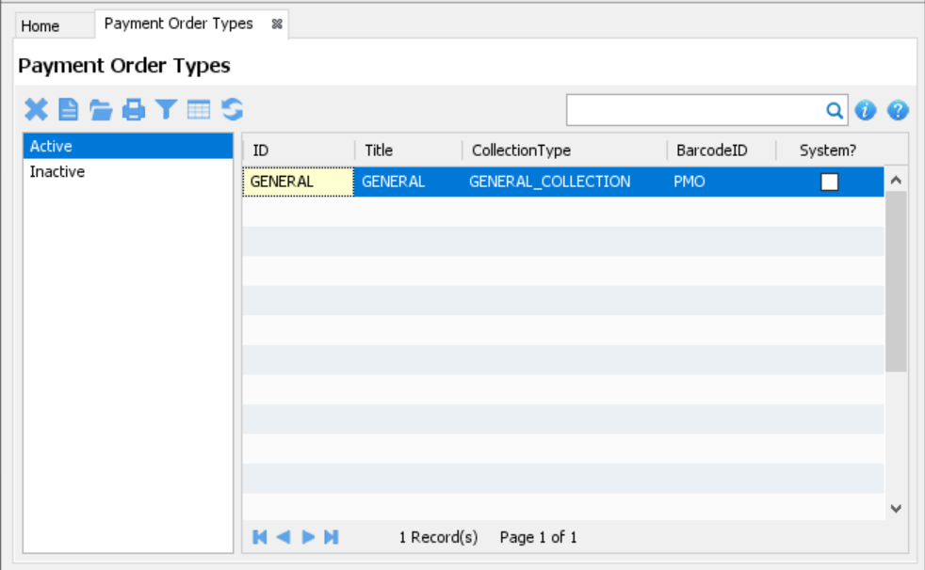
Payment Order Types Screen

Slide 29
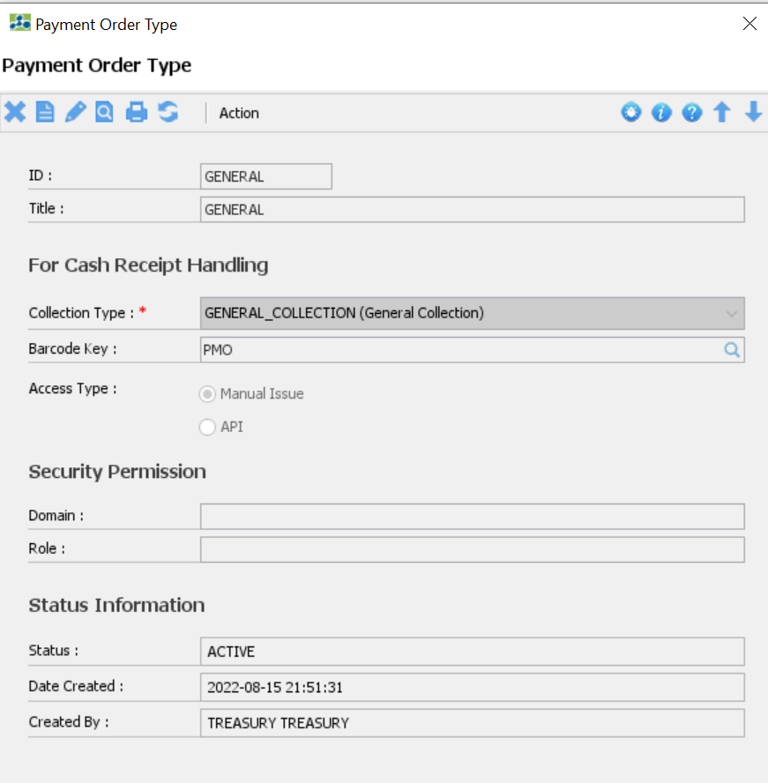
Payment Order Type Screen

Slide 30
Required Role:
AFO Features
Accountable Form Inventory
Accountable Form Transactions
Accountable Form Monitoring
Request Accountable Form (Purchase)
CRAAF
RAAF
TREASURY.AFO

Slide 31
Request Accountable Form (Purchase)
Create a purchase request
Location:
Home-> Treasury-> Request Accountable Form (Purchase)

Slide 32
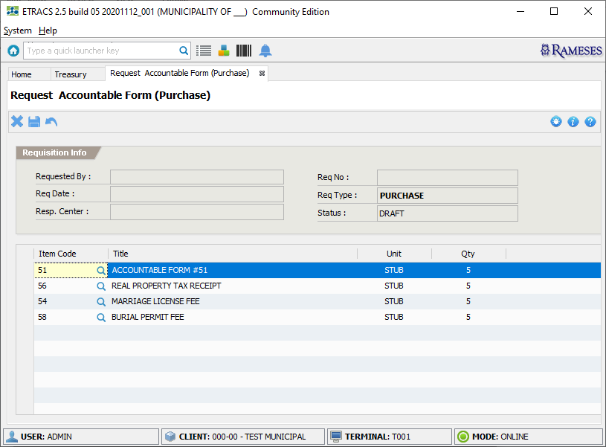
Request Account Form (Purchase)

Slide 33
Activity: Request Accountable Form (Purchase)
Go to “Home-> Treasury”
Under “Accountable Forms” category, click “Request Accountable Form (Purchase)”
Add the applicable AF in the list together with the quantity
Click icon to save information
Click the “Yes” button to confirm saving
After saving, a request number is generated by the system
Click icon to close the screen

Slide 34
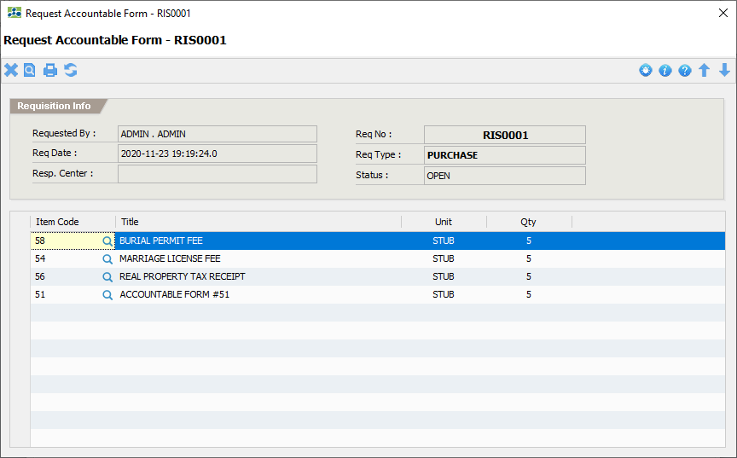
Request Account Form (Purchase)

Slide 35
AF Requests
List management of all AF request transactions
Location:
Home-> Treasury-> View AF Requests

Slide 36
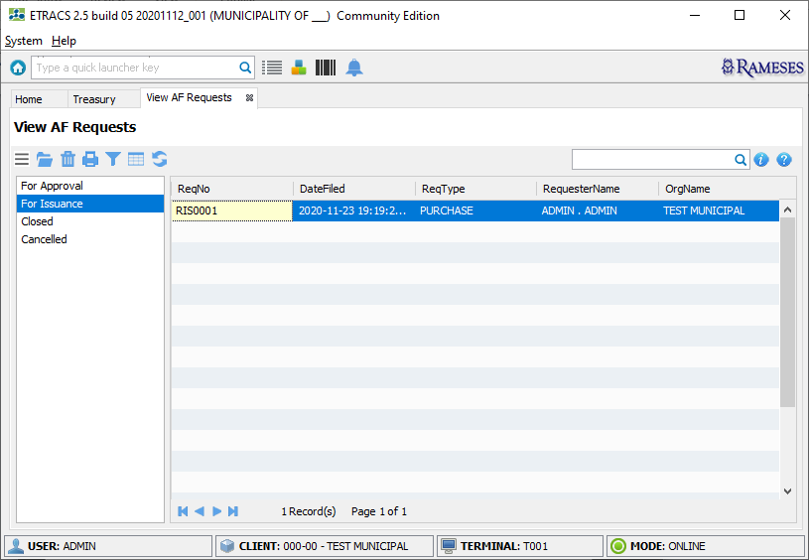
AF Requests

Slide 37
AF Transactions
List management of all AF transactions
Purchase Receipt
Begin Balance
Issue
Forward
Transfer
Return
Manual Issue
Location:
Home-> Treasury-> View AF Transactions

Slide 38
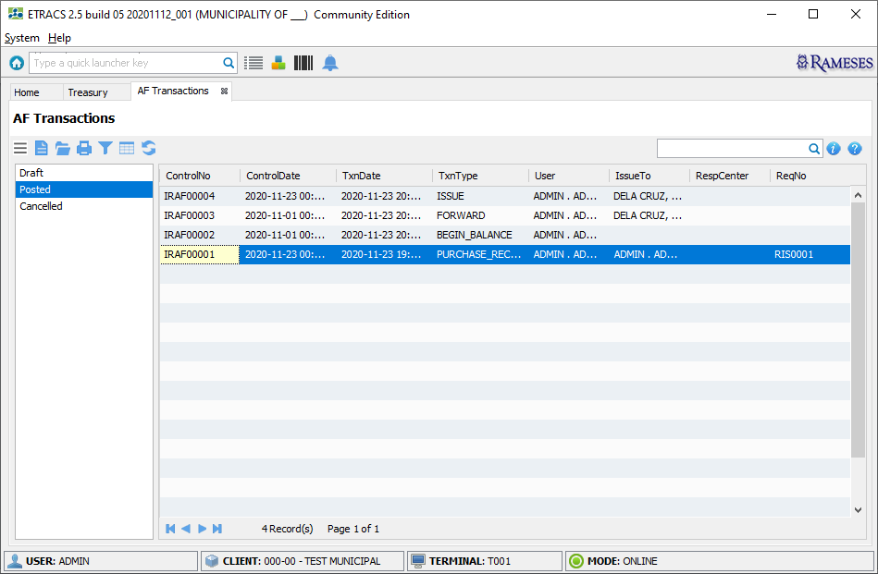
AF Transactions

Slide 39
AF Transaction: Purchase Receipt
Go to “Home-> Treasury”
Under “Accountable Forms” category, click “New AF Transaction”
Set the “Type of Transaction” to “PURCHASE RECEIPT”
Set the “Date Issued” to the actual date of the transaction
Choose the “With Request” option
Enter the request number
Click the “Next” button to continue
Check and verify the information
Click the “Next’ button to continue
Click the “Yes” button to confirm saving
For each AF, click the “Add Entry” action
Fill-in the required fields that are marked with (*)
Click the “OK” button to add
Repeat Step-11 for the next AF entry
Click the “Post” button to submit
Click the “Yes” button to confirm posting

Slide 40
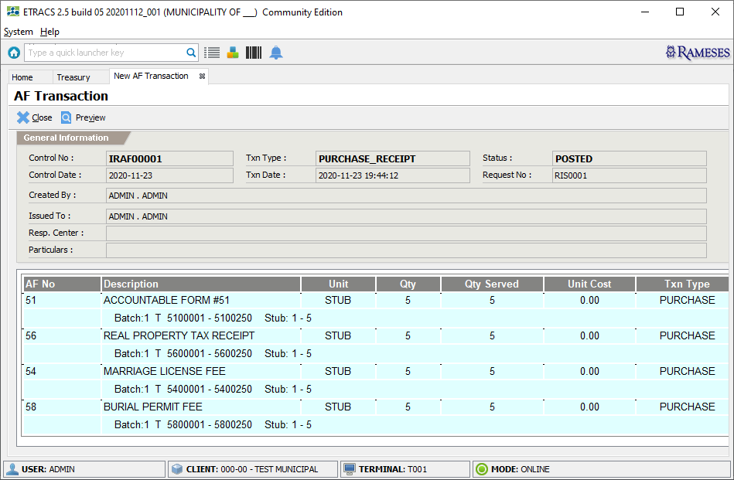
AF Transaction: Purchase Receipt

Slide 41
AF Transaction: Begin Balance
Go to “Home-> Treasury”
Under “Accountable Forms” category, click “New AF Transaction”
Set the “Type of Transaction” to “BEGIN BALANCE”
Set the “Date Issued” to the actual date of the transaction
Click the “Next” button to continue
Add the applicable AF in the list together with the quantity
Click the “Next’ button to continue
Click the “Yes” button to confirm saving
For each AF, click the “Add Entry” action
Fill-in the required fields that are marked with (*)
Click the “OK” button to add
Repeat Step-9 for the next AF entry
Click the “Post” button to submit
Click the “Yes” button to confirm posting

Slide 42
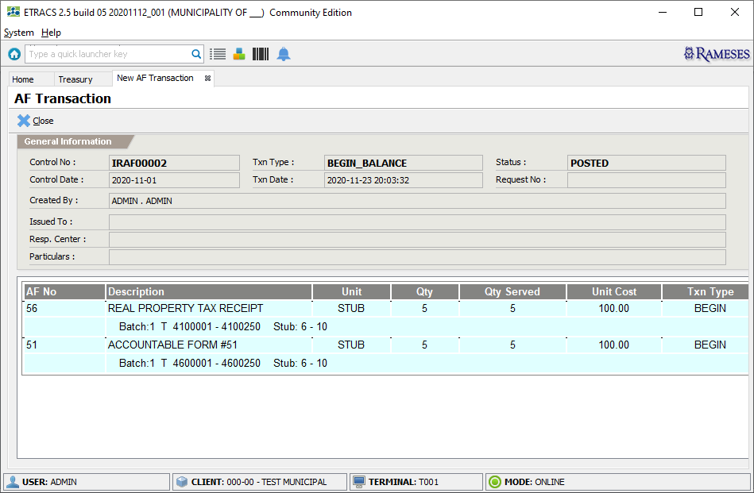
AF Transaction: Begin Balance

Slide 43
AF Transaction: Forward
Go to “Home-> Treasury”
Under “Accountable Forms” category, click “New AF Transaction”
Set the “Type of Transaction” to “FORWARD”
Set the “Date Issued” to the actual date of the transaction
Click the “Next” button to continue
Fill-in the required fields that are marked with (*)
Click the “Save” button to save
Click the “Yes” button to confirm saving

Slide 44
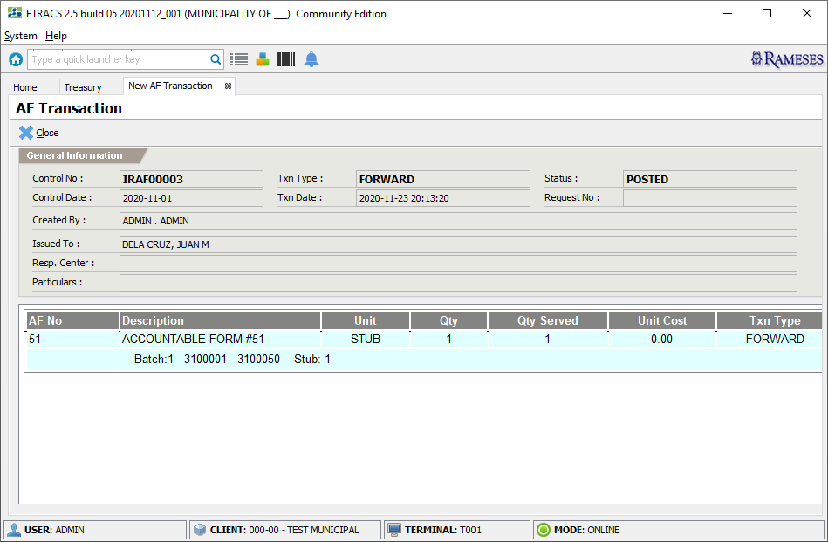
AF Transaction: Forward

Slide 45
AF Transaction: Issue
Go to “Home-> Treasury”
Under “Accountable Forms” category, click “New AF Transaction”
Set the “Type of Transaction” to “ISSUE”
Set the “Date Issued” to the actual date of the transaction
Choose “With Request” option
Enter the request number
Click the “Next” button to continue
Check and verify the request items
Click the “Next” button to continue
For each AF, click the “Issue” action
Set the “Qty to Issue”
Click the “OK” button to process
Repeat Step-10 for the next AF
Click the “Post” button to submit
Cick the “Yes” button to confirm posting
Click the “Preview” button for the report

Slide 46
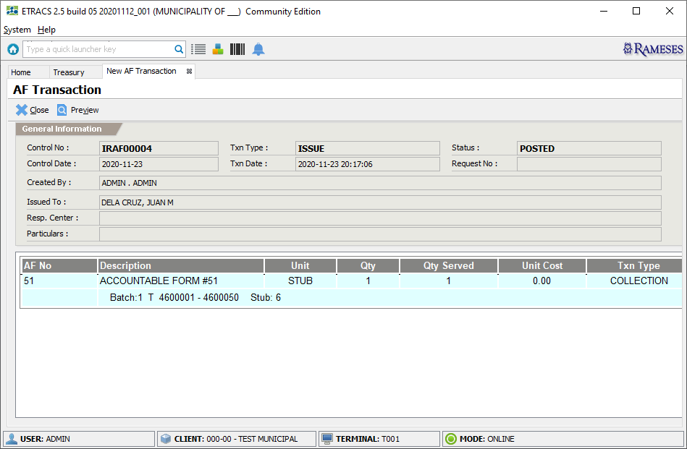
AF Transaction: Issue

Slide 47
AF Transaction: Transfer
Go to “Home-> Treasury”
Under “Accountable Forms” category, click “New AF Transaction”
Set the “Type of Transaction” to “TRANSFER”
Set the “Date Issued” to the actual date of the transaction
Click the “Next” button to continue
Set the “Issued From”
Set the “Transfer To”
Set the “AF Type”
Select the items to transfer
Click the “Next” button to process
Cick the “Yes” button to confirm posting

Slide 48
AF Transaction: Return
Go to “Home-> Treasury”
Under “Accountable Forms” category, click “New AF Transaction”
Set the “Type of Transaction” to “RETURN”
Set the “Date Issued” to the actual date of the transaction
Click the “Next” button to continue
Set the “Issued From”
Set the “AF Type”
Select the items to return
Click the “Next” button to process
Cick the “Yes” button to confirm posting

Slide 49
AF Transaction: Manual Issue
Go to “Home-> Treasury”
Under “Accountable Forms” category, click “New AF Transaction”
Set the “Type of Transaction” to “MANUAL ISSUE”
Set the “Date Issued” to the actual date of the transaction
Click the “Next” button to continue
Set the “Transfer To”
Set the “AF Type”
Select the items to issue
Click the “Next” button to process
Cick the “Yes” button to confirm posting

Slide 50
AF Inventory Summary
Quick preview of the AF Inventory status
Location:
Home-> Treasury-> Accountable Forms-> AF Inventory Summary

Slide 51
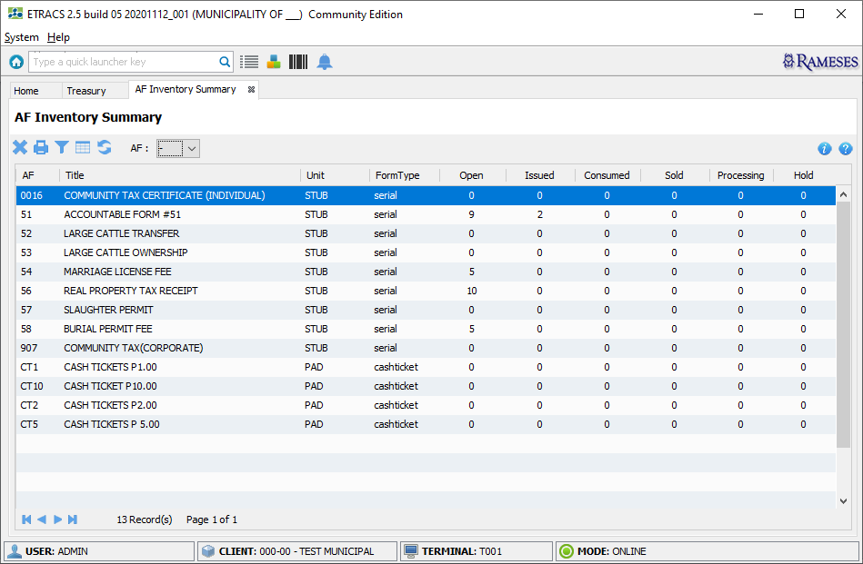
AF Inventory Summary

Slide 52
AF Control Monitoring
Monitor Collector’s AF
Location:
Home-> Treasury-> Management-> AF Control Monitoring

Slide 53
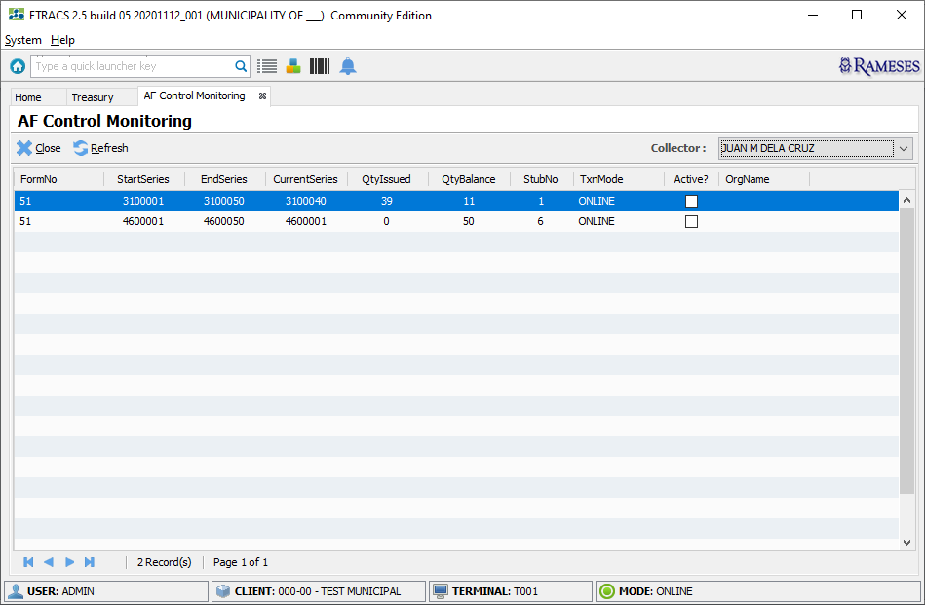
AF Control Monitoring

Slide 54
AF Controls
List management of all Accountable Forms
Location:
Home-> Treasury-> Accountable Forms-> AF Controls

Slide 55
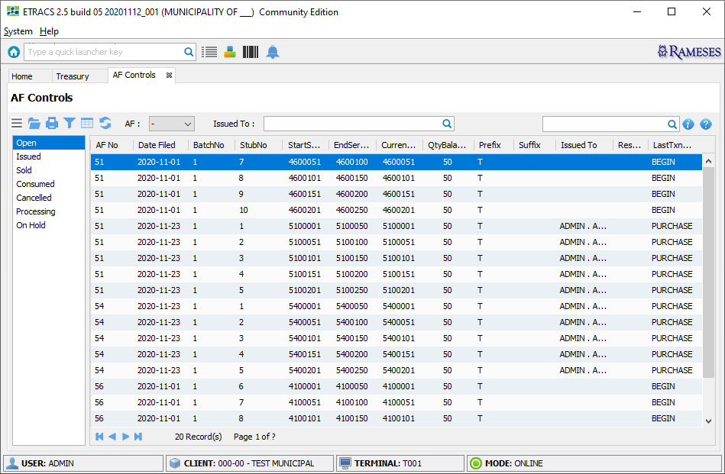
AF Controls

Slide 56
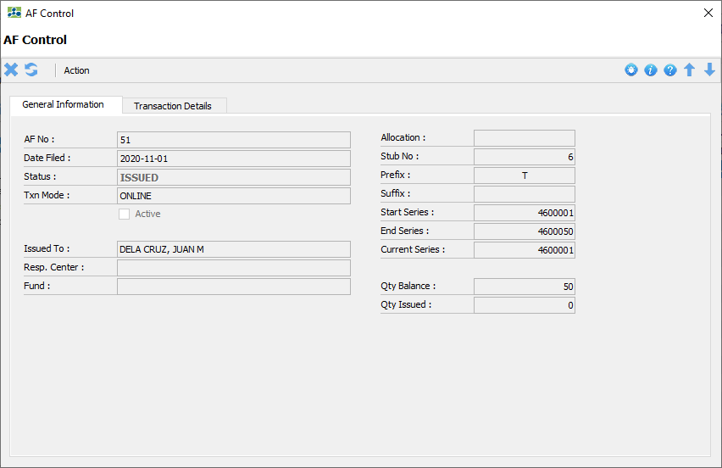
AF Control

Slide 57
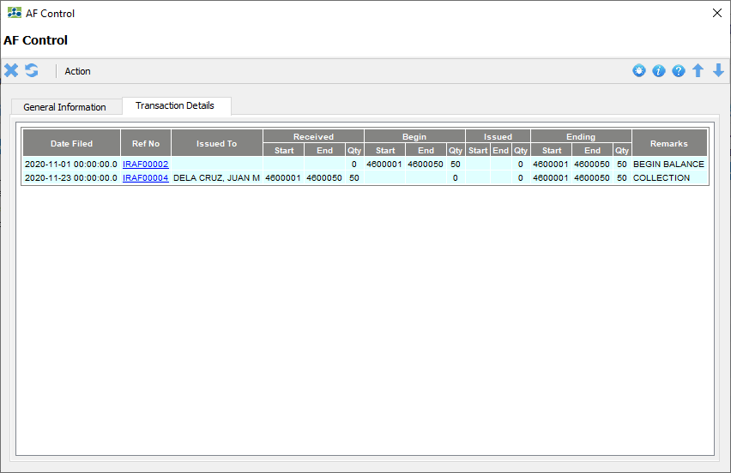
AF Control

Slide 58
AFO Reports
AF Inventory Report
CRAAF
RAAF
Location:
Main Menu-> Reports-> Treasury

Slide 59
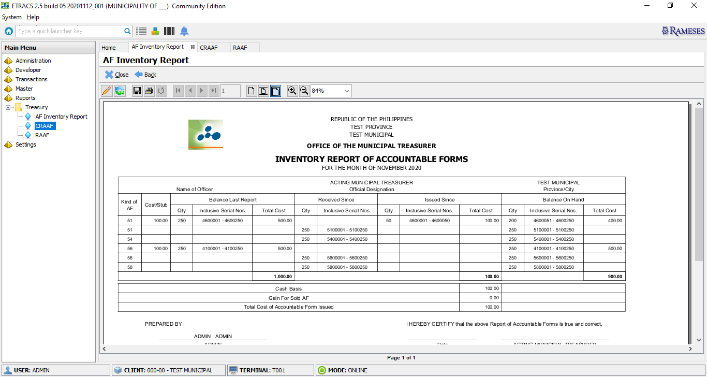
AF Inventory Report

Slide 60
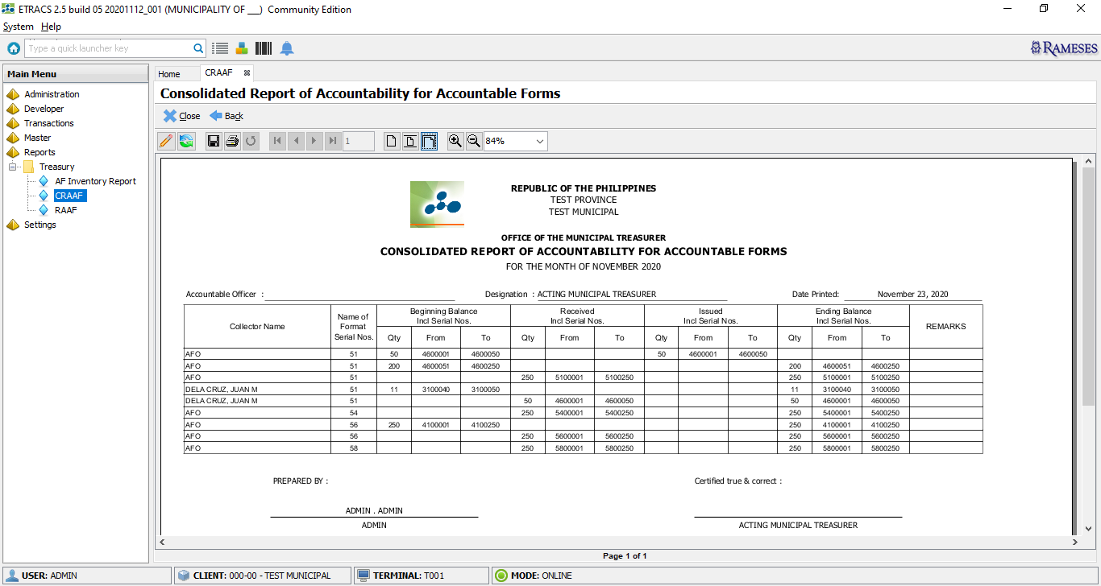
CRAAF

Slide 61
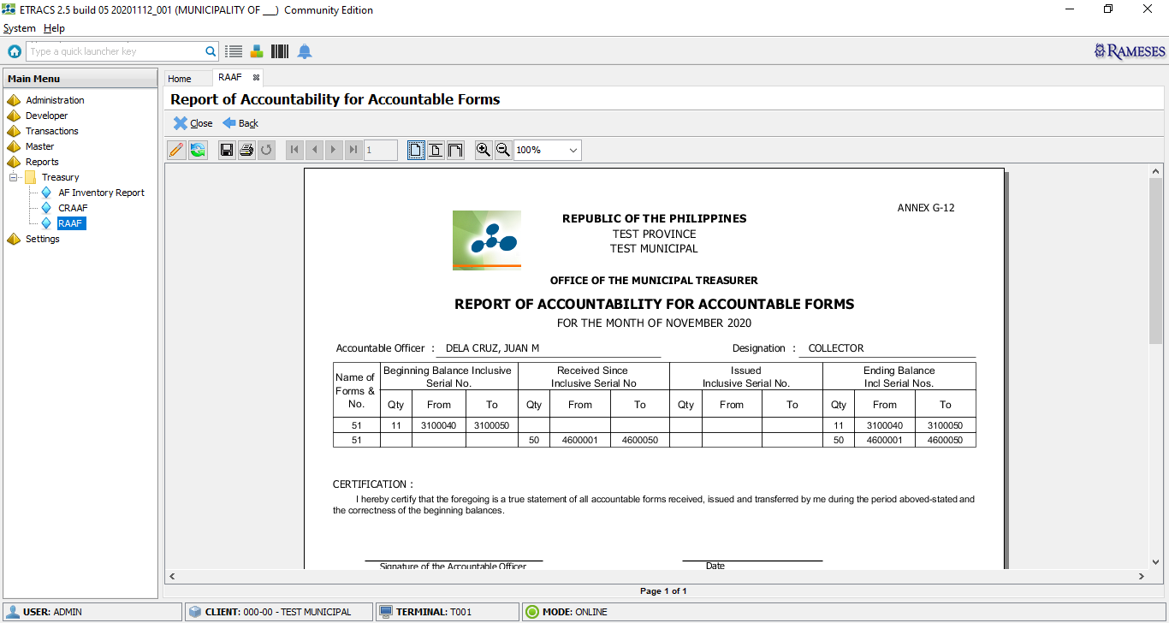
RAAF

Slide 62
Required Role:
Collector Features
Request Accountable Form
Collection
Batch Capture
Remittance
Reports
Tools
TREASURY.COLLECTOR

Slide 63
Request Accountable Form
Creates request of AF to be processed by AFO
Location:
Home-> Treasury-> Collection-> Request Accountable Form

Slide 64
Request Accountable Form
Go to “Home-> Treasury”
Under “Collection” category, click “Request Accountable Form”
Add the applicable AF in the list together with the quantity
Click icon to save
Click the “Yes” button to confirm saving
After saving, a request number is generated by the system

Slide 65
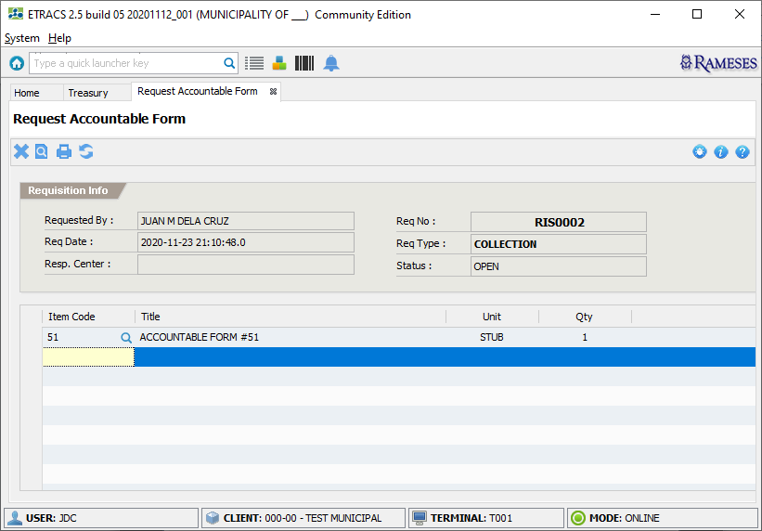
Request Accountable Form

Slide 66
Collection
Issue Cash Receipt
Issue Cash Ticket
Location:
Home-> Treasury-> Collection

Slide 67
Issue Cash Receipt: General Collection
Go to “Home-> Treasury”
Under “Collection” category, click “Issue Cash Receipt”
Set the “Mode”
Set the “AF Type” to “51”
Set the “Collection Type” to “General Collection”
Click the “Next” button to continue
If no activated stubs, you will be prompted with a “Select Stub to Use”
Set the “Paid By” and “Address”
Add the applicable accounts in the list together with the amount
Click the “F9 - Cash” button and set the “Cash Tendered”
Click the “OK” button to continue
Click the “OK” button to confirm receipt

Slide 68
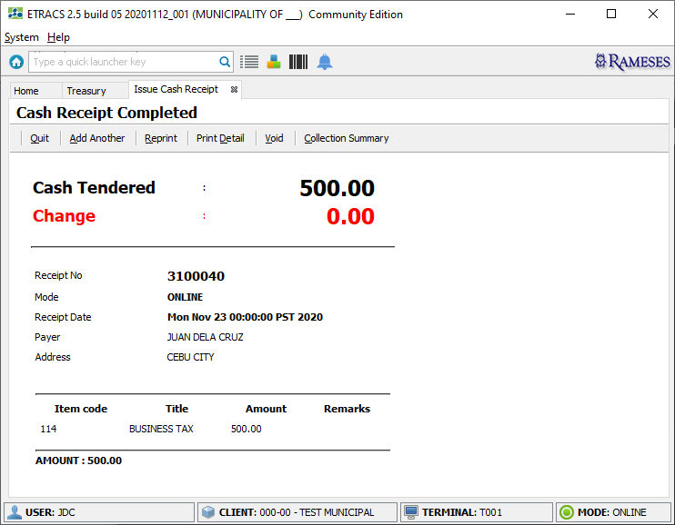
Issue Cash Receipt: General Collection

Slide 69
Issue Cash Ticket
Go to “Home-> Treasury”
Under “Collection” category, click “Issue Cash Ticket”
Set the “Mode”, “AF Type” and “Collection Type”
Click the “Next” button to continue
If no activated stubs, you will be prompted with a “Select Stub to Use”
Set the “Total Cash Collector” or “Quantity Issued”
Add the applicable accounts in the list together with the amount
Click the “Save” button to submit
Click the “Yes” button to confirm saving

Slide 70
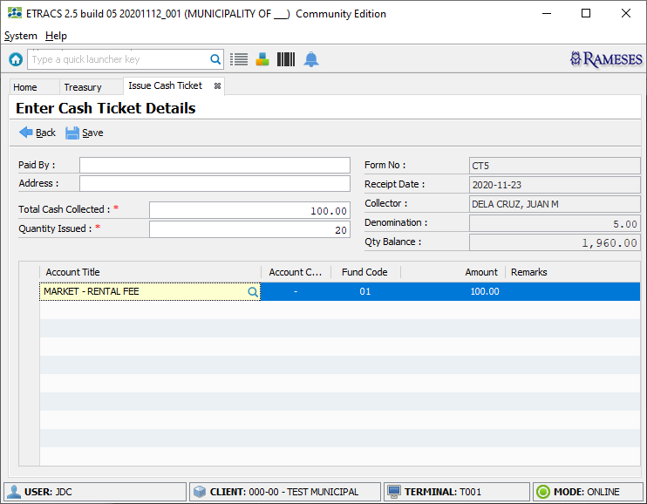
Issue Cash Ticket

Slide 71
Required Role:
Void Receipt
Go to “Home-> Treasury-> View Cash Receipts”
Select Cash Receipt to be voided
Click the “Void” button to void cash receipt
Enter Approver login credentials and indicate the reason for voiding receipt
Click the “OK” button to continue
TREASURY.APPROVER

Slide 72
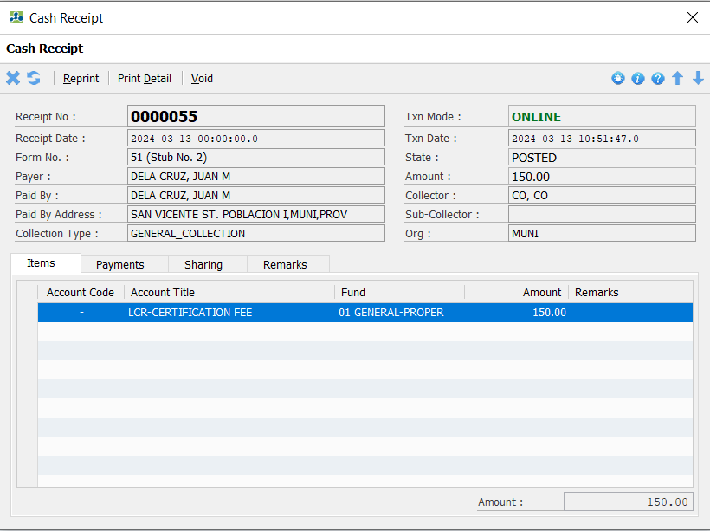

Slide 73
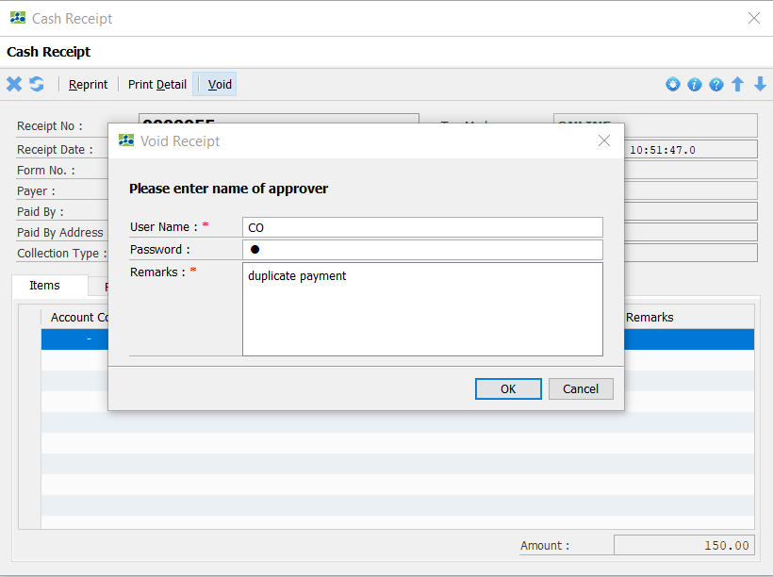
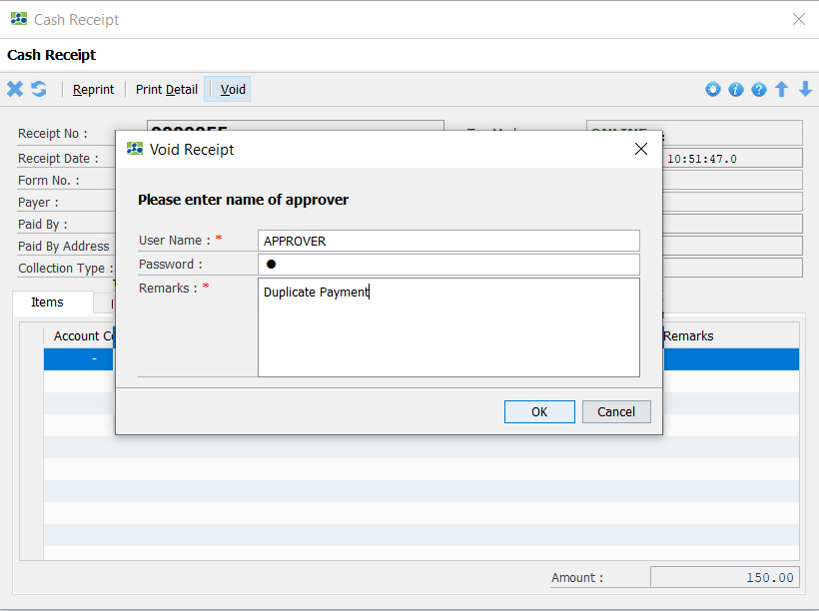

Slide 74
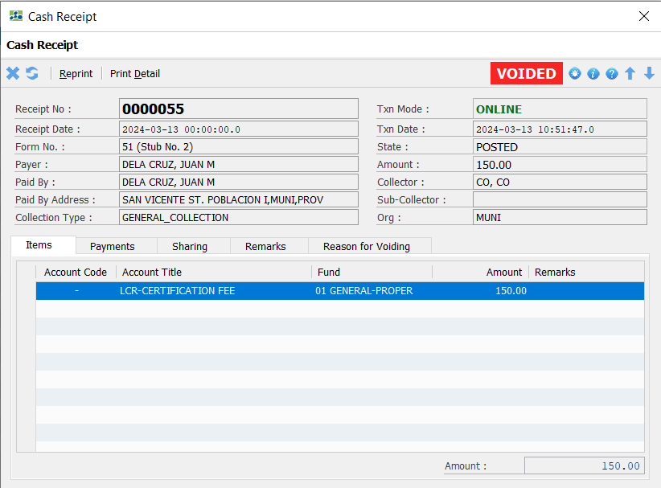

Slide 75
Required Role:
Sub Collector Features
Collection
Batch Capture
Remittance
Note: Subcollector is under Collector.
All transactions made by subcollector is under Collector supervision.
TREASURY.SUBCOLLECTOR

Slide 76
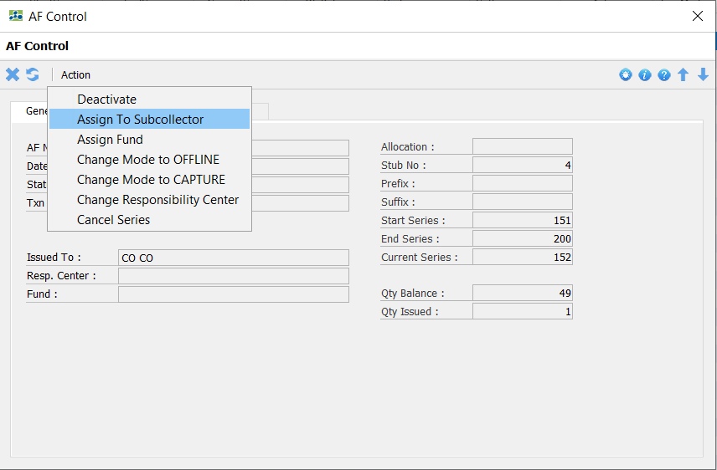
Assign Accountable Form
Collector must assign AF to Subcollector.
Location:
Home-> Treasury-> Collection-> View Accountable Forms

Slide 77
Remittance
To prepare a remittance of the unremitted receipts
Location:
Home-> Treasury-> Collection-> Prepare Remittance

Slide 78
Prepare Remittance
Go to “Home-> Treasury”
Under “Collection” category, click “Prepare Remittance”
Review and verify the data displayed on the screen
Click the “Submit For Remittance” button to submit
A draft remittance transaction is successfully created
Click the “Cash Breakdown” button to set denomination
Click the “OK” button to save
Click the “Submit For Liquidation” button
An Official Control Number is generated by the system
Preview and printing of RCD

Slide 79
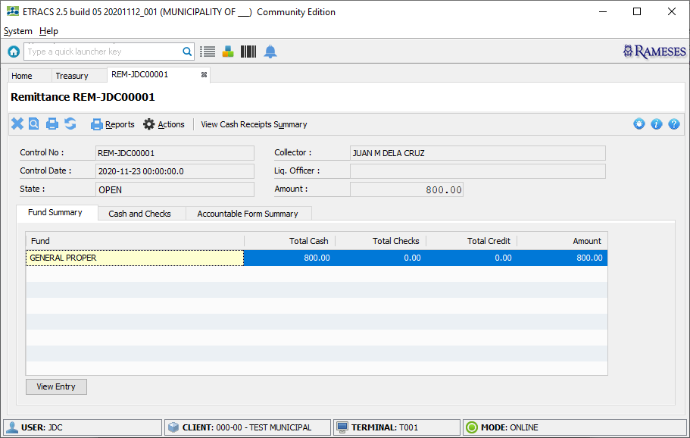
Remittance

Slide 80
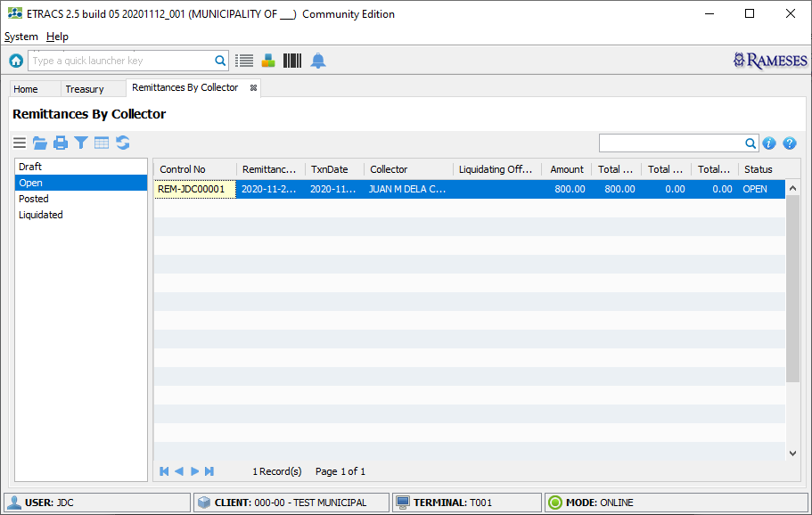
View Remittances

Slide 81
Batch Capture
Capture the manual issuance of receipts
Location:
Home-> Treasury-> Collection-> View Batch Captures

Slide 82
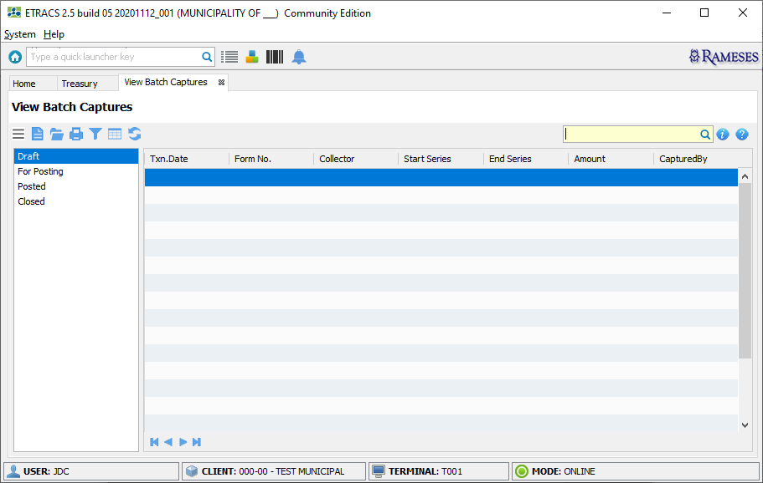
Batch Captures

Slide 83
Part-1
Batch Capture
Go to “Home-> Treasury”
Under “Collection” category, click “View Batch Captures”
Click icon to create
Set the “Start Series” and “Receipt Date”
Be sure that the stub you want to use has changed the mode to “CAPTURE” or else it prompt an error
Click the “Next” button to continue
Select the “Collection Type” you want to use and click the “OK” button to continue
Click the “Add” button to add a receipt
Fill-in the required fields that are marked with ( * )
Add the applicable accounts in the list together with the amount
Click the “Save” button to save
Repeat Step-8 to add more receipts

Slide 84
Part-2
Batch Capture
Click the “Submit For Posting” button
Click the “Post” button
Click the “Submit For Online Remittance” button
Click the “Yes” button to confirm
Status of the transaction becomes CLOSED

Slide 85
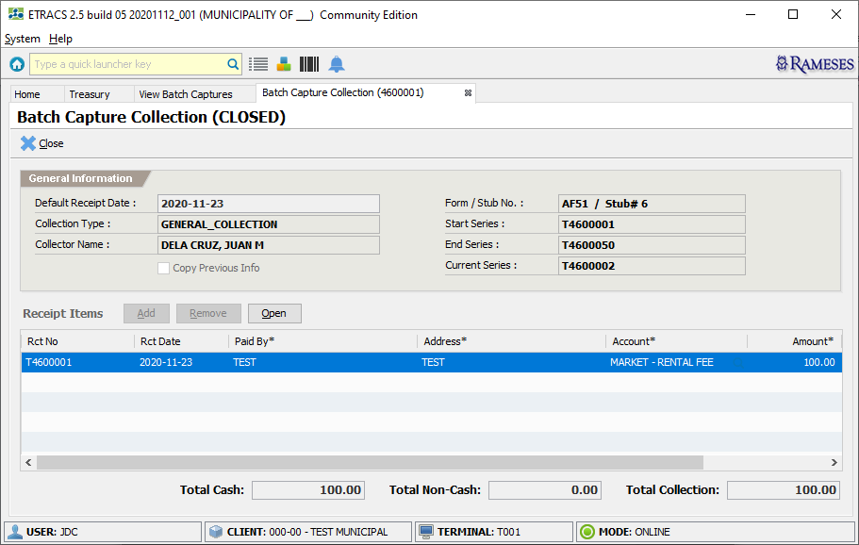
Batch Capture

Slide 86
Payment Order
Manage Payment Order records
A Payment Order can be paid through ePayment or over-the-counter transaction
Location:
Home-> Treasury-> Management-> View Payment Orders

Slide 87
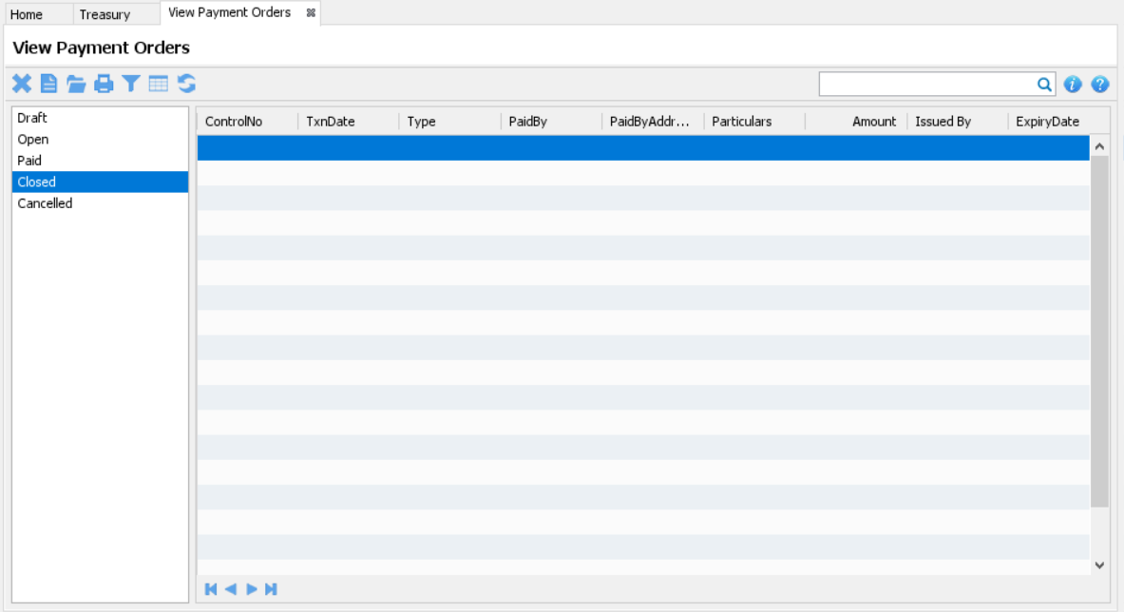
View Payment Orders

Slide 88
Part-1
Create Payment Order
Go to “Home-> Treasury”
Under “Management” category, click “View Payment Orders”
Click icon to create
From the “Select Type” field, choose the type of payment order and click the “Next” button
Fill-in the required fields that are marked with ( * ), while the “Email” and “Mobile No.” fields must be set if used for online payment transaction
Add the applicable accounts in the list together with the amount
Click icon to save
Click the “Approve” button to make the transaction final
You may click the “Send Email” button to send the order slip to the taxpayer
Click icon to to preview the order slip

Slide 89
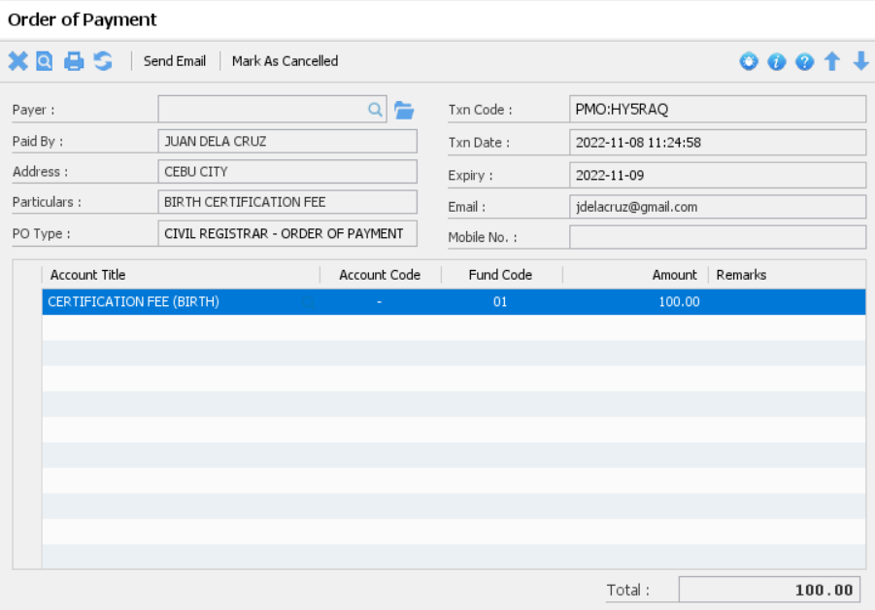
Payment Order

Slide 90
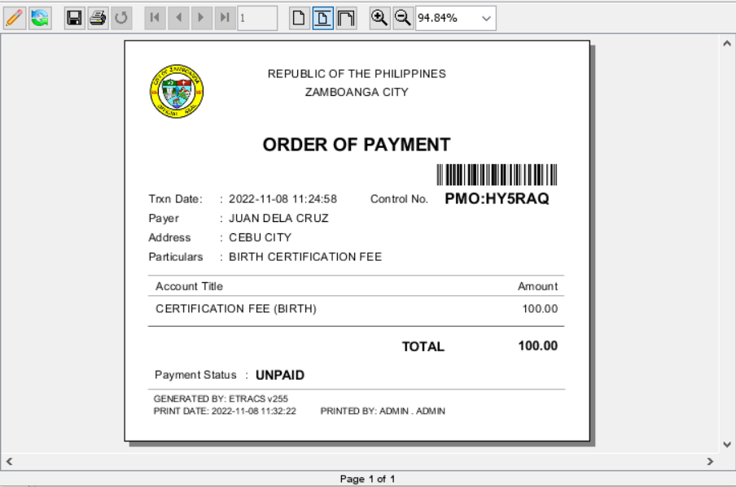
Payment Order Slip

Slide 91
Required Role:
Liquidating Officer Features
Accept Remittance
Liquidation
TREASURY.LIQUIDATING_OFFICER

Slide 92
Accept Remittance
To accept the remittance transaction submitted by the collector
Location:
Home-> Treasury-> Remittance-> Prepare Collection Voucher

Slide 93
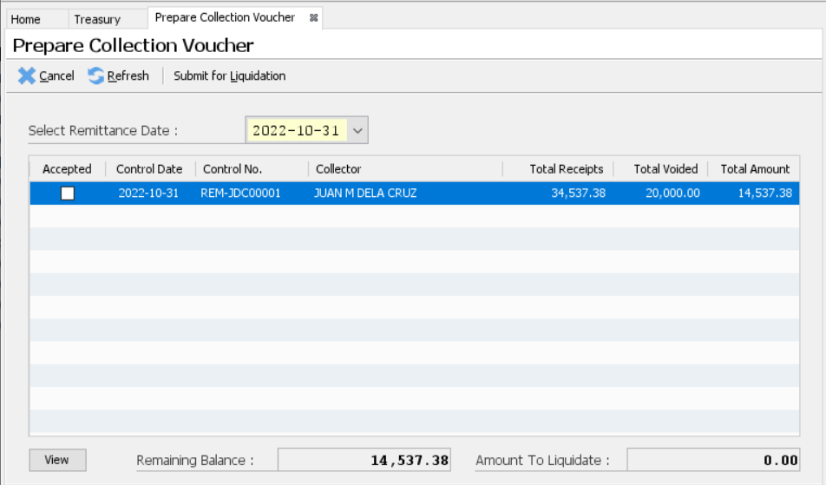
Accept Remittance

Slide 94
Accept Remittance
Go to “Home-> Treasury”
Under “Remittance / Deposit” category, click “Prepare Collection Voucher”
Select an item from the list and click the “View” button to open the remittance RCD information
Click the “Accept” button to marked the transaction as accepted and is ready for liquidation
Repeat Step-3 until all items are as accepted

Slide 95
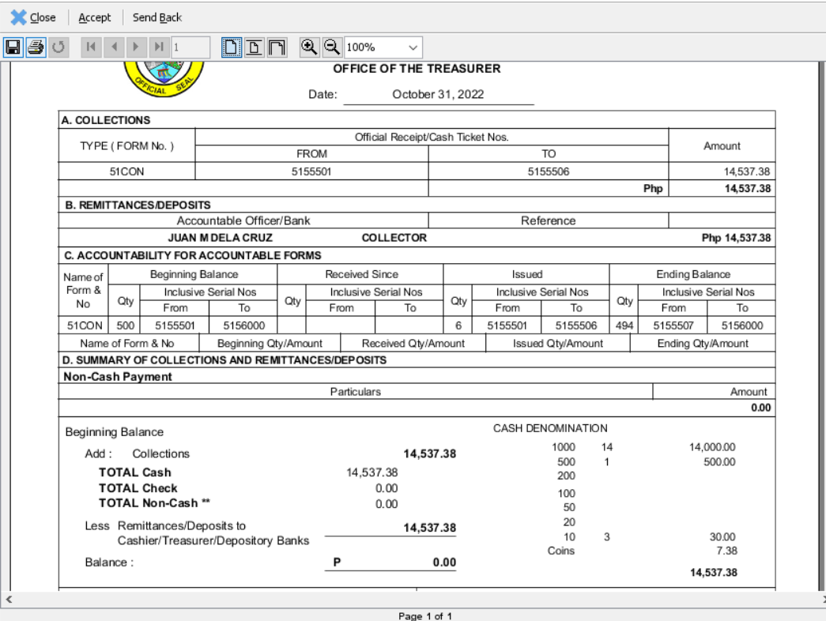
Accept Remittance

Slide 96
Liquidation
To liquidate accepted remittances
Location:
Home-> Treasury-> Remittance-> Prepare Collection Voucher

Slide 97
Liquidation
Go to “Home-> Treasury”
Under “Remittance / Deposit” category, click “Prepare Collection Voucher”
Review all accepted remittances
Click the “Submit for Liquidation” button
A temporary Collection Voucher record is created that needs to be reviewed
Click the “Post” button
An official control number is created after successfully posted.

Slide 98
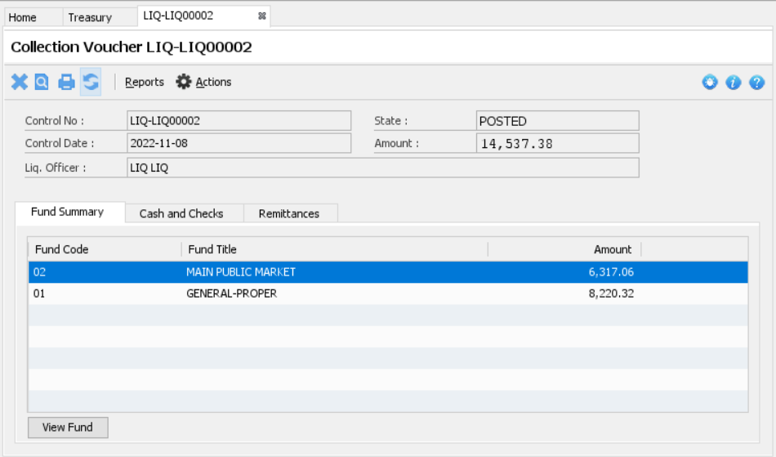
Liquidation

Slide 99
Required Role:
Cashier Features
Prepare Deposit
Print Deposit Slip
Validate Deposit
TREASURY.CASHIER

Slide 100
Prepare Deposit Voucher
Part -1
Go to “Home-> Treasury”
Under “Remittance / Deposit” category, click “Prepare Deposit Voucher”
Select the items you want to deposit
Click the “Submit” button to proceed
In the “Funds” tab, select and open the item
In the “Deposit Slips” tab, click the “Add Deposit Slip” button
Fill in the required fields that are marked with ( * )
Select the necessary Checks to be included in the deposit slip and adjust the Cash Breakdown
Click the “Save” button to proceed
Repeat Step-6 if you want to create another deposit slip
Proceed to the Next Slide…

Slide 101

Prepare Deposit Voucher
Part -2
In the “Deposit Slips” tab, select an items and then click the “Approve for Printing” button
Print the deposit slip of each item by clicking the “Print” button
Click the “Mark as Printed” button for each item
After depositing to bank, go back to this step to validate each item by clicking the “Validate” button
Click icon to close the Deposit Voucher Fund screen
Repeat Step-5 until all items have their own deposit slips created
When all deposit slips are validated, you may now click the “Post” button

Slide 102
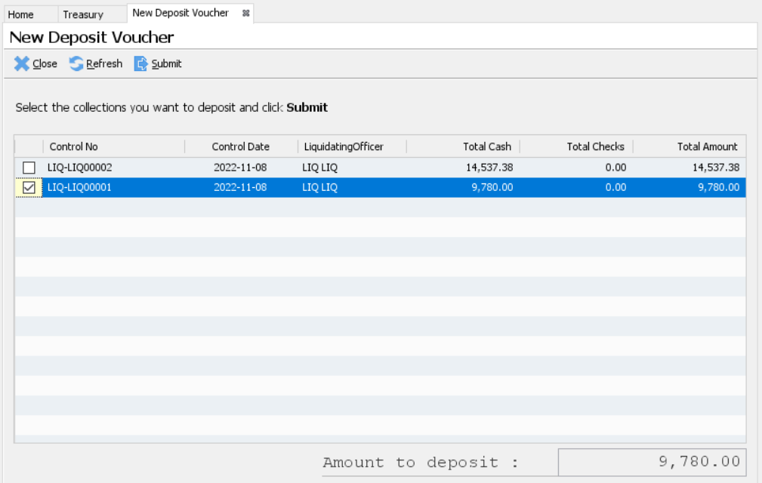
Prepare Deposit Voucher

Slide 103

Deposit Voucher

Slide 104

Deposit Voucher Fund

Slide 105

Deposit Slip

Slide 106
Up Next BPLS

