Slide 1

Business Permit and Licensing Module

Slide 2
Features
Master Data
Capture Application
Online Application
Assessment
Business Ledger
Business Permit Issuance
Business Rules
Red Flags
Reports

Slide 3
Roles

Slide 4
Domain
BPLS
Roles
ADMIN
MASTER
RULE_AUTHOR
BUSINESSINFO
ASSESSOR
APPROVER
LICENSING
SHARED
REPORT
EXT
RECORD_ADMIN
ONLINE_DATA_APPROVER

Slide 5
Domain
BPLS
Roles ( for other offices )
OBO
MHO / CHO
MPDO / CPDO
BFP
AGRI
VET
TOUR

Slide 6
Home Screen and Menus

Slide 7
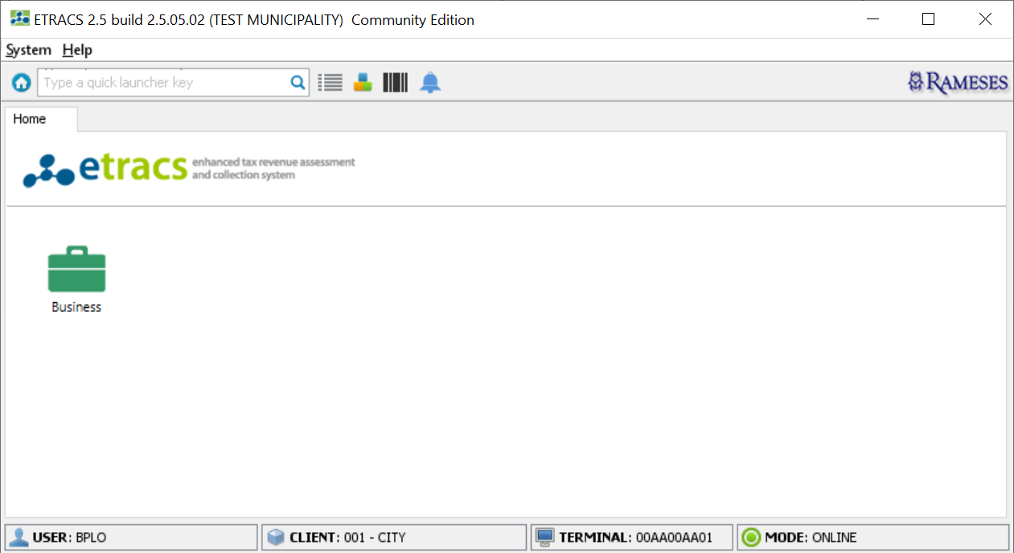
Home Screen

Slide 8
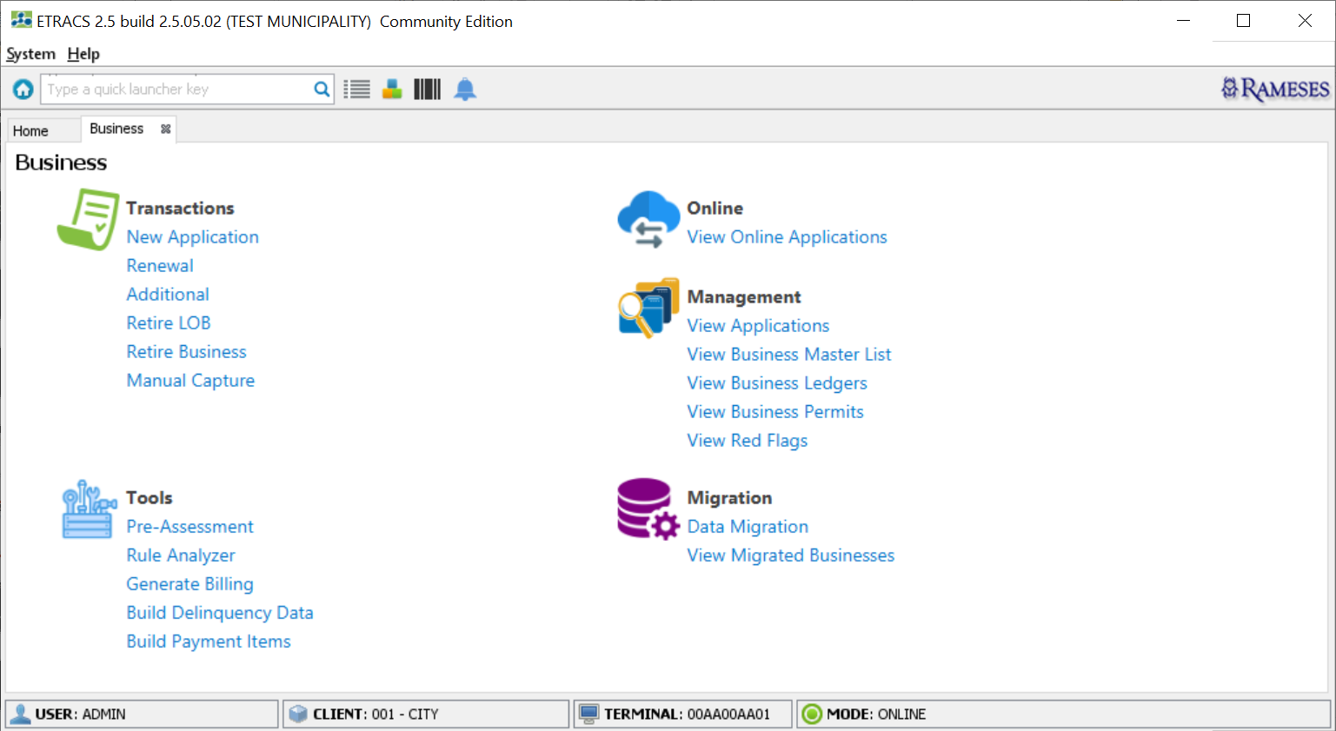
Business Menus

Slide 9
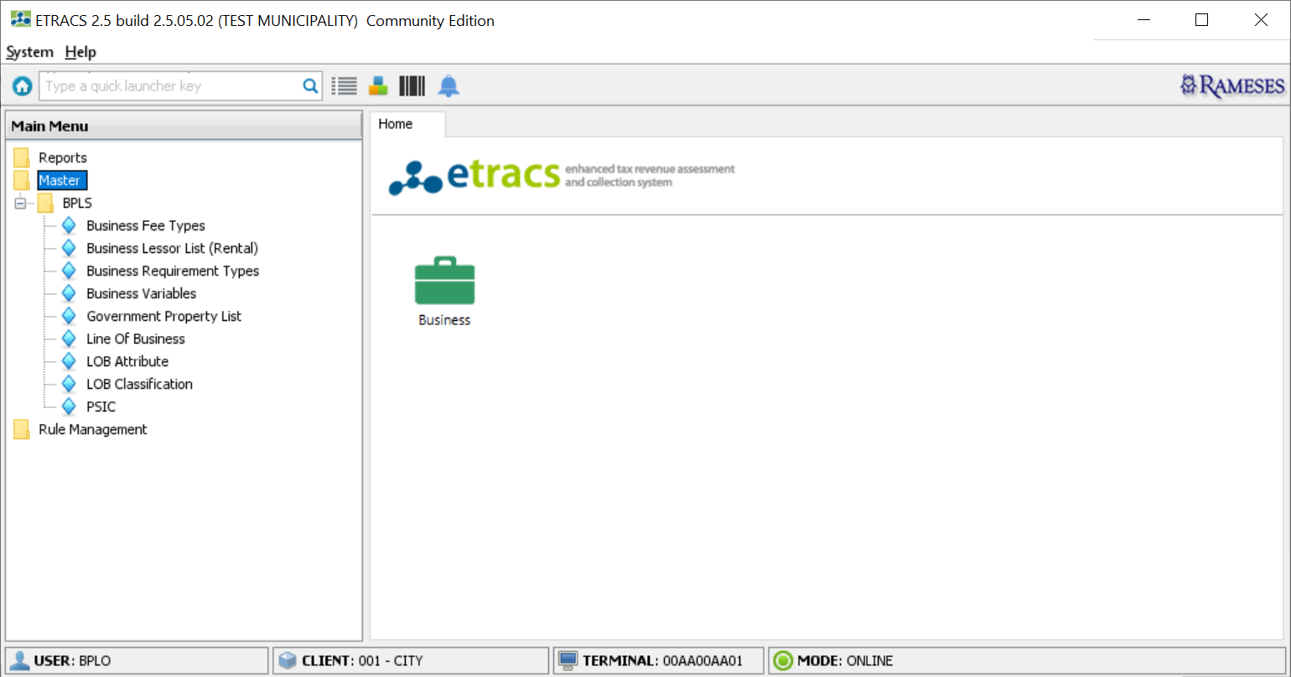
Master Menu

Slide 10
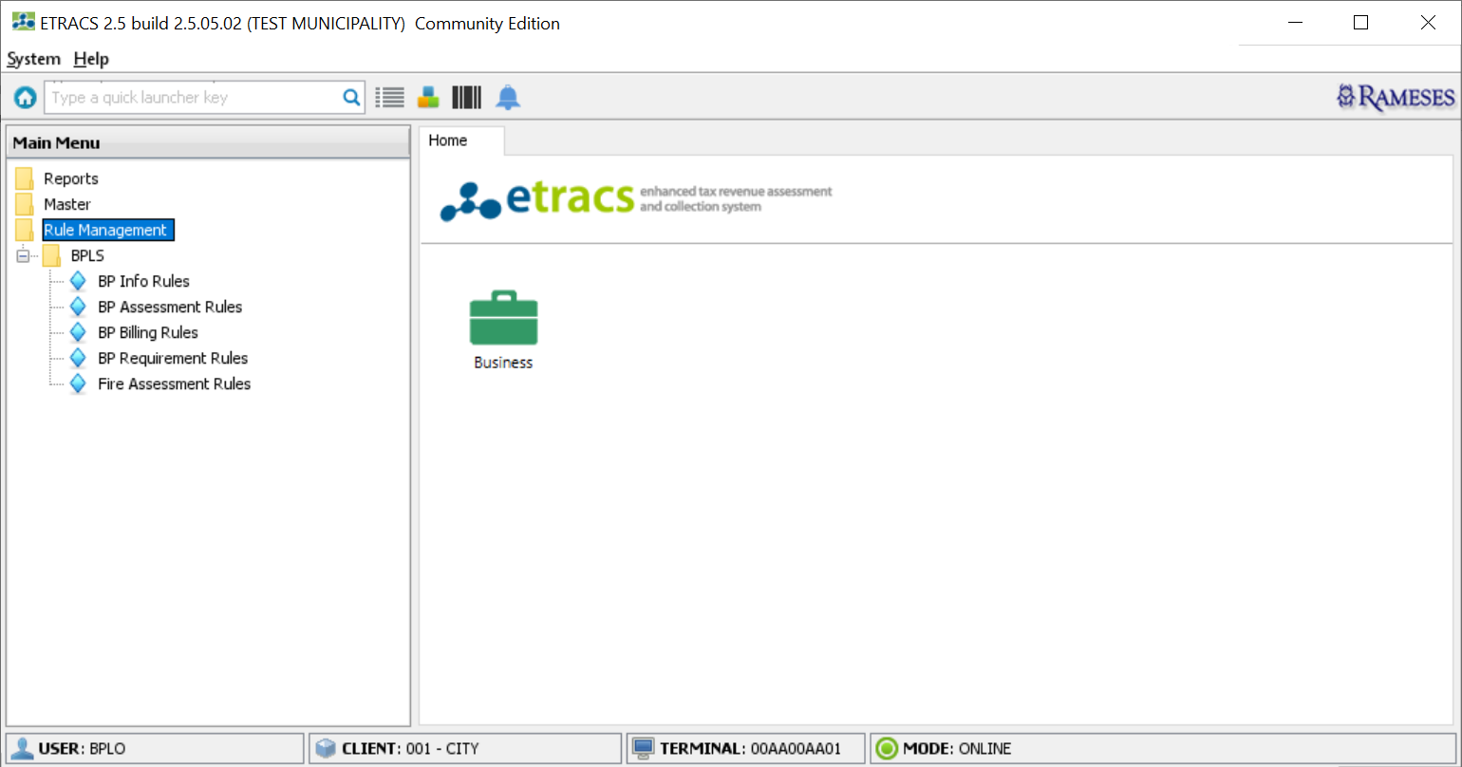
Rule Management Menu

Slide 11
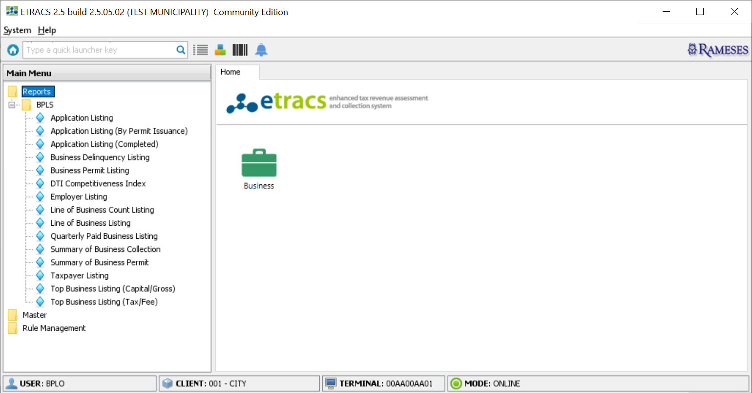
Reports Menu

Slide 12
Activity-01:

Slide 13
Create Users
MASTER
BPLS.MASTER
LICENSING
BPLS.LICENSING
BPLS.SHARED
BPLS.REPORT
ASSESSMENT OFFICER
BPLS.ASSESSOR
BPLS.SHARED
BPLS.REPORT
BPLS.RULE_AUTHOR
APPROVING OFFICER
BPLS.APPROVER
BPLS.SHARED
BPLS.REPORT
ENCODER
BPLS.RECORD_ADMIN
BPLS.BUSINESSINFO
BPLS.SHARED
BPLS.REPORT
ENTITY.MASTER

Slide 14
Create Users
Engineering Office
BPLS.SHARED
BPLS.OBO
BPLS.EXT
Health Office
BPLS.SHARED
BPLS.MHO
Zoning
BPLS.SHARED
BPLS.MPDO
Bureau of Fire
BPLS.SHARED
BPLS.BFP

Slide 15
Master Data

Slide 16
Master Data
Business Classification
Line of Business
LOB Attribute
Business Variable
Business Requirement Type
Business Lessor List
Government Property List
BP Expiry Date

Slide 17
Business Classification
Identifies the classification of LOB
System Defined
Location:
Main Menu-> Master-> BPLS-> LOB Classification

Slide 18
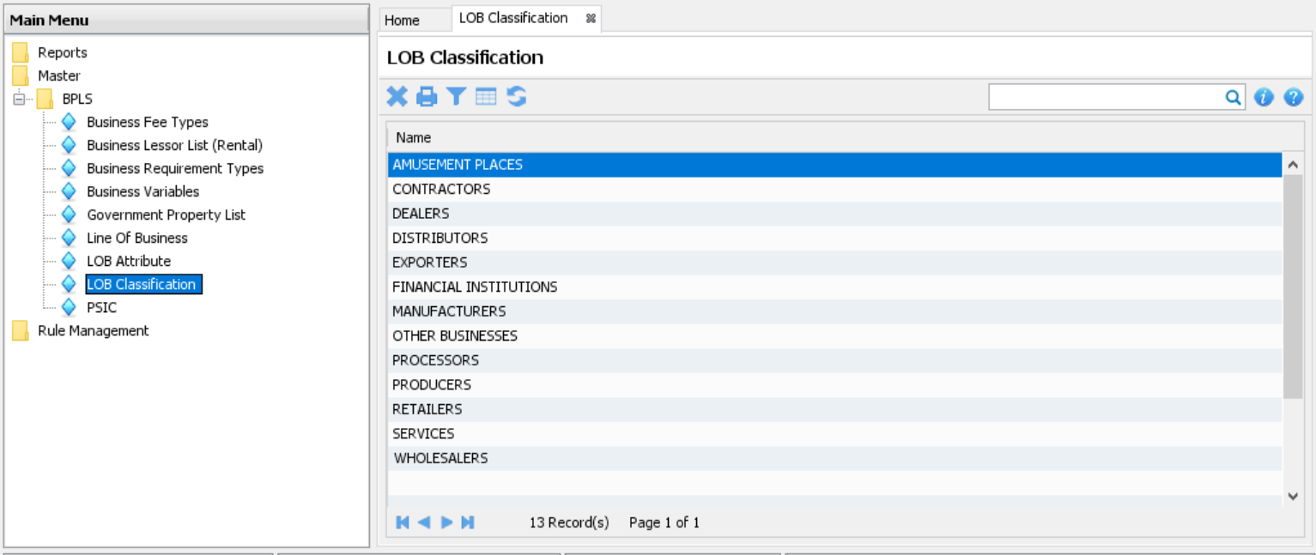
Business Classification

Slide 19
Line of Business
Line of Business operated
Location:
Main Menu-> Master-> BPLS-> Line Of Business

Slide 20
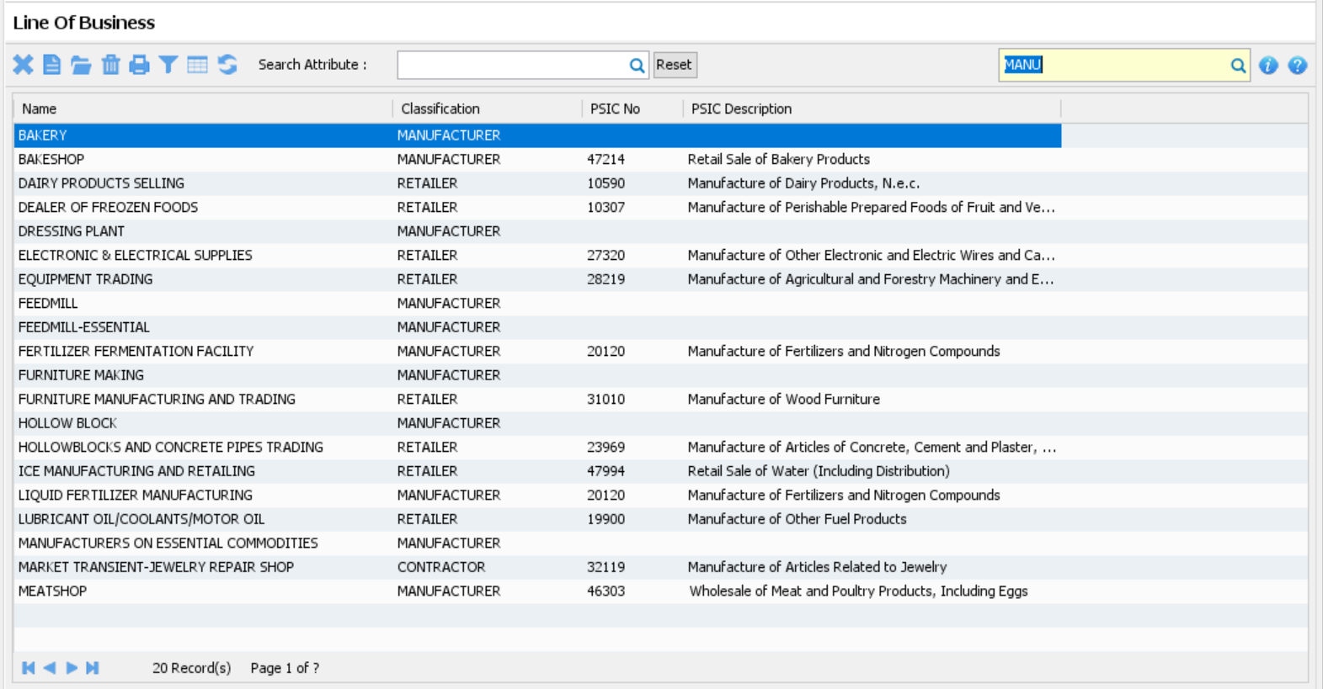
Line of Business

Slide 21
Activity-02

Slide 22
Activity-02: Create LOBs
Create a new Line of Business
Create a mapping to PSIC
Update existing Line of Business

Slide 23
LOB Attribute
Extended information or tags attached to the LOBs
Location:
Main Menu-> Master-> BPLS-> LOB Attribute

Slide 24
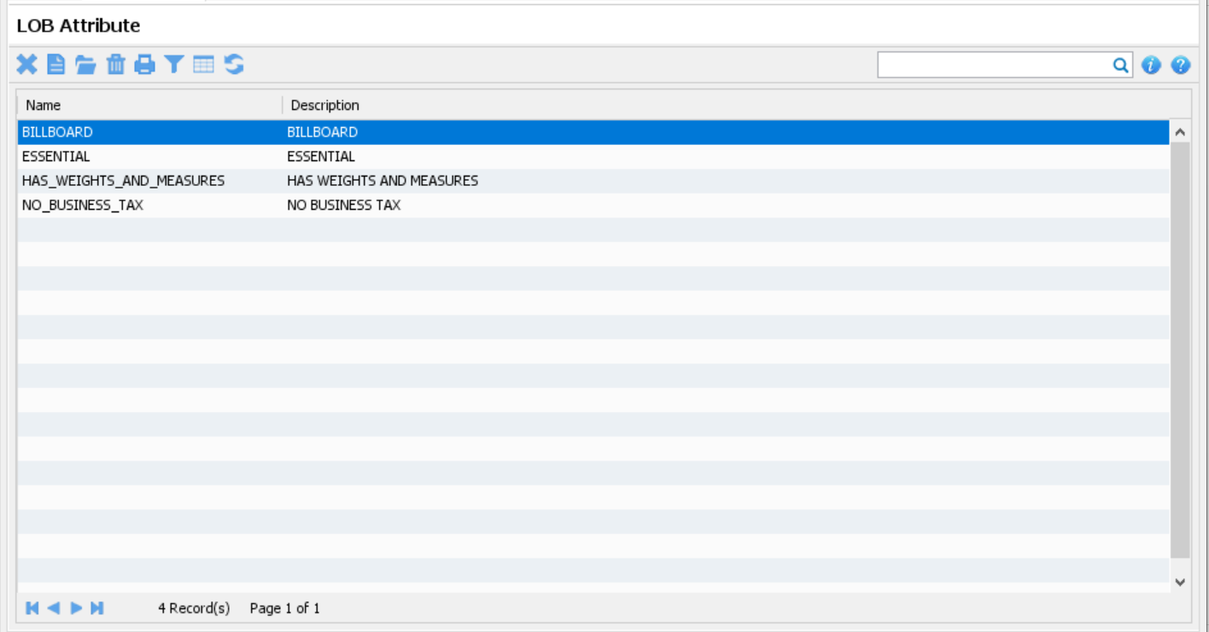
LOB Attribute

Slide 25
Business Variable
A named unit of data that has a value assigned to it.
Location:
Main Menu-> Master-> BPLS-> Business Variables

Slide 26
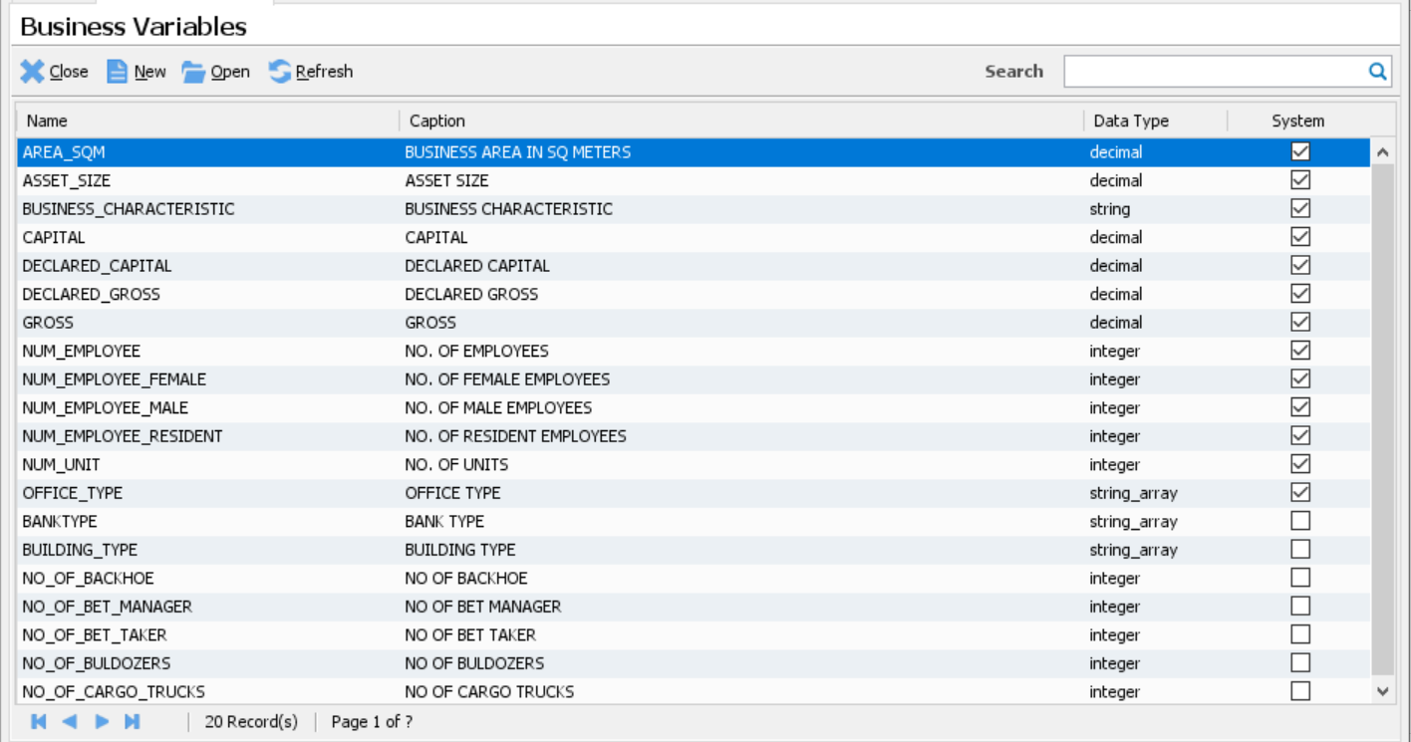
Business Variable

Slide 27
Business Requirement Type
Documents required in the application
Displayed in the Unified Application Form
Location:
Main Menu-> Master-> BPLS-> Business Requirement Types

Slide 28
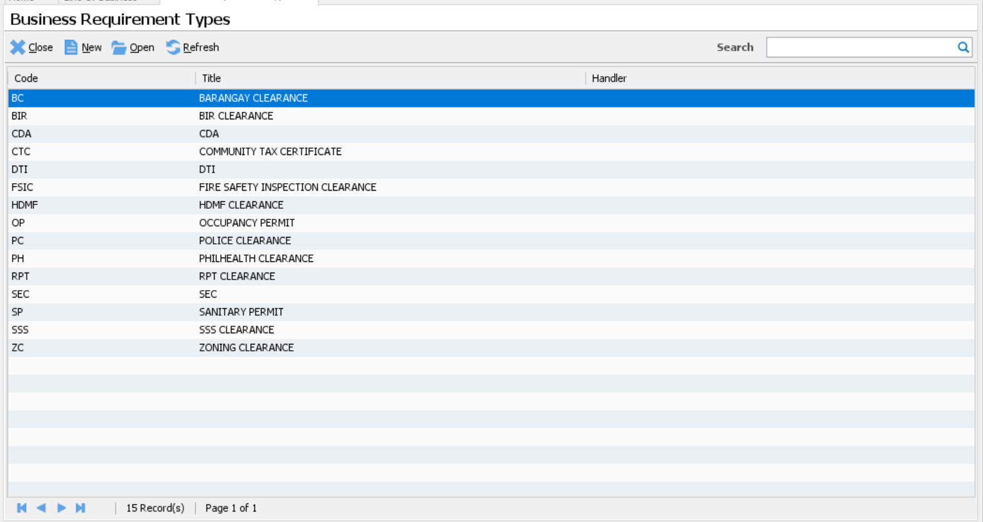
Business Requirement Types

Slide 29
Activity-03: Encode Requirement Types
Remove the unnecessary requirement types
Create a new requirement type
Update existing requirement type

Slide 30
Business Lessor List
Records the Building Name and Address information together with the owner
The owner must have a record in the Profile list
Location:
Main Menu-> Master-> BPLS-> Business Lessor List

Slide 31
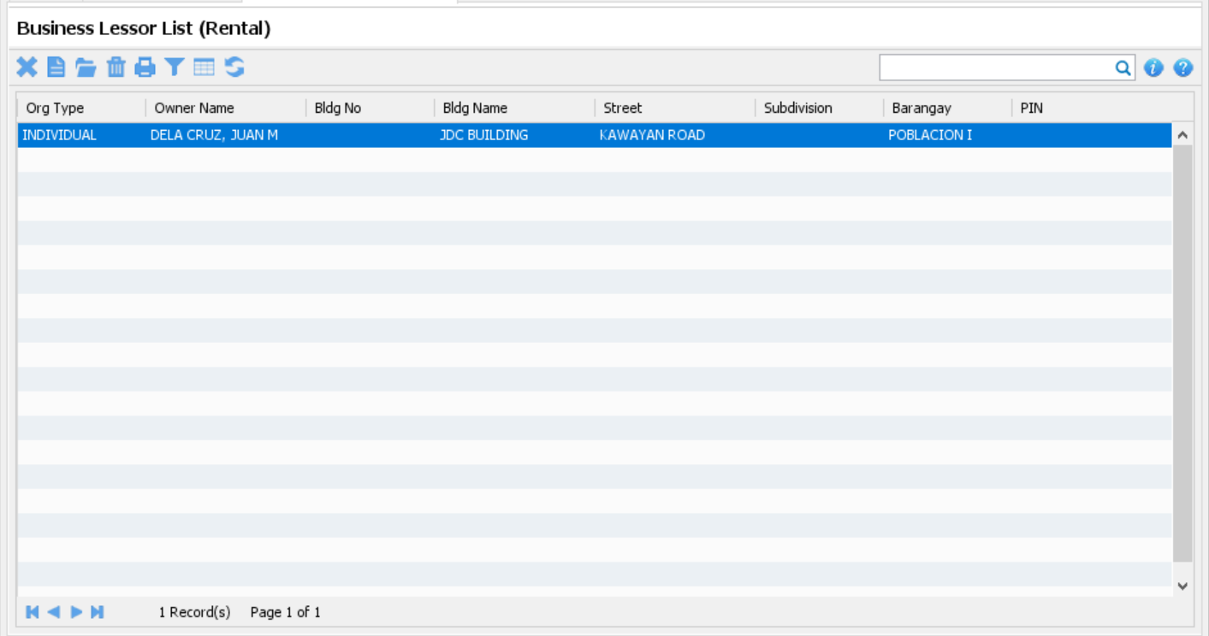
Business Lessor List

Slide 32
Government Property List
Records the Building Name and Address information owned by the government
Location:
Main Menu-> Master-> BPLS-> Government Property List

Slide 33
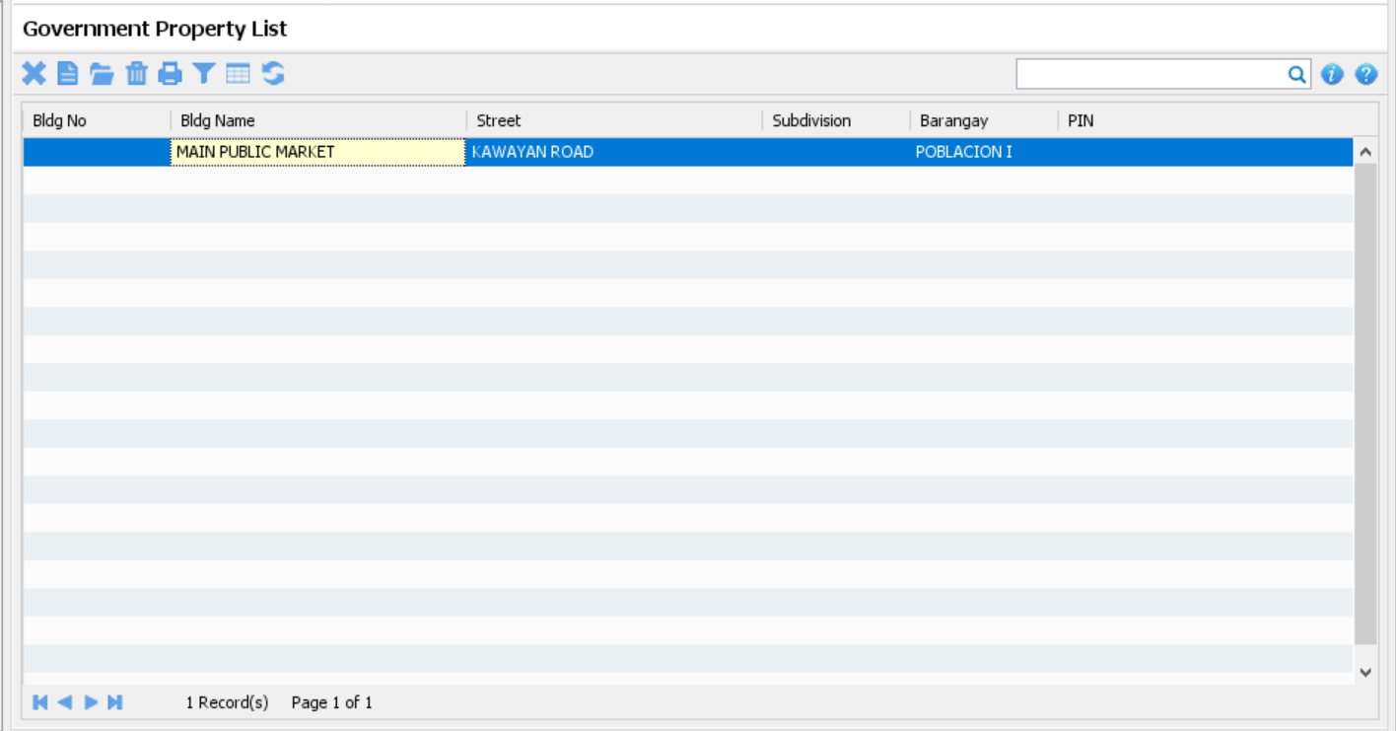
Government Property List

Slide 34
Business Fee Types
Records the applicable fees associated to a particular Domain and Role, such as fees from the Engineering Office, Health Office, Zoning, etc…
Location:
Main Menu-> Master-> BPLS-> Business Fee Types

Slide 35
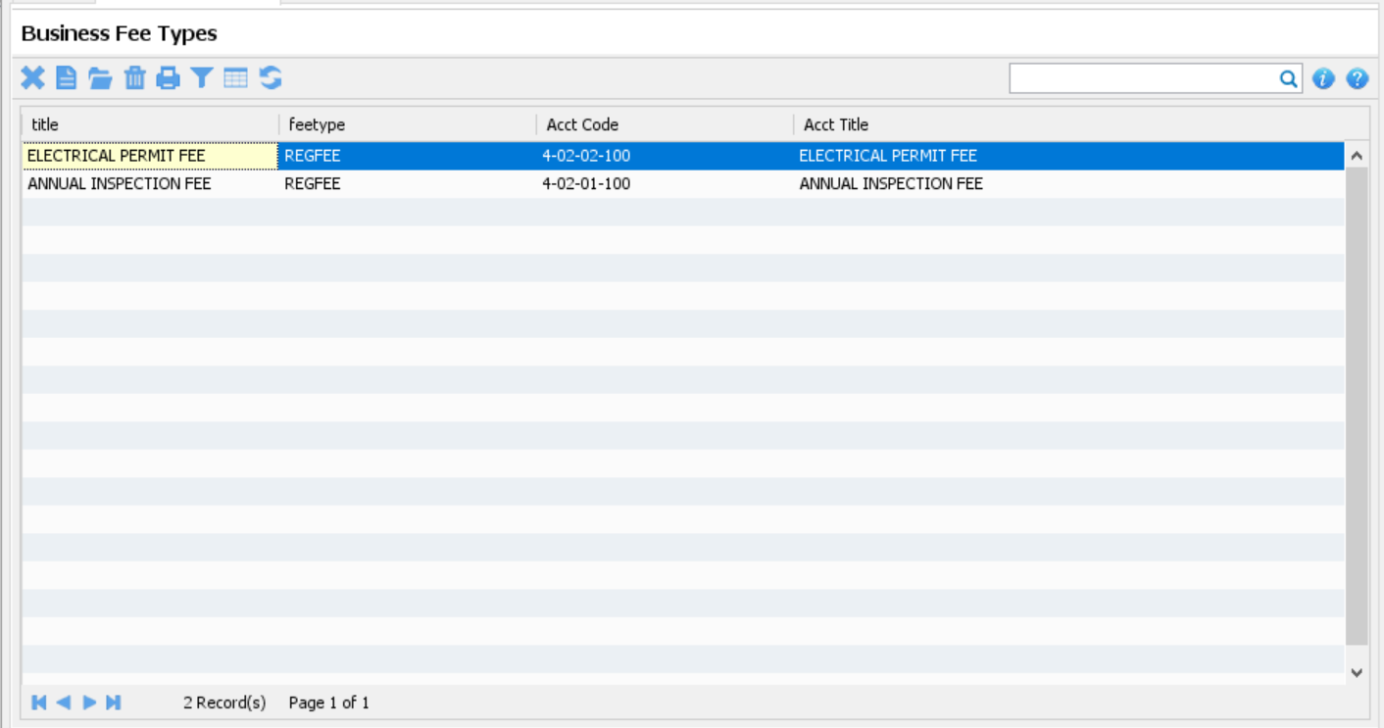
Business Fee Types

Slide 36
PSIC
A detailed classification of industries according to its kind of productive activities undertaken by the establishments
Location:
Main Menu-> Master-> BPLS-> PSIC

Slide 37
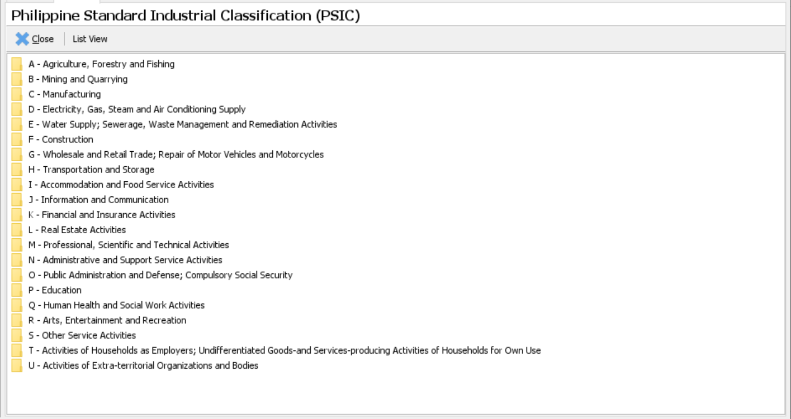
PSIC

Slide 38
Business Expiry Dates
Records the override value of the quarterly due dates
Location:
Main Menu-> Master-> BPLS-> BP Expiry Dates

Slide 39
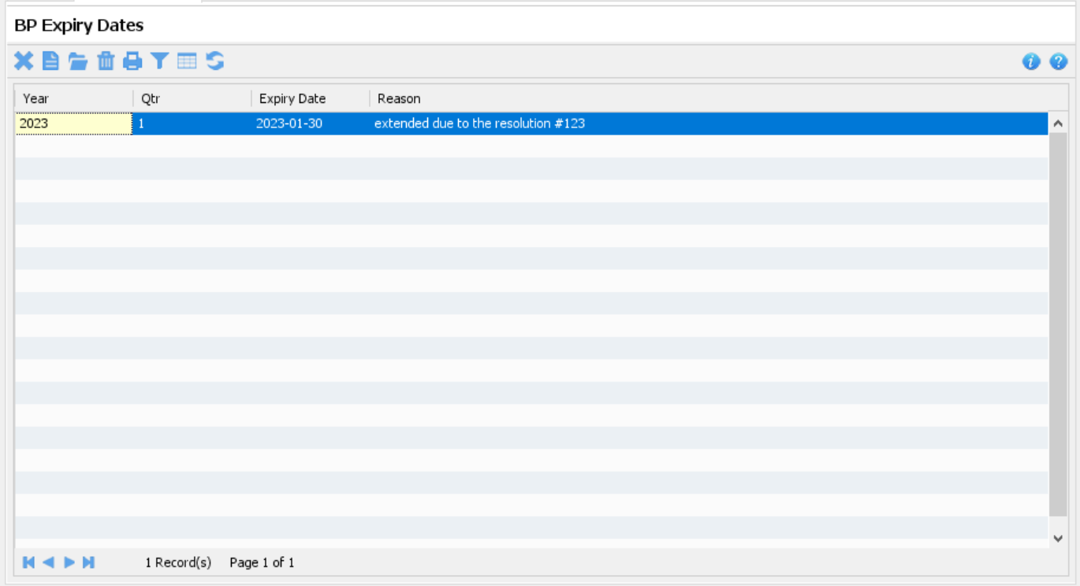
Business Expiry Dates

Slide 40
Capture Application

Slide 41
Capture Application
Manual Capture
Encode the information of a particular business application
Location:
Home-> Business-> Transactions-> Manual Capture
Data Migration
Migrates a business application from another system going to ETRACS system
Location:
Home-> Business-> Migration-> Data Migration

Slide 42
Manual Capture Demo

Slide 43
Activity-04
Capture a NEW application that is already active for the current year

Slide 44
Activity-05
Capture a renewal application that is already active for the current year

Slide 45
Activity-06
Capture an application that has not renewed for the current year

Slide 46
Activity-07
Capture an application that is not registered in the system but is already operating

Slide 47
Business Rules Management

Slide 48
Getting To Know Rules
Business Rules uses a Rule-Engine
A Rule-Engine is an expert-system program, which runs the rules on the data and if any condition matches then it executes the corresponding actions

Slide 49

Terminologies
Rule
It is a set of conditions followed by the set of actions
It contains mainly two parts, condition, and action
The condition also knows as a fact or antecedents or patterns. And action also knows as a consequent.

Slide 50
Terminologies
Human expert
A person who is an expert in a corresponding business domain and provides knowledge in the form of rules
Expert System
It is a program that uses the knowledge of a human expert to solve the problems and giving a solution

Slide 51
Terminologies
Inference Engine
It is a brain of expert-system which manage a large number of rules and facts inside the expert system
Its job is picking rules and applying on data and generate a solution

Slide 52
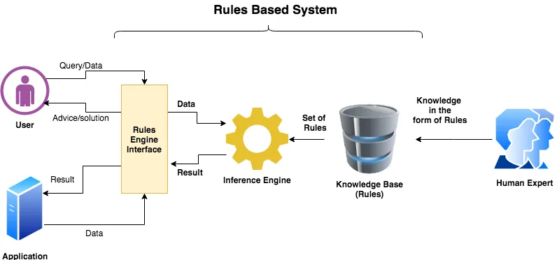
Rule-Engine Diagram

Slide 53
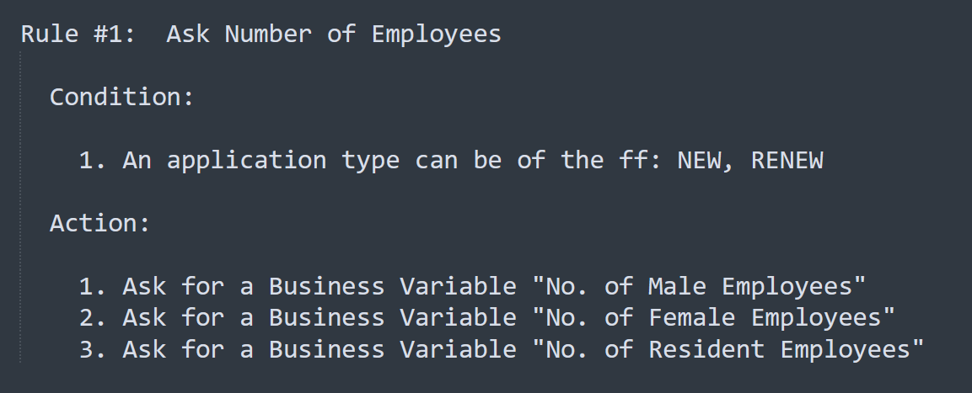
Knowledge in the form of rules

Slide 54
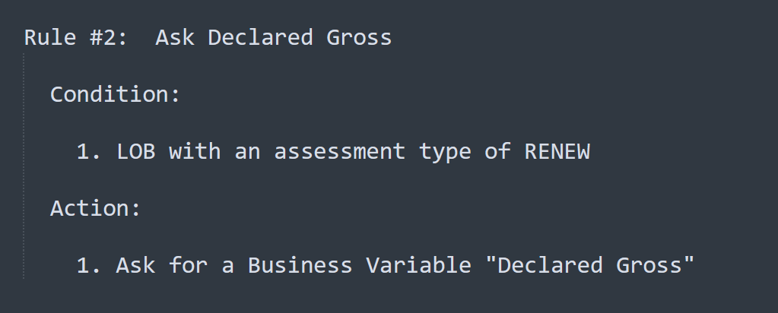
Knowledge in the form of rules

Slide 55
Advantages of Rule-Engine
Greater Flexibility
Keeping your rules into a Knowledge Base lets you adapt easily to your decisions when they are changing
Easy to Understand
Rules are easy to understand as compared to other business logic.
And this also creates a bridge between Business Analyst and Developers to understand and implement the business logic.

Slide 56
Advantages of Rule-Engine
Reduced Complexity
It reduced the complexity as we no longer need to build the rule engine logic in the source
Reusability
By keeping rules in one place leads to greater reusability of your business rules

Slide 57
Business Ruleset

Slide 58
Business Ruleset
BP Info Rules
Collects initial information to be used in the assessment rules
BP Assessment Rules
Computes Tax, Regulatory Fees and Other Charges
BP Billing Rules
Computes Surcharge and Interest
Determines the Quarterly Due Dates
Determines the Bill Expiry Date

Slide 59
Business Ruleset
BP Requirement Rules
Determines the documents required in the application
Fire Assessment Rules
Computes fees related to BFP

Slide 60
Business Rule Analyzer

Slide 61
Business Rule Analyzer
A simulator to run, test and evaluates the result of the rules configured under the different rulesets
Location:
Home-> Business-> Tools-> Rule Analyzer

Slide 62
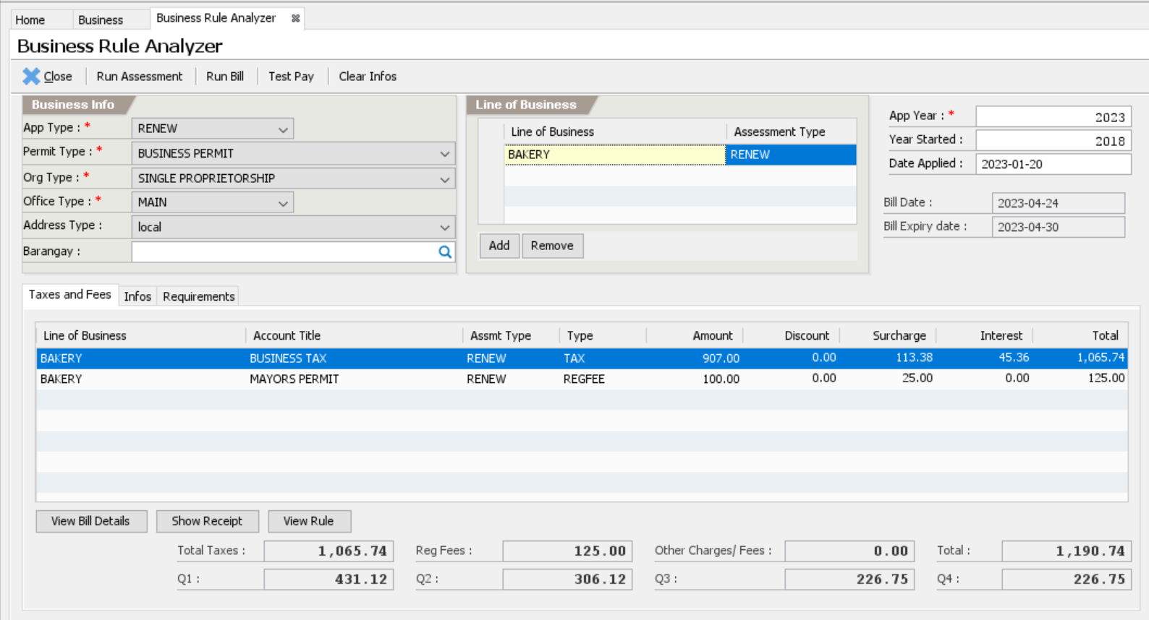
Business Rule Analyzer

Slide 63
Demo: BP Info Rules

Slide 64
Demo: BP Assessment Rules

Slide 65
Demo: BP Billing Rules

Slide 66
Demo: BP Requirement Rules

Slide 67
Demo: Fire Assessment Rules

Slide 68
Activity-08
Translate the LGU Business Ordinance into Business Rules and configure the Conditions and Actions to meet the correct computation of fees as stated in the ordinance.

