Slide 1
Online Application

Slide 2
Online Application
New
Used to register a new business entity
Location:
Home-> Business-> Transactions-> New Application
Renewal
Used to renew an existing business entity
Location:
Home-> Business-> Transactions- > Renewal

Slide 3
Online Application
Additional
Used to add a new LOB to an existing business entity
Location:
Home-> Business-> Transactions-> Additional
Retire LOB
Used to retire a specific LOB to an existing business entity
Location:
Home-> Business-> Transactions- > Retire LOB

Slide 4
Online Application
Retire Business
Used to retire an existing business entity
Location:
Home-> Business-> Transactions-> Retire Business

Slide 5
Online Application Process Flow

Slide 6
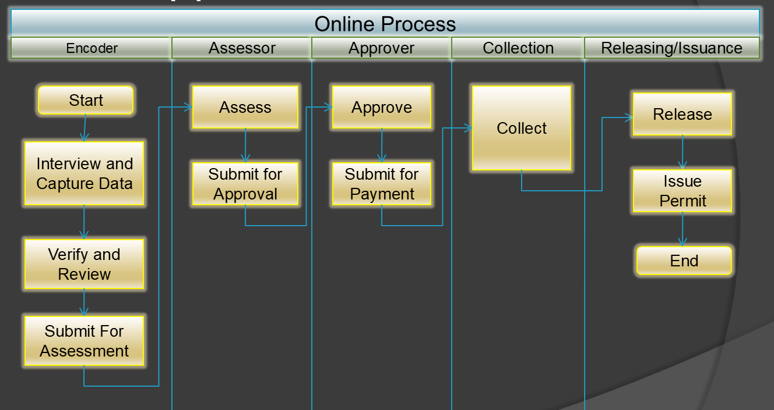
Online Application Process Flow

Slide 7
Activity-09
Create a New Application

Slide 8
Encoder Creates New Application
Open the “New Application” screen
Enter the Business Name and Trade Name
Find or create a Business Owner
Enter the Business Location
Enter the Contact information
Add the necessary LOBs
Fill-in the Business Infos
Review the required docs
Review and Confirm all information
Submit the application

Slide 9
OBO Assess The Application
Open the application from the notification menu or go to Home-> Business-> Management-> View Applications and click the Engineering folder
Click the Assign To Me button
Click the Recurring Fees menu item
Click the Add Fee button
After completely added the fees, click the Submit button

Slide 10
MHO Assess The Application
Open the application from the notification menu or go to Home-> Business-> Management-> View Applications and click the MHO folder
Click the Assign To Me button
Click the MHO Fees menu item
Click the Add Fee button
After completely added the fees, click the Submit button

Slide 11
MPDO Assess The Application
Open the application from the notification menu or go to Home-> Business-> Management-> View Applications and click the MPDO folder
Click the Assign To Me button
Click the MPDO Fees menu item
Click the Add Fee button
After completely added the fees, click the Submit button

Slide 12
Assessor Assess The Application
Open the application from the notification menu or go to Home-> Business-> Management-> View Applications and click the Assign Assessor folder
Click the Assign To Me button
Click the Assessment menu item
Click the Assess button and provide the necessary information to output the correct computation of fees
After completely assessed, click the Submit for Approval button

Slide 13
Approver Approves The Application
Open the application from the notification menu or go to Home-> Business-> Management-> View Applications and click the Approval folder
Click the Assign To Me button
Click the Assessment menu item to review the fees
Click the Approve For Payment button

Slide 14
BFP Process the Application
Open the application from the notification menu or go to Home-> Business-> Management-> View Applications and click the BFP folder
Click the Assign To Me button
Compute the fees for payment
Once completed, click the Submit button

Slide 15
Collector Process the Payment
Issue Cash Receipt using the BPLS collection type
Search the particular application to pay or use the barcode feature to open the Bill information right away
Select the Method of Payment
Save the receipt record and print

Slide 16
Licensing Process the Application
Open the application from the notification menu or go to Home-> Business-> Management-> View Applications and click the For Release folder
Review the requirements
After the review, click the Release button
Click the Issue Permit button
Print the permit

Slide 17
Activity-10
Create a Renewal Application

Slide 18
Encoder Creates Renewal Application
Open the “Renewal” screen
Search the Business account
Update the Owner address
Update the Business location
Update the Contact information
Add or Retire a specific LOB if neccessary
Update the Business Infos
Review and Confirm all information
Submit the application

Slide 19
MHO Assess The Application
Open the application from the notification menu or go to Home-> Business-> Management-> View Applications and click the MHO folder
Click the Assign To Me button
Click the MHO Fees menu item
Click the Add Fee button
After completely added the fees, click the Submit button

Slide 20
MPDO Assess The Application
Open the application from the notification menu or go to Home-> Business-> Management-> View Applications and click the MPDO folder
Click the Assign To Me button
Click the MPDO Fees menu item
Click the Add Fee button
After completely added the fees, click the Submit button

Slide 21
Assessor Assess The Application
Open the application from the notification menu or go to Home-> Business-> Management-> View Applications and click the Assign Assessor folder
Click the Assign To Me button
Click the Assessment menu item
Click the Assess button and provide the necessary information to output the correct computation of fees
After completely assessed, click the Submit for Approval button

Slide 22
Approver Approves The Application
Open the application from the notification menu or go to Home-> Business-> Management-> View Applications and click the Approval folder
Click the Assign To Me button
Click the Assessment menu item to review the fees
Click the Approve For Payment button

Slide 23
BFP Process the Application
Open the application from the notification menu or go to Home-> Business-> Management-> View Applications and click the BFP folder
Click the Assign To Me button
Compute the fees for payment
Once completed, click the Submit button

Slide 24
Collector Process the Payment
Issue Cash Receipt using the BPLS collection type
Search the particular application to pay or use the barcode feature to open the Bill information right away
Select the Method of Payment
Save the receipt record and print

Slide 25
Licensing Process the Application
Open the application from the notification menu or go to Home-> Business-> Management-> View Applications and click the For Release folder
Review the requirements
After the review, click the Release button
Click the Issue Permit button
Print the permit

Slide 26
Activity-11
Create an Add LOB Application

Slide 27
Encoder Creates Add-LOB Application
Open the “Additional” screen
Search the Business account
Add the specific LOBs
Fill-in the Business Infos
Review and Confirm all information
Submit the application

Slide 28
Activity-12
Create a Retire LOB Application

Slide 29
Encoder Creates Retire-LOB Application
Open the “Retire LOB” screen
Search the Business account
Mark the LOBs as retire
Fill-in the Business Infos
Review and Confirm all information
Submit the application

Slide 30
Activity-13
Create a Retire Business Application

Slide 31
Encoder Creates Retire Business Application
Open the “Retire Business” screen
Search the Business account
Enter the reason for retirement
Fill-in the Business Infos
Review and Confirm all information
Submit the application

Slide 32
List Management

Slide 33
List Management
View Applications
View Business Master List
View Business Ledgers
View Business Permits
View Red Flags

Slide 34
View Applications
List of business applications for a particular year
Business applications are managed by workflow to identify the tasks that are to be executed
Location:
Home-> Business-> Management-> View Applications

Slide 35
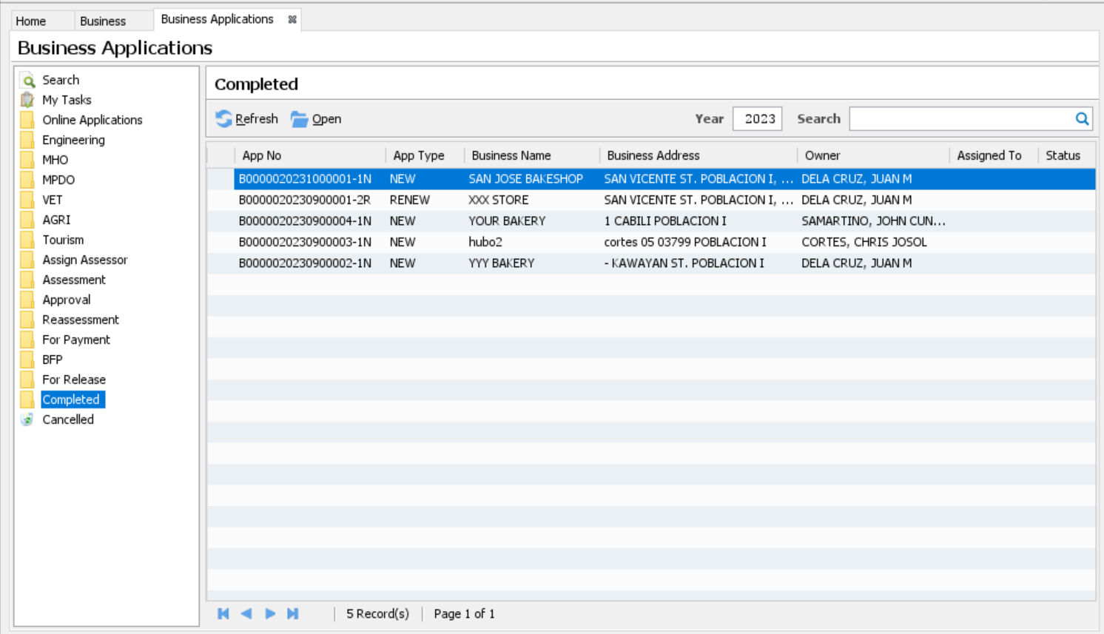
View Applications

Slide 36
View Business Master List
List of all business accounts
Location:
Home-> Business-> Management-> View Business Master List

Slide 37
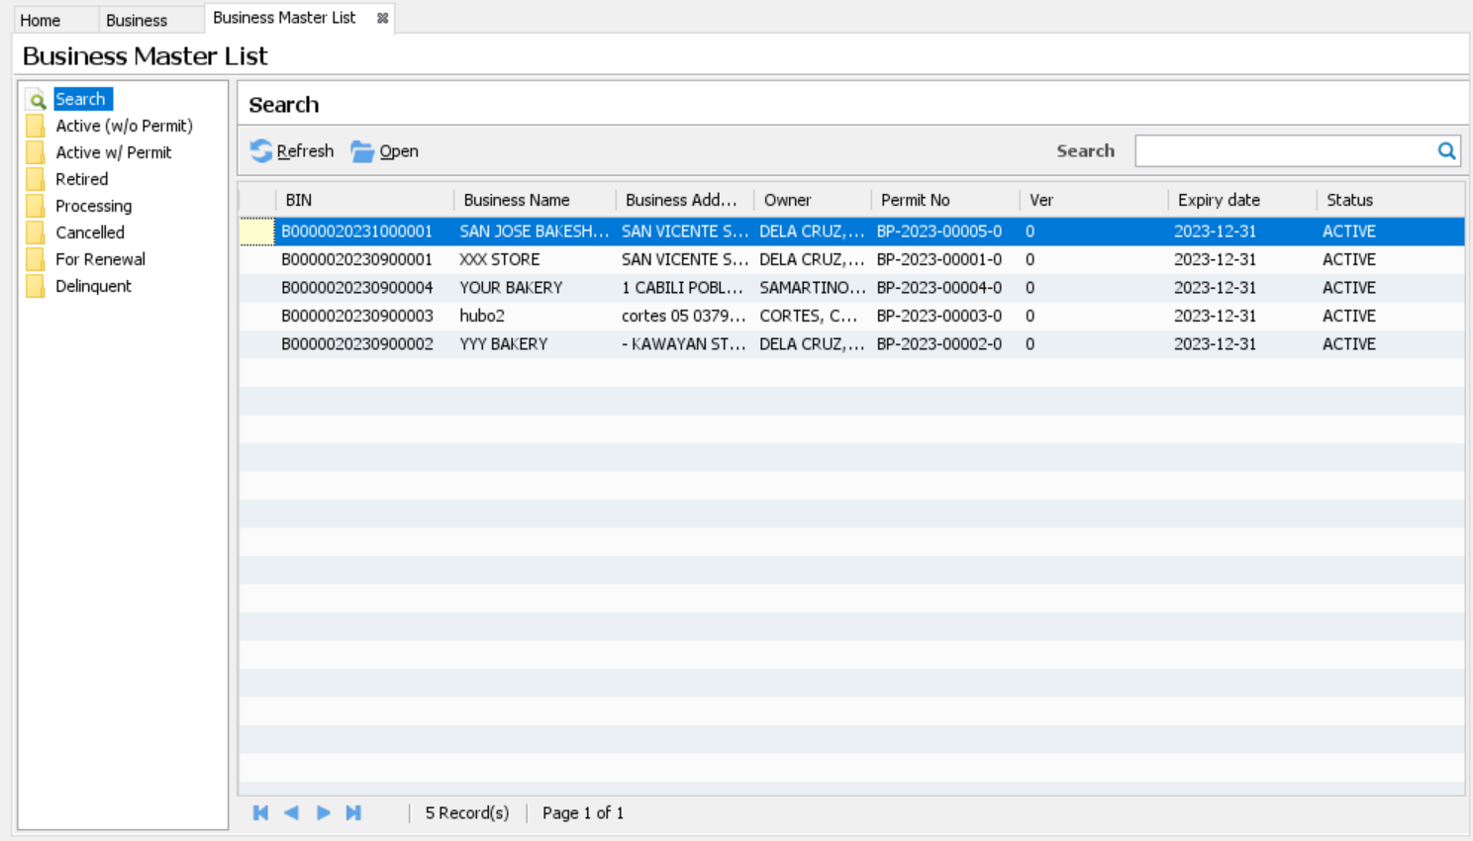
View Business Master List

Slide 38
View Business Ledgers
List of all business ledgers
Location:
Home-> Business-> Management-> View Business Ledgers

Slide 39
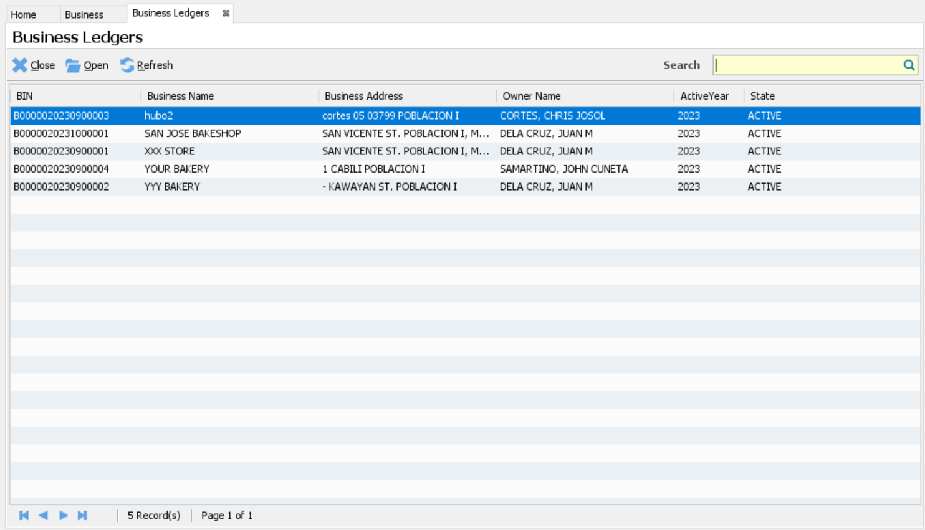
View Business Ledgers

Slide 40
View Business Permits
List of all business permits
Location:
Home-> Business-> Management-> View Business Permits

Slide 41
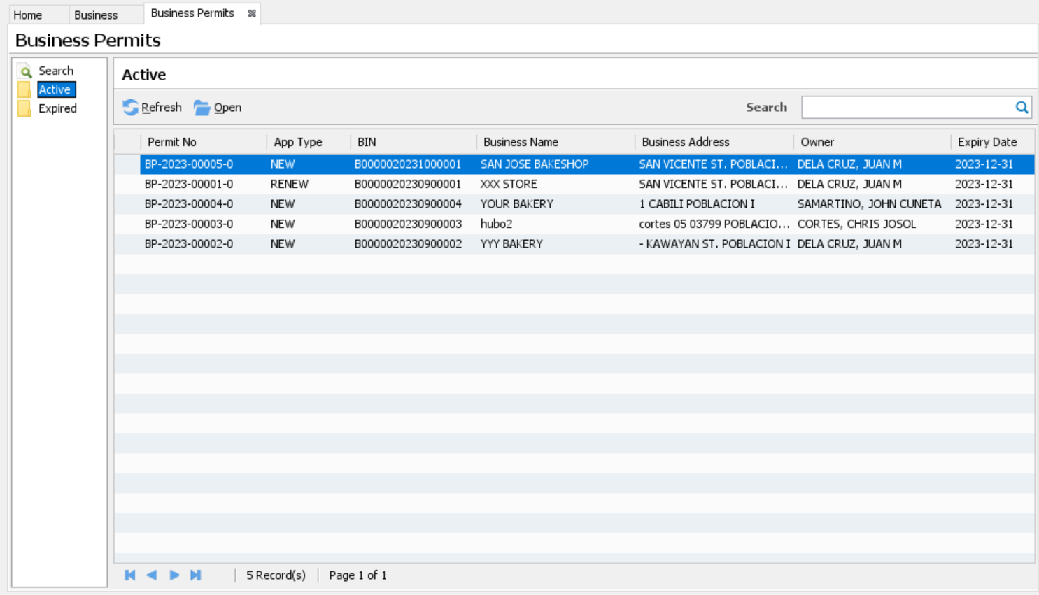
View Business Permits

Slide 42
View Red Flags
List of all cases of red flags
Location:
Home-> Business-> Management-> View Red Flags

Slide 43
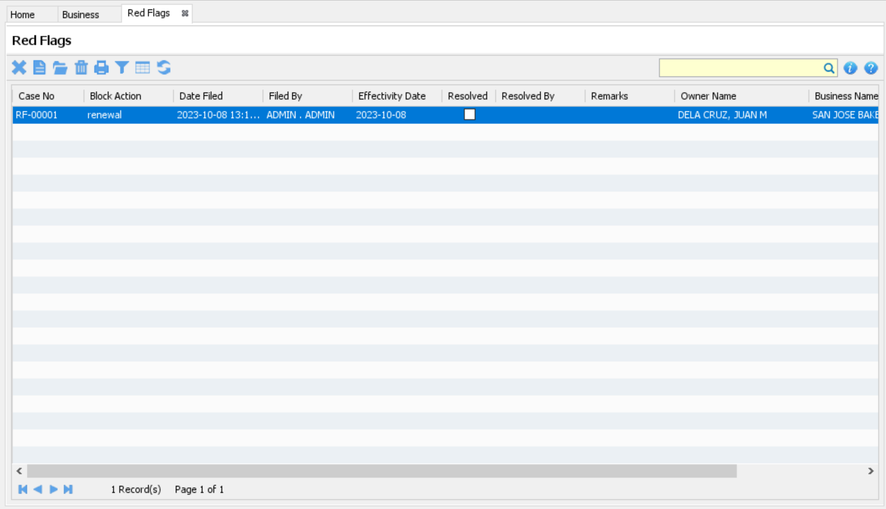
View Red Flags

Slide 44
Tools

Slide 45
Tools
Pre-Assessment
Rule Analyzer
Generate Billing
Build Delinquency Data
Build Payment Items

Slide 46
Pre-Assessment
A tool used to generate an unofficial assessment report based on the preliminary information before the actual renewal of registration process begins
Location:
Home-> Business-> Tools-> Pre-Assessment

Slide 47
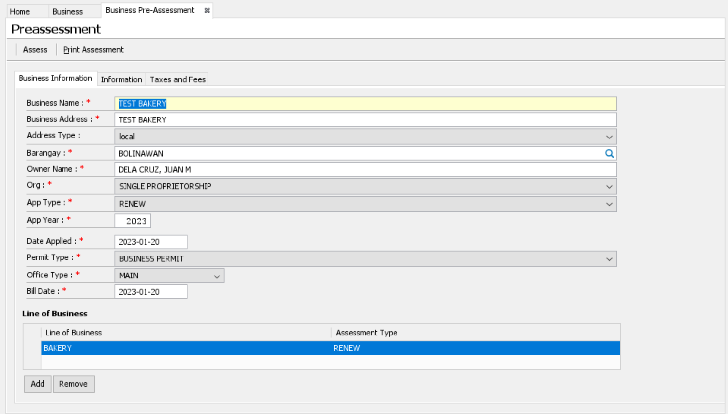
Pre-Assessment

Slide 48
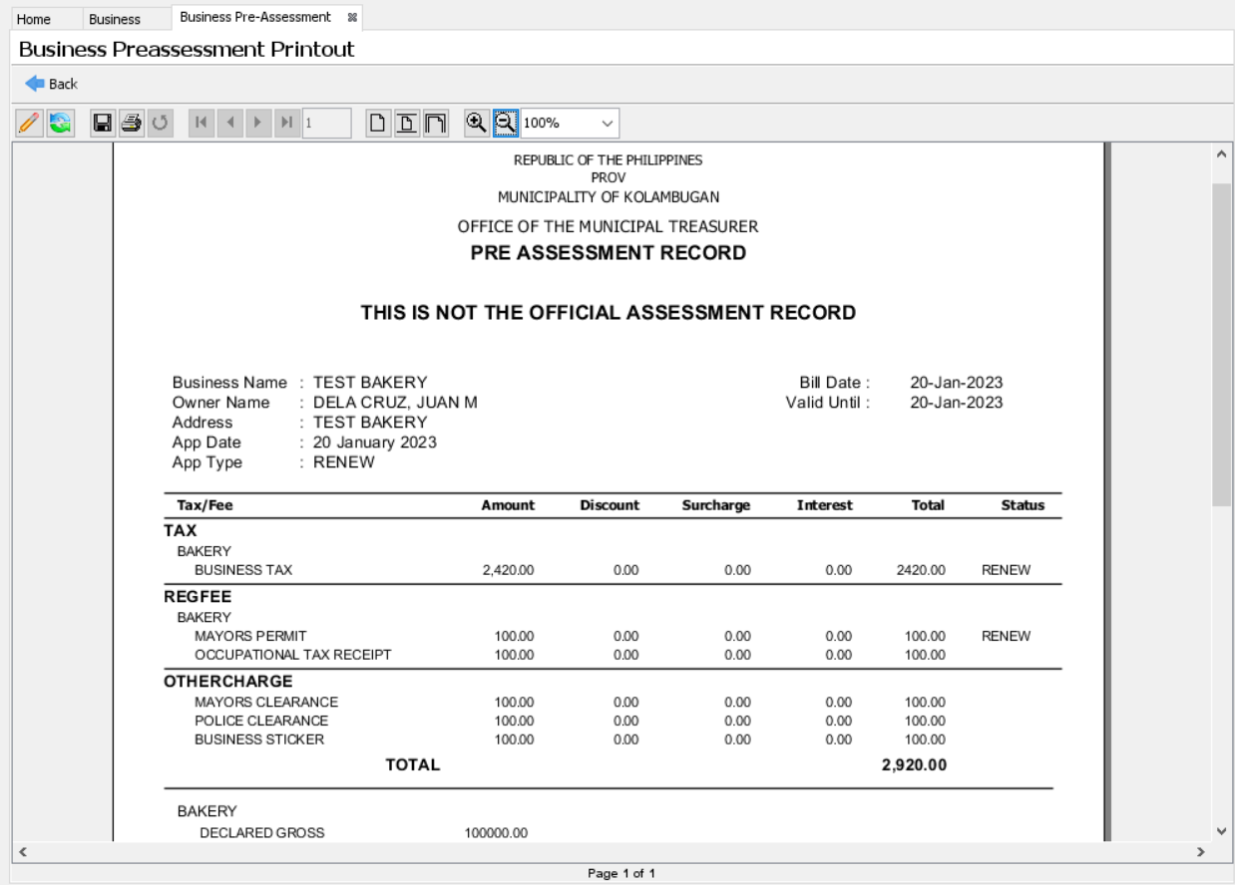
Pre-Assessment

Slide 49
Generate Billing
A tool used to generate a billing statement for a particular business account
Location:
Home-> Business-> Tools-> Generate Billing

Slide 50
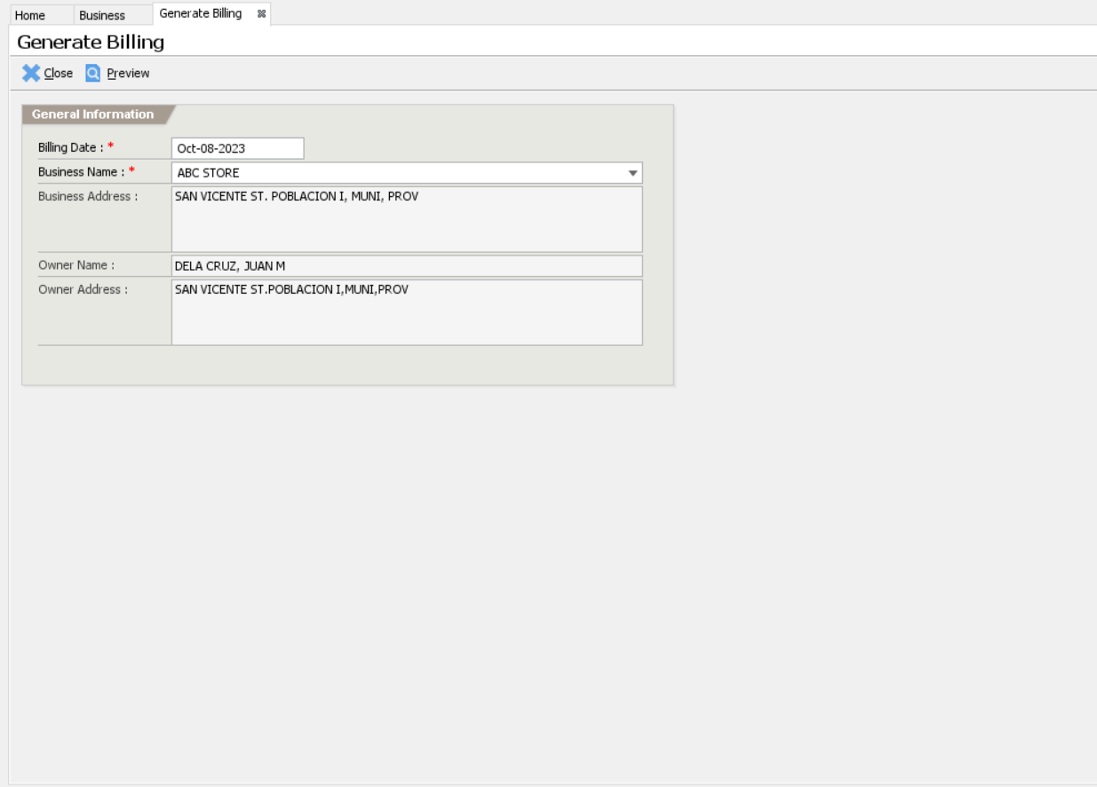
Generate Billing

Slide 51
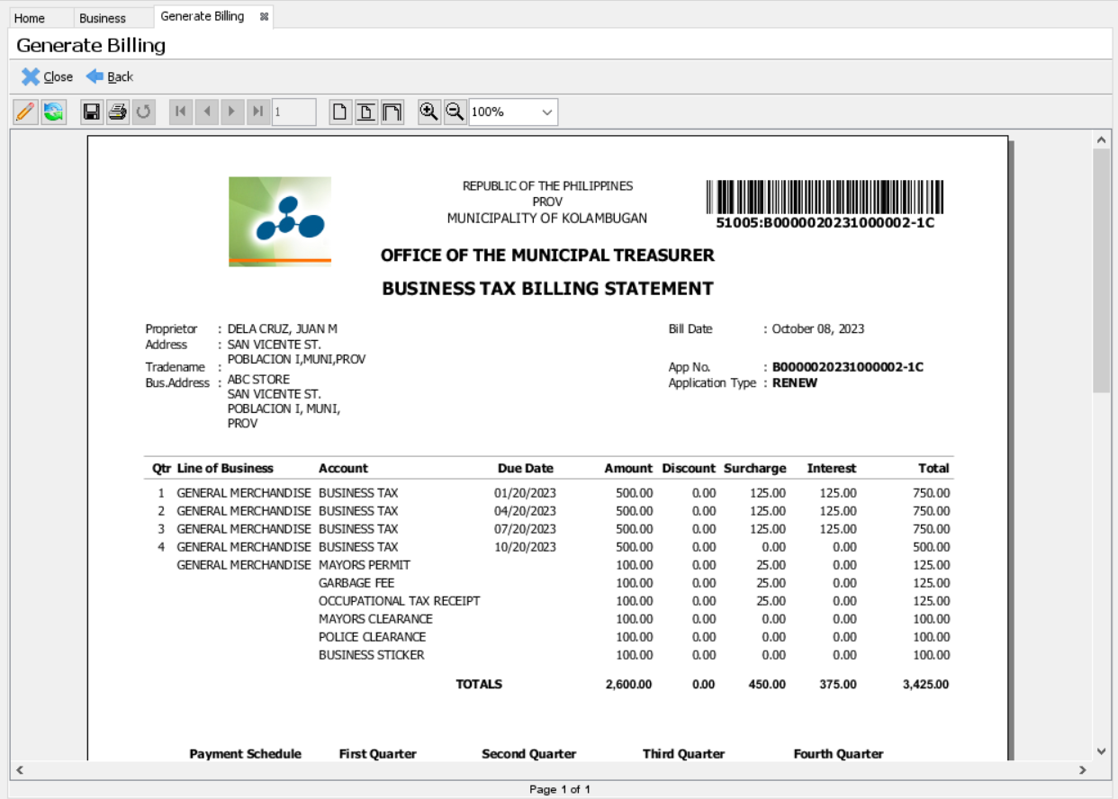
Generate Billing

Slide 52
Build Delinquency Data
A tool used to build the delinquency data before generating the Delinquency Report
Location:
Home-> Business-> Tools-> Build Delinquency Data

Slide 53
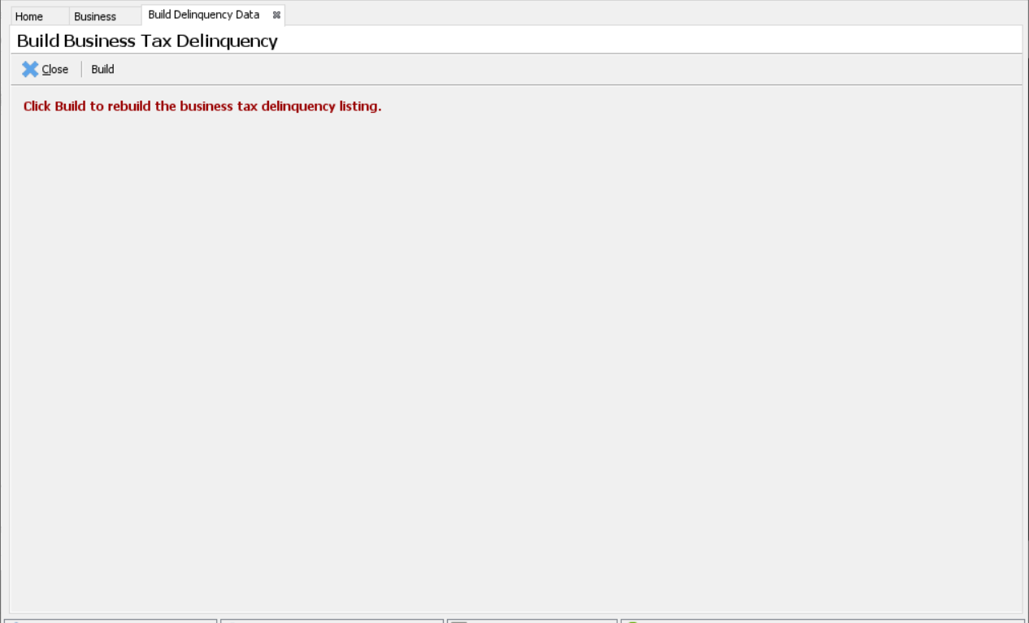
Build Delinquency Data

Slide 54
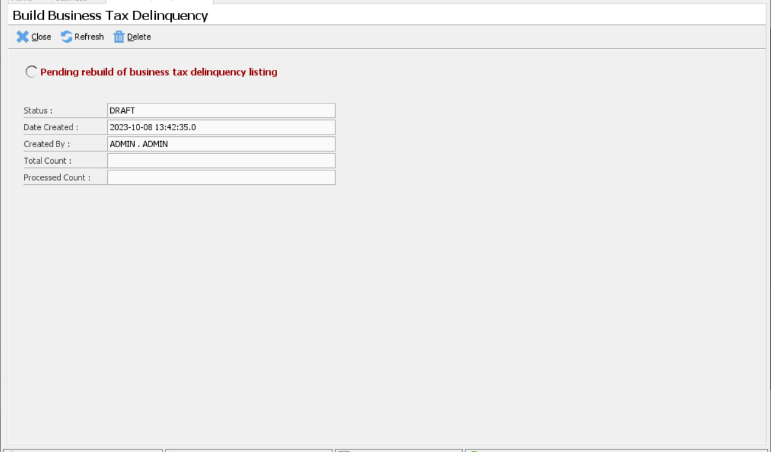
Build Delinquency Data

Slide 55
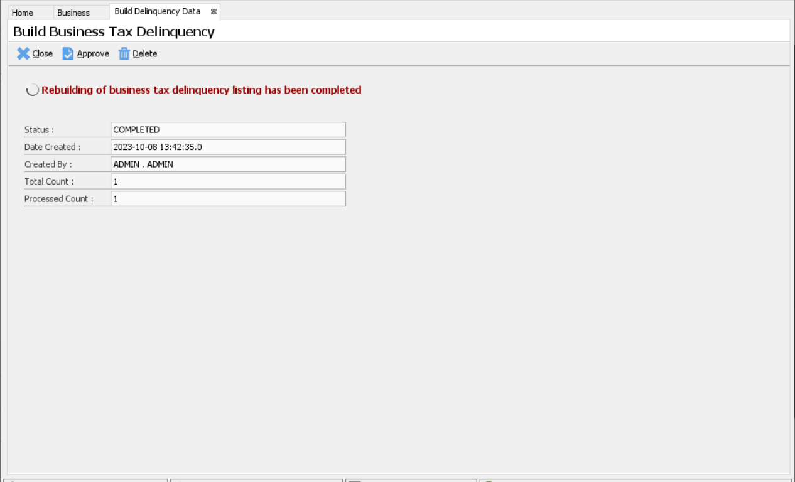
Build Delinquency Data

Slide 56
Build Payment Items
A tool used to build the payment items and updates the ledger
Only cash receipt record applies to this feature
This is used only for a special scenario when payment items are not build after a successful cash receipt record is posted
Location:
Home-> Business-> Tools-> Build Payment Items

Slide 57
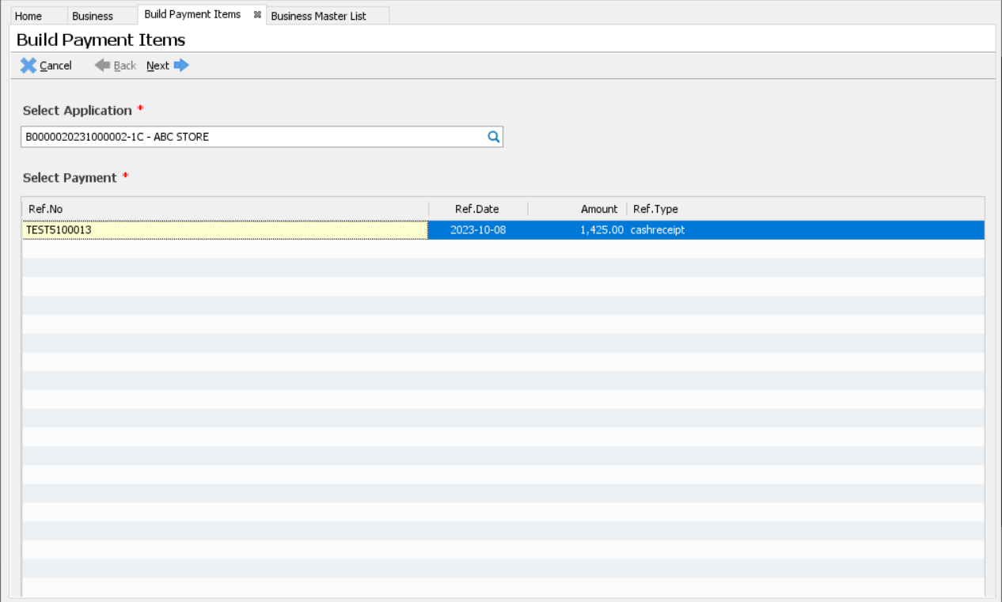
Build Payment Items

Slide 58
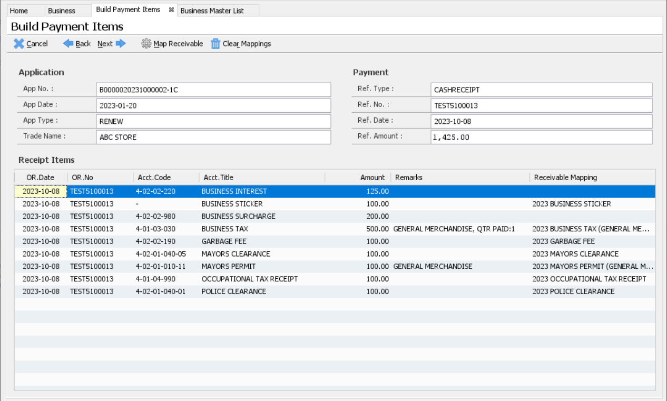
Build Payment Items

Slide 59
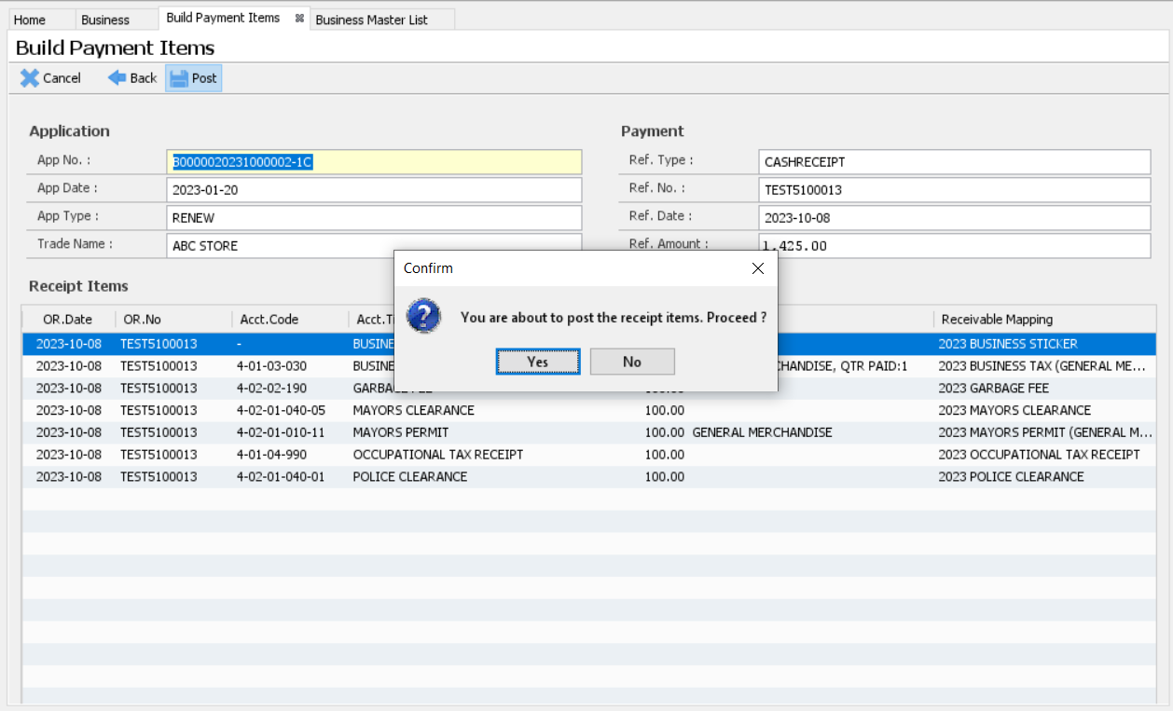
Build Payment Items

Slide 60
Reports

Slide 61
Reports
Application Listing
Application Listing (By Permit Issuance)
Application Listing (Completed)
Business Delinquency Listing
Business Permit Listing
DTI Competitiveness Index
Employer Listing

Slide 62
Reports
Line of Business Count Listing
Line of Business Listing
Quarterly Paid Business Listing
Summary of Business Collection
Summary of Business Permit
Taxpayer Listing
Top Business Listing (Capital/Gross)
Top Business Listing (Tax/Fee)

Slide 63
Reports
Location:
Main Menu-> Reports-> BPLS

Slide 64
Reports Demo

