Slide 1
MAMIDALA URVI KEY LOGGER AND SECURITY FINAL PROJECT

Slide 2

Agenda
Introduction
Problem statement
Project Overview
End Users
Solution and Value Proposition
The "WOW" Factor in our Solution
Modelling
Results

Slide 3

Problem Statement
Keyloggers are a serious danger to cybersecurity since they make it possible for unauthorized parties to access private data, aid in identity theft, and support financial fraud. Keystrokes are quietly recorded and logged by these harmful apps, frequently without the user's awareness, exposing private and sensitive information. Thus, keyloggers have the ability to breach online accounts, pilfer financial data, and seriously hurt both people and businesses.

Slide 4
Project Overview
1. Risk Assessment: Conduct a thorough assessment to identify cybersecurity vulnerabilities, especially related to keyloggers.
2. Evaluate Solutions: Research and compare keylogging technologies based on features, encryption, and privacy safeguards.
3. Deployment Strategy: Plan a secure deployment aligned with organizational policies and legal requirements, ensuring proper consent and privacy protection.
4. Security Measures: Implement additional security measures such as firewalls and regular updates to enhance overall cybersecurity.
5. Monitoring and Auditing: Establish protocols to monitor keylogger usage, audit data access, and detect unauthorized activities promptly.

Slide 5
Who are the end users
Organizations : Businesses Government Agencies
Individuals: Parents Individual Users
Security Professionals: IT Security Teams Ethical Hackers and Penetration Testers
Law Enforcement and Legal Investigators: Digital Forensic Experts
Educational and Research Purposes: Researchers Educational Institutions

Slide 6
Solution and value proposition
SOLUTION: Our keylogging solution provides robust monitoring capabilities to enhance cybersecurity and safeguard sensitive information across sectors. It discreetly logs keystrokes for comprehensive oversight without user disruption. Featuring advanced encryption and secure storage, our solution ensures data protection and regulatory compliance. Whether used for parental control, employee monitoring, or forensic investigations, our keylogger seamlessly operates across major platforms, offering actionable insights to prevent unauthorized access and mitigate cybersecurity threats.
VALUE PROPOSITION: Enhanced Security: Empower organizations and individuals with proactive cybersecurity through comprehensive monitoring and detection of suspicious activities. Privacy Compliance: Ensure legal and regulatory adherence with built-in encryption and privacy safeguards, protecting sensitive data. Operational Efficiency: Streamline operations and optimize productivity by effectively monitoring user activities and mitigating risks promptly. Versatile Applications: From parental control to corporate security audits, our solution offers actionable insights across diverse environments. User-Friendly Interface: Simplify deployment and management with an intuitive interface that integrates seamlessly into existing IT infrastructures.

Slide 7
The "WOW" in your Solution
Innovative Approach: We integrate technical measures with comprehensive user education to enhance protection against keylogging attacks.
Demonstration: We provide real-time demonstrations of keyloggers to illustrate threats and showcase the effectiveness of our security measures.
Impact: Our proactive approach significantly reduces the likelihood of successful keylogging attacks, ensuring enhanced cybersecurity across all sectors.

Slide 8
Modelling
Components: Key Press Handling: Function: on_press(key) Description: Captures and logs pressed keys. Details: Updates a list with key press events and maintains a JSON log file. Key Release Handling: Function: on_release(key) Description: Captures and logs released keys. Details: Appends key release events to a list, updates the JSON log file, and accumulates keys for the text log. Logging Functions: Text Logging: Function: generate_text_log(keys) Description: Writes recorded keys to key_log.txt. JSON Logging: Function: generate_json_file(keys) Description: Stores the list of key events in key_log.json
Architecture Overview:
Modular Design: The keylogger code is structured into modular functions for improved readability and easier maintenance.
Event Handling: Utilizes the pynput library to capture and manage keyboard events efficiently.
Data Logging: Implements functions to log captured data into both text and JSON formats.

Slide 9
GUI Integration:​
​
Tkinter Framework:​
Utilizes tkinter for creating a user-friendly graphical interface.​
User Interaction:​
Start Button: Initiates the keylogger to begin capturing keystrokes.​
Stop Button: Halts the keylogger from capturing further keystrokes.​
Status Updates:​
Provides real-time feedback on the keylogger's current status (running or stopped).
Flow Diagram:
Initialization:
Sets up the main GUI window.
Initializes global variables for key logging.
Event Capture:
Begins capturing key events upon pressing the "Start" button.
Logs both key press and release events.
Data Logging:
Continuously updates both text and JSON log files with captured key events.
Stop Logging:
Stops capturing key events when the "Stop" button is pressed.
Updates the GUI to indicate that the keylogger has been stopped.

Slide 10
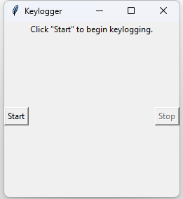
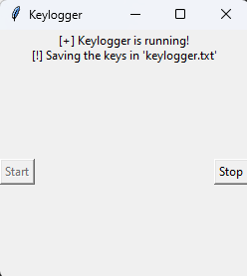
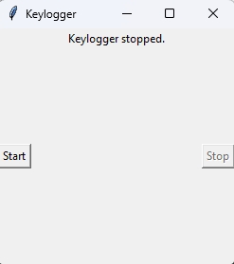
Results
1. Created a robust keylogging solution that effectively captures and stores keystrokes in both text and JSON formats.
2. Offers real-time keylogging functionality with intuitive start and stop controls provided through a user-friendly GUI interface.

Slide 11
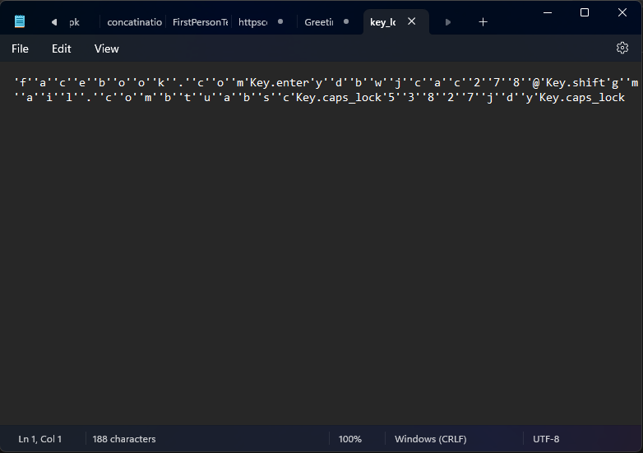
The keylogger project successfully showcased its ability to capture and record keystrokes in real-time.
Utilizing a straightforward GUI, it offered easy control over the keylogging process, ensuring user accessibility and simplicity.
The project emphasized ethical considerations in keylogger usage and highlighted the necessity of implementing strong security measures to safeguard against potential misuse.

Slide 12
Thank you
GITHUB LINK: https://github.com/rvi0304/APSSDC_project
NAME: MAMIDALA URVI
EMAIL: murvi2019@gmail.com

