Slide 1
Academic Success Initiative (asi)
Team C:
Luis Castillo
Rodolfo Viant
Eric Aguiar

Slide 2
Application Description
Allows a student to schedule a tutoring session
schedule by subject and tutor
tutors can confirm the student attendance
Student can view their booked tutoring sessions
Tutors can view and update their schedule
Use Online data from Server to store and retrieved tutoring sessions, registered users.
License Selection:
Creative Commons Attribution-Non Commercial 4.0 International License

Slide 3
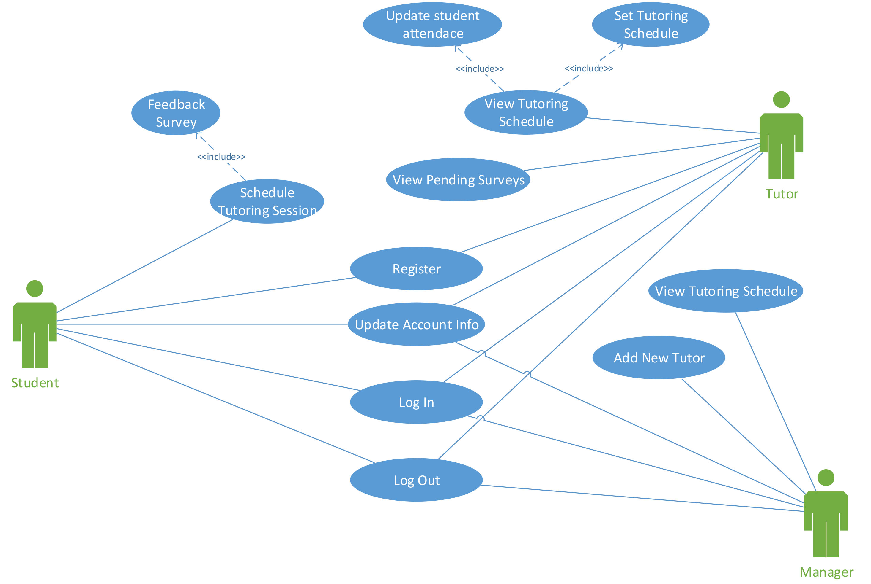
Use Cases
Log In
Log Out
Student:
Schedule Tutoring Session
Feedback Survey
Manager:
Add New Tutor
Tutor:
View Tutoring Schedule
Update Student Attendance
Set Tutoring Schedule

Slide 4
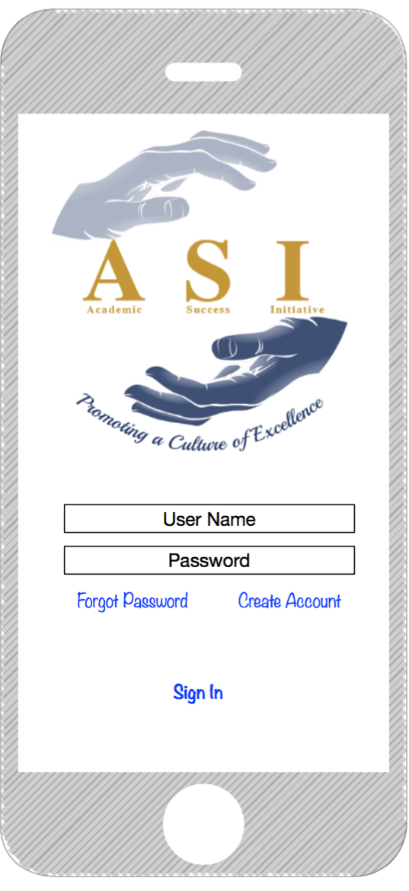
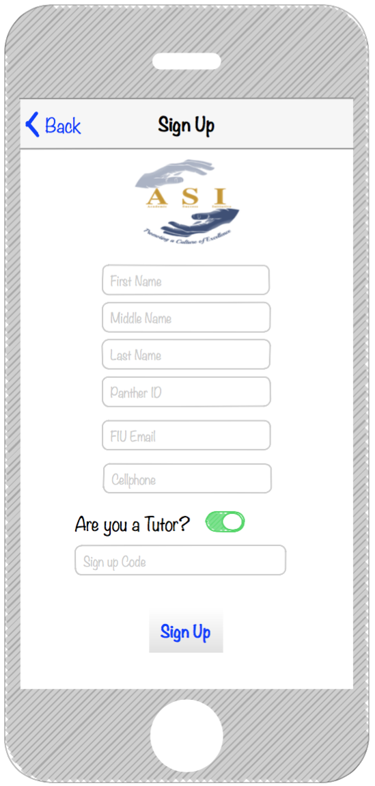
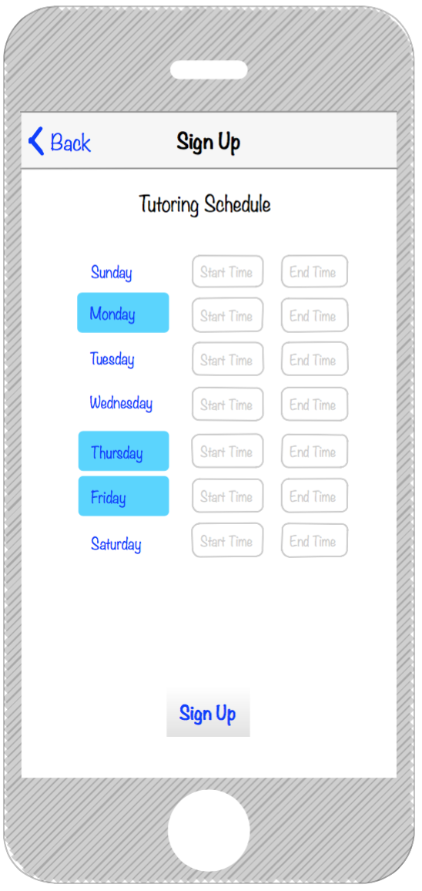
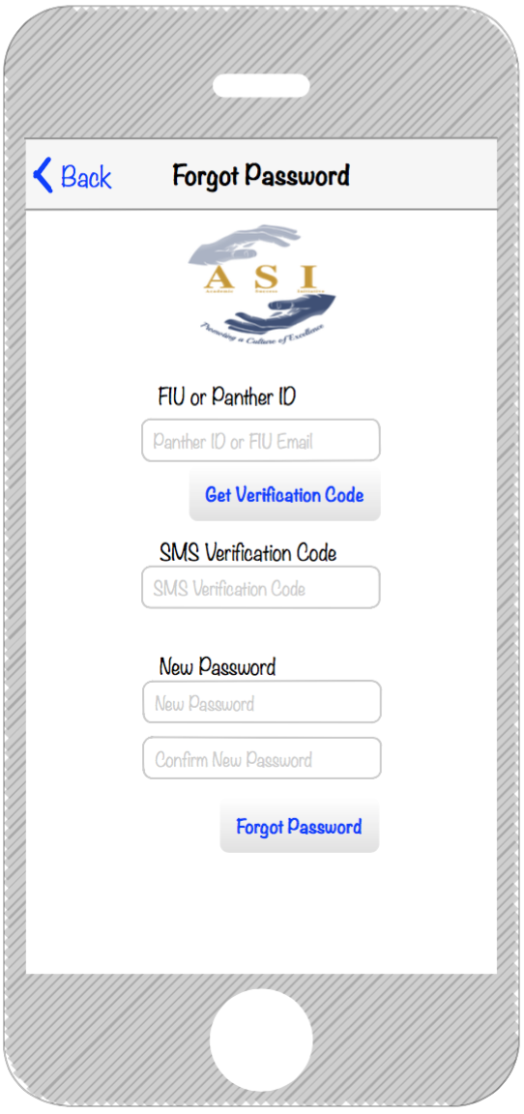
Mockups
Sign In
Register
Register (Tutor )
Forgot Password

Slide 5
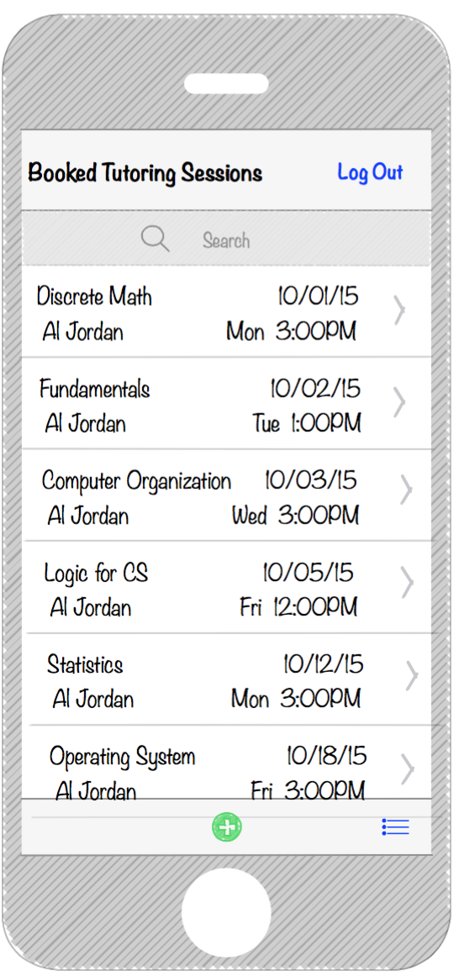
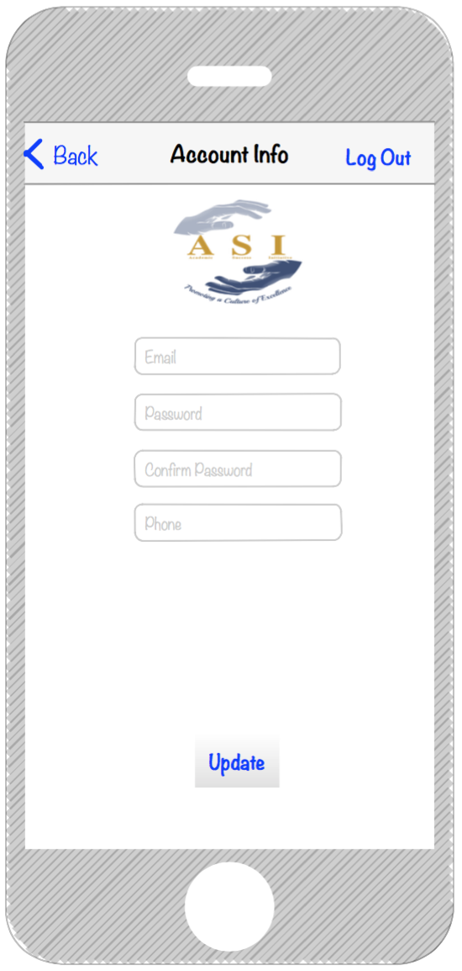
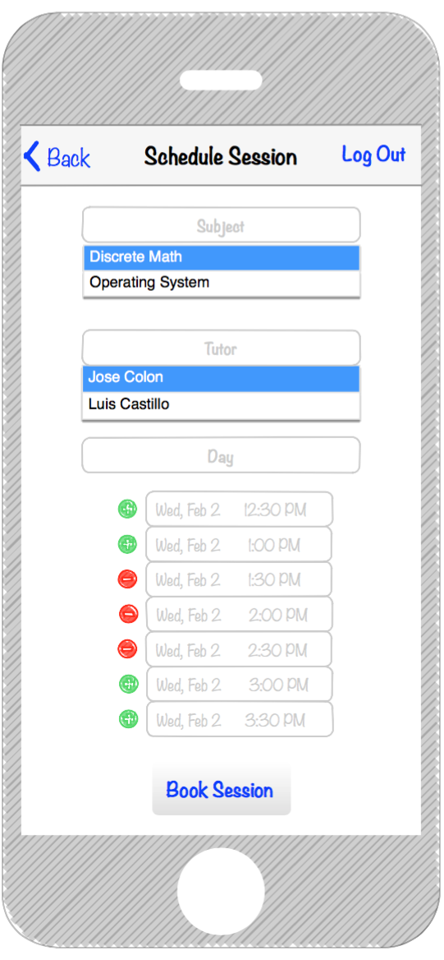
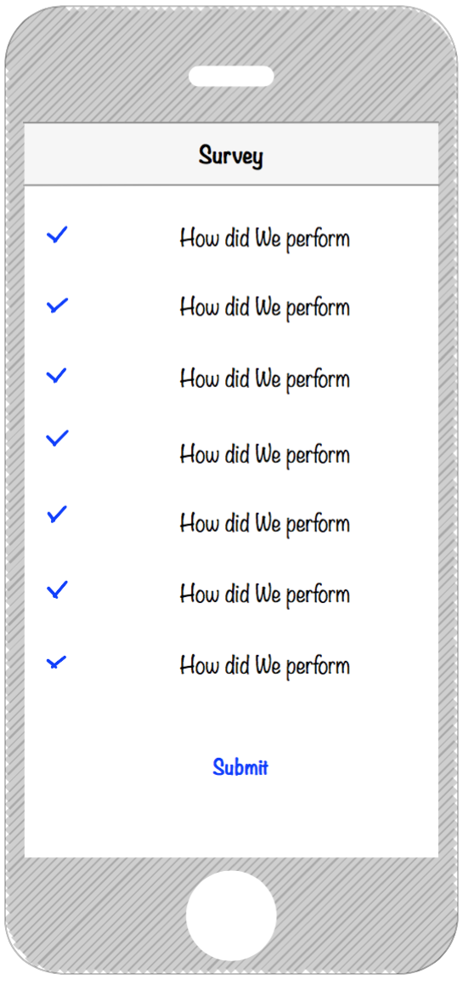
Mockups
Student Home
Update Account
Book Tutoring Session
Tutoring Survey

Slide 6
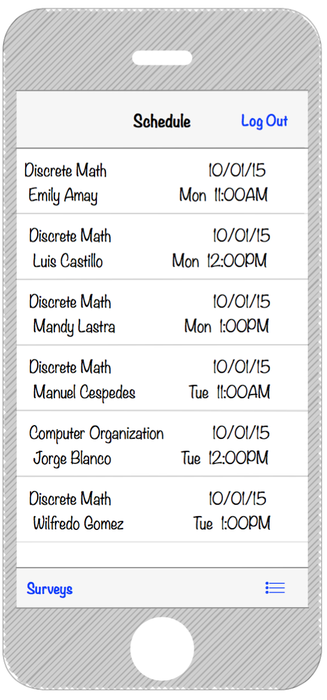
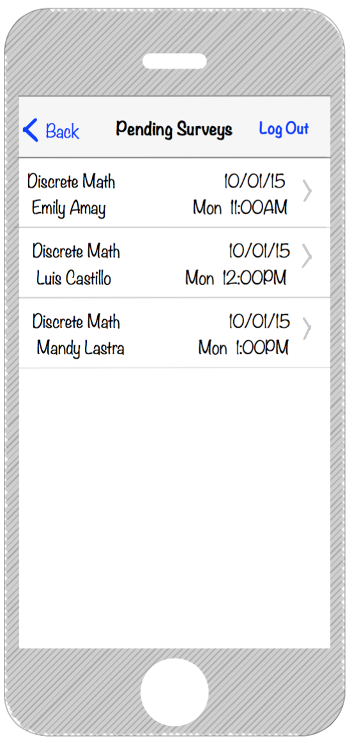
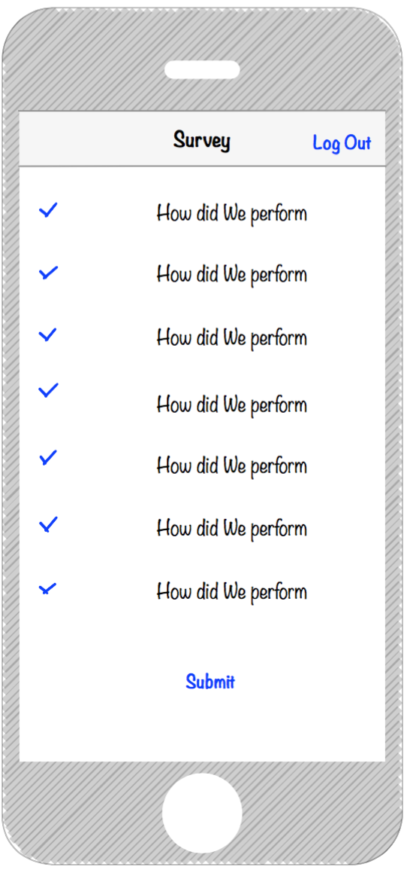
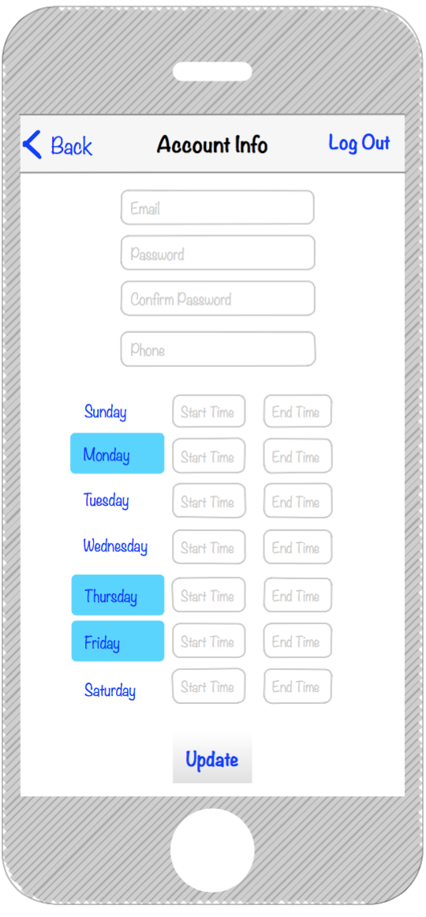
Mockups
Tutor Home
Pending Surveys
Surveys
Update Account

Slide 7
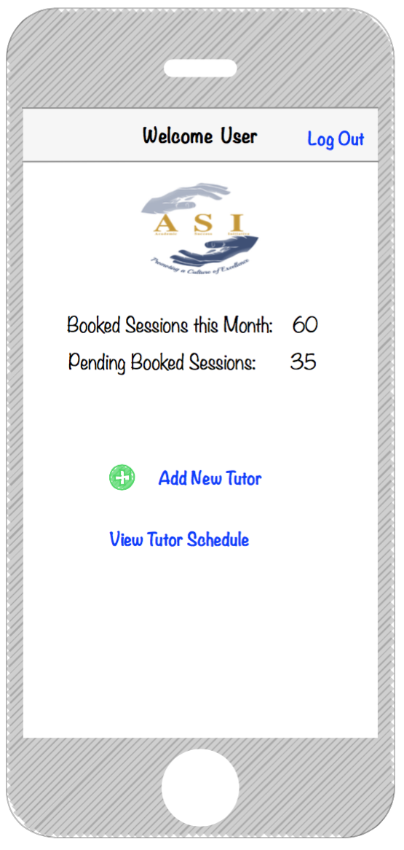
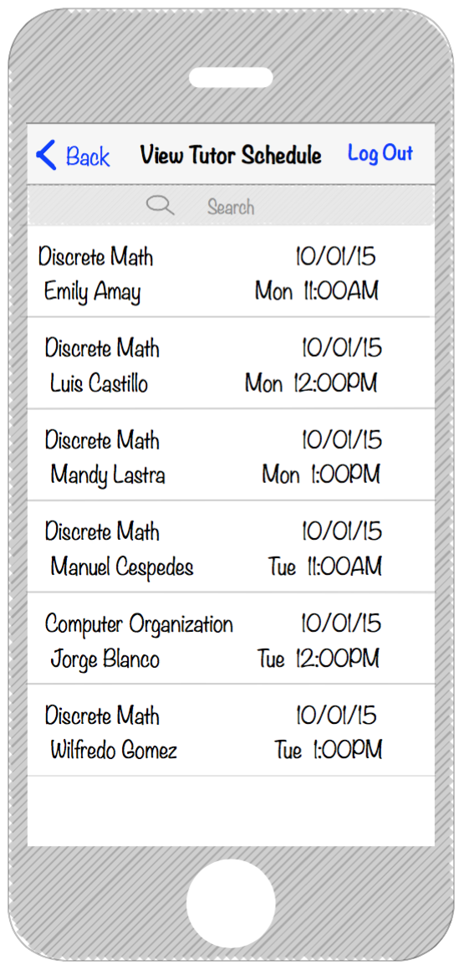
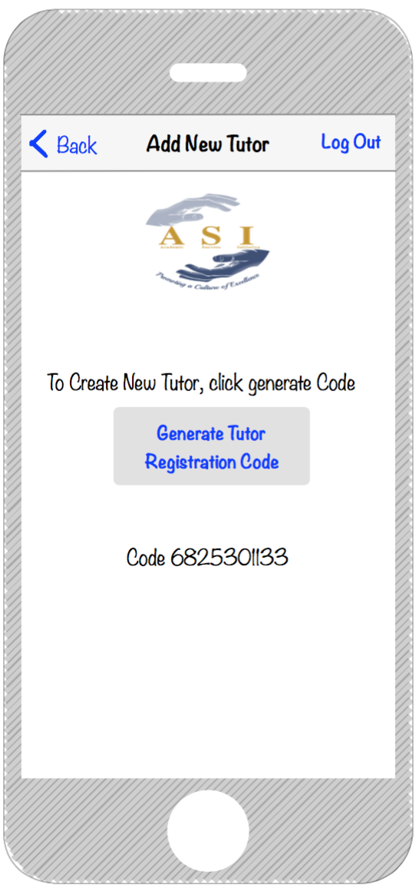
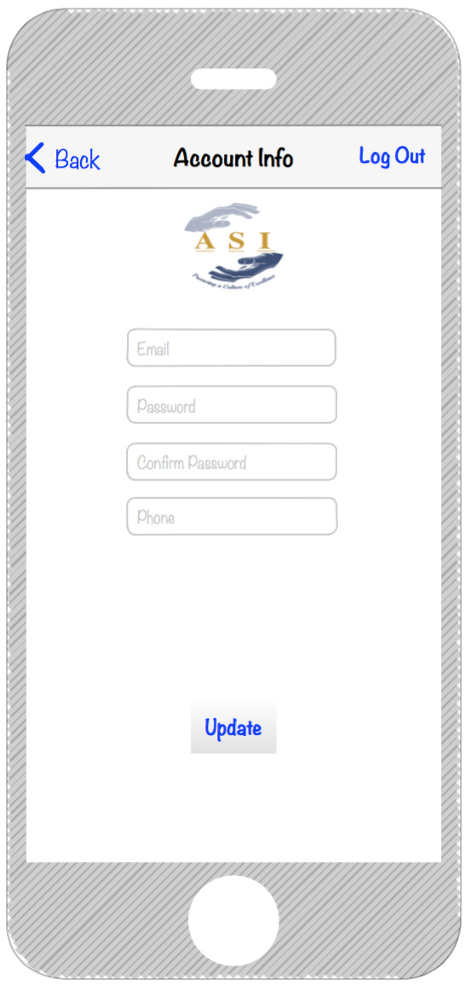
Mockups
Manager Home
View Tutor Schedule
Add New Tutor
Update Account

Slide 8

Contact Information
Myrian Herlle
Academic Advisor II / ASI Team Leader
School of Computing and Information Sciences
Email: mherlle@fiu.edu
Phone: 305-348-7900

