Slide 1
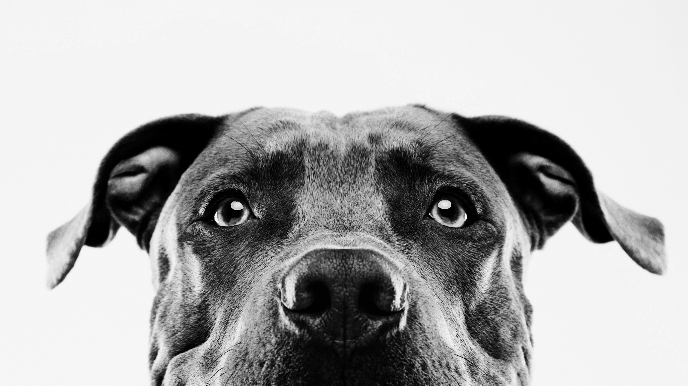
Combatting No-Kill Stigma with Goal-to-Zero
Rebecca Lewis
DSC 640

Slide 2
Executive Summary
Who are we?
Who do no-kill advocates think we are?
Reality
How we are we improving?
Are we on target with our community partner shelters?
How should we communicate our success?

Slide 3

Who is the Louisiana SPCA?
a mission to promote, protect and advance the welfare of animals in the community
Open admission shelter that accepts all animals regardless of species or condition
Impact the lives of over 70,000 animals per year through programs and services

Slide 4
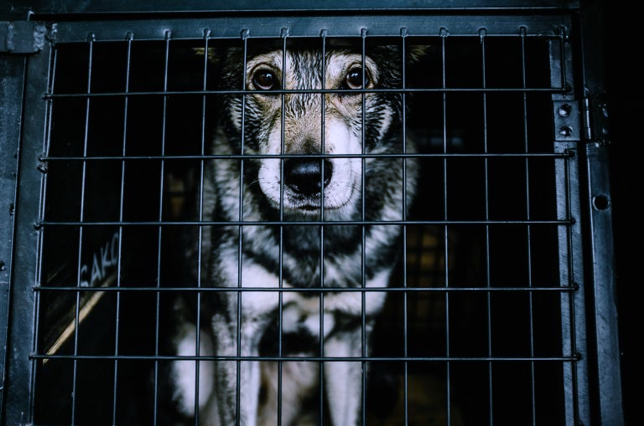

Who do No-Kill Advocates think we are?
Image Courtesy of PETA [2]

Slide 5
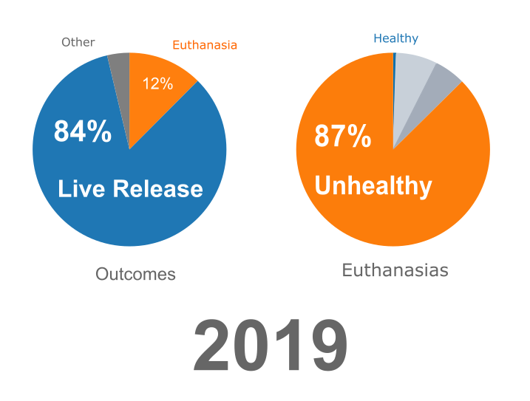
The Reality

Slide 6
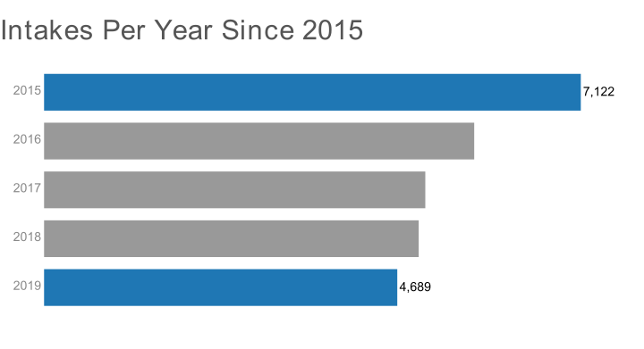
Overpopulation Interventions are working

Slide 7
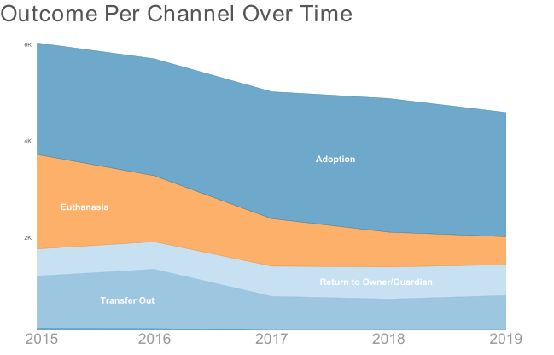
Adoption is becoming more popular

Slide 8
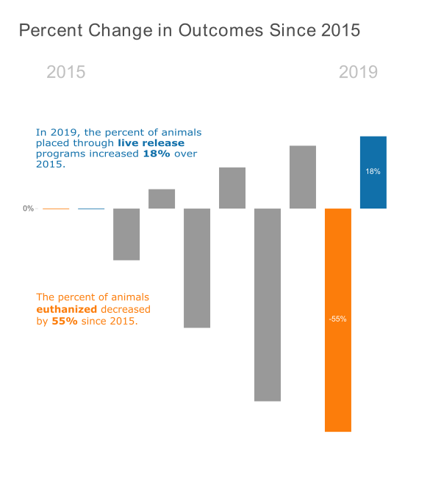
Attacking the Problem from Both Sides

Slide 9
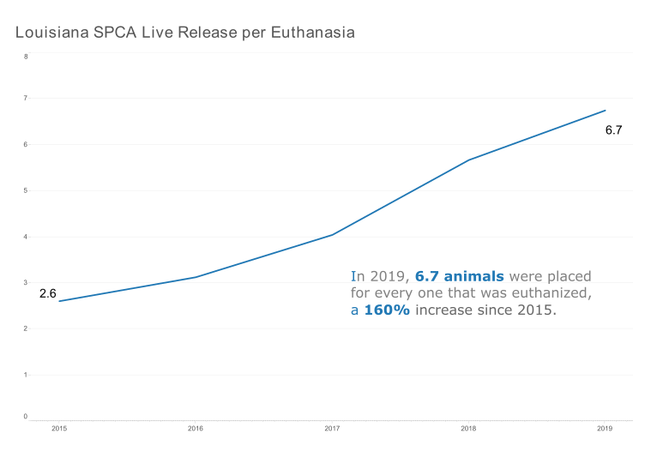
Saving more animals every year

Slide 10
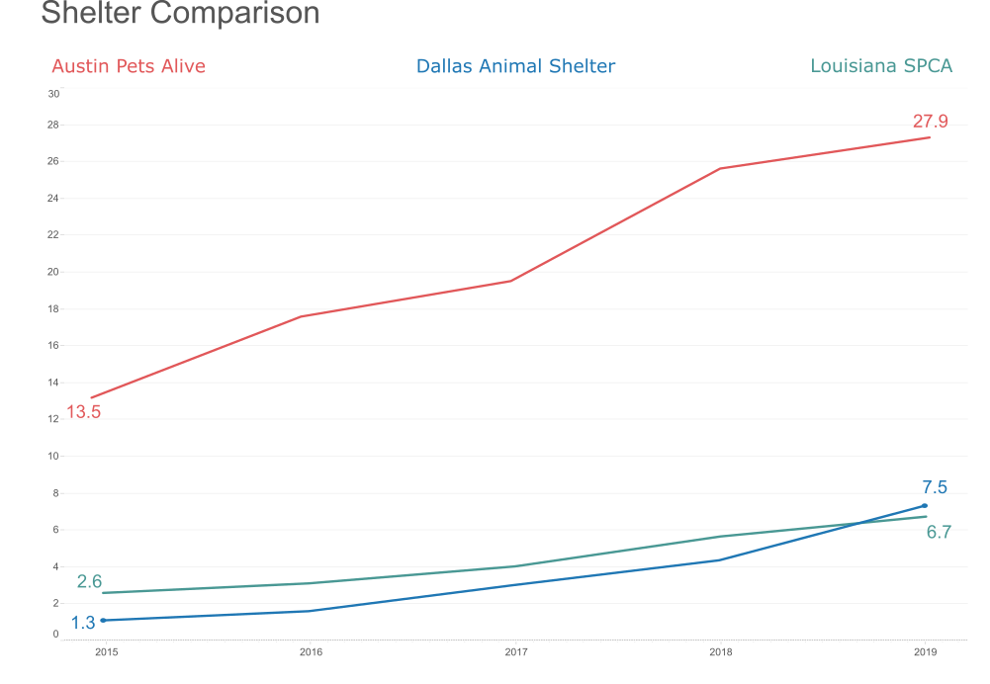
Keeping up with industry standards
Austin Data Courtesy of Austin’s Open Data Program. [1]
Dallas Data Courtesy of Dallas’ Open Data Program. [3]

Slide 11
Goal to
0

Slide 12
References
Animal Services. (2016). Austin Animal Center Outcomes: Austin Animal Center Outcomes [Application/xml]. 3KB. https://doi.org/10.26000/025.000001
Crating Dogs: Are You a Dog Guardian or a Prison Guard? (2018, August 3). PETA. https://www.peta.org/living/animal-companions/is-your-dog-a-prisoner-in-her-own-home/
Dallas OpenData. (n.d.). City of Dallas. Retrieved October 10, 2020, from https://www.dallasopendata.com/browse?q=animal+shelter

