Slide 1
The Impact of Leadership Compensation and Administrative Overhead on Fundraising Efficiency
Final Project Presentation
Rebecca Lewis DSC 530 August 10, 2019

Slide 2
Inspiration
Many donors are unwilling to give to organizations with high paid leaders and higher administrative expenses in general. Changing the world unfortunately is not free and an investment is often required in staff and overhead to make an impact.
The initial inspiration behind this project was to determine if leadership compensation and administrative expenses have an effect on an organization’s fundraising success. Do the dollars invested behind the scenes increase the ability of nonprofits to make an impact on the people they serve? Are larger organizations more efficient at raising money than smaller organizations simply because they can pay their staff better?

Slide 3
DataSet
The dataset used for this project is from Charity Navigator, a nonprofit organization that evaluates charities and assigns a rating based on financial health, accountability and transparency with the goal of aiding donors with deciding where to spend their charitable contributions. ¹
The data includes financial and rating information for charities from 2017 and can be accessed from:
https://www.kaggle.com/katyjqian/charity-navigator-scores-expenses-dataset
[1] About Us. Charity Navigator. Retrieved August 10, 2019 from http://www.charitynavigator.org/index.cfm?bay=content.view&cpid=1653

Slide 4
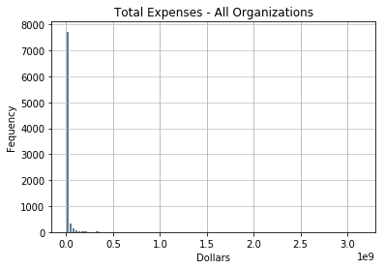
Total Expenses
Total expenses for the organization in US dollars; sum of administrative, program and fundraising expenses for the fiscal year including 2017
Mean: $14,484,281 Standard Deviation $69,437,316.
The standard deviation is much larger than the mean which indicates a large spread in the data. The distribution is positively skewed.

Slide 5
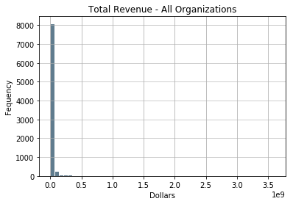
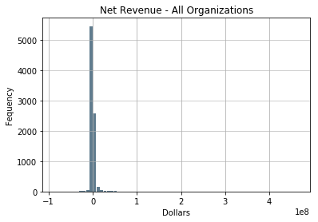
Revenue (total and Net)
The dataset provides total revenue for the organization in US dollars. Net revenue was calculated and added to the dataset during the cleaning phase.
Total Revenue: Mean: $15,827,234 Standard Deviation $75,576,578
The standard deviation is much larger than the mean which indicates a large spread in the data. The distribution is positively skewed.
Net Revenue: Mean: $1,342,952 Standard Deviation: $11,567,885
The distribution for the net revenue is more of a normal than the total revenue.

Slide 6
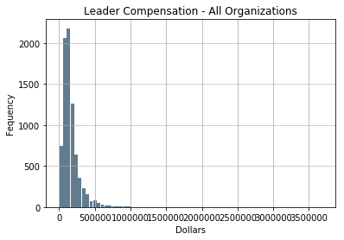
Leader Compensation
Compensation of the organization’s top leader.
Mean: $164,159 Standard Deviation: $145,319
The distribution is approximately normal with slightly positive skew.
Null values as well as 0 values are present in this column. Based upon the Charity Navigator website, this can indicate either the data was not available or the leader is not compensated.

Slide 7
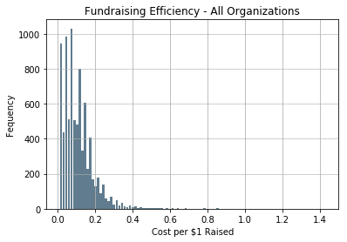
Fundraising Efficiency
The fundraising efficiency is the approximate cost of raising one US dollar. An important consideration is that a lower fundraising efficiency is better.
Mean: .11 Standard Deviation: .09
The distribution is approximately normal and a positive skew.

Slide 8
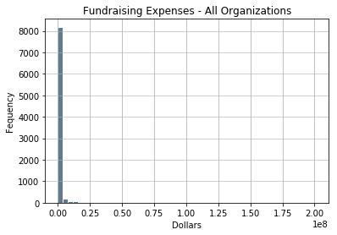
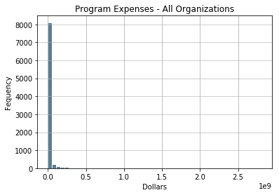
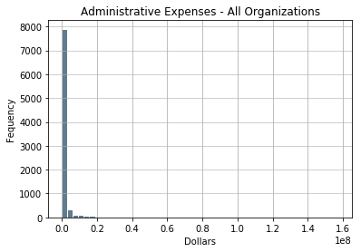
Expense Subcategories
Fundraising Expenses:
Amount spent on raising money
Program Expenses:
Amount spent on programs and services
Administrative Expenses:
Amount spent on staffing and overhead
Mean: $892,930 Standard Deviation: $4,355,881
Mean: $12,430,698 Standard Deviation: $63,494,723
Mean: $1,138,577 Standard Deviation: $4,362,715

Slide 9
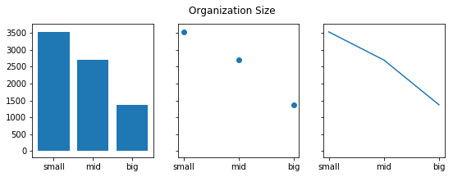
Organization Size
Charity Navigator grouped organizations into the following size categories:
Small – organizations with total expenses < 3.5M
Mid – organizations with total expenses between 3.5M and 13.5M
Large – organizations with total expenses between 13.5M and 1B

Slide 10
Outliers
All of the plots had a heavy positive skew which was a result of some mega organizations with expenses and revenue well over a billion dollars. I created an additional category of organization labeled as mega and excluded them from any categorical analysis with the big group of organizations. They are still included in the analysis of all organizations.
Leadership Compensation included null and zero values. According to charity navigator, these could be due to data that was not reported or the leader not receiving compensation. Because we do not have a way to determine which scenario applies, rows with a 0 or null in leadership compensation were removed.

Slide 11
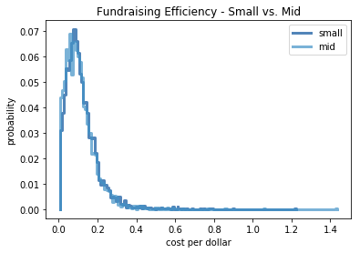
Fundraising Efficiency PMF
Small vs Mid Sized Organizations
Small and mid sized organizations are just as likely to be efficient at fundraising with mid level organizations slightly more efficient with a higher probability of organizations at a cost per dollar of .10.
Tying this back to our goal, the mean leader compensation for each category is very close:
Small: $112,890 Mid: $171,094
However, the mean administrative expenses are very different:
Small: $229,415 Mid: $665,166

Slide 12
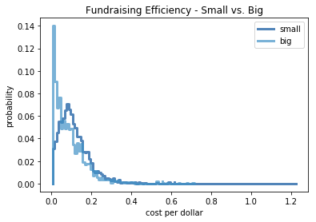
Fundraising Efficiency PMF
Small vs Big Organizations
Smaller organizations are less likely to be as efficient at fundraising. Most big organizations are likely to spend 0-.5 cents per dollar where most small organizations are likely to spend .10-.20 cents per dollar.
Both the mean leader compensation and the mean administrative expenses for big organizations are much higher:
Leader Compensation Small: $112,890 Big: $325,895
Administrative Expenses: Small: $229,415 Big: $4,418,345
NOTE: Organizations with over one billion dollars in total revenue or expenses are excluded.

Slide 13
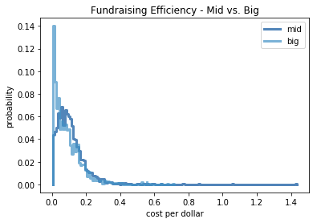
Fundraising Efficiency PMF
Mid vs Big Organizations
the plot for mid level and big organizations is similar to the small and big. Mid level and small organizations were very close.
Both the mean leader compensation and the mean administrative expenses for big organizations are much higher:
Leader Compensation Mid: $171,094 Big: $325,895
Administrative Expenses: Mid: $665,166 Big: $4,418,345
NOTE: Organizations with over one billion dollars in total revenue or expenses are excluded.

Slide 14
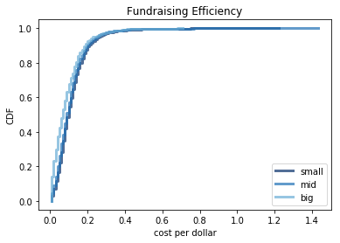
Fundraising Efficiency CDF
About 80% of the organizations reported have a fundraising cost of .20 cents on the dollar.
There are very few organizations above .70 cents.
Overall, big organizations are the most efficient at raising money and out-perform smaller organizations at the 0-.15 cost per dollar level. As we saw earlier, the mean leader compensation and administrative expenses are much larger for big organizations.
NOTE: Organizations with over one billion dollars in total revenue or expenses are excluded.

Slide 15
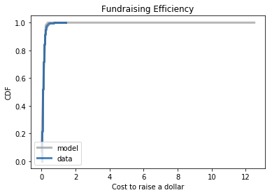
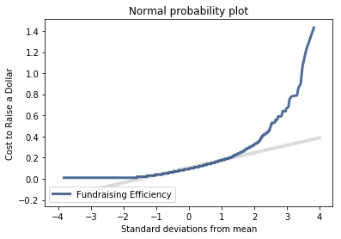
Analytical Distribution
The normal distribution model is a good fit for the data because the data line follows the model with a slight deviation as it approaches 100%.
The normal probability plot also supports this as the majority of the data surrounding the mean is along the model line.

Slide 16
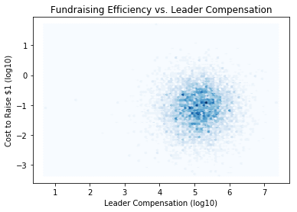
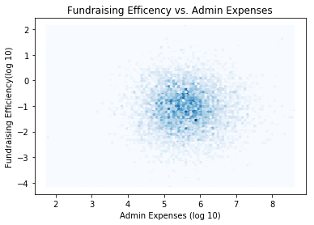
Bivariate Relationships All Organizations
Fundraising Efficiency vs. Leader Compensation
Fundraising Efficiency vs. Admin Expenses
Pearson’s Correlation: .01
Spearman’s rank Correlation: .06
Pearson’s Correlation: -.02
Spearman’s rank Correlation: -.01

Slide 17
Correlation vs Causation
Causation cannot be assumed by any of the data presented in this project.
Plotting the variables without transformations presented a fan shape which indicated heteroscedasticity. This could be attributed to the large range of values in the independent variable and a smaller range in the dependent variable. By taking the log of both variables, the plots were clearer however the relationship was still difficult to determine by the plots alone.
Spearman’s Rank Correlation is more reliable in this dataset because of the null and zero values in the leader compensation column. Spearman’s correlation coefficient (.06) presented a very slight positive relationship between leader compensation and the cost to raise a dollar. This means that as the leader’s compensation increased, the cost to raise a dollar increased. In summary, higher compensation for a leader has a negative impact on the fundraising efficiency because a lower “cost to raise a dollar” is better.
Pearson’s correlation coefficient (-.02) presented a very slight negative relationship between administrative expenses and the cost to raise a dollar. This means that as the administrative expenses increased, the cost to raise a dollar decreased. In summary, higher administrative expenses have a positive impact on the fundraising efficiency because a lower “cost to raise a dollar” is better.

Slide 18
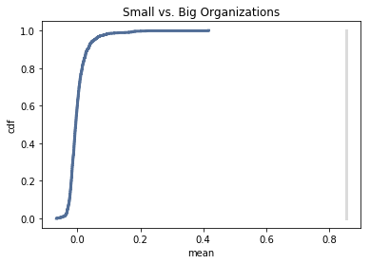
Hypothesis: Larger organizations are more efficient at raising money
Test statistic is the mean of fund efficiency.
Null Hypothesis - the size of the organization has no effect on their fundraising efficiency
P Value – 0
The p value of 0 indicates the difference in fundraising efficiency between small and big organizations is statistically significant because p < .001.

Slide 19
Hypothesis: Admin expenses have an impact on fundraising efficiency
Test statistic is the Pearson’s correlation coefficient
Null Hypothesis - the amount of money spent on staffing and overhead has no effect on their fundraising efficiency
P Value – .037
The p value is less than .05 which is still considered statistically significant. Also, the max correlation out of 1000 iterations is relatively close to the actual which supports that this correlation is not likely due to chance.

Slide 20
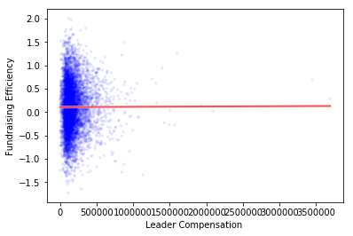
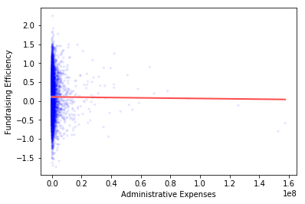
Regression analysis
Leader Compensation
Administrative Expenses
Slope Test P-value: .18
Slope Test P-value: .98

Slide 21
Regression analysis
While the model lines seem to match the results we received in our correlation analysis, it is difficult to see if they fit the data in the visualization. To make the visualizations clearer, I could have transformed the variables with a log 10 function, but I wanted the model to use the actual data.
The p-values from the slope test indicate that that our results are not statistically significant since they are above .05. This means that the impact of both leadership compensation and administrative expenses on fundraising efficiency could be due to chance.

