Slide 1
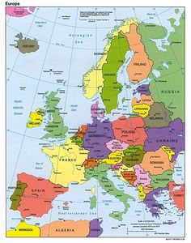
Machine Learning Models Design assoc. prof. Dariusz Put Krakow University of Economics, Poland
Krakow

Slide 2
Agenda
Introduction to Artificial Intelligence and Machine Learning
Selected concepts related to Machine Learning
The types of Machine Learning tasks
Python libraries used in ML
Data in ML

Slide 3
Introduction to
Artificial Intelligence (AI) and Machine Learning (ML)

Slide 4
Introduction
To be Machine Learning specialist you have to:
be very good at mathematics, statistics, probability theory and practice
be quite good at programming
be able to organize data (cope with different data formats and missing data, be able to select parts of texts)
be familiar with Exploratory Data Analysis (EDA) and be able to interpret various types of graphs
be very good at logical thinking
have time and strong motivation to practice
be able to keep going despite setbacks
know ML methods and be able to put them into practice

Slide 5
Introduction
Expected benefits upon completion of the course:
you will be familiar with the key concepts related to ML
you will be able to prepare data for analysis
you will be able to choose an ML algorithm suited to the task
you will be able to build a machine learning model, train it and verify its accuracy

Slide 6
Introduction
Artificial Intelligence (AI) is a branch of Computer Science that focuses on creating machines or software capable of performing tasks that normally require human intelligence.
Artificial Intelligence is about building smart systems that can learn, „think,” and act like humans,
or even better in some cases.
AI systems can perform various tasks, including:
learning (from data and experience)
reasoning (making decisions, solving problems, planning)
perception (understanding images, speech, or text)
These capabilities are often built using techniques from Machine Learning and Deep Learning.

Slide 7
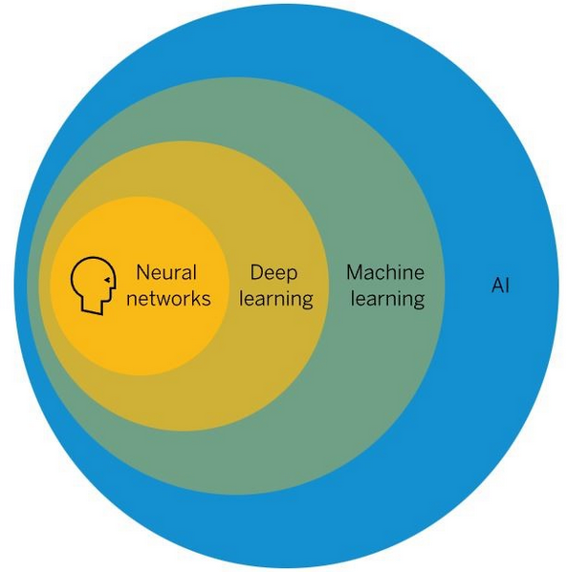
Introduction
Artificial Intelligence is an umbrella term for all subsets of machine learning. The first subset is machine learning itself, and the next is deep learning, which is implemented using neural networks.

Slide 8
Introduction
Machine – a mechanically, electrically, or electronically operated device for performing a task.
Learning – the activity or process of gaining knowledge or skill by studying, practicing, being taught, or experiencing something.
Machine Learning (ML) is a type of artificial intelligence that allows computers to learn from data and improve their performance without being explicitly programmed.
Instead of writing rules manually, you give the computer data, and it finds patterns and makes predictions or decisions on its own.
Machines learn by studying data to detect patterns or by applying known rules to:
• categorize or catalog like people or things
• predict likely outcomes or actions based on identified patterns
• identify hitherto unknown patterns and relationships
• detect anomalous or unexpected behaviors
Example:
If you show a system many emails labeled “spam” or “not spam,” it learns how to recognize spam automatically.

Slide 10
Introduction
The processes machines use to learn are known as algorithms. Different algorithms learn in different ways.
As new data regarding observed responses or changes to the environment are provided to the “machine” the algorithm’s performance improves. Thereby resulting in increasing “intelligence” over time.

Slide 11
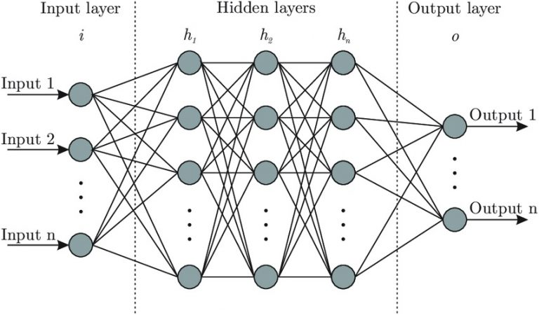
Introduction
Deep Learning (DL) is a subfield of machine learning. It uses artificial neural networks with many layers to learn complex patterns from large amounts of data. Deep learning is especially useful for tasks such as:
image recognition
speech recognition
natural language processing
generative AI

Slide 12
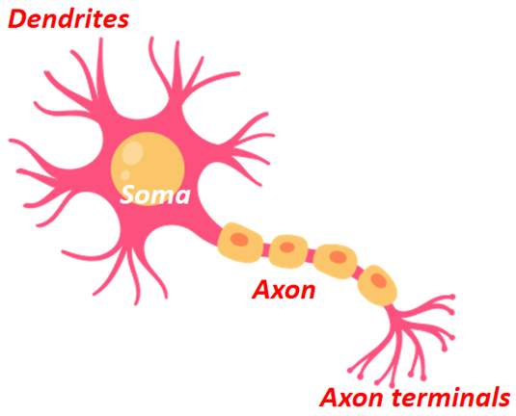
Introduction
Neural networks consist of artificial neurons.
Their operation is based on the functioning of biological neurons.

Slide 13
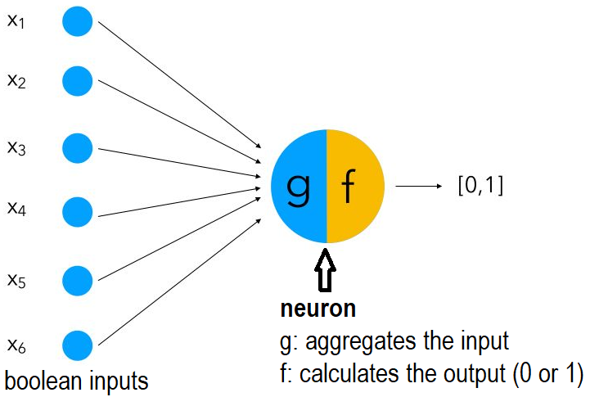
Introduction
The first model of artificial neuron was proposed by Warren McCulloch and Walter Pitts in 1943.
The binary input values are aggregated (g), and then the result is compared to a threshold value: if it is greater than the threshold, the neuron outputs 1; otherwise, it outputs 0 (remains inactive).

Slide 14
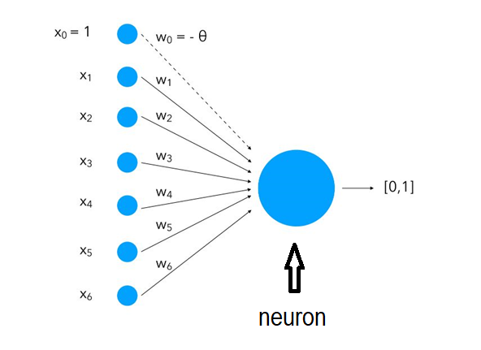
Introduction
In 1957 Frank Rosenblatt designed a perceptron to overcome most issues of the McCulloch-Pitts neuron:
it can process non-boolean values
it can assign different weights to each input automatically
the threshold that determines whether a neuron will be activated is computed automatically
A perceptron is a single layer Neural Network. Since introduction, it has been the core of Deep Learning.

Slide 15
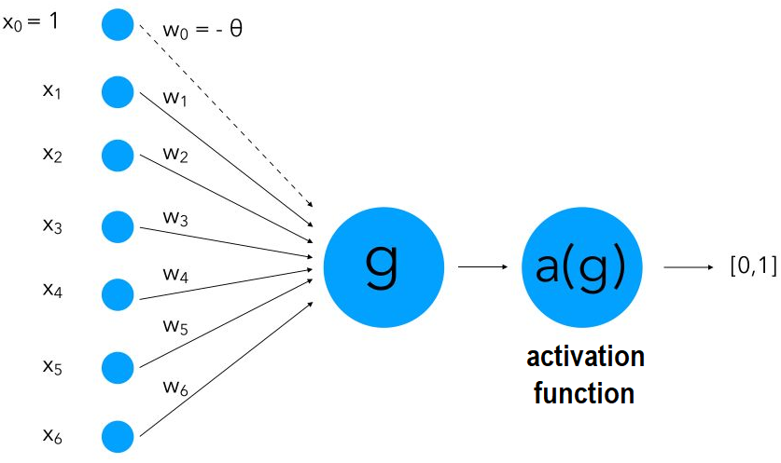
Introduction
The version of perceptron we use nowadays was introduced by Minsky and Papert in 1969.
They bring a major improvement to the classic model: they introduced an activation function.
In artificial neurons, inputs are denoted as X, their corresponding weights as w. The inputs are multiplied by the weights before reaching the neuron body.
Processing in an artificial neuron is usually performed using two functions. First, an aggregation function (g), often a sum function, combines the weighted inputs into one value. Then, an activation function determines whether the neuron should activate.
If the aggregated value exceeds a given threshold, a signal is passed to the next neuron; otherwise, the output is 0.
Together, the aggregation and activation functions correspond to the soma of a biological neuron. The final output corresponds to the axon. However, artificial neurons do not include a structure equivalent to the axon terminals of biological neurons.
dendrites soma axon
input aggregate/activation function output

Slide 16
Introduction
Machine learning vs computer programming:
In ML a person enters data and the expected responses, and the computer is supposed to create rules that allow those responses to be obtained – the machine learning system is trained to discover these rules.
data
Programming
output
deterministic approach
probabilistic approach
rules
data
Machine Learning
rules
output(?)

Slide 17
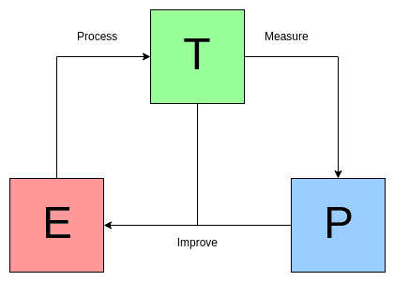
Introduction
prof. Tom Mitchel:
A computer program is said to learn from experience E with respect to some class of tasks T and performance measure P, if its performance at tasks in T, as measured by P, improves with experience E.
T (Task): What the system is trying to do (e.g., classify emails as spam)
E (Experience): The data it learns from (e.g., past emails)
P (Performance): How well it performs (e.g., accuracy)
Simply:
A machine “learns” if it gets better at a task by using experience (data).

Slide 18
Introduction
The machine learning process:
1. Problem identification (What is the model supposed to learn, and what will it be used for?)
2. Data collection and preparation (the data must be of high quality, representative, consistent, and free of noise)
3. Dividing dataset into the training (sometimes also validating) and testing datasets
4. Choosing the algorithm (or many algorithms) (the algorithm must be tailored to the type of problem and the nature of the available data)
5. Training the model (training involves reducing errors and improving accuracy)
6. Assessing the model’s performance and, if necessary, fine-tuning it and returning to step 5 (or even 4, 3, or 2)
7. Model deployment and quality monitoring

Slide 19
Selected concepts related to Machine Learning

Slide 20
Concepts
We already know:
AI, ML, DL
biological vs artificial neuron
dendrites, soma, axon, axon terminals
input, weights, aggregation function, activation function, output
ML vs computer programming
ML process

Slide 21

Concepts
Selected concepts related to Machine Learning:
Dataset – all the data analyzed
Sample – one element of the dataset processed by the model (e.g.: one photo, complete information about a single borrower, one of the texts analyzed).
Dataset
Sample

Slide 22
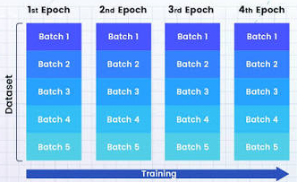
Concepts
Selected concepts related to machine learning:
Batch – a set of samples processed by the model. Most often, the number of samples is a power of 2. A batch is used to compute a single update of the model’s weights.
Epoch – a single pass through the entire dataset.
Example:
dataset: 10,000 samples
one batch: 2,000 samples
To process the entire dataset (epoch), 5 iterations are required

Slide 23
Concepts
Selected concepts related to machine learning:
ML model
A model is a mathematical representation of relationships found in data.
After training, it can classify, predict, or generate new content.
A model does not “understand” the world in the same way a human does – it operates on patterns and probabilities.

Slide 24
Concepts
Parameters are the set of (usually small) numbers. Machine learning involves finding the right weights so that the network correctly maps the input data to the output.
Each neuron in the hidden layer is assigned a weight. These weights are model parameters and contain the network’s knowledge
Hyperparameters – model attributes tuned by model developers.
Types of hyperparameters:
model hyperparameters (relating to the model’s structure, e.g., number and size of hidden layers, number of epochs, batch size),
learning algorithm hyperparameters (e.g., learning rate, optimizer, activation function).
The weights (parameters) are tuned automatically during the training process,
while the hyperparameters are set by experts or using various methods.

Slide 25
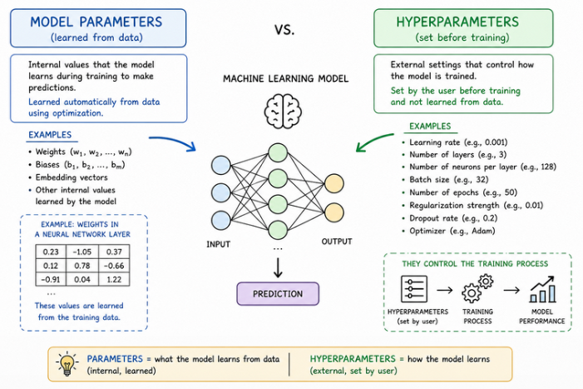
Concepts

Slide 26
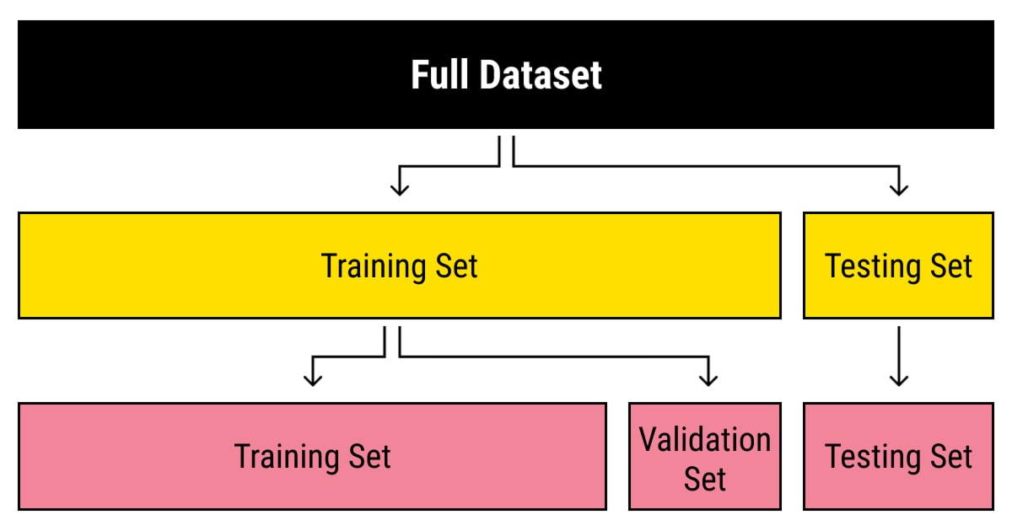
Concepts
Datasets in ML:
training set – used in the model training process
testing set – used to verify the model’s accuracy; it is not involved in the training or validation processes; it must accurately reflect the underlying distribution from which the data originates (the frequency of occurrence of individual classes in the test set should match their expected frequency occurrence in reality)
validation set (evaluation set, development set) – used to assess the model’s performance and fine-tune it during training process; it provides feedback based on an analysis of the model’s performance using validation data and is used to determine when training should end

Slide 27
The types of Machine Learning tasks:
Based on the type of the problem being solved: classification regression clustering
Based on the learning method
Based on the method of data streaming

Slide 28
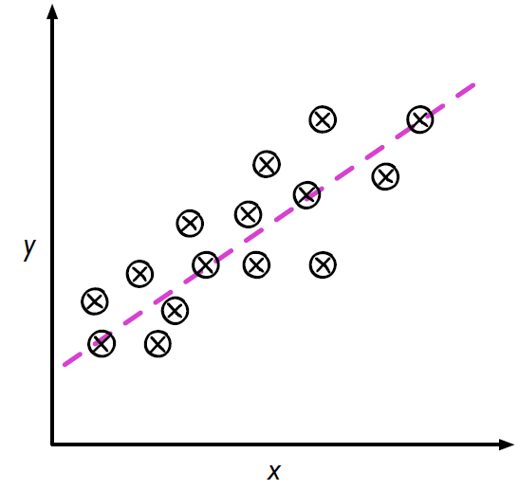
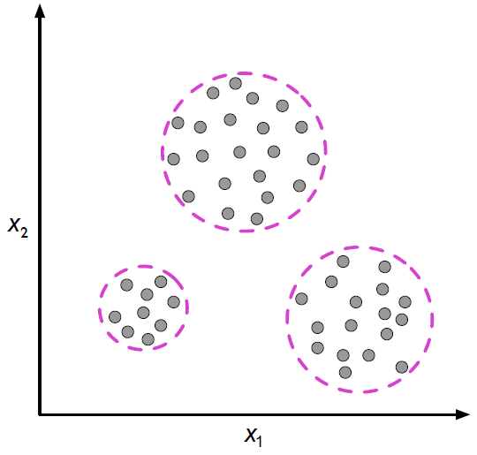
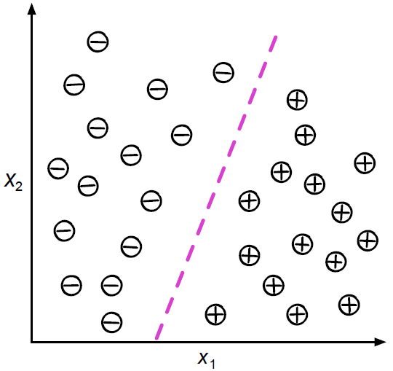
Types of ML tasks
The types of Machine Learning tasks based on the type of the problem being solved:
classification – a model predicts a class label for given input data
regression – model predicts a continuous numerical value
clustering – model groups similar samples
classification
regression
clustering

Slide 29
The types of Machine Learning tasks based on the type of the problem being solved:
classification (binary, multiclass, multilabel)

Slide 30
Concepts
Class – the set of all possible categories in a classification problem. For example, the classes “cat,” “dog,” and “pigeon” are all the possible categories that can be assigned to photos.
Label – a specific value (class) assigned to a given sample. For example, in a task involving the classification of photos into those depicting dogs, cats, and pigeons, there are three classes: dog, cat, and pigeon, whereas a label is a specific value selected from the available classes and assigned to a sample (e.g., cat).
A class refers to a general category within a set of possible responses, whereas a label is a specific class assigned to a single observation.
Class: {lion, elephant, deer, cougar}
Label: elephant

Slide 31
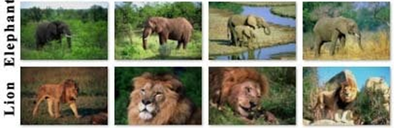
Types of ML tasks
Binary classification A classification task in which each sample is assigned to one of two categories. Example: Determining whether a photo shows a lion or an elephant.
Binary classification: a class is a two-element set (the labels are “lion” and “elephant”). The result of the classification is assignment to one of the categories – the photo shows either a lion or an elephant.
Only two possibilities (lion, elephant).
Exactly one animal in the picture.

Slide 32
Types of ML tasks
Multiclass classification
Each sample is assigned to a single category from a set containing more than two categories.
Example:
Identifying one animal from among more than two options.
More than two possibilities (lion, elephant, deer, cougar).
Exactly one animal in the picture.

Slide 33
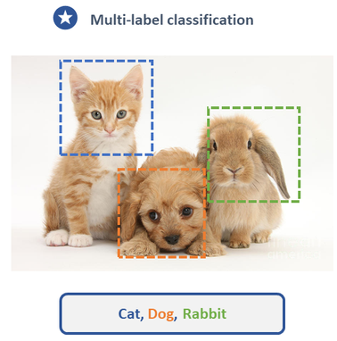
Types of ML tasks
Multilabel classification
Multiple classes can be assigned to each sample.
Example:
There are several animals in the photo, so multiple categories can be assigned to each photo.
Two or more possibilities.
There may be many animals in the picture.

Slide 34
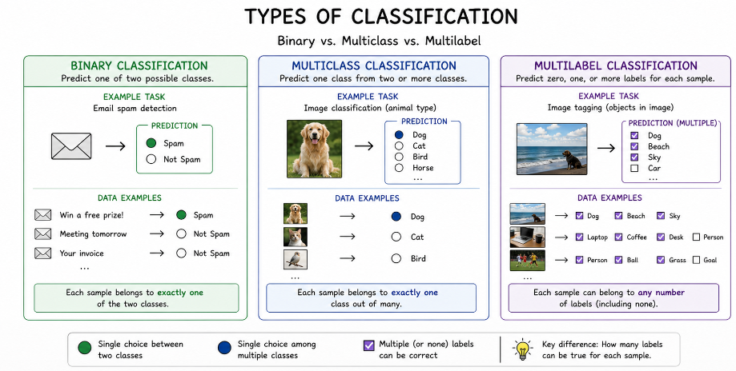
Types of ML tasks

Slide 35
The types of Machine Learning tasks based on the type of the problem being solved:
regression (scalar, vector, single-factor, multiple-factor)
– a model predicts a continuous numerical value (values)

Slide 36
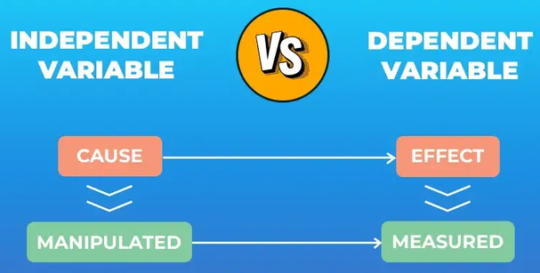
Concepts
Independent variable
input or factor used to explain or predict something (e.g. car age, colour, mileage, make, model). It is usually written as X.
Dependent variable
output or result that depends on the independent variable (e.g. car price). It is usually written as Y.

Slide 37
Types of ML tasks
Scalar regression
Target values are continuous scalar values.
Example:
predicting the price of one commodity (based on one or many factors, e.g.: age, shape, colour).
Vector regression
Target values are a vector of continuous values.
Example:
predicting the price of a basket of goods (based on one or many factors, e.g.: age, shape, colour).

Slide 38
Types of ML tasks
Single-factor regression
We examine the relationship between the dependent variable and a single independent variable (rarely used).
Example:
estimating the price of a house based solely on its size.

Slide 39
Types of ML tasks
Multi-factor (multiple) regression:
We use many features (independent variables) to predict the outcome.
Example:
Estimating the price of a house (dependent variable) based on its characteristics (independent variables).
We have a two-story, 25-year-old house with an area of 100 square meters and three bathrooms.
We divide the city into 10 areas (districts), and our house is located in the area labeled with the number 7. We can therefore describe the house using a five-dimensional vector:
x = [100, 25, 3, 2, 7].
Let’s assume that the approximate value of the house is $200,000.
The goal is to find a vector
w = [w1, w2, w3, w4, w5]
such that 100*w1 + 25*w2 + 3*w3 + 2*w4 + 7*w5 = 200,000.
When dealing with a large dataset of houses and their prices, the learning algorithm can find a vector w such that the difference between the estimated price and the real price is minimized.

Slide 40
Types of tasks in Machine Learning based on the type of the problem being solved:
clustering

Slide 41
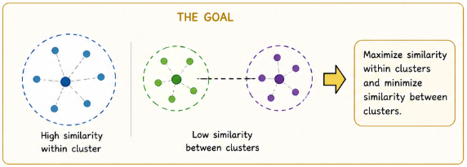
Types of ML tasks
Clustering involves grouping data into clusters (groups) based on their similarity, without any prior human-defined categories.
The goal of clustering is to discover hidden structures in the data.

Slide 42
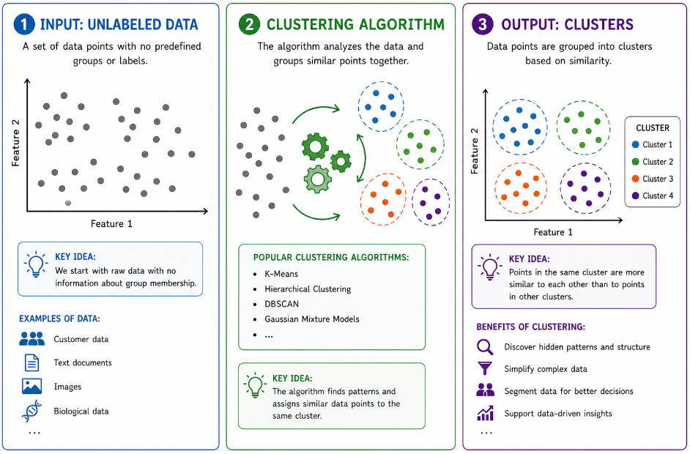
Types of ML tasks

Slide 43
The types of Machine Learning tasks:
Based on the type of the problem being solved
Based on the learning method
supervised
unsupervised
semi-supervised
reinforcement
Based on the method of data streaming

Slide 44
Types of ML tasks
Supervised learning is a type of machine learning where a model learns from labeled examples.
Training dataset (y is known):
x₁₁, x₁₂, x₁₃, …, x_{1n} y₁
x₂₁, x₂₂, x₂₃, …, x_{2n} y₂
…
x_{m1}, x_{m2}, x_{m3}, …, x_{mn} y_{m}
Testing dataset (y is estimated by the model):
x_{t11}, x_{t12}, x_{t13}, …, x_{t1n} y_{t1}(?)
…
Model is learning using dataset WITH LABELS
The trained model estimates the values of y

Slide 45
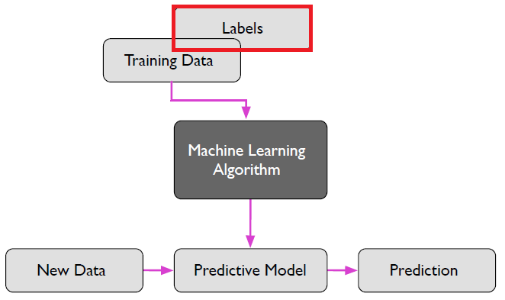
Types of ML tasks
Supervised learning process

Slide 46
Types of ML tasks
Examples of supervised learning.
In each case, the model learns from examples where the correct answer is already known.
Example | Input | Label/Answer | ML task
Email spam detection | Email text | spam / not spam | binary classification
House price prediction | Size, location, bedrooms | sale price | scalar regression
Image classification | Photo | cat / dog / car / flower | multiclass classification
Sentiment analysis | Product review text | positive / negative | binary classification

Slide 47
Types of ML tasks
Unsupervised learning – a model finds patterns or groups in unlabeled data without being given the correct answers.
Examples:
Example | Input data | Pattern the model finds
Customer grouping | Shopping behavior | Groups of similar customers
Topic discovery | News articles | Common topics like sports, politics, tech
Image clustering | Photos | Similar images grouped together
Market basket analysis | Purchase records | Items often bought together
Gene analysis | DNA/gene data | Groups with similar genetic patterns

Slide 48
Types of ML tasks
Task | ML method
Classification | Supervised
Regression | Supervised
Clustering | Unsupervised

Slide 49
Types of ML tasks
Semi-supervised learning – a model learns from a small amount of labeled data and a large amount of unlabeled data.
Examples:
Example | Labeled data | Unlabeled data
Image recognition | Some photos labeled “cat” or “dog” | Many photos with no labels
Email filtering | Some emails marked “spam” or “not spam” | Many unmarked emails
Medical diagnosis | Some patient records with diagnosis | Many records without diagnosis
Webpage classification | Some pages labeled by topic | Many unlabeled webpages
So, supervised learning needs many labeled examples, while semi-supervised learning uses fewer labeled examples plus many unlabeled ones. The model learns from a few correct answers and also looks for patterns in the unlabeled data.

Slide 50
Types of ML tasks
Semi-supervised learning uses unlabeled data to learn patterns and improve its predictions.
For example, with cat/dog photos:
It learns from a few labeled photos: “cat” and “dog.”
Then it looks at many unlabeled photos.
It finds similarities, like ear shape, fur, face shape, etc.
It uses those patterns to make better guesses on new photos.
So, unlabeled data helps the model understand the structure of the data, even without correct answers.

Slide 51
Types of ML tasks
Reinforcement learning – at the beginning, the model is given rules. Then model learns by trying actions and receiving rewards or penalties.
In reinforcement learning, the fundamental concept is reward. The algorithm aims to maximize the reward. The system is not trained using a training dataset but learns through trial and error. This technique is used primarily in games (chess, Go). It has the potential for application in autonomous vehicles, robotics, management, and education.
Reinforcement learning can be compared to a person who uses a device without reading the user manual – they learn how to use it through trial and error.

Slide 52
The types of Machine Learning tasks:
Based on the type of the problem being solved
Based on the learning method
Based on the method of data streaming

Slide 53
Types of ML tasks
Types of machine learning tasks based on how the data stream is delivered:
1. Batch learning
All available data is used for training. The system is first trained and then deployed to the production cycle, after which it is no longer trained. This type of training usually takes place offline. If new data becomes available, the model must be retrained from scratch using all available data, and then the old model is replaced with the new one.
2. Online learning
The system is trained on an ongoing basis through the sequential delivery of data.
3. Transfer learning
It involves using the knowledge gained from solving one task and applying it to solve another (in a related domain).
This allows for better results, faster model training times, and savings in computational resources.
Applying this technique is not trivial. It will only work in situations where the learned representations and data structures are well-generalized, and the domains of both tasks are related.

Slide 54
Types of ML tasks
Machine learning tasks – summary
Type of the problem being solved |  | Learning method | Data streaming
Classification | binary multiclass multilabel | Supervised | Batch
Regression | scalar vector single factor multi factor | Unsupervised | Online
Clustering |  | Semi-supervised | Transfer
 |  | Reinforcement

Slide 55
Python libraries used in ML tasks

Slide 56
Python libraries
The most popular tool used in ML is the Python programming language.
The Python environment offers many tools and libraries to assist with data preparation, exploratory analysis, visualization, and the development, training, and validation of machine learning models.
Library | Main use
NumPy | Working with numbers, arrays, and mathematical operations | Working with data
Pandas | Loading, cleaning, and organizing data in tables
SciPy | Scientific computing, statistics, and advanced math
Matplotlib | Creating basic graphs and charts | Visualisation
Seaborn | Creating more attractive statistical charts
Scikit-learn | Building common ML models like regression, classification, clustering | Machine Learning
TensorFlow | Building deep learning models, especially neural networks | Deep Learning
Keras | Simple interface for building neural networks, often used with TensorFlow
PyTorch | Building deep learning and AI models, popular in research

Slide 57
Data in ML

Slide 58
Data in ML
The importance of accurate data
The output of a machine learning algorithm is entirely dependent on the data it is exposed to.
Change the data, change the result.
Kimberly Nevala – the director of Business Strategies for SAS Best Practices
A model learns solely from the data available to it.
Incomplete, incorrect, or biased data can lead to inaccurate results.
A large amount of data does not always mean high quality.
Like traditional analytics, a majority of time on machine learning projects is spent munging, validating and formatting data. Sometimes a simple algorithm with more data can often beat a complicated algorithm with less data. Even when the bigger data set is slightly dirtier.

Slide 59
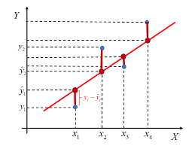
Concepts
Input data – data provided to the model (x_{i}).
Actual (target, real, true) values
● – the actual values (y_{i}), e.g. the actual car price
Predicted (estimated) values
● – results estimated by the model (ŷ_{i}).
Loss value
the gap between the actual and predicted values (y_{i} – ŷ_{i})
model

Slide 60
Data in ML
Data classification
1. Numerical
discrete (whole numbers) – interval – the difference, or distance, between values is meaningful, for example the number of products (1, 5, 99). – ordinal – The order is meaningful, but the difference between values is not. e.g. high has a value of 2, medium has a value of 1, and low has a value of 0.
continuous (float, real, e.g. product price)
Categorical
nominal – no compared with one another; there is no order (e.g., colour, occupation, location, unit of measurement)
ordinal – comparable to one another e.g., grade A is better than grade B height can be high, medium, or low test can be difficult, neutral, or easy
Only numerical data can be fed into ML models. All other data must be converted to a numerical format.

Slide 61
Data in ML
Independent variable (predictor, explanatory, input, or manipulated variable).
Dependent variable (outcome, response, output, or measured variable).
An independent variable is the factor you intentionally change or control in an experiment.
A dependent variable is the result you measure. It changes in response to the independent variable.
Example:
You want to test whether study time, sleep time before exam and number of practice tests completed affects exam scores.
independent variables: study time, sleep time, number of tests.
dependent variable: exam score.
The exam score depends on study time, sleep time and number of tests completed.

Slide 62
Data in ML – normalization
Data normalization
Normalization is necessary when the method used requires it or when the data are on different scales (e.g., attribute A takes values from 5 to 10, and attribute B takes values from 2,000 to 3,000).
Normalization is the process of transforming data values to a common scale, usually to make features comparable and improve the performance of machine learning algorithms.
There are many normalization methods, e.g.:
standardization
min-max normalization
normalization by maximum

Slide 63
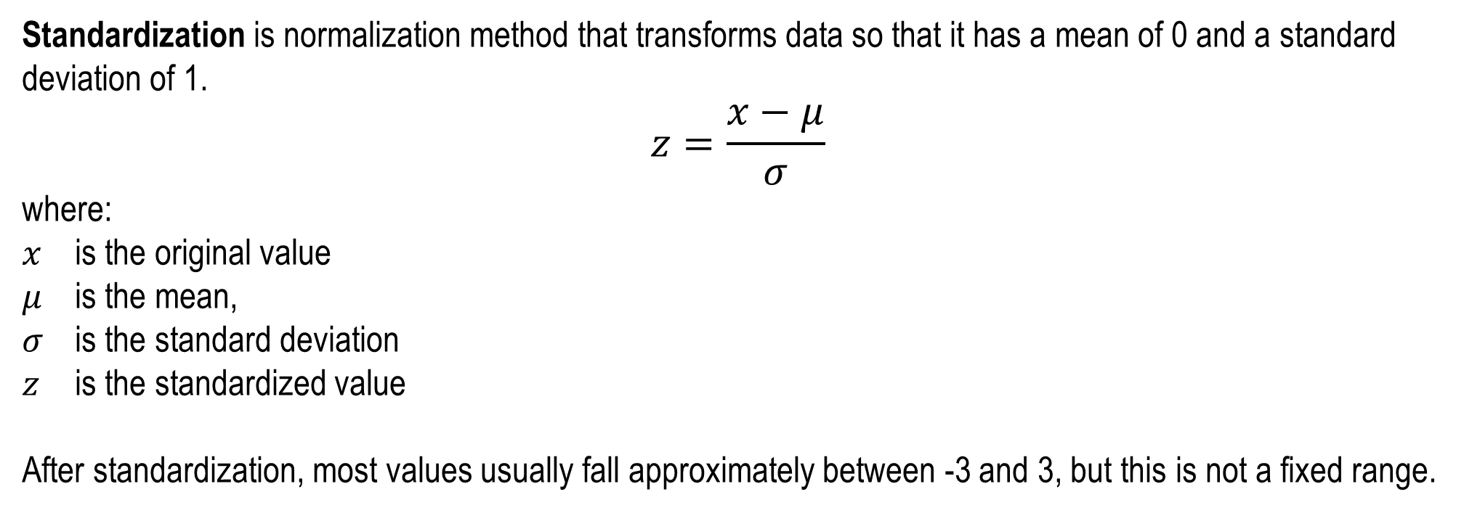
Data in ML – normalization
Standardization is normalization method that transforms data so that it has a mean of 0 and a standard deviation of 1.
$$z=\frac{x−μ}{σ}$$
where: $x$ is the original value $μ$ is the mean, $σ$ is the standard deviation
$z$ is the standardized value
After standardization, most values usually fall approximately between -3 and 3, but this is not a fixed range.

Slide 64
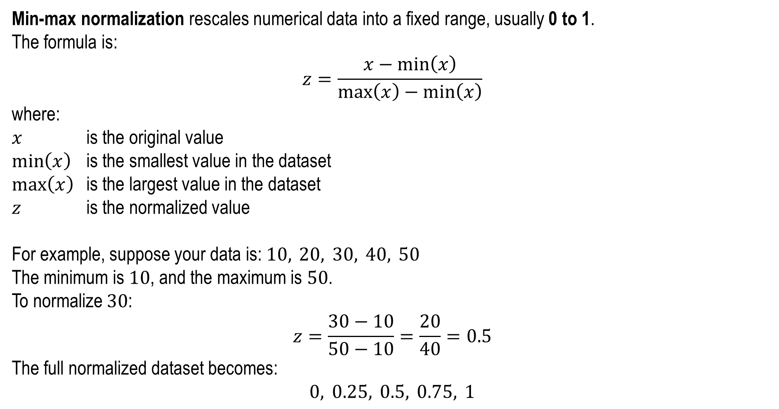
Data in ML – normalization
Min-max normalization rescales numerical data into a fixed range, usually 0 to 1.
The formula is:
$$z=\frac{x−min⁡\left(x\right)}{max⁡\left(x\right)−min⁡\left(x\right)}$$
where:
$x$ is the original value
$\min\left(x\right)$ is the smallest value in the dataset
$max⁡\left(x\right)$ is the largest value in the dataset
$z$ is the normalized value
For example, suppose your data is:$10, 20, 30, 40, 50$
The minimum is $10$, and the maximum is $50$.
To normalize $30$:
$$z=\frac{30−10}{50−10}=\frac{20}{40}=0.5$$
The full normalized dataset becomes:
$$0, 0.25, 0.5, 0.75, 1$$

Slide 65
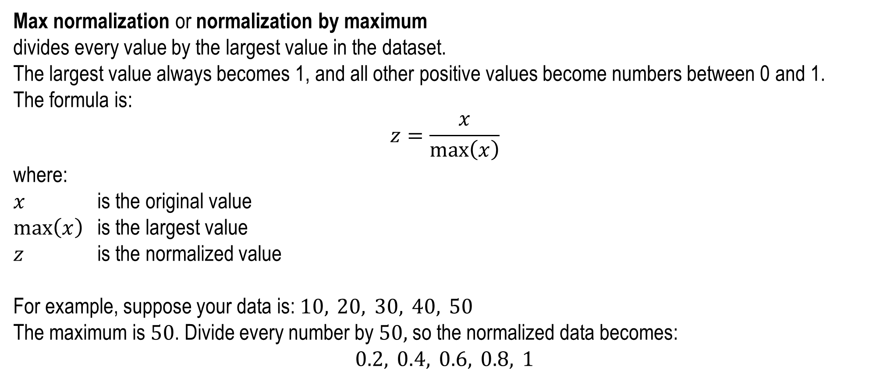
Data in ML – normalization
Max normalization or normalization by maximum
divides every value by the largest value in the dataset.
The largest value always becomes 1, and all other positive values become numbers between 0 and 1.
The formula is:
$$z=\frac{x}{max⁡\left(x\right)}$$
where:
$x$ is the original value
$max⁡\left(x\right)$ is the largest value
$z$ is the normalized value
For example, suppose your data is:$10, 20, 30, 40, 50$
The maximum is $50$. Divide every number by $50,$ so the normalized data becomes:
$$0.2, 0.4, 0.6, 0.8, 1$$

Slide 66
Data in ML – one hot encoding
One-hot encoding
The technique involves generating a vector representation of a word, sentence, text, categorical data.
Example:
Original colour column contains the following possible colours: red, green, blue, yellow. Of course, every color appears many times in the column.
If we assign the numbers 1, 2, 3, 4 to these colors, we establish an order among them – that is, implying that colour number 2 is “more important” than colour number 1, and so on, but that is not true. As a result, our data would convey incorrect information.
Instead, we use one-hot encoding, which converts categorical values into separate binary columns.
Each unique colour becomes its own column:
Colour | Colour_red | Colour_green | Colour_blue | Colour_yellow
red | 1 | 0 | 0 | 0
green | 0 | 1 | 0 | 0
blue | 0 | 0 | 1 | 0
yellow | 0 | 0 | 0 | 1
As a result, we have more columns, but we aren't introducing any relationships between data that don't actually exist, so our data are correct and more precise.

Slide 67
Tensors
Tensor – the basic data structure in ML systems.
A tensor is a generalization of a matrix:
a zero-dimensional tensor is a scalar, e.g. 3.56.
a one-dimensional tensor is a vector, e.g. [3, 5, 6, 2, 56, 21].
a two-dimensional tensor is a matrix.
there are also multidimensional tensors.

Slide 68
Tensors
Tensor attributes:
1. Number of axes (rank) – for example, a matrix has two axes, so it is a rank-2 tensor.
2. Shape – a tuple of integer values that defines the size of each axis of the tensor.
For example:
a scalar, or zero-dimensional tensor, is described by an empty shape tuple: ()
a vector, or rank-one tensor, has shape (m,). For example, the vector [3, 5, 6, 2, 56, 21] has shape (6,).
a matrix has shape (n, m).
3. Data type:
real-number type, such as float, or in NumPy, float32 or float64
integer type, such as int, int8, int32, or int64
text type, such as string
Example:
2.3 4.2 3.3
4.1 4.6 0.2
Is a tensor:
rank?
shape?
data type?
2
(2,3)
float

Slide 69
Tensors
Examples of tensors
Two-dimensional tensors (samples, features) – the most commonly used.
Example:
A dataset containing 100,000 people (samples), each described by three attributes: age, height, and weight, will be stored as a tensor with shape?
(100000, 3)
The number of axes, or rank, of this tensor is?
2
Three-dimensional tensors (samples, features, time) – used for time-series analysis.
Example:
Every minute, the minimum and maximum stock price is recorded as a vector: time, minimum price, maximum price. Data from one whole day (480 minutes) will be stored as a two-dimensional tensor with shape: (480, 3). Data from one whole year, assuming that there are 250 trading days in the year, will be stored as a tensor with shape?
(250, 480, 3)

Slide 70
Tensors
Examples of tensors, cont.
Four-dimensional tensors (samples, height, width, color depth) – used for image recognition.
Example:
For 500 colour images with a size of 50 × 60 pixels, a tensor with the following shape is required(?):
(500, 50, 60, 3)
where the last axis, with dimension 3, represents the color channels (RGB).
Five-dimensional tensors (samples, frames, height, width, color depth).
Example:
A video with a resolution of 144 × 256 lasting 60 seconds, at a frame rate of 4 frames per second, would consist of 240 frames (4 × 60).
A sample of five videos can be stored in a tensor with the following shape(?):
(5, 240, 144, 256, 3)

Slide 71
Tensors
Selected operations on tensors:
reshaping a tensor – changing the size, number of axes, or rank of a tensor. For example, a one-dimensional tensor can be transformed into a two-dimensional tensor. The reshaped tensor has the same number of elements as the original one. Example: tensor (24,) can be converted into (8,3) or (4,2,3)
flattening – a reshape operation that involves transforming a multidimensional tensor into a one-dimensional tensor
split – dividing a tensor into several smaller tensors along a selected axis. Example: a tensor with dimensions 8×4 can be divided into two tensors with dimensions 6×4 and 2×4.

