Slide 1

TAPI 1.0 SDK Overview ONF MWD, Sept 7, 2016
Karthik Sethuraman, NEC
Bernd Zeuner, Deutsche Telekom
Hui Ding, CATR
Ricard Vilalta, CTTC
Italo Busi, Huawei
Lyndon Ong, Ciena

Slide 2
Session Outline
TAPI SDK 1.0.x Overview
TAPI SDK Eclipse Environment
TAPI UML Model
TAPI YANG Schema
TAPI Swagger and RI
TAPI Developer Guide
TAPI Englewood
TAPI Next Steps

Slide 3
TAPI SDK Overview
Karthik Sethuraman

Slide 4
Key features of TAPI SDK
Technology-agnostic API Framework
Standardizes a single core technology-agnostic specification that abstracts common transport network functions for the interface
Facilitate exchange of diverse network information, specific to different technology layers in a consistent manner using the same set of APIs
Modular & Extensible
Functional features are packaged into small self-contained largely-independent modules
TAPI Core Spec is designed to be fully extensible
Industry-wide Interoperability Objective – developed within
Open Source SDN SNOWMASS project under Apache 2 license
SDK components generated using tools for agile prototyping
YANG schema generated from UML using guidelines developed in an multi-SDO initiative (IISOMI)
Swagger/JSON APIs generated from YANG following RESTConf specification

Slide 5
TAPI – ONF and OSSDN Project Dependencies
ONF-OTWG
TAPI FRS
Use cases & Requirements
ONF-IMP
ONF Core Information Model
TAPI UML Information Model
Prune-Refactor
Open Model Profile
ONF Technology Specification Models
UML-YANG Generation Tool
TAPI YANG Data Schema
OSSDN SNOWMASS
YANG-SWAGGER Generation Tool
SWAGGER/REST APIs
OTN
(ITU-T G.874.1)
ETH
(ITU-T G.8052)
MPLS-TP
(ITU-T G.8152)
Code
Python Stub Generation Tool
ONF OTWG IM
Python Reference Implementation
OSSDN EAGLE
TAPI Platform Abstraction Layer & Framework
OSSDN ENGLEWOOD

Slide 6
TAPI SDK Organization & Modularity
ONF Transport API Functional Requirements – TR-527, June 2016
ONF Open Transport WG Project
Input to the TAPI SDK
Software-wise, TAPI SDK 1.0.0 is packaged as 4 eclipse sub-projects
Papyrus-UML Information Model
A pruned/refactored version of ONF Core IM
Is a technology-agnostic generic framework + technology specific extensions (OTN, ETH)
YANG Data Schema
auto-generated from UML using OSSDN Eagle Tools
Swagger-JSON RESTConf API
auto-generated from YANG using OSSDN Eagle tools
Reference Implementation (RI) in Python
Feature-wise, TAPI SDK is organized as a module-set of {UML-Model, YANG-Module, Swagger-API} per TAPI functional interface

Slide 7
TAPI Functional Interface Modules
TAPI functional interface modules are defined in terms of TAPI services
TAPI v1.0 supports following key Services
Topology-Service
Connectivity-Service
Path-Computation-Service
Virtual-Network-Service
Notification-Service
TAPI v1.0 supports following key Resources
Service-End-Point, Layer-Protocol
Topology, Node, Link, Node-Edge-Point,
Connection, Connection-End-Point, Route, Path
Notification, Subscription-Filter
TAPI resources are controlled/manipulated via service operations
TAPI defines an shared Context between the TAPI provider and client
Acts as a container for all exchanged TAPI services and resources

Slide 8
ONF Transport – API & Interfaces: Functional Architecture
Application
SDN Controller
NE
NE
NE
NE
Transport API
Topology Service
Connectivity Service
Path Computation Service
Virtual Network Service
Notification Service
Shared Network Information Context
SBIs (e.g. Openflow Optical)
Transport API
Network Resource Groups
SDN Controller
NE
NE
NE

Slide 9
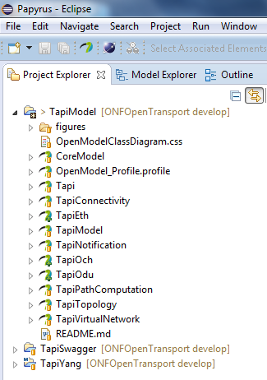
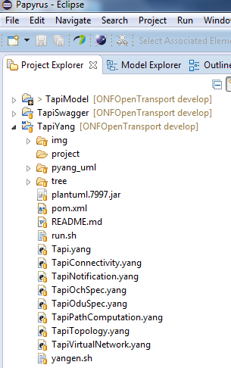
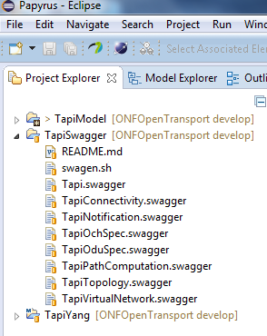
TAPI Projects & Models/Modules

Slide 10
Extensibility
TAPI Core Spec is designed to be fully extensible
Extensions can be Technology, SDO, Operator or Vendor specific
Using following design patterns
Specialization – via standard UML inheritance (sub-classing)
Specification – via UML composition decorated with OpenModelProfile stereotypes
TAPI Core defines following base classes to model specification pattern
Service-Spec – Used to specify different types of TAPI services
Resource-Spec – Used to specify different types of TAPI resources
Extensions-Spec – Used to specify extensions to standardized TAPI services/resources
All concrete TAPI global/local classes (services/resources) can be extended via the extensions attribute

Slide 11
Compliance & Interoperability
TAPI-compliance is measured per TAPI-functionality (service/module)
It is allowed to support only some of the defined TAPI functional modules as along the required module dependencies are supported
For TAPI-compliance, it is necessary to conform to the standardized TAPI Core service/resource construct, attributes and relationships
Encouraged to use the TAPI extensions mechanism to extend TAPI core specification, so that TAPI interoperability is well defined.
With maturity & acceptance, the common abstractions in extensions would be migrated into the core spec (if possible)
For TAPI compliance, it is not compulsory to support any of the TAPI-defined extensions including TAPI technology-extensions
SDOs/Operators/Vendors are free to define their own extensions by directly implementing the Extension-Spec
It is recommended to leverage TAPI-defined technology extensions, by specializing (sub-classing) those extensions

Slide 12
TAPI Eclipse IDE
Bernd Zeuner – onf2016.285.xx

Slide 13
Content
„Installing“ Papyrus
Latest Version
Older Version
Adding Gendoc Plugin
Adding YANG Viewer/Editor
Constructing TAPI Modeling Environment

Slide 14







Overview
YANG IDE
JSON Editor Swagger
Eclipse Modeling Tools
Download Package

Slide 15

“Installing Papyrus”
Latest Version
For details see TR-515 Papyrus Guidelines section 5.1.1

Slide 16
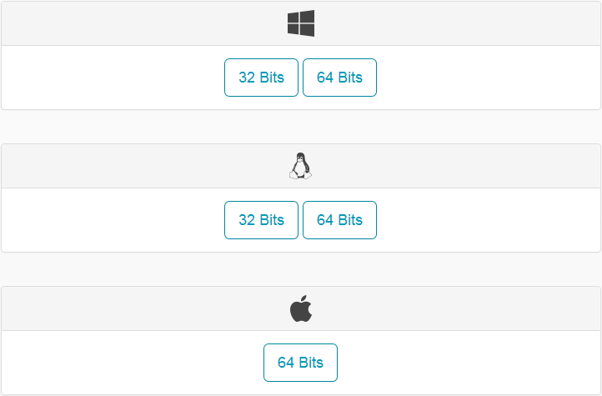
“Installing” Papyrus Latest Version
Papyrus Neon release 2.0.0 (soon to be used in ONF)
Note: Requires a 1.8 compatible JVM
Papyrus homepage: https://eclipse.org/papyrus/download.html

Slide 17
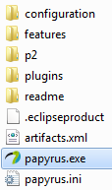

“Installing” Papyrus Latest Version
Once downloaded, just extract the downloaded zip-file:
To launch Papyrus, double-click on the papyrus.exe file
A default workspace folder is created in the home directory (…/users/<users name>/)
Any empty (need not be empty but is recommended) folder can be used as a workspace-folder.

Slide 18
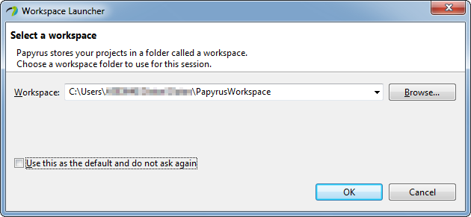
“Installing” Papyrus Latest Version
Workspace can be selected during launch of Papyrus
Done

Slide 19
“Installing Papyrus”
Older Version
For details see TR-515 Papyrus Guidelines section 5.1.2

Slide 20
“Installing” Papyrus Older Version
Papyrus Mars release 1.1.x (used so far in ONF)
Note: Requires a 1.7 compatible JVM
Eclipse “Mars” Modeling Tools download: http://www.eclipse.org/downloads/packages/eclipse-modeling-tools/mars2
Download Links
Windows 32-bit
Windows 64-bit
Mac OS X (Cocoa) 64-bit
Linux 32-bit
Linux 64-bit

Slide 21
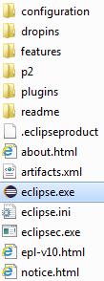
“Installing” Papyrus Older Version
Once downloaded, just extract the downloaded zip-file:
To launch Papyrus, double-click on the eclipse.exe file
A default workspace folder is created in the home directory (…/users/<users name>/)

Slide 22
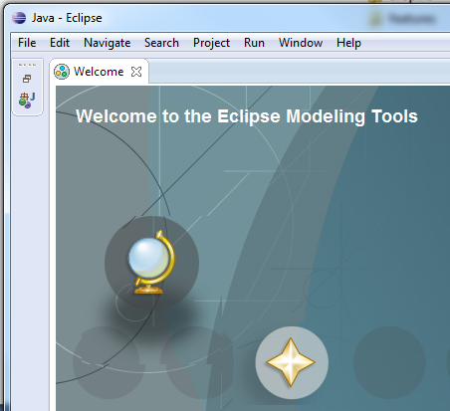
“Installing” Papyrus Older Version
Any empty (need not be empty but is recommended) folder can be used as a workspace-folder.
Workspace can be selected during launch of Papyrus
Close Welcome page

Slide 23
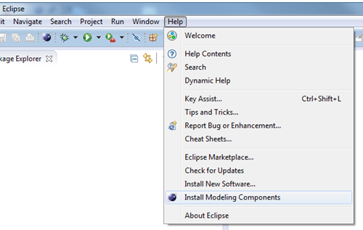
“Installing” Papyrus Older Version
Add Papyrus Modeling Component to eclipse

Slide 24
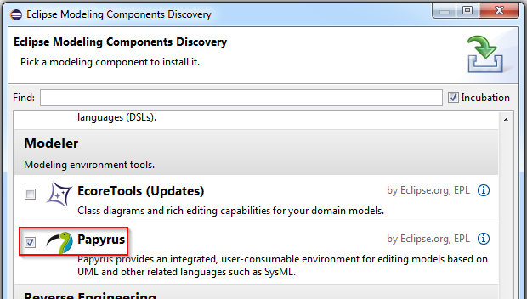
“Installing” Papyrus Older Version
Add Papyrus Modeling Component to eclipse
Restart eclipse

Slide 25
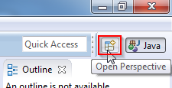
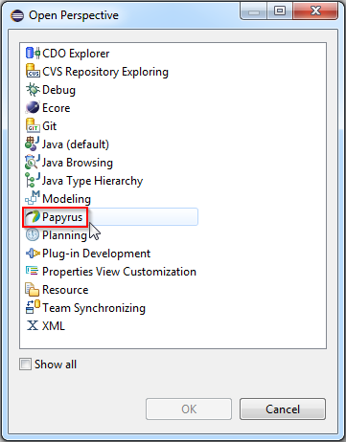

“Installing” Papyrus Older Version
Switch to the Papyrus Perspective
Done

Slide 26
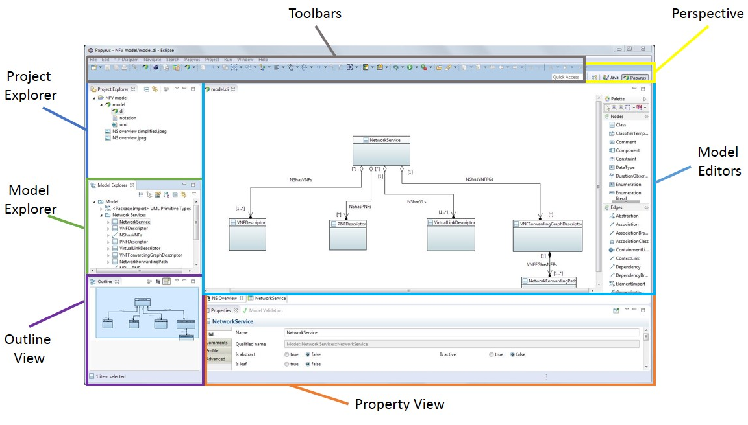
Outline of Papyrus Perspective

Slide 27
Adding Gendoc Plugin
For installation details see TR-515 Papyrus Guidelines section 5.3
For usage details see TR-515 Papyrus Guidelines section 8

Slide 28

Adding Gendoc Plugin
Gendoc generates model documentation
Gendoc version 0.5.x (used so far in ONF)
Gendoc v0.5.1 update site: http://download.eclipse.org/gendoc/updates/releases/0.5.0/
Latest Gendoc version 0.6.0 (not released yet)
How to use it? See TR-515 Papyrus Guidelines section 8
template
documentation

Slide 29
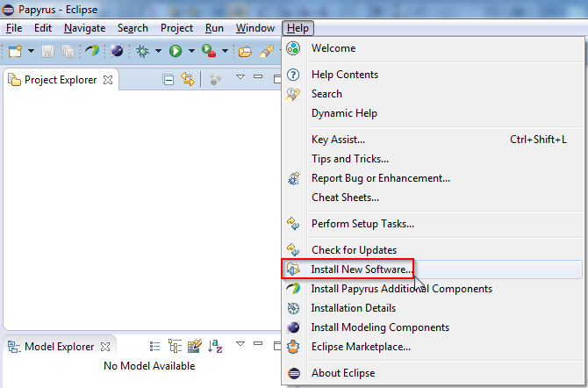
Adding Gendoc Plugin
Adding Gendoc to eclipse

Slide 30
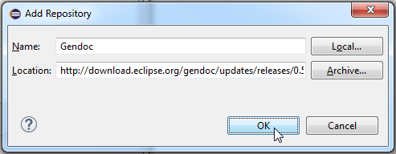
Adding Gendoc Plugin
Add Gendoc update site

Slide 31
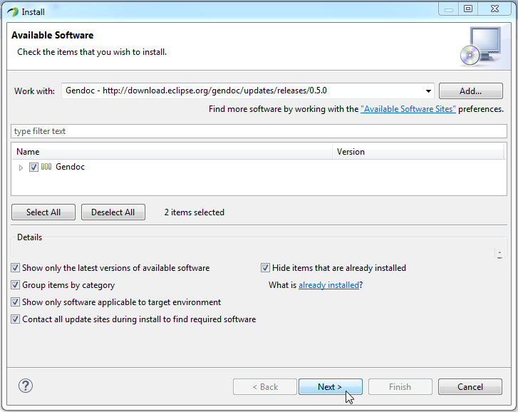
Adding Gendoc Plugin

Slide 32
Adding YANG Viewer/Editor
For details see TAPI Guide section 4.2?

Slide 33
Adding YANG Viewer/Editor
Using xored YANG IDE
Wiki page: https://github.com/xored/yang-ide/wiki
YANG IDE version 1.1.1 (used so far in ONF)
Git repository: http://dl.xored.com/yang/releases

Slide 34
Adding YANG Viewer/Editor
Adding YANG IDE to eclipse

Slide 35
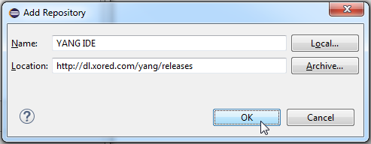
Adding YANG Viewer/Editor
Add YANG IDE repository site

Slide 36
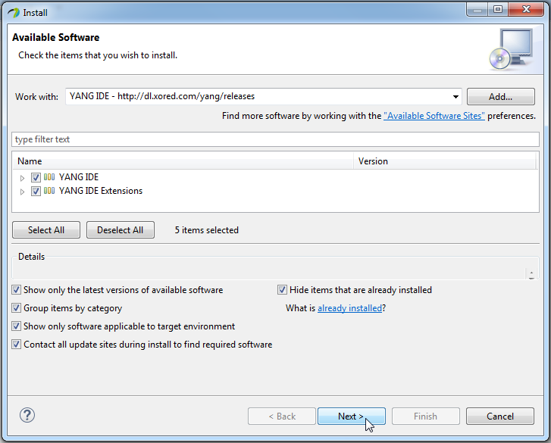
Adding YANG Viewer/Editor

Slide 37
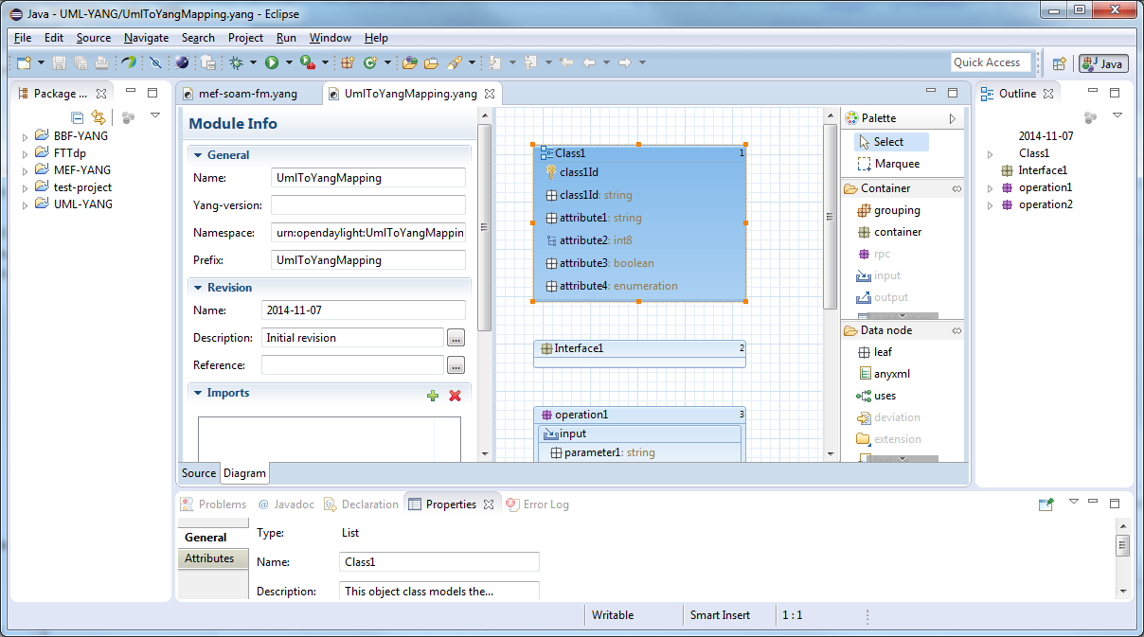
Adding YANG Viewer/Editor

Slide 38
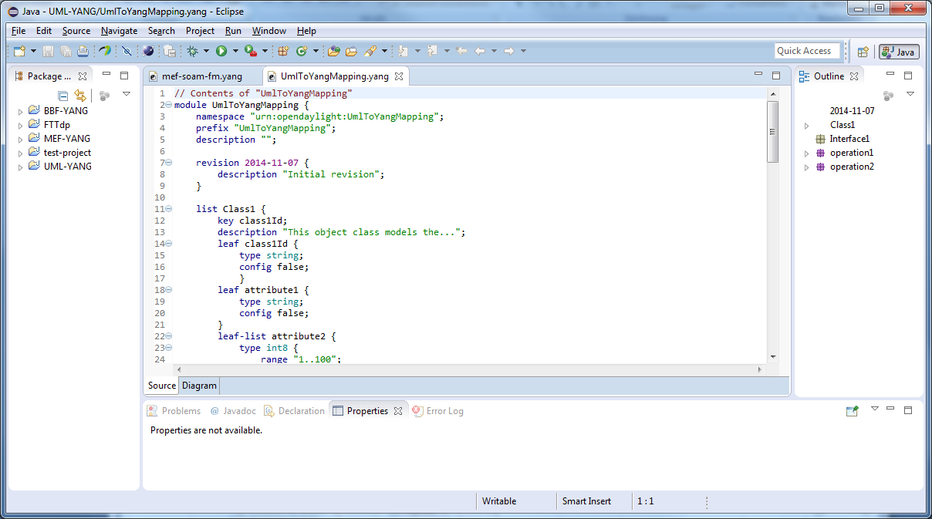
Adding YANG Viewer/Editor

Slide 39
Constructing TAPI Modeling Environment
For details see TR-515 Papyrus Guidelines section 7.6

Slide 40
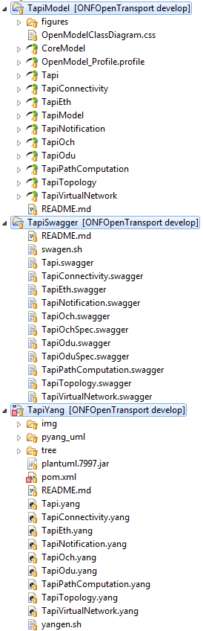
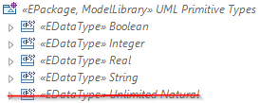
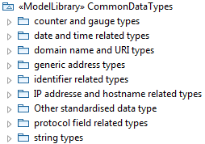

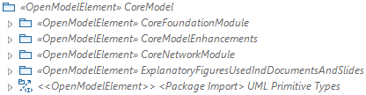
New stereotypes for the Spec model:
ExtendedComposite
SpecifiedComposite
DefinedBySpec
SpecReference
Apply Profile to Model
Import UML Primitive Types
Import TAPI Model
Import Class Diagram Style Sheets
Import Data Types Library
Import CoreModel
Structure not agreed!!
planned

Slide 41
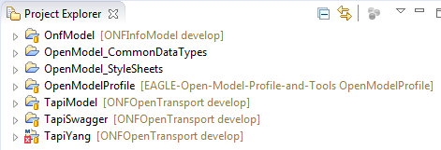
Constructing TAPI Modeling Environment Resource Locations
OpenModel_CoreModel Repository
OpenModel_CommonDataTypes Repository*
OpenModel_StyleSheets Repository*
OpenModel_Profile Repository
TAPI Repository
* not yet created
cloned

Slide 42





Constructing TAPI Modeling Environment Git Workflow
remote on GitHub
local on my PC
My Remote Repository
Local Repository
Local Working Directory
2
clone
OpenModel Profile
7
push
3
checkout branch
Staging
EAGLE Open Source Remote Repository
6
merge
1
fork
create remote
0
4
OpenModel Profile
5
fetch remote
administrator
user
automatically

Slide 43

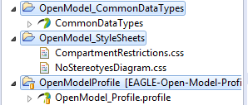
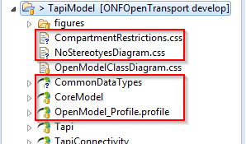
Constructing TAPI Modeling Environment Copy Resources to TAPI Project
copy

Slide 44
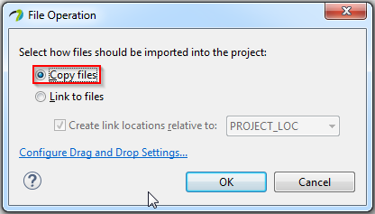
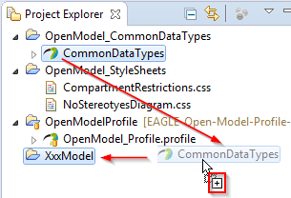
Constructing TAPI Modeling Environment Drag&Drop Resources to TAPI Project

Slide 45
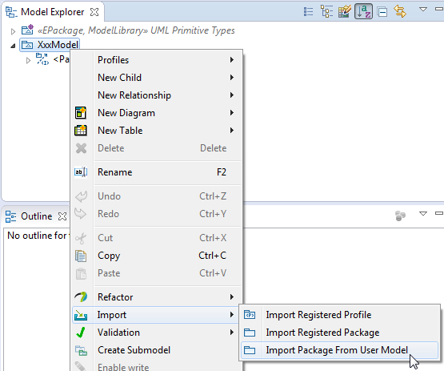
Constructing TAPI Modeling Environment Load CommonDataTypes library

Slide 46
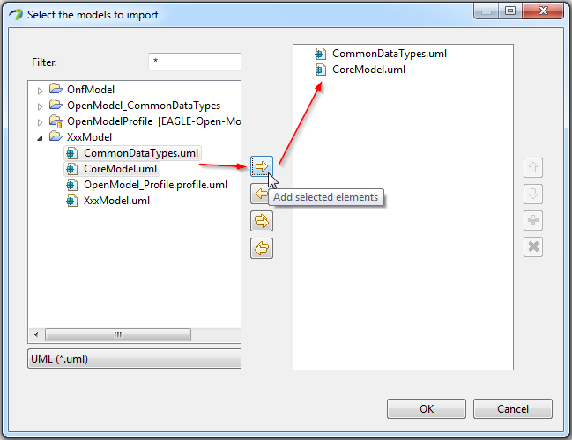
Constructing TAPI Modeling Environment Load CommonDataTypes library

Slide 47
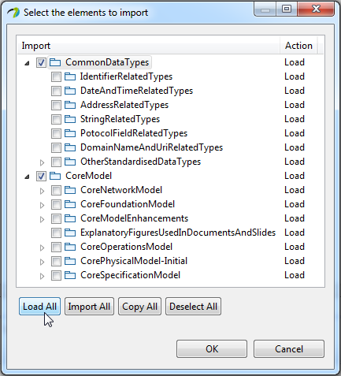
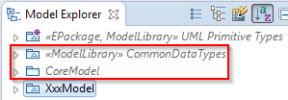
Constructing TAPI Modeling Environment Load CommonDataTypes library

Slide 48
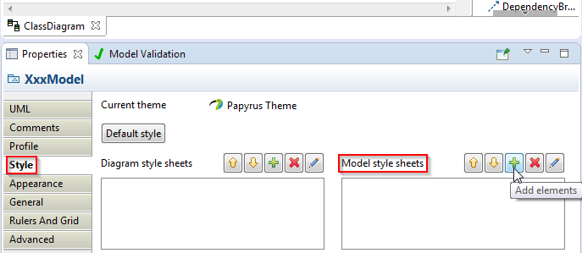
Constructing TAPI Modeling Environment Add Style Sheets

Slide 49
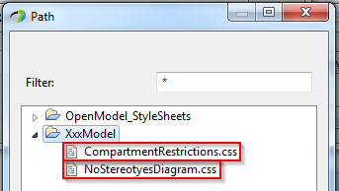
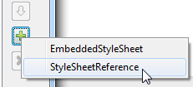
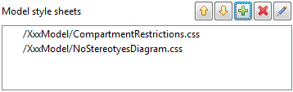
Constructing TAPI Modeling Environment Add Style Sheets

Slide 50
TAPI UML Information Model
Karthik Sethuraman

Slide 51
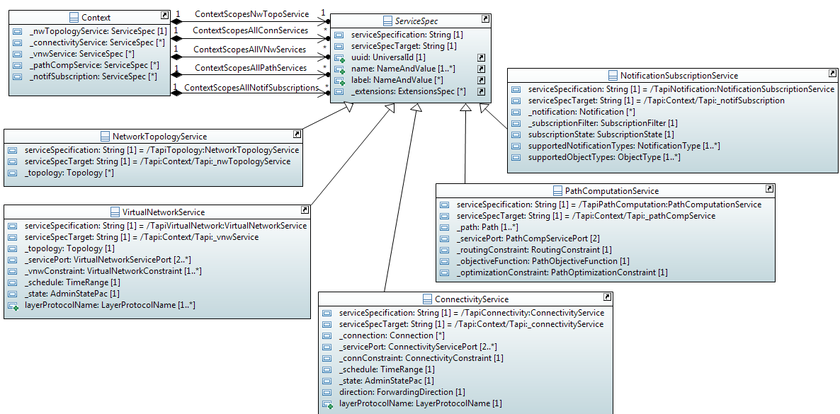
TAPI Core Spec - Services

Slide 52
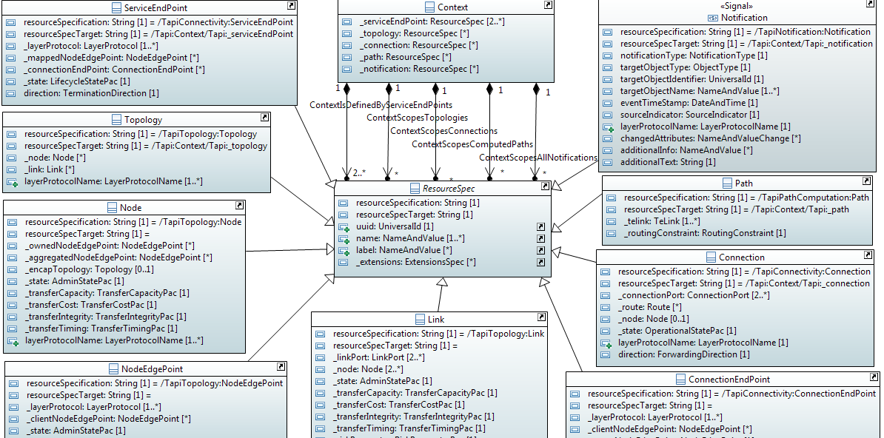
TAPI Core Spec - Resources

Slide 53
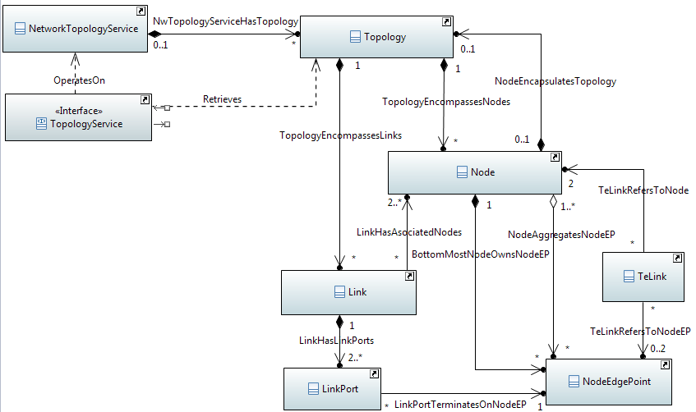
TAPI Topology Skeleton

Slide 54
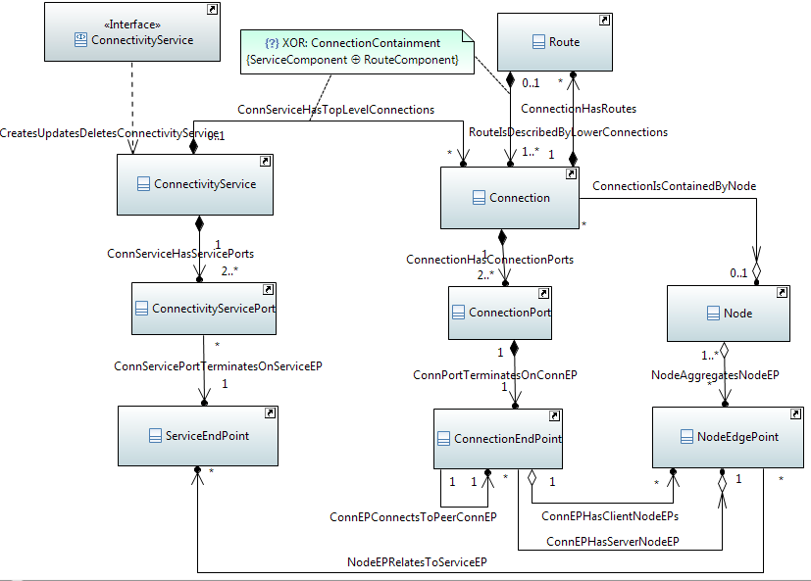
TAPI Connectivity Skeleton

Slide 55
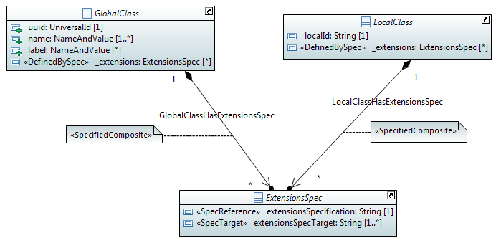
TAPI Classes & Extensions-Spec Pattern
Stereotype indicates that the attribute information will be defined by an concrete specification class in an external (unknown) entity rather than the currently assigned abstract type/class
These attributes will be populated by the concrete specification sub-class

Slide 56
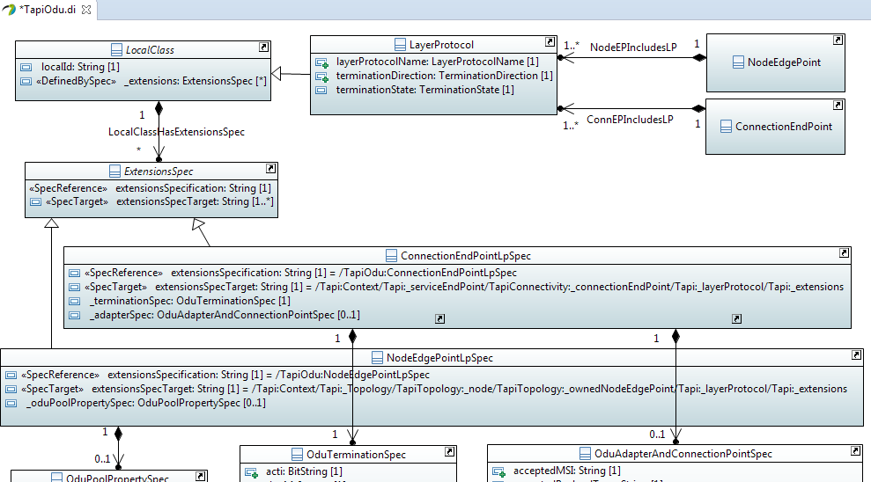
Spec Example: Extension-Spec for ODU Layer-Protocols
TAPI Core Spec Classes
Extends LayerProtocol
TAPI Odu Extension-Spec Classes

Slide 57
TAPI YANG Data Schema
Hui Ding

Slide 58
Overview
Objective
Translates a UML (Unified Modeling Language) model to a YANG model defined in RFC6020
Scope
Work with swagger tool to generate RESTful/RESTconf APIs
Fed to controllers, Apps for interface generation
UML to YANG Mapping Gdls
UML Model
YANG Model
ONF TR-514
IETF RFC 6020

Slide 59



UML to YANG Tool
UML model
Object
Classes
owned
Attributes
Associations
OpenModelProfile
YANG Tool
module
node
leaf
leaf-list
type
rpc
YANG model

Slide 60
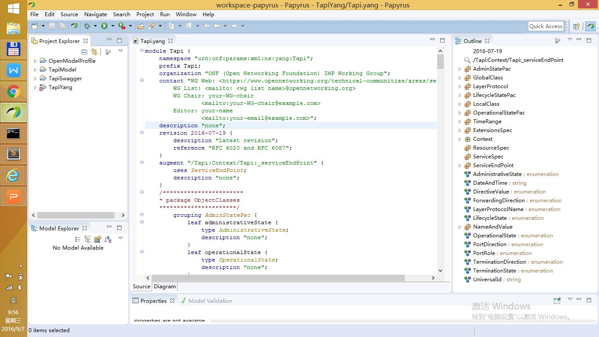
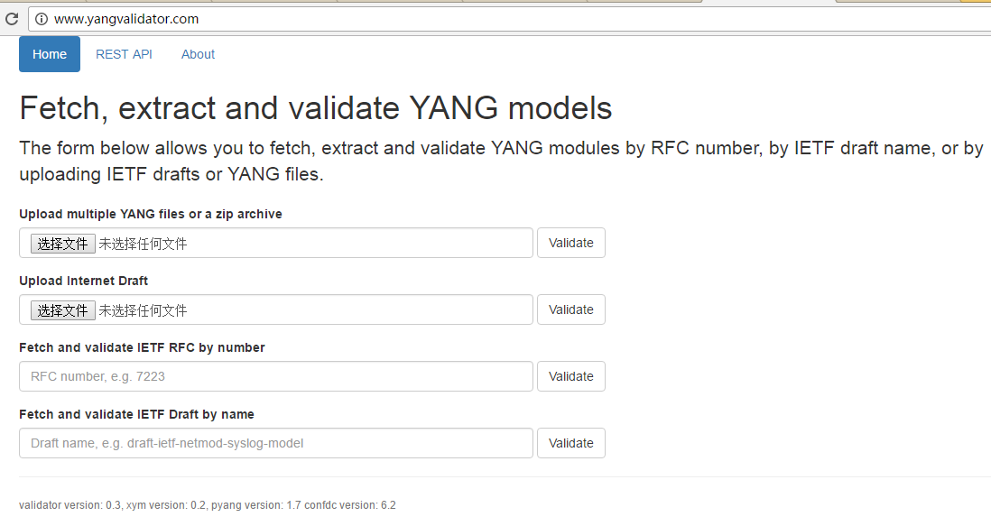
Validate/View YANG files
Eclipse xored IDE: RFC 6020 validation, GUI view
pyang: RFC 6020/6087 validation, command line
YANG validator: RFC 6020/6087 validation, online tool

Slide 61
Yang Tool Demonstration

Slide 62
TAPI SWAGGER API
Ricard Vilalta

Slide 63
T-API Swagger specifications
The T-API Swagger specifications provide a mapping from the Yang data schema into JSON Swagger, which can then be used to generate Python and Java code for implementation of the API in RestConf.

Slide 64
YANG data models
YANG is a modeling language designed to create data models for the NETCONF protocol and more recently to RESTCONF. YANG is capable to define configuration and operational state data, remote procedure calls (RPCs) and Notifications.
YANG includes description of:
Config
State
RPCs
Notifications

Slide 65
RESTconf
RESTCONF is a REST-like protocol that provides a HTTP-based API to access the data, modeled by YANG. The REST-like operations are used to access the hierarchical data within a data store. The information modeled in YANG is structured in the following tree:
/restconf/config : “Data (configuration/operational) accessible from the client but not editable”
/restconf/modules : “Set of YANG models supported by the RESTCONF server”
/restconf/operations : “Set of operations (YANG-defined RPCs) supported by the server”
/restconf/streams: “Set of notifications supported by the server”. They are implemented in a websocket
With YANGs + RESTconf ➔
We have the complete Transport REST NBI

Slide 66
T-API Swagger: Documentation
Swagger is a project used to describe and document RESTful APIs.
Swagger 2.0 specification:
http://swagger.io/specification/

Slide 67
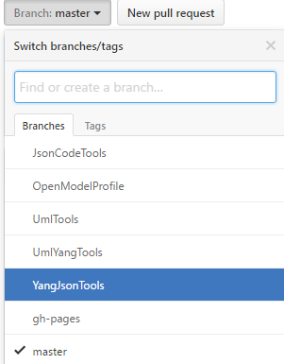
T-API Swagger: From YANG to Swagger Specs
Project Eagle YangJsonTools
https://github.com/OpenNetworkingFoundation/EAGLE-Open-Model-Profile-and-Tools/tree/YangJsonTools
Includes a plugin for Pyang
https://github.com/mbj4668/pyang
Pyang is a YANG validator, transformator and code generator, written in python. It can be used to validate YANG modules for correctness, to transform YANG modules into other formats, and to generate code from the modules.
The project EAGLE YangJsonTools plugin processes the YANG files and describes the associated RESTconf interface using Swagger REST definitions.

Slide 68
T-API Swagger: Project SNOWMASS

Slide 69
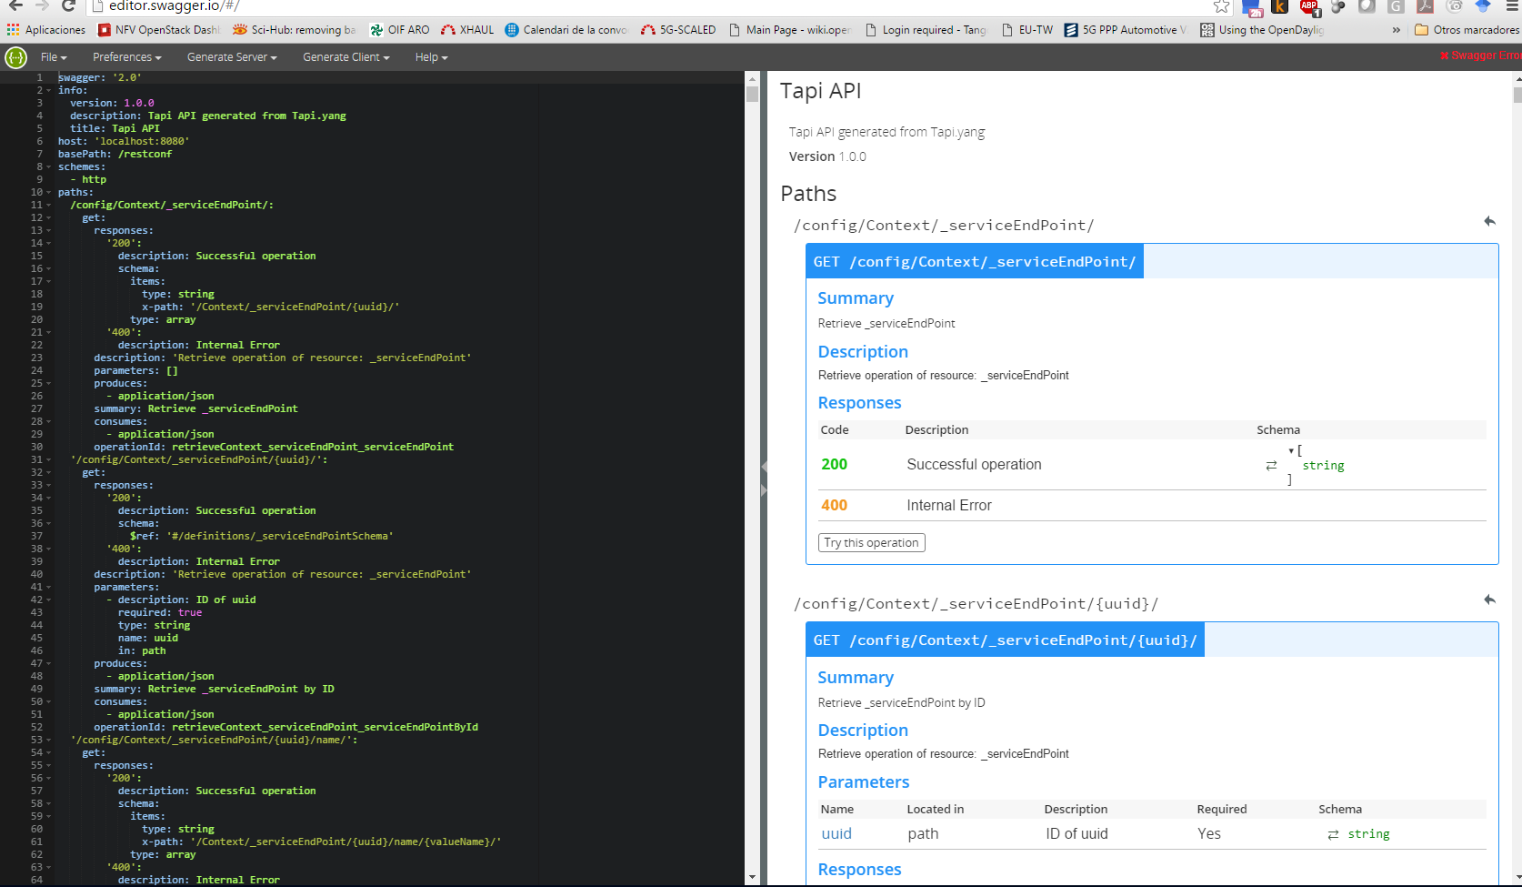
T-API Swagger: Editing Swagger Specs
Using Eclipse JSON editor
Described in T-API Developer Guide
Using Swagger on-line editor
http://editor.swagger.io/

Slide 70
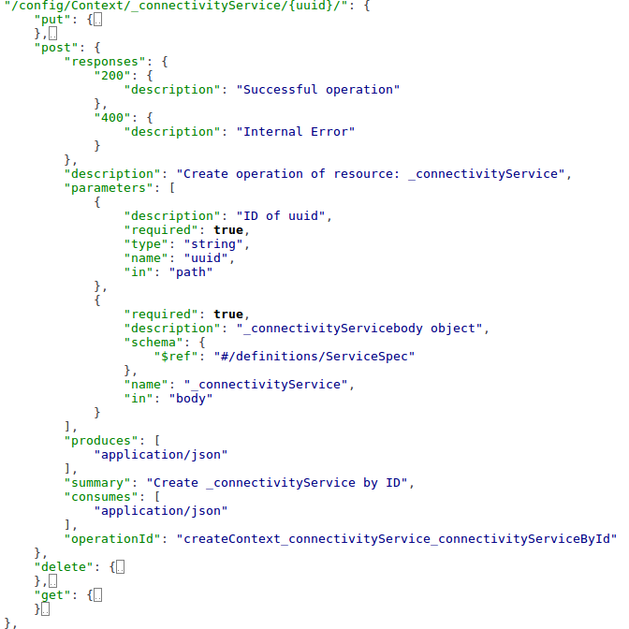
T-API Swagger: Understanding Swagger specs
Paths
Each path may include CRUD (POST, GET, PUT, DELETE) if config
Only GET is allow for State data
Each CRUD includes the following details:
Summary
Parameters (in path or in body)
Responses
Produces/consumes

Slide 71
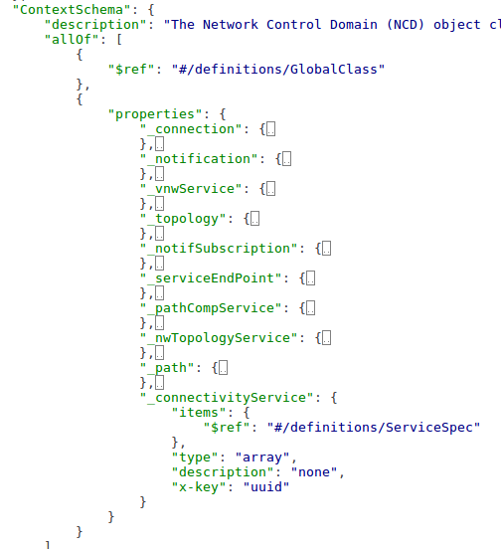
T-API Swagger: Understanding Swagger specs
Definitions
They allow inheritance (allOf)
Items are described in properties
Other descriptions might be referenced (e.g., connectivityService)

Slide 72



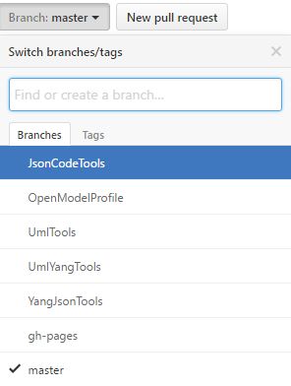
Creating a T-API Reference Implementation
Project EAGLE JsonCodeTools
https://github.com/OpenNetworkingFoundation/EAGLE-Open-Model-Profile-and-Tools/tree/JsonCodeTools
Server Generator for Python
Python code that uses Swagger json outputs from YangJsonTools to generate a RESTful and websocket server and the defined swagger objects, paths and notifications.
SWAGGER files
Project EAGLE JsonCodeTools
T-API Reference Implementation

Slide 73

T-API RI: Reference Network
Described in: https://github.com/OpenNetworkingFoundation/Snowmass-ONFOpenTransport/blob/develop/TAPI_RI/server_backend_state.json

Slide 74
T-API RI: Status load
In order to load this scenario in T-API RI, please use the following REST call:
curl -X POST -H "Content-Type: application/json" http://127.0.0.1:8080/backend/load_state/
Response: 200 Loaded State

Slide 75
T-API RI: Basic commands I
GET topologies
curl -X GET -H "Content-Type: application/json" http://127.0.0.1:8080/restconf/config/Context/_topology/
Response:
{
"itemlist": [
"http://127.0.0.1:8080/restconf/config/Context/_topology/top0"
]
}

Slide 76
T-API RI: Basic commands II
GET topology top0
curl -X GET -H "Content-Type: application/json" http://127.0.0.1:8080/restconf/config/Context/_topology/top0/
Response:
{
“_node” : [ … ],
“_link” : [ …],
“uuid” : “top0”
}

Slide 77
T-API RI: Basic commands III
GET ServiceEndPoints
curl -X GET -H "Content-Type: application/json" http://127.0.0.1:8080/restconf/config/Context/_serviceEndPoint/
Response:
{
"itemlist": [
"http://127.0.0.1:8080/restconf/config/Context/_serviceEndPoint/se1",
"http://127.0.0.1:8080/restconf/config/Context/_serviceEndPoint/se2"
]
}

Slide 78

T-API RI: Connectivity Service workflow

Slide 79

T-API RI: Establish Connectivity Service
curl -X POST -H "Content-Type: application/json" http://127.0.0.1:8080/restconf/config/Context/_connectivityService/cs1/ -d‘
{"uuid":"cs1",
"_connConstraint":{
"serviceType":"POINT_TO_POINT_CONNECTIVITY", "serviceLayer":["OCH"] }, "_servicePort":[
{ "localId":"sp1", “serviceLayer":"OCH" , "direction":"BIDIRECTIONAL", "role":"SYMMETRIC", "_serviceEndPoint":http://127.0.0.1:8080/restconf/config/Context/_serviceEndPoint/se1
},
{ "localId":"sp2", "serviceLayer":"OCH" , "direction":"BIDIRECTIONAL", "role":"SYMMETRIC", "_serviceEndPoint":http://127.0.0.1:8080/restconf/config/Context/_serviceEndPoint/se2
} ]
}'

Slide 80

T-API RI: Notifications
Notifications will be provided with Websockets. T-API reference implementation provides an example of a client accessing the websocket:
http://localhost:8182/restconf/streams/NotificationService

Slide 81
TAPI ENGLEWOOD PAL
Italo Busi

Slide 82
Overview
Objective – Facilitate implementation and deployment of ONF T-APIs
Addressing SDN environments where different platforms are used, including migration from legacy networks toward SDN
Application implementation independent from the controller platform
Provide feedbacks to the ONF about the requirements for T-API definitions
Scope – develop code (SW modules) to prototype, test and validate ONF standard Transport APIs
Platform Abstraction Layer (PAL) over existing controller platforms: current focus are ONOS, ODL and NetIDE
Simple example APPs to test and demonstrate Transport API capabilities
Simple Network emulator, based on message and event generator, to support simple testing of Transport API code
Integration work to verify correct operation and standard compliance for APPs and controllers

Slide 83
Status
Project started at the September 2015 MWD
Procject Scope defined
SW Architecture for the PAL finalized
Next steps
Finalise the SW architecture for the ONOS and NetIDE Handlers
Start coding
Develop ODL Handler and Emulator

Slide 84
Englewood Deliverables
APP1
APP2
APP3
APP2
APP1
T-API
T-API
PAL
T-API Layout
assemble
T-API Layout
Utils Layout
Utils
Layout
Adapter Layout
Adapter Layout
Handler 1
Handler 2
Handler 3
Handler 3
Controller 3
Output of Englewood projects
Instance
(Englewood Components)
Due to the standard T-API and generic PAL infrastructure, the deployment of Englewood can be very flexible by assembling those Englewood components e.g. picking up some APPs, an handler and the common PAL to build up an instance.

Slide 85
PAL Deployment Models
T-API
T-API
PAL
T-API Layout
PAL
T-API Layout
Utils Layout
Utils Layout
Adapter Layout
Adapter Layout
Broker Device
Platform-specific Handler
Platform-specific Handler
Internal APIs
Wire Protocol
Core Platform
Core Platform
Integrated Approach
Split Approach

Slide 86
Testing and Integration
Code Testing Purposes
Integration
APP1
APP1
T-API
T-API
PAL
PAL
T-API Layout
Utils Layoyt
T-API Layout
Utils Layout
Adapter Layout
Adapter Layout
Handler
Handler 3
Emulator /
Event Generator
Controller 3
SBI
Mininet/LincOE
Emulator

Slide 87
PAL Deployment
APP
PAL
Controller
(ONOS, ODL, Proprietary)
T-API
PAL
PAL
PAL
PAL
NMS
ONOS
ODL
Proprietary
Any new Platform

Slide 88
Platform Abstraction Layer
Build Transport APIs support over any existing controller platform
NOT to build a new controller platform
NOT to implement features complementing those offered by existing controller platforms
Develop software modules that would support T-API processing, mapping and translation of standard Transport APIs toward platform-specific APIs encompassing:
platform-independent Platform Abstraction Layer (PAL) Layout
platform-dependent Handler
Develop Handlers for existing open-source platforms, like ONOS and ODL
NetIDE is also another platform for which an handler will be developed
Other open-source platforms can be considered in the future.

Slide 89
Project Buildup: PAL using Karaf
T-API
Implement the standard T-API in restful style.
Karaf
NBI-Rest server (HTTP+JSON)
Mapping logic between standard restful T-API and internal programming interface.
Mapping
Unified Common interfaces, various underlying network models can be adapted to common interfaces to make a unified description of network.
There is a one-to-one relationship between common interface and standard T-API.
T-API Interface adapter/T-API Common interfaces
Interface Implement
Mapping to T-API common interface. Need to follow the programming interface that is defined by the PAL.
API handler Logic
Communication
Module
Communicate with underlying platform, no constraint for this part, free to choose any method/protocol (Rest/PCEP/OF/…)
Platform-Specific Handler
WHY Karaf ?
Apache Karaf is a small OSGi based runtime which provides a lightweight container onto which various components and applications can be deployed.
Features:
1. Open source framework
Well known, stable, Opensource/Free
2. Dynamic install/uninstall
Fit our requirement, decoupled component, Parallel development.
Development environment
1.JDK 8
2.apache-maven-3.x.x
3.apache-karaf-3.x.x
Deliverable
1. Available PAL code
2. Document/tutorial
3. Demo

Slide 90

PAL SW Architecture
PAL is a multi-module project whose modules are managed as OSGi bundles. Englewood is designed with a few goals in mind
Code Modularity: It should be possible to introduce new functionalities as self-contained units.

Slide 91

Englewood and NetIDE

Slide 92
Englewood and ONOS
Application
Standard T-API
Englewood
PAL Layout
Utils Layout
3th party library(Logging,, SSH,…)
TAPI Layout
(RESTful API bind specific Network Service, Topology Service, Intent Service…)
Service Layout
(Using OSGi component to provide Network Service. )
Adapter Layout
(Common Java Interface )
ONOS Handler
(Dynamic install/uninstall plug-in implementing Common Java Interface)
ONOS API: different options
ONOS

Slide 93
ONOS Hander Options – Summary
 | Feature Coverage | Split (1) Approach | ONOS Support | SW Upgrade to Option 3
Option 1 (REST) | Lower | Yes | Current | Yes
Option 2 (Java API) | Highest | No | Current | Hard
Option 3 (gRPC) | > option 1 = option 2 (tbc) | Yes | Planned
Option 4 (ONOS Java RMI) | = option 2 | Partially (2) | No (2) | Yes
Option 5 (T-API Java RMI) | = option 2 | Not really (3) | No (3) | Yes
Notes:
All options can support the integrated approach so not listed in the table
Need to implement RMI Skeleton within ONOS
Need to implement RMI Skeleton and ONOS handler-Java within ONOS: the interface between PAL and ONOS is not ONOS specific

Slide 94
ONOS Handler – Option 1 (REST)
Karaf
The two Karaf containers can be deployed in different systems (split approach) or in the same system (integrated approach)
PAL
PAL Layout (Common Part)
T-API Java
ONOS Handler - REST
ONOS REST API
Karaf
ONOS
REST API

Slide 95
ONOS Handler – Option 2 (Java APIs)
Karaf
This means PAL and ONOS are in the same Karaf container: PAL can be seen as an APP for ONOS.
The Karaf container can be implemented only in one system (integrated approach)
It seems hard to upgrade from this implementation to another implementation based on option 3
PAL
PAL Layout (Common Part)
T-API Java
ONOS Handler - Java
ONOS Java API
ONOS
Java API

Slide 96
ONOS Handler – Option 3 (gRPC)
Karaf
The two Karaf containers can be deployed in different systems (split approach) or in the same system (integrated approach)
Support for gRPC in ONOS not available today but planned for future releases
The translation logic within the ONOS handler-gRPC may be different than the translation logic within the ONOS handler-Java of option 2 (depending on the ONOS gRPC implementation)
Preferable approach for the future (when gRPC is supported by ONOS)
PAL
PAL Layout (Common Part)
T-API Java
ONOS Handler - gRPC
gRPC Stub
ONOS Protocol Buffer
Karaf
ONOS
Java API
gRPC Server

Slide 97
ONOS Handler – Option 4 (ONOS Java RMI)
Karaf
The two Karaf containers can be deployed in different systems (split approach) or in the same system (integrated approach)
Support for RMI in ONOS not available today and not planned: need to change ONOS to support RMI Skeleton
The translation logic within the ONOS handler-RMI is different than the translation logic within the ONOS handler-Java of option 2
PAL
PAL Layout (Common Part)
T-API Java
ONOS Handler - RMI
RMI Stub
ONOS Java RMI
Karaf
ONOS
Java API
RMI Skeleton

Slide 98
ONOS Handler – Option 5 (T-API Java RMI)
Karaf
PAL
PAL Layout (Common Part)
The two Karaf containers can be deployed in different systems (split approach) or in the same system (integrated approach)
Not really a split approach since requires ONOS to be changed to support RMI Skeleton, T-API Java RMI and translation from T-API to ONOS: the interface between PAL and ONOS is not ONOS specific but based on T-API
PAL is not translating between T-API and ONOS APIs but between T-API REST and T-API Java RMI
T-API Java
RMI Handler
RMI Stub
T-API Java RMI
Karaf
ONOS Translator
RMI Skeleton
ONOS Java API
ONOS
Java API

Slide 99
TAPI Developer Guide
Lyndon Ong

Slide 100
TAPI Developer’s Guide (onf2016.189)
Background rationale
Present what it is for
Document basic document/file structure
Record implementation issues
Provide guidelines on use of tools
Provide basic examples
Input from OIF/ONF Demo discussions
REST vs. RPC
Websockets vs. SSL
UUID
Context/CRUD

Slide 101
Plans
Continue to add missing sections
Tools
Bootstrapping
Experience from Demo
Demo
5 carriers, 10 vendors
TAPI implementation
Multi-domain Parent/Child Controllers
Testing mid-October through November
Whitepaper and readouts 1Q2017

Slide 102
TAPI Next Steps
Lyndon Ong

Slide 103
TAPI Next Steps – 2.0
ONF Transport API 2.0 focus items
Node Configuration – functional aspects
Includes Port/NodeEdgePoint configuration
Termination functions, etc
Forwarding, Processing
Protection
Multi-layer, Multi-Domain
Based on focus use cases under discussion
OAM/Monitoring
Consistent Multi-layer abstraction and model – L0-L2
Alarms/TCAs/Counters
Multi-Point, Multi-Layer, Multi-Domain use case enhancements
Virtual Transport Network enhancements

Slide 104
References
Interested? – weekly ONF Webex @ 6 AM US Pacific Time
The TAPI SDK project resides at following OSSDN/github locations:
http://opensourcesdn.org/projects/project-snowmass/
https://github.com/OpenNetworkingFoundation/Snowmass-ONFOpenTransport
TAPI latest release:
https://github.com/OpenNetworkingFoundation/Snowmass-ONFOpenTransport/releases
The TAPI controller-agnostic platform abstraction layer (PAL) and framework can be found at the following OSSDN location:
http://opensourcesdn.org/projects/project-englewood/
https://community.opensourcesdn.org/wg/ENGLEWOOD/dashboard

