Slide 1
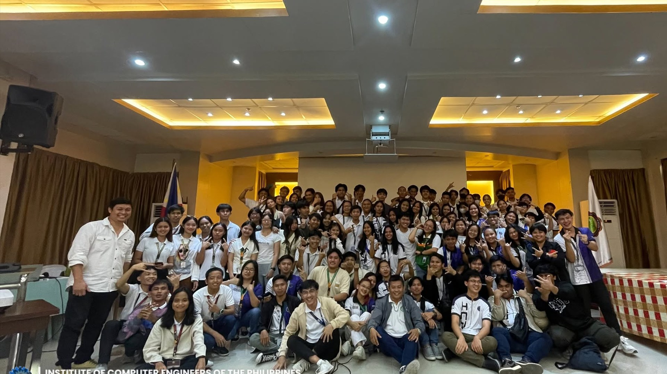

01 / 34
ICPEP CONNECT
Website Features
and User Guide
A detailed tour of the public portal, member workspace, community hub, and role-aware admin tools.
NWSSU COMPUTER ENGINEERING ORGANIZATION
Prepared for organization members, editors, faculty, and administrators
ICpEP Connect | Feature tour + how-to guide
Notes:
Presenter note: This slide describes the current ICpEP Connect experience.
[Sources]
- src/App.jsx
- public/images/nwssu-cpe-logo.png
- public/images/nwssu-cpe-hero.jpg

Slide 2
ICPEP CONNECT / ORIENTATION
02 / 34
A public-facing digital home for the CPE community
The site connects public information, verified-member services, and governed organization work in one experience.
01
02
03
Discover
Participate
Steward
Visitors can understand the organization, browse announcements, view stories, explore events, and meet the alumni community without an account.
Approved students and faculty can use the Student Portal, open protected resources, and join moderated community rooms.
Editors and administrators publish content, maintain people records, review accounts, and keep the archive orderly.
The experience is designed around a simple promise:
make the organization easy to understand, easy to join, and easy to manage.
The same brand language carries across public pages, member tools, and the admin workspace.
Notes:
Presenter note: This slide describes the current ICpEP Connect experience.
[Sources]
- src/App.jsx
- src/pages/Home.jsx
- src/pages/Account.jsx
- src/pages/AdminDashboard.jsx

Slide 3
ICPEP CONNECT / ORIENTATION
03 / 34
One portal, five everyday destinations
Navigation is organized around the questions people arrive with.
Home
Announcements
News & Gallery
01
What is happening?
02
What changed?
03
What should I see?
Events
Student Portal
Alumni
04
What is next?
05
What can I learn?
06
Who came before?
About
Community
Internal Audit
07
Who are we?
08
Where do we talk?
09
What is documented?
Account and Admin are role-aware destinations: the interface reveals the right tools after authentication and approval.
Notes:
Presenter note: This slide describes the current ICpEP Connect experience.
[Sources]
- src/App.jsx
- src/components/Navbar.jsx
- src/pages/AdminDashboard.jsx

Slide 4
ICPEP CONNECT / PUBLIC WEBSITE
04 / 34
Home makes the organization legible in seconds
The landing page acts as a live front door: identity first, current stories next, useful pathways after that.
ICpEP Connect / Home
What visitors get
A recognizable hero and organization identity.
News, gallery highlights, and upcoming events.
Quick access to portal, alumni, community, and audit records.
WHO WE ARE
Computer Engineering
with a community pulse.
Trust signals: transparency, verified profiles, and official contacts.
09
01
Explore stories ->
primary destinations
shared visual system
Notes:
Presenter note: This slide describes the current ICpEP Connect experience.
[Sources]
- src/pages/Home.jsx
- src/components/Navbar.jsx
- public/images/nwssu-cpe-hero.jpg

Slide 5
ICPEP CONNECT / PUBLIC WEBSITE
05 / 34
Navigation adapts without losing the thread
The header, route transitions, loading states, and mobile menu keep the same information architecture across screen sizes.
Desktop navigation
Responsive navigation
ICpEP Connect
Home Announcements News & Gallery Events
ICpEP Connect
≡
Account
Theme
Mobile: the menu collapses while route loading and scrolling behavior stay controlled.
Desktop: direct access to the full public map.
Keyboard-friendly controls
Reduced-motion support
Loading skeletons for lazy routes
Notes:
Presenter note: This slide describes the current ICpEP Connect experience.
[Sources]
- src/components/Navbar.jsx
- src/App.jsx
- src/hooks/useMotionPreferences.js
- src/lib/motion.js

Slide 6
ICPEP CONNECT / PUBLIC WEBSITE
06 / 34
Announcements turn updates into a searchable record
Visitors can scan the latest notices, narrow the list by category, and open a dedicated announcement detail page.
Announcements / browse
Useful behaviors
⌕ Search announcements...
Search by keyword
All
Website Update
Events
Merchandise
Filter by current categories
WEBSITE UPDATE
MERCHANDISE
Open full details from a card
New member approval
window is open
Official order
window details
Receive in-app notification popups for relevant alerts
Open the notice for the full context and date.
Category filters keep the archive fast to scan.
Notes:
Presenter note: This slide describes the current ICpEP Connect experience.
[Sources]
- src/pages/Announcements.jsx
- src/pages/AnnouncementDetails.jsx
- src/data/announcements.js
- src/components/NotificationPopup.jsx

Slide 7
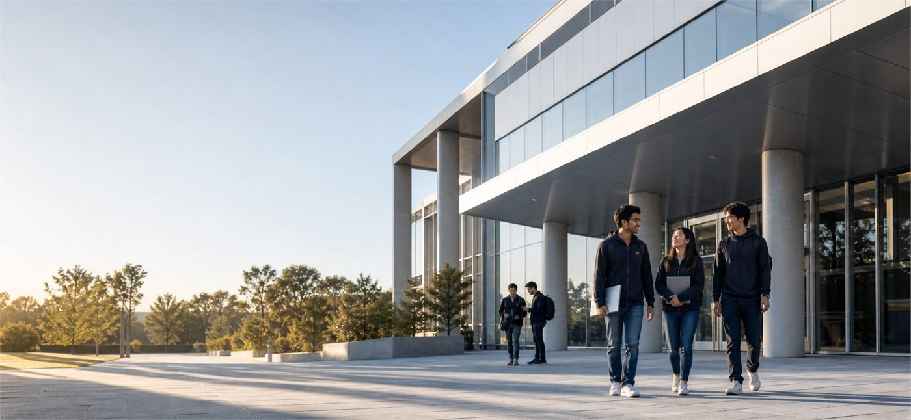
ICPEP CONNECT / PUBLIC WEBSITE
07 / 34
News & Gallery keeps the story visual
The media experience combines a readable story card with a gallery surface for images, highlights, and featured content.
01
02
Story cards
Gallery surfaces
Headline, category, date, excerpt, reactions, comments, and a clear path to the full story.
Multiple images can be organized into a focused news or gallery entry with a cover image.
03
04
Featured content
Detail view
Editors can highlight the items that deserve attention on the homepage and in the public feed.
Clicking through preserves the full original image and the complete story context.
Visual context makes updates easier to remember.
Notes:
Presenter note: This slide describes the current ICpEP Connect experience.
[Sources]
- src/pages/Gallery.jsx
- src/pages/NewsDetails.jsx
- src/components/AdminMedia.jsx
- src/pages/Home.jsx
- public/images/ce-campus-hero.jpg

Slide 8
ICPEP CONNECT / PUBLIC WEBSITE
08 / 34
Photo editing separates the card crop from the full story
Editors can shape the preview image for consistent cards while visitors can still open the original image in the detail experience.
EDITOR WORKFLOW
TWO VIEWS, ONE SOURCE
1
Upload
Select the source image for a news, gallery, or event item.
2
Crop + zoom
Choose the focal area and adjust the crop without rewriting the original.
Preview
Homepage card
Detail view
3
Consistent crop + readable layout
Full image stays accessible
See the card treatment before publishing so the composition is intentional.
4
Publish
The edited card image appears in listings; the full source remains available in detail view.
Notes:
Presenter note: This slide describes the current ICpEP Connect experience.
[Sources]
- src/components/PhotoCropEditor.jsx
- src/components/PublishedPhotoPreview.jsx
- src/components/AdminMedia.jsx
- src/pages/Events.jsx
- src/pages/NewsDetails.jsx

Slide 9
ICPEP CONNECT / PUBLIC WEBSITE
09 / 34
Events carry the schedule and the context
An event entry is more than a date: it gives visitors the what, when, where, and why in a compact public card.
Editor controls
UPCOMING
Create and update event details
General Assembly
A campus-wide moment for orientation, updates, and community participation.
Set status: upcoming, ongoing, completed, or cancelled
Add venue, description, registration link, and featured state
AUG 28, 2026
Attach or crop event media for consistent cards
Engineering Building
Registration or external link can be surfaced when available.
Visitor habit: scan the date first, then open the details that matter.
Notes:
Presenter note: This slide describes the current ICpEP Connect experience.
[Sources]
- src/pages/Events.jsx
- src/components/AdminEvents.jsx
- src/components/PublishedPhotoPreview.jsx

Slide 10
ICPEP CONNECT / PUBLIC WEBSITE
10 / 34
Reactions and notifications create a lightweight feedback loop
Visitors can respond to stories quickly, while the site keeps the interaction compact and readable.
News card / reactions
Experience details
ICpEPians Join the 59th ASEAN Founding Anniversary
Custom reaction picker with member filters
A preview excerpt introduces the story before the reader commits to the full detail view.
Comment replies and deletion permissions
In-app notification popup for relevant alerts
♡ Love
✦ Celebrate
● Wow
↔ Support
Compact controls that stay aligned across cards
Comments and replies keep the conversation attached to the story.
Notes:
Presenter note: This slide describes the current ICpEP Connect experience.
[Sources]
- src/components/NewsReactionSummary.jsx
- src/components/NotificationPopup.jsx
- src/pages/NewsDetails.jsx

Slide 11
ICPEP CONNECT / MEMBER WORKSPACE
11 / 34
Student Portal is the member-only learning layer
After approval, the portal gives students and faculty a focused place to find resources and understand the program.
Portal areas
APPROVED MEMBER VIEW
Resource library: reviewers, lab manuals, tutorials, and more
Learn, review,
and move forward.
Curriculum map by year level and term
The portal is protected by account approval, so internal resources stay inside the intended community.
Program background, outcomes, and context
Protected file access for approved accounts
APPROVED ACCESS
Student / Faculty
Notes:
Presenter note: This slide describes the current ICpEP Connect experience.
[Sources]
- src/pages/StudentPortal.jsx
- src/data/resources.js
- src/components/ApprovedOnly.jsx

Slide 12
ICPEP CONNECT / MEMBER WORKSPACE
12 / 34
Resources are organized for quick retrieval
A resource record carries the context a member needs before opening the file.
Student Portal / resources
File behavior
Reviewers
Microcontroller Reviewers
Search or filter before opening
Reviewers
Course preparation material
Lecture Notes
Published records show title, category, course, year, and description
Lab Manuals
Digital Logic Lab Manual
Lab Manuals
Hands-on reference for laboratory work
PDFs open directly in the browser when possible
Tutorials
References
CPE Tutorials
Tutorials
Non-PDF attachments can keep download behavior
Guides and explainers for members
Notes:
Presenter note: This slide describes the current ICpEP Connect experience.
[Sources]
- src/pages/StudentPortal.jsx
- src/data/resources.js
- src/lib/storage.js

Slide 13
ICPEP CONNECT / MEMBER WORKSPACE
13 / 34
Curriculum and program context live beside the files
The portal is useful because it answers both “where is the document?” and “how does this fit the program?”
01
02
03
Year-level map
Term structure
Program identity
Browse first-year through fourth-year content without the irregular status in the public-facing structure.
See subjects and resources in a course-aware context instead of scanning an undifferentiated file list.
Mission, outcomes, and background connect individual study materials back to the organization.
A good portal reduces the number of decisions between “I need help” and “I found the right thing.”
Notes:
Presenter note: This slide describes the current ICpEP Connect experience.
[Sources]
- src/pages/StudentPortal.jsx
- src/data/yearLevels.js
- src/data/curriculum.js

Slide 14
ICPEP CONNECT / ALUMNI
14 / 34
Alumni becomes a browsable yearbook
Not a spreadsheet: visitors can move through graduate batches, search names, and open approved profiles with a consistent portrait-first layout.
GRADUATE DIRECTORY
Portrait grid
Browse the Yearbook
Batch 2026
Batch 2025
⌕ Search alumni by name
Aileen
Christian
Jessa
Jason
Batch 2025
Batch 2025
Batch 2025
Batch 2025
Aileen · Christian · Jessa · Jason
The directory prioritizes readable faces, even card heights, and quick batch switching.
Notes:
Presenter note: This slide describes the current ICpEP Connect experience.
[Sources]
- src/pages/Alumni.jsx
- src/components/AdminAlumni.jsx
- public/images/samples/person-blue.svg
- public/images/samples/person-emerald.svg
- public/images/samples/person-orange.svg
- public/images/samples/person-violet.svg

Slide 15
ICPEP CONNECT / ALUMNI
15 / 34
Every alumni profile can carry a richer story
The public profile combines verified identity with the achievements and leadership background that make a graduate memorable.
Profile fields
Christian L. Lungsod
Name, batch, institute, and professional role
Batch 2025
Achievements displayed as separate lines
Multiple leadership background entries per graduate
Institute of Computer Engineering
Spotlight note relabeled as Achievements in the profile view
Approved public details only
Consent and approval keep the public profile respectful
Notes:
Presenter note: This slide describes the current ICpEP Connect experience.
[Sources]
- src/pages/Alumni.jsx
- src/components/AdminAlumni.jsx
- supabase/alumni.sql

Slide 16
ICPEP CONNECT / ORGANIZATION
16 / 34
About turns the organization into a living profile
History explains where the program came from; current faculty and officers show who carries it forward.
Organization content
Program history and milestone timeline
Mission, vision, contact, and homepage stats
Faculty listed by Program Chairperson or Faculty
Organization officers ordered by position
History → Faculty → Officers
Portrait crop, zoom, preview, and initials fallback
The page makes governance visible without making it feel bureaucratic.
Notes:
Presenter note: This slide describes the current ICpEP Connect experience.
[Sources]
- src/pages/About.jsx
- src/components/AdminOrganization.jsx
- src/components/PhotoCropEditor.jsx
- src/components/PublishedPhotoPreview.jsx
- public/images/ce-campus-hero.jpg

Slide 17
ICPEP CONNECT / TRANSPARENCY
17 / 34
Internal Audit makes approved records findable
The public archive turns formal documents into a structured browsing experience instead of a folder of mystery files.
Reader experience
ARCHIVE CATEGORIES
Search by title or metadata
Project Proposals
Plans, objectives, and committee responsibilities.
Filter by archive category
Activities
Completed programs, initiatives, and organization outputs.
Read period, publication date, and document context
Liquidation Report
Funds, expenses, receipts, and balances.
View the PDF directly in the browser
Resolutions
Official decisions, approvals, and policies.
Optional prepared, reviewed, and approved fields
Notes:
Presenter note: This slide describes the current ICpEP Connect experience.
[Sources]
- src/pages/InternalAudit.jsx
- src/data/internalAudit.js
- src/components/AdminInternalAudit.jsx

Slide 18
ICPEP CONNECT / COMMUNITY
18 / 34
Community Hub follows a familiar conversation model
The desktop layout uses three zones so members can see where they are, what is being said, and what the room contains.
ROOMS
GENERAL LOUNGE
ROOM OVERVIEW
Open student conversations and quick organization questions.
#
General Lounge
Members / photos / files / links
Academic Help
Kenjoobies · Editor
Events Talk
guys?
The side panel keeps shared context visible while the middle remains focused on the conversation.
Announcements Q&A
rvin · Administrator
Resource Requests
hello @Kenjoobies
Notes:
Presenter note: This slide describes the current ICpEP Connect experience.
[Sources]
- src/pages/Community.jsx
- src/components/CommunityLauncher.jsx
- src/lib/communityChat.js

Slide 19
ICPEP CONNECT / COMMUNITY
19 / 34
Messaging supports real community work
The chat is built for approved members, practical attachments, and the small interactions that keep a room usable.
01
02
03
Talk
Share
Moderate
Send messages, mention members, reply to a specific message, and search within a room.
Attach approved image, PDF, Office, or text files within the current limits.
Delete messages according to permissions and keep rooms limited to approved accounts.
Current attachment guardrails
5
10 MB
25 MB
files per message
per file
total message
The input also supports Enter to send, Shift + Enter for a new line, and a compact pin-style attachment control.
Notes:
Presenter note: This slide describes the current ICpEP Connect experience.
[Sources]
- src/pages/Community.jsx
- src/lib/communityChat.js
- src/components/MessageComposer.jsx

Slide 20
ICPEP CONNECT / ACCOUNTS
20 / 34
Sign-in is simple, with role-aware access
One account flow supports public browsing, member access, faculty participation, editor work, and administrator control.
1
Create an account
Choose the account type and submit the required identity details.
Role-aware by design
Wait for approval
Public pages stay open
2
The admin team reviews the request before protected access opens.
Student and faculty use protected resources
Editors publish assigned content
3
Use your role
Administrators manage people and governance
Student, faculty, editor, and admin roles reveal the right capabilities.
Notes:
Presenter note: This slide describes the current ICpEP Connect experience.
[Sources]
- src/pages/Account.jsx
- src/components/AdminRoute.jsx
- src/pages/AdminDashboard.jsx
- supabase/migrations

Slide 21
ICPEP CONNECT / ACCOUNTS
21 / 34
Student sign-up: identity first, access second
Students provide the identity details needed to connect the account to the organization, then wait for admin review.
How to use it
STUDENT SIGN-UP
Full name
Open Account and switch to Sign up.
Student number
Choose Student and complete every required field.
Year level / 1st–4th Year
Use a working email and a password you can remember.
Regular email
Password / 8+ characters
Submit once; approval status is shown in the account area.
Confirm password
After approval, sign in again to reach protected tools.
Submit for approval
Notes:
Presenter note: This slide describes the current ICpEP Connect experience.
[Sources]
- src/pages/Account.jsx
- src/data/yearLevels.js
- src/lib/auth.js

Slide 22
ICPEP CONNECT / ACCOUNTS
22 / 34
Faculty sign-up: regular email, same approval gate
Faculty do not need a student number or employee ID in the form. The account is still reviewed before member access is granted.
Approval workflow
FACULTY
A lighter sign-up form
for a different role.
1
Faculty submits
The form stores the request using the faculty role.
2
Admin reviews
Required fields
The request appears in Users & Roles alongside student requests.
Full name
Regular email
3
Admin decides
Password
Approve, suspend, change role, or delete the account as needed.
Confirm password
No employee ID field is needed.
Notes:
Presenter note: This slide describes the current ICpEP Connect experience.
[Sources]
- src/pages/Account.jsx
- src/components/AdminUsers.jsx
- src/pages/AdminDashboard.jsx

Slide 23
ICPEP CONNECT / ACCOUNTS
23 / 34
Account area: a personal control panel
Once signed in, members can see their status and reach the parts of the site that matter to them.
Account / member dashboard
Member habits
Check approval status after sign-up
RVIN
Welcome back, rvin
Approved member
Update profile information when needed
A
B
C
Use the quick actions to return to protected tools
Profile
Updates
Resources
Nickname, avatar, and sign-out.
Announcements and events.
Portal and community links.
Sign out from the account menu when using a shared device
Notes:
Presenter note: This slide describes the current ICpEP Connect experience.
[Sources]
- src/pages/Account.jsx
- src/components/ProfileAvatar.jsx
- src/components/Navbar.jsx

Slide 24
ICPEP CONNECT / ADMIN WORKSPACE
24 / 34
Admin Dashboard compresses the work into one workspace
The admin side keeps the operational surface compact while still separating the responsibilities of each editor area.
WORKSPACE
OVERVIEW
Overview
See the work at a glance.
Announcements
Events
The overview surfaces metrics, activity, attention signals, and role context before the editor opens a specialized section.
News & Gallery
About Content
Alumni
Resources
10
04
01
Internal Audit
editor areas
active roles
compact sidebar
Team
Users & Roles
Admin access is protected by role checks and a dedicated route.
Notes:
Presenter note: This slide describes the current ICpEP Connect experience.
[Sources]
- src/pages/AdminDashboard.jsx
- src/components/AdminRoute.jsx
- src/components/AdminActivityCenter.jsx
- src/components/AdminAnalyticsPanel.jsx

Slide 25
ICPEP CONNECT / ADMIN WORKSPACE
25 / 34
Editors can publish content without touching code
Each section is a focused editor with the right fields, status controls, and feedback states for its content type.
Announcements
Events
News & Gallery
Create, edit, publish, archive, feature
Schedules, venue, registration, status
Stories, albums, cover image, ordering
About Content
Alumni
Internal Audit
History, contact, faculty, officers
Profiles, batches, achievements, leadership
Documents, metadata, archive status
Common editor rhythm: open section → edit record → preview → publish → verify on the public page.
Notes:
Presenter note: This slide describes the current ICpEP Connect experience.
[Sources]
- src/pages/AdminDashboard.jsx
- src/components/AdminAnnouncements.jsx
- src/components/AdminEvents.jsx
- src/components/AdminMedia.jsx
- src/components/AdminOrganization.jsx
- src/components/AdminAlumni.jsx
- src/components/AdminInternalAudit.jsx

Slide 26
ICPEP CONNECT / ADMIN WORKSPACE
26 / 34
Media workflow: crop, preview, publish
The reusable photo tools make visual publishing predictable across news, gallery, event, faculty, officer, and alumni surfaces.
SOURCE
EDIT
PREVIEW
PUBLISH
Choose the original
Zoom + crop
See the card
Save the record
→
→
→
Keep the full upload for detail view and future use.
Move the focal area inside a defined aspect ratio.
Check the crop inside the actual published treatment.
Use the edited card image while preserving the full source.
Reusable components keep the interaction consistent instead of teaching editors a different crop tool on every form.
Notes:
Presenter note: This slide describes the current ICpEP Connect experience.
[Sources]
- src/components/PhotoCropEditor.jsx
- src/components/PublishedPhotoPreview.jsx
- src/components/AdminMedia.jsx
- src/components/AdminEvents.jsx
- src/components/AdminOrganization.jsx
- src/components/AdminAlumni.jsx

Slide 27
ICPEP CONNECT / ADMIN WORKSPACE
27 / 34
Organization and alumni content stay structured
People records are handled as data, so cards, profile pages, and future updates can stay aligned.
A
B
Organization editor
Alumni editor
Maintain profile details, history, mission, vision, contact information, homepage stats, faculty, and officers. Positions come from selectable lists, and portraits support zoom, crop, preview, and initials fallback.
Search by name, work by batch, edit achievements line by line, add multiple leadership backgrounds, feature spotlight profiles, and keep consent-aware public details.
Structured records make presentation a rendering decision, not a manual formatting task.
Notes:
Presenter note: This slide describes the current ICpEP Connect experience.
[Sources]
- src/components/AdminOrganization.jsx
- src/components/AdminAlumni.jsx
- src/components/PhotoCropEditor.jsx
- src/components/PublishedPhotoPreview.jsx
- supabase/alumni.sql

Slide 28
ICPEP CONNECT / ADMIN WORKSPACE
28 / 34
Resources and audit records keep their context
The editor captures enough metadata that members and visitors can understand a file before opening it.
RESOURCES
INTERNAL AUDIT
Upload a file or provide a link
Choose the archive type
Choose category and audience context
Add period, published date, title, and summary
Add description, course, year, and term
Capture financial fields when relevant
Move records through draft, published, and archived states
Prepared by, reviewed by, and approved by are optional
Keep PDFs viewable directly when possible
Publish only reviewed public records
Notes:
Presenter note: This slide describes the current ICpEP Connect experience.
[Sources]
- src/components/AdminResources.jsx
- src/components/AdminInternalAudit.jsx
- src/pages/StudentPortal.jsx
- src/pages/InternalAudit.jsx

Slide 29
ICPEP CONNECT / ADMIN WORKSPACE
29 / 34
Users, roles, and team ownership protect the system
Administration is also governance: deciding who can enter, what they can do, and who owns the next action.
01
02
03
Users & Roles
Role model
Team
Search and filter accounts by status, role, and year level. Approve, suspend, change roles, or delete accounts. An admin cannot delete their own account.
Student, faculty, editor, and admin roles separate member access from publishing and system control.
Assign editor tasks with status, priority, due date, and familiar profile context so work does not disappear into the interface.
Governance loop: request → review → approve or reject → assign access → audit the work.
Notes:
Presenter note: This slide describes the current ICpEP Connect experience.
[Sources]
- src/components/AdminUsers.jsx
- src/components/AdminTeam.jsx
- src/pages/AdminDashboard.jsx
- src/components/AdminRoute.jsx

Slide 30
ICPEP CONNECT / EXPERIENCE QUALITY
30 / 34
The design system is built for clarity under pressure
Visual polish matters, but the useful part is consistency: people can predict what a control, card, or state will do.
Readable hierarchy
Responsive behavior
Dark mode
Strong section labels, compact metadata, and predictable card alignment.
Desktop and mobile layouts adapt without changing the underlying task.
Surfaces, borders, chat bubbles, and forms are tuned for contrast in both themes.
Accessible states
Performance
Fallbacks
Labels, focus behavior, alt text, keyboard controls, and reduced motion support.
Lazy routes, loading skeletons, optimized image behavior, and controlled animation.
Initials can stand in for missing photos, so content does not break when media is absent.
Notes:
Presenter note: This slide describes the current ICpEP Connect experience.
[Sources]
- src/index.css
- src/App.jsx
- src/hooks/useMotionPreferences.js
- src/components/ThemeToggle.jsx
- src/components/ProfileAvatar.jsx

Slide 31
ICPEP CONNECT / EXPERIENCE QUALITY
31 / 34
Small details make the portal feel alive
The interface has a quiet layer of delight: motion and character that reward attention without taking over the task.
HIDDEN ROBOT BUDDIES
OTHER POLISH
10 distinct designs.
One per chosen card surface.
A
B
Notification popup
Initials fallback
They randomize their card placement on reload, move along the card outline, emote, and animate feet or booster fire when the design calls for it.
In-app feedback, not browser prompts.
People stay visible without a photo.
C
D
Living cards
Controlled motion
DISCOVERABLE, NOT DISTRACTING
Hover, reaction, and preview stay aligned.
Motion respects reduced-motion.
Notes:
Presenter note: This slide describes the current ICpEP Connect experience.
[Sources]
- src/components/PixelPals.jsx
- src/components/RobotEasterEgg.jsx
- src/components/RobotParade.jsx
- src/components/NotificationPopup.jsx
- src/hooks/useMotionPreferences.js

Slide 32
ICPEP CONNECT / HOW TO USE
32 / 34
A member’s path through the site
A practical walkthrough for a student or faculty member arriving for the first time.
01
02
03
04
05
Start at Home
Browse public content
Create an account
Wait for approval
Use protected tools
Understand the organization and scan current highlights.
Open announcements, news, events, alumni, or About.
Choose Student or Faculty and submit the regular email form.
Check Account for status while the admin team reviews.
Enter Student Portal and Community Hub after approval.
Shortcut: use Account for status, Student Portal for files, and Community Hub for conversation.
Notes:
Presenter note: This slide describes the current ICpEP Connect experience.
[Sources]
- src/pages/Home.jsx
- src/pages/Account.jsx
- src/pages/StudentPortal.jsx
- src/pages/Community.jsx
- src/components/Navbar.jsx

Slide 33
ICPEP CONNECT / HOW TO USE
33 / 34
An editor’s path from draft to published
A repeatable publishing routine helps keep the public site current without losing review discipline.
01
02
03
04
05
Open the section
Create or edit
Shape media
Set status
Verify
Choose the content area from the compact admin sidebar.
Enter the required record details and optional metadata.
Crop, zoom, and use the published preview where photos apply.
Keep drafts internal until the record is ready for publication.
Open the public page and check the card, detail, and mobile treatment.
Quality check: alignment, copy, image crop, metadata, and permissions should all agree before publish.
Notes:
Presenter note: This slide describes the current ICpEP Connect experience.
[Sources]
- src/pages/AdminDashboard.jsx
- src/components/AdminMedia.jsx
- src/components/AdminEvents.jsx
- src/components/AdminOrganization.jsx
- src/components/AdminInternalAudit.jsx

Slide 34
ICPEP CONNECT / HOW TO USE
34 / 34
Quick reference: what to do next
A closing checklist for members, editors, and administrators.
MEMBER
MEMBER
EDITOR
I need information
I need access
I need to publish
Start at Home. Use Announcements for changes, News & Gallery for stories, Events for schedules, Alumni for the yearbook, and About for organization context.
Open Account, sign up with the correct role, wait for approval, then use Student Portal and Community Hub.
Use the relevant admin section, preview media, set the correct status, and verify the public card and detail view.
ICpEP Connect works best when every person can answer three questions:
Where do I go? What do I do? What happens next?
END OF FEATURE TOUR
Notes:
Presenter note: This slide describes the current ICpEP Connect experience.
[Sources]
- src/App.jsx
- src/pages/Account.jsx
- src/pages/AdminDashboard.jsx
- src/components/Navbar.jsx

