Slide 1
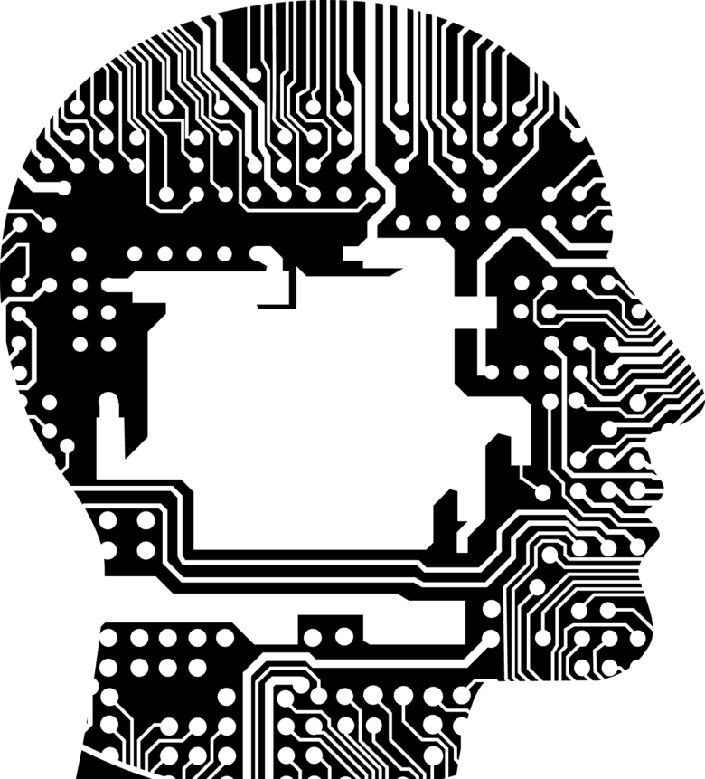
RUDRANK ASR TRAINING OGS ANALYTICS
By:
Nirmal A Kannan Ravi Pandey Kunal Sharma
Priyanka Jain
11/1/2019-18/1/2019

Slide 2
Our Journey
1. CMU Sphinx
Contributing Factors
1
PHI/PII
UHG data used to train model
No data flow outside of UHG
2. IBM Watson
3. Google STT
3
2
Data Privacy & Security
Custom-made for Healthcare
Customizable for different businesses
20,000 call/day
Avg. Call Duration: 3min.
Hence 20,000*3*1.25=$50K
Custom- made
Cost
4
3rd Part independent
5. Rudrank
4. Kaldi
Long Lasting solution
Independent of 3rd party restrictions
5
Notes:
CMU Sphinx – Accuracy very less
IBM Watson – Accuracy lesser than Google, but better for long text/conversations because the latency is lesser
Google STT – Accuracy better for short text because it has more latency more latency
Kaldi – Tested – Reverse Engineered
Rudrank

Slide 3
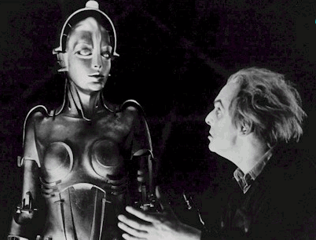
Recreating the Speech Chain
DIALOG
SEMANTICS
SPOKEN
LANGUAGE
UNDERSTANDING
SPEECH
RECOGNITION
SYNTAX
LEXICON
MORPHOLOGY
SPEECH
SYNTHESIS
PHONETICS
DIALOG
MANAGEMENT
INNER EAR
ACOUSTIC NERVE
VOCAL-TRACT
ARTICULATORS
Notes:
Metropolis (1927) Directed By: Fritz Lang

Slide 4
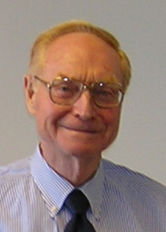
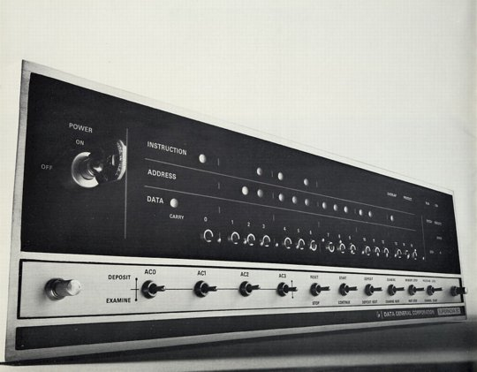
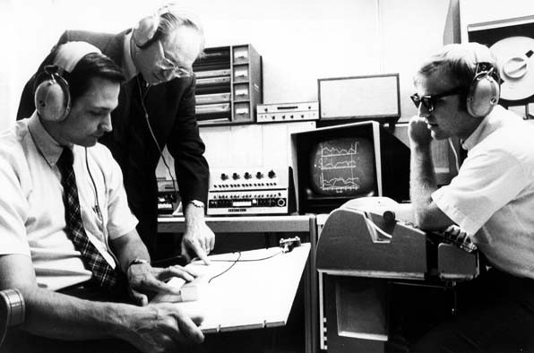
1960’s – Speech Processing and Digital Computers
AD/DA converters and digital computers start appearing in the labs
James Flanagan
Bell Laboratories
Notes:
Flanagan joined Bell Labs in 1957. Although there was already some work done in speech processing it was mostly using analog circuits. Jim helped to introduce AD/DA and start pioneering new research in speech processing using computers. Much easier, more flexible and cheaper than building electric circuits. Much larger experiments possible altho not in real time for quite a while.

Slide 5
Voice Recognition
Aimed towards identifying the person who is speaking
How it works
Every individual has unique pattern of speech due to their anatomy and behavioral patterns
Speaker verification vs. Speaker identification

Slide 6
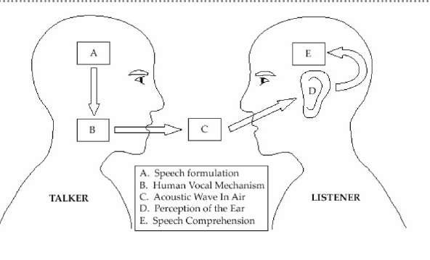
Diagram of the Speech Production/Perception Process

Slide 7
Speech Representation
Speech signal represented in two different domains: time and the frequency domain
Three speech representations:
Able to use speech signal and interpret its characteristics
Three-state Representation
Spectral Representation
Parameterization of the Spectral Activity
Useful to label the speech waveform being analyzed in a linguistic sense

Slide 8
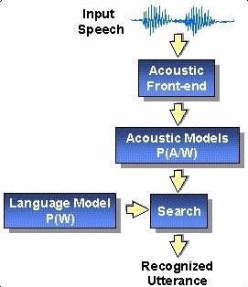
Basic Model of Speech Recognition
This is a diagram of the recognition process
Standard Approach
P(W,Y)
Goal:
Decode string

Slide 9
Types of Speech Recognition
Different classes based on types of utterances they are able to recognize
1. Isolated Words
“Listen/Not-Listen” states
2. Connected Words
“run-together”
3. Continuous Speech
Natural speech
4. Spontaneous Speech
“ums”, “ahs”, stutter

Slide 10
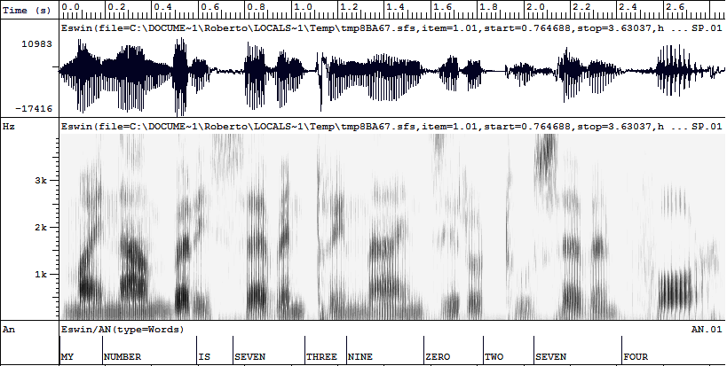
The Illusion of Segmentation... or...
Why Speech Recognition is so Difficult
(user:Roberto (attribute:telephone-num value:7360474))
VP
NP
NP
MY
IS
THREE
ZERO
SEVEN
NUMBER
SEVEN
NINE
TWO
FOUR
m
I
n
&
m
&
i
s
e
th
I
z
&
n
n
E
o
t
s
r
v
n
r
ü
e
&
f
O
r
b
E
r
v
n
Notes:
Phone segmentation → word identification → syntactic structure → semantic representation

Slide 11
Approaches to Speech Recognition
3 different approaches:
1. Acoustic Phonetic Approach
2. Pattern Recognition Approach
HMM
3. Artificial Intelligence Approach

Slide 12
Building an ASR System
Build a statistical model of the speech-to-words process
Collect lots of speech and transcribe all the words
Train the model on the labeled speech
Paradigm:
Supervised Machine Learning + Search
The Noisy Channel Model

Slide 13
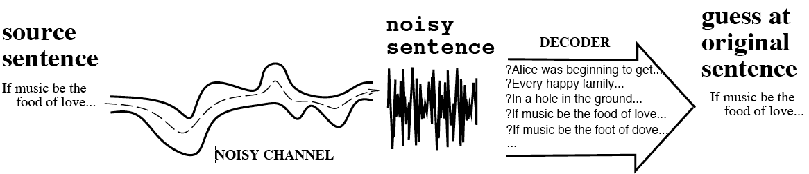
The Noisy Channel Model
Search through space of all possible sentences.
Pick the one that is most probable given the waveform

Slide 14
The Noisy Channel Model (II)
What is the most likely sentence out of all sentences in the language L, given some acoustic input O?
Treat acoustic input O as sequence of individual acoustic observations
O = o₁,o₂,o₃,…,o_{t}
Define a sentence as a sequence of words:
W = w₁,w₂,w₃,…,w_{n}

Slide 15
Noisy Channel Model (III)
Probabilistic implication: Pick the highest probable sequence:
We can use Bayes rule to rewrite this:
Since denominator is the same for each candidate sentence W, we can ignore it for the argmax:

Slide 16
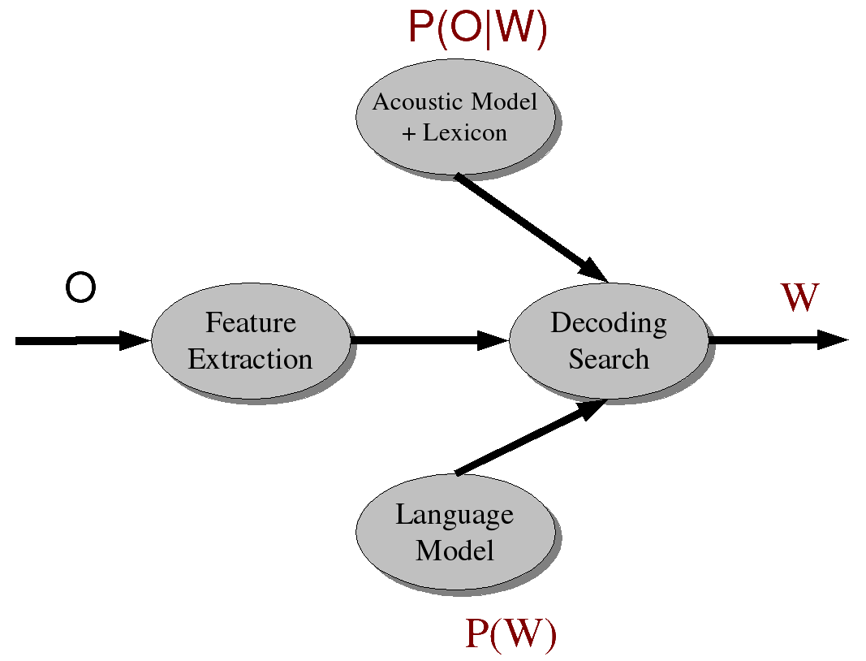
Speech Recognition Meets Noisy Channel: Acoustic Likelihoods and LM Priors

Slide 17
Components of an ASR System
Corpora for training and testing of components
Representation for input and method of extracting
Pronunciation Model
Acoustic Model
Language Model
Feature extraction component
Algorithms to search hypothesis space efficiently

Slide 18
Training and Test Corpora
Collect corpora appropriate for recognition task at hand
Small speech + phonetic transcription to associate sounds with symbols (Acoustic Model)
Large (>= 60 hrs) speech + orthographic transcription to associate words with sounds (Acoustic Model)
Very large text corpus to identify ngram probabilities or build a grammar (Language Model)

Slide 19
Building the Acoustic Model
Goal: Model likelihood of sounds given spectral features, pronunciation models, and prior context
Usually represented as Hidden Markov Model
States represent phones or other subword units
Transition probabilities on states: how likely is it to see one sound after seeing another?
Observation/output likelihoods: how likely is spectral feature vector to be observed from phone state i, given phone state i-1?

Slide 20
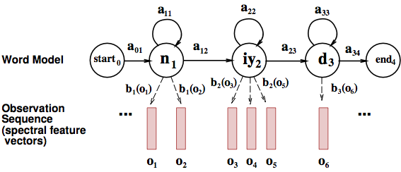
Word HMM

Slide 21
Initial estimates from phonetically transcribed corpus or flat start
Transition probabilities between phone states
Observation probabilities associating phone states with acoustic features of windows of waveform
Embedded training:
Re-estimate probabilities using initial phone HMMs + orthographically transcribed corpus + pronunciation lexicon to create whole sentence HMMs for each sentence in training corpus
Iteratively retrain transition and observation probabilities by running the training data through the model until convergence

Slide 22
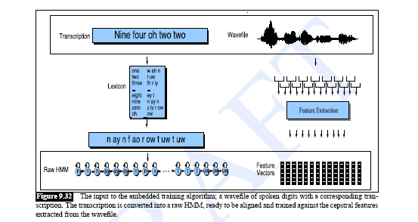
Training the Acoustic Model

Slide 23
Building the Pronunciation Model
Models likelihood of word given network of candidate phone hypotheses
Multiple pronunciations for each word
May be weighted automaton or simple dictionary
Words come from all corpora (including text)
Pronunciations come from pronouncing dictionary or TTS system

Slide 24
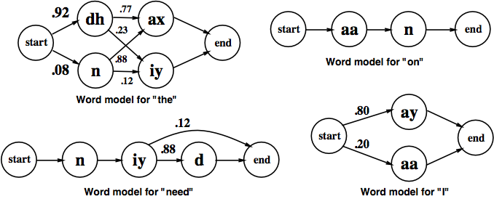
ASR Lexicon: Markov Models for Pronunciation

Slide 25
Building the Language Model
Models likelihood of word given previous word(s)
Ngram models:
Build the LM by calculating bigram or trigram probabilities from text training corpus: how likely is one word to follow another? To follow the two previous words?
Smoothing issues
Grammars
Finite state grammar or Context Free Grammar (CFG) or semantic grammar
Out of Vocabulary (OOV) problem

Slide 26
Search/Decoding
Find the best hypothesis P(O|W) P(W) given
A sequence of acoustic feature vectors (O)
A trained HMM (AM)
Lexicon (PM)
Probabilities of word sequences (LM)
For O
Calculate most likely state sequence in HMM given transition and observation probs
Trace back thru state sequence to assign words to states
N best vs. 1 best vs. lattice output

Slide 27
Thank You

