Slide 1

Exploratory Data Analysis
Cab Investment
18/11/2022

Slide 2
Agenda
Problem Statement
Approach
EDA
EDA Summary
Recommendations

Slide 3
Problem Statement
XYZ is a private firm in US. Due to remarkable growth in the Cab Industry in last few years and multiple key players in the market, it is planning for an investment in Cab industry and as per their Go-to-Market(G2M) strategy they want to understand the market before taking final decision.
Objective: To provide actionable insights to help XYZ company to choose the best investment in the Cab industry.

Slide 4
Approach
To understand Data
To compare the two Cab Companies
To find the most profitable Cab Company
To make recommendations for investment

Slide 5
Data Understanding
The final dataset comprised of three datasets Customer_ID_df, Transaction_ID_df and Cab_Data_df; the City_df dataset has not been used due to the data not being a true representation of the population.
The final dataset had 359392 rows and 14 variables

Slide 6
Exploratory Data Analysis
Included use of descriptive statistics to understand the data such as minimum value, maximum value.
Use of boxplots to check for outliers. Presence of outliers could be found be found in the Price Charged but it has not be treated as outliers as it could be seen later that it increased with the KM travelled by the cab company.
Use of histograms to check for normality of data and it could be seen that most data was not normal .

Slide 7
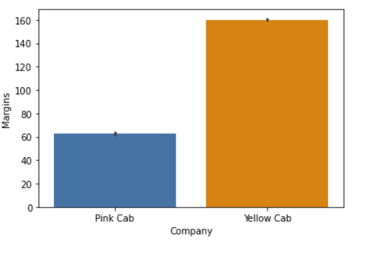
Margins have been calculated by taking in consideration only Price Charged –Cost of Trip Yellow Cab company has higher margins than the Pink Cab company.

Slide 8
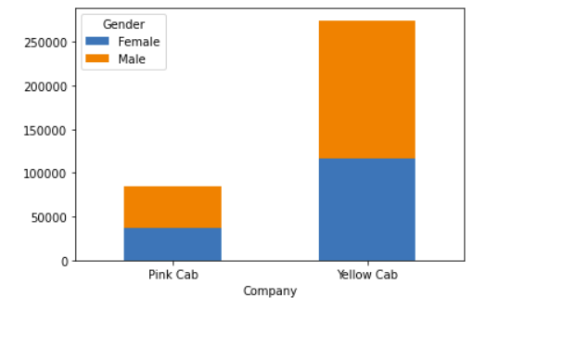
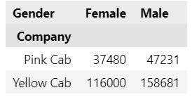
Yellow Cab has more customers than Pink Cab and that both companies have more male customers than female.

Slide 9
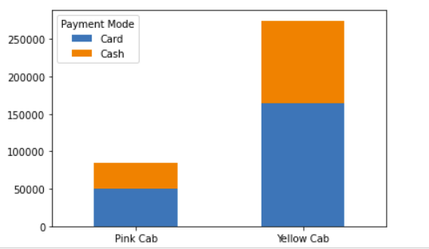
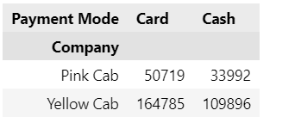
Yellow Cab has more customers than Pink Cab. Both companies have higher number of payments made by card

Slide 10
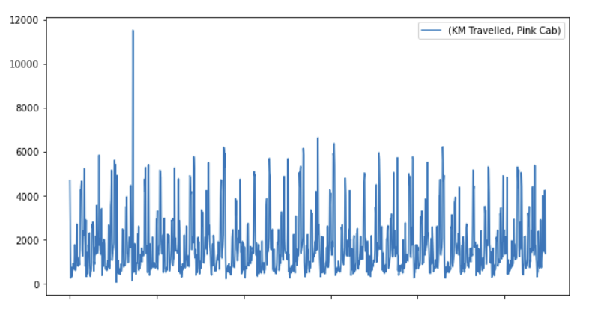
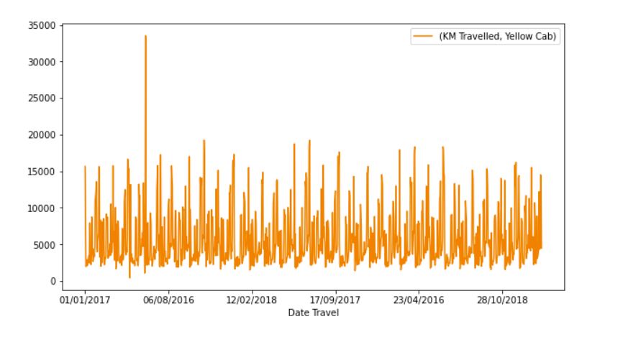
Yellow Cab company has travelled more km than the Pink Cab company.

Slide 11
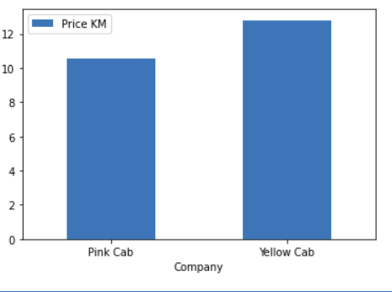
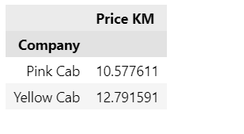
The average price charged per KM travelled by Pink Cab is 10.57 The average price charged per KM travelled by Yellow is 12.79

Slide 12
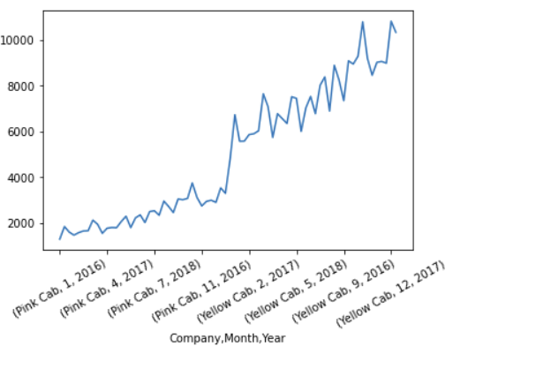
Pink Cab company has in all three years a lower number of customers comparing to the Yellow Cab company.

Slide 13
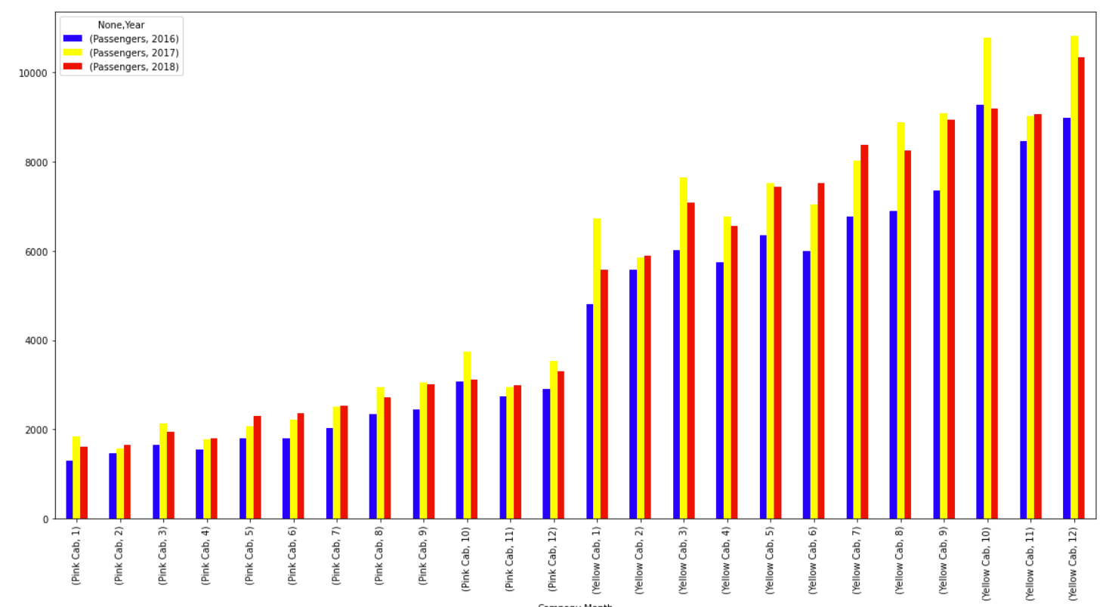
In the year 2017 both companies had the most customers and in the 2016 both companies had the least customers.

Slide 14
Recommendations
Yellow Cab company has higher margins than the Pink Cab company.
Yellow Cab has more customers than Pink Cab
Yellow Cab has travelled more KM than Pink Cab
Both companies take most payments by card and have more male than female.
The price charged per Km by Pink Cab company is lower than the Yellow Cab company.
Yellow Company has more customers even if the price charged is higher than Pink Cab
Age has no influence over margins of both cab companies
From all this insights is advisable to invest in Yellow Cab.

Slide 15
Thank You

